Slide 1
A Practical Guide to Implementing SMART in Asthma Management
Helen K. Reddel, MB, BS, PhD, Eric D. Bateman, MB, ChB, MD, Michael Schatz, MD, MS, Jerry A. Krishnan, MD, PhD, Michelle M. Cloutier, MD
The Journal of Allergy and Clinical Immunology: In Practice
Volume 10 Issue 1 Pages S31-S38 (January 2022)
DOI: 10.1016/j.jaip.2021.10.011
Copyright © 2021 American Academy of Allergy, Asthma & Immunology Terms and Conditions

Slide 2
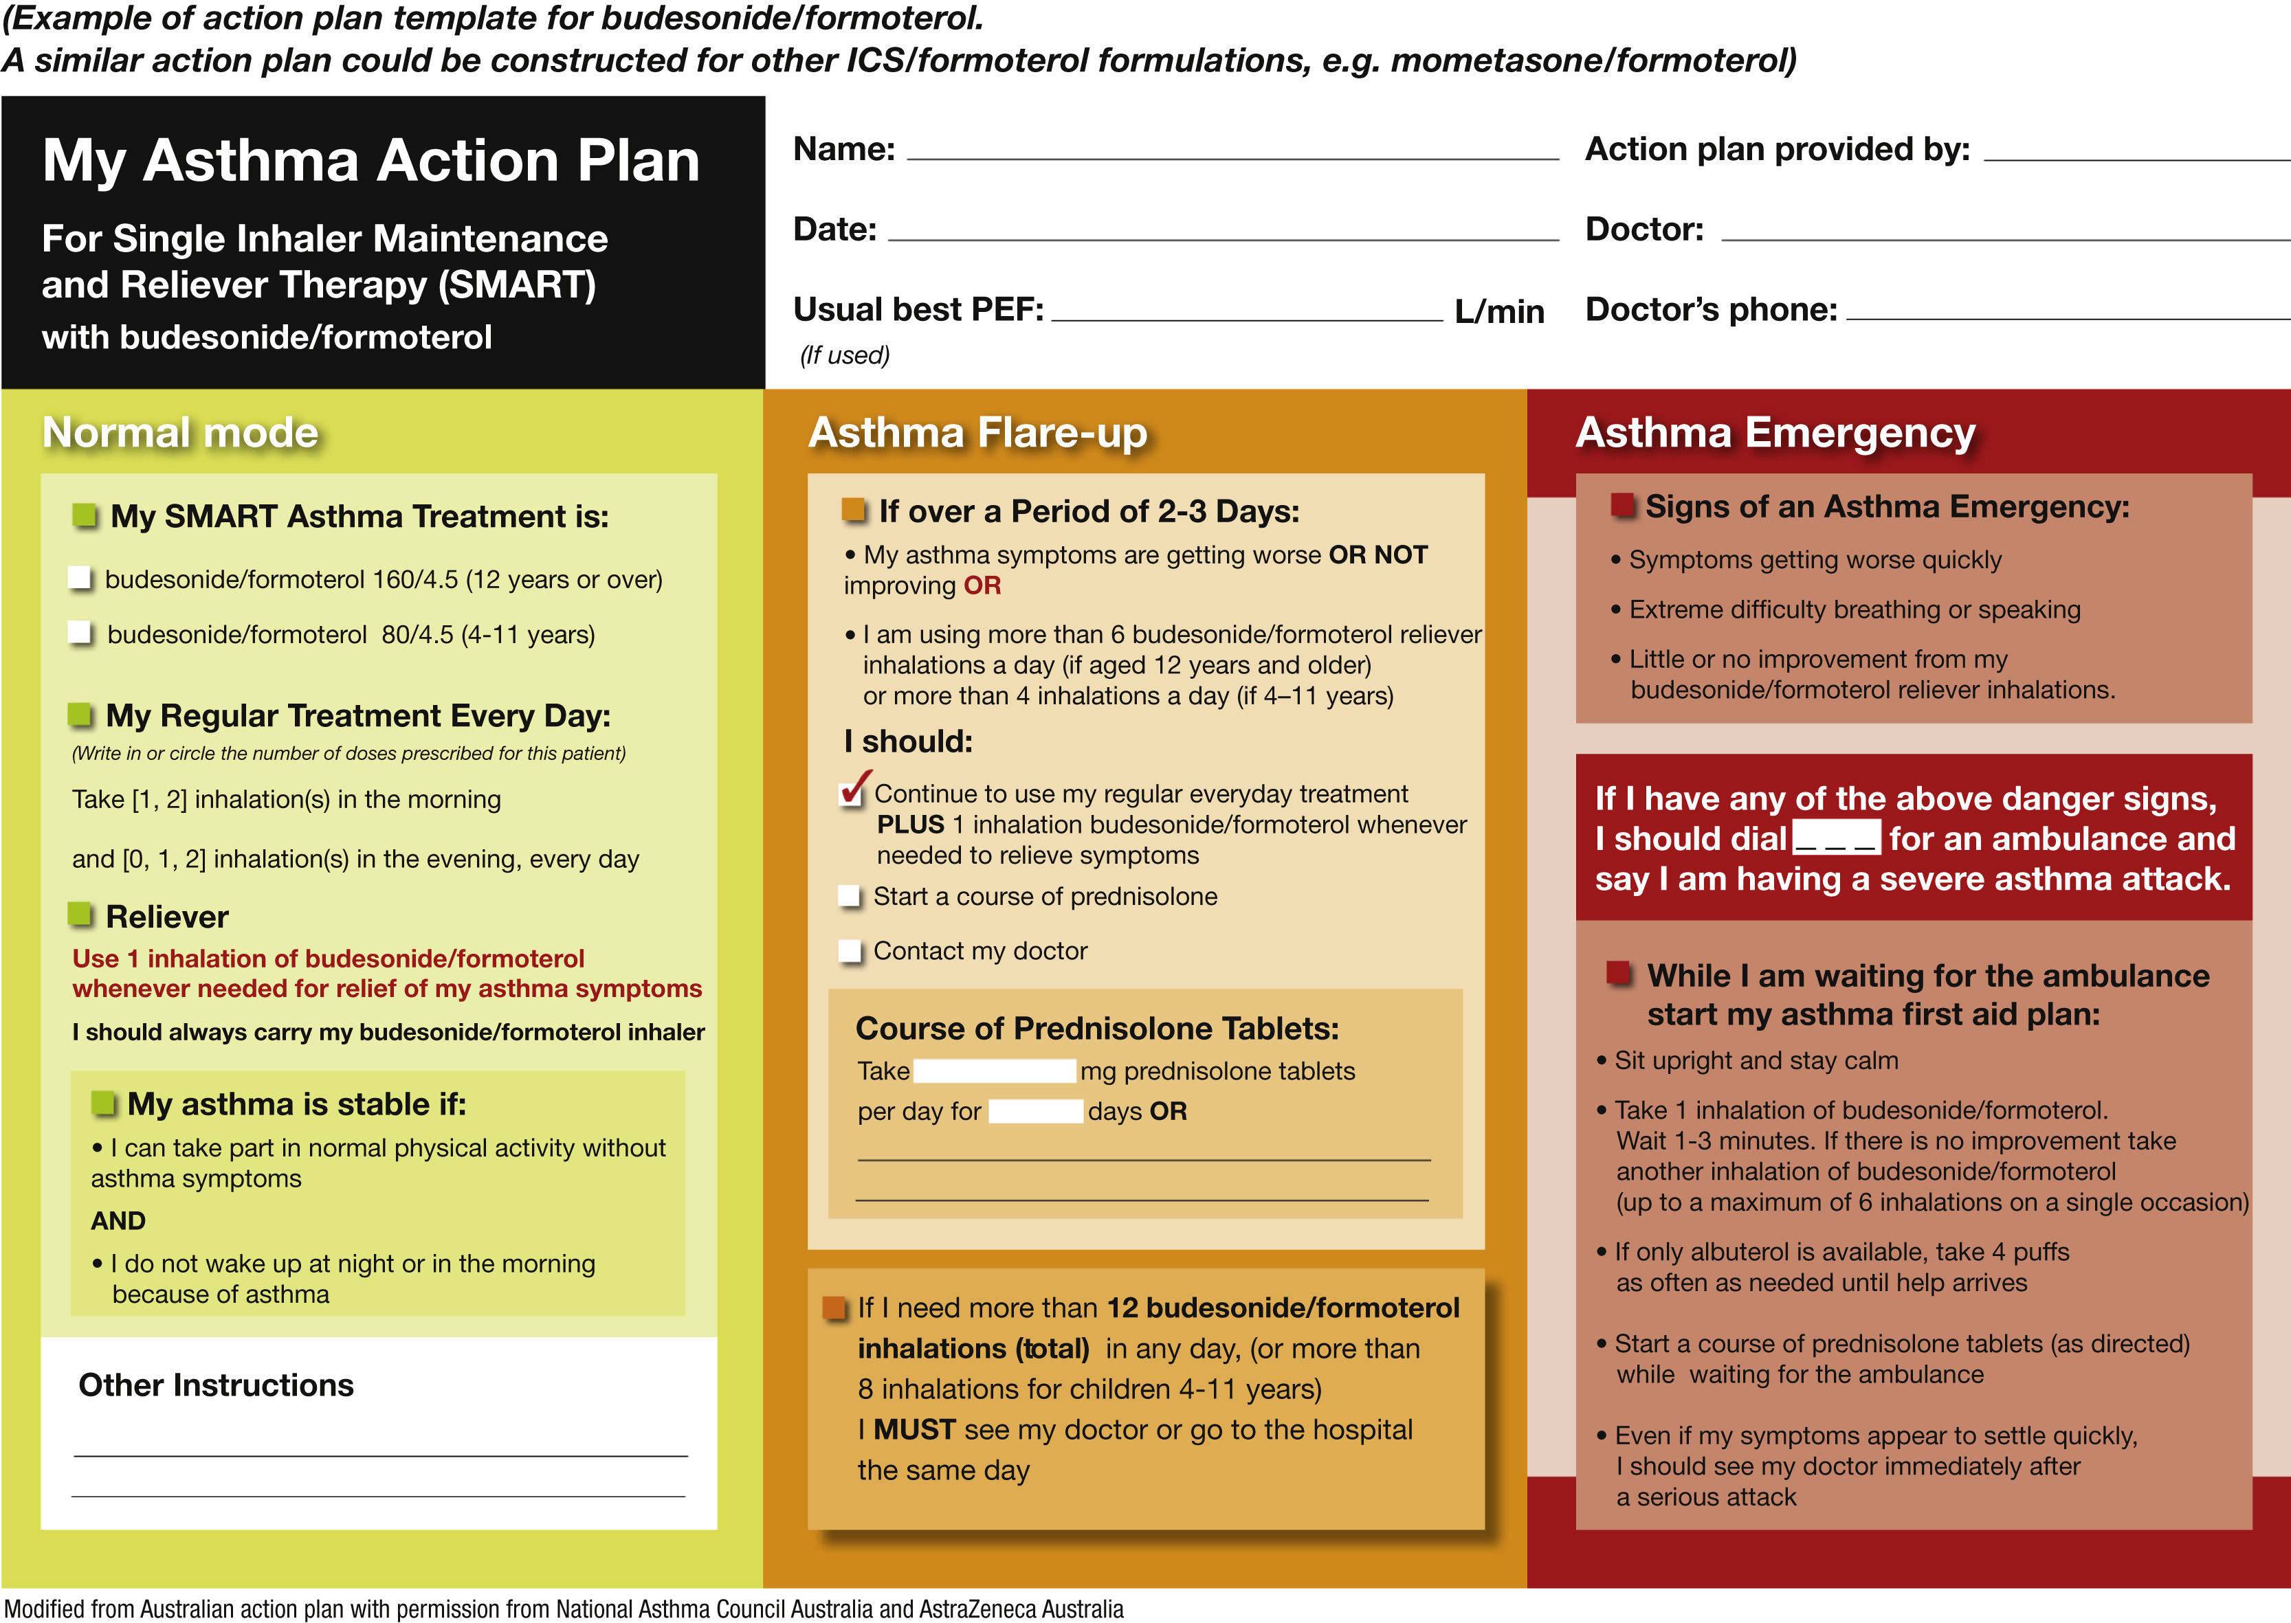
Figure 1
The Journal of Allergy and Clinical Immunology: In Practice 2022 10S31-S38DOI: (10.1016/j.jaip.2021.10.011)
Copyright © 2021 American Academy of Allergy, Asthma & Immunology Terms and Conditions
Notes:
Example of action plan template for patients using SMART with budesonide/formoterol. See Appendix E1 (available in this article's Online Repository at www.jaci-inpractice.org) for a customizable version of this action plan. A similar action plan could be constructed for patients using SMART with other inhaled corticosteroids (ICS)-formoterol formulations (eg, mometasone-formoterol). PEF, peak expiratory flow.

