Slide 1



Supporting adult seasonal allergic rhinitis in community pharmacy
Case study
Garry McDonald, Pharmacist (Scotland, UK)
Sarah Ben Hamida, Pharmacist (Tunisia)
November 2025

Slide 2

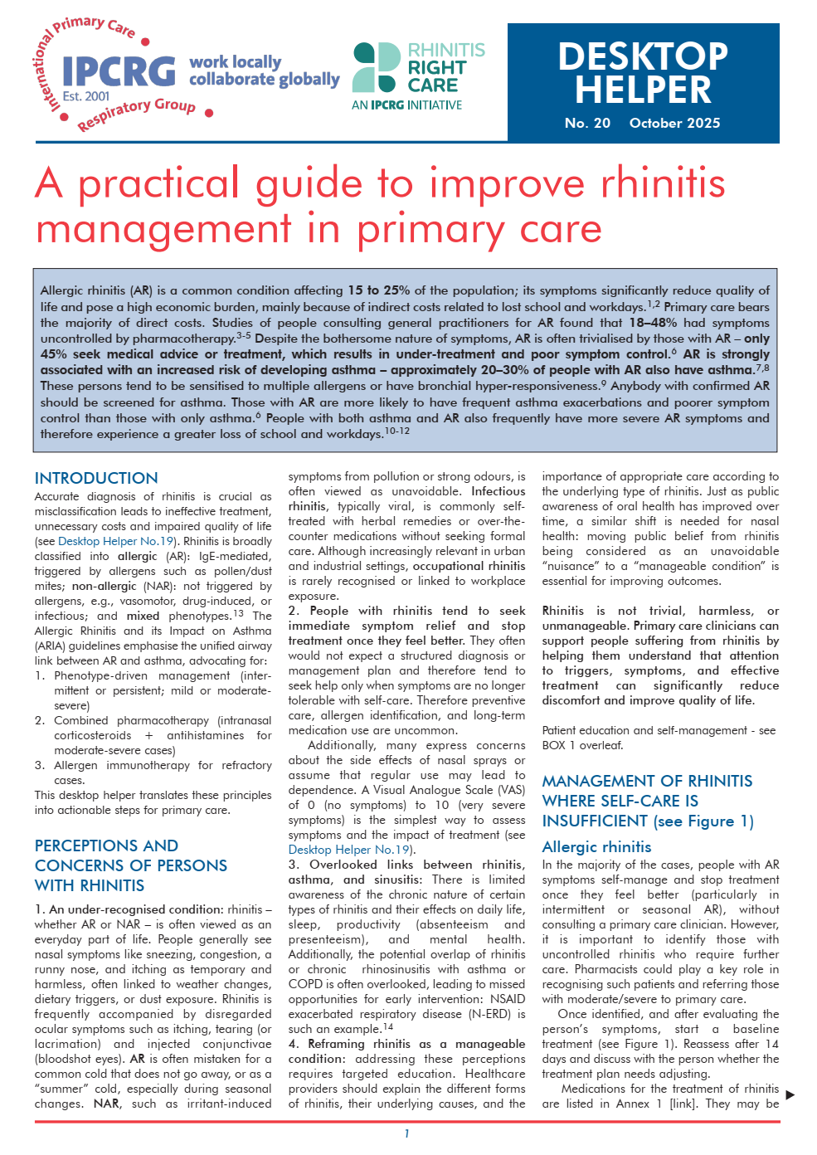


A practical guide to improve rhinitis management in primary care
scan
to access
ALK-Abelló provided an unrestricted educational grant to support the development of this case study but did not contribute to its content

Slide 3

Learning objectives
Describe the clinical presentation and common causes of rhinitis in patients.
Differentiate between the symptoms, triggers, and pathophysiology of allergic and non-allergic rhinitis.
Formulate an appropriate management plan for patients presenting with symptoms of allergic rhinitis in a community pharmacy setting.
ALK-Abelló provided an unrestricted educational grant to support the development of this case study but did not contribute to its content

Slide 4
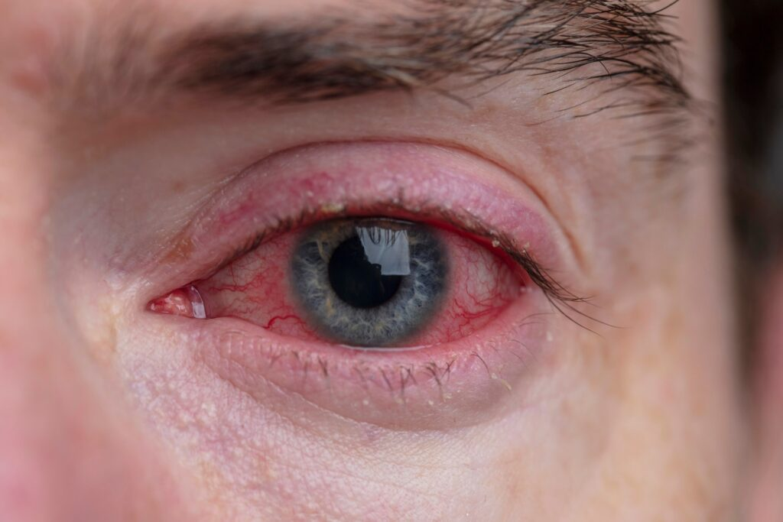

What is allergic rhinitis (AR)?
Rhinitis is inflammation of the nasal mucosa, characterized by at least 2 symptoms, more than one hour per day on most days:
Runny nose (rhinorrhoea)
Blocked/stuffy nose (congestion)
Sneezing
Itchy nose
Itchy throat
Itchy eyes
Allergic conjunctivitis can also cause itchy eyes, common with AR
ALK-Abelló provided an unrestricted educational grant to support the development of this case study but did not contribute to its content
Notes:
Upto 70% ocular
Caution kerto conjunctivitis more for Opthalmologist than rhinologist eczema of the eye

Slide 5
Difference between Allergic and Non Allergic Rhinitis
Symptoms NOT associated with AR or the common cold
Symptoms suggestive of the common cold
Symptoms suggestive of AR
Duration:
Variable (months or shorter)
Recurrent episodes
Duration:
5 – 10 days
Season:
Anytime of the year
Usually pollen season
Season:
Usually winter
Unilateral symptoms
Only nasal congestion
Mucopurulent rhinorrhoea
Clear rhinorrhoea, worse bending over
Posterior rhinorrhoea (post nasal drip)
Pain
Recurrent epistaxis
Orbital cellullitis
≥2 of the following symptoms for >1hr on most days, for the days symptomatic
Watery rhinorrhoea (anterior & posterior)
Sneezing, especially paroxysmal
Nasal congestion
Nasal pruritus, throat pruritus
± Conjunctivitis
Severe nasal congestion
Rhinorrhoea
Sneezing (rarely bouts of sneezing)
NO Nasal or ocular pruritus
Rare bilateral ocular symptoms
Frequent anosmia
Consider GP referrral
Treat according to protocol for the cold
Assess severity and Impact
Adapted from: Lourenço, Olga et al. “Managing Allergic Rhinitis in the Pharmacy: An ARIA Guide for Implementation in Practice.”
Pharmacy (Basel, Switzerland) vol. 8,2 85. 16 May. 2020, doi:10.3390/pharmacy8020085
ALK-Abelló provided an unrestricted educational grant to support the development of this case study but did not contribute to its content

Slide 6
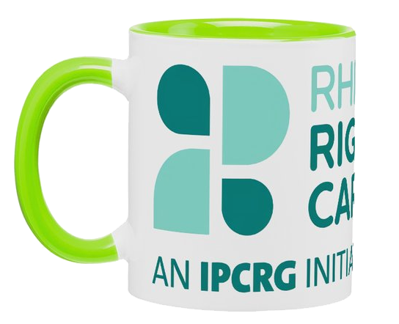
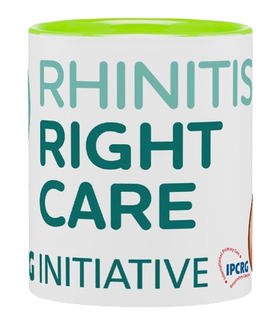
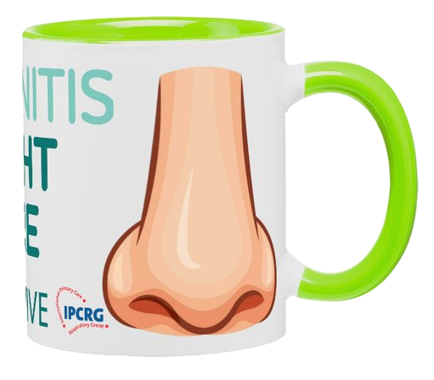

Difference between Allergic and Non Allergic Rhinitis
Allergic Rhinitis | Non-Allergic Rhinitis
Allergens e.g. pollen & dust Seasonal pattern Itchy eyes, sneezing Often associated with atopy | Irritants e.g. smoke or perfume No specific time in the year Nasal congestion dominates No allergic background
ALK-Abelló provided an unrestricted educational grant to support the development of this case study but did not contribute to its content

Slide 7

Meet Sam
40 year old male
Business consultant
Travels often, no pets
Wants a nasal decongestant OTC for:
Rhinorrhea
Sneezing
Nasal congestion
Itchy eyes
ALK-Abelló provided an unrestricted educational grant to support the development of this case study but did not contribute to its content

Slide 8
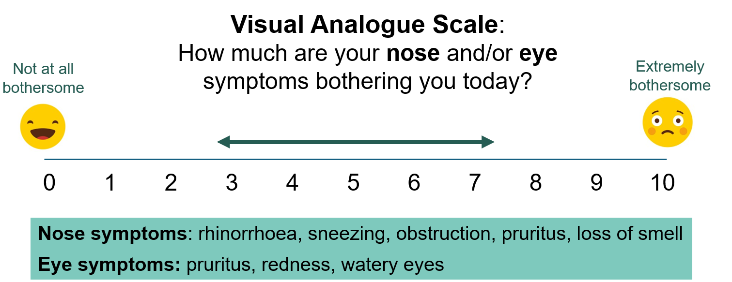
History
Identifying triggers
Season change? (autumn, spring)
Pollen and dust, especially when working from home
Bothersome symptoms
7-8 /10 on Visual Analogue Scale
Adapted from: Sousa-Pinto, Bernardo et al. “Validity, reliability, and responsiveness of daily monitoring visual analog scales in MASK-air®.” Clinical and translational allergy vol. 11,7 e12062. 19 Sep. 2021, doi:10.1002/clt2.12062
ALK-Abelló provided an unrestricted educational grant to support the development of this case study but did not contribute to its content

Slide 9

Duration and severity
Duration: 3 days a week maximum
Frequency: 2-3 weeks, never for more than 4 weeks
ACTIVITY | SEVERITY
Sleep
Work
Daily Activities
Disturbing Symptoms
ALK-Abelló provided an unrestricted educational grant to support the development of this case study but did not contribute to its content

Slide 10
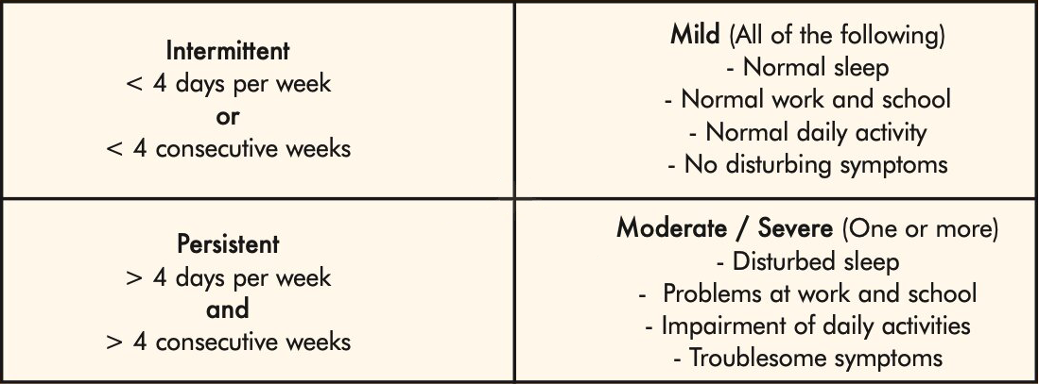
Classification
ALK-Abelló provided an unrestricted educational grant to support the development of this case study but did not contribute to its content

Slide 11
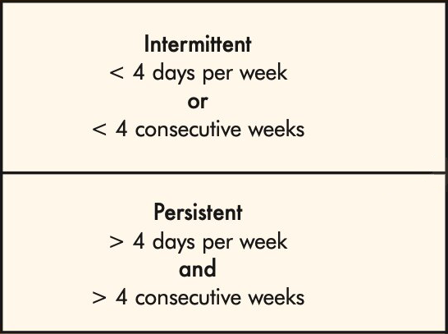
Classification
ALK-Abelló provided an unrestricted educational grant to support the development of this case study but did not contribute to its content

Slide 12
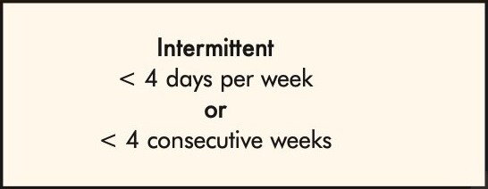
Classification
ALK-Abelló provided an unrestricted educational grant to support the development of this case study but did not contribute to its content

Slide 13
Classification
ALK-Abelló provided an unrestricted educational grant to support the development of this case study but did not contribute to its content

Slide 14
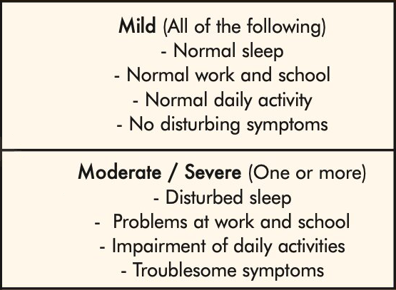
Classification
ALK-Abelló provided an unrestricted educational grant to support the development of this case study but did not contribute to its content

Slide 15
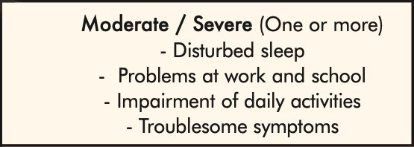
Classification
ALK-Abelló provided an unrestricted educational grant to support the development of this case study but did not contribute to its content

Slide 16
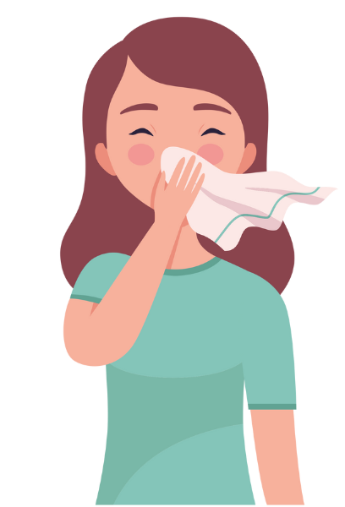
AR treatment ladder when self-care is insufficient (adults)
Clinical presentation
2 or more nasal symptoms indicating AR
Uncontrolled AR VAS≥5
Step 1 was ineffective
Severe AR
Step 1 & 2 were ineffective
- Confirm diagnosis
- Check adherence
- Evaluate comorbidities
- Review diagnosis
- Consider referral to allergy specialist or step-up treatment
Patient education
Involve patients in their treatment plan.
Ask which symptoms are their priority (all, nose, eyes?)
Advise them to avoid irritants and allergens, and practise regular nasal hygiene
Costs vary globally, and should be discussed
Consider locally produced medicines to reduce environmental impact
Never use injectable steroids
Intranasal corticosteroid
or
Antihistamine (oral or intranasal)
Step
1
if VAS≥ 5 = uncontrolled AR
* Possible add-on treatments depending on symptom profile/diagnosis:
(monotherapy often leads to greater satisfaction than combined therapy)
- Runny nose: ipratropium
- Rhinoconjunctivitis and asthma: leukotriene antagonist
- Itchy eyes/skin: non-sedating oral antihistamines
- Itchy, red, watery eyes: eye drops (antihistamine or cromones) for immediate relief, longer term use adds no benefit beyond oral AH
- Nasal congestion: topical decongestants for 5 days maximum (to avoid rhinitis medicamentosa)
- At Step 3, a short course of oral steroids may also (rarely) be considered (e.g., prednisolone 10 mg × 1 for 2–3–4 days). In such cases, follow-up is important to evaluate the need for allergen immunotherapy.
For children and adolescents, dosing and medication should be adjusted according to age and weight.
** if you cannot provide Allergen immunotherapy, refer to a specialist
Fixed combination
Intranasal corticosteroid
+
Intranasal antihistamines
when VAS< 5
consider step down treatment
Step
2
if VAS≥ 5 = uncontrolled AR
Add-on treatment
and/or
Oral steroid course (rarely)
and/or
Allergen immunotherapy
*
Step
3
**

Slide 17
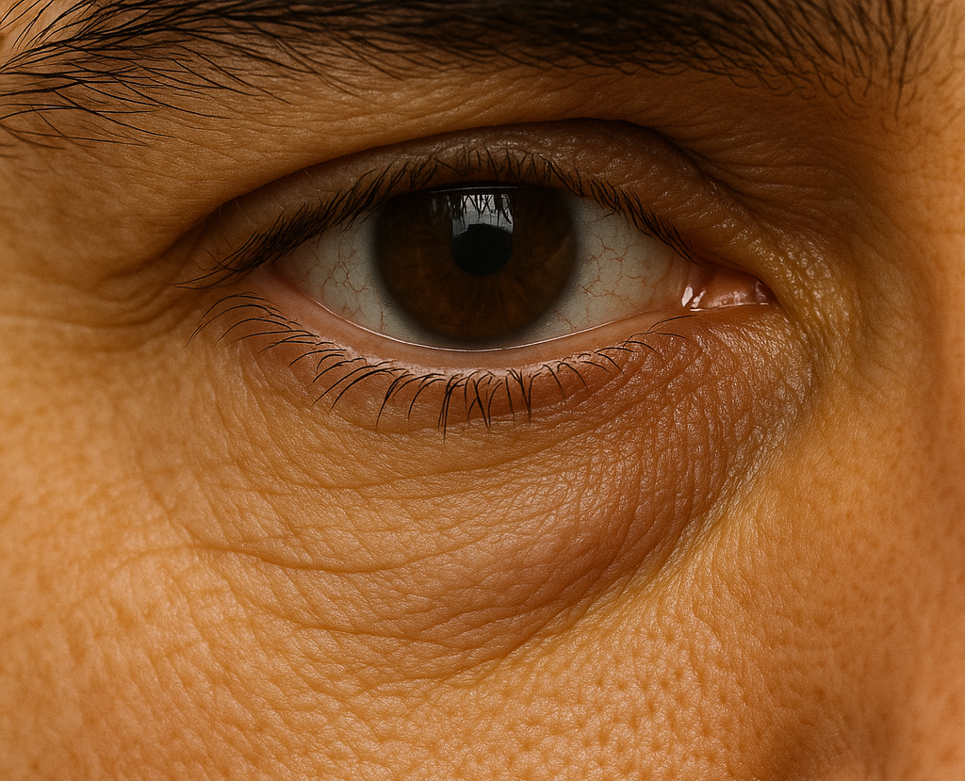
On presentation
Symptoms:
Nasal discharge: clear and watery most of the time
Mild wheezing with occasional shortness of breath
Frequent sneezing
Frequent throat clearing
Now more aware of possible anosmia when eating
Observations:
Atopic dermatitis (hands)
Dark circles under the eyes
Presence of infraorbital skin fold
Headache
Changes in ear pressure ‘not popping’
ALK-Abelló provided an unrestricted educational grant to support the development of this case study but did not contribute to its content
Notes:
Infraorbital Dennie Morgan lines
headache, not pain in the nose

Slide 18
Diagnosis
Allergens identified that trigger, pollen and dust when cleaning
Sneezing and congestion are biggest problems
Had “hay fever” as a child, atopic dermatitis on hands
Wheezy but not breathless
Watery discharge
Infraorbital folds, pain in the middle ear, no redness on ear drum
Allergic Rhinitis
ALK-Abelló provided an unrestricted educational grant to support the development of this case study but did not contribute to its content

Slide 19
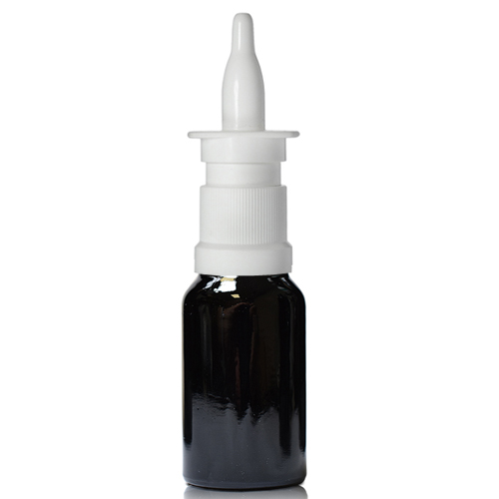
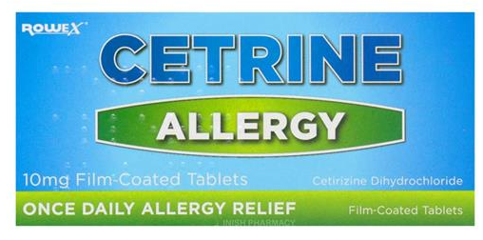
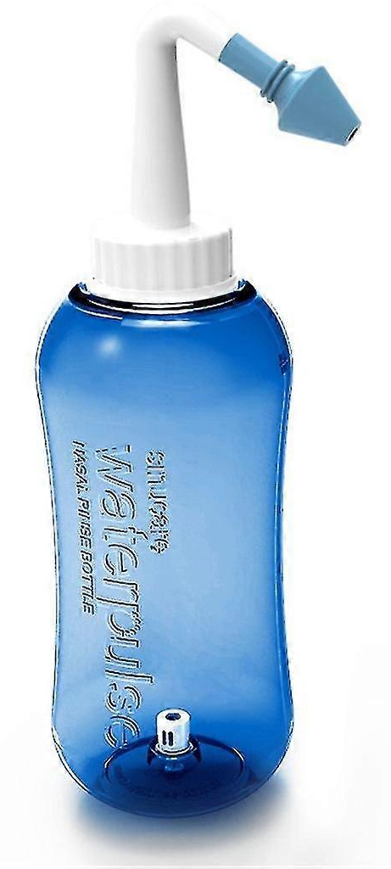
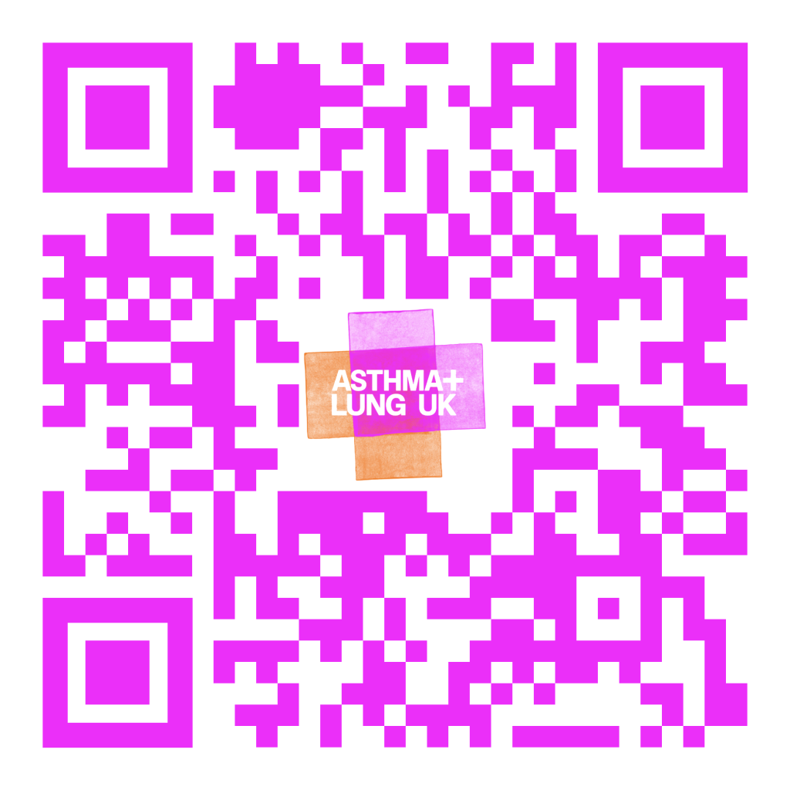
Management
Pharmacological:
Oral or ocular antihistamines
Intranasal corticosteroids or intranasal antihistamine
Avoid prolonged topical decongestant use (5 days max)
Non-Pharmacological:
Saline nasal irrigation
Allergen avoidance e.g. dust, pollen & pets
Proper inhaler and spray technique
ALK-Abelló provided an unrestricted educational grant to support the development of this case study but did not contribute to its content
Notes:
Eg cetirizine (non drowsy) older gen are sedative
Rebound effect with decongestants 5 days max
Pharaoh pose, opposite hand to opposite ear, esp with INCS, spray on to apply not to inhale, avoid septum cartilidge

Slide 20



The role of the community pharmacist
Ask about duration and pattern of symptoms
Check medication history and OTC use
Educate on correct nasal spray technique
Encourage follow-up and referral when necessary
Convenient location, no appointment needed
ALK-Abelló provided an unrestricted educational grant to support the development of this case study but did not contribute to its content
Notes:
Almost 20% of the population will have AR
Most people with rhinitis manage the condition episodically, either with self-management or over-the-counter medications (OTC). Many underestimate and neglect their symptoms and often do not bring this to the attention of their general practitioner (GP). However, as this is a common problem and a frequent comorbidity affecting the management of other conditions, it needs to be recognised and managed appropriately in primary care.
80% of asthmatics will have some form of Rhinitis, one airways disease
Identifying the cause of rhinitis is important for successful management, pharmacists are best placed for this conversation
Although no Skin prick testing or sIgE testing is available in the pharmacy, some now can check the ear canal with an oto scope
Pharmacists are key members of an integrated care pathways, resolving medication-related problems, optimizing regimens, improving adherence and recommending therapies while establishing liaisons between patients and physicians. Community pharmacists are the most accessible healthcare professionals to the public and allergic rhinitis is one of the most common diseases managed by pharmacists

Slide 21

Review and follow-up
Review after 1 week
Assess symptom control and adherence
Reinforce trigger management
Adjust treatment if needed eg INCS+INAH
ALK-Abelló provided an unrestricted educational grant to support the development of this case study but did not contribute to its content

Slide 22
Summary
Seasonal allergic rhinitis is common and often under managed
Pharmacists can identify triggers and prevent misuse of OTC decongestants
A combination of pharmacological and behavioural measures ensures better long-term outcomes
Convenient location, no appointment needed
ALK-Abelló provided an unrestricted educational grant to support the development of this case study but did not contribute to its content
Notes:
Community pharmacists are well positioned to diagnose, treat, and manage allergic rhinitis because they are highly accessible, trained to distinguish AR from similar conditions, and able to recommend evidence-based treatments without the need for an appointment. Their expertise in medicines, ability to provide immediate symptom relief, and capacity to monitor patients over time make them an efficient first point of care. Pharmacists also identify red flags that require medical referral, ensuring safe and effective management.

Slide 23
A practical guide to improve rhinitis management in primary care
scan
to access
ALK-Abelló provided an unrestricted educational grant to support the development of this case study but did not contribute to its content

