Slide 1



A person with rhinitis and lower respiratory symptoms
Monsur Habib
Jaime Correia de Sousa
November 2025

Slide 2

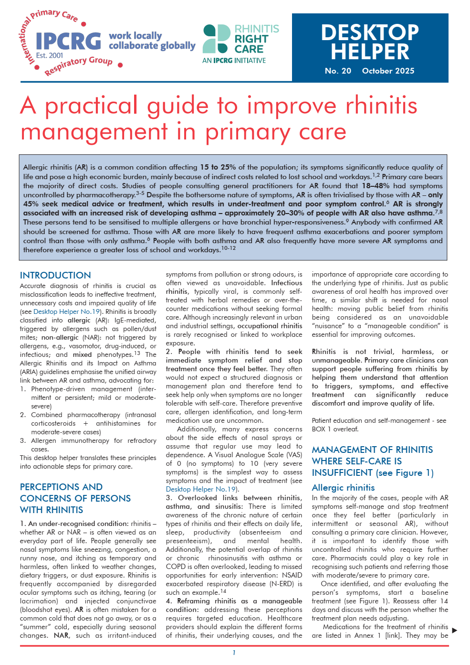


A practical guide to improve rhinitis management in primary care
scan
to access
ALK-Abelló provided an unrestricted educational grant to support the development of this case study but did not contribute to its content

Slide 3
Learning objectives
At the end of this case study, participants should be able to:
List and recognise some challenges in the management of Allergic Rhinitis (AR);
Consider a diagnosis of asthma as the most important comorbidity in people with AR;
Analyse and evaluate the benefits and limitations of different management approaches in patients with coexisting AR and Asthma;
Support shared decision-making by addressing patient’s fears, expectations and preferences and discussing risks and benefits;
Design a personalised management plan including non-pharmacological and pharmacological approaches.
ALK-Abelló provided an unrestricted educational grant to support the development of this case study but did not contribute to its content

Slide 4

The patient
Malcolm is 32-year-old.
He is a London bus driver.
It’s a sunny day at the end of spring.
He comes to see you because of his rhinitis.
You have previously prescribed a fixed combination of an intranasal corticosteroid and intranasal antihistamines.
ALK-Abelló provided an unrestricted educational grant to support the development of this case study but did not contribute to its content

Slide 5
Medical history
Malcolm has had nose symptoms intermittently since his teen age year.
Every year, when spring arrives, and he drives near gardens or parks the symptoms get worse (runny and itchy nose, sneezing and itchy eyes).
He has been using the intranasal medication regularly and felt much better in the beginning.
ALK-Abelló provided an unrestricted educational grant to support the development of this case study but did not contribute to its content

Slide 6
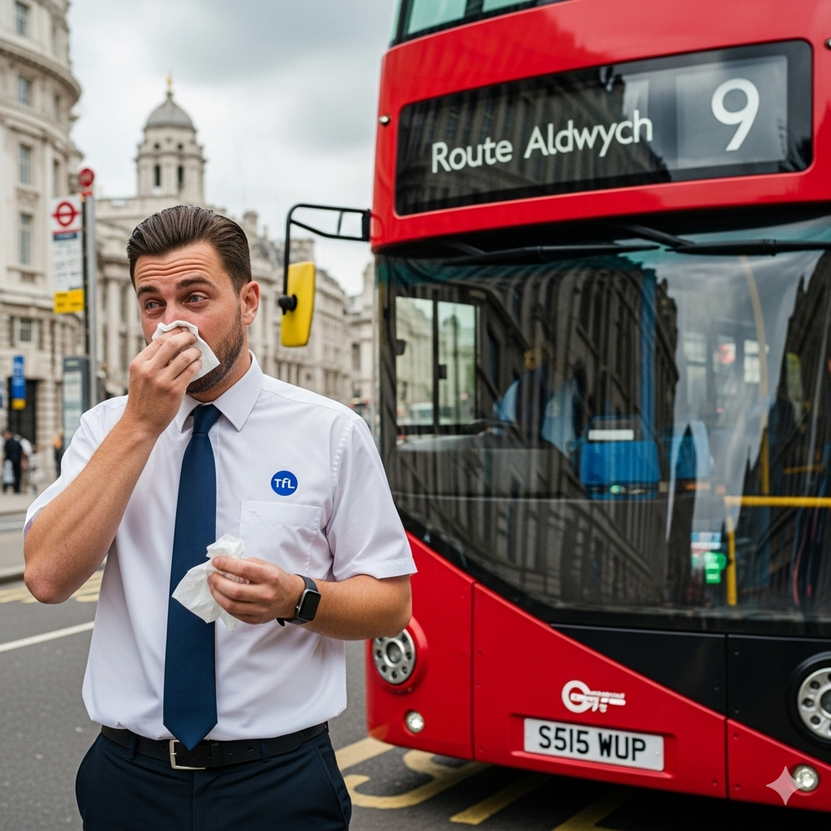
Medical history
Recently he says he feels night wheezing and breathlessness which wake him up 1 or 2 times a week.
This has been happening with more intensity in the last three months.
Sometimes he also has a dry cough and seldom chest tightness.
He remembers having similar symptoms as a child between 5 and 9 years.
The doctors said it was bronchitis and prescribed a blue inhaler which helped, though it took him a few days to get better.
ALK-Abelló provided an unrestricted educational grant to support the development of this case study but did not contribute to its content

Slide 7
Summary of current presentation
Before:
Allergic rhinitis
Previous fixed combination of an intranasal corticosteroid and intranasal antihistamines – felt better
Reason for present appointment:
Recently, night wheezing and breathlessness waking him up 1 or 2 times a week, worse in the last 3 months.
Seldom dry cough and chest tightness
Similar symptoms in childhood, relieved with blue inhaler
ALK-Abelló provided an unrestricted educational grant to support the development of this case study but did not contribute to its content

Slide 8

Clinical examination
General and Facial Features
Atopic Salute - a transverse crease across the lower third of the nose
Allergic Shiner - dark circles or infraorbital edema and darkening beneath the eyes
Eyes (Ocular Findings)
Reddish (injected) conjunctiva and watery (teary).
ALK-Abelló provided an unrestricted educational grant to support the development of this case study but did not contribute to its content

Slide 9
Clinical examination
Nasal Examination
Nasal Turbinates - examination with a speculum shows signs of chronic inflammation and congestion, hypertrophy (enlargement) and a pale appearance.
The nasal mucosa is swollen and wet.
Pharyngeal Examination
Posterior Nasal Dripping (PND)
Cobblestone Appearance of the Posterior Pharyngeal Wall
ALK-Abelló provided an unrestricted educational grant to support the development of this case study but did not contribute to its content

Slide 10
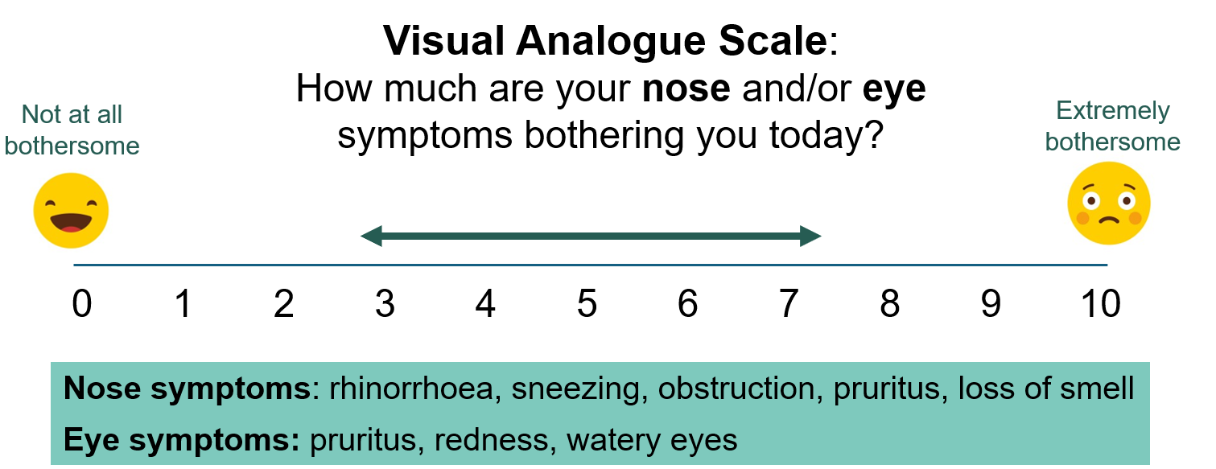
Clinical examination
VAS rhinitis score: 8/10
ALK-Abelló provided an unrestricted educational grant to support the development of this case study but did not contribute to its content

Slide 11
Quantifying the impact: Visual Analogue Scale
Initial VAS Score: 8/10
Indicates severe symptom burden
VAS is a validated tool for assessing allergic rhinitis severity
Scores >7 typically indicate moderate-to-severe disease requiring intensive treatment
Baseline measurement essential for monitoring treatment response
ALK-Abelló provided an unrestricted educational grant to support the development of this case study but did not contribute to its content

Slide 12
Clinical examination
Pulmonary auscultation:
normal intensity of the breath sounds
diffuse light wheeze more marked during forced expiration
PEF: 400 L/min* (height 178 cm, age 32)
*Predicted normal PEF value for a 32-year-old male with a height of 178 cm is in the range of 580 to 600 Liters per Minute (L/min).
ALK-Abelló provided an unrestricted educational grant to support the development of this case study but did not contribute to its content

Slide 13
Investigations
Which investigations would you recommend?
Spirometry, where available.
Otherwise,
PEF before and after (15 min) 200 mcg salbutamol at the practice (PEF increase ≥ 20% in adults).
or PEF before and after a 4-week course of ICS (PEF increase ≥ 20% in adults).
or PEF serial at home over 2 weeks (average diurnal variability > 10%).
Blood tests (complete blood count, CBC) – eosinophils.
ALK-Abelló provided an unrestricted educational grant to support the development of this case study but did not contribute to its content

Slide 14
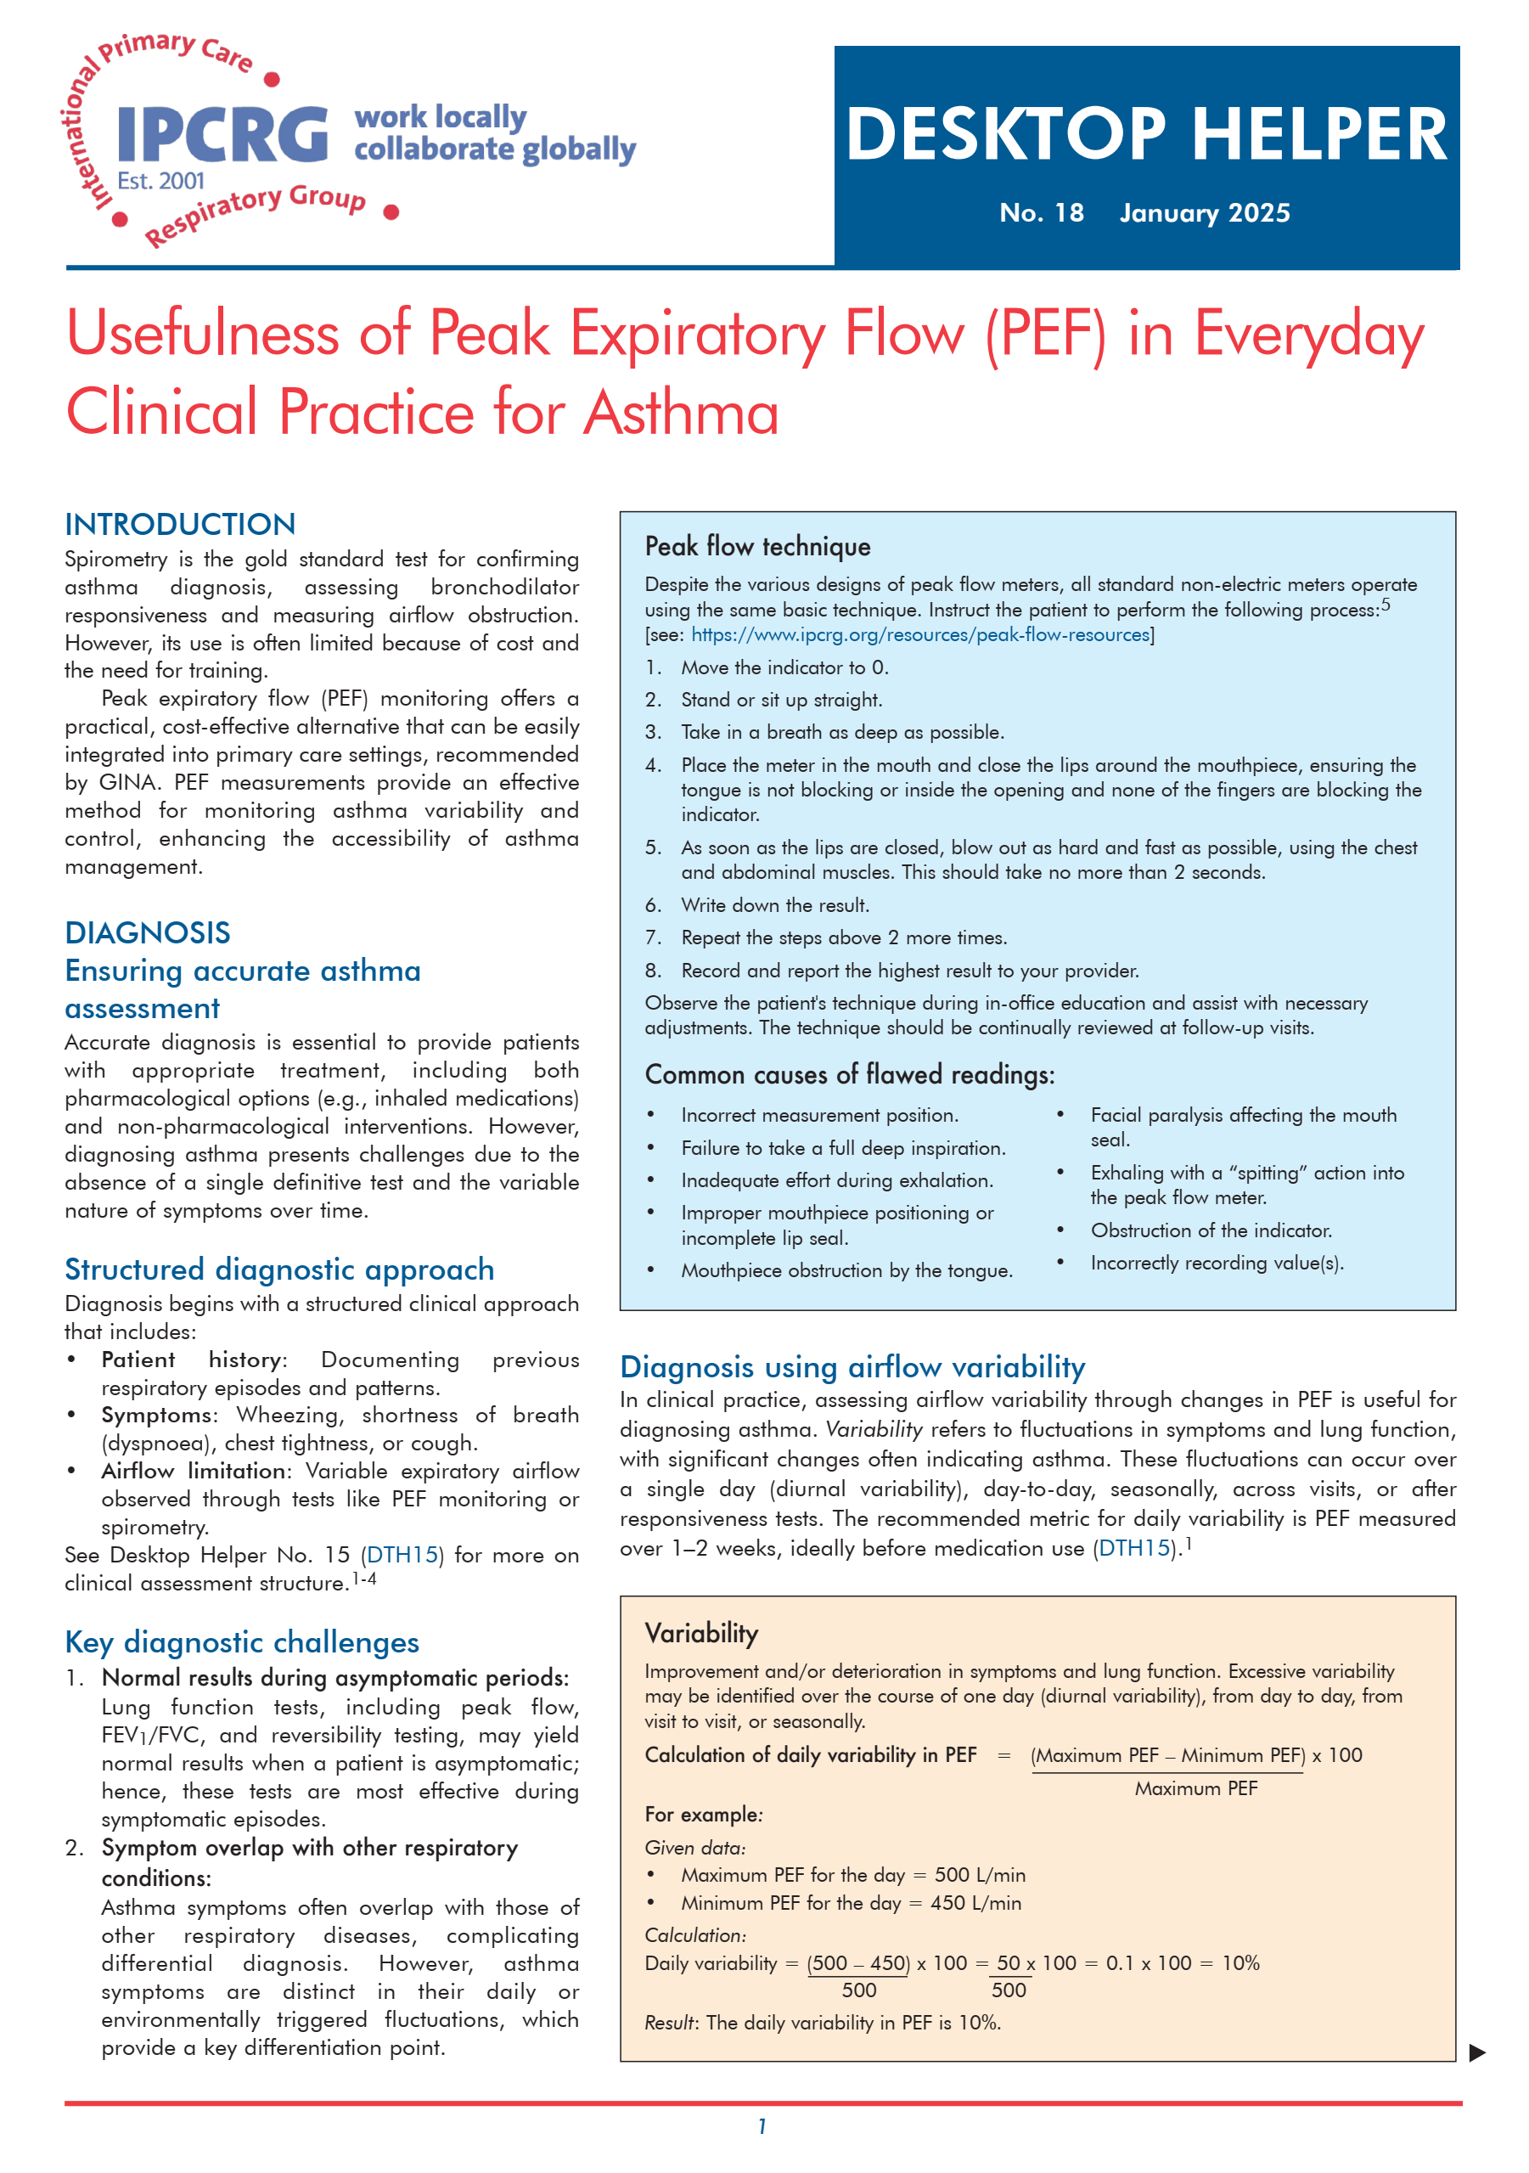

Read more about Peak Expiratory Flow for Asthma
scan
to access

Slide 15
Clinical decision
You decide to perform a PEF before and after (15 min) 200 mcg salbutamol at the practice and it shows an increase from to 400 L/min to 500 L/min (PEF increase ≥ 20%).
His ACT shows a score of 9/25 indicating uncontrolled asthma.
You explain Malcolm that he has asthma and AR.
You prescribe a DPI containing ICS + formoterol to be used on demand and explain him how to use it.
You agree with him that he will do the tests and use his medication daily and he should return after four weeks with the results.
Meanwhile, he should continue the same medication for rhinitis.
ALK-Abelló provided an unrestricted educational grant to support the development of this case study but did not contribute to its content

Slide 16
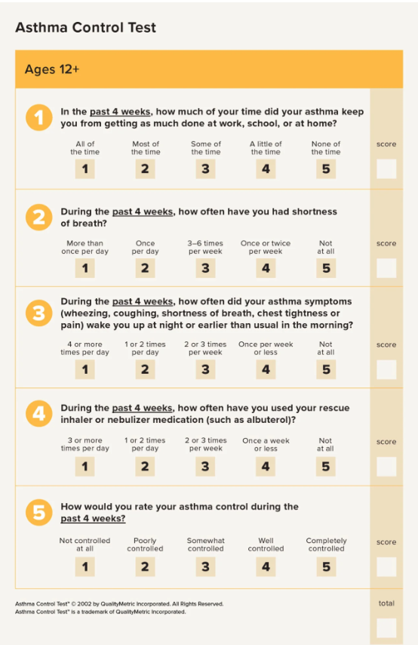
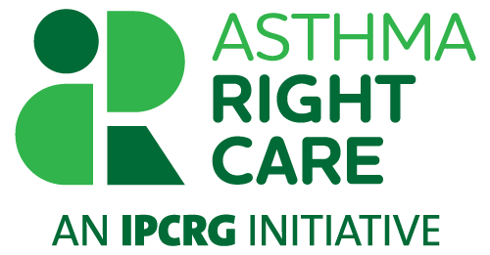
Score
20 - 25 - well controlled asthma
19 or below - not well controlled asthma
less than 16 - very poorly controlled asthma
minimally important clinical difference - 3 points.
https://www.asthmacontroltest.com/en-gb/welcome/
9

Slide 17
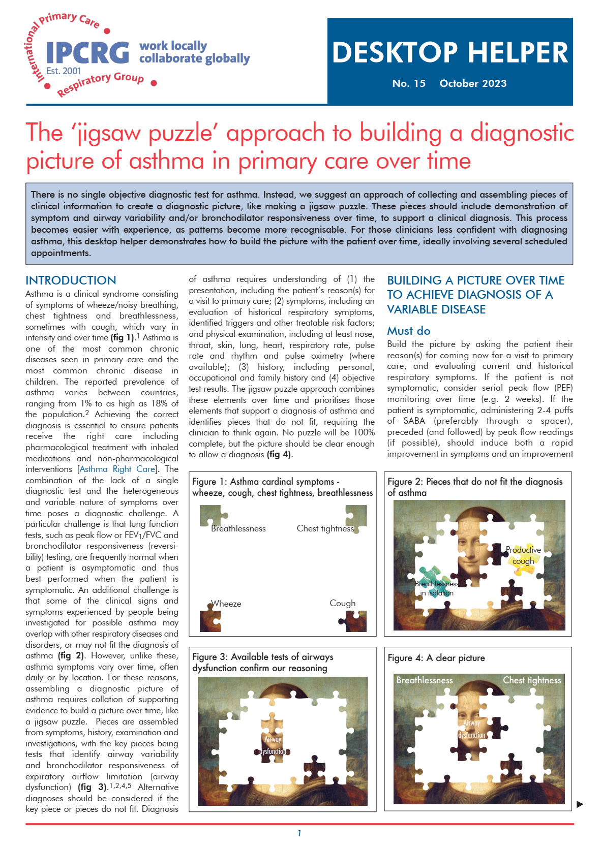

Read more about Asthma diagnosis
scan
to access

Slide 18
Second consultation
Malcolm returns after four weeks with the test results.
He is feeling slightly better, but still has lower respiratory symptoms, such as wheezing and a dry cough at night. His nasal symptoms are the same.
Spirometry results show an obstructive pattern with a reduction in airflow, and significant reversibility after bronchodilator.
Blood tests (CBC) - eosinophilia.
VAS – 5/10
PEF at the practice - 550 L/min.
ACT score - 20 (shows an increase, but still partially controlled asthma).
ALK-Abelló provided an unrestricted educational grant to support the development of this case study but did not contribute to its content

Slide 19
Diagnosis
Allergic Rhinitis - probably controlled with a fixed combination of an intranasal corticosteroid and intranasal antihistamines.
Asthma - partially controlled, requiring treatment review/ decision.
ALK-Abelló provided an unrestricted educational grant to support the development of this case study but did not contribute to its content

Slide 20
Allergic Rhinitis management
General principles: pharmacological and non-pharmacological
Discuss with Malcolm and consider keeping the same AR treatment (fixed combination of an intranasal corticosteroid and intranasal antihistamines), as the main cause of symptoms seems to be due to asthma.
Check with the patient the nasal inhalers technique, nasal hygiene, allergen avoidance, etc (see right upper green box on next slide).
ALK-Abelló provided an unrestricted educational grant to support the development of this case study but did not contribute to its content

Slide 21


Allergic rhinitis (AR) treatment ladder when self-care is insufficient (adults)
Clinical presentation
2 or more nasal symptoms indicating AR
Uncontrolled AR VAS≥5
Step 1 was ineffective
Severe AR
Step 1 & 2 were ineffective
- Confirm diagnosis
- Check adherence
- Evaluate comorbidities
- Review diagnosis
- Consider referral to allergy specialist or step-up treatment
Patient education
Involve patients in their treatment plan.
Ask which symptoms are their priority (all, nose, eyes?)
Advise them to avoid irritants and allergens, and practise regular nasal hygiene
Costs vary globally, and should be discussed
Consider locally produced medicines to reduce environmental impact
Never use injectable steroids
Intranasal corticosteroid
or
Antihistamine (oral or intranasal)
Step
1
if VAS≥ 5 = uncontrolled AR
Fixed combination
Intranasal corticosteroid
+
Intranasal antihistamines
* Possible add-on treatments depending on symptom profile/diagnosis: (monotherapy often leads to greater satisfaction than combined therapy)
- Runny nose: ipratropium
- Rhinoconjunctivitis and asthma: leukotriene antagonist
- Itchy eyes/skin: non-sedating oral antihistamines
- Itchy, red, watery eyes: eye drops (antihistamine or cromones) for immediate relief, longer term use adds no benefit beyond oral AH
- Nasal congestion: topical decongestants for 5 days maximum (to avoid rhinitis medicamentosa)
- At Step 3, a short course of oral steroids may also (rarely) be considered (e.g., prednisolone 10 mg × 1 for 2–3–4 days). In such cases, follow-up is important to evaluate the need for allergen immunotherapy.
For children and adolescents, dosing and medication should be adjusted according to age and weight.
** if you cannot provide Allergen immunotherapy, refer to a specialist
when VAS< 5
consider step down treatment
Step
2
if VAS≥ 5 = uncontrolled AR
Add-on treatment
and/or
Oral steroid course (rarely)
and/or
Allergen immunotherapy
*
Step
3
**

Slide 22
Asthma management
General principles: pharmacological and non-pharmacological.
Address patient’s fears, expectations and preferences and discuss risks and benefits.
Discuss with Malcolm and consider initiating an ICS+formoterol DPI in MART regimen as recommended by GINA.
Check if Malcolm is comfortable with his inhaler and offer options of ICS/Formoterol containing inhaler devices for him to choose from.
Teach and check the inhalation technique or send to nurse for training.
Provide a written asthma action plan and include ACT.
Book a follow-up appointment in 12 weeks.
ALK-Abelló provided an unrestricted educational grant to support the development of this case study but did not contribute to its content

Slide 23
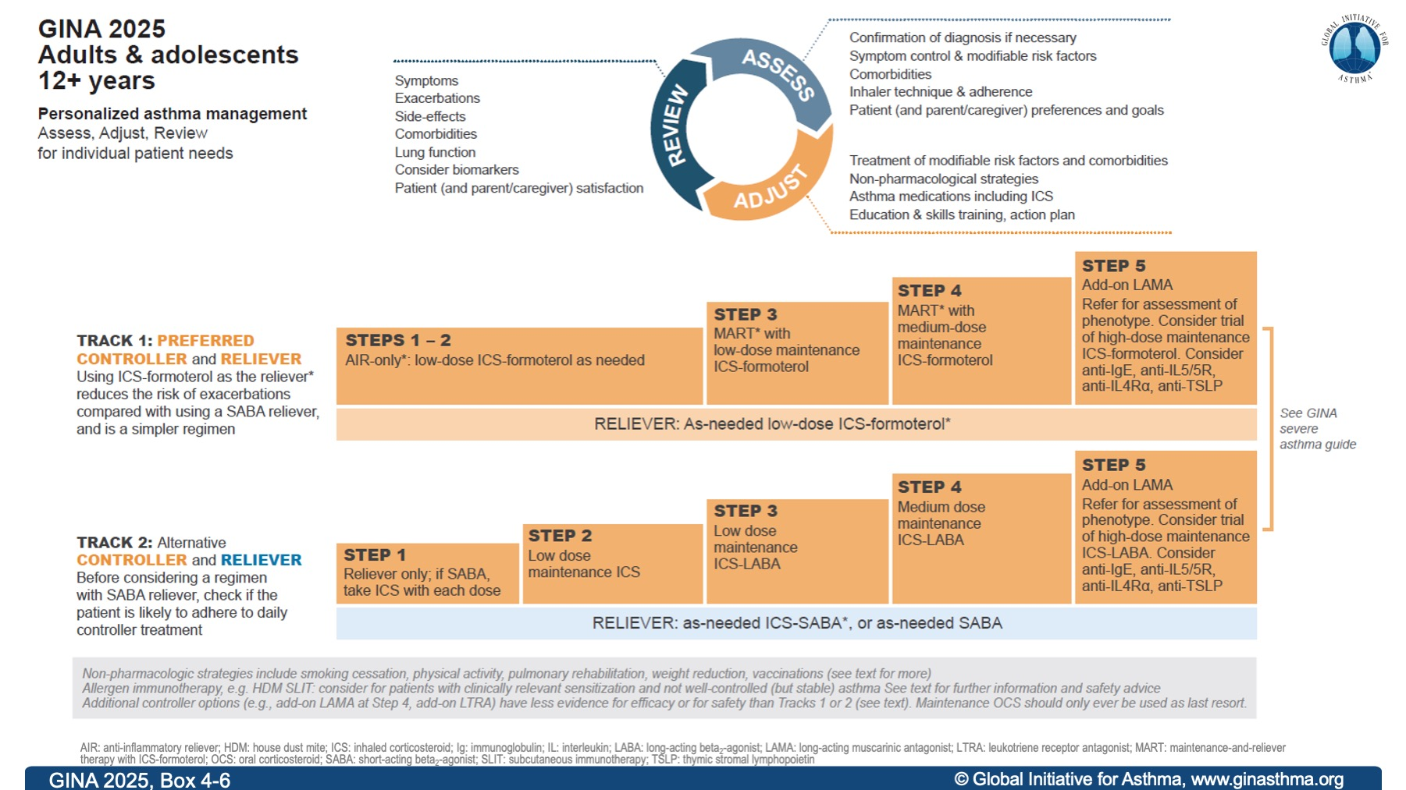

Slide 24

Review – 12 weeks later
Symptoms after treatment
Malcolm feels much better; he has no day or night wheezing, breathlessness, dry cough or chest tightness. He says he used his DPI ICS/formoterol inhaler on a regular basis and only a few times as a reliever because he felt tired when walking fast and was afraid to get worse. He thinks his asthma is well controlled.
He doesn’t have any new fears and expectations regarding his condition or treatment,
ALK-Abelló provided an unrestricted educational grant to support the development of this case study but did not contribute to its content

Slide 25
Review – 12 weeks later
Adherence - includes pharmacological and nonpharmacological
He says he has been using the medication every day and very seldom forgets it; he knows that if he skips a dose, he feels worse.
There were no side effects with the treatment.
The inhaler technique was checked and there are no errors to report.
PEF after treatment at the practice increased to 550 L/min.
ACT after treatment – 23 points (partially controlled asthma).
ALK-Abelló provided an unrestricted educational grant to support the development of this case study but did not contribute to its content

Slide 26
Score
20 - 25 - well controlled asthma
19 or below - not well controlled asthma
less than 16 - very poorly controlled asthma
minimally important clinical difference - 3 points.
https://www.asthmacontroltest.com/en-gb/welcome/
9

Slide 27
Clinical decision
Together with Malcolm, you decide to continue the same treatment for AR and Asthma.
You review any other concerns regarding the management and the inhaler technique and review the asthma action plan.
You agree with him that he should return for an appointment after three months.
He should contact the practice if there are any concerns or if he gets worse.
ALK-Abelló provided an unrestricted educational grant to support the development of this case study but did not contribute to its content

Slide 28
Age-related global prevalence of Allergic Rhinitis
The prevalence of AR peaks during adolescence and early adulthood,
Then gradually declines with increasing age.
Nearly 80% of affected individuals experience their first symptoms before reaching 20 years of age.
Nur Husna, Siti Muhamad, et al. "Allergic rhinitis: a clinical and pathophysiological overview." Frontiers in medicine 9 (2022): 874114.
Hardjojo A, Shek LP, van Bever HP, Lee BW. Rhinitis in children less than 6 years of age: current knowledge and challenges. Asia Pac Allergy. 2011 Oct;1(3):115-22
Yan, Xiaobo, and Limin Li. "Epidemiological investigation of allergic rhinitis in children aged 6–12 years in Bayannur City, China." Frontiers in Pediatrics 12 (2024)
Barne, Monica, et al. "Global Asthma Network Phase I, India: Results for allergic rhinitis and eczema in 127,309 children and adults." Journal of Allergy and Clinical Immunology: Global 1.2 (2022): 51-60.
Jones, G.; House, R.; Bosnic-Anticevich, S.; Cheong, L.; Cvetkovski, B. Young Adults and Allergic Rhinitis: A Population Often Overlooked but in Need of Targeted Help. Allergies 2024, 4, 145-161.
Savouré M, Bousquet J, Jaakkola JJK, Jaakkola MS, Jacquemin B, Nadif R. Worldwide prevalence of rhinitis in adults: A review of definitions and temporal evolution. Clin Transl Allergy. 2022 Mar;12(3):e12130

Slide 29

How frequent is asthma in people with AR?
The prevalence of the link between allergic rhinitis and asthma varies across regions and age groups. However, worldwide, it is estimated to be between 10% and 40%.
Furthermore, allergic rhinitis is a widely acknowledged risk factor for developing asthma.
Di Cara, Giuseppe, et al. "Severity of allergic rhinitis and asthma development in children." World Allergy Organization Journal 8.1 (2015): 1-3.
Acevedo-Prado A, Seoane-Pillado T, López-Silvarrey-Varela A, Salgado FJ,et al. Association of rhinitis with asthma prevalence and severity. Sci Rep. 2022 Apr 16;12(1):6389.
Shen, Yang, et al. "Prevalence of allergic rhinitis comorbidity with asthma and asthma with allergic rhinitis in China: a meta-analysis." Asian Pac J Allergy Immunol 37.4 (2019): 220-225

Slide 30
Transition from AR to asthma:
Risk factors | Protective factors
Sensitisation load / poly-sensitisation Persistent / more severe AR Early onset / young age of sensitisation Bronchial hyper-responsiveness is already present Genetic / immunological predisposition Cross-talk between nose and lung | Less severe AR, more intermittent rather than persistent Fewer allergen sensitisations Low baseline bronchial hyperreactivity. Good control of air. Non-atopic phenotypes Genetic or developmental factors. Less environmental insults.
The likelihood of an individual developing asthma from allergic rhinitis can be estimated based on specific clinical and personal risk factors. Clinicians should assess this risk early to implement appropriate preventive measures.
Case of Malcolm:
Developed allergic rhinitis during his teenage years — the typical age of peak AR prevalence.
Later developed asthma at around 30 years of age, with an interval of 15–16 years after the onset of AR — the most common time gap observed*.
Had a childhood predisposition to asthma, indicating baseline bronchial hyperreactivity.
*Makris, M., et al. "Temporal relationship of allergic rhinitis with asthma and other co-morbidities in a Mediterranean country: a retrospective study in a tertiary reference allergy clinic." Allergologia et immunopathologia 38.5 (2010): 246-253.
Luo G, Nkoy FL, Stone BL, Schmick D, Johnson MD. A systematic review of predictive models for asthma development in children. BMC Med Inform Decis Mak. 2015 Nov 28;15:99.
ALK-Abelló provided an unrestricted educational grant to support the development of this case study but did not contribute to its content

Slide 31
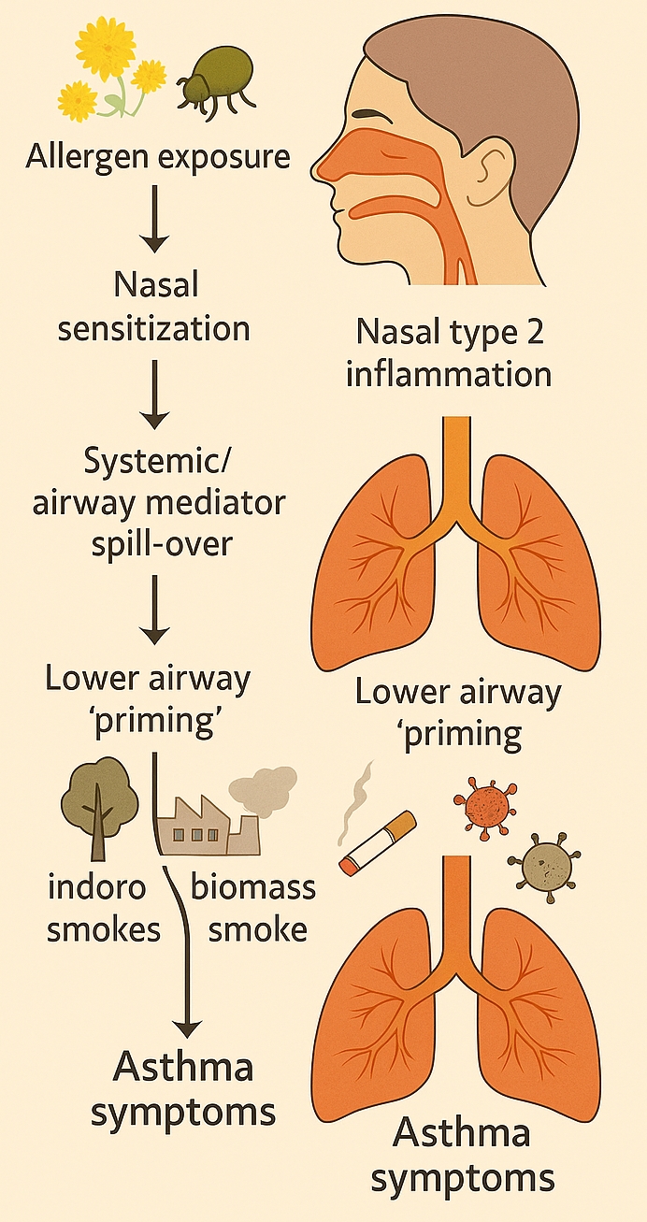
Mechanism of Transition: Allergic Rhinitis to Asthma
Inflammation: Type 2 cytokine
Mediator release
Spill over the mediators and inflammatory process from the nose to the lower airway.
Impaired epithelial barrier
AR to Asthma
Risk factors: allergen burden, biomass smoke, dust, smoking, pollution, and infection.
Egan, M., Bunyavanich, S. Allergic rhinitis: the “Ghost Diagnosis” in patients with asthma. asthma res and pract 1, 8 (2015). https://doi.org/10.1186/s40733-015-0008-0
Kim H, Bouchard J, Renzi PM. The link between allergic rhinitis and asthma: a role for antileukotrienes? Can Respir J. 2008 Mar;15(2):91-8. doi: 10.1155/2008/416095. PMID: 18354749; PMCID: PMC2677841.
Feinstein, E. (2013). The Common Allergic Mechanism of Rhinitis and Asthma. The Science Journal of the Lander College of Arts and Sciences, 7(1). Retrieved from https://touroscholar.touro.edu/sjlcas/vol7/ iss1/5

Slide 32
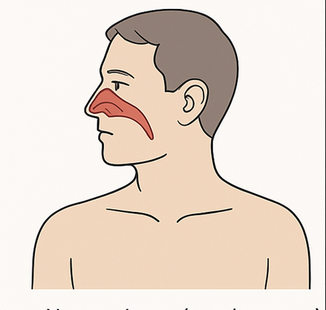
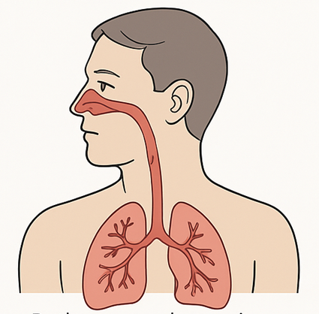
AR alone is different from AR + Asthma
Clinically, two distinct allergic rhinitis (AR) phenotypes are identified:
(i) rhinitis alone, and (ii) AR + asthma.
Allergic Rhinitis alone (70–80%):
Limited to the Nose
Symptoms – Sneezing, congestion, Itching, Runny or blocked nose
Localized Eosinophilic Inflammation
Can progress to asthma
AR with asthma (20–30%):
Both upper and lower airways (Nose & bronchial tree)
Typical Asthma symptoms
Generalized Th2-type inflammation
Established airway hyper-reactivity
Bousquet, Jean, et al. "Rhinitis associated with asthma is distinct from rhinitis alone: the ARIA‐MeDALL hypothesis." Allergy 78.5 (2023): 1169-1203.
Nur Husna, Siti Muhamad, et al. "Allergic rhinitis: a clinical and pathophysiological overview." Frontiers in medicine 9 (2022): 874114.

Slide 33

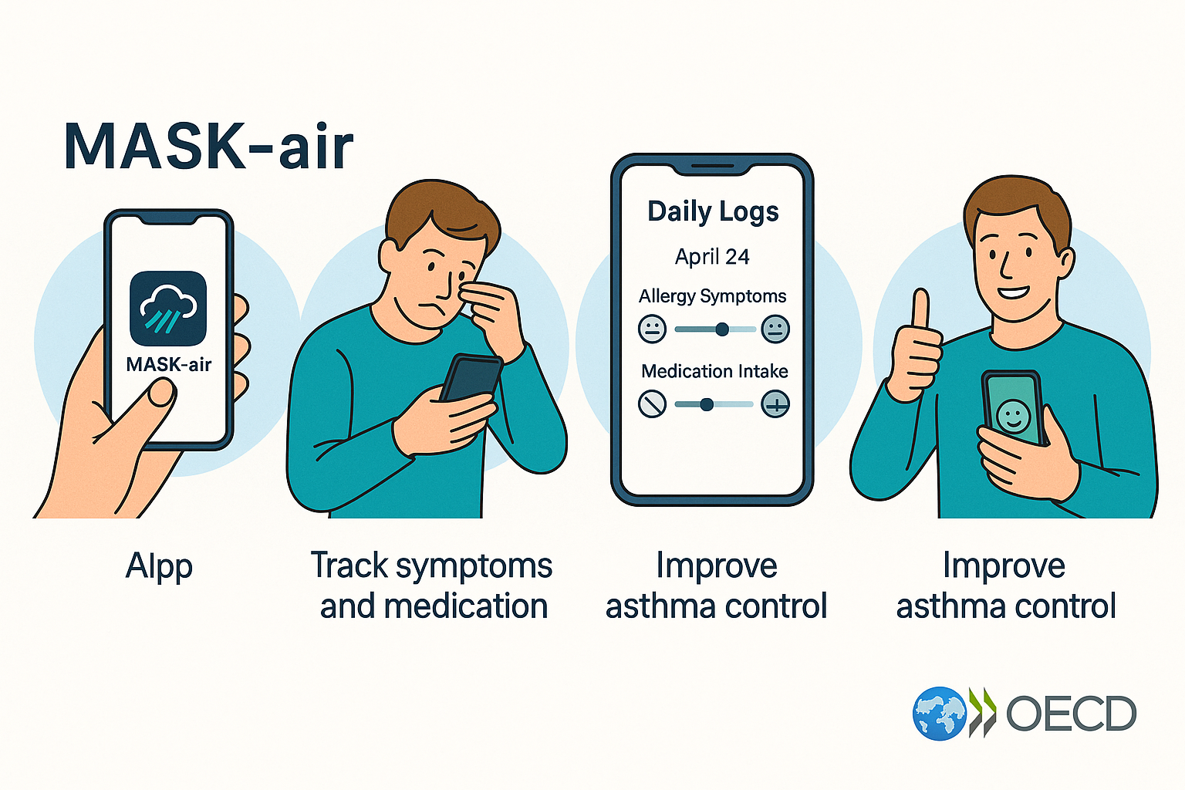
MASK-air is one of OECD-recognized (2023) 13 Best Practice integrating digital, patient-centered care for allergic rhinitis and asthma
The Organisation for Economic Co-operation and Development (OECD) recognized the MASK-air app as a best practice for integrated chronic respiratory care due to its success in using digital health for patient-centered approaches and generating real-world data.
Key messages highlight the app's role
Digitally empowering patients for understanding and managing their condition.
Producing extensive real-life evidence on symptoms and medication, and
Improving integrated care pathways between primary and specialist practitioners.
ALK-Abelló provided an unrestricted educational grant to support the development of this case study but did not contribute to its content

Slide 34
Take-Home Messages
Allergic Rhinitis (AR) affects 15–25% of the global population.
Only about 45% seek medical advice or treatment.
AR is closely linked to asthma — 20–30% of AR patients also have asthma.
Early management of AR may help prevent progression to asthma.
AR is often seen as a common issue as a persistent cold rather than a disease.
Patients rarely expect a structured diagnosis or treatment plan.
The Visual Analogue Scale (VAS) (0 = no symptoms; 10 = very severe) is a simple and effective tool.
Reframe rhinitis as a manageable, non-trivial condition.
Therapy should be tailored according to symptom pattern.
Daily therapy for frequent, severe, or seasonal symptoms.
As-needed therapy for mild or intermittent cases.
Saline irrigation can reduce symptom severity.
Consider Allergen Immunotherapy (AIT / SLIT) for persistent cases.
Rhinitis is not harmless or trivial. With proper diagnosis, education, and personalized treatment, patients can regain comfort, productivity, and control over their symptoms.
ALK-Abelló provided an unrestricted educational grant to support the development of this case study but did not contribute to its content

Slide 35
A practical guide to improve rhinitis management in primary care
scan
to access
ALK-Abelló provided an unrestricted educational grant to support the development of this case study but did not contribute to its content

