Slide 1



非过敏性鼻炎
案例研究
Garry McDonald (Scotland, UK)
Osman Yusuf (Pakistan)

Slide 2

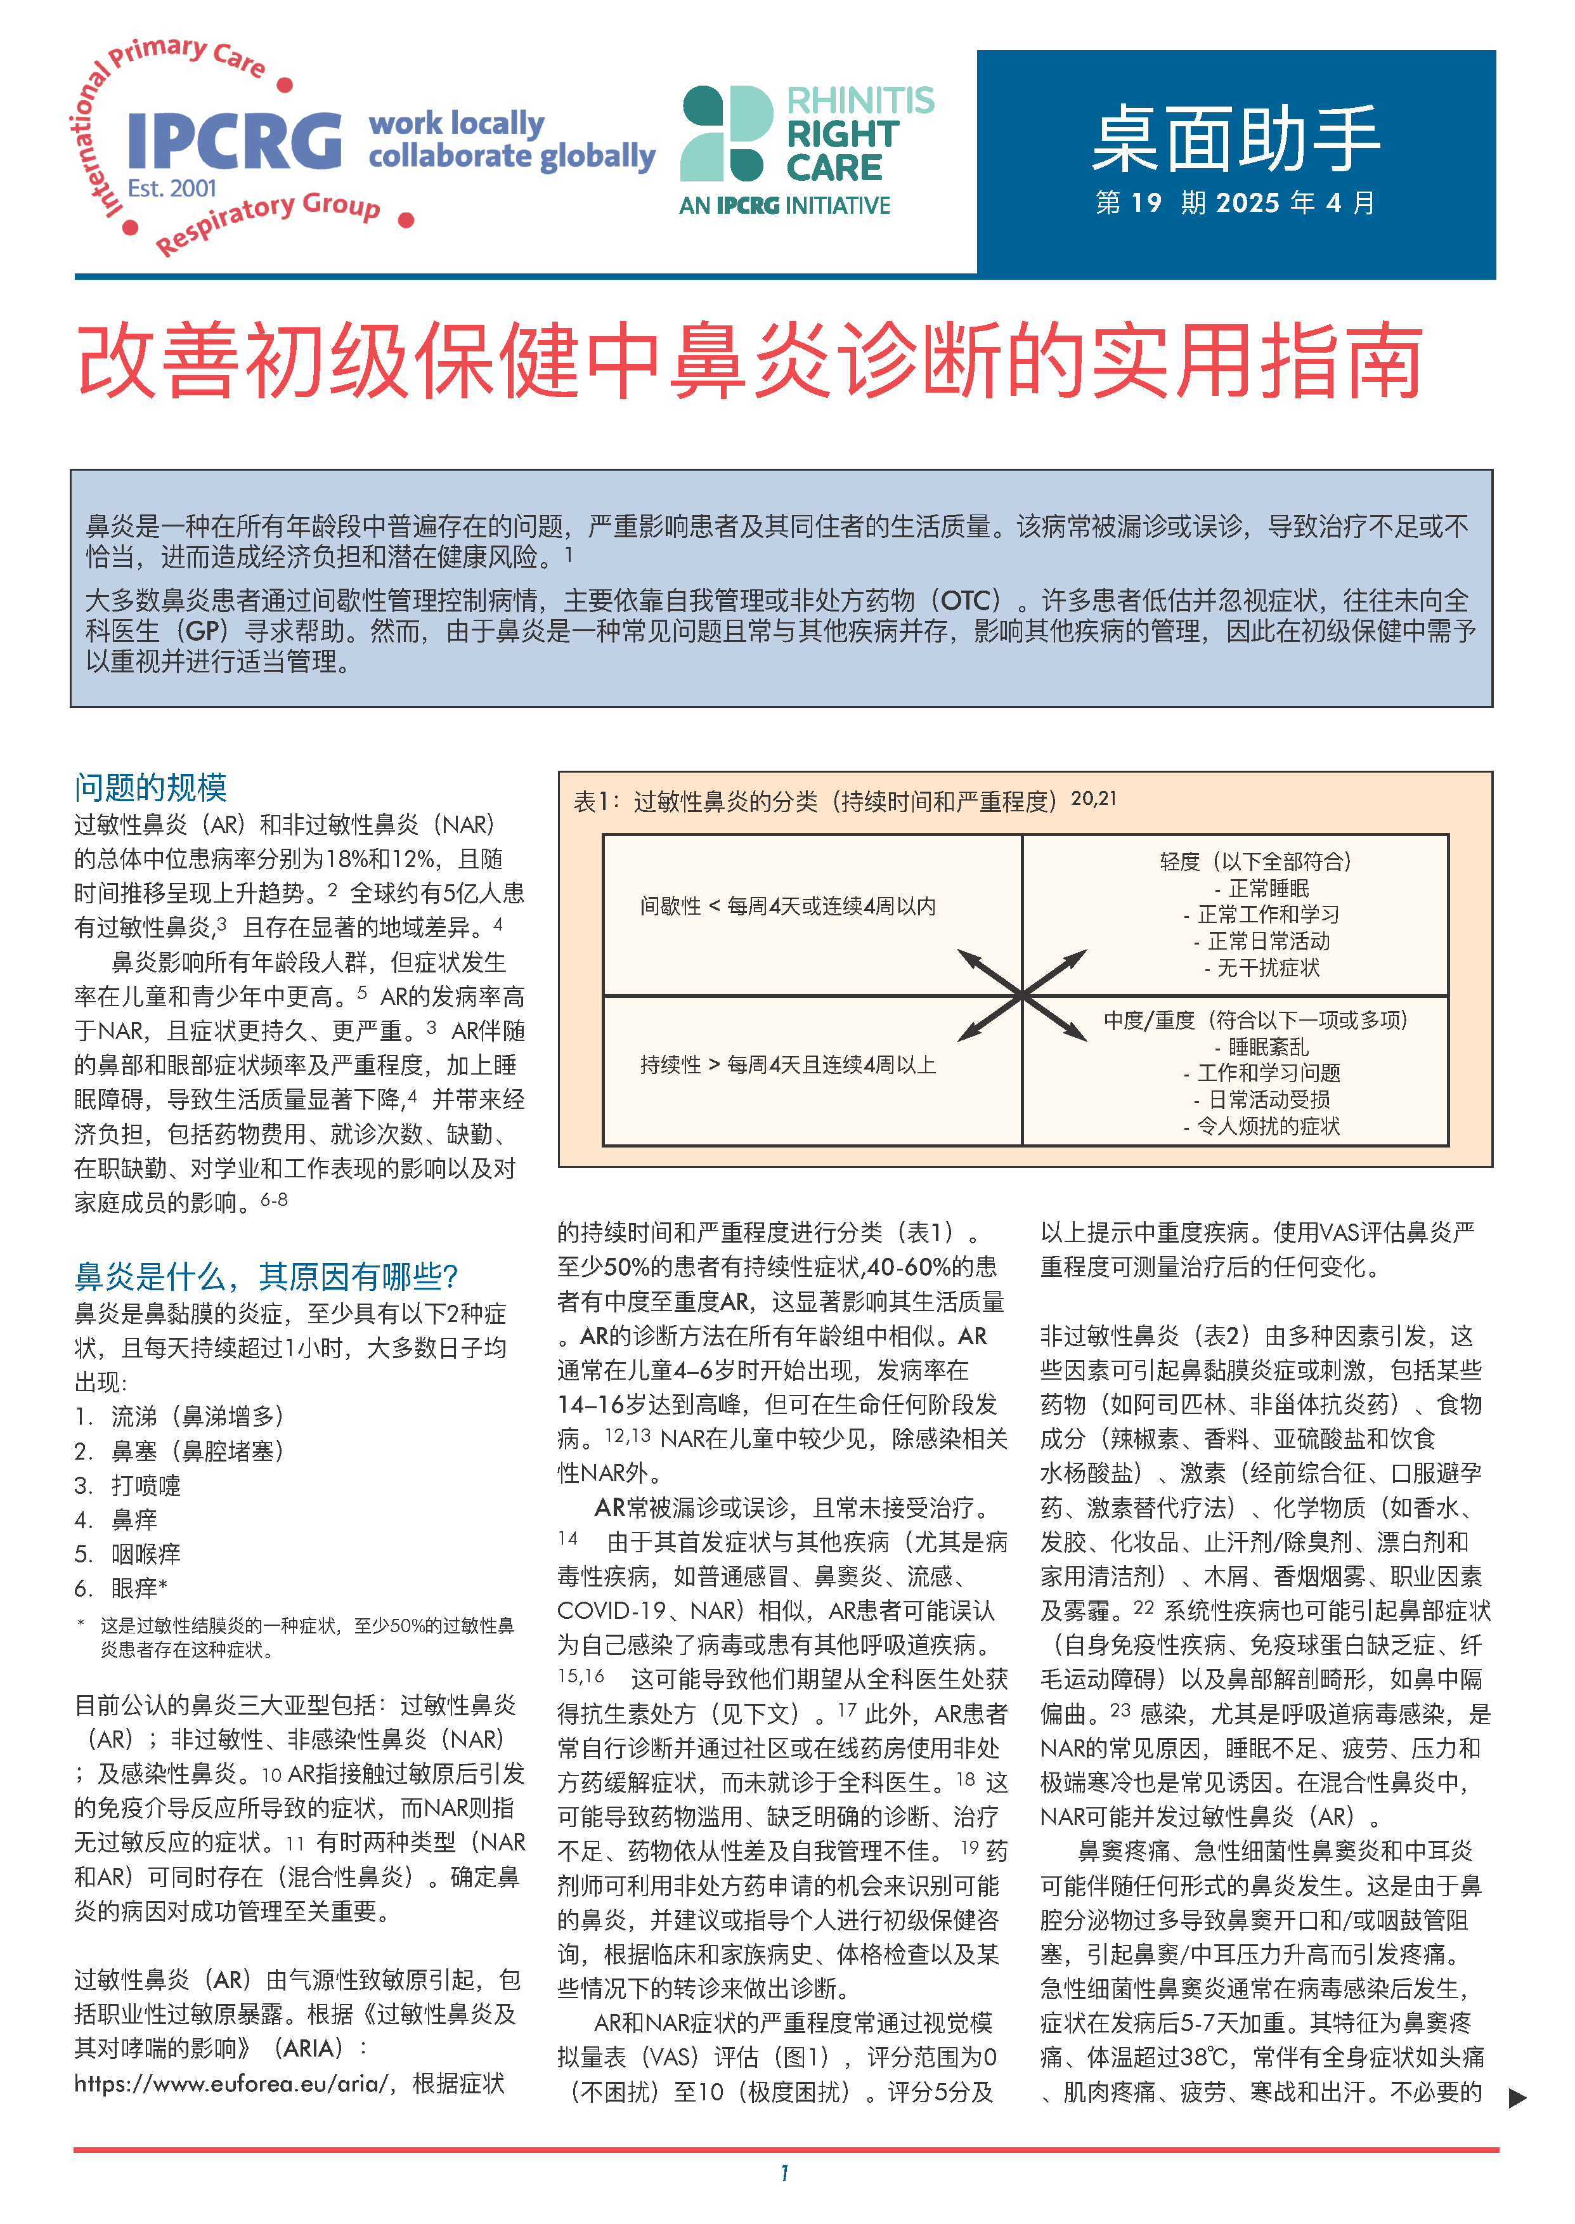
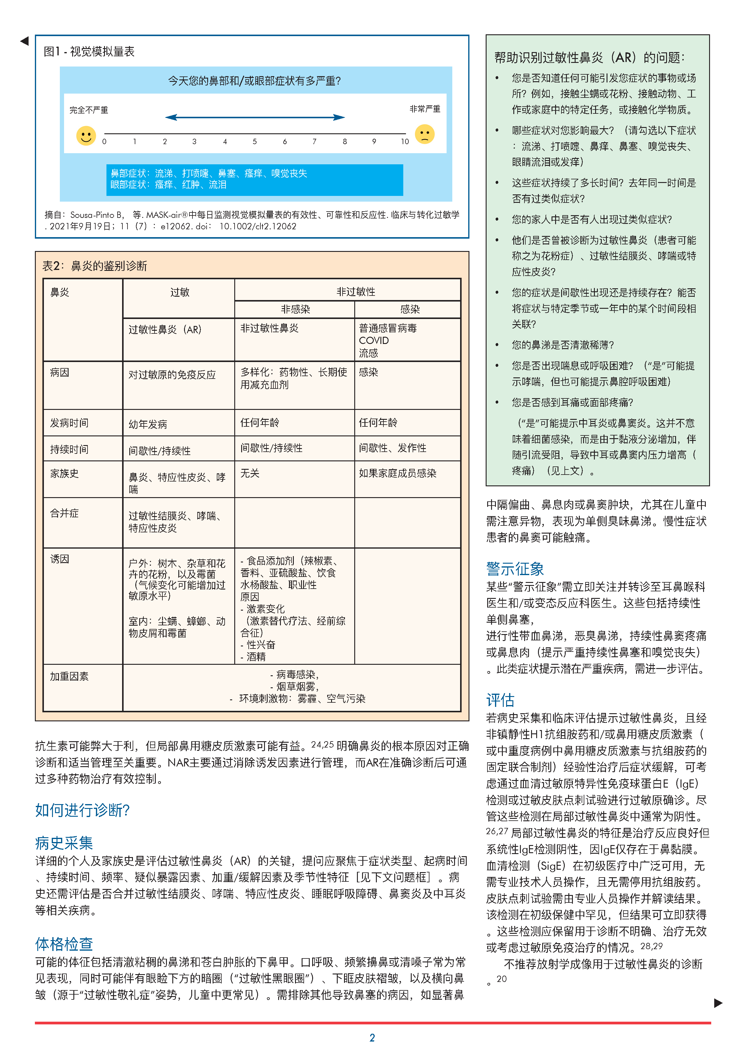
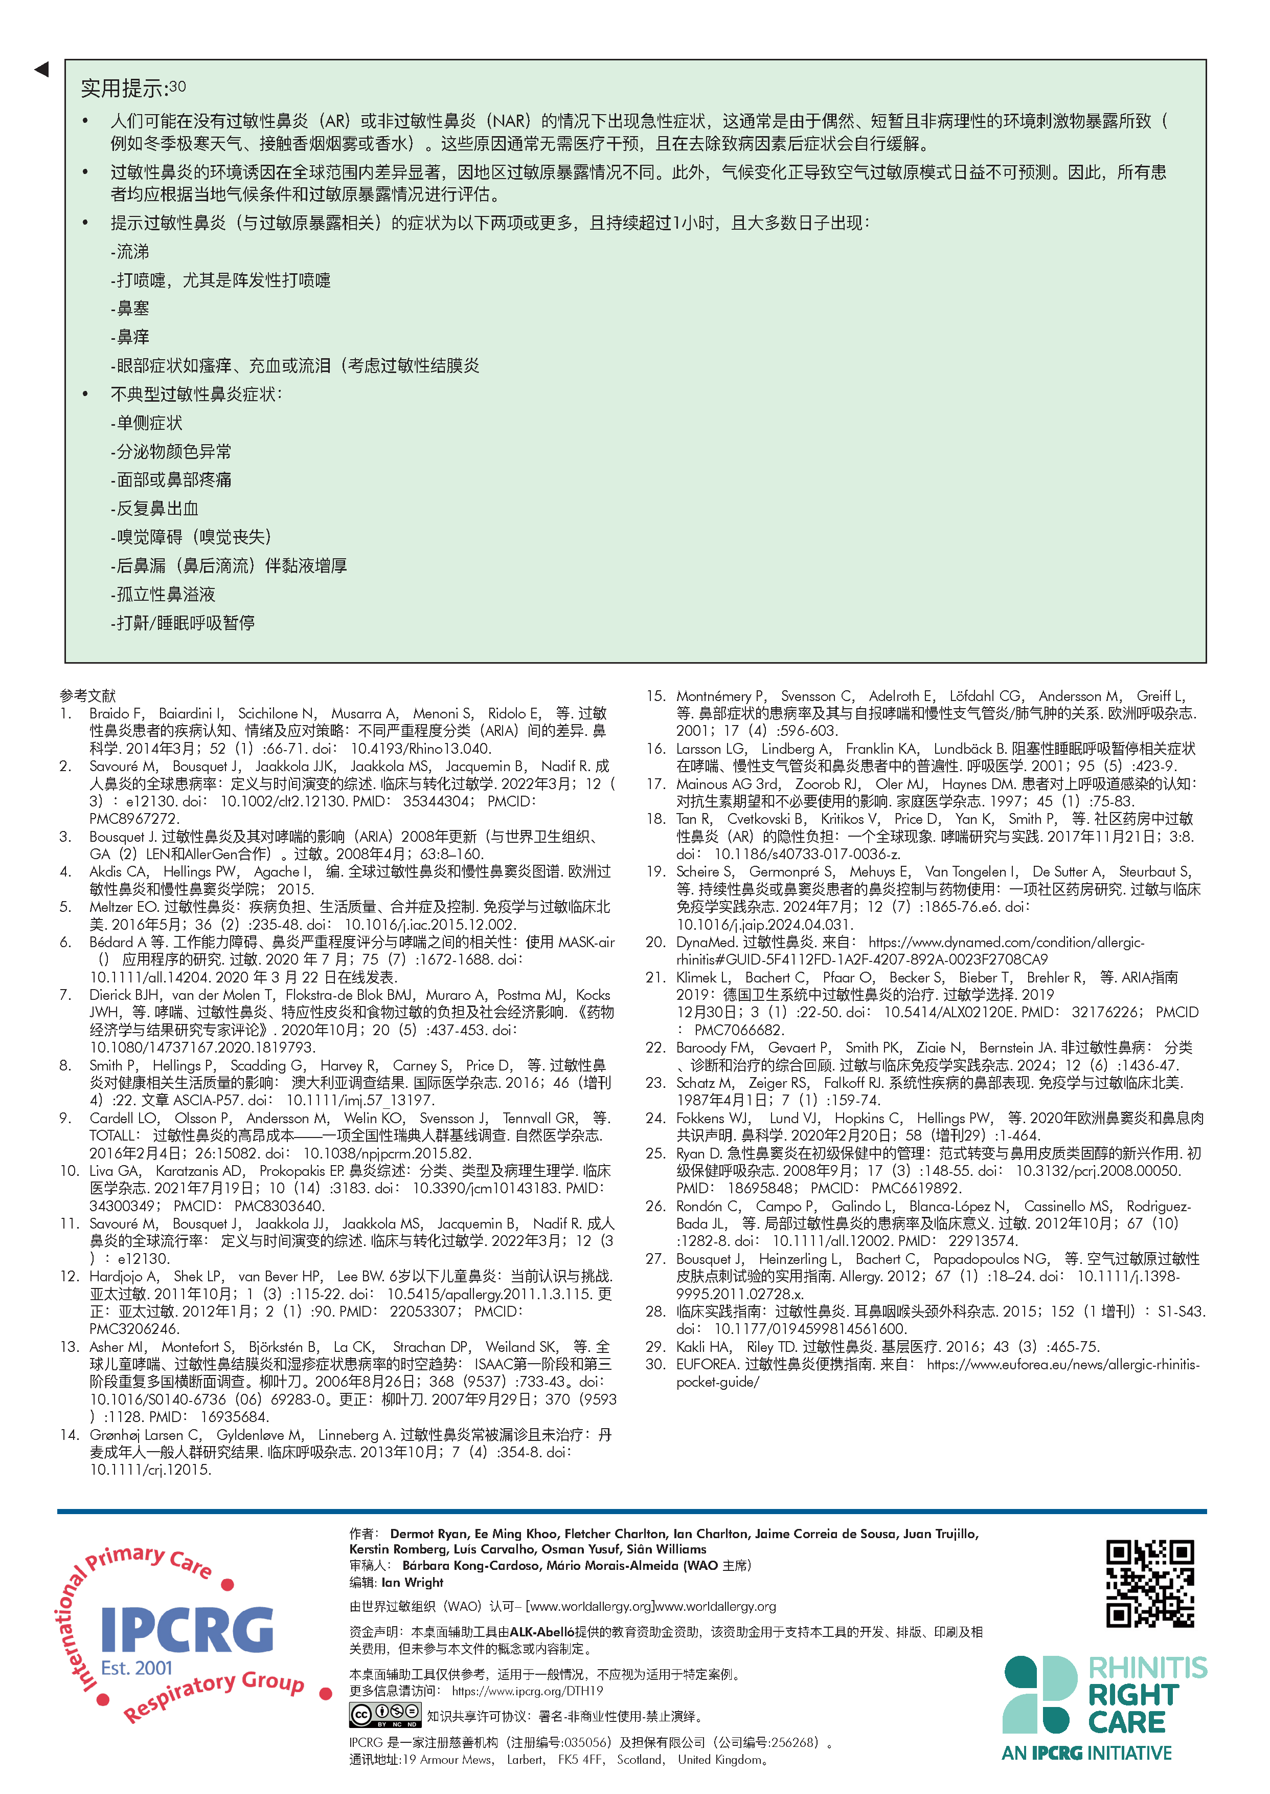

桌面助手No19
https://www.ipcrg.org/search-resources/ipcrg-dth-no19-a-practical-guide-to-improve-rhinitis-diagnosis-in-primary-care
Notes:
Rhinitis is a highly prevalent problem in all age groups that significantly impairs the lives of people with the condition, including
their cohabitants. Underdiagnosis and misdiagnosis are common, which leads to under or inappropriate treatment, economic
impact, and potential harm.
Most people with rhinitis manage the condition episodically, either with self-management or over-the-counter (OTC) medications
. Many underestimate and neglect their symptoms and often do not bring this to the attention of their general practitioner
(GP). However, as this is a common problem and a frequent comorbidity affecting the management of other conditions, it needs
to be recognised and managed appropriately in primary care.

Slide 3
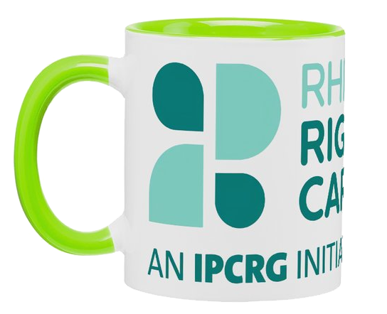
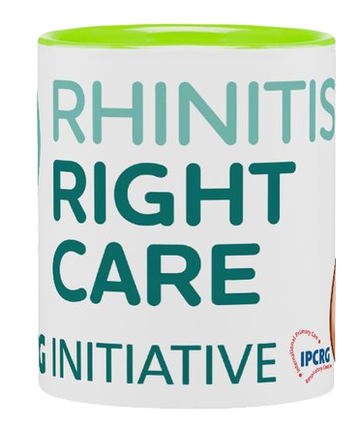
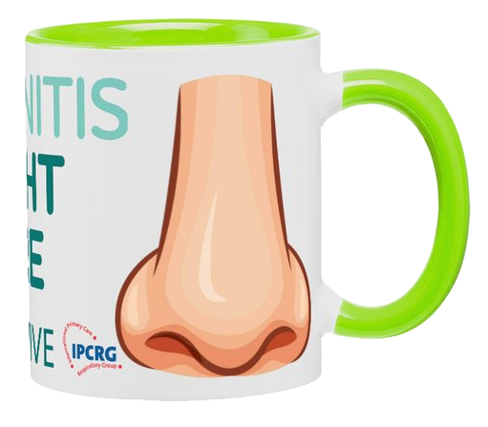

学习目标
识别患者的鼻炎
区分过敏性鼻炎（AR）与非过敏性鼻炎
诊断非过敏性鼻炎
管理非过敏性鼻炎

Slide 4
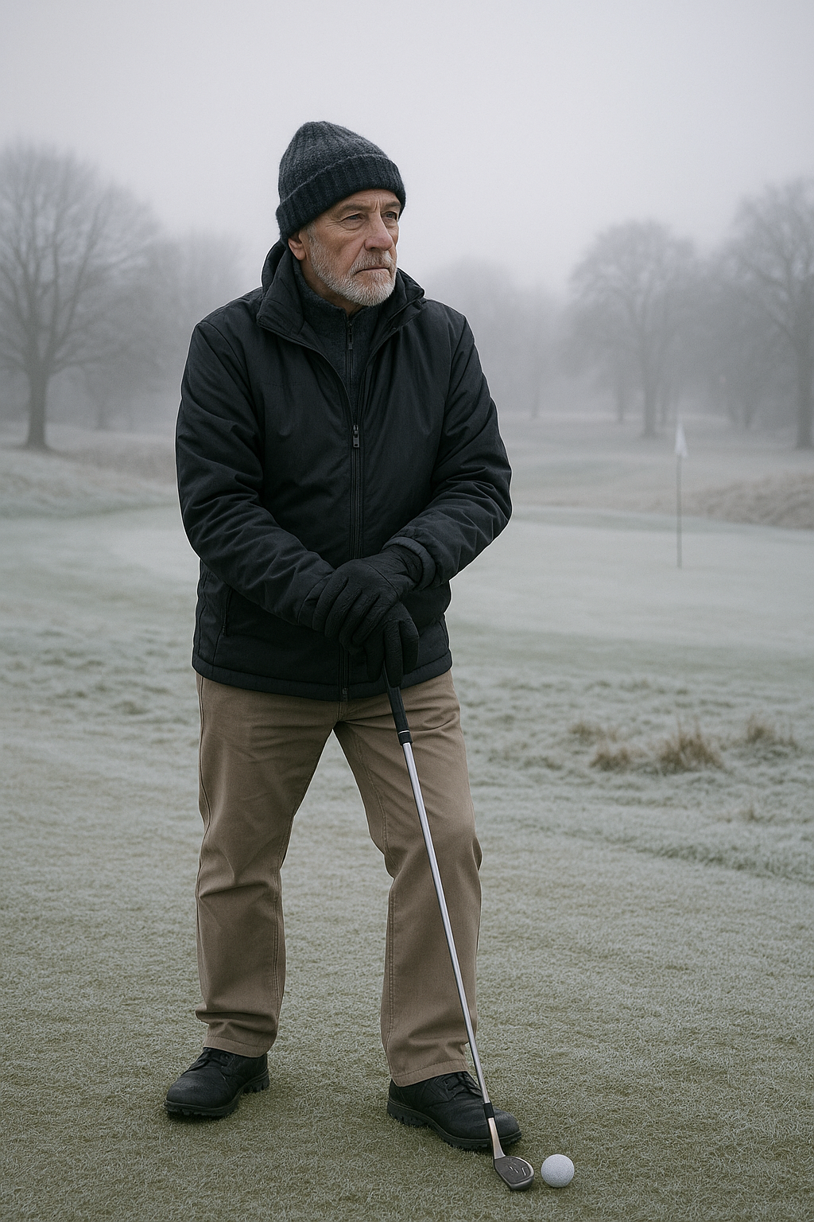
认识汤姆
65岁的苏格兰男性
喜爱高尔夫和登山
曾任电子公司首席执行官
每年至少度假两次
家中无宠物

Slide 5

初始演示
药房非处方鼻充血缓解剂
两周内第三次购买
药剂师干预与咨询
转诊至初级保健全科医生
建议在治疗期间进行鼻腔冲洗

Slide 6

在GP的演讲
6月12日 鼻塞/流涕病史
无眼部症状
遇冷加剧
无喷嚏、无瘙痒
导致夜间失眠
Notes:
Grumpy old man nose, never used to bother me but now it gets right up my nose!. Runny nose an issue when he bends over to play a shot LOL Out in the cold could be golfing or hill walking 6/12 history, so not seasonal and therefore not allergy/pollen

Slide 7

病史
十年前曾被诊断高血压
目前服用ACE抑制剂、他汀类药物及钙通道阻滞剂
无哮喘或慢性阻塞性肺疾病病史
偶尔购买绿唇贻贝提取物及非处方布洛芬缓解关节疼痛
Notes:
ACEi Statin and meds for primary CVD prevention OTC purchases mentioned as NSAIDS can be bought OTC

Slide 8


临床检查与检测
ACE抑制剂可引发鼻部症状
非甾体抗炎药改变环氧化酶-1通路
鼻镜检查显示黏膜充血
胸部听诊清晰
总IgE未升高，皮肤点刺试验？
Notes:
ACE inhibitors can cause nasal rhinitis, also known as nonallergic rhinitis or vasomotor rhinitis, a condition characterized by inflammation of the nasal tissues leading to symptoms like nasal congestion, runny nose, and sneezing. This is because ACE inhibitors can lead to an accumulation of bradykinin and substance P, which can irritate the nasal mucosa
NSAIDs like aspirin and ibuprofen can induce rhinitis by inhibiting the body's natural anti-inflammatory pathways. Block both COX, COX 1 housekeeping hormone, not like prostaglandin-Leukotriene shift in asthma Also mention COCP and spicy foods, neither applicable but worthy of mention Rhinoscopy if skilled, no CRSwNP, no anosmia, no epistaxis Chest auscultation clear, so no infection and no Abx! Low total IgEs, although not specific, ?need for skin prick test? Not already using decongestant nasal sprays, and using for a proilonged period, rebound congestion?

Slide 9

诊断
考虑将ACEI转换为ARB
未服用非甾体抗炎药时出现症状
总IgE水平低且皮肤点刺试验无阳性反应
需注意过敏性鼻炎与非过敏性鼻炎可同时存在
若排除过敏性鼻炎则考虑非过敏性鼻炎诊断
Notes:
Probably not caused by ACE or NSAIDs low IgEs and nothing on skin prick tends towards a non allergic path diagnosi
Sherlock Holmes famously stated, "When you have eliminated the impossible, whatever remains, however improbable, must be the truth."

Slide 10
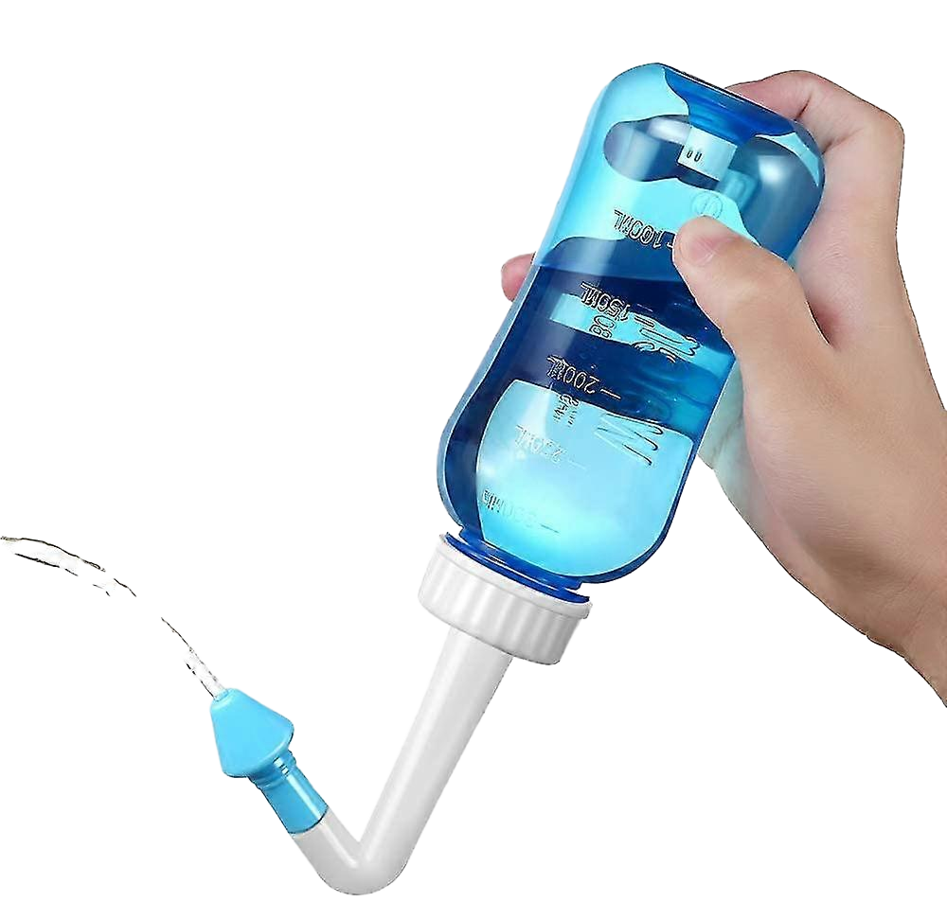
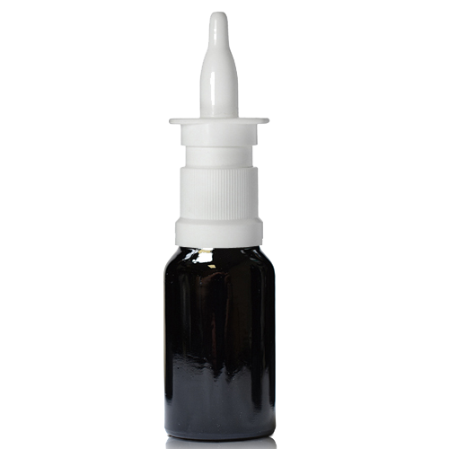
管理
使用煮沸冷却后的水进行鼻腔冲洗
尝试使用抗胆碱能鼻喷雾剂
双效皮质类固醇/抗组胺喷雾剂
佩戴口罩或围巾以加热吸入空气
寒冷天气时在鼻前庭涂抹凡士林/石油膏
Notes:
Explain why boiled and cooled demonstrate nasal inhaler technique, nasal application rather than inhale, pharoh pose cross hands Mention cryotherapy or laser surgery

Slide 11

评论
6/52 随访
夏季及冬季前复查日期：6/12
病情恶化陈述：
嗅觉丧失
鼻出血
ALK-Abelló provided an unrestricted educational grant to support the development of this case study but did not contribute to its content
Notes:
6-8 week followup, As summer time followup to confirm only winter cold weather trigger

Slide 12
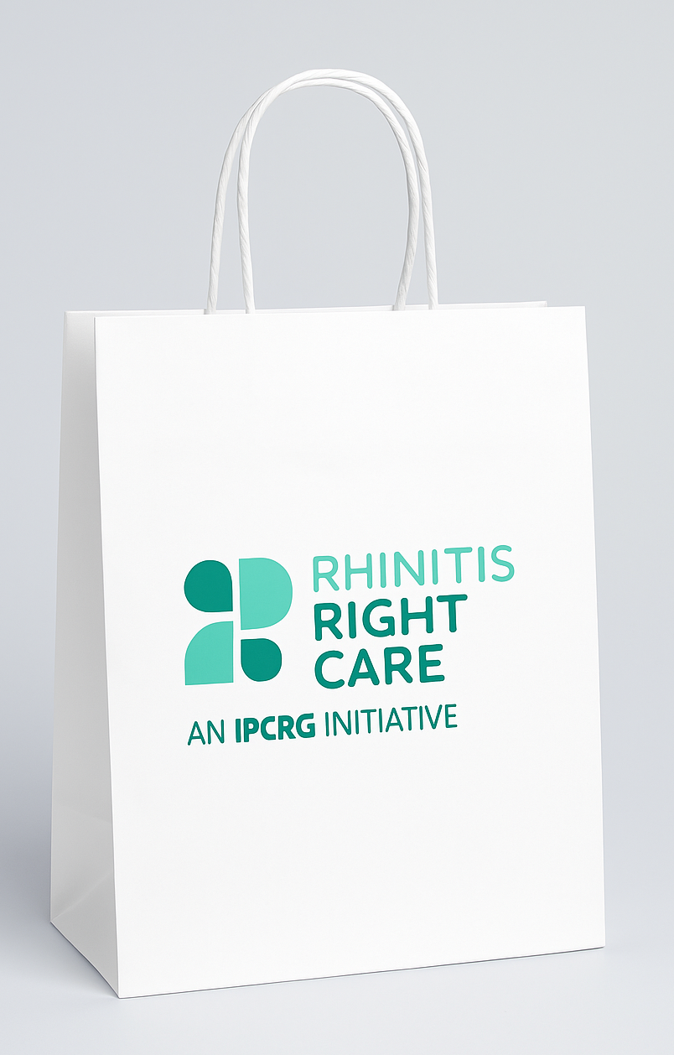
核心要点总结
并非所有鼻炎都是过敏性
彻底调查症状成因至关重要
非药物治疗和预防措施对管理非过敏性鼻炎（NAR）极为重要
需意识到患者可能同时患有过敏性鼻炎（AR）和非过敏性鼻炎（NAR）
Notes:
Even after treating what could be diagnosed as AR, patient may have NAR symptoms

Slide 13
桌面助手
www.ipcrg.org

