Slide 1



Rinitis no alérgica
Caso clínico
Garry McDonald (Scotland, UK)
Osman Yusuf (Pakistan)

Slide 2

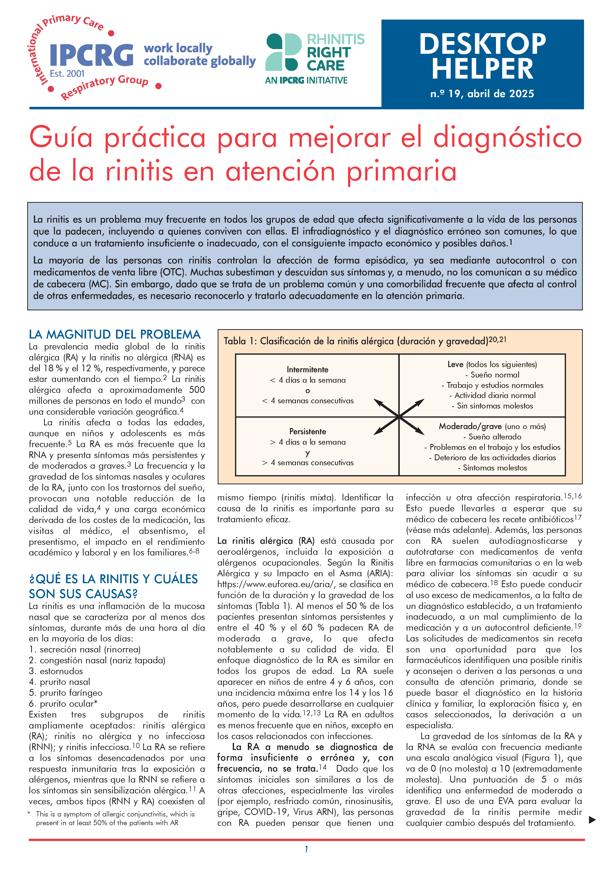
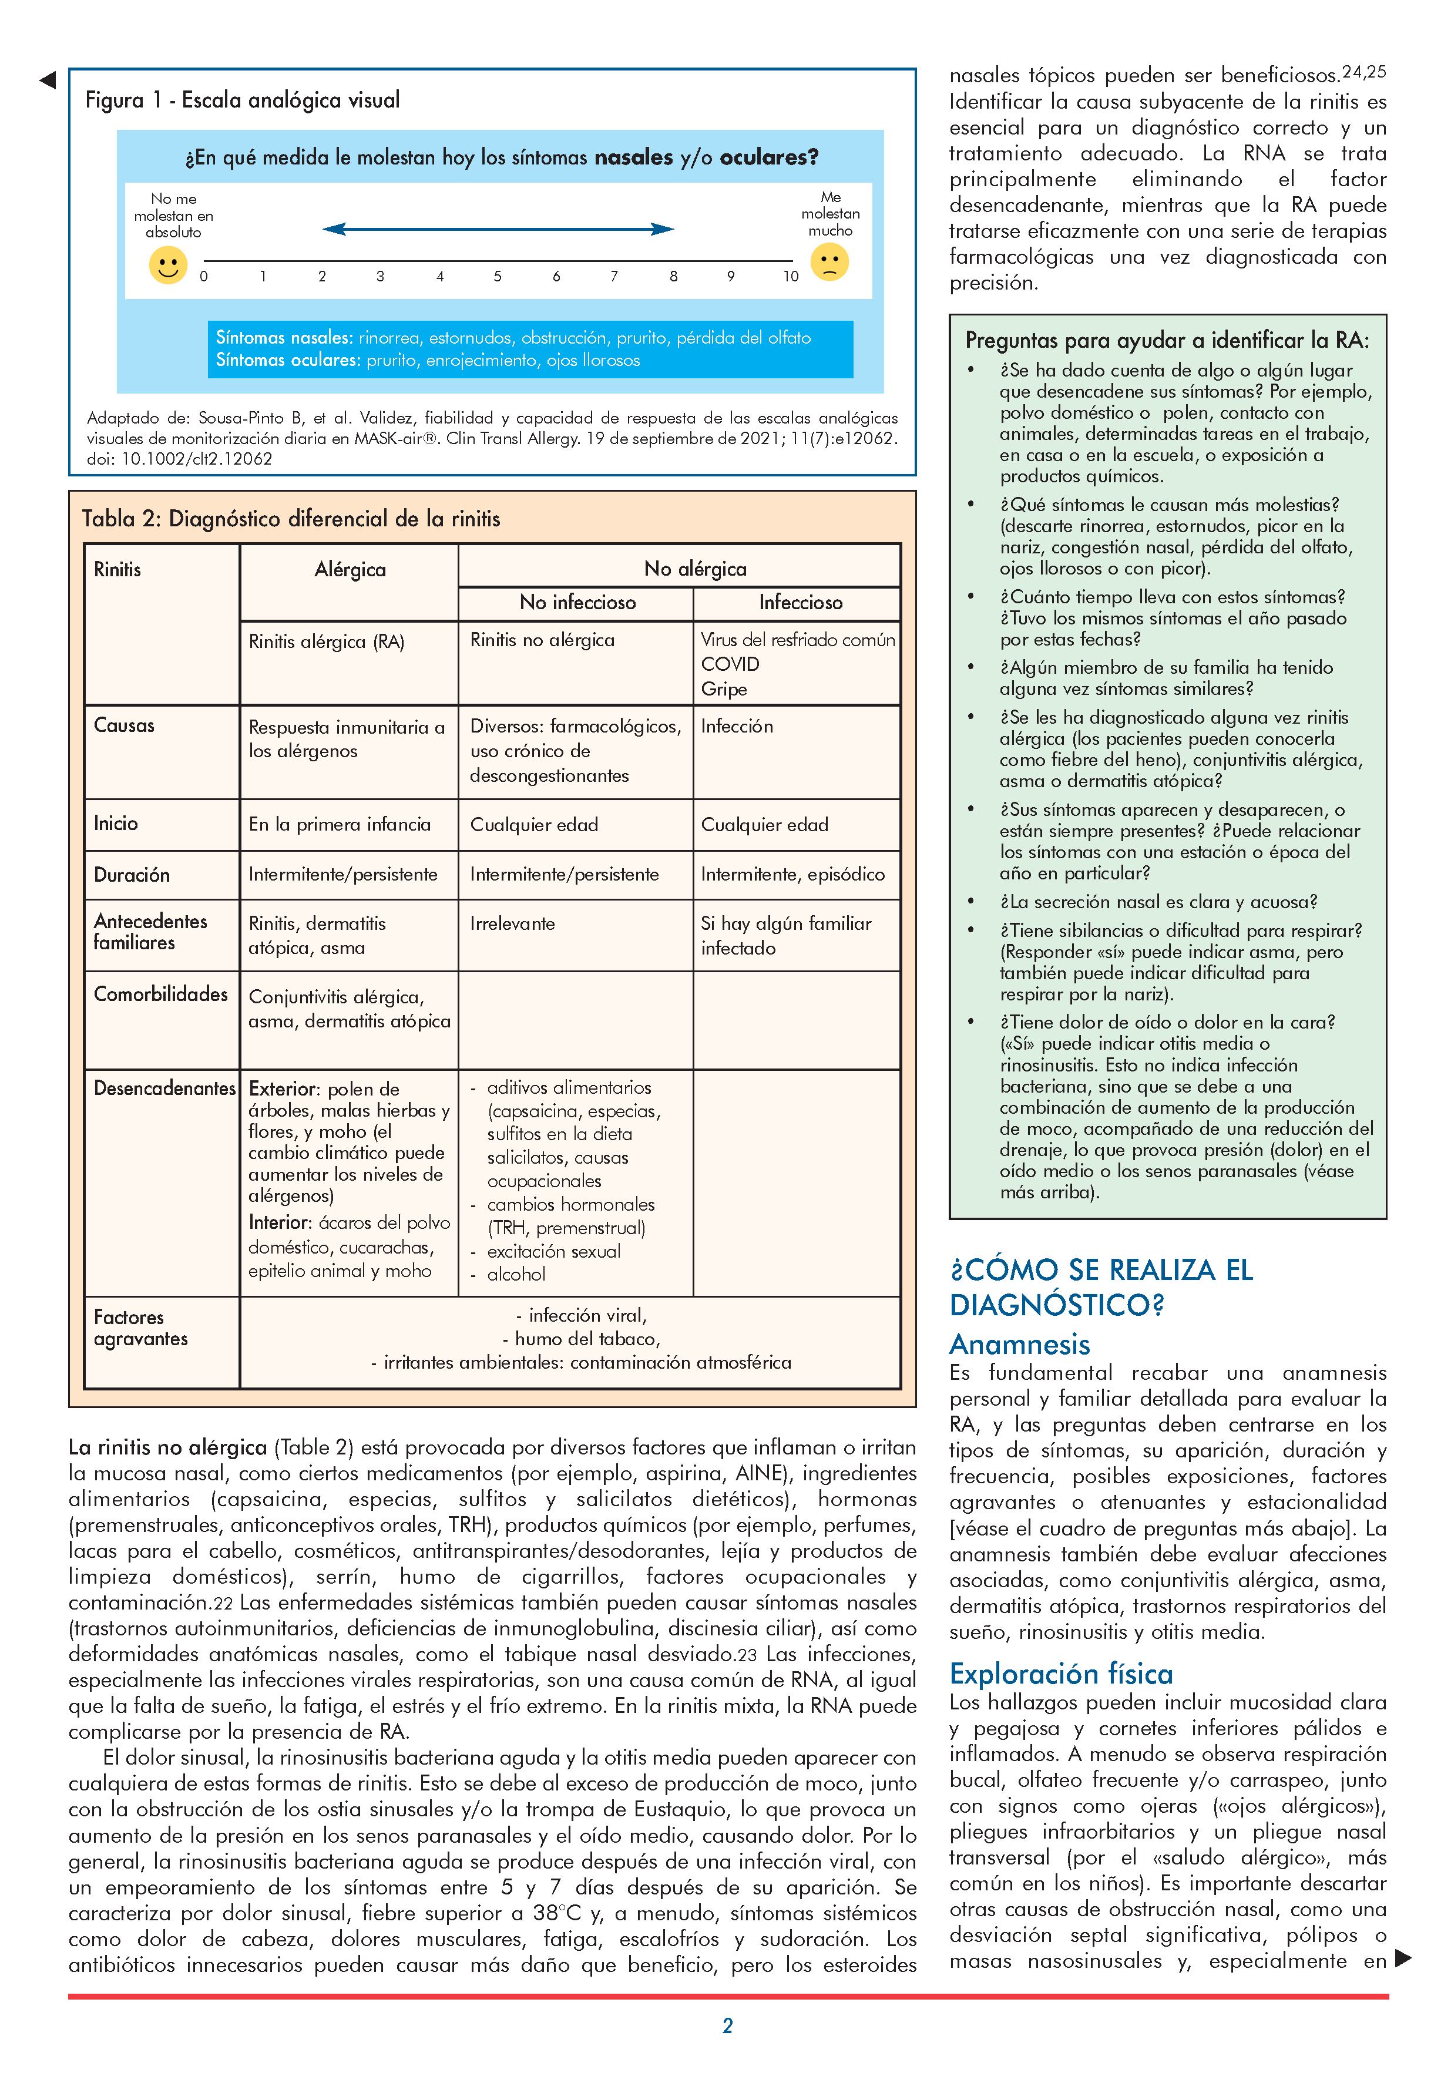
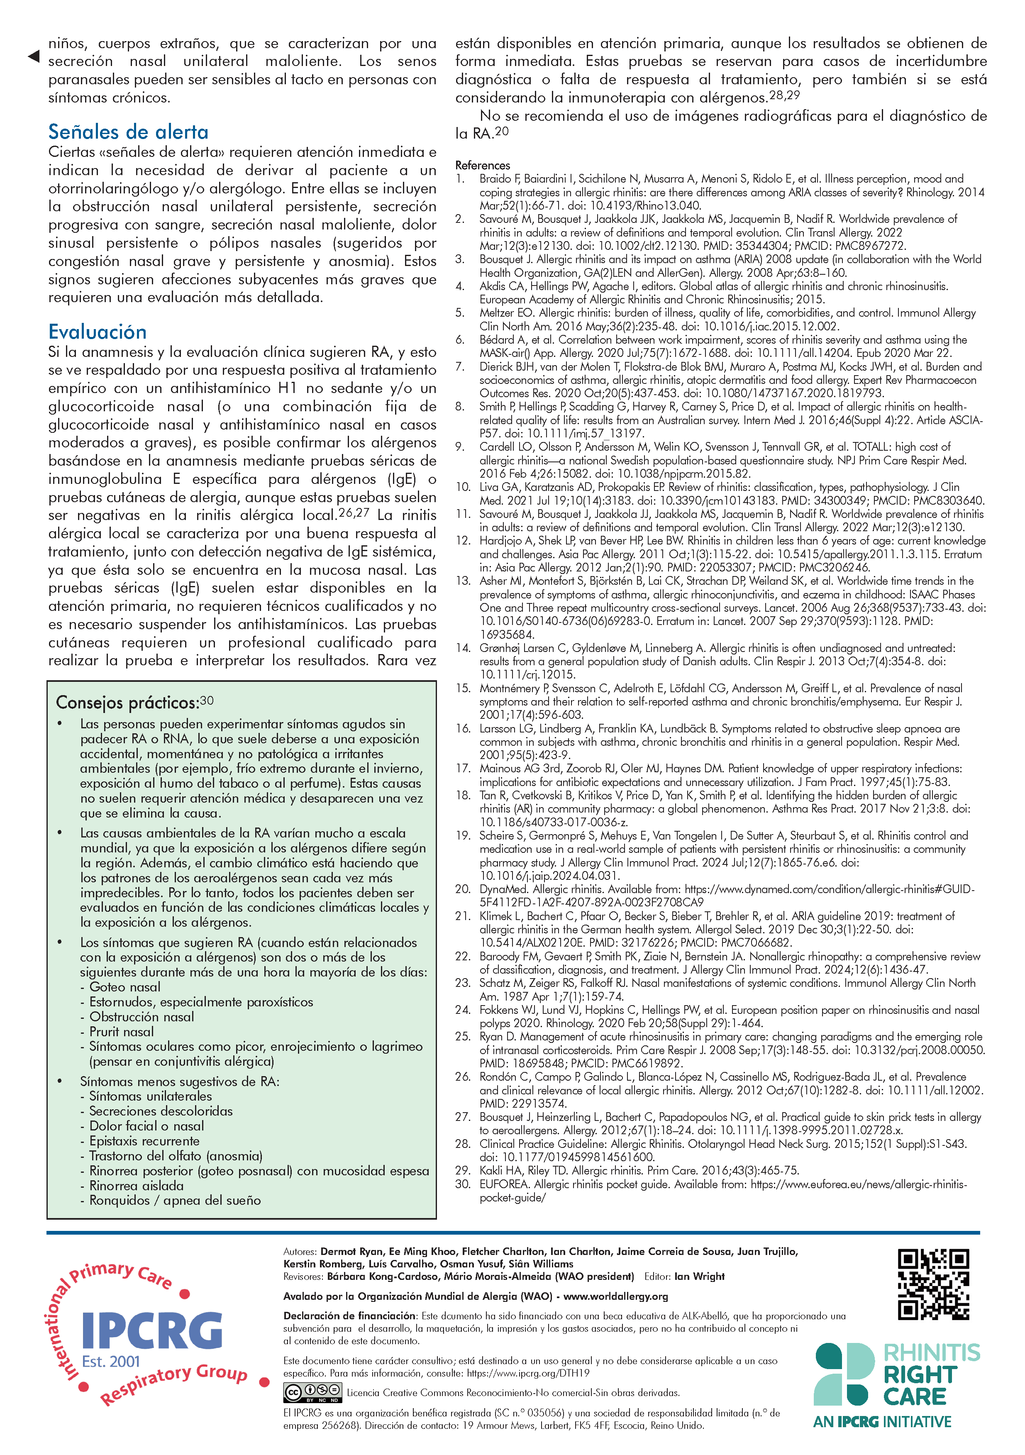

El Desktop Helper
https://www.ipcrg.org/DTH19
Notes:
Rhinitis is a highly prevalent problem in all age groups that significantly impairs the lives of people with the condition, including
their cohabitants. Underdiagnosis and misdiagnosis are common, which leads to under or inappropriate treatment, economic
impact, and potential harm.
Most people with rhinitis manage the condition episodically, either with self-management or over-the-counter (OTC) medications
. Many underestimate and neglect their symptoms and often do not bring this to the attention of their general practitioner
(GP). However, as this is a common problem and a frequent comorbidity affecting the management of other conditions, it needs
to be recognised and managed appropriately in primary care.

Slide 3
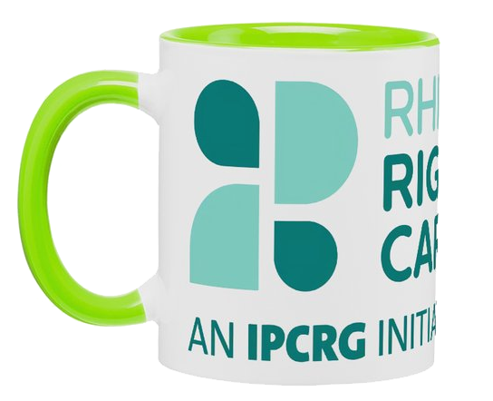
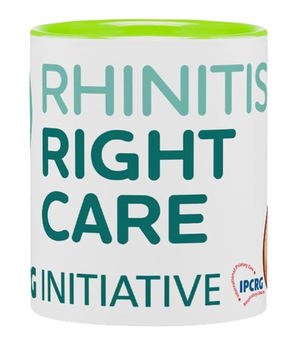
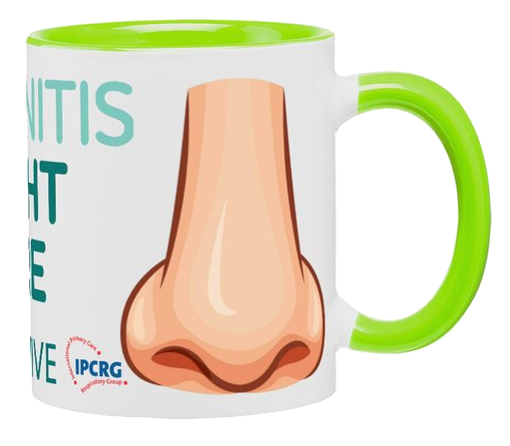

Objetivos de aprendizaje
Identificación de los pacientes con rinitis
Diferenciación entre rinitis alérgica (RA) y no alérgica
Diagnóstico de la rinitis no alérgica
Tratamiento de la rinitis no alérgica

Slide 4
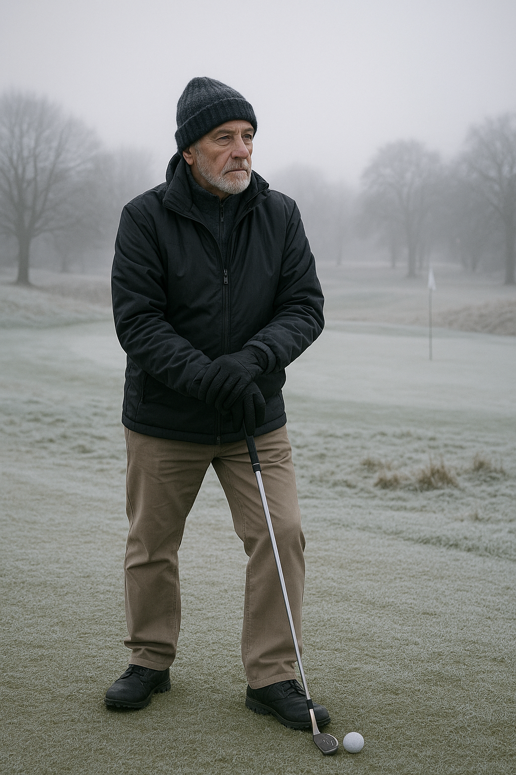
Conoce a Tom
Hombre escocés de 65 años
Le gusta el golf y el senderismo
Fue director ejecutivo de una empresa de electrónica
Se va de vacaciones al menos dos veces al año
No tiene mascotas en su casa

Slide 5

Presentación inicial
Descongestionante nasal de venta libre en farmacia
3.ª compra en 2 semanas
Intervención y consulta del farmacéutico
Derivación al médico de cabecera en atención primaria
Se sugiere irrigación nasal como medida provisional

Slide 6

La consulta del médico de familia
6/12 antecedentes de congestión nasal y secreción nasal
Sin síntomas oculares
Empeora cuando está al aire libre en el frío
Sin estornudos ni picazón
Le mantiene despierto por la noche
Notes:
Grumpy old man nose, never used to bother me but now it gets right up my nose!.
Runny nose an issue when he bends over to play a shot LOL
Out in the cold could be golfing or hill walking
6/12 history, so not seasonal and therefore not allergy/pollen

Slide 7

Historial medico: antecedentes
Diagnóstico previo de hipertensión arterial hace 10 años
Actualmente toma IECA, estatinas y calcioantagonistas
Sin antecedentes de asma ni EPOC
De vez en cuando compra ibuprofeno sin receta
Notes:
ACEi Statin and meds for primary CVD prevention
OTC purchases mentioned as NSAIDS can be bought OTC

Slide 8

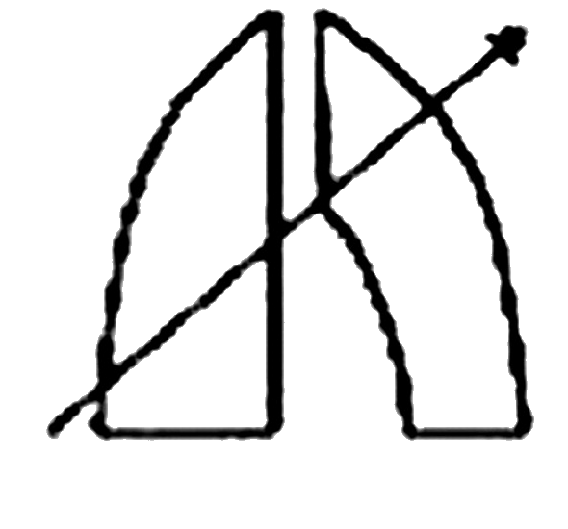
Exploración física y pruebas complementarias
Los IECA pueden causar síntomas nasales
Los AINE alteran la vía COX-1
La rinoscopia mostró congestión de la mucosa
Auscultación torácica normal
IgE total no elevada, ¿prueba cutánea?
Notes:
ACE inhibitors can cause nasal rhinitis, also known as nonallergic rhinitis or vasomotor rhinitis, a condition characterized by inflammation of the nasal tissues leading to symptoms like nasal congestion, runny nose, and sneezing. This is because ACE inhibitors can lead to an accumulation of bradykinin and substance P, which can irritate the nasal mucosa
NSAIDs like aspirin and ibuprofen can induce rhinitis by inhibiting the body's natural anti-inflammatory pathways.
Block both COX, COX 1 housekeeping hormone, not like prostaglandin-Leukotriene shift in asthma
Also mention COCP and spicy foods, neither applicable but worthy of mention
Rhinoscopy if skilled, no CRSwNP, no anosmia, no epistaxis
Chest auscultation clear, so no infection and no Abx!
Low total IgEs, although not specific, ?need for skin prick test?
Not already using decongestant nasal sprays, and using for a proilonged period, rebound congestion?

Slide 9

Diagnóstico
Considerar cambiar de IECA a ARAII
Síntomas sin tomar AINE
IgE totales bajas y sin resultados en la prueba cutánea
Tener en cuenta que las rinitis alérgica y la no alérgica pueden coexistir
Si se descarta la RA, considerar el diagnóstico de NAR
Notes:
Probably not caused by ACE or NSAIDs
low IgEs and nothing on skin prick tends towards a non allergic path diagnosi
Sherlock Holmes famously stated, "When you have eliminated the impossible, whatever remains, however improbable, must be the truth."

Slide 10
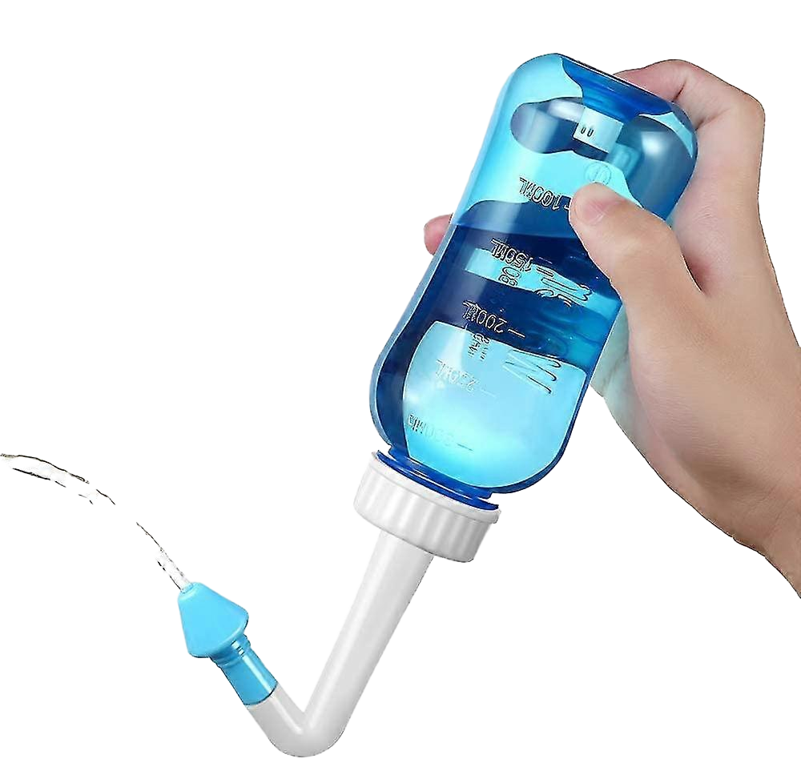
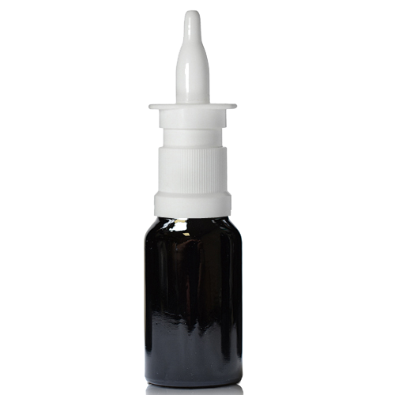
Gestión
lavado nasal con agua hervida enfriada
Prueba con un aerosol nasal antimuscarínico
Aerosol de doble acción con corticosteroide y antihistamínico
Usar una mascarilla o bufanda para calentar el aire antes de inhalar
emolientes/vaselina faríngea cuando hace frío
Notes:
Explain why boiled and cooled
demonstrate nasal inhaler technique, nasal application rather than inhale, pharoh pose cross hands
Mention cryotherapy or laser surgery

Slide 11

Revisión
6/52 seguimiento
Revisión 6/12 en verano y antes del invierno
Signos de alarma:
  Anosmia
  Epistaxis
ALK-Abelló provided an unrestricted educational grant to support the development of this case study but did not contribute to its content
Notes:
6-8 week followup,
As summer time followup to confirm only winter cold weather trigger

Slide 12
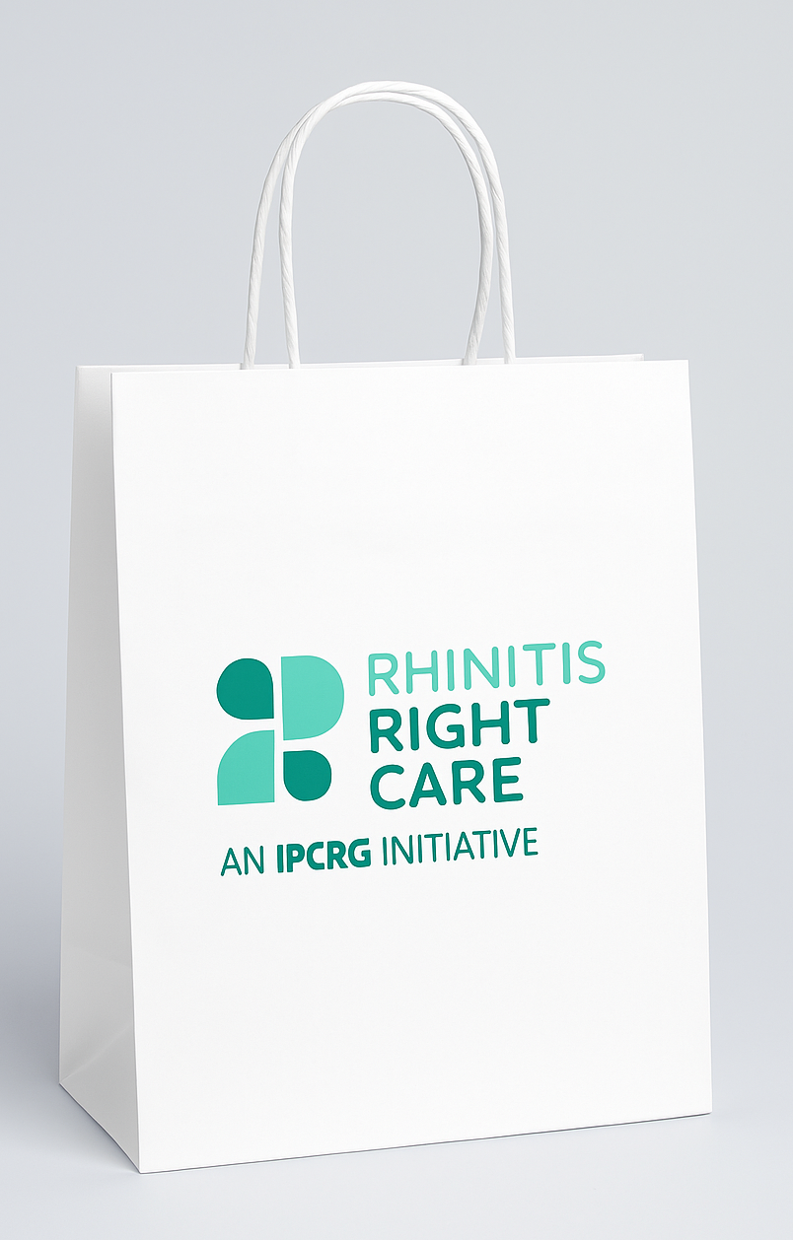
Mensajes clave
No TODAS las rinitis son alérgicas
Es esencial investigar a fondo la causa de los síntomas
Los tratamientos no farmacológicos y las medidas preventivas son muy importantes en el manejo de la rinitis no alérgica
Hay que tener en cuenta que los pacientes pueden padecer ambas
Notes:
Even after treating what could be diagnosed as AR, patient may have NAR symptoms

Slide 13
El Desktop Helper
www.ipcrg.org

