Slide 1
Desktop Helper No. 12 COPD and Mental Health Ioanna Tsiligianni, Siân Williams With special thanks to Anna Spathis (contributor) and Steve Holmes, Nazim Uzzaman and Oscar Flores-Flores (reviewers)

Slide 2
Aims
DESKTOP Helper No. 12. https://www.ipcrg.org/dth12
We aim to
Raise awareness of the challenge of identifying and managing mental health problems in people with COPD
Direct primary care professionals (PCPs) to assessment tools
Summarise non-pharmacological and pharmacological interventions
COPD, chronic obstructive pulmonary disease;

Slide 3
COPD and mental health
DESKTOP Helper No. 12. https://www.ipcrg.org/dth12
Mental health problems are common among people with COPD¹⁻³
~30% have comorbid depression (increasing to ~80% with increasing severity)
10–30% have comorbid anxiety
Prevalence increases with age and as symptoms worsen and is associated with poorer QoL
PCPs often have low confidence to treat mental health problems in the context of COPD and guidelines are lacking
QoL, quality of life.
1. Pollok J, et al. Cochrane Database Syst Rev 2019;3:CD012347; 2. Sohanapal R, et al. Trials 2020;21:18(2020); 3. Yohannes AM, Alexopoulos GS. Eur Respir Rev 2014;23:345-9.

Slide 4
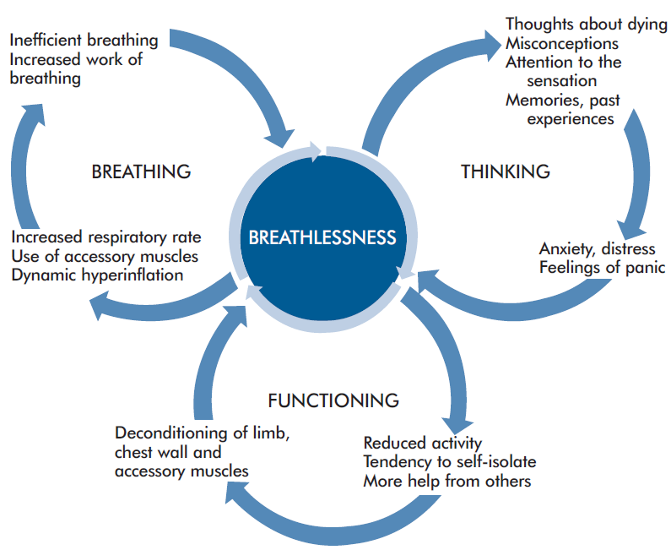
Breathlessness and psychological distress
DESKTOP Helper No. 12. https://www.ipcrg.org/dth12
Breathlessness can contribute to anxiety, feelings of panic, frustration, anger and low mood
Interventions should seek to:
Address negative thoughts
Manage COPD symptoms
Manage anxiety and low mood
Reproduced with permission of the Cambridge Breathlessness Intervention Service (https://www.btf.phpc.cam.ac.uk/) .
Spathis A, et al. npj Prim Care Respir Med 2017;27:27.

Slide 5
Tobacco use and poor mental health
DESKTOP Helper No. 12. https://www.ipcrg.org/dth12
Smoking, depression and anxiety are all associated with a higher risk of death among people with COPD
Support people with COPD to quit tobacco use and reassure them that:
Quitting reduces anxiety and depression
Quitting is the single most important intervention to slow progression, increase survival and reduce morbidity¹⁻³
See our Desktop Helper No. 4. Helping patients quit smoking⁴
1. GOLD 2022 Report. Available at https://goldcopd.org/2022-gold-reports-2/; 2. Williams S, et al. IPCRG Position paper No. 1. Available at: https://www.ipcrg.org/primaryrespiratorycare; 3. Tonnesen P. Eur Respir Rev 2013;1:241-50; 4. Desktop Helper No. 4 - Helping patients quit tobacco - 3rd edition. https://www.ipcrg.org/desktophelpers/desktop-helper-no-4-helping-patients-quit-tobacco-3rd-edition.

Slide 6
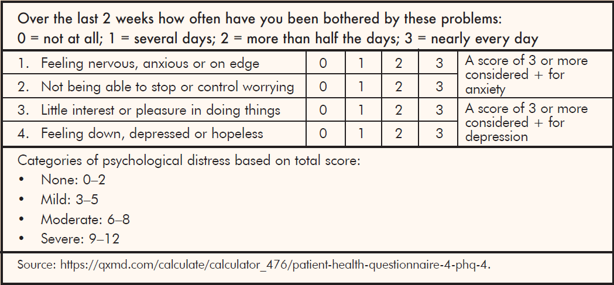
Assessment of mental health problems
DESKTOP Helper No. 12. https://www.ipcrg.org/dth12
Patient Health Questionnaire 4 (PHQ-4)¹
Anticipate presence of comorbid depression and anxiety
Employ active listening, show empathy, observe carefully
Be alert for physical symptoms
Additional tools if score is high: PHQ-9 (depression), GAD7 (anxiety) Available in multiple languages
1. Available at: https://qxmd.com/calculate/calculator_476/patient-health-questionnaire-4-phq-4.

Slide 7
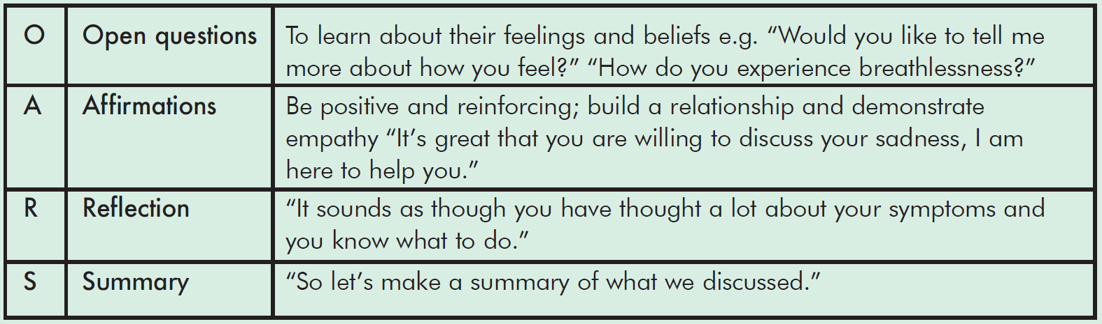
Use OARS skills in assessment
DESKTOP Helper No. 12. https://www.ipcrg.org/dth12
Available at: https://www.euro.who.int/__data/assets/pdf_file/0008/394208/Session-5.pdf

Slide 8
Non-pharmacological interventions to address mental health problems in COPD
DESKTOP Helper No. 12. https://www.ipcrg.org/dth12
Intervention | Benefits
Cognitive behavioural therapy | Challenges unhelpful thoughts/behaviours and reduces anxiety
Mindfulness/meditation | Reduces breathlessness as well as anxiety/depression in advanced disease
Relaxation techniques | Can help breathlessness as well as anxiety and fatigue
Acupuncture/pressure | Helpful in advanced disease and may reduce anxiety
Singing therapy | Can improve lung function and may improve anxiety and QoL
Positive psychology giving sense of control/confidence | Improved self-efficacy
Social presence | May reduce breathlessness perception; patients describe reassurance from the presence of others
See our online version for full details of supporting evidence.

Slide 9
Pharmacological interventions to address mental health problems in COPD
DESKTOP Helper No. 12. https://www.ipcrg.org/dth12
Manage breathlessness using bronchodilator therapy¹
Treat tobacco dependence²
Consider antidepressant medication for low mood:²
SSRIs (preferred)
TCAs (not for those with severe COPD)
Consider benzodiazepines for management of acute, distressing anxiety³ but not for breathlessness⁴
SSRI, selective serotonin reuptake inhibitor; TCA, tricyclic antidepressant.
1. GOLD 2022 Report. Available at https://goldcopd.org/2022-gold-reports-2/; 2. Pollok J, et al. Cochrane Database Syst Rev 2019;3:CD012347; 3.
NICE. BNF. Hypnotics and anxiolytics. Available at: https://bnf.nice.org.uk/treatment-summary/hypnotics-and-anxiolytics.html; 4. Simon S, et al. Cochrane Database Syst Rev 2010;1: CD007354.

Slide 10
Acknowledgements
DESKTOP Helper No. 12. https://www.ipcrg.org/dth12
Funded from an education grant provided by Boehringer Ingelheim to support the development, typesetting, printing and associated costs; did not contribute to the content

Slide 11
Questions?

