Slide 1



Adult with seasonal allergic rhinitis
Case study
Ee Ming Khoo
Jaime Correia de Sousa
July 2025

Slide 2

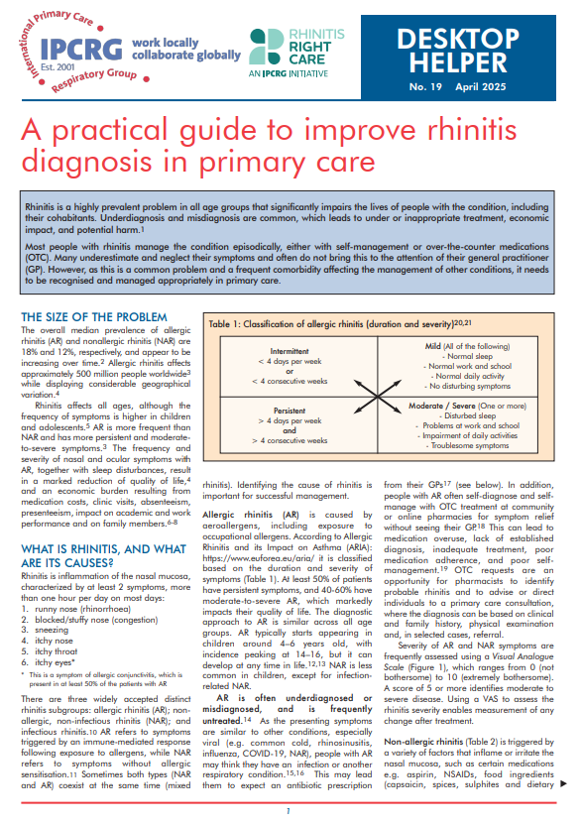
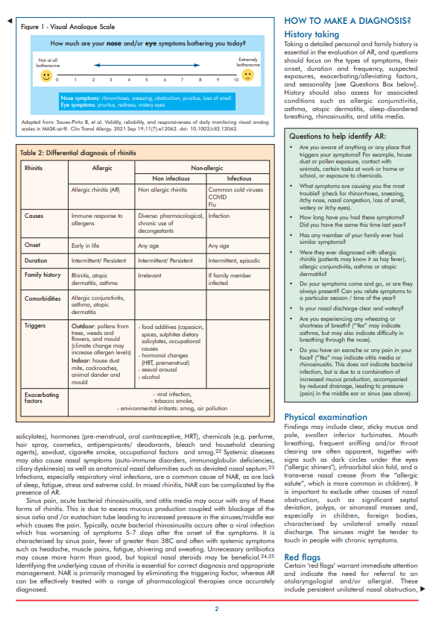
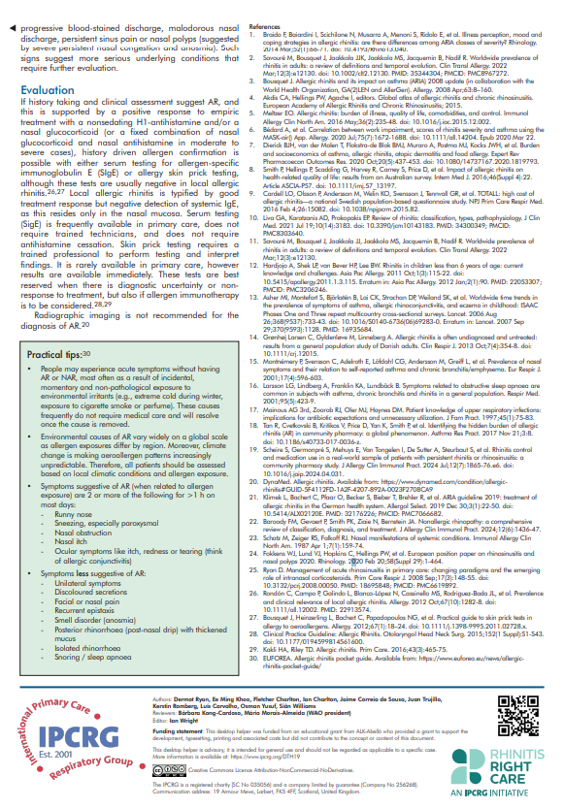

The desktop-helper
Desktop Helper No. 19, April 2025
A practical guide to improve rhinitis diagnosis in primary care

Slide 3
Learning objectives
At the end of this case study, participants should be able to:
  List some challenges in the diagnosis and management of rhinitis;
  Assess the impact of patient’s symptoms considering the patient’s ideas, concerns and expectations;
  Design a personalised management plan including non-pharmacological and pharmacological approaches;
  Identify red flags and know when to refer.

Slide 4

The patient
Hana is 26 years old;
She works as a mail carrier;
She has runny, itchy and blocked nose with sneezing and sometimes itchy eyes for the past month;
These symptoms have become worse in the last week and are affecting her work;
There is no wheezing.

Slide 5
Medical history
She uses oral antihistamines purchased over the counter and nasal decongestants, which seems to help for a short period of time;
She has these symptoms intermittently since her childhood;
Every year during spring, her symptoms get worse when she walks near gardens or parks.

Slide 6
Medical history
She does not have any other illness
Her father has asthma
She does not smoke and avoids smoky environments

Slide 7
Clinical examination/investigations
Mouth breathing, frequent sniffing and/or throat clearing
Dark circles under the eyes ("allergic shiners")
Infraorbital skin fold
Transverse nasal crease
Nasal examination
  profuse light coloured aqueous discharge from both nasal cavities
  slightly swollen turbinates bilaterally
  no polyps, no deviated nasal septum, no sinonasal masses, no foreign bodies, no sinus tenderness

Slide 8
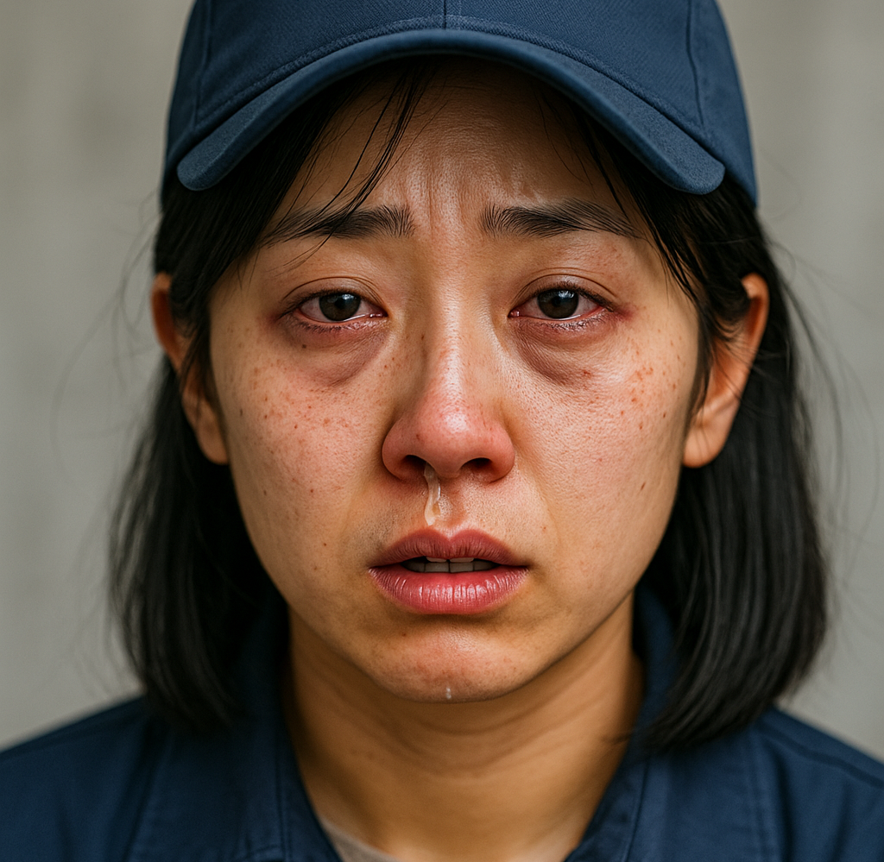
Diagnosis
Allergic rhinitis

Slide 9
Management
Nonsedating H1-antihistamine and/or a nasal glucocorticoid
  or
Fixed combination of nasal glucocorticoid and nasal antihistamine
Consider:
  +Serum testing for allergen-specific immunoglobulin E (SIgE)
  +Allergy skin prick testing

Slide 10
Review
Hana returns after twelve weeks
Although her symptoms have improved, she is still experiencing them and asks if there is any other treatment to get rid of these symptoms that are bothering her

Slide 11
Refer
Non-response to treatment (symptoms persisting 12 weeks or more, suggesting chronic rhino sinusitis - EPOS)
Consider allergen immunotherapy
Review for red flags
Persistent unilateral nasal obstruction
Blood-stained discharge
Malodorous nasal discharge
Severe persistent nasal congestion and anosmia

Slide 12
Summary
AR is common and symptoms are triggered by an immune-mediated response following exposure to allergens
Diagnosis can often be made clinically, supported by a positive response to treatment with a nonsedating H1-antihistamine and/or a nasal glucocorticoid
Allergen confirmation with either serum testing for allergen-specific immunoglobulin E (SIgE) or allergy skin prick testing can be performed when there is diagnostic uncertainty or non-response to treatment, or if allergen immunotherapy is considered

Slide 13
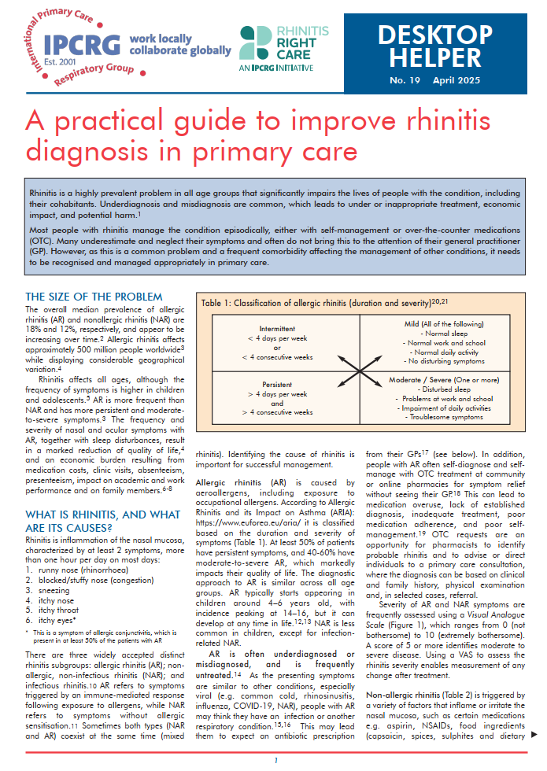
The desktop-helper
www.ipcrg.org

