Slide 1



Non-allergic rhinitis
Case study
Garry McDonald (Scotland, UK)
Osman Yusuf (Pakistan)

Slide 2

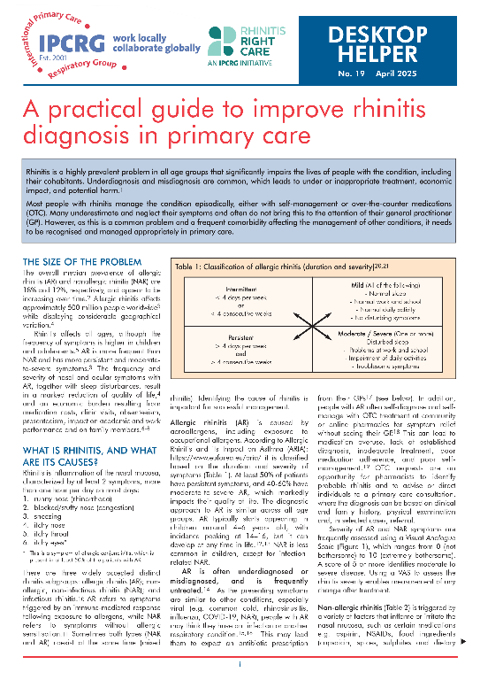
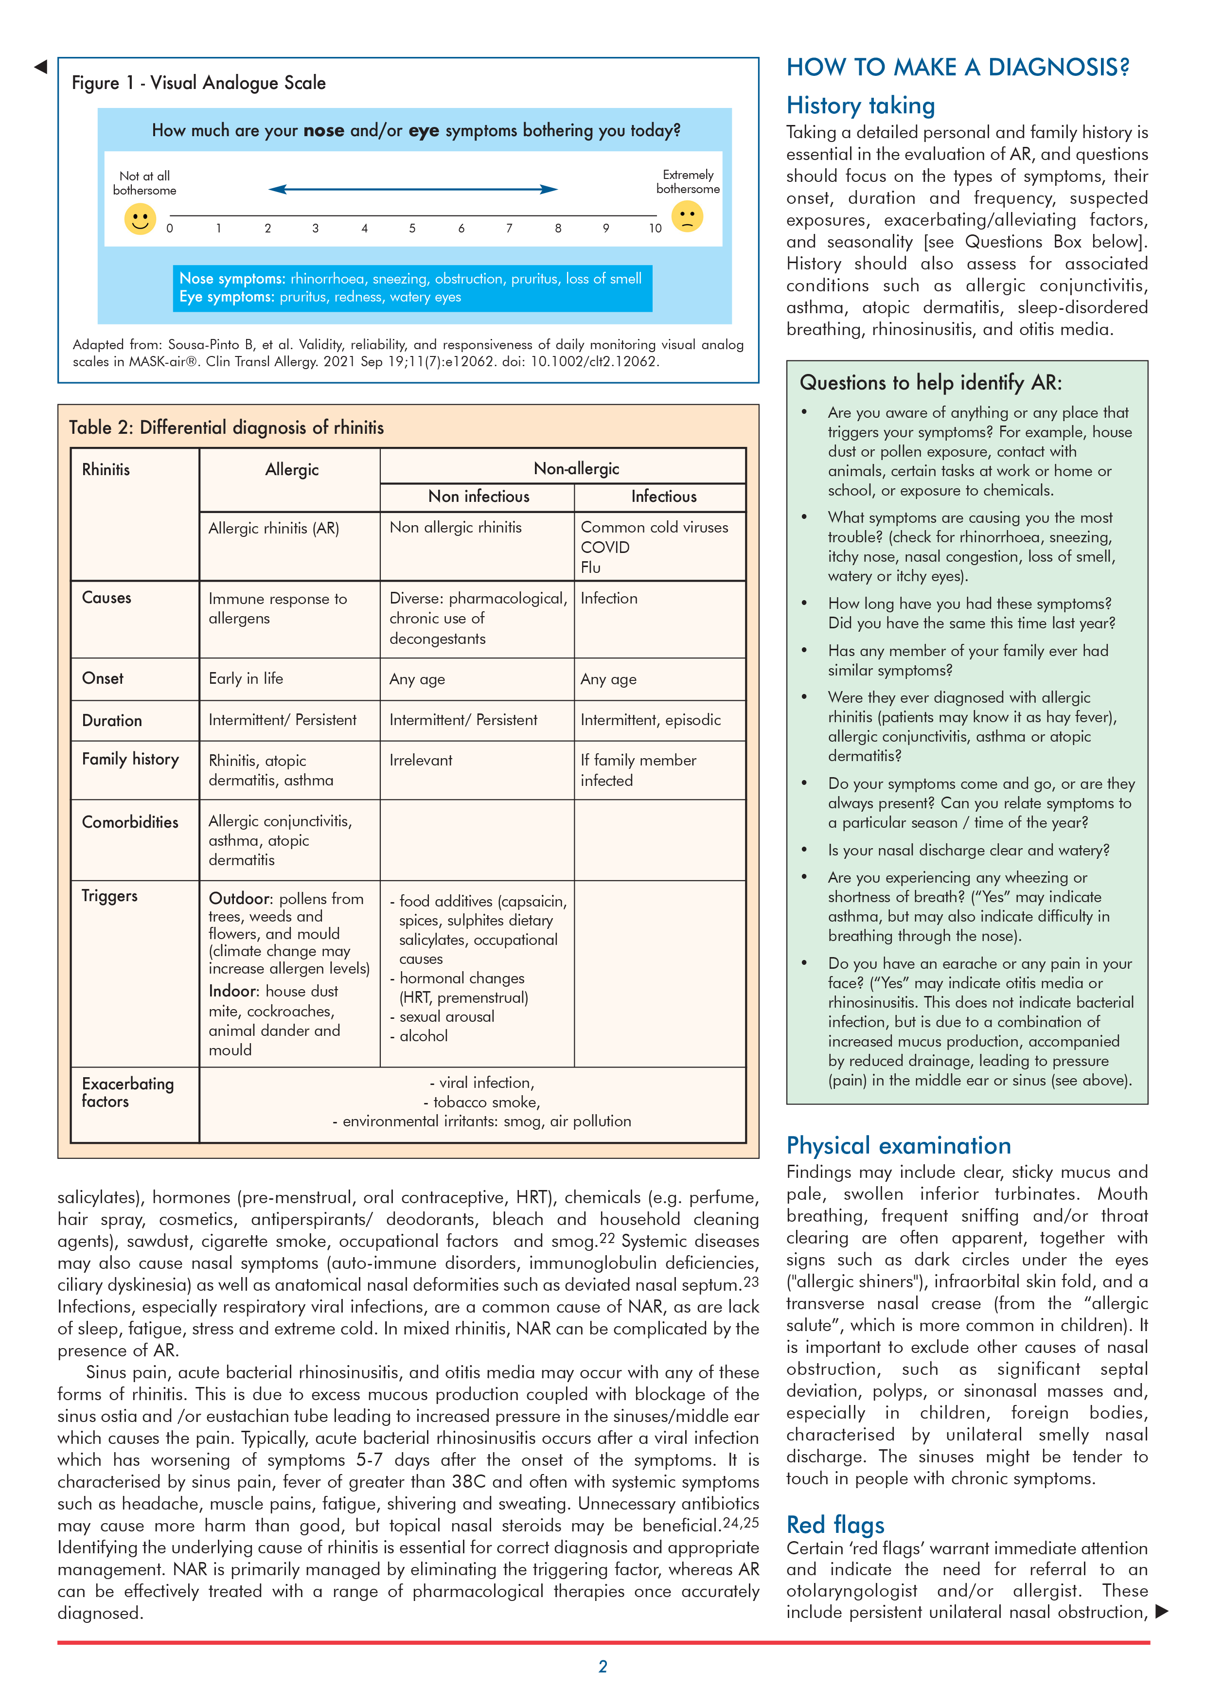
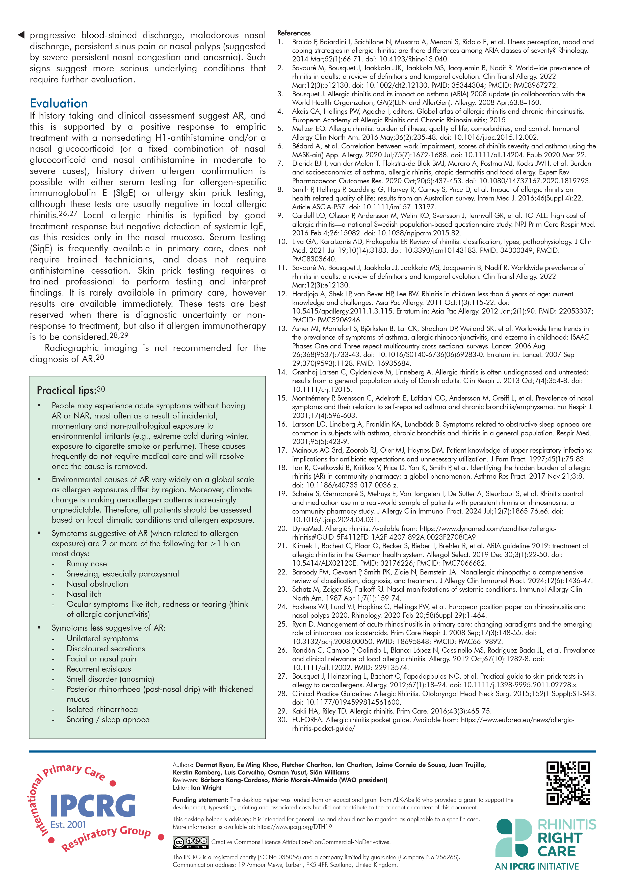

The desktop-helper No19
https://www.ipcrg.org/search-resources/ipcrg-dth-no19-a-practical-guide-to-improve-rhinitis-diagnosis-in-primary-care
Notes:
Rhinitis is a highly prevalent problem in all age groups that significantly impairs the lives of people with the condition, including
their cohabitants. Underdiagnosis and misdiagnosis are common, which leads to under or inappropriate treatment, economic
impact, and potential harm.
Most people with rhinitis manage the condition episodically, either with self-management or over-the-counter (OTC) medications
. Many underestimate and neglect their symptoms and often do not bring this to the attention of their general practitioner
(GP). However, as this is a common problem and a frequent comorbidity affecting the management of other conditions, it needs
to be recognised and managed appropriately in primary care.

Slide 3
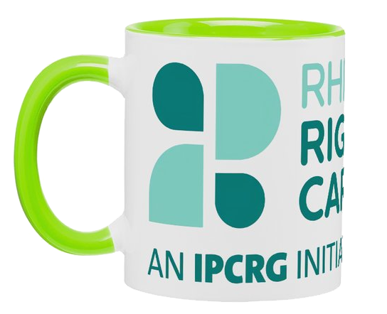
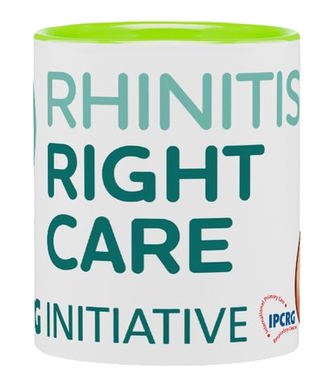
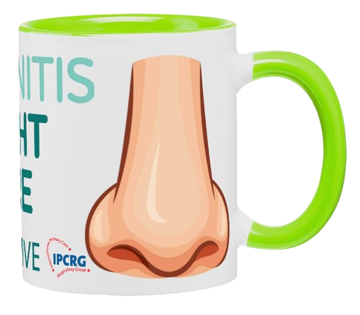

Learning objectives
Identifying Rhinitis in patients
Differentiating between Allergic Rhinitis (AR) and Non-AR
Diagnosing non-allergic rhinitis
Managing non-allergic rhinitis

Slide 4
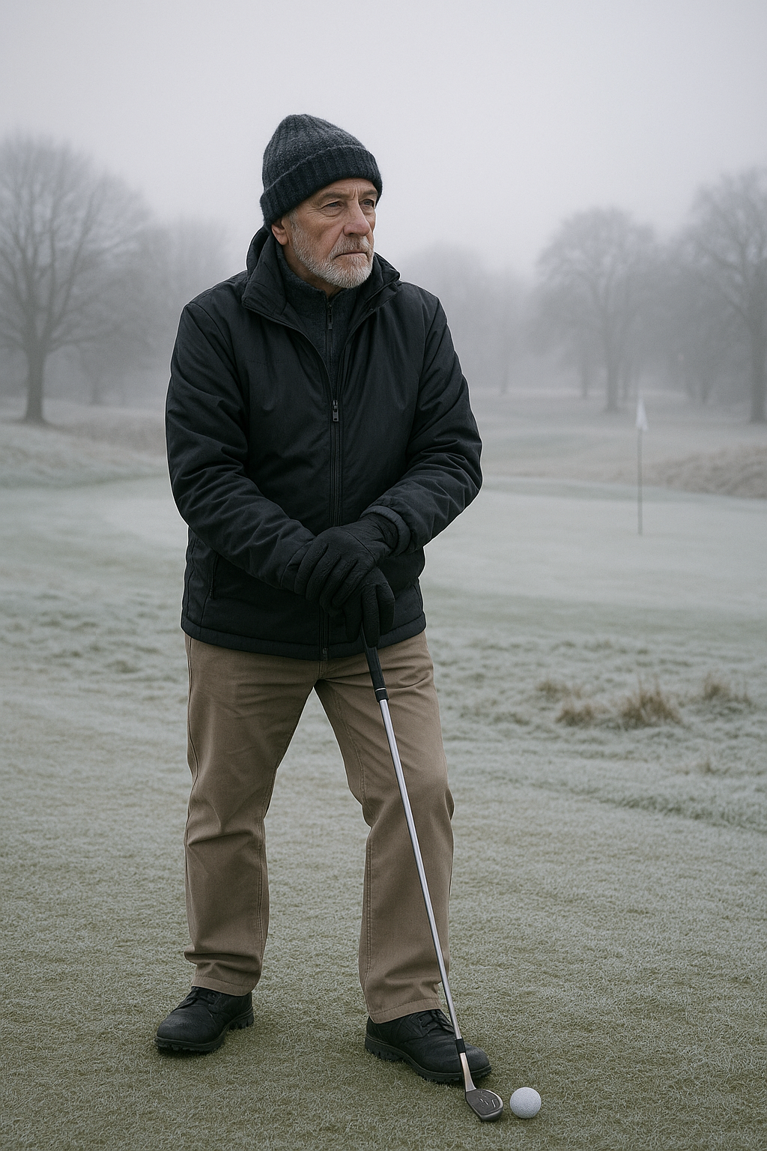
Meet Tom
65 year old Scottish male
Enjoys golf and hill walking
Was CEO of an electronics company
Holidays at least twice a year
No pets in his house

Slide 5

Initial Presentation
Nasal decongestant OTC from Pharmacy
3rd purchase in 2 weeks
Pharmacist intervention & consultation
Referral to GP in primary care
Nasal irrigation suggested in interim

Slide 6

Presentation at GP
6/12 history of blocked +/- runny nose
No ocular symptoms
Worse when outside in the cold
No sneezing, no itching
Keeping him awake at night
Notes:
Grumpy old man nose, never used to bother me but now it gets right up my nose!.
Runny nose an issue when he bends over to play a shot LOL
Out in the cold could be golfing or hill walking
6/12 history, so not seasonal and therefore not allergy/pollen

Slide 7

Medical History
Previous HTN diagnosis 10 years ago
Currently taking ACEi Statin and Ca Blocker
No history of asthma or COPD
Occasionally purchases Green Lipped Mussel extract and Ibuprofen OTC for joints
Notes:
ACEi Statin and meds for primary CVD prevention
OTC purchases mentioned as NSAIDS can be bought OTC

Slide 8

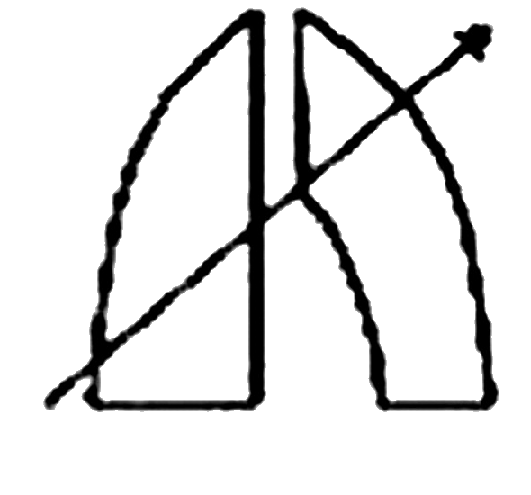
Clinical Examination & Investigations
ACEi can cause nasal symptoms
NSAIDs shift COX-1 pathway
Rhinoscopy showed mucosa congestion
Chest auscultation clear
Total IgE not elevated, ?Skin Prick test?
Notes:
ACE inhibitors can cause nasal rhinitis, also known as nonallergic rhinitis or vasomotor rhinitis, a condition characterized by inflammation of the nasal tissues leading to symptoms like nasal congestion, runny nose, and sneezing. This is because ACE inhibitors can lead to an accumulation of bradykinin and substance P, which can irritate the nasal mucosa
NSAIDs like aspirin and ibuprofen can induce rhinitis by inhibiting the body's natural anti-inflammatory pathways.
Block both COX, COX 1 housekeeping hormone, not like prostaglandin-Leukotriene shift in asthma
Also mention COCP and spicy foods, neither applicable but worthy of mention
Rhinoscopy if skilled, no CRSwNP, no anosmia, no epistaxis
Chest auscultation clear, so no infection and no Abx!
Low total IgEs, although not specific, ?need for skin prick test?
Not already using decongestant nasal sprays, and using for a proilonged period, rebound congestion?

Slide 9

Diagnosis
Consider ACEi to ARB switch
Symptomatic without taking NSAIDs
Low total IgEs and nothing on skin prick test
Be aware that AR and NAR can co-exist
If AR ruled out then consider NAR diagnosis
Notes:
Probably not caused by ACE or NSAIDs
low IgEs and nothing on skin prick tends towards a non allergic path diagnosi
Sherlock Holmes famously stated, "When you have eliminated the impossible, whatever remains, however improbable, must be the truth."

Slide 10
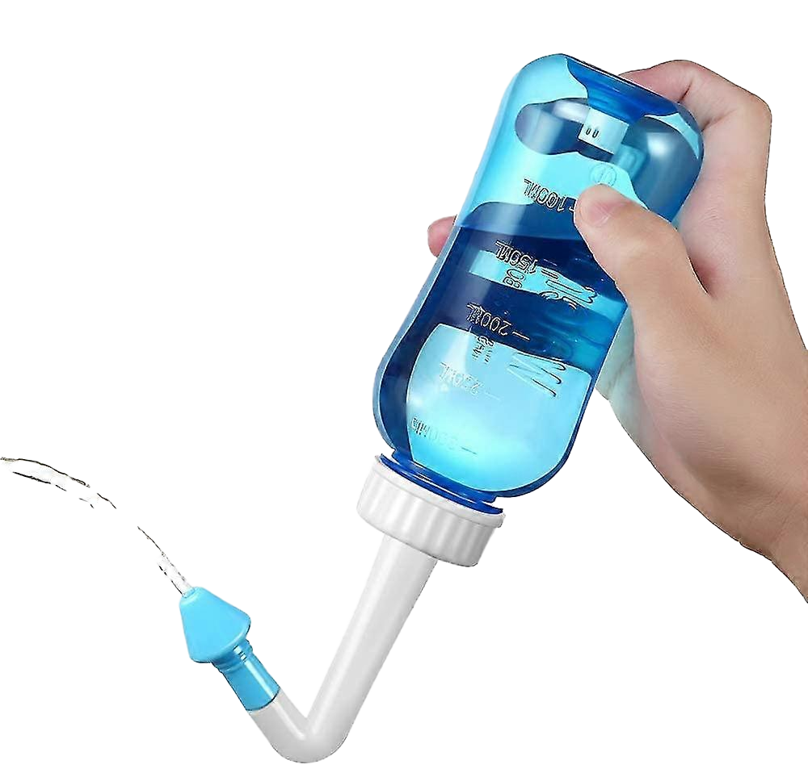
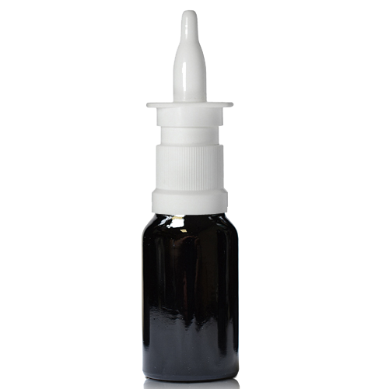
Management
Nasal Rinse using boiled cooled water
Trial of an anti muscarinic nasal spray
Dual action corticosteroid/anti histamine spray
Wear a mask or scarf to warm up air before inhaling
WSP/Petroleum jelly on vestibule when cold weather
Notes:
Explain why boiled and cooled
demonstrate nasal inhaler technique, nasal application rather than inhale, pharoh pose cross hands
Mention cryotherapy or laser surgery

Slide 11

Review
6/52 follow up
Review 6/12 in summer and before winter
Worsening statement given:
Anosmia
Epistaxis
ALK-Abelló provided an unrestricted educational grant to support the development of this case study but did not contribute to its content
Notes:
6-8 week followup,
As summer time followup to confirm only winter cold weather trigger

Slide 12
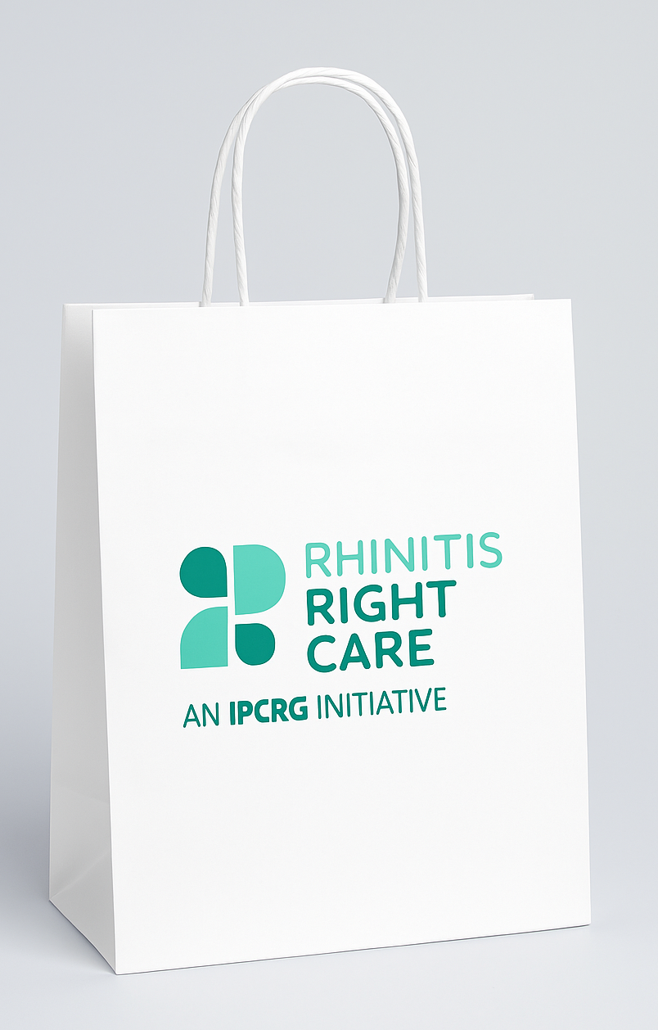
Summary Takeaway Messages
Not ALL Rhinitis is Allergic
Thorough investigation of the cause of symptoms is essential
Non-pharmacological treatments and preventative measures are very important in managing NAR
Aware that patients may have AR and NAR
Notes:
Even after treating what could be diagnosed as AR, patient may have NAR symptoms

Slide 13
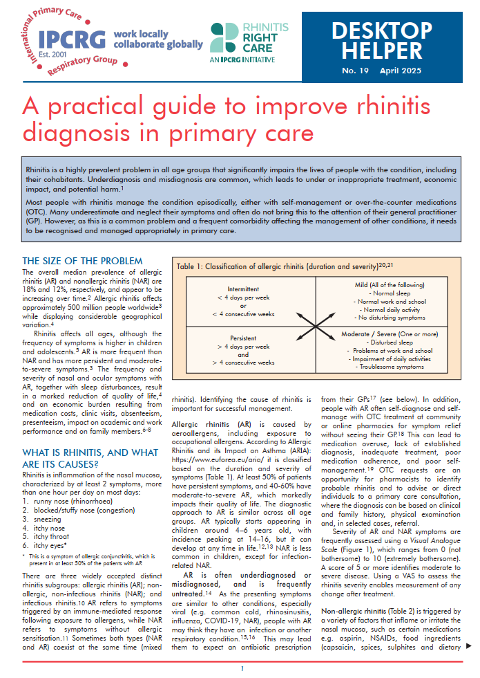
The desktop-helper
www.ipcrg.org

