Slide 1


A child with persistent upper airways symptoms
Case study
Dermot Ryan
Juan Trujillo Wurttele
June 2025

Slide 2

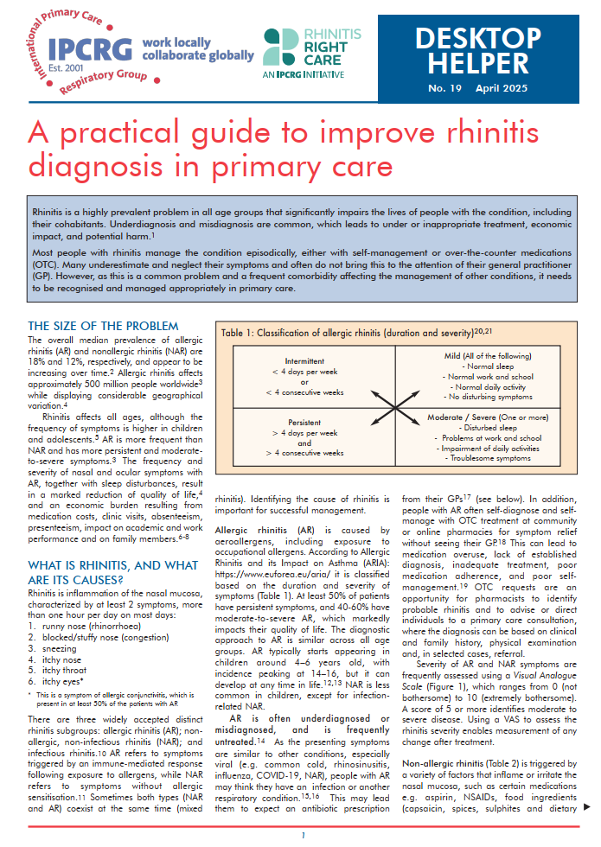

The desktop-helper
Rhinitis is a highly prevalent problem in all age groups that significantly impairs the lives of people with the condition, including their cohabitants. Underdiagnosis and misdiagnosis are common, which leads to under or inappropriate treatment, economic impact, and potential harm.
Most people with rhinitis manage the condition episodically, either with self-management or over-the-counter medications (OTC). Many underestimate and neglect their symptoms and often do not bring this to the attention of their general practitioner (GP).
However, as this is a common problem and a frequent comorbidity affecting the management of other conditions, it needs to be recognised and managed appropriately in primary care.

Slide 3
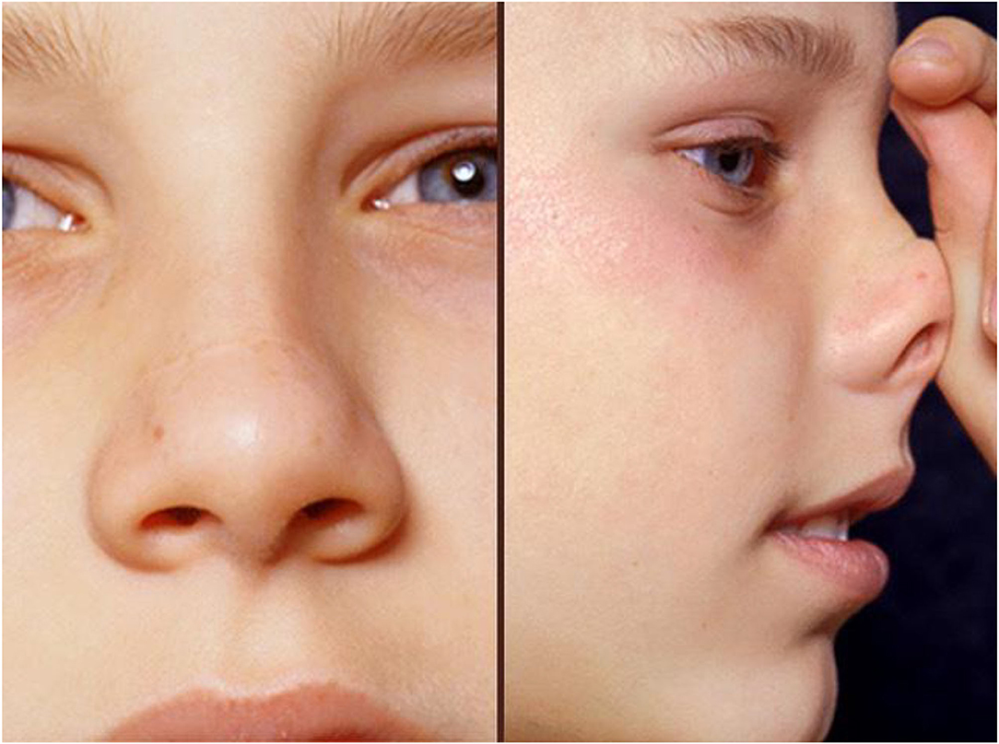
The desktop-helper
Liam is a seven-year-old lad who loves playing football and playing around outside with his friends.
He has had symptoms of nasal running and blocking with sneezing for a couple of years
His parents do not like to trouble the doctor and have used over the counter (OTC) remedies to help Liam with his symptoms over the last couple of years
These remedies no longer appear to work

Slide 4



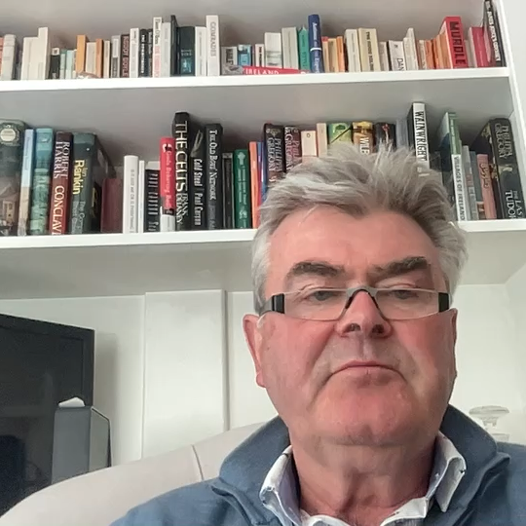
Learning objectives
Understanding of the negative impact of Allergic Rhinitis (AR) on children
Distinguish between some of the treatment obstacles of AR
Identify potential of use of Allergen Immunotherapy (AIT) for AR

Slide 5

The patient
Since mid-May, there has been a decline in Liam’s energy levels.
He does not appear to be sleeping well and Mum and Dad sometimes hear him snore
Teacher complains that Liam is inattentive in class and does not appear to hear what is being said to him
Coughing a lot
Reasons for visiting the doctor

Slide 6
Medical history
Mum has been purchasing OTC anti-histamines for him (but they are not sure he takes them)
Mum had eczema and hay fever as a child
They live on the edge of town, with fields opposite the house
Neither parent smokes cigarettes
They have noticed that although Liam has mild symptoms throughout the year, that these are much worse over the last three weeks. He does not seem to have the energy to play football and generally appears lethargic.
Liam’s mom also noted he is coughing a lot
Notes:
heading 1. Abrogation of parental responsibility. Need to say we suggest to parents that they need to supervise medication taking

Slide 7
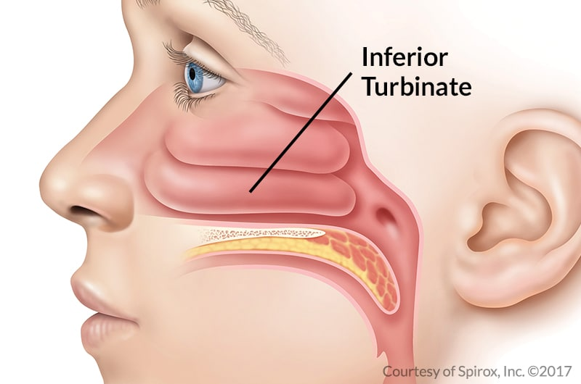
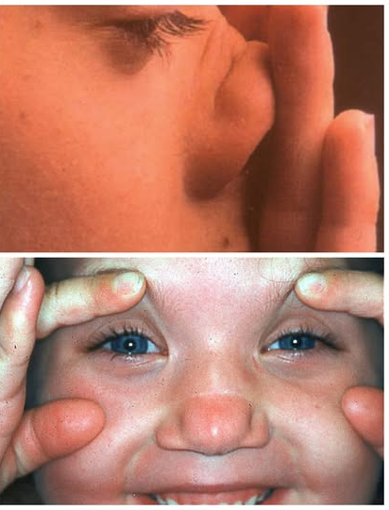
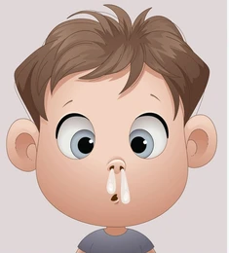
Current presentation
Liam looks miserable.
He has a transverse nasal crease and shadows around his eyes. His chest examination is normal and peak flow reading exceeds the expected value by 15%
The inferior turbinates are swollen and edematous, and there is a clear nasal discharge.
Ear exam reveals bilateral secretory otitis media

Slide 8


Clinical examination/investigations
You suspect that he has seasonal on top of perennial allergic rhinitis and co-morbid
secretory otitis media
Liam agrees to a blood test to aid the diagnosis, so a sample is taken off and sent for Specific IgE (SpIgE) to common aeroallergens

Slide 9
Diagnosis
You explain to Liam and to his parents that Liam appears to have
Perennial Allergic Rhinitis (probably due to house dust mites) and now has
Seasonal Allergic Rhinitis, probably due to grass pollens
This is causing blockage of his nose, postnasal drip (causing cough) and fluid behind the ear drums (leading to his reduced hearing) altogether this is also interfering with his sleep quality causing loss of “get up and go”

Slide 10
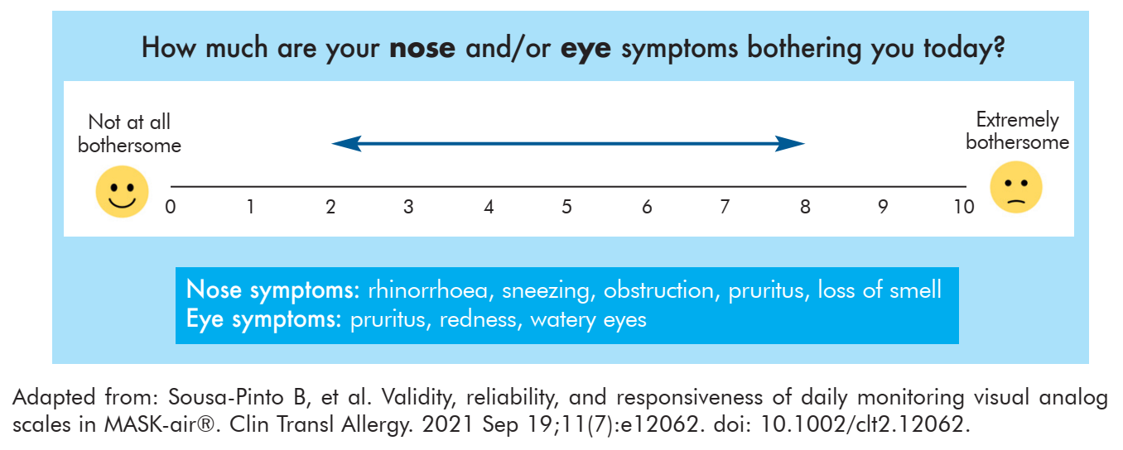
Management
Liam scores 8 on the Visual Analogue Scale for global Rhinitis Symptoms (VAS)
Blood tests will be sent off for SpIgE
The importance of ruling out asthma (as a cause of cough) is shared, and Liam and parents agree to doing twice daily PEF
Visual Analogue Scale
A score of 5 or more identifies moderate to severe disease.

Slide 11

Management
We agree to use a topical nasal decongestant, for 5 days only, every 4-6 hours to reduce swelling
We agree to use nasal steroids
It is explained that the nasal steroids are very safe
It is demonstrated how to use the nasal spray
Liam is started on one puff of Fluticasone propionate, Fluticasone Furoate or Mometasone. one squirt each nostril daily.
The importance of taking the medication as directed is emphasized
Parents ask about AIT: we will discuss at next visit
Follow up in 10-14 days

Slide 12
Review
Liam looks a lot happier.
Parents report he is now going out to play again
Peak flows reveal normal diurnal variability suggesting he does not have asthma
The VAS score is down to 5.
Blood tests suggests a moderate titer to House dust mite (HDM) and a high titer to Grass pollen. They are negative for cat, dog and molds
A further conversation is had concerning AIT especially SLIT or SCIT

Slide 13
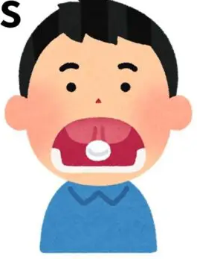
Conversation for AIT
After counselling, Liams parents understand the following about AIT
It has better results in patients with moderate-to severe symptoms (intermittent or persistent)
It helps when after standard treatment and not been successful decreasing symptoms completely despite avoidance measures and pharmacotherapy
Excellent option if AR is interfering with daily activities or sleep
You explain the AIT comes in two main forms SCIT and SLIT.
Liam’s have decided they would like to see an allergist to discuss this more and so a referral is made.

Slide 14

Conversation for AIT
Liams parent came to the allergist and are interested in allergen immunotherapy (AIT) and have many questions.
This are the most important questions they have
  What Type of AIT exists and how long is the treatment?
  Are there any side effects?
  Is this going to cure Liams Allergy?

Slide 15
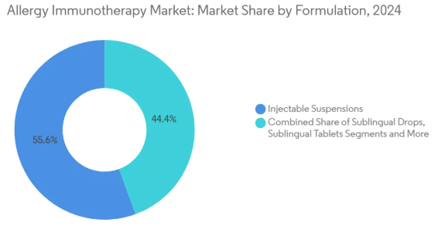
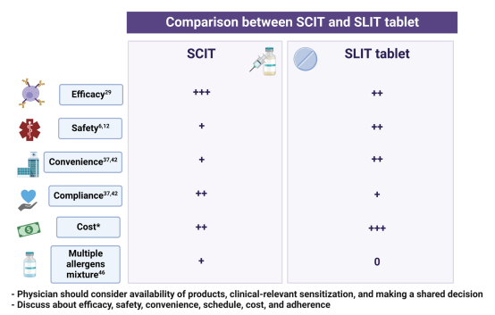
Conversation for AIT
What Type of AIT exists and how long is the treatment?
  Sublingual immunotherapy (SLIT) and Subcutaneous Immunotherapy (SCIT)
  Both of them with years of research and clinical use
  SLIT: tablets and drops 3-5 years.
  SCIT: SC injection 3-5 years

Slide 16

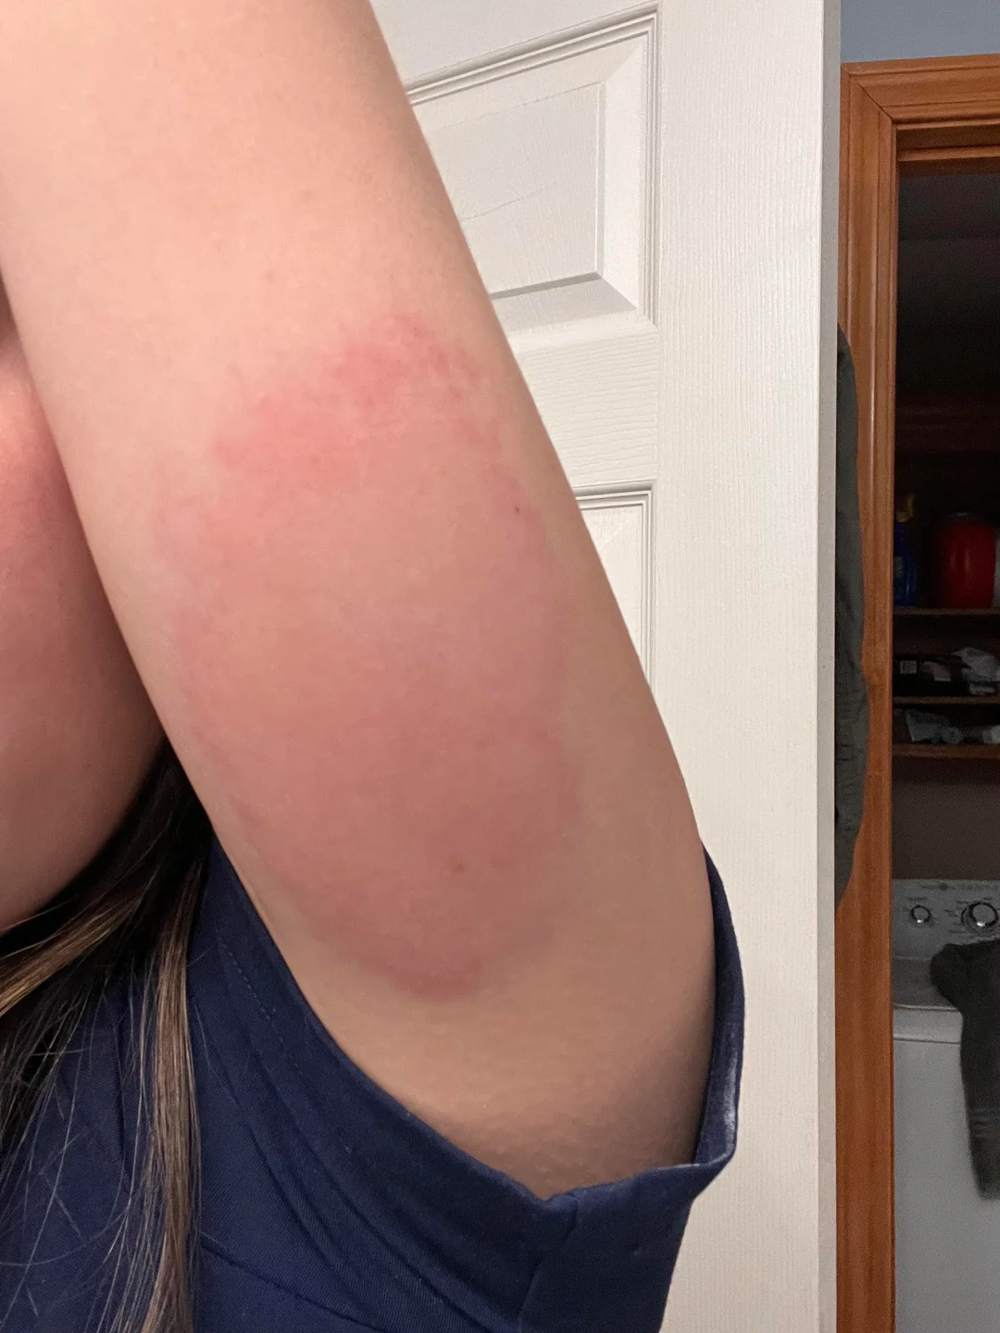
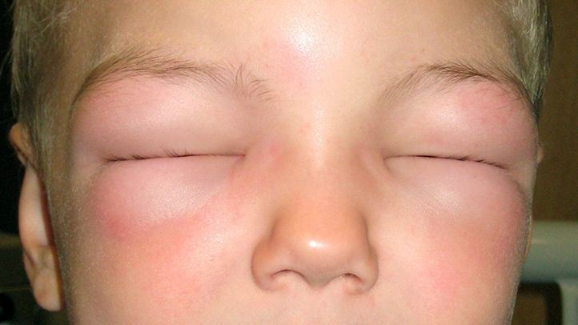
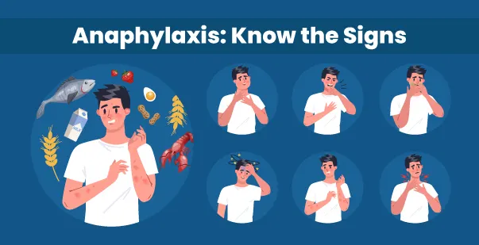
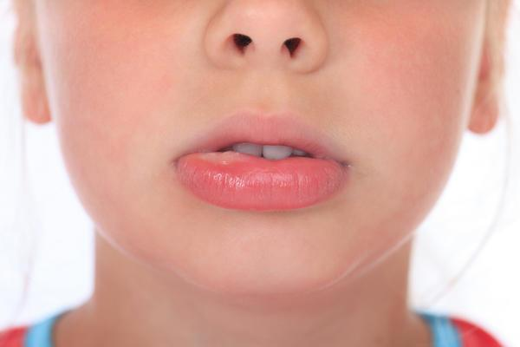
Conversation for AIT
Are there any side effects?

Slide 17
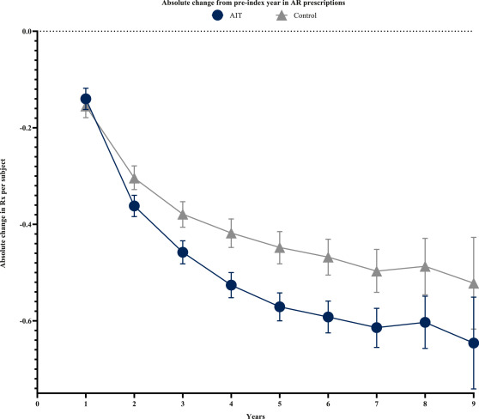
Conversation for AIT
Is this going to cure Liams Allergy?
Is not perfect but works for most patients.
Better results in moderate to severe patients
Selection of the allergen
Short and long-term relieve
Disease modify medication

Slide 18
Aspect | SLIT (Sublingual Immunotherapy) | SCIT (Subcutaneous Immunotherapy)
How it's given | Drops or tablets under the tongue at home, daily | Injections at a doctor's office, usually weekly at first, then monthly maintenance
Convenience | Very convenient — no office visits needed | Less convenient — requires regular clinic visits
Safety | Lower risk of severe allergic reactions | Higher risk of systemic reactions, requires monitoring after each injection
Effectiveness | Effective, but may be slightly less robust for some allergens | Very effective across a wide range of allergens
Onset of benefit | Gradual improvement over months to a year | Similar gradual improvement
Cost considerations | Fewer office visits may lower costs, but tablets can be expensive | Office visits increase overall cost, but injections often covered by insurance
Adherence | Daily home use requires strong patient commitment | In-office schedule can improve adherence
Best for | Those preferring home treatment or who dislike needles | Those who want tailored mixes and don’t mind injections

Slide 19



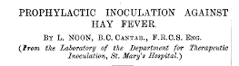
Take home messages
Allergic Rhinitis (AR) in children should be a diagnosis considered by primary care practitioners
There are several treatments for AR that will depend on the type and severity of AR
Nasal Steroid administration technique and appropriate training is essential for its’ effectiveness
AIT was the first (and only) treatment for allergic rhinitis
AIT is a good option for patients to improve outcomes over those achieved by conventional therapy

Slide 20
The desktop-helper
www.ipcrg.org

