Slide 1

Asthma Right Care for Pharmacists Presentation of the potential role of community pharmacists in asthma management according to Asthma Right Care
Case study for pharmacists
Francesc Moranta Ribas. Pharmacist. Spain
IPCRG received funding from AstraZeneca to develop the Asthma Right Care Initiative

Slide 2
Introduction
Asthma is one of the most common chronic non-communicable diseases worldwide, and the most prevalent chronic respiratory disease.
Patients living with this disease have a poorer quality of life, lower work productivity and more associated comorbidities. Despite the improvements that have occurred in recent decades in the management and treatment of asthma, and although asthma is considered manageable and treatable, the majority of patients with asthma are not well-controlled. Deaths from asthma exacerbations still occur in Western countries.
Moranta F, Sánchez N, Plaza FJ. Update on the Role of the Community Pharmacist in the Management of Asthmatic Patients. *Farmacéuticos Comunitarios. * 2021;13(3): 29-37. [accessed: 27 May 2022]. Available at: https://www.farmaceuticoscomunitarios.org/es/journal-article/actualizacion-del-papel-del-farmaceutico-comunitario-manejo-del-paciente-asmatico

Slide 3
Introduction
The role of the community pharmacist is very relevant. Given their training and accessibility, they can and should play a decisive role in the management of patients with asthma in primary care by actively collaborating with other healthcare professionals to better support people living with asthma.
This approach could be carried out through different interventions within the comprehensive asthma care service, such as:
case-finding of undiagnosed patients with asthma;
detection of risk factors and triggers in patients with uncontrolled or poorly-controlled asthma;
non-pharmacological interventions and smoking cessation;
identification of patients over-reliant on rescue medication;
identification of patients with low adherence to anti-inflammatory treatment with inhaled corticosteroids;
review of the use of inhalation devices;
health education;
and assistance in obtaining personalised written action plans.

Slide 4
Case study objective
The aim of this case study is to demonstrate, through a fictitious scenario based on real experiences, the role community pharmacists can play in the management of patients with asthma, considering different national or local contexts, and regardless of whether such actions are encouraged or reimbursed by public or private administrations.

Slide 5
How to use this case study?
This case study was developed as a teaching and learning tool to equip pharmacists with the knowledge, skills, and resources needed to actively participate in asthma management.
To achieve this, references to renowned international guidelines, as well as widely used and validated tools and devices, have been incorporated.
Many of the materials, documents, and tools used were created by IPCRG for Asthma Right Care, as open-source resources.

Slide 6
Learning objectives
By the end of this session, participants should be able to:
Identify at least two appropriate actions a community pharmacist can take during the first contact to identify a potential asthma patient and describe one specific non-pharmacological measure they could initially recommend.
Sequence the key interventions a community pharmacist can undertake, explain the rationale behind at least one specific intervention in a follow-up visit, and identify at least one scenario where a referral to the GP would be a necessary step for joint asthma control.
List three potential indicators a community pharmacist might observe during an initial patient contact that could suggest possible asthma and describe how a community pharmacist can explain one prescribed first-line asthma treatment and one initial non-pharmacological measure to a patient. Furthermore, participants should be able to identify one example of a community pharmacist intervention during a follow-up visit and explain how the results of such an intervention might influence a subsequent referral to the GP.
Further information can be accessed at https://www.ipcrg.org/asthmarightcareforpharmacists and https://www.ipcrg.org/asthmarightcare

Slide 7
Case finding
Studies conducted globally across various age groups, including children, adults, and older people, suggest that between 20% and 70% of individuals with asthma in the community may remain undiagnosed.
Community pharmacists can play a crucial role in identifying undiagnosed patients, particularly among adolescents and adults who did not have asthma diagnosed in childhood and also, in those whose asthma initiated in adulthood.
It is essential to take advantage of the opportunity when individuals visit the pharmacy seeking relief for symptoms they may perceive as minor, which could actually be part of a more complex chronic condition.
Aaron SD, Boulet LP, Reddel HK et al. Underdiagnosis and Overdiagnosis of Asthma. Am J Respir Crit Care Med. 2018;198(8):1012-20. [accessed: 2 February 2025]. Available at: https://www.ncbi.nlm.nih.gov/pubmed/29756989
Global Initiative for Asthma. Global Strategy for Asthma Management and Prevention. [Internet]. 2024. [accessed: 2 February 2025]. Available at: https://ginasthma.org/2024-report/
Moranta F, Sánchez N, Plaza FJ. Update on the Role of the Community Pharmacist in the Management of Asthmatic Patients. *Farmacéuticos Comunitarios. * 2021;13(3): 29-37. [accessed: 27 May 2022]. Available at: https://www.farmaceuticoscomunitarios.org/es/journal-article/actualizacion-del-papel-del-farmaceutico-comunitario-manejo-del-paciente-asmatico
International Pharmaceutical Federation. Chronic respiratory diseases: A handbook for pharmacists. The Hague: International Pharmaceutical Federation; 2022 [accessed: 8 feb 2025]. Available at: https://ncd.fip.org/fip-practice-transformation-programme-on-ncds/publications/

Slide 8
Case finding
Pharmacists should be vigilant when encountering individuals with a persistent history of symptoms such as wheezing, breathlessness, chest tightness, or dry cough, especially when accompanied by a history of atopy or other allergic conditions like rhinitis or eczema.
Additionally, pharmacists should be alert to patients frequently requesting cough remedies or using SABAs without a formal diagnosis, as well as those with poorly controlled chronic rhinitis. In such cases, pharmacists should advise these individuals to consult their physicians for confirmation or exclusion of an asthma diagnosis.
Aaron SD, Boulet LP, Reddel HK et al. Underdiagnosis and Overdiagnosis of Asthma. Am J Respir Crit Care Med. 2018;198(8):1012-20. [accessed: 2 February 2025]. Available at: https://www.ncbi.nlm.nih.gov/pubmed/29756989
Global Initiative for Asthma. Global Strategy for Asthma Management and Prevention. [Internet]. 2024. [accessed: 2 February 2025]. Available at: https://ginasthma.org/2024-report/
Moranta F, Sánchez N, Plaza FJ. Update on the Role of the Community Pharmacist in the Management of Asthmatic Patients. *Farmacéuticos Comunitarios. * 2021;13(3): 29-37. [accessed: 27 May 2022]. Available at: https://www.farmaceuticoscomunitarios.org/es/journal-article/actualizacion-del-papel-del-farmaceutico-comunitario-manejo-del-paciente-asmatico
International Pharmaceutical Federation. Chronic respiratory diseases: A handbook for pharmacists. The Hague: International Pharmaceutical Federation; 2022 [accessed: 8 feb 2025]. Available at: https://ncd.fip.org/fip-practice-transformation-programme-on-ncds/publications/

Slide 9

Case study for pharmacists
John comes to the pharmacy because he has had a dry cough for several months. Sometimes, his cough causes him to have difficulty breathing. He has gone to different pharmacies where he has been dispensed different over-the-counter (OTC) cough syrups, containing various active substances, without any results. He asks for a salbutamol inhaler, since, when he was a child, he had it prescribed on several occasions, and it worked for him.
How should the pharmacist respond to this request?
Should he simply “sell” the inhaler without a prescription to keep the “customer” happy?
Or find out more about John’s history and symptoms to ensure the correct medication is provided?

Slide 10
Case study for pharmacists
John comes to the pharmacy because he has had a dry cough for several months. Sometimes, his cough causes him to have difficulty breathing. He has gone to different pharmacies where he has been dispensed different over-the-counter (OTC) cough syrups, containing various active substances, without any results. He asks for a salbutamol inhaler, since, when he was a child, he had it prescribed on several occasions, and it worked for him.
How should the pharmacist respond to this request?
Should he simply “sell” the inhaler without a prescription to keep the “customer” happy?
Or find out more about John’s history and symptoms to ensure the correct medication is provided?

Slide 11
First contact
The pharmacist should consider that a prescription is always required to dispense an inhaled short-acting beta₂ agonist (SABA), since it is not an OTC medicine. Furthermore, its use without supervision by a healthcare professional may put the patient's health at risk.
The pharmacist invites John to the consultation room to explain why he will not dispense the SABA

Slide 12
The patient: John
John is 43 years old and has had a dry cough for about 4 months, especially after participating in sport. He runs in the mountains 3 or 4 times a week, and sometimes he has difficulty breathing due to coughing fits. He sometimes wakes up at night with cough and difficulty breathing.
In previous years, he has had similar but less severe symptoms during spring.
It appears his symptoms have increased in duration and intensity over the years.
He remembers that when he was a child, he was prescribed a salbutamol inhaler a few times, and a few years ago when he went to the emergency room for similar symptoms he was prescribed it once again. Within a few weeks, he was feeling better.
One of John's brothers and his mother has asthma.
In summer, he sometimes presents with a skin rash, which the doctor explained could be allergic eczema.
John is not a smoker.

Slide 13
First referral
The pharmacist explains to John that his symptoms could be indicative of asthma, and that is the reason why he should see his doctor to confirm or exclude this diagnosis.
In addition, he should not continue self-medicating under any circumstances, as this exposes John to complications from inappropriate medication use and/or lack of a formal diagnosis enabling him to be treated accordingly.
Next, the pharmacist writes a referral letter for the doctor to assess the situation.
How is asthma diagnosed?
Asthma is diagnosed based on a patient’s history of typical symptoms and proof of variable airflow obstruction during exhalation. This should be confirmed through bronchodilator reversibility testing or other diagnostic methods. Sometimes, multiple tests may be needed to either confirm asthma or rule out other respiratory conditions. In cases where spirometry is not available, healthcare providers should rely on peak expiratory flow (PEF) measurements rather than symptoms alone.
1.Global Initiative for Asthma. Global Strategy for Asthma Management and Prevention. [Internet]. 2024. [accessed: 2 February 2025]. Available at: https://ginasthma.org/2024-report/

Slide 14
Diagnosis and treatment
John returns to the pharmacy three weeks later to have his prescription dispensed, since he has confidence that this pharmacist is more interested in his health than in making a sale.
He has had an appointment with his GP. The doctor performed a spirometry, as well as other examinations, and eventually confirmed the asthma diagnosis.
His doctor prescribed him an inhaler containing budesonide 80mcg/formoterol 4.5mcg, in a dry powder inhaler (DPI) called Turbohaler ® and explained that he should use it when he has symptoms, as needed and also, one inhalation before doing sports.
1. IPCRG Desktop Helper No.15 - The ‘jigsaw puzzle’ approach to building a diagnostic picture of asthma in primary care over time. [accessed: 25 April 2025]. Available at: https://www.ipcrg.org/DTH15

Slide 15
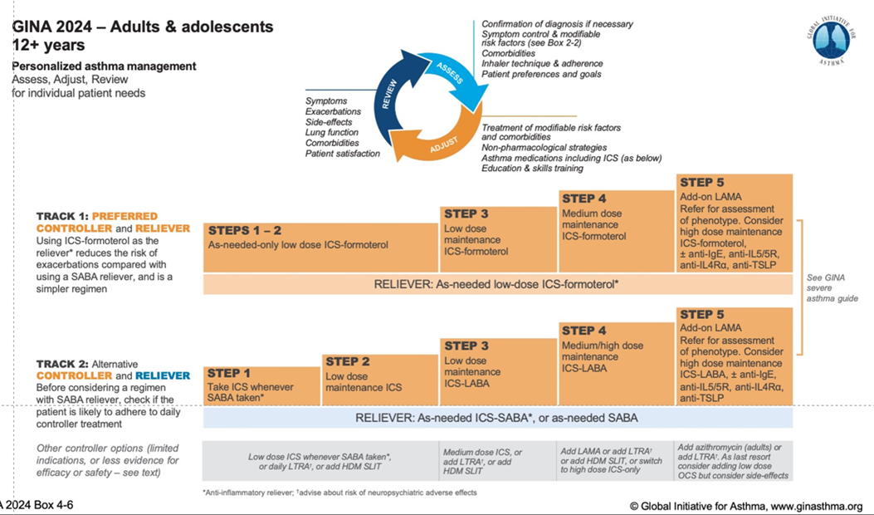

Recommended treatment
Global Initiative for Asthma. Global Strategy for Asthma Management and Prevention. [Internet]. 2024. [accessed: 2 February 2025]. Available at: https://ginasthma.org/2024-report/

Slide 16
John’s doubts and expectations
According to the clinical guide of the Global Initiative for Asthma Global Strategy for Asthma Management and Prevention (GINA), John has been diagnosed with asthma in step 1-2 of treatment.
John is unsure about the diagnosis, as he does not experience wheezing, and, according to him, if he does not have "whistling" it is not asthma. In addition, the doctor didn’t want to prescribe salbutamol, which has worked well for him on previous occasions.
What should the pharmacist do in this case?
Tell John to get a second opinion from another doctor.
John is right, the main asthma symptom is whistling.
Explain to John that there are different asthma clinical phenotypes.

Slide 17
John’s doubts and expectations
According to the clinical guide of the Global Initiative for Asthma Global Strategy for Asthma Management and Prevention (GINA), John has been diagnosed with asthma in step 1-2 of treatment.
John is unsure about the diagnosis, as he does not experience wheezing, and, according to him, if he does not have "whistling" it is not asthma. In addition, the doctor didn’t want to prescribe salbutamol, which has worked well for him on previous occasions.
What should the pharmacist do in this case?
Tell John to get a second opinion from another doctor.
John is right, the main asthma symptom is whistling.
Explain to John that there are different asthma clinical phenotypes.

Slide 18
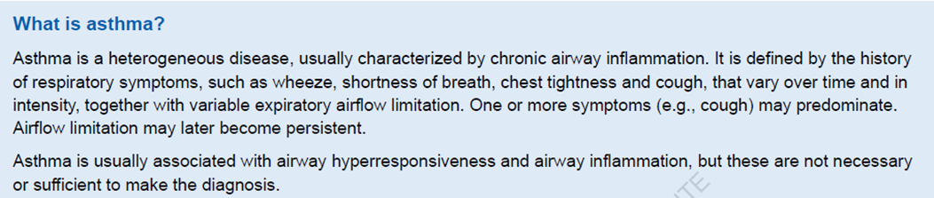
What is asthma? Clinical phenotypes
Allergic asthma: Common in childhood, associated with allergies, and responds well to ICS treatment.
Non-allergic asthma: Not linked to allergies, with varied inflammatory cell profiles; responds less effectively to ICS.
Cough variant asthma: Cough is the primary symptom; airflow limitation may not be evident except in bronchial tests. ICS treatment is effective.
Adult-onset asthma: Often affects non-allergic adults, particularly women; may require higher ICS doses and can be resistant to corticosteroids. Occupational asthma should also be considered.
Asthma with persistent airflow limitation: Long-standing asthma can cause irreversible or partially reversible airflow restriction, linked to airway remodelling and COPD.
Asthma with obesity: Patients experience more severe respiratory symptoms with a unique inflammation pattern, typically low in eosinophils.
Global Initiative for Asthma. Global Strategy for Asthma Management and Prevention. [Internet]. 2024. [accessed: 2 February 2025]. Available at: https://ginasthma.org/2024-report/

Slide 19
Reinforcing asthma treatment
The pharmacist should remind the patient that wheezing is not always present in patients with asthma. Symptoms are highly variable, including wheezing, shortness of breath, chest tightness or dry cough. In addition, two of the asthma phenotypes are sports-induced asthma and dry cough due to asthma.
In addition to dispensing the prescribed inhaled treatment for the first time, the pharmacist should instruct and train the patient in the correct use of his inhaler, as the patient is not familiar with the inhaler. The patient should be reminded that, unlike pressurised metered dose inhalers (pMDI), when using a DPI, the inhalation must be fast and forceful.
The pharmacist should insist on the use of the prescribed inhaler when symptoms occur or before exercising, explaining the difference between preventive and emergency use of the same medication.
The pharmacist makes an appointment to see John for an asthma control review in a month.
https://www.ipcrg.org/resources/search-resources/7-steps-to-using-a-dry-powder-inhaler-2-min-10-sec

Slide 20
Missed check-up appointment
John missed the check-up appointment. The pharmacist called him, but he responded evasively.
Three months later, he returns to the pharmacy with an electronic prescription for a salbutamol inhaler.
He explains that the inhaler he was initially prescribed was not really working. Therefore, a month ago, after a long sport session, he was having difficulty breathing, went to the emergency room and was prescribed a salbutamol inhaler to use as needed. [Emergency and Urgent Care Centres - response to asthma/suspected asthma TOP TIPS – English]
He explains that his symptoms are now under control.
What should the pharmacist do in this case?
- Simply dispense the salbutamol inhaler.
- Check how controlled John's asthma is.

Slide 21
Missed check-up appointment
John missed the check-up appointment. The pharmacist called him, but he responded evasively.
Three months later, he returns to the pharmacy with an electronic prescription for a salbutamol inhaler.
He explains that the inhaler he was initially prescribed was not really working. Therefore, a month ago, after a long sport session, he was having difficulty breathing, went to the emergency room and was prescribed a salbutamol inhaler to use as needed.
He explains that his symptoms are now under control.
What should the pharmacist do in this case?
- Simply dispense the salbutamol inhaler.
- Check how controlled John's asthma is.

Slide 22
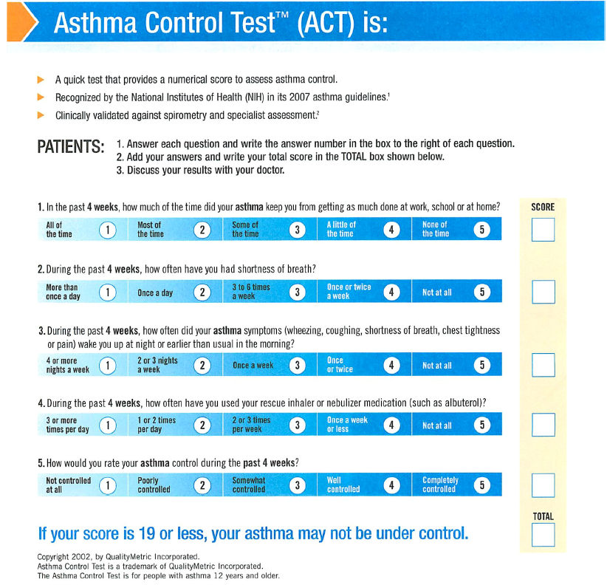
Asthma Control Test (ACT)
Using the Asthma Control Test (ACT) the pharmacist can assess how well John's asthma is controlled
Nathan RA, Sorkness CA, Kosinski M, Schatz M, Li JT, Marcus P, Murray JJ, Pendergraft TB. Development of the asthma control test: a survey for assessing asthma control. J Allergy Clin Immunol. 2004 Jan;113(1):59-65. doi: 10.1016/j.jaci.2003.09.008. PMID: 14713908.

Slide 23
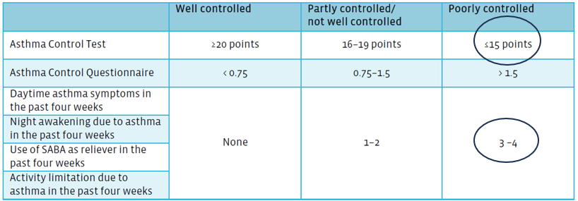
Asthma Control Test (ACT)
John's ACT score is 14 points. He uses his salbutamol inhaler each day he exercises, both before and after, and even some nights when he wakes up because of coughing. When he starts coughing again, he uses the salbutamol inhaler and the cough disappears for hours. John thinks the treatment works very well since it relieves his symptoms quickly.
Nathan, R. A., Sorkness, C. A., Kosinski, M., Schatz, M., Li, J. T., et al. (2004). Development of the asthma control test: a survey for assessing asthma control. The Journal of Allergy and Clinical Immunology, 113(1), 59-65. https://doi.org/10.1016/j.jaci.2003.09.008.
Global Initiative for Asthma. Global Strategy for Asthma Management and Prevention. [Internet]. 2024. [accessed: 2 February 2025]. Available at: https://ginasthma.org/2024-report/
IPCRG Breath https://share.minicoursegenerator.com/12-asthma-treatment-638810899487225390/1?shr=1

Slide 24
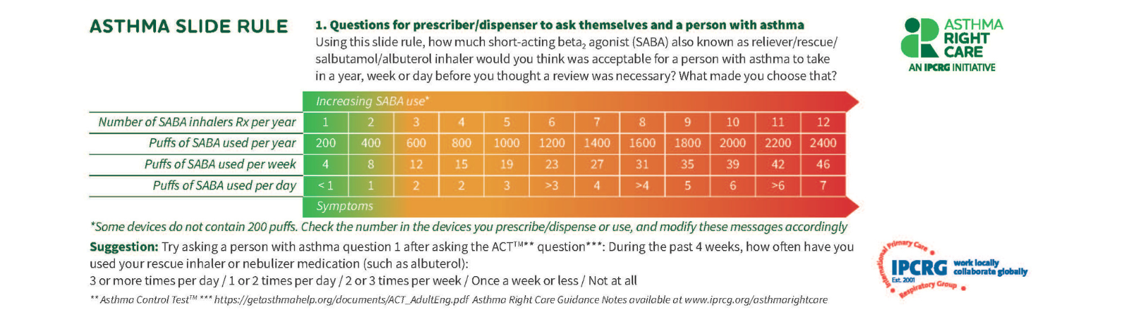
Asthma Slide Rule
Please follow the guidance to use the slide rule. An example video is available here.
We explain to John that his asthma is not as controlled as he thinks. John takes between 15 and 20 doses of salbutamol a week. The best time to use the slide rule is after Question 4 of the ACT.
1. International Primary Care Respiratory Group (IPCRG). Asthma Slide Rule. [Internet]. 2023 [cited 2025 Feb 8]. Available from: https://www.ipcrg.org/search-resources/asthma-slide-rule-english
2. Guidance notes https://www.ipcrg.org/search-resources/asthma-right-care-slide-rule-guidance-notes-English
3. https://www.ipcrg.org/resources/search-resources/asthma-right-care-slide-rule-and-question-challenge-cards-in-a-pharmacy

Slide 25
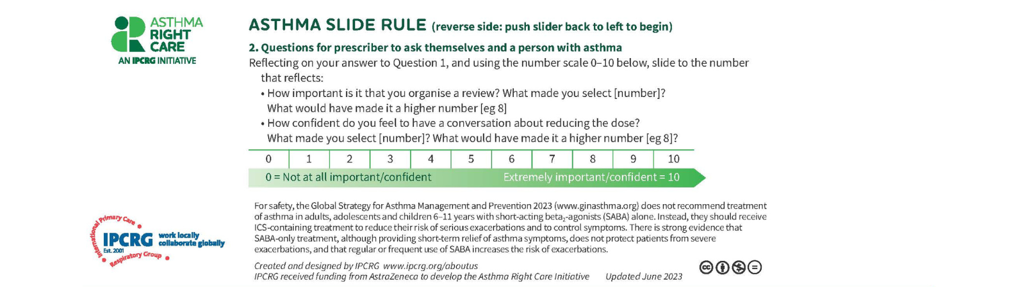
Asthma Slide Rule
Please follow the guidelines to use the slide rule. An example video is available here.
1. International Primary Care Respiratory Group (IPCRG). Asthma Slide Rule. [Internet]. 2023 [cited 2025 Feb 8]. Available from: https://www.ipcrg.org/search-resources/asthma-slide-rule-english
2. Guidance notes https://www.ipcrg.org/search-resources/asthma-right-care-slide-rule-guidance-notes-English
3. https://www.ipcrg.org/resources/search-resources/asthma-right-care-slide-rule-and-question-challenge-cards-in-a-pharmacy

Slide 26
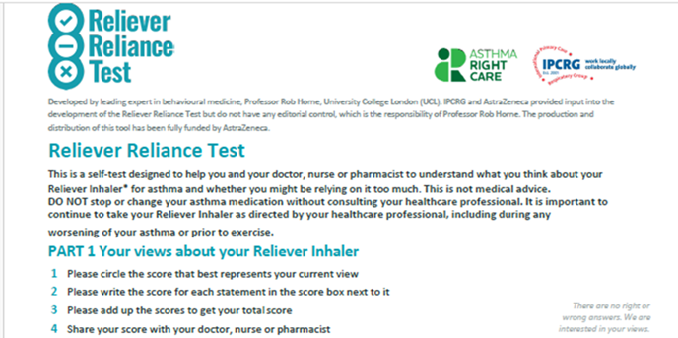
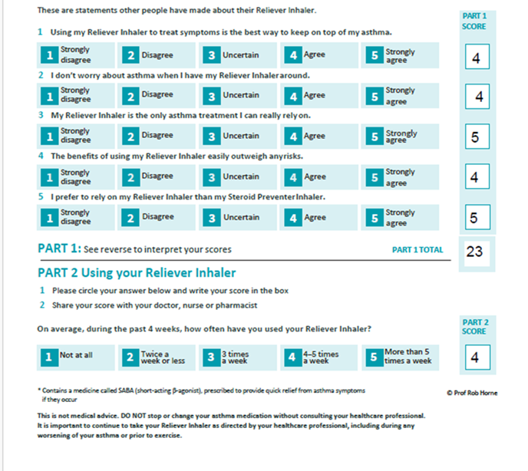
Reliever Reliance Test
Price, D., et al. (2014). The Reliever Reliance Test: a simple tool for assessing asthma control in clinical practice. Primary Care Respiratory Journal, 23(1), 35-41. https://doi.org/10.1016/j.pcrj.2013.10.002.
Reliever Reliance Test – English https://www.ipcrg.org/resources/search-resources/reliever-reliance-test-english

Slide 27
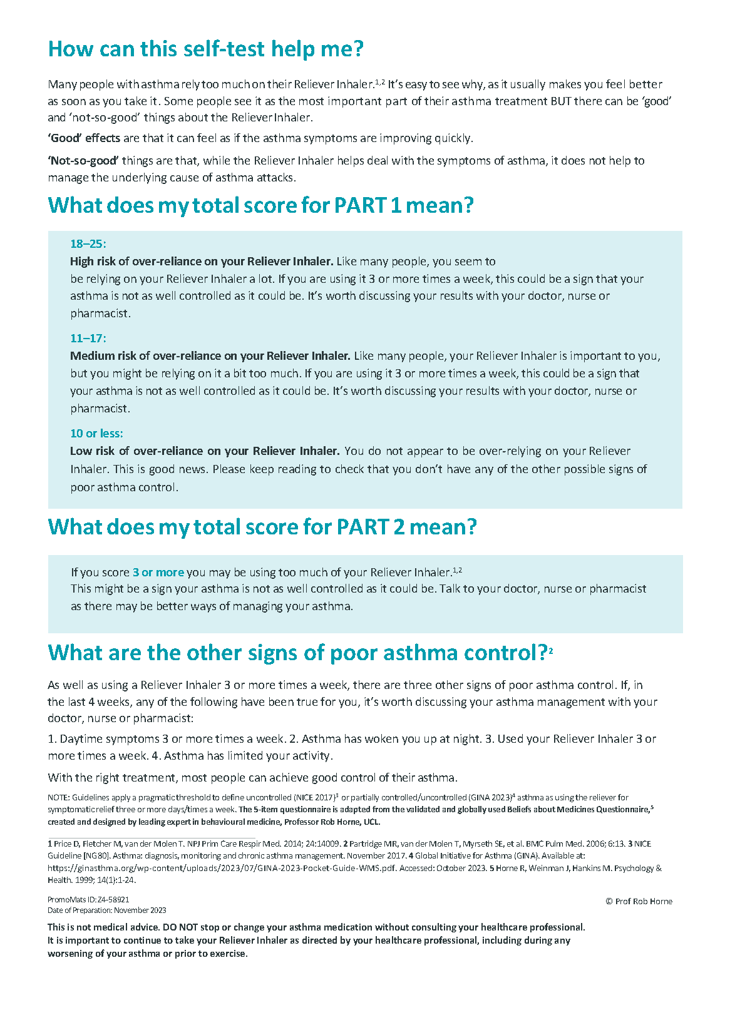
Reliever Reliance Test Guidance
Price, D., et al. (2014). The Reliever Reliance Test: a simple tool for assessing asthma control in clinical practice. Primary Care Respiratory Journal, 23(1), 35-41. https://doi.org/10.1016/j.pcrj.2013.10.002.
Reliever Reliance Test – English https://www.ipcrg.org/resources/search-resources/reliever-reliance-test-english

Slide 28
Outcomes
Taking into account the Asthma Slide Rule and RRT tests, the pharmacist shares the information with John, and they both agree that his asthma is not well controlled, and that excessive use of salbutamol can be a medium- to long-term risk.
The pharmacist explains to John that, among other things, having poorly controlled asthma can lead to a decrease in his lung function in the long term, and an increased risk of suffering asthma attacks or more serious exacerbations in the short term.
Poor asthma control is associated with a progressive decline in lung function over time. This decline is partly due to repeated exacerbations and ongoing airway inflammation, which can cause permanent structural changes in the airways (airway remodeling). These changes may result in irreversible airflow limitation and reduced lung capacity as the patient age.
The pharmacist suggests John should have a new appointment with his GP. He agrees
The pharmacist writes a new referral letter for John’s family doctor, which includes the results of the tests carried out. John is encouraged to make an appointment for a review with his doctor.
Soremekun S, Heaney LG, Skinner D, Chaudhuri R, Niven R, Mansur AH, et al. Asthma exacerbations are associated with a decline in lung function: a longitudinal population-based study. Thorax. 2023 Jul;78(7):643-652. doi:10.1136/thorax-2021-217032

Slide 29
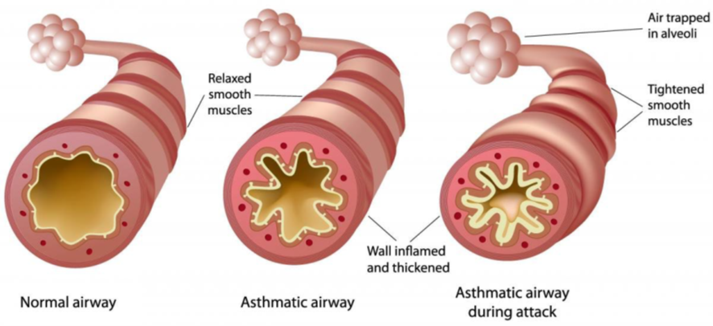
Asthma: an inflammatory condition
Asthma is a chronic inflammatory disease of the airways characterised by recurrent episodes of wheezing, shortness of breath (dyspnea). These symptoms are caused by inflammation and narrowing of the airways, leading to variable and generally reversible airflow obstruction.
Due to the mainly inflammatory nature of the disease, the main anti-inflammatory treatment for asthma is inhaled glucocorticoids. These medications, either alone or combined with formoterol, are the most effective for asthma control, as they reduce airway inflammation and prevent asthma attacks, as well as the long-term decline in lung function
1. Shutterstock. Pathology of asthma [Internet]. New York: Shutterstock; 2025 [cited 2025 Apr 28]. Available from: https://www.shutterstock.com/search/asthma-pathophysiology
2. Global Initiative for Asthma. Global Strategy for Asthma Management and Prevention. [Internet]. 2024. [accessed: 2 February 2025]. Available at: https://ginasthma.org/2024-report/
3. Soremekun S, Heaney LG, Skinner D, Chaudhuri R, Niven R, Mansur AH, et al. Asthma exacerbations are associated with a decline in lung function: a longitudinal population-based study. Thorax. 2023 Jul;78(7):643-652. doi:10.1136/thorax-2021-217032

Slide 30

GINA 2019: a fundamental change in asthma management
Why shouldn't John use a salbutamol inhaler as the only treatment for his asthma?
John’s treatment with SABA only is not successfully controlling his asthma. Moreover, there is globally a call to move away from using SABAs as monotherapy in asthma.
Reddel HK, FitzGerald JM, Bateman ED, Bacharier LB, Becker A, Brusselle G, et al. GINA 2019: a fundamental change in asthma management. Eur Respir J. 2019; 53:1901046. Available: https://doi.org/10.1183/13993003.01046-2019.

Slide 31
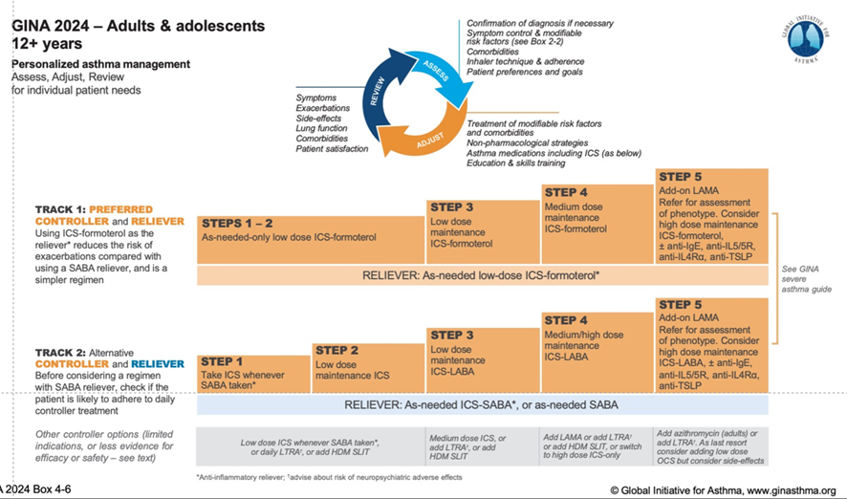
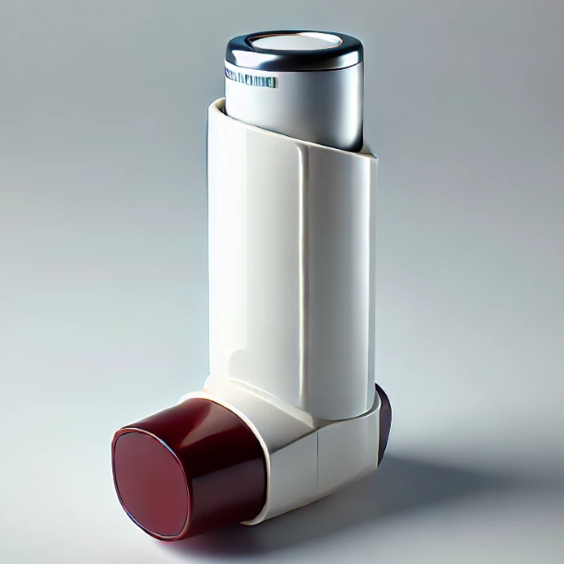

John’s reassessment
John returns to the pharmacy after a few weeks, having made changes to his treatment.
His doctor has taken him off the salbutamol inhaler.
As a maintenance treatment, he has been prescribed an ICS/formoterol combination, budesonide 160 mcg/formoterol 4.5 mcg 1 puff/12 h daily dosage. Additionally, it is used as a rescue as needed. This time he has prescribed it in a pMDI as John prefers it, since he says that he is more familiar with this type of device.
The doctor has made an appointment for him in 3 months for a follow-up visit.
Global Initiative for Asthma. Global Strategy for Asthma Management and Prevention. [Internet]. 2024. [accessed: 2 February 2025]. Available at: https://ginasthma.org/2024-report/

Slide 32
New treatment, new inhaler
The pharmacist dispenses the inhaler and wants to explain how to use it, but John tells him that he has used pMDI previously and that's why he already knows how to do it.
What should the pharmacist do in this case?
Do not insist, and simply dispense the inhaler.
Give it to him in order to take the first dose and then watch him use it
Schedule an appointment to check that John is using his inhaler properly
When a person shows inadequate asthma control, the initial step is to assess their inhaler technique and ensure adherence to its use. Studies have shown that the prevalence of incorrect inhaler technique, with at least one critical mistake, can be as high as 80%. Factors contributing to poor or incorrect inhaler techniques include the use of multiple inhalers, age, cognitive ability, manual dexterity, and the coordination between inhaler actuation and inhalation
Sanchis J, Gich I, Pedersen S; Aerosol Drug Management Improvement Team (ADMIT). Systematic Review of Errors in Inhaler Use: Has Patient Technique Improved Over Time? Chest. 2016 Aug;150(2):394-406. doi: 10.1016/j.chest.2016.03.041. Epub 2016 Apr 7. PMID: 27060726.
International Pharmaceutical Federation. Chronic respiratory diseases: A handbook for pharmacists. The Hague: International Pharmaceutical Federation; 2022 [accessed: 8 feb 2025]. Available at: https://ncd.fip.org/fip-practice-transformation-programme-on-ncds/publications/

Slide 33
New treatment, new inhaler
The pharmacist dispenses the inhaler and wants to explain how to use it, but John tells him that he has used pMDI previously and that's why he already knows how to do it.
What should the pharmacist do in this case?
Do not insist, and simply dispense the inhaler.
Give it to him in order to take the first dose and then watch him use it
Schedule an appointment to check that John is using his inhaler properly
When a person shows inadequate asthma control, the initial step is to assess their inhaler technique and ensure adherence to its use. Studies have shown that the prevalence of incorrect inhaler technique, with at least one critical mistake, can be as high as 80%. Factors contributing to poor or incorrect inhaler techniques include the use of multiple inhalers, age, cognitive ability, manual dexterity, and the coordination between inhaler actuation and inhalation
Sanchis J, Gich I, Pedersen S; Aerosol Drug Management Improvement Team (ADMIT). Systematic Review of Errors in Inhaler Use: Has Patient Technique Improved Over Time? Chest. 2016 Aug;150(2):394-406. doi: 10.1016/j.chest.2016.03.041. Epub 2016 Apr 7. PMID: 27060726.
International Pharmaceutical Federation. Chronic respiratory diseases: A handbook for pharmacists. The Hague: International Pharmaceutical Federation; 2022 [accessed: 8 feb 2025]. Available at: https://ncd.fip.org/fip-practice-transformation-programme-on-ncds/publications/

Slide 34
New visit
The pharmacist schedules a new visit to coincide with the next renewal of John's maintenance treatment, when he will be about to finish the inhaler dispensed.
John returns to the pharmacy earlier than he theoretically should have done, since according to the electronic prescription records the new container is not available for dispensing yet.
The patient tells the pharmacist that he has had to use the inhaler many times because he does not notice its effects, he has not noticed any improvement in his symptoms, and now he also suffers from throat discomfort, hoarseness and aphonia.
The pharmacist tells John that it is very important to know how he is using his inhaler, before referring him back to the doctor. Even though he is not very convinced by it, John agrees to use a placebo to show the pharmacist how he usually uses his inhaler.

Slide 35
Inhaler use demonstration
The device that John uses is a pMDI, and in theory he is familiar with its use.
However, after seeing the demonstration that he gave with a placebo, the pharmacist observes three critical errors:
He does not completely empty his lungs before inhalation.
He inhales too quickly and too forcefully. This is probably because he remembers how to use dry powder devices and repeats the same technique.
In addition, he does not correctly coordinate the pressing of the cartridge with the inhalation. When he puffs, he stops inhaling.
Because it is such a quick and short inhalation, there is a high impact of the propellant delivered in the oropharynx, which can produce the signs reported by the patient.
The pharmacist believes that John could have used pMDIs incorrectly for years.
https://www.ipcrg.org/resources/inhaler-resources

Slide 36
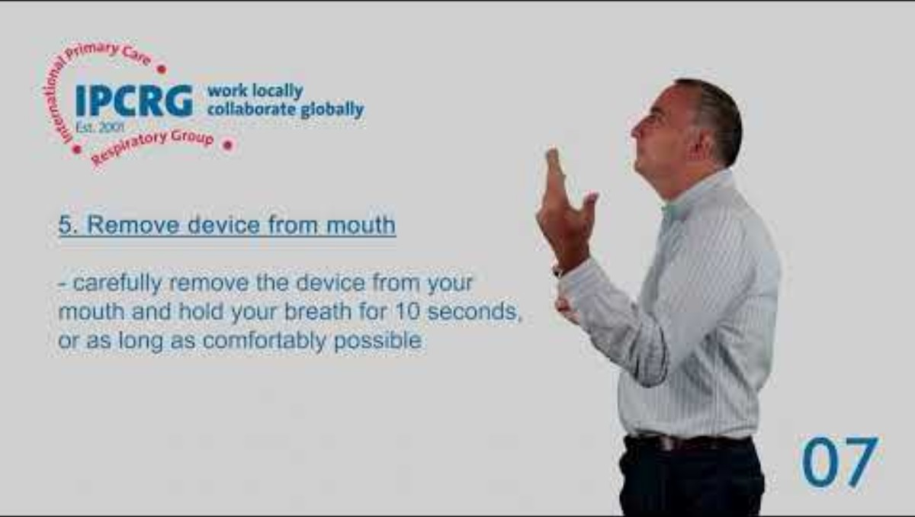
How to use a pMDI
https://www.ipcrg.org/resources/inhaler-resources

Slide 37
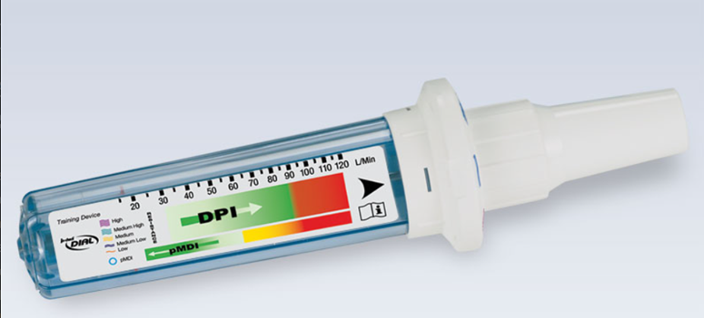
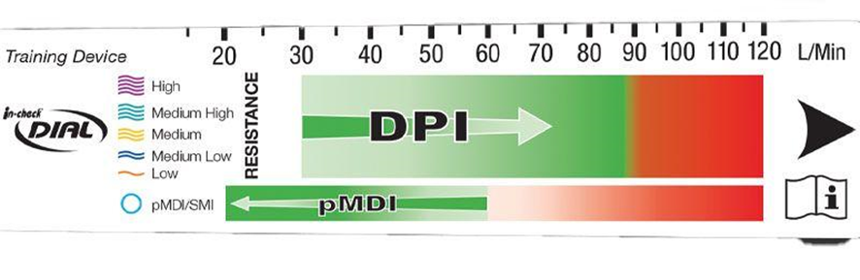
Instructing John on the correct technique
The pharmacist may instruct the patient on the correct technique for using a pMDI, using an In-check Dial G16 device. The use of this tool has more value for Dry powder Inhalers (DPI); however, its use could also be significant in teaching the patient how to use any inhaler.
Using this tool, the pharmacist teaches the patient the inhalation flow required for the proper use of a pMDI, emphasising that the inhalation flow must be slow and steady over 3 to 5 seconds.
In any case, if the patient has difficulty achieving correct coordination between inspiration and pulsation, the most advisable option is the use of a spacer chamber.
Clement Clarke International Ltd. In-check Dial G16 device. [device]. 2025 [cited 2025 Feb 8]. Available from: [URL, hop.clement-clarke.com/ProductDetails/tabid/122/ProductID/84/Default.aspx]

Slide 38
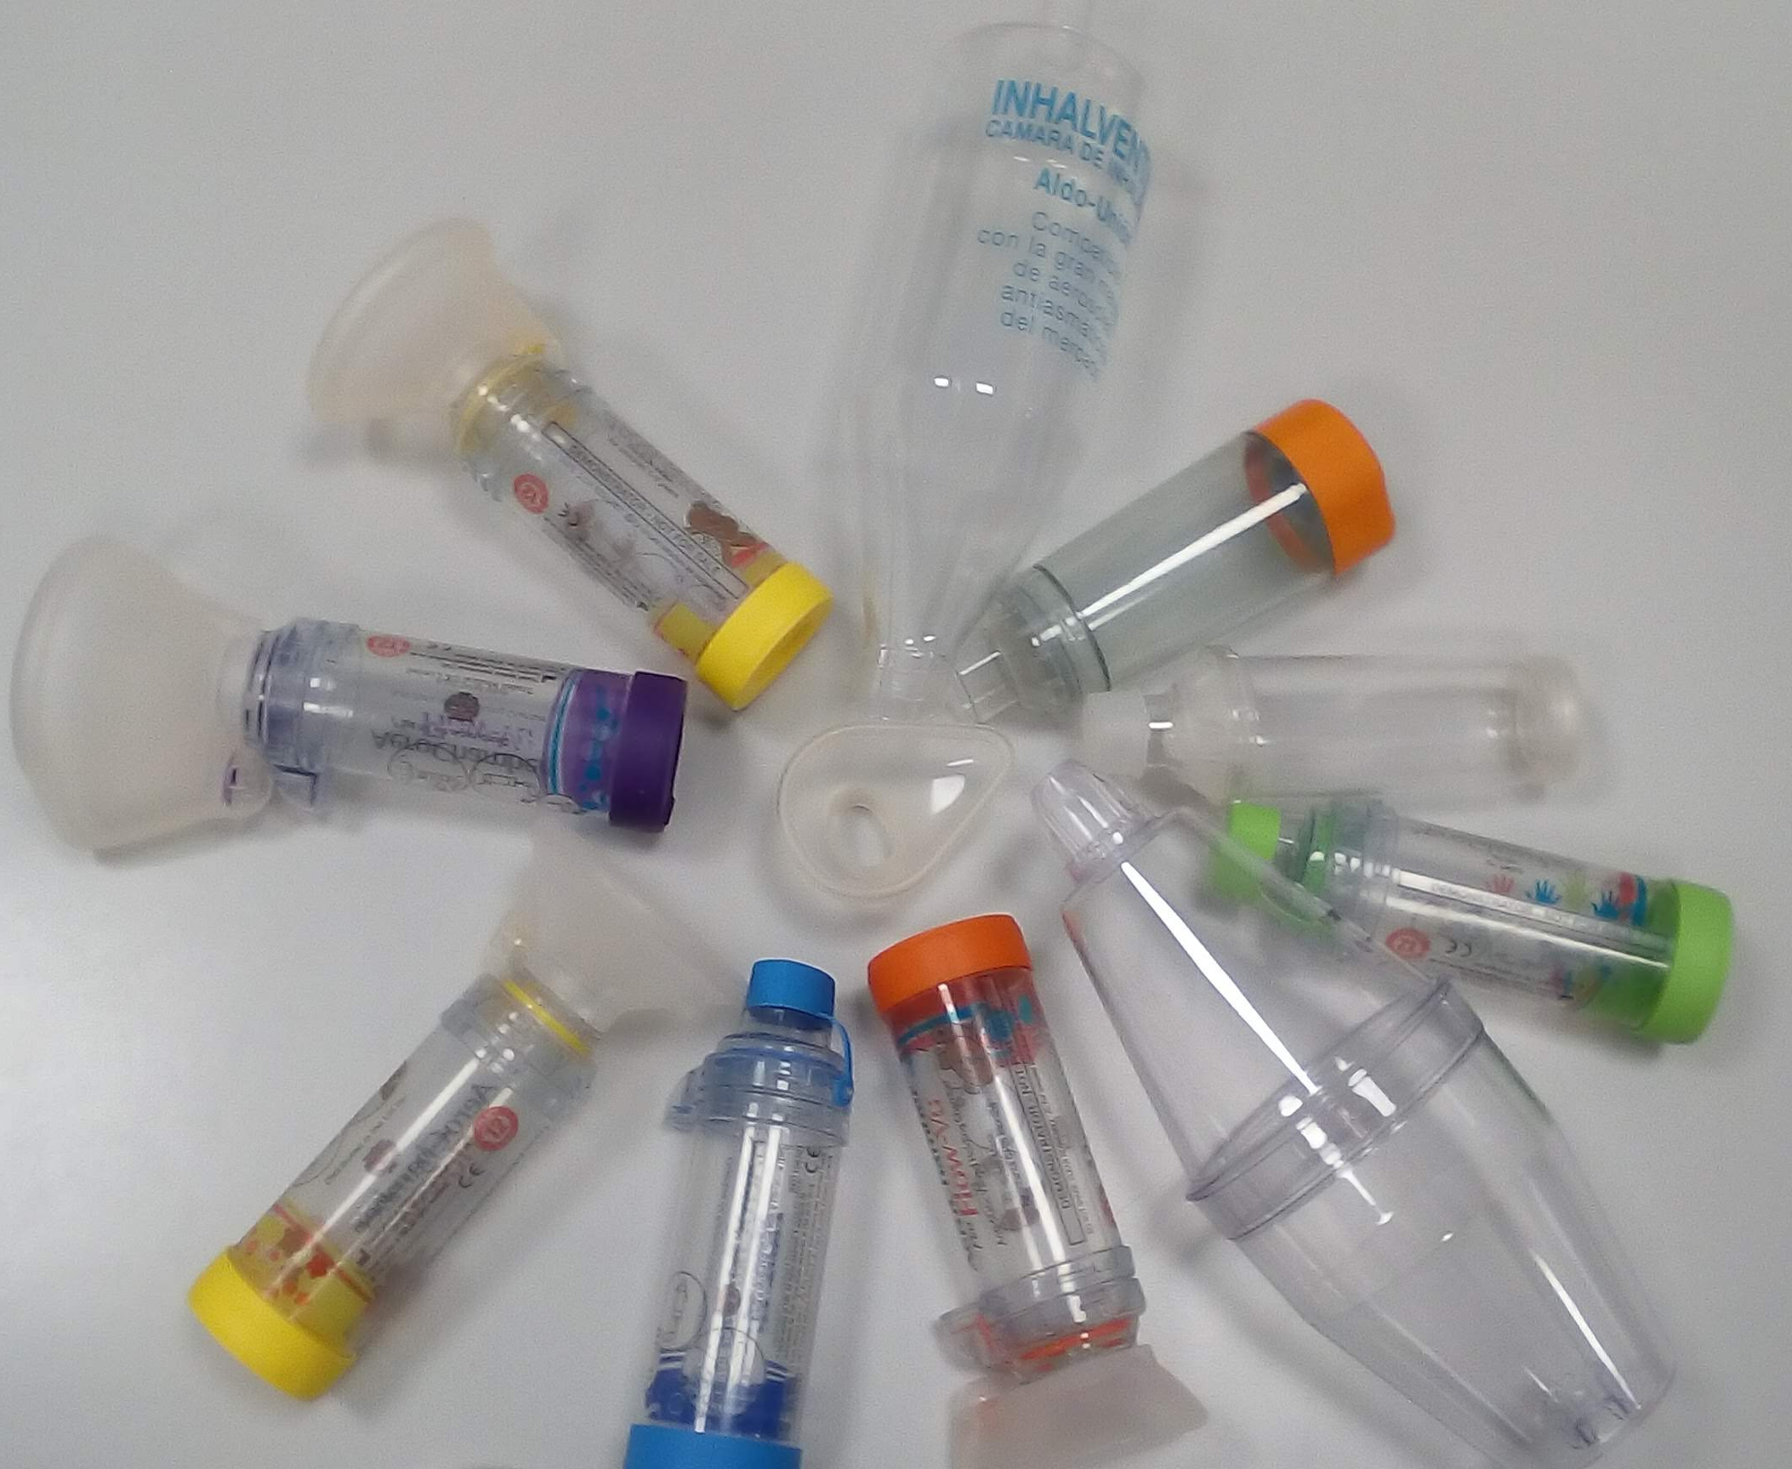
Spacer
A spacer, or holding chamber, is an attachment that should always be used with pMDI inhalers, as this allows the medicine to be contained within the hollow tube after dispensing the dose, slowing down the speed and allowing the patient to inhale the medicine slowly.
Given John's difficulties in properly coordinating the release of the dose with inhalation, the pharmacist suggests him to use his pMDI in conjunction with a new modern spacer chamber. John accepts it.
International Primary Care Respiratory Group (IPCRG). 7 Steps to Using a Metered Dose Inhaler and Medium Spacer (Front View) - 1 min. [video]. 2025 [cited 2025 Feb 8]. Available from: https://www.ipcrg.org/resources/search-resources/7-steps-to-using-a-metered-dose-inhaler-and-medium-spacer-front-view-1min
Image gallery International Primary Care Respiratory Group (IPCRG) Available at: https://www.ipcrg.org/gallery

Slide 39
Steps to use spacers with a pMDI are:
1. Prepare the Inhaler and Spacer - remove the mouth piece cover, examine for foreign objects, check expiry date and dose counter - prime inhaler on first use (according to manufacturer’s instructions)
2. Prepare or Load the Dose - shake the inhaler and insert into the spacer device
3. Breathe OUT fully and gently away from the device - form a seal with your lips around the spacer, tilt the chin up slightly and place spacer between your teeth without biting it
4. Breathe IN - Press down on the pMDI and breathe in slow and steady for 3-5 seconds (whatever feels comfortable)
5. Remove device from mouth - carefully remove the device from your mouth and hold your breath for 10 seconds, or as long as comfortably possible
6. Breathe OUT - Exhale and wait 30-60 seconds before taking a second dose (if required)
7. Rinse/gargle mouth if using inhaled corticosteroids

Slide 40
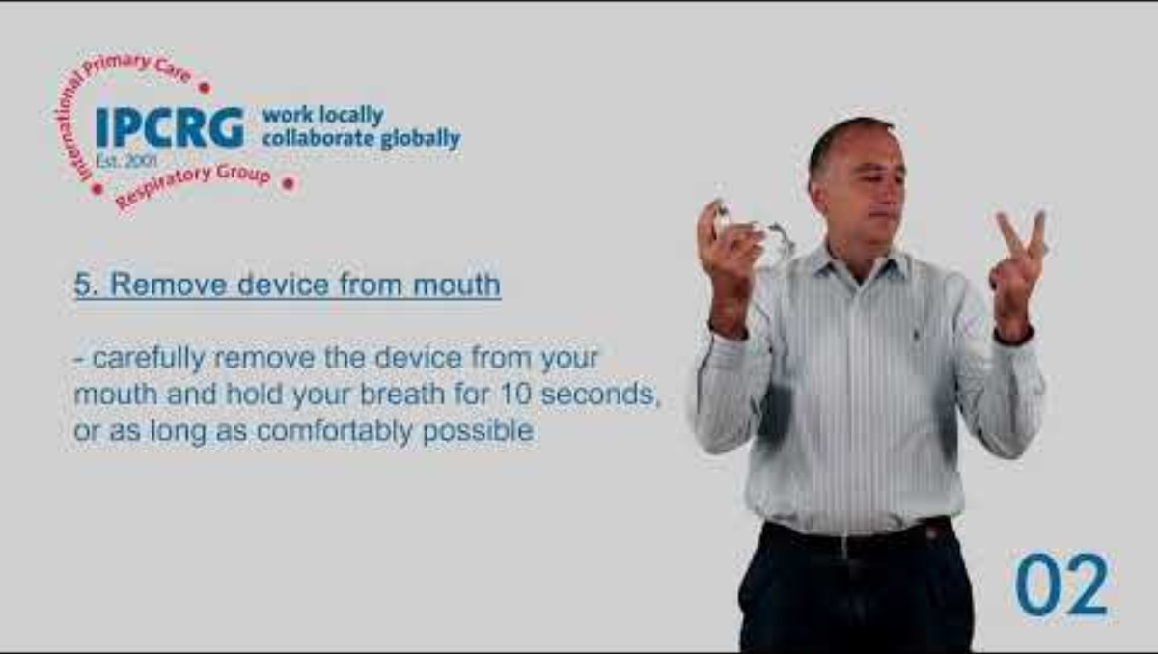
How to use a pMDI with a large spacer
https://www.ipcrg.org/resources/inhaler-resources

Slide 41
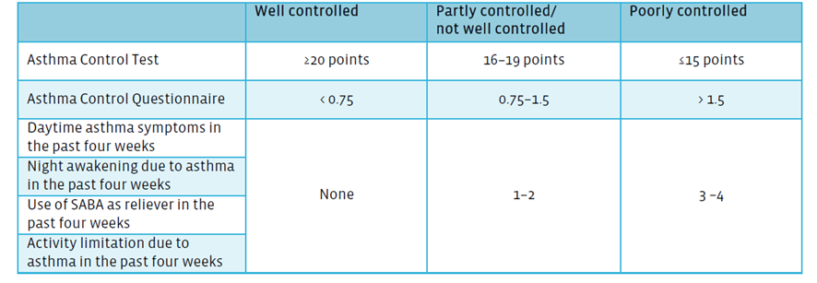

Asthma Control Test
John returns to the pharmacy two months after the follow-up visit with his doctor and tells the pharmacist that his symptoms are completely under control, that he practically never has to use his inhaler as a rescue measure, and that he leads a normal life, doing more sports than ever.
The pharmacist checks with a quick series of questions, and by applying the ACT he confirms that this is really the case.
Nathan, R. A., Sorkness, C. A., Kosinski, M., Schatz, M., Li, J. T., et al. (2004). Development of the asthma control test: a survey for assessing asthma control. The Journal of Allergy and Clinical Immunology, 113(1), 59-65. https://doi.org/10.1016/j.jaci.2003.09.008.
Global Initiative for Asthma. Global Strategy for Asthma Management and Prevention. [Internet]. 2024. [accessed: 2 February 2025]. Available at: https://ginasthma.org/2024-report/

Slide 42
Lack of treatment adherence
John returns to the pharmacy 5 months later to pick up his inhaler.
The pharmacist checks the electronic prescription records to see that he has not picked up his treatment for 3 months.
The pharmacist asks him about this situation, and he says that because he was feeling so well and experiencing no symptoms, he thought he was cured and stopped using the inhaler completely. In addition, a friend explained to him that because his treatment contained a corticosteroid, he could not take it for a long time. Now his symptoms have returned, and he needs the maintenance treatment again.
Non-adherence to treatment is one of the problems that we also face in patients with asthma. It is estimated that only 50% of patients use their maintenance treatment daily. Pharmacists can play a crucial role in reversing this trend, overcoming the reluctance that certain patients have to using corticosteroids on a regular basis by explaining that with a correct inhalation technique and subsequent mouthwash, the side effects are minimal and, of course, the doses are insignificant, even if used daily, when compared to the oral doses that are administered in cases of severe exacerbation. In addition, the pharmacist should remind his patients that treatment with inhaled corticosteroids is the best way to reduce the inflammation of the airways
Price D, Fletcher M, van der Molen T. Asthma control and management in 8,000 European patients: the REcognise Asthma and LInk to Symptoms and Experience (REALISE) survey. NPJ Prim Care Respir Med. 2014 Jun 12;24:14009. doi:10.1038/npjpcrm.2014.9
Global Initiative for Asthma. Global Strategy for Asthma Management and Prevention. [Internet]. 2024. [accessed: 2 February 2025]. Available at: https://ginasthma.org/2024-report/

Slide 43
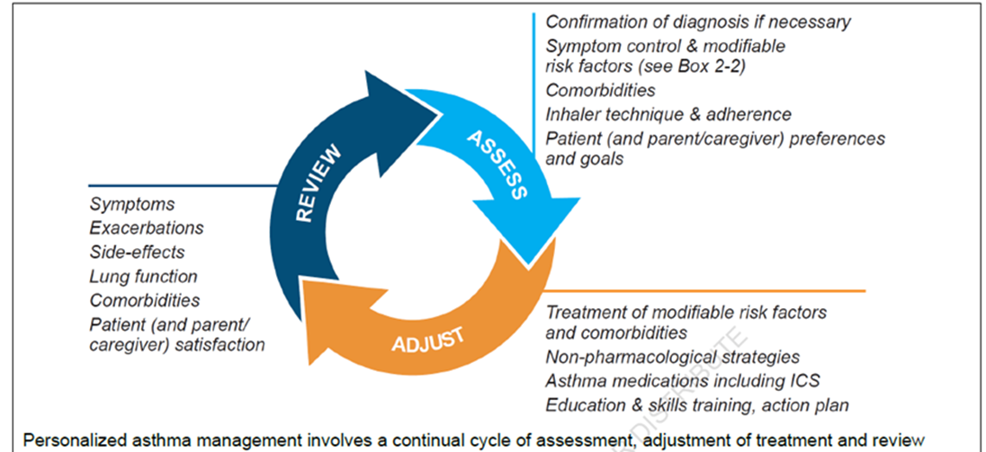
Asthma, a chronic condition
John finally understands that he must restart his control treatment and can only reduce the dosage or use after his doctor has evaluated his symptoms and the degree of control of his asthma. Additionally, there are some non-pharmacological strategies available to John that can help him to keep his condition under control, such as informing him about medicines that may make asthma worse, and trigger avoidance.
Asthma is a diverse condition marked by a chronic inflammation in the airways. Consequently, an individual with asthma aims to achieve good control over their condition through proper management. While some patients may experience clinical remission, particularly during childhood and adolescence, asthma frequently returns later in life.
While medication plays a crucial role in asthma management, it is essential to consider other key strategies to control symptoms and reduce the risk of adverse outcomes
In conclusion, asthma is a long-term condition, and remission does not equate to a cure.
Global Initiative for Asthma. Global Strategy for Asthma Management and Prevention. [Internet]. 2024. [accessed: 2 February 2025]. Available at: https://ginasthma.org/2024-report/

Slide 44
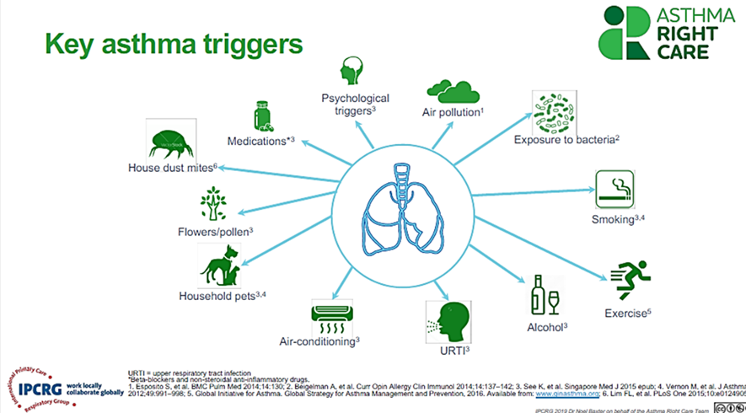
Non-pharmacological strategies
While medication plays a crucial role in asthma management, it is essential to consider other key strategies to control symptoms and reduce the risk of adverse outcomes. Therefore, it is critical to emphasise non-pharmacological approaches for asthma patients, as medication alone is insufficient for controlling asthma symptoms.
There is a long list of non-pharmacological strategies to put in place in asthma management. Some of them may be applied in the pharmacy setting, such as:
- Inform about medicines that may make asthma worse (e.g., beta-blocker medicines, aspirin and other NSAIDs).
- Advise on asthma and support the management of occupational asthma with identification and avoidance of allergen exposure as early as possible.
- Inform patients about trigger avoidance.
- Advise on smoking cessation.
Global Initiative for Asthma. Global Strategy for Asthma Management and Prevention. [Internet]. 2024. [accessed: 2 February 2025]. Available at: https://ginasthma.org/2024-report/

Slide 45
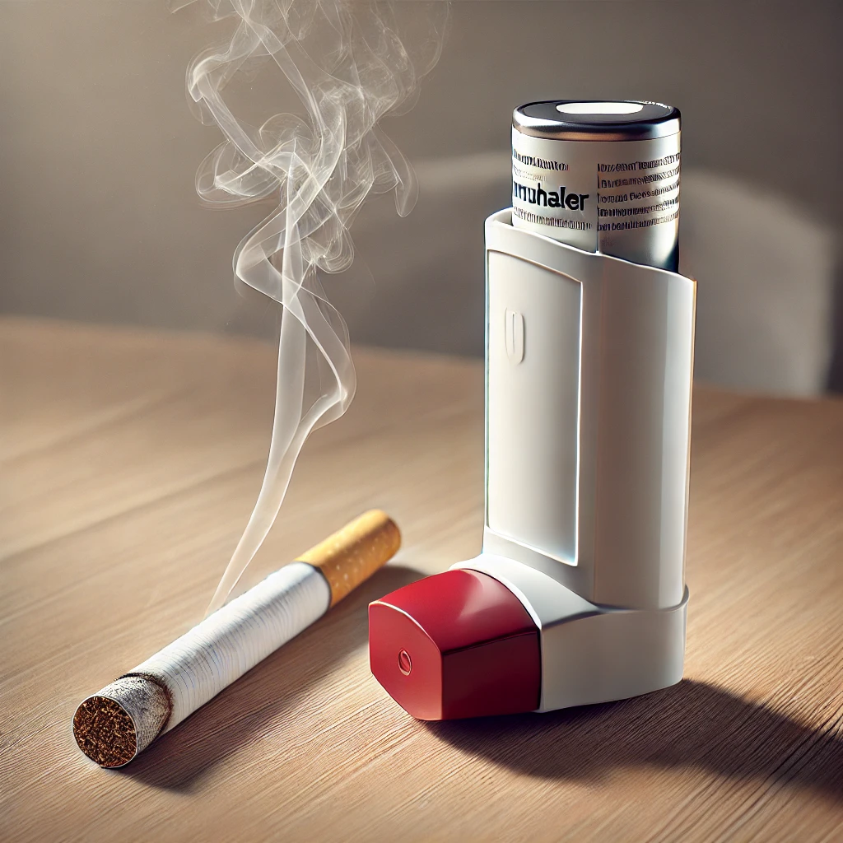
Smoking cessation
Tobacco has multiple harmful effects on asthma patients. Consequently, one of the most important non-pharmacological treatments would be smoking cessation if the patient is an active smoker. More information on smoking cessation is available here - http://ipcrg.org/tobacco-dependence
Pharmacists can help asthma patients by encouraging them to quit smoking, advising on smoking cessation programs, referring them to a family doctor, or offering the smoking cessation service that some pharmacies provide. In any case, patients with asthma should always avoid secondhand smoke, as it is one of the most significant triggers
Smoking as a Risk Factor: Exposure to tobacco smoke is listed among the major risk factors for asthma exacerbations, poor symptom control, and the development of persistent airflow limitation.
Impact on Asthma Outcomes: Smoking (including active smoking and secondhand exposure) worsens asthma symptoms, increases the frequency and severity of exacerbations, and reduces the effectiveness of inhaled corticosteroids (ICS) and other asthma medications
Bearing in mind that John is not a smoker, what the pharmacist should do in this case is to tell John to avoid passive exposure to smoke since it could trigger or worsen his symptoms.
Global Initiative for Asthma. Global Strategy for Asthma Management and Prevention. [Internet]. 2024. [accessed: 2 February 2025]. Available at: https://ginasthma.org/2024-report/
IPCRG Tobacco Dependence http://ipcrg.org/tobacco-dependence

Slide 46
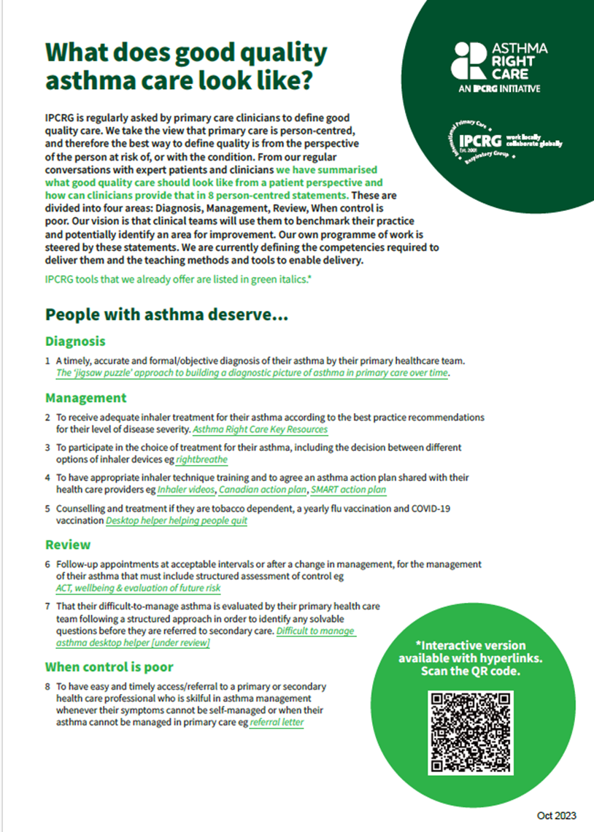
People with asthma deserve…
IPCRG is regularly asked by primary care teams to define good quality care.
We take the view that primary care is person-centred, and therefore the best way to define quality is from the perspective of the person at risk of, or with the condition.
From our regular conversations with expert patients and clinicians we have summarised what good quality care should look like from a patient perspective and how can clinicians provide that in 8 person-centred statements.
These are divided into four areas: Diagnosis, Management, Review, When control is poor.
Our vision is that clinical teams will use them to benchmark their practice and potentially identify an area for improvement.
Our own programme of work is steered by these statements. We are currently defining the competencies required to deliver them and the teaching methods and tools to enable delivery.
https://www.ipcrg.org/asthmarightcare/what-does-good-quality-asthma-care-look-like

Slide 47
Summary
Main points to develop during the patient journey from the perspective of a community pharmacist:
1. Case-finding and referral of undiagnosed patients with asthma.
2. Monitoring and referring patients with asthma.
Identification of risk factors and triggers as well as patients with uncontrolled or poorly-controlled asthma. ACT, Peak Flow Meter
3. Pharmacological treatment of asthma.
Correct and appropriate use of inhalers is essential in maintaining control of asthma.
Identification of patients over-reliant on relievers (SABAs): RRT, and Asthma Slide Rule.
Identification of patients with low adherence to anti-inflammatory treatments.
Improving medication acceptance and adherence.
Consideration that a doctor’s prescription is necessary before dispensing SABA: SABA guardians.
4. Non-pharmacological management.
Medicines that may make asthma worse (e.g., beta-blocker medicines, aspirin and other NSAIDs).
Advise on asthma and support the management of occupational asthma with identification and avoidance of allergen exposure as early as possible.
Inform patients about trigger avoidance.

Slide 48
Learning objectives
By the end of this session, participants should be able to:
Identify at least two appropriate actions a community pharmacist can take during the first contact to identify a potential asthma patient and describe one specific non-pharmacological measure they could initially recommend.
Sequence the key interventions a community pharmacist can undertake, explain the rationale behind at least one specific intervention in a follow-up visit, and identify at least one scenario where a referral to the GP would be a necessary step for joint asthma control.
List three potential indicators a community pharmacist might observe during an initial patient contact that could suggest possible asthma and describe how a community pharmacist can explain one prescribed first-line asthma treatment and one initial non-pharmacological measure to a patient. Furthermore, participants should be able to identify one example of a community pharmacist intervention during a follow-up visit and explain how the results of such an intervention might influence a subsequent referral to the GP.
Further information can be accessed at https://www.ipcrg.org/asthmarightcareforpharmacists and https://www.ipcrg.org/asthmarightcare

