Slide 2

EUROPEAN UNION OF MEDICAL SPECIALISTS (UEMS)
EUROPEAN ACCREDITATION COUNCIL ON CME (EACCME®)
Rue de l’Industrie 24, BE- 1040 BRUSSELS
T + 32 2 649 51 64 - F + 32 2 640 37 30
https://eaccme.uems.eu - accreditation@uems.eu
Conflict of Interest Disclosure Form
Amanda Barnard- I have received funding from Astra Zeneca for facilitating online workshops in 2024
Dermot Ryan
In accordance with criterion 13 of document UEMS 2023/07 “EACCME® Criteria for the Accreditation of Live Educational Events (LEEs)”, all declarations of perceived or actual conflicts of interest for the last 3 years, whether due to a financial or other relationship, must be provided to the EACCME® upon submission of the application. COI declarations signed more than 6 months before the date of the event will not be accepted. Declarations must be made available online on the event website of the LEE. Declarations must include whether any fee, honorarium or arrangement for re-imbursement of expenses in relation to the LEE has been provided.

Slide 3

Building a diagnostic picture of asthma in primary care: Development of a novel jigsaw puzzle approach
Dermot Ryan Amanda Barnard
Siân Williams, Janwillem Kocks,
Jaime Correia de Sousa

Slide 4
Workshop outline
PART 1
What is a jigsaw (puzzle)
Why did we do it
How did we do it
What it is
What next
PART 2
Small group work – applying the jigsaw strategy
to a presented case
to a patient you’ve found diagnostically challenging

Slide 5

What is a jig-saw puzzle?
CREATING ORDER……
…………FROM CHAOS

Slide 6
What did we do?
We produced a short, accessible, comprehensible aid
reflecting medical practice and locally adaptable,
to facilitate and enhance clinical reasoning.

Slide 7

Why did we do it?
making a diagnosis is a critical diagnosis
if the diagnosis is incorrect, patients receive
the wrong treatment
If the diagnosis is wrong, patients will not
receive the correct treatment
current guidelines are complex and confusing ¹
there is a great educational need
2
A different approach is needed
Cabana MD, Rand CS, Powe NR, et al. Why don’t physicians follow clinical practice guidelines? JAMA 1999; 282: 1458–1465
Ryan D et al. Results of an allergy educational needs questionnaire for primary care. Allergy. 2017 Jul;72(7):1123-28. doi: 10.1111/all.13134

Slide 8

Current level of Asthma control In Primary Care
Well Contolled | 20%
Partially controlled | 34.8%
Uncontrolled | 45.1%
Prim Care Resp Med 24, 14009 (2014).
https://doi.org/10.1038/npjpcrm.2014.9

Slide 9
Overdiagnosis is common
Asthma overdiagnosis
Reevaluation of diagnosis in adults with physician-diagnosed asthma
Multicentre cohort study, enrolling 701 randomly selected adults with physician-diagnosed asthma in the previous five years
Findings:
  current asthma was excluded in 33% of the 613 participants who completed the study
  28% asymptomatic
  25% rhinitis
Asthma Diagnostic
Consultation Service
Referred with Asthma n=644
Confirmed asthma n=277
No asthma n=338
Diagnoses rhinitis n=99
GERD n=55
post infectious cough n=54
smokers cough n=15
Non pulmonary diagnosis n=39
GP referral
Definite asthma
43
Asthma 17
No Airway Narrowing 11
Restrictive 9
Other 6
62% not asthma
GP Referral
Suspected asthma
99
33% not asthma
Asthma 11
No Airway Narrrowing 70
88% not asthma
55% not asthma
Restrictive 7
COPD 2
Other 9
Aaron SD et al. JAMA 2017; 317(3): 269–279.
Gillis et al. PCRJ 2017
Starren et al PCRJ, 2012

Slide 10
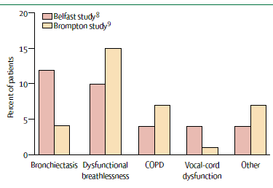
Over-diagnosis
in Tertiary Care ≅ 30%
Lancet 2005;365:974-76

Slide 11
Great Educational Need
Ryan D et al. Results of an allergy educational needs questionnaire for primary care. Allergy. 2017 Jul;72(7):1123-28. doi: 10.1111/all.13134.

Slide 12
Why do we need a different approach?
•
The diagnosis of asthma is not always straight forward
The initial diagnosis of asthma is based on
  the combination of presence of characteristic symptoms (cough, dyspnea, chest tightness and wheeze),
  demonstration of airflow limitation and variability
Diagnostic errors arise because:
  day to day variability of symptoms and the numerous phenotypes of disease
  Reliance on a single diagnostic symptom e.g.cough
  failure to confirm reversible airflow obstruction,
  poor sensitivity of spirometry alone to confirm asthma

Slide 13

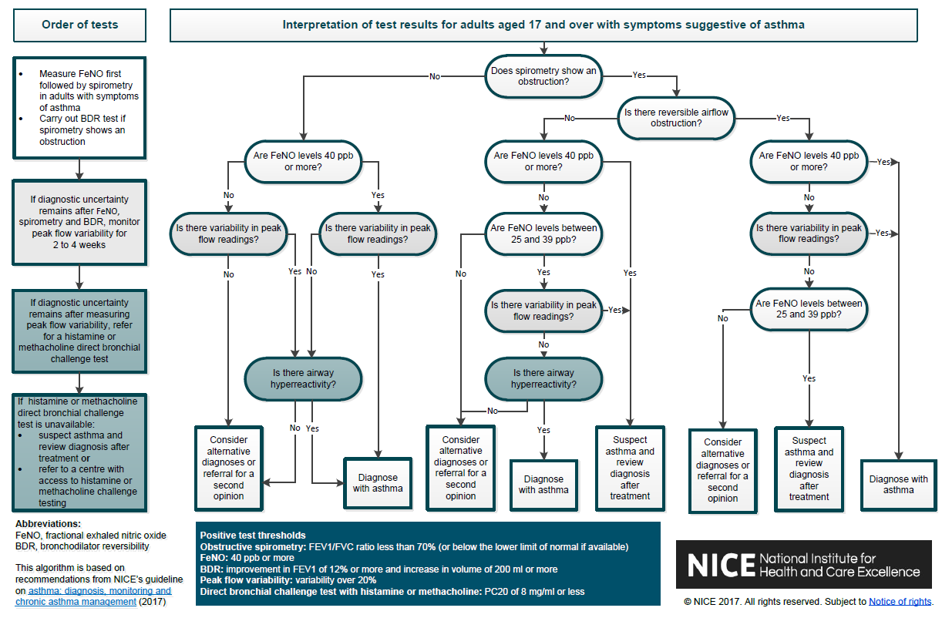
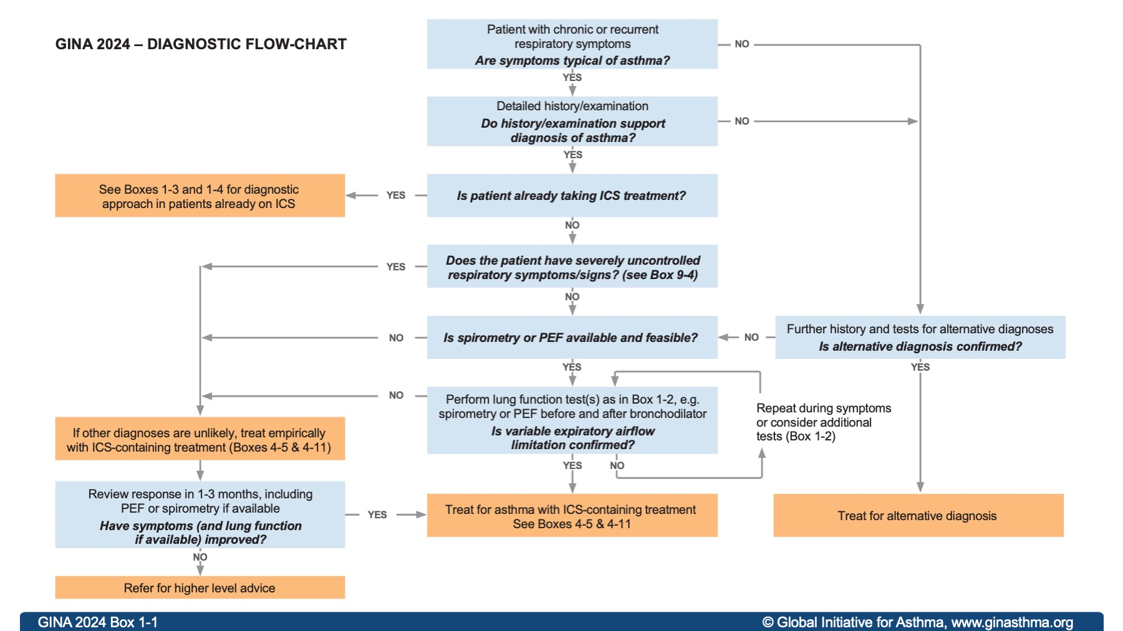
Current guidelines create complexity and confusion
GINA 2024
NICE, UK, 2017

Slide 14
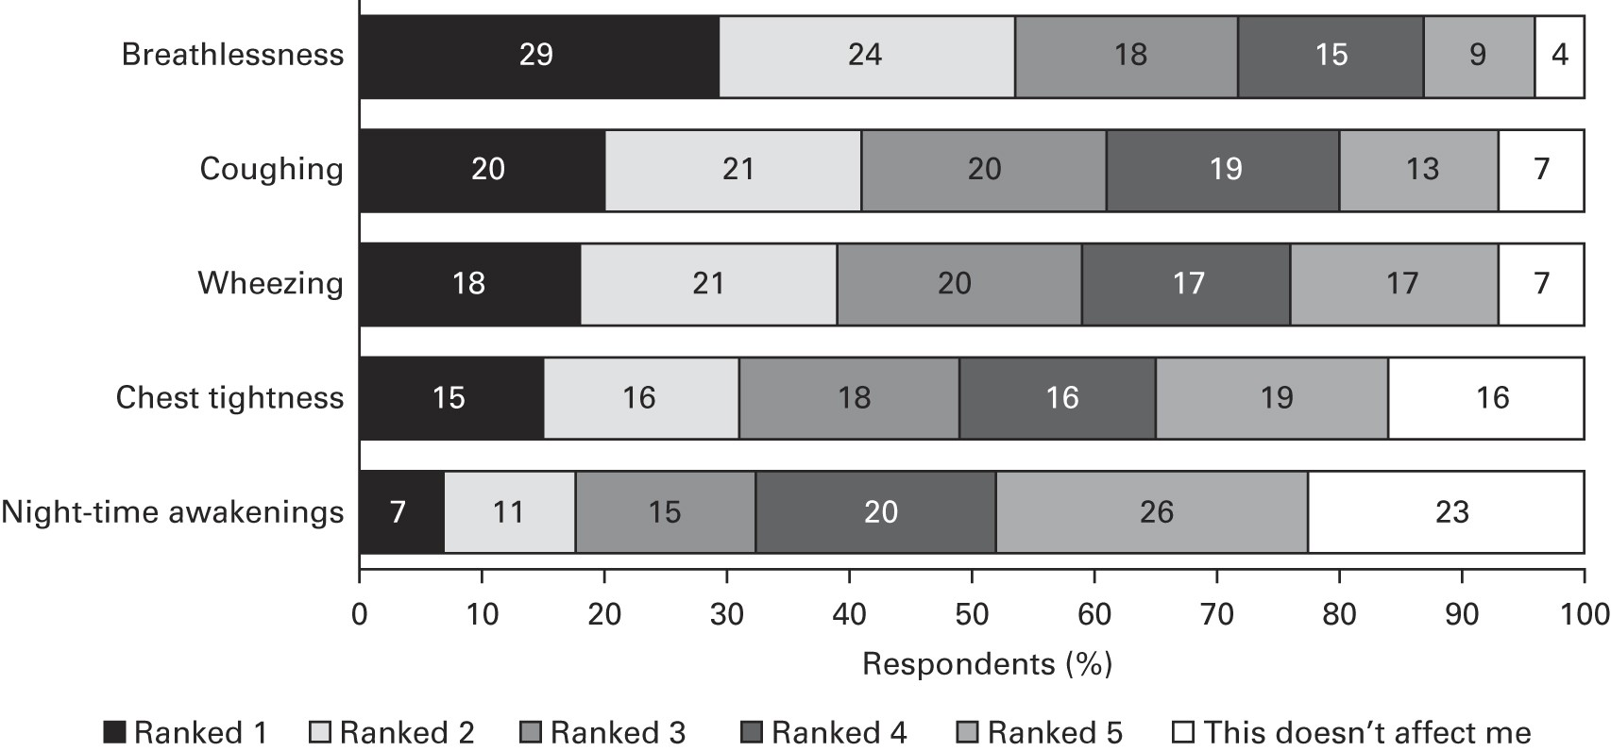
Individual symptom priority n=8000
Note: not everyone
has all symptoms
symptom combinations are critical
Prim Care Resp Med 24, 14009 (2014). https://doi.org/10.1038/npjpcrm.2014.9
Notes:
Price, D., Fletcher, M. & van der Molen, T. Asthma control and management in 8,000 European patients: the REcognise Asthma and LInk to Symptoms and Experience (REALISE) survey. npj Prim Care Resp Med 24, 14009 (2014). https://doi.org/10.1038/npjpcrm.2014.9

Slide 15
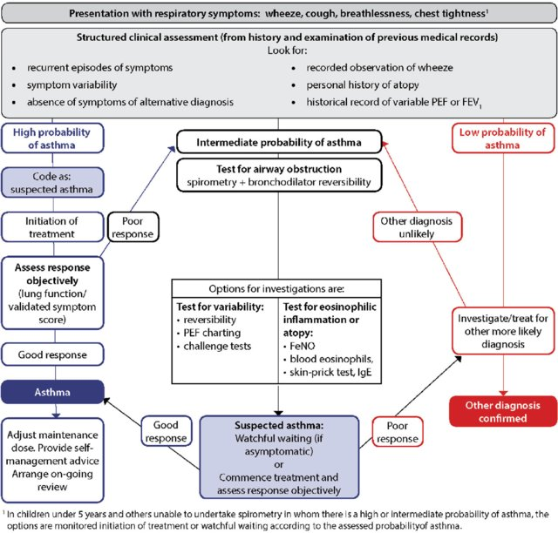
SIGN/BTS Guideline: stratifies
Clinical table of key symptoms: wheeze, cough, shortness of breath, chest tightness
Highly likely to be asthma
Possiblity of asthma
Asthma unlikely
Notes:
note prioritization of probability

Slide 16

Information is presented without structure
Viral infection
Response
to treatment
Passive
smoking
Birth eg prematurity
Adherence
Sx
Tight
chest
Nocturnal
Hobbies
Salicylate hypersensitivity
Exercise
intolerance
Cough
Occupation
Reversibility
Eczema
Exercise
Sx
Tobacco depen
dence
Eosinphilia
Hayfever
FeNO
Family
history
Allergic
sensitis- ation
Fatigue
Rhinitis
Wheeze
Atopy
Notes:
https://www.clipartmax.com/download/m2H7G6H7A0K9b1i8_jigsaw-puzzles-template-coloring-book-puzzle-video-jigsaw-puzzle/

Slide 17

How did we do it?
How did we fit it
Together?

Slide 18



We held a half-day ‘puzzle’ workshop
Four working groups (international) in two rounds negotiated and categorized jigsaw pieces most relevant for building a clinical picture of asthma
This process can be repeated and adapted at national level - local context
Presentation
Symptoms and
physical examination
History
Objective tests
https://www.youtube.com/watch?v=jguPHc8XHDE

Slide 19
Our aims were:
1 Use a (jigsaw) puzzle as an analogy for building a picture over time, which better represents clinical practice
2. Describe the process of defining the format and content of this approach with
the aim of improving the quality of asthma diagnosis in primary care and
to use in IPCRG education work (Desktop Helper)

Slide 20
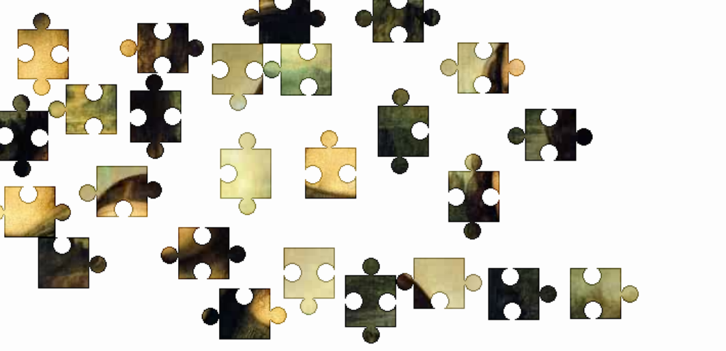
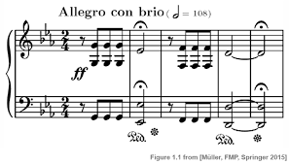
In reality, patients present many complex
pieces of information (puzzle pieces)
…all the right notes ♬,🎶, ♬
not necessarily in the right order !!
http://www.jigzone.com/puzzles/BA055D4CF4A2

Slide 21
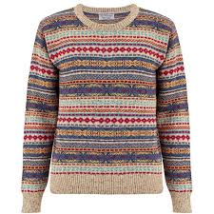


How do we make sense of this?

Slide 22
Defining the content for asthma diagnosis
Presentation
Symptoms and physical examination
History
Objective tests
Why has the person come to see you?
Ask about symptoms & conduct physical exam
Personal and family
Airway dysfunction,
Biomarkers
These factors and their relative importance may differ at national level
BD, bronchodilator.

Slide 23
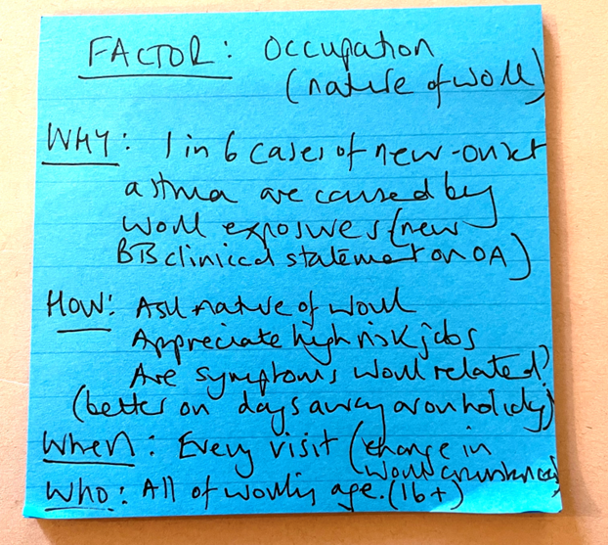
Puzzle piece: Occupation (example) Each group was asked to suggest pieces using this format
WHY? | How will it influence decision-making?
HOW? | How will you elicit it? (question, test, observation, other); How will you interpret the answer? How will you code it?
WHEN? | When would you ask? (first consultation, subsequent, every time, once…)
WHO? | All, child, adult, sub-group?

Slide 24
Defining the content for asthma diagnosis
Presentation
Symptoms and physical examination
History
Objective tests
Why has the person come to see you?
Examples:
Tight chest
Wheeze
Cough
‘Infection’
Breathless
Chest pain
Ask about symptoms & conduct physical exam
Examples:
Wheeze
Night-time symptoms
Fatigue
Exercise intolerance
Personal and family
Examples:
Occupation
Atopy
Smoking
Hobbies
Rhinitis
Airway dysfunction,
Biomarkers
Examples:
Spirometry with reversibility
Serial peak flow
Microspirometry
Other: FeNO, biomarkers
These items are not exhaustive
BD, bronchodilator.

Slide 25
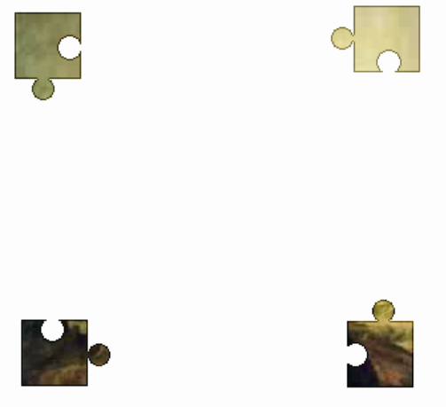
Using the jigsaw metaphor ….
Symptoms and
Physical examination
Presentation
Allocating puzzle piece to each of the domains
(“corner pieces”) as it is acquired
History
Objective tests

Slide 26
Some people prefer starting with the corners ….
Symptoms and
Physical examination
Presentation
Building the picture or assembling the information,
problem solving approach
History
Objective tests

Slide 27
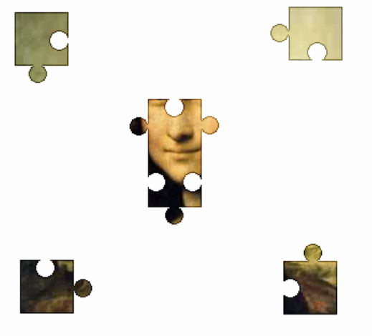
Sometimes we find clinical clue combinations that are so relevant, they almost allow us to see the whole picture right away

Slide 28

Even if not all the clinical signs and symptoms are present, the diagnosis may be obvious

Slide 29

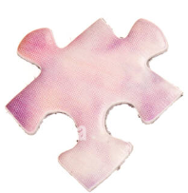

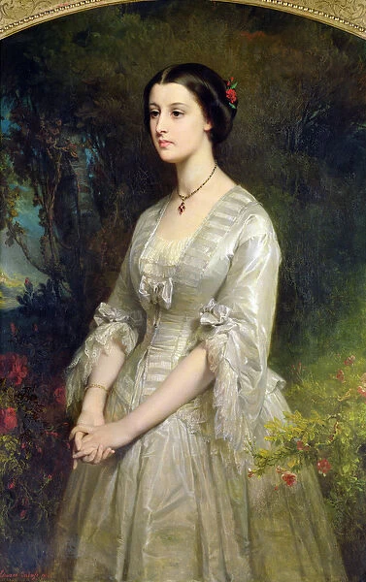
Some clinical signs and symptoms might not fit in the overall picture
Pieces which do not fit
should prompt a search for
another picture/
alternative diagnosis
Productive cough
Paraesthesia

Slide 30

Now we are fairly sure….
? something missing ?

Slide 31

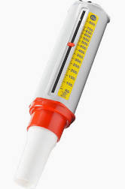
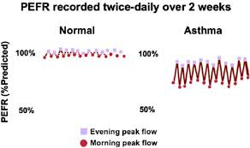
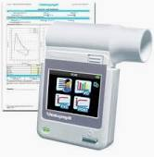
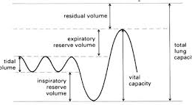
Now we have the whole picture
Evidence of airways dysfunction

Slide 32

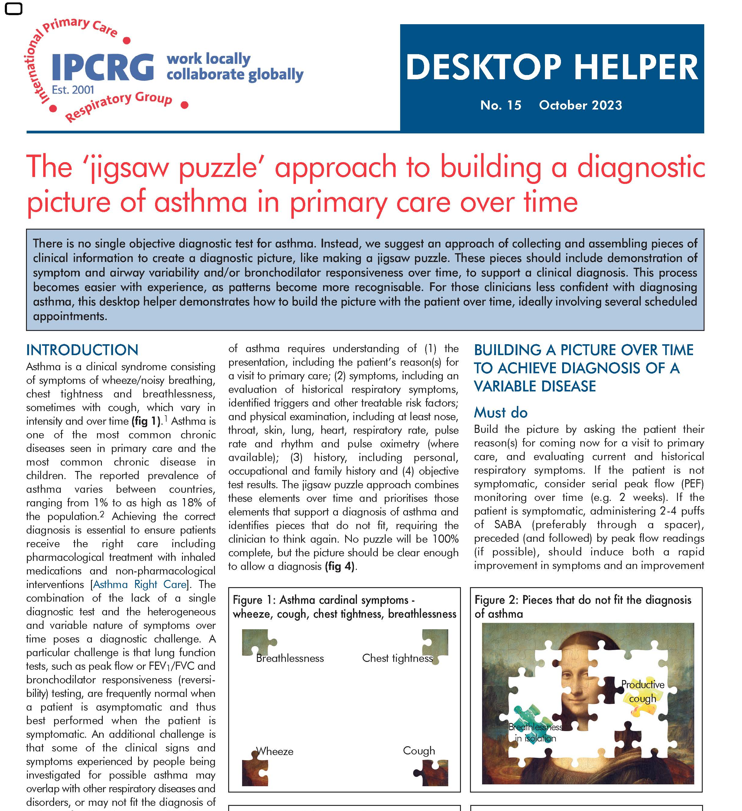

available at:
https://www.ipcrg.org/DTH15

Slide 33
Summary: developing a teaching and learning tool to support asthma diagnosis
The asthma (jigsaw) puzzle is a new teaching and learning strategy- it is not comprehensive
Created using a context-specific problem-solving diagnostic process reinforcing pattern recognition
Enables primary care practitioners to visualize the clinical picture and decide on the likelihood of an asthma diagnosis
Further tools are being developed using the puzzle metaphor

Slide 34




Part 2 – using the strategy/tool
You have a piece of paper with the 4 corner pieces/domains and others (uncolored)
We will present a case – write in the information on the blank pieces in the relevant areas

Slide 35
Case : John is a 21 year old man “ Please may I have some more salbutamol?
As many as you can give me. I’ve had asthma for many years.”
He has symptoms of cough, wheeze, SoB on exertion tight chest and wakes most nights
He has never been admitted to hospital for asthma, but has had several ED presentations – treated with oral steroids
He has current hay fever
He had eczema as a child
Never smoked
works as a delivery driver
Rarely socializes, no hobbies
Anxious
Chest clear pulse 76
PEFR 580 (exp 620)

Slide 36


So, what do you think?
History
His mother has eczema as did he as a child.
Was never admitted to hospital but has a course of oral steroids at A+E most years.
He is nervous.
He works for a delivery company
He is a never smoker
No hobbies,
Rarely socialises
Case 1
Presentation
John is a 21 year old man
First consultation: Please may have some more Salbutamol?
As many as you can give me
I have had asthma for many years
Symptoms and physical examination
He has symptoms of cough, wheeze, SoB on exertion, tight chest and wakes most nights
He takes Salbutamol 20puffs daily
He has current hay fever.
Objective Test
His Peak flow is 580 (exp 620)
Pulse rate 76
His chest is clear
Notes:
ERS Task force: European Respiratory Society Guidelines for the Diagnosis of Asthma in Adults
Recommendation • The TF suggests not recording PEF variability as the primary test to make a diagnosis of asthma diagnosis (conditional recommendation against the test, low quality of evidence) Remarks • PEF may be considered if no other lung function test is available including spirometry at rest and bronchial challenge testing • PEF should be monitored over a two--week period and a variation of >20% considered as supportive of asthma diagnosis • PEF variability

Slide 37

What supports a diagnosis of
asthma?
What pieces are missing?
symptoms of cough, wheeze, SoB on exertion,
tight chest and night waking; current hay fever.
No physical signs
no objective evidence
His mother has eczema
as did he as a child.
What might you do next?
Objective evidence
Notes:
Symptoms
Past history
Maternal history
No evidence of airways ddysfunction
normal physical exam
Serial peak flows
eosinophil count
Feno
Spirometry with reversibility
Specific IgE

Slide 38
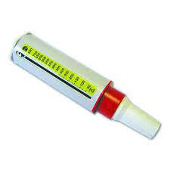
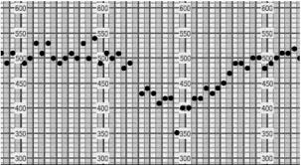

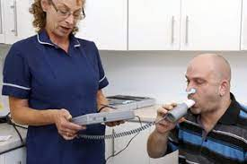
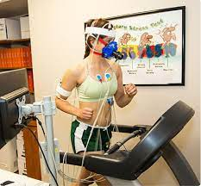
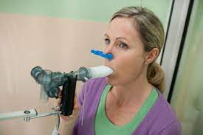

Tests of Airways function
Comments
Easy and available
Strong recommendation, weak evidence.
A normal test does not exclude asthma.
Possible to carry out informally in primary care.
Frequently used in specialist care whene diagnosis is difficult
Serial Peak flows:
Spirometry with reversibility
Exercise tolerance test
Bronchoprovocation (methacholine, mannitol)
Lung function tests are best carried out when the patient is symptomatic or untreated
Notes:
An exercise challenge test (ECT) is a non-obtrusive, real-life test that provides patients, caregivers and medical professionals more insight into the predominant cause(s) of exertional dyspnea. An ECT is an indirect bronchoprovocation test assessing bronchial hyperreactivity to exercise. Subjects perform a submaximal effort during 4–6 min, attempting to provoke recognizable symptoms (48). Lung function is measured at baseline, post-exercise and post-salbutamol. EIB is diagnosed when exercise results in a fall in FEV1 (or FEV0.5) of ≥ 13–15% post-exercise compared to baseline (31). Indirect challenge tests trigger airway narrowing through activation of the endogenous inflammatory pathways involved in asthma. Direct bronchoprovocation challenges (e.g., methacholine) do not activate these pathways but act directly on the airway smooth muscle receptor. They are generally more sensitive but less specific than indirect bronchoprovocation challenges (49, 50). An advantage of an ECT compared to other direct and indirect tests is the possibility to identify other causes of exertional dyspnea besides EIB during one test (19, 51). Figure 1 visualizes the steps and points of attention during the phases of an ECT.

Slide 39
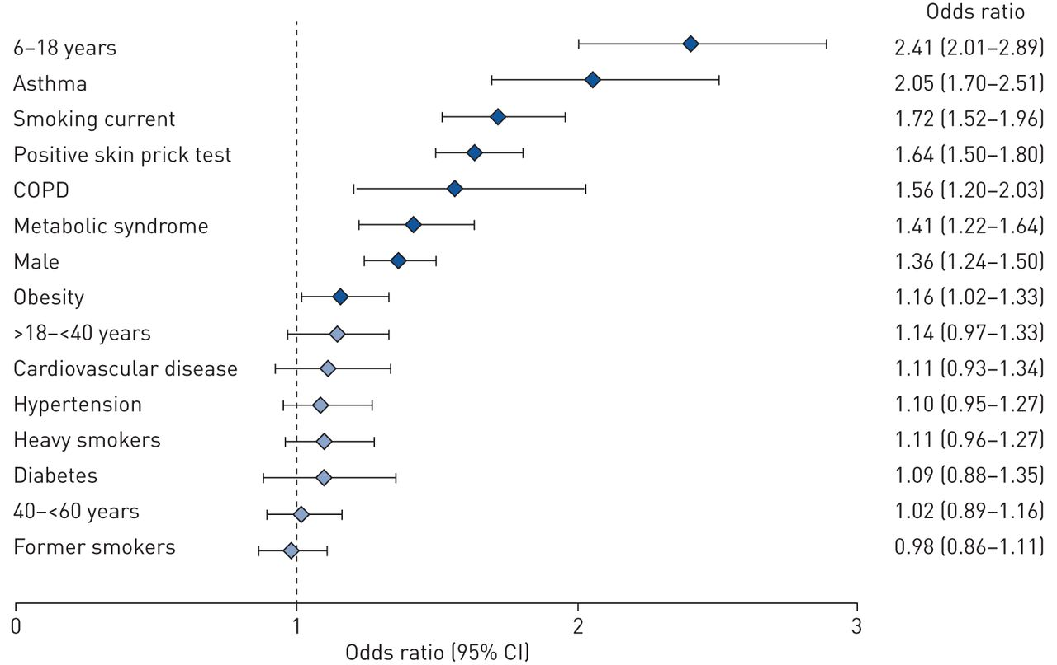
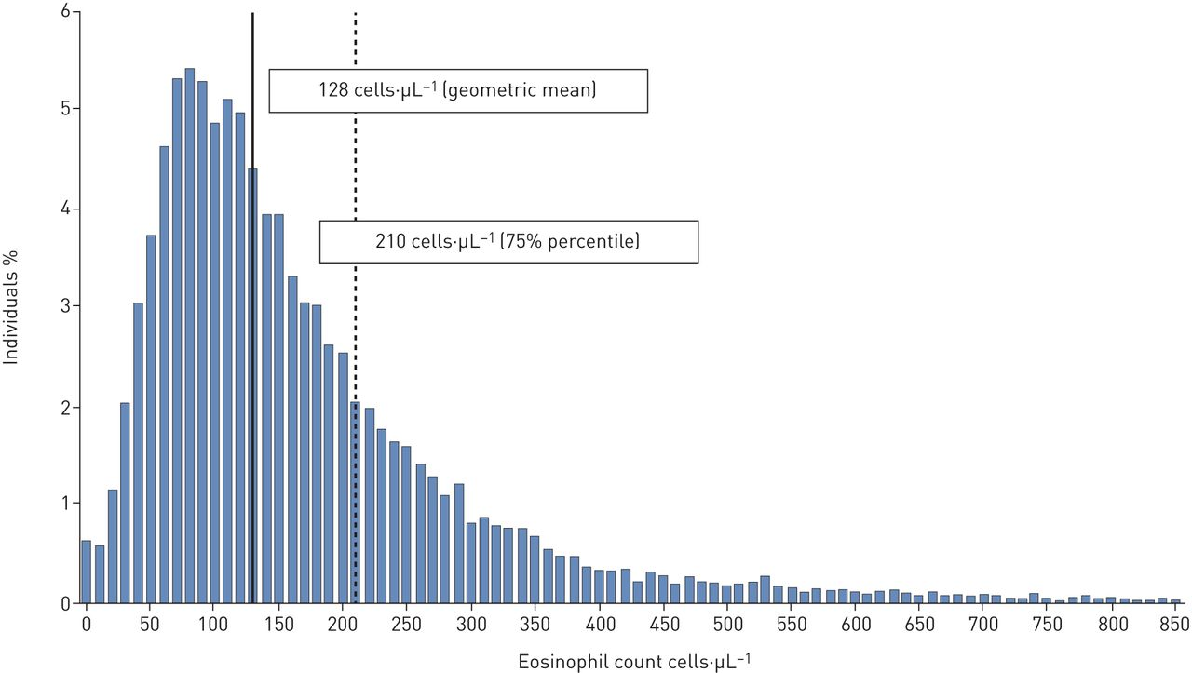
Supporting investigations: Blood Eosinophil Count
128 cells per µL (mean)
201 cells per µL 75th centile
Distibrution of BEC values in population (n=11K)
Odds ratio of association with high BEC: >201
European Respiratory Journal 2020 55: 1901874; DOI: 10.1183/13993003.01874-2019
Notes:
Blood eosinophil count in the general population: typical values and potential confounders
Sylvia Hartl, Marie-Kathrin Breyer, Otto C. Burghuber, Alina Ofenheimer, Andrea Schrott, Matthias H. Urban, Alvar Agusti, Michael Studnicka, Emiel F.M. Wouters, Robab Breyer-Kohansal
European Respiratory Journal 2020 55: 1901874; DOI: 10.1183/13993003.01874-2019

Slide 40
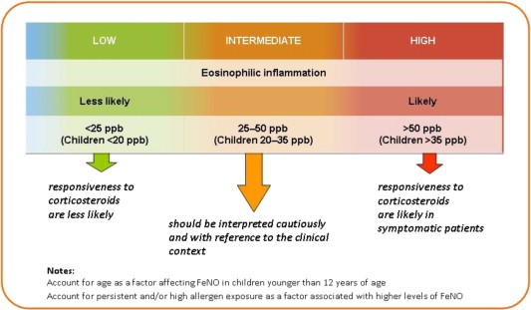
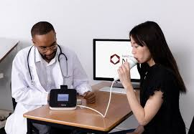
Cut off levels for FeNO
Supporting investigations: Fractional exhaled nitic oxide (FeNO
Factors Suppressing FeNO:
Smoking, alcohol and caffeine
Inhaled steroids
Factors increasing FeNO:
Green leafy vegetables,
lettuce, broccoli, beetroot…

Slide 41
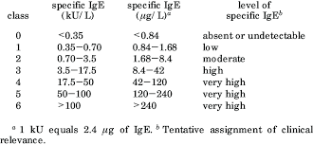
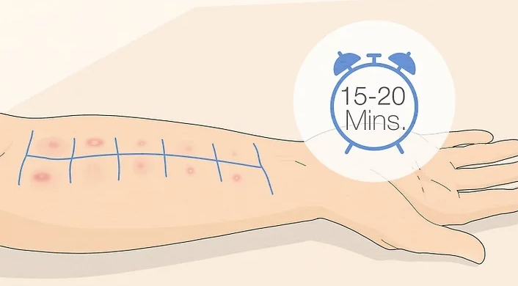
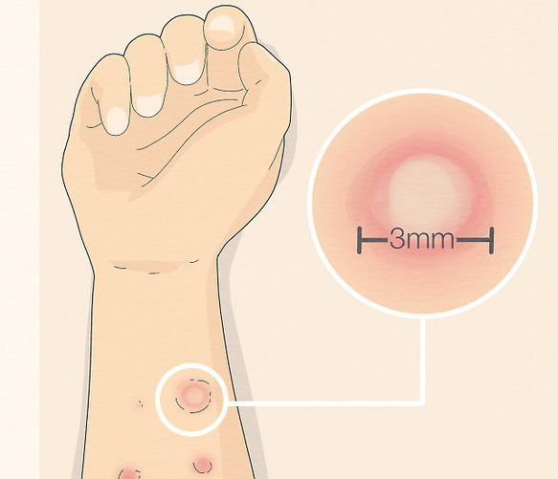
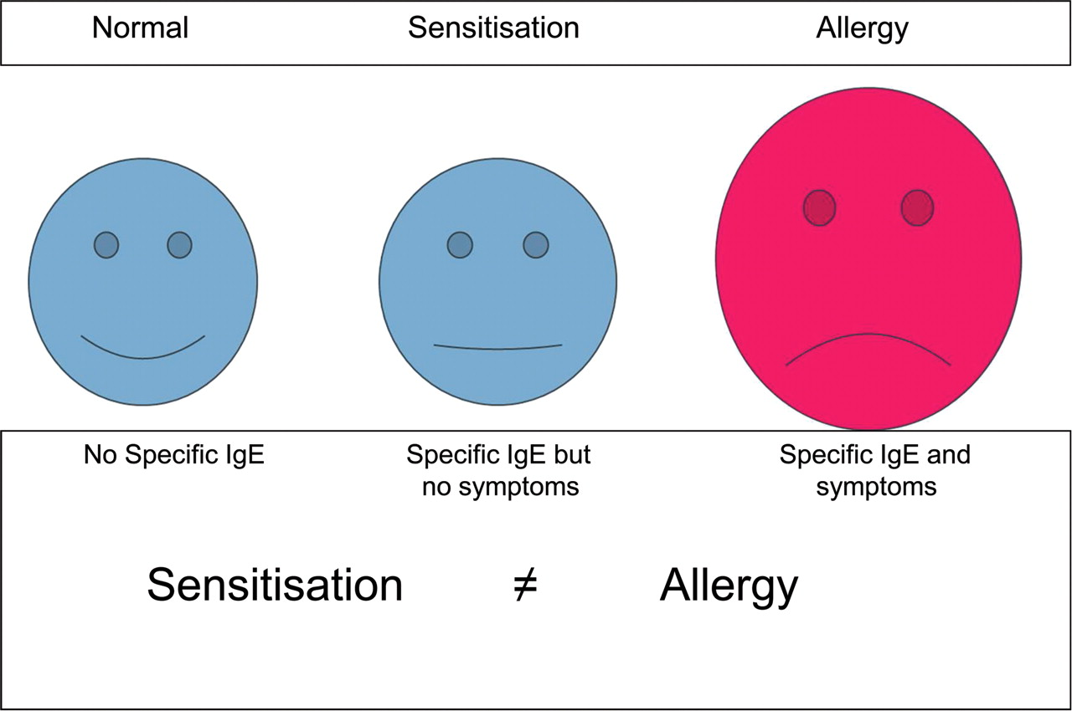
Supporting investigations: specific IgE (SIgE)

Slide 42
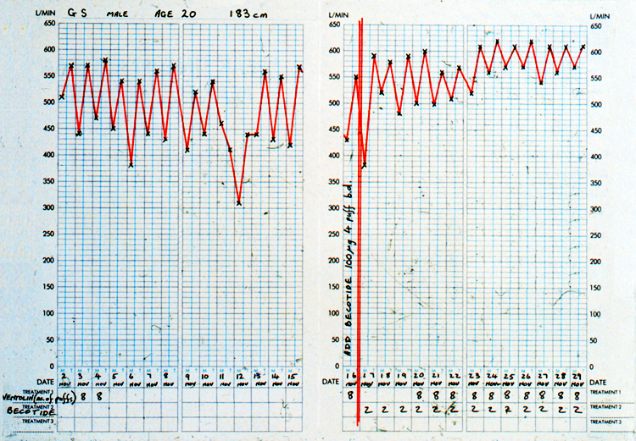
find some more pieces
Note marked diurnal variation
Note evening readings
0–14% variability | Uncharacteristic of asthma
15–19% variability | Supports diagnosis of asthma
20–30% variability | Mild persistent asthma
31–100% variability | Moderate to severe persistent
26% variability
48% variabilit
PEF𝑚−PEF𝑒
0.5 (PEF𝑚+PEF𝑒)×100
Commence ICS
Teach and check inhaler technique
Notes:
Kunzli N, Stutz EZ, Perruchoud AP, Brandli O, Tschopp JM, Bolognini G, Karrer W, Schindler C, Ackermann-Liebrich U, Leuenberger P. Peak flow variability in the SAPALDIA study and its validity in screening for asthma-related conditions. American Journal of Respiratory and Critical Care Medicine. 1999 Aug 1;160(2):427-34.
Burge PS, o'Brien IM, Harries MG. Peak flow rate records in the diagnosis of occupational asthma due to colophony. Thorax. 1979 Jun 1;34(3):308-16.
Cross D, Nelson HS. The role of the peak flow meter in the diagnosis and management of asthma. Journal of allergy and clinical immunology. 1991 Jan 1;87(1):120-8.

Slide 43



Slide 44
Two week follow-up: response to treatment
6% variability
Note response to treatment
GINA 2022:
a significant response to treatment after 4W.
FEV1> 12% or 200ml
PEF >20%
Notes:
ERS Task force: European Respiratory Society Guidelines for the Diagnosis of Asthma in Adults
Recommendation • The TF suggests not recording PEF variability as the primary test to make a diagnosis of asthma diagnosis (conditional recommendation against the test, low quality of evidence) Remarks • PEF may be considered if no other lung function test is available including spirometry at rest and bronchial challenge testing • PEF should be monitored over a two--week period and a variation of >20% considered as supportive of asthma diagnosis • PEF variability

Slide 45

History
His mother has eczema as did he as a child.
Was never admitted to hospital but has a course of oral steroids at A+E most years.
He is nervous.
He works for a delivery company
He is a never smoker
No hobbies,
Rarely socialises
Presentation
First consultation: Please may have some more Salbutamol?
As many as you can give me
I have had asthma for many years
Building the jigsaw over time
Symptoms and physical examination
John is a 21 year old man
He has symptoms of cough, wheeze, SoB on exertion, tight chest and wakes most nights
He takes Salbutamol 20puffs daily
He has hay fever.
.
Objectively
His Peak flow is 580 (exp 620)
Pulse rate 76
His chest is clear
Airway variability over time
Response to treatment
Notes:
ERS Task force: European Respiratory Society Guidelines for the Diagnosis of Asthma in Adults
Recommendation • The TF suggests not recording PEF variability as the primary test to make a diagnosis of asthma diagnosis (conditional recommendation against the test, low quality of evidence) Remarks • PEF may be considered if no other lung function test is available including spirometry at rest and bronchial challenge testing • PEF should be monitored over a two--week period and a variation of >20% considered as supportive of asthma diagnosis • PEF variability

Slide 46
How might you use this strategy/tool?
Think of a patient with challenging respiratory symptoms…….
Turn to your neighbour and discuss how this may have helped you –or may help you

