Slide 1
Breathlessness- a distressing, disabling tabling, daily challenge for patients and GPs
Dr Amanda Barnard
Dr Gillian Doe
DR Ioanna Tsiligianni
Dr Steve Homes

Slide 2
Disclosure of Interests
Amanda Barnard- I declare that I do not have any affiliation with, or financial interest in a commercial organization that poses a conflict of interest in relation to the content of my talk.
Gillian Doe -I declare that I do not have any affiliation with, or financial interest in a commercial organization that poses a conflict of interest in relation to the content of my talk.
Ioanna Tsiligianni-I declare that I do not have any affiliation with, or financial interest in a commercial organization that poses a conflict of interest in relation to the content of my talk.
Steve Holmes --I declare that I do not have any affiliation with, or financial interest in a commercial organization that poses a conflict of interest in relation to the content of my talk.

Slide 3
Who we are and Why this workshop
IPCRG
WHY- A common problem… and a symptom with multiple possible aetiologies….. So practical tips

Slide 4
Workshop format
Assessment and diagnosis of the cause of breathlessness : Appropriate context-dependent diagnostic approaches in primary care: eliciting a bio-psycho-social history
Breathing Thinking Functioning model
Group Work - Practical Tips to help patients and GPs (40 minutes)
Functioning
Thinking

Slide 5
Turn to your neighbour
What as GP are your challenges with patients with breathlessness?

Slide 6
Assessment and diagnosis of the cause of breathlessness Appropriate context-dependent diagnostic approaches in primary care: eliciting a bio-psycho-social history
Dr Gillian Doe
Department of Respiratory Sciences, University of Leicester, UK
IPCRG Breathlessness working group

Slide 7
Burden of Breathlessness
High burden to individuals living with breathlessness
High burden to healthcare system
Long delays to diagnosis
B U R D E N

Slide 8
Delays to diagnosis
Delayed presentation to seek help
Incremental approach to investigations
A disease focused model of care
Poor adherence to specific disease-specific pathways

Slide 9
2. Clinical decision-making for breathlessness is complex
4. Disease management rather than symptom management is prioritised by clinicians
1. Recognising and validating symptoms of breathlessness is an important first step
SYMPTOMS
3. Difficult conversations arise when a disease-related diagnosis is not confirmed
DIAGNOSIS
Patient experience is influenced by clinician communication style

Slide 10
Disease-based v. Symptom based approach
Local and National pathways
Multi-morbidity
Time, resource and investigations
Readily available investigations
Clinical expertise
Diagnose or exclude common causes

Slide 11
We have developed a desktop helper to support a symptom-based approach to breathlessness

Slide 12
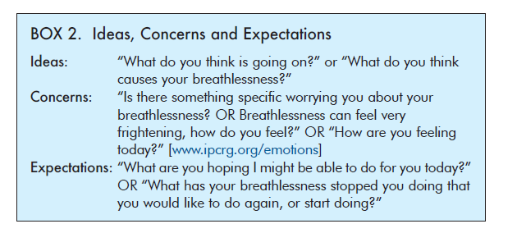
Don’t make assumptions
Consider all causes
Hold uncertainty and communicate this to the patient
Continue to offer symptom management advice

Slide 13
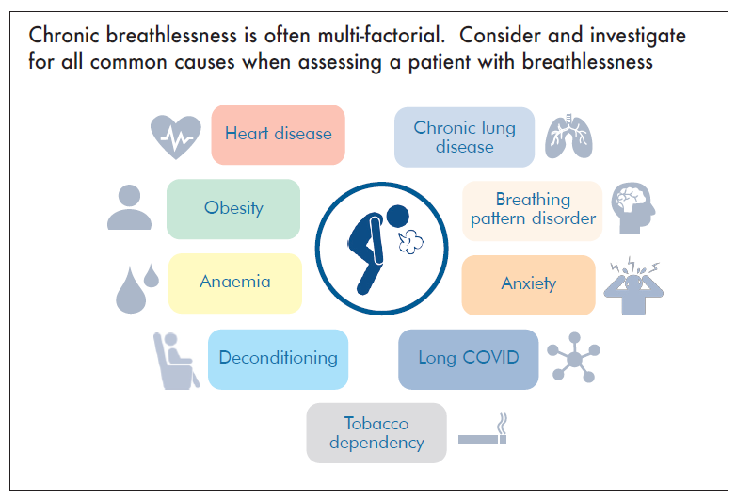

Slide 15
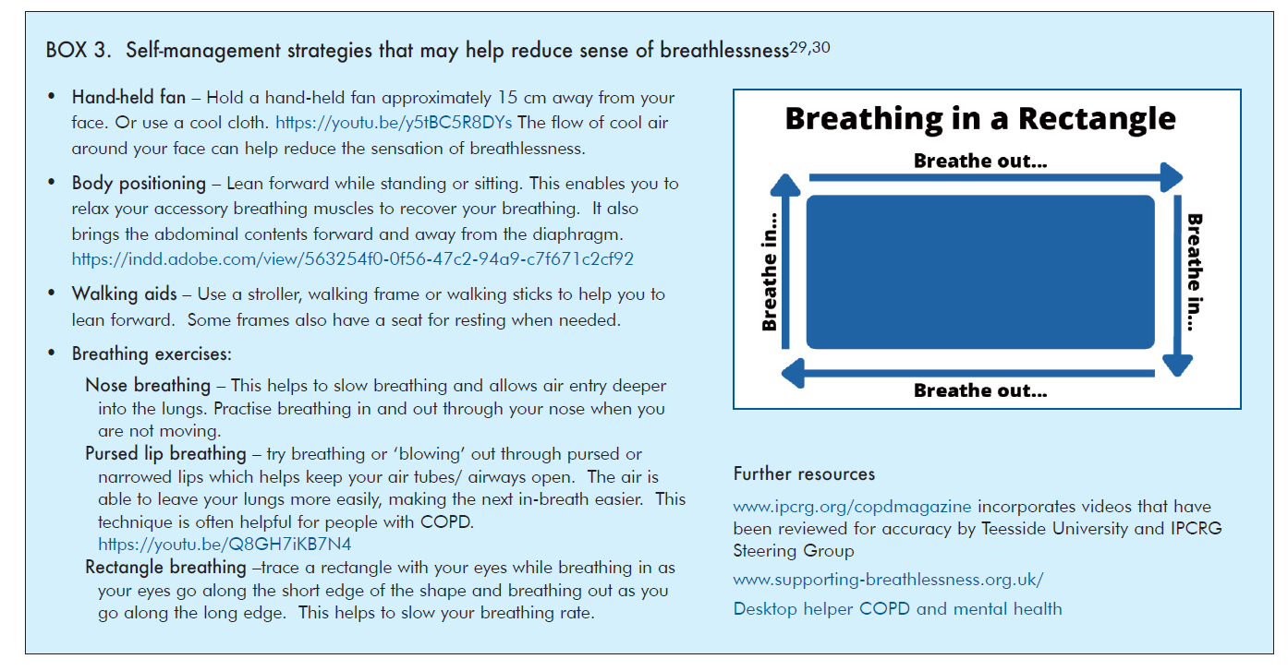
Breathlessness management

Slide 16
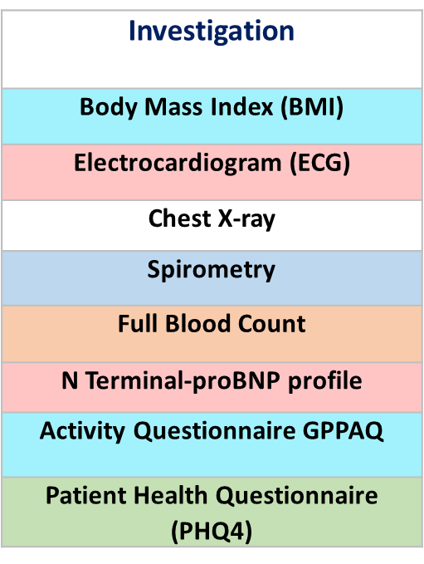
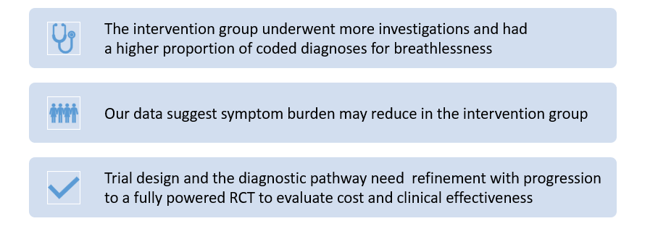
Would a symptom-based pathway for breathlessness with early investigations lead to early diagnosis and better outcomes for patients?
Would this be cost-effective?

Slide 17
In summary
Breathlessness affects 1 in 10 people and causes significant distress
Breathlessness and associated diagnosis is complex
Consider all causes and offer breathlessness management advice
CONSIDER A SYMPTOM BASED APPROACH

Slide 18
References
Bowden JA, To TH, Abernethy AP, Currow DC. Predictors of chronic breathlessness: a large population study. BMC Public Health. 2011;11:33.
Currow DC, Plummer JL, Crockett A, Abernethy AP. A community population survey of prevalence and severity of dyspnea in adults. J Pain Symptom Manage. 2009;38(4):533-45.
Doe GE, Williams MT, Chantrell S, Steiner MC, Armstrong N, Hutchinson A, et al. Diagnostic delays for breathlessness in primary care: a qualitative study to investigate current care and inform future pathways. British Journal of General Practice. 2023:BJGP.2022.0475
Hutchinson A, Pickering A, Williams P, Bland JM, Johnson MJ. Breathlessness and presentation to the emergency department: a survey and clinical record review. BMC Pulm Med. 2017;17(1):53.
Kim D, Hayhoe B, Aylin P, Majeed A, Cowie MR, Bottle A. Route to heart failure diagnosis in English primary care: a retrospective cohort study of variation. Br J Gen Pract. 2019;69(687):e697-e705
Laribi S, Keijzers G, van Meer O, Klim S, Motiejunaite J, Kuan WS, et al. Epidemiology of patients presenting with dyspnea to emergency departments in Europe and the Asia-Pacific region. European Journal of Emergency Medicine. 2019;26(5):345-9
Sandberg J, Ekstrom M, Borjesson M, Bergstrom G, Rosengren A, Angeras O, et al. Underlying contributing conditions to breathlessness among middle-aged individuals in the general population: a cross-sectional study. BMJ Open Respir Res. 2020

Slide 19
Breathing Thinking Functioning model
Dr Ioanna Tsiligianni, MD, PhD, MPH/HCM,
Associate Professor in General Practice and Public Health, Department of Social Medicine, University of Crete
IPCRG past president
EiC npj PCRM

Slide 20
What can we do about breathlessness?
Think holistically…
…a whole system (person) approach

Slide 21
Think holistically…
…a whole system (person) approach

Slide 22
Think holistically…
…a whole system (person) approach

Slide 23
Think holistically…
…a whole system (person) approach

Slide 24
Think holistically…
…a whole system (person) approach
Anna Spathis, BTF model and key evidence-based interventions

Slide 25
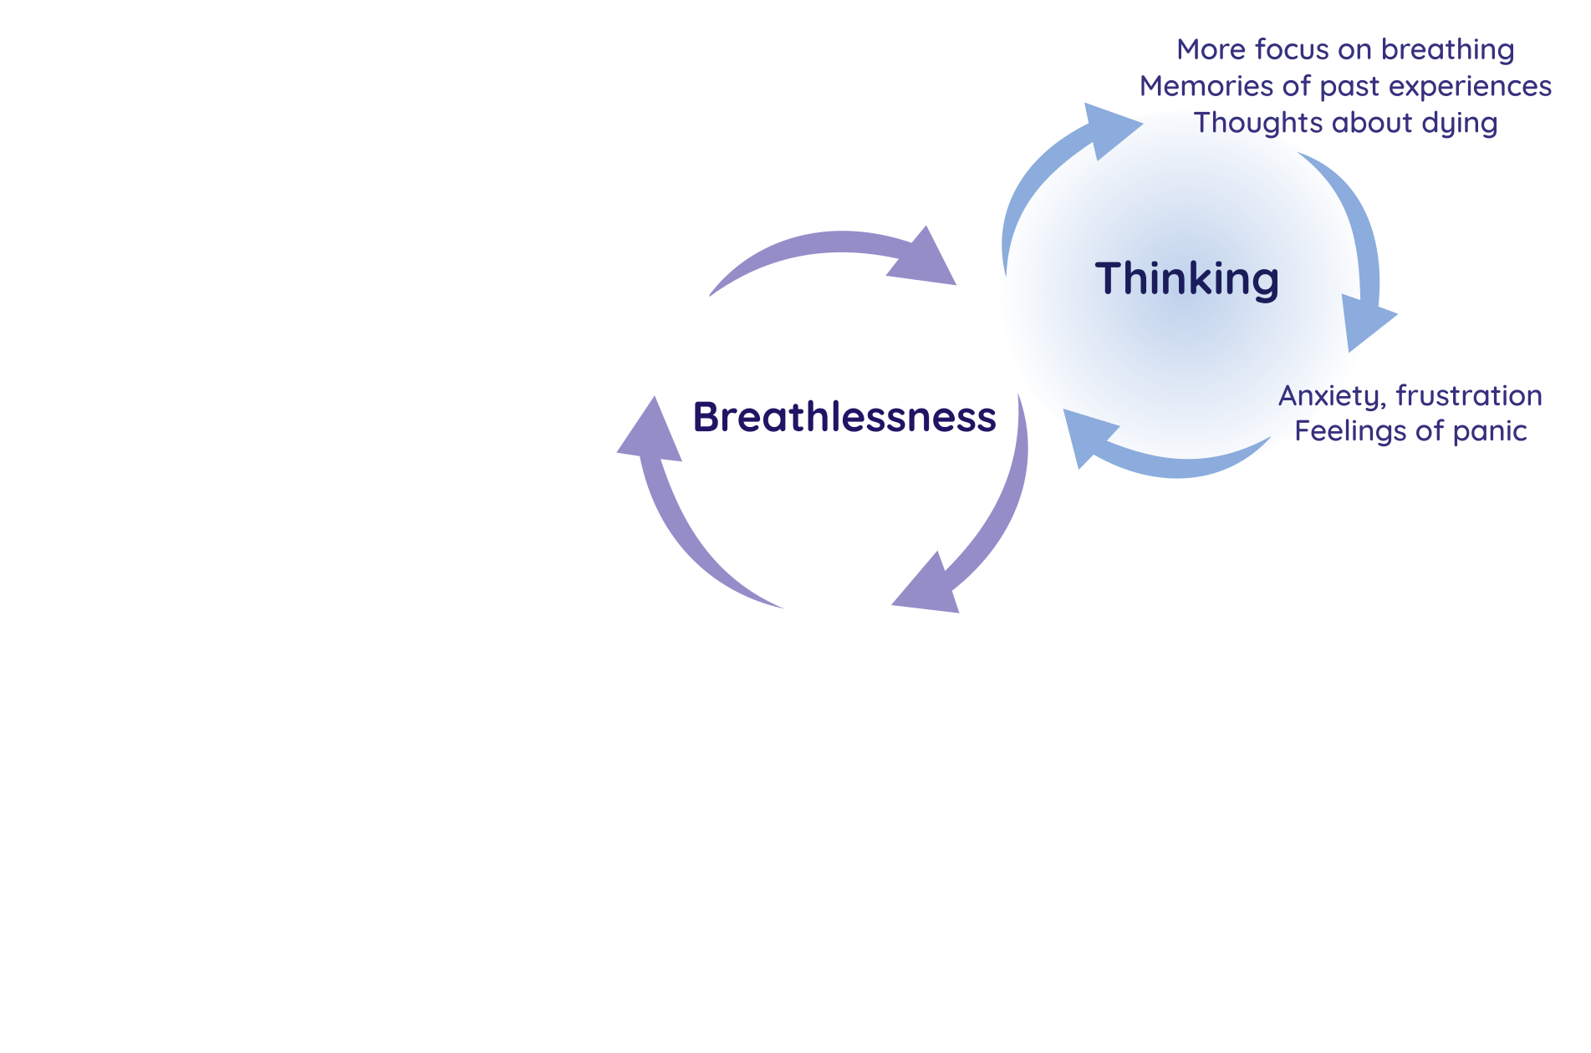
Anna Spathis, BTF model and key evidence-based interventions

Slide 26
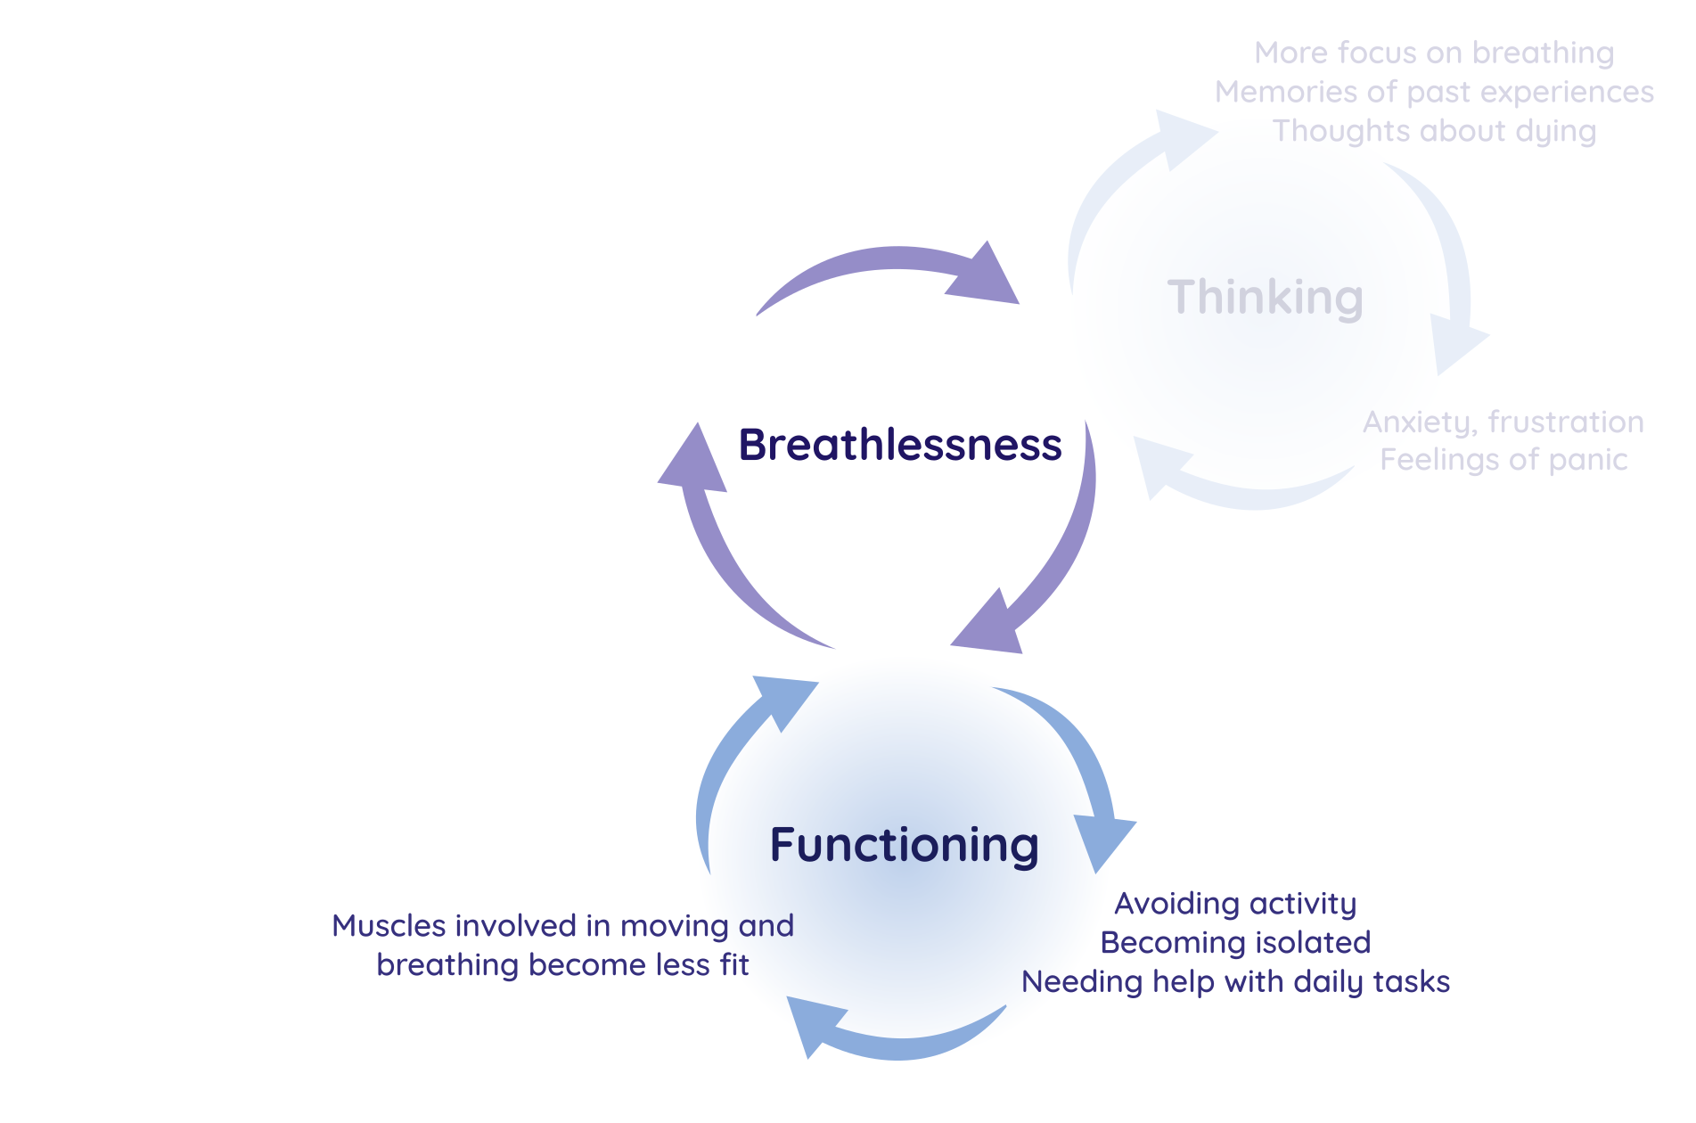
Anna Spathis, BTF model and key evidence-based interventions

Slide 27
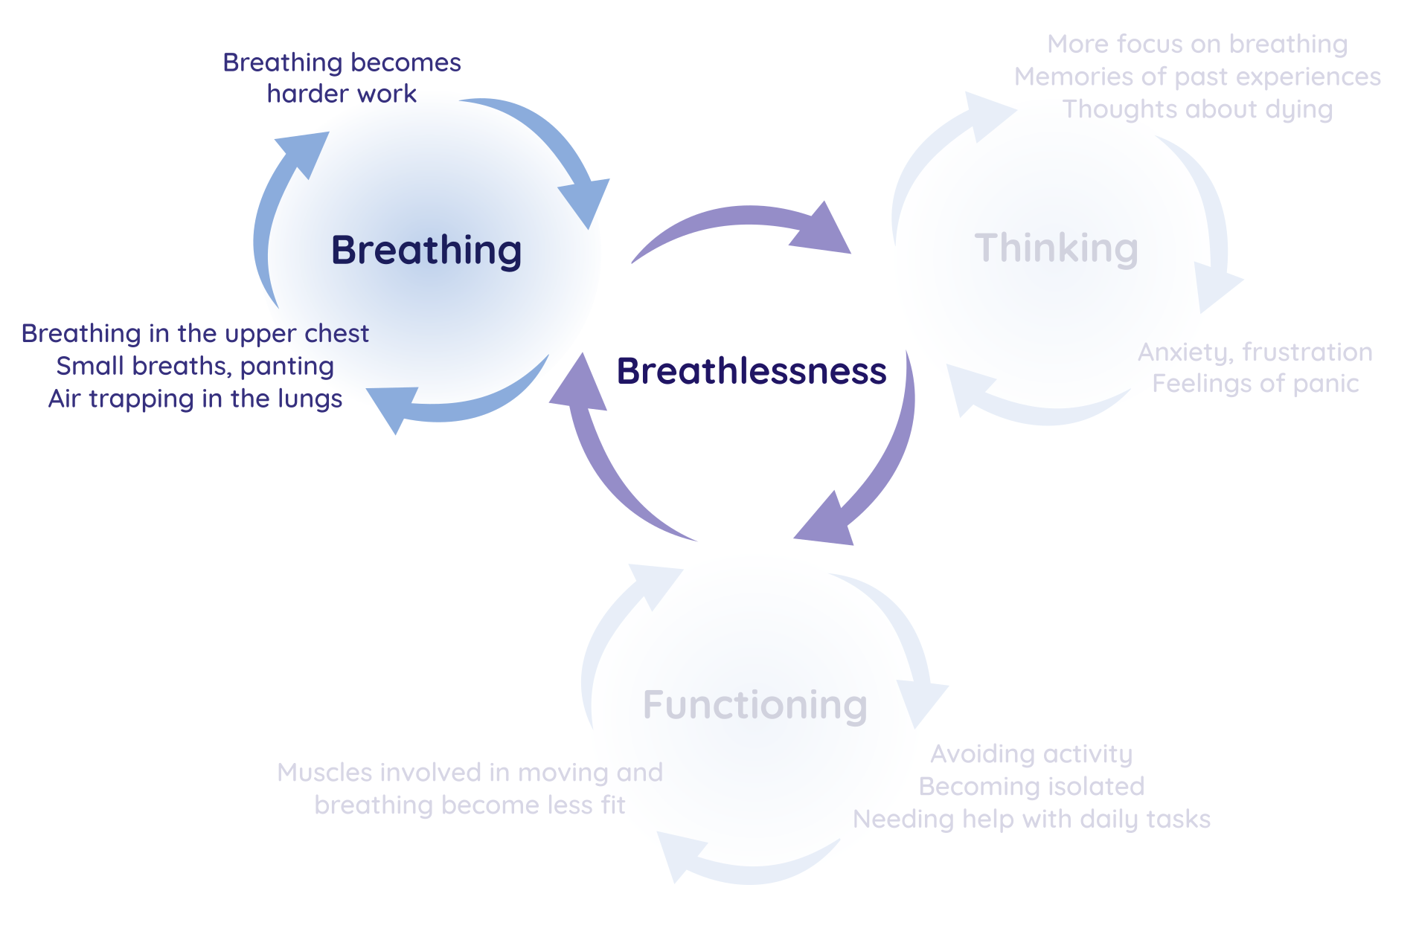

Slide 28
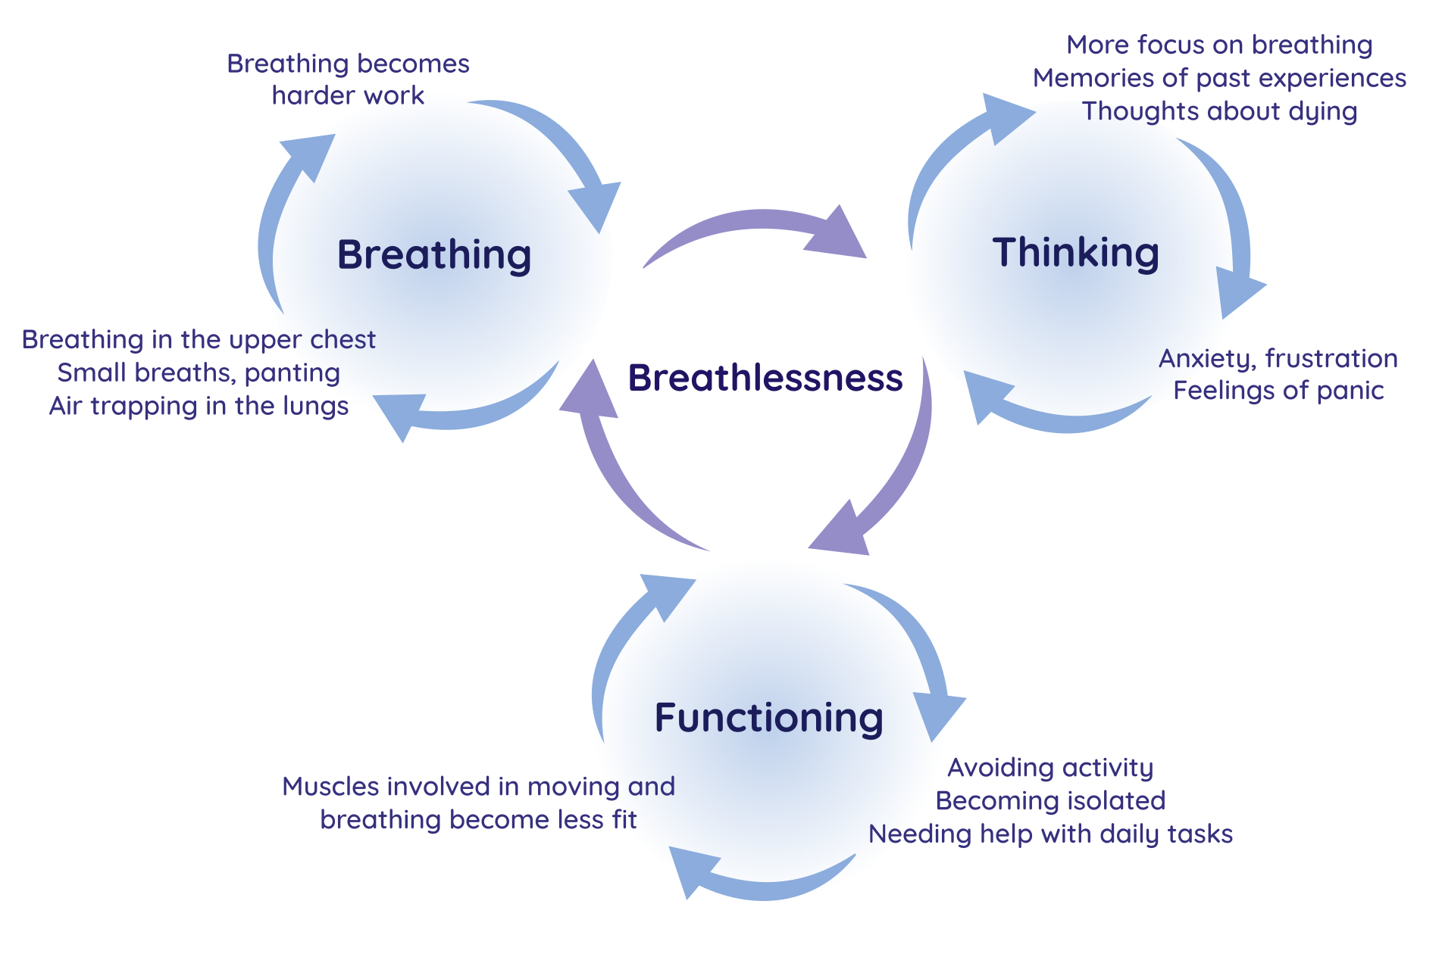
Anna Spathis, BTF model and key evidence-based interventions

Slide 30
Anna Spathis, BTF model and key evidence-based interventions

Slide 35
Non-pharmacological intervention
Evidence summary
Pulmonary rehabilitation
Consistent, moderately large benefits on breathlessness, fatigue, emotional function, quality of life, exercise capacity
Fan, facial cooling
Most patients perceive benefit from short-term use, both at rest and on exercise
CBT
Strength of evidence
Relief of breathlessness and anxiety in the short-term; inconclusive evidence for long-term impact
Mindfulness
Emerging evidence of benefit for breathlessness and other symptoms, including from just a single 20-min session
Relaxation
Benefit on breathlessness and well-being; preference for ‘thinking of a nice place’ and muscular relaxation
Walking, walking aids
Community-based walking can benefit; evidence for use of walking aids like a rollator
Breathing techniques
Positive impact on breathlessness, most evidence for pursed lip breathing

Slide 36
Breaking the Breathing cycle
When feeling breathless, it’s natural to think you need to take more air in. There’s plenty of air in your lungs. Try to lengthen your out breath instead. This makes the breathing more efficient and gives space for the next breath.
Breaking the Thinking cycle
Many people instinctively feel something bad might happen when they’re feeling breathless. Although very understandable, this tends not to happen with usual day-to-day breathlessness.
Breaking the Functioning cycle
Choosing to make yourself moderately breathless by being active will not harm you. In fact, it builds up muscle fitness again, improving your breathing and general health over weeks and months.

Slide 37
How does this help?
Making sense of breathlessness
Misconceptions explained
Why underlying disease management may not be enough
Why non-pharmacological interventions (NPI) work
For the main cycle(s) being experienced…
A simple explanation to address any misconception
Motivation and hope
Management focus
‘Something can still be done even if the disease(s) cannot be improved’
‘Small changes can make a big difference over time’
For the main cycle(s) being experienced…
One or two NPI that fit with a person’s values and a goal

Slide 38
Examples of NPI with the main cycle targeted
Recovery breathing
Facial cooling or fan
Pursed-lip breathing
Singing or chanting
5-4-3-2-1 mindful moment
Cognitive behavioural therapy
Tranquillity exercise
Meditation
Walking programme
Planning, pacing, prioritising
Yoga
Tai Chi

Slide 39
3) So what, for me?
Find out
Manage
Experiences
Making sense of breathlessness
Existing coping strategies
Motivation and hope
Expectations, concerns
Misconceptions
Each of the B, T and F cycles
Management focus

Slide 40
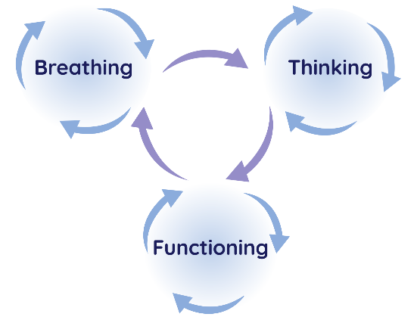
Main messages!
Non-pharmacological interventions have a rationale and do work
Pick one cycle, normalize it, and suggest taking NPI like a ‘daily pill’
You can do this, whatever your discipline and context

Slide 41
What the doctor was actually thinking during the consultation was…
I don't know why this woman comes to see me every 3 months. I never change anything. I've optimised her puffers. Of course she's breathless – she has a forced expiratory volume (FEV1) of 34%.
And after all, if her breathing is really distressing, she would tell me about it…wouldn’t she?
[Adapted from David Currow 2015]
Notes:
E: What the clinician was actually thinking during this consultation was….
A “I don't know why this woman comes to see me every 3 months.
I never change anything. I've optimised his puffers. Of course she's breathless
– she has a forced expiratory volume (FEV1) of 34%.
And after all, if her breathing is really distressing, she would tell me about it” [1, 2].

Slide 42
Key message
Support the patient to develop ‘engaged coping’ by focusing on breathlessness management as well as underlying disease
Desktop Helper on Breathlessness https://www.ipcrg.org/desktophelpers
Bringing the Breathing, Thinking Functioning model into your consultations
[attend our workshops!]
Remembering the therapeutic impact of simply: asking, listening and validating your patients experience of breathlessness
Working with creative community assets to develop/encourage creative approaches to ‘engaged coping’
Spectrum of creative responses a healthcare professional can take
Notes:
The take away message is that:
HCPS can support the patient to develop ‘engaged coping’ by focusing on breathlessness management as well as underlying disease
And you can do this:
Bringing the Breathing, thinking, functioning model into your consultations [which the workshop will demonstrate further tomo]
Remembering the therapeutic impact of:
1. asking and listening to your patients experience of breathlessness
2. communicating that you understand how difficult it is/it is a burden
3. validating the impact of breathlessness on your patients particular life context
Working with creative community assets to develop/encourage creative approaches or find out what is available locally.
The desktop helper website link is there to help you to support your patients manage living with the symptom of breathlessness better.

Slide 43
Thank you for your attention!!! E-mail: i.tsiligianni@uoc.gr

Slide 44
Group Work
Thinking – Dr Steve Holmes and Dr Amanda Barnard
Functioning - Dr Gillian Doe and Dr Ioanna Tsiligianni

Slide 45
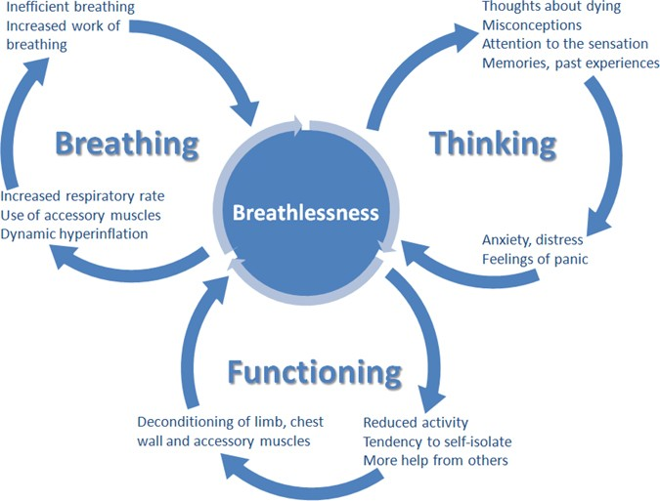
Helping manage breathlessness
The Thinking Component

Slide 46
Steve Holmes Declaration of Interests (1)
General practitioner, Park Medical Practice, Shepton Mallet
Primary Care Respiratory Society (Service development, Policy and Conference committees)
NHS England South West – Regional Clinical Respiratory Lead
RCGP (Clinical Adviser Lead (Clinical Policy) Hon Sec Severn Faculty Board, Taskforce for Lung Health Rep)
International Primary Care Respiratory Group (IPCRG) Education Committee
NHS Somerset Integrated Care and Respiratory Lead
Health Education England (GP Trainer / Ed Sup in Somerset)
NHS England (National CVD and Respiratory Programme Board)
NHS England (Appraiser)
Recent guideline involvement (Air Travel, Asthma, COPD, Respiratory disease in athletic individuals, Spirometry, Tobacco Dependency)

Slide 47
Steve Holmes Declarations of Interest (2) Speaker engagements, educational projects, conference attendance, advisory board work (in the last three years)
Academic work
University College, London; Universities of Birmingham, Cambridge, Edinburgh, Sheffield
Other providers
Asthma and Lung UK, Best Practice, Education for Health, EQUIP, Guidelines in Practice, Mediconf, MIMS, Omniamed, Pulse, RCGP Conferences, Somerset GP Education Trust
Pharmaceutical / device companies
Astra Zeneca, Boehringer Ingelheim, Chiesi, Pulmonx, Sanofi, Teva, Trudell Medical International, Viatris
No tobacco shares.

Slide 48
Breathing Thinking functioning Model. From Spathis A, Booth S, Moffat C, Hurst R, Ryan R, Chin C, et al. The Breathing, Thinking, Functioning clinical model: a proposal to facilitate evidence-based breathlessness management in chronic respiratory disease. npj Primary Care Respiratory Medicine. 2017;27(1):27.

Slide 49
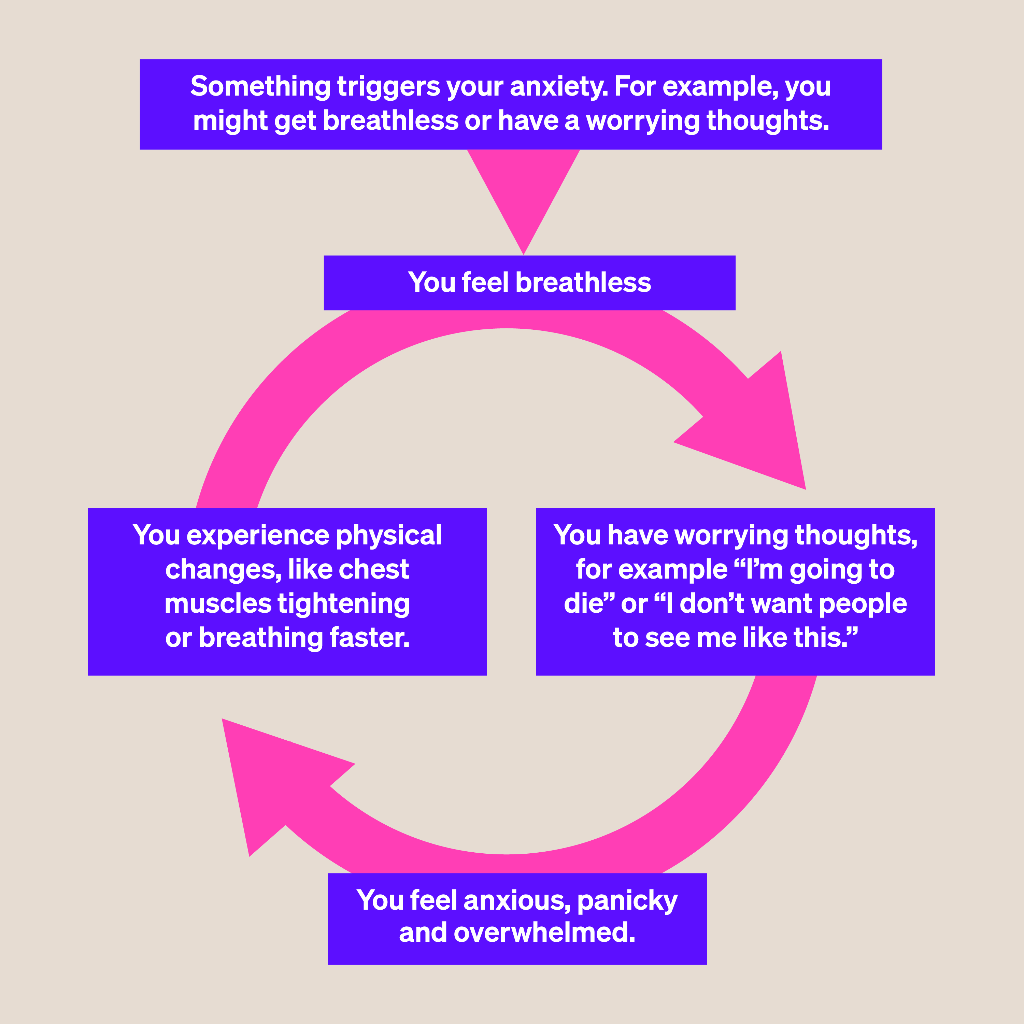
The Anxiety Cycle
From Asthma and Lung UK Website (access May 2024)

Slide 50
What are the key issues to discuss?

Slide 51
How to open up the discussion with a patient?
What phrases do you use / might you use?
What issues do you highlight to patient?
How do people feel about anxiety in discussion (stigma)?
What techniques are there to use ?
For example “My friend John”
Normal to feel this way
Neighbour R. The Inner Consultation. Lancaster: Kluwer Academic Publishers; 1987.

Slide 52
Now we have identified a problem – what are we going to do?
Neighbour R. The Inner Consultation. Lancaster: Kluwer Academic Publishers; 1987.

Slide 53
Results of thinking and anxiety
Feel more breathless
Frightening – is it dangerous?
Increased anxiety
Increased respiratory rate
Best to avoid becoming breathless (more deconditioned)
Seek an easy cure? (medication)
Breathing Thinking functioning Model. From Spathis A, Booth S, Moffat C, Hurst R, Ryan R, Chin C, et al. The Breathing, Thinking, Functioning clinical model: a proposal to facilitate evidence-based breathlessness management in chronic respiratory disease. npj Primary Care Respiratory Medicine. 2017;27(1):27.

Slide 54
Key clinical areas
Feel more breathless
Frightening – is it dangerous?
Increased anxiety
Increased respiratory rate
Normal people feel this way
It is a shared problem – we can work on it (no magic – but big improvement)
There are techniques that many have learnt to break the spiral of anxiety – fear – breathlessness
Breathing Thinking functioning Model. From Spathis A, Booth S, Moffat C, Hurst R, Ryan R, Chin C, et al. The Breathing, Thinking, Functioning clinical model: a proposal to facilitate evidence-based breathlessness management in chronic respiratory disease. npj Primary Care Respiratory Medicine. 2017;27(1):27.

Slide 55
Self Care
getting active
doing breathing exercises
connecting with others who have had similar experiences
self-help therapies that you can try on your own to help with problems

Slide 56
Treatment
talking treatments, counselling, or therapy – cognitive behavioural therapy (CBT) is often used to treat anxiety
antidepressants or other medication, you can discuss which type is right for you with your doctor – but they should offer you talking therapy alongside medication too
pulmonary rehabilitation (PR) – research has shown PR improves not only your fitness, but your mental well-being.
The charity Mind has more advice about how to seek help for a mental health problem.
From Asthma and Lung UK Website (access May 2024)

Slide 57
Managing breathlessness: The Breathing component
Dr Gillian Doe
University of Leicester, UK
IPCRG Breathlessness working group

Slide 58
Why do we need to offer breathlessness management? A patient perspective….
Just help to know, to be a bit more aware of what I can do to live with this yeah.
Yeah, they’ve not given me any treatment to help it because it’s not diagnosed, which is what I found a bit odd. I mean they could have given me something to just tide me through a bit.

Slide 59
How confident do we feel to offer breathlessness management advice? A clinician perspective…
In terms of for example breathing exercises and mindfulness and that side of things, I think I’m probably not in a particularly good position to advise patients very well.
For me personally I don’t know that I necessarily give breathlessness management advice in terms of breathing techniques and things like that. I don’t know that I give that initially. It probably ends up happening once you get the actual formal diagnosis of COPD and then we maybe get into the disease management side of things.

Slide 60
What does normal breathing look like?

Slide 61
What signs might you pick up in a consultation that someone is struggling with breathlessness?
Increased respiratory rate
Increased work of breathing
Accessory muscle use
Purse lip breathing
Forward leaning
Sighing
Yawning

Slide 62
Techniques to try today
Positioning – Some positions such as forward leaning in standing or sitting can help patients to reduce their breathlessness.
Nose breathing – Encourage patients to practise breathing in and out through their nose when they are at rest. This helps to slow the breathing and allows air entry deeper in to the lungs.
Try a mindful minute.
Pursed lip breathing – When patients breathe or ‘blow’ out through pursed or narrowed lips this helps to keep the airways open. The air is able to leave the lungs more easily and therefore making the next breath in easier.
Square breathing – This technique encourages patients to trace a square or rectangle with their eyes while breathing in along one edge of the shape and breathing out along the next edge. It can help to focus on slowing down the rate of breathing.
Tracing hand – Patients use their finger to trace up and down the fingers on their opposite hand. Breathing IN as they trace up and OUT as they trace down.
Blow as you go – This can help for activities such as bending, reaching or lifting. Patients are encouraged to breath OUT as they make the effort.

Slide 63
Breathlessness management

Slide 64
Further information
IPCRG stand in Wonca village

