Slide 1
Lung Foundation Australia
Dr Kerry Hancock

Slide 2


Slide 3
About Lung Foundation Australia
Our Vision
Lung Foundation Australia enables life-saving lung health and lung cancer research, and champions programs so that Australians with lung disease and lung cancer can live their best life.
Our Mission
By 2030, Lung Foundation Australia will be recognised as one of the world’s most innovative and effective lung health charities and a fearless leader of lung health and lung cancer policy, programs and research
Notes:
As you may know the Lung Foundation was established over 30 years ago by the TSANZ to create awareness for lung diseases, advocate for patients and HCPs, to education and support patients across chronic and rare lung diseases, lung cancer and now occupational lung diseases.
We are committed to working in meaningful long term partnerships with professionals societies, research programs and with patients and their families so that people can live their best life.
Over the last 3 years Lung Foundation has experienced unprecedented growth in both influence and services

Slide 4
IPCRG Associate Membership
Global reach and connectedness with other organisations to improve global respiratory health
Exchange of learning, resources and expertise
Consumers are at the heart of what we do
Strong reach into primary care

Slide 5
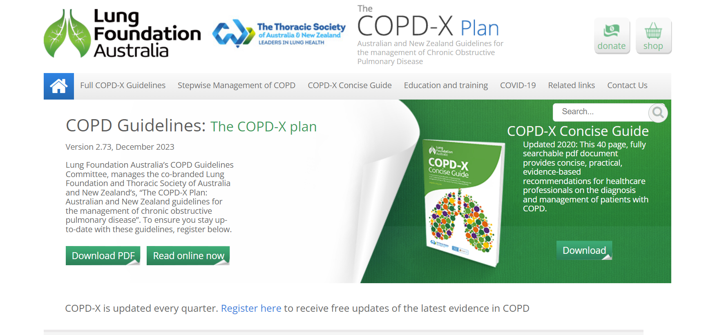
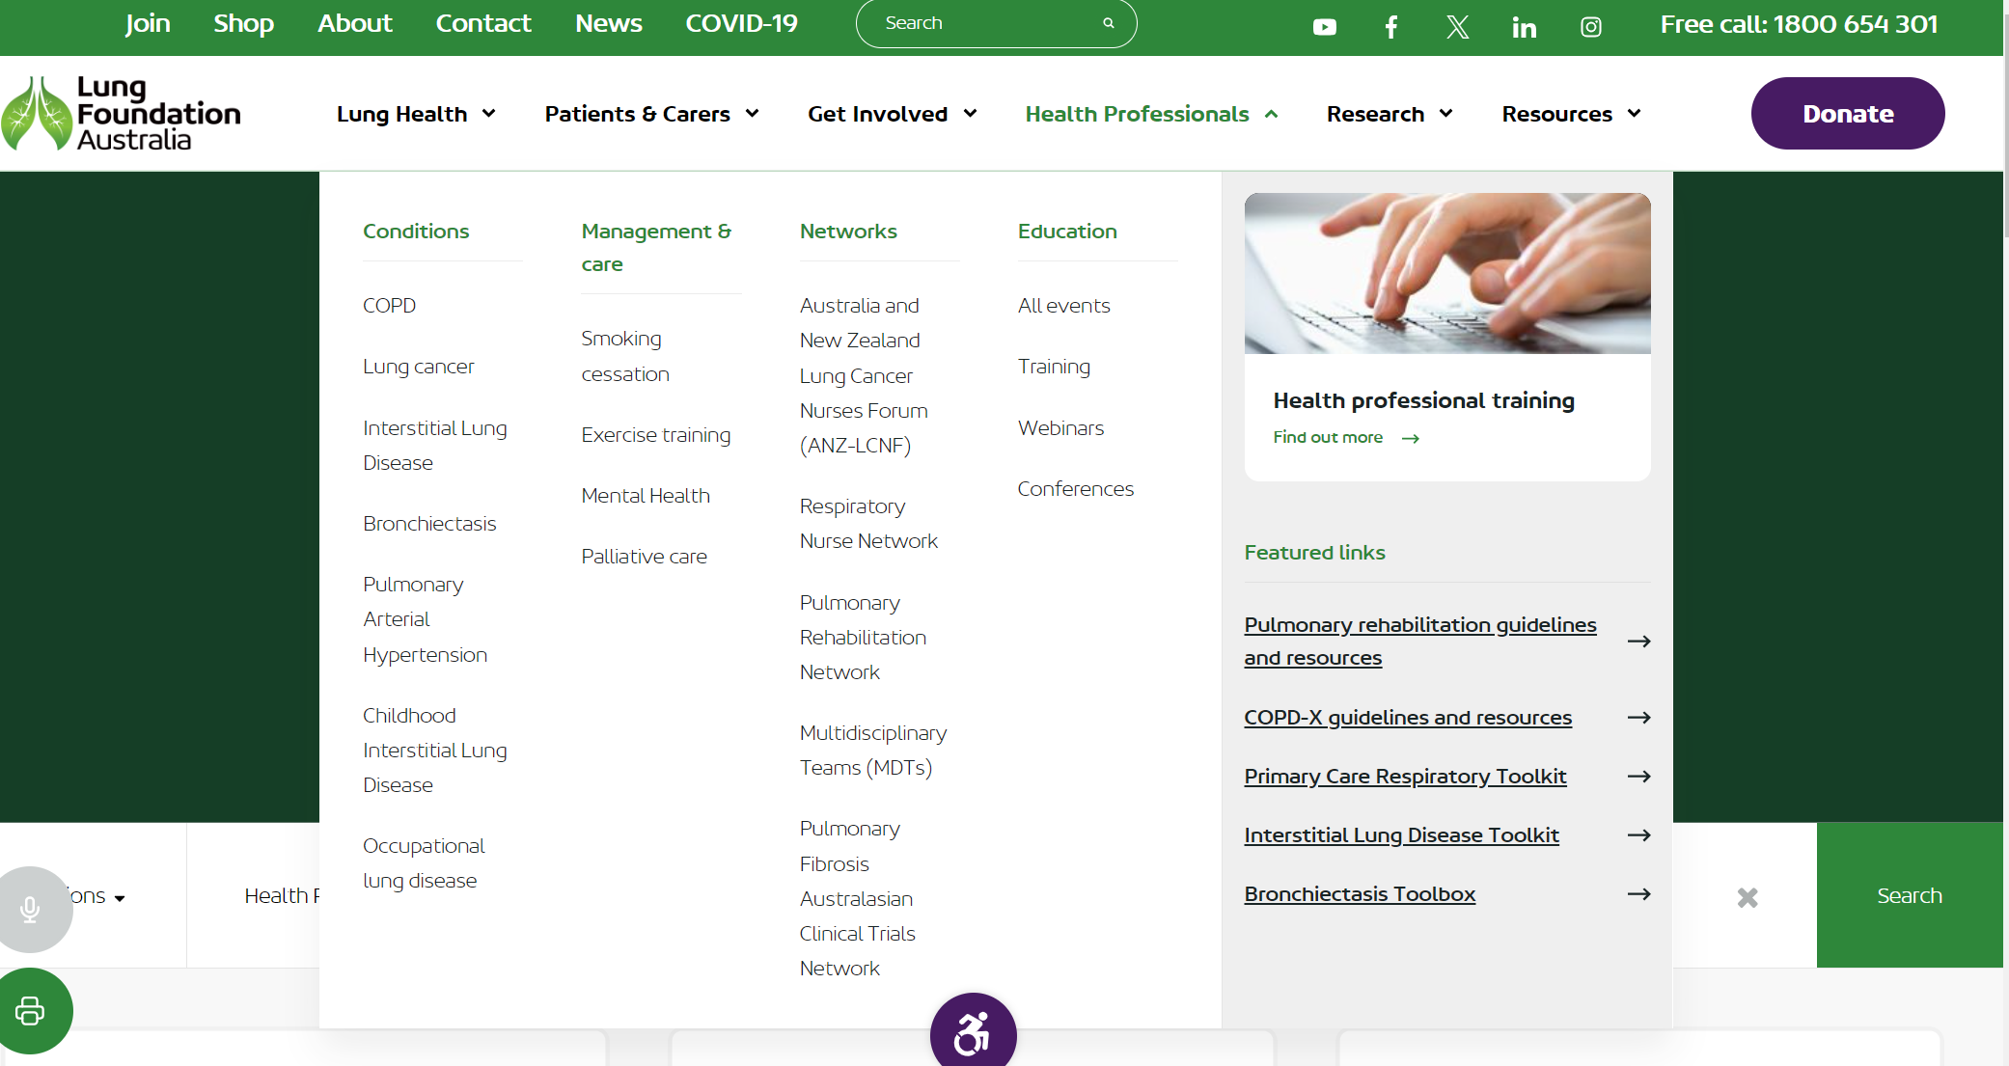
Health Professional Support and Resources

Slide 6
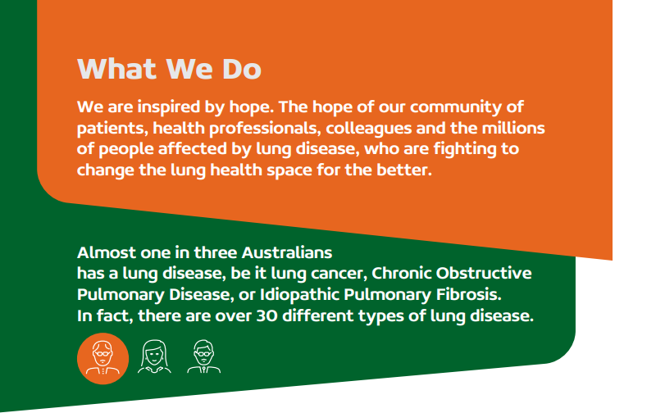
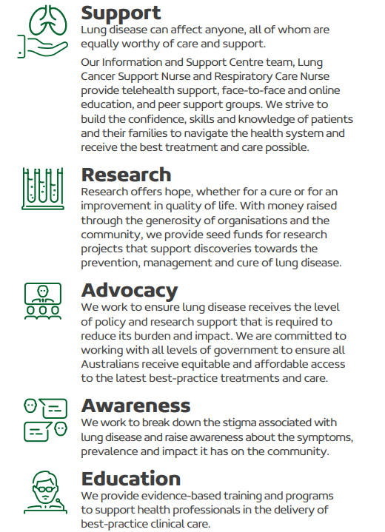

Support
Lung disease can affect anyone, all of whom are equally worthy of care and support. Our Information and Support Centre team, Lung
Cancer Support Nurse and Respiratory Care Nurse provide telehealth support, face-to-face and online education, and peer support groups. We strive to build the confidence, skills and knowledge of patients and their families to navigate the health system and receive the best treatment and care possible.
Research
Research offers hope, whether for a cure or for an improvement in quality of life. With money raised through the generosity of organisations and the community, we provide seed funds for research projects that support discoveries towards the prevention, management and cure of lung disease.
Advocacy
We work to ensure lung disease receives the level of policy and research support that is required to reduce its burden and impact. We are committed to working with all levels of government to ensure all Australians receive equitable and affordable access
to the latest best-practice treatments and care.
Awareness
We work to break down the stigma associated with lung disease and raise awareness about the symptoms, prevalence and impact it has on the community.
The Lung Learning Hub is one of Australia’s most trusted sources of respiratory health training and education for health professionals.
Education
We work to break down the stigma associated with lung disease and raise awareness about the symptoms, prevalence and impact it has on the community.

Slide 7
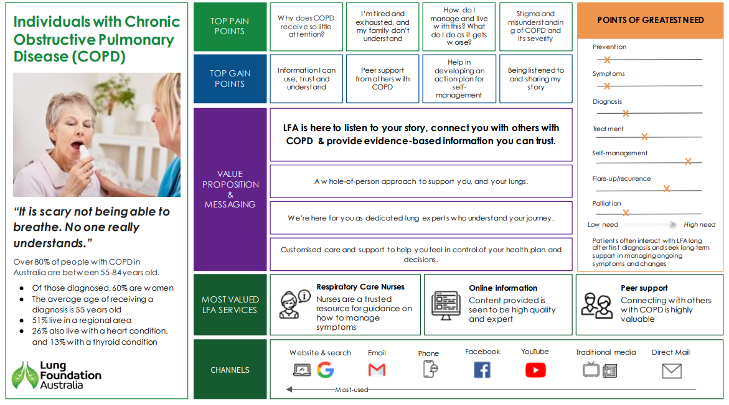

Consumers are at the heart of what we do
Our work is driven by the needs of consumers and their care-givers with the aim of empowering consumers to be effective partners in their healthcare, improving their experience of care and achieving optimal health outcomes
We invest in understanding the lived experience through:
Australia wide lived experience survey
Community Advisory Committees – LFA has four committees focused on COPD, Lung Cancer, Bronchiectasis, IPF/ILD
And Person mapping – capturing ‘pain and gain’ points

Slide 8
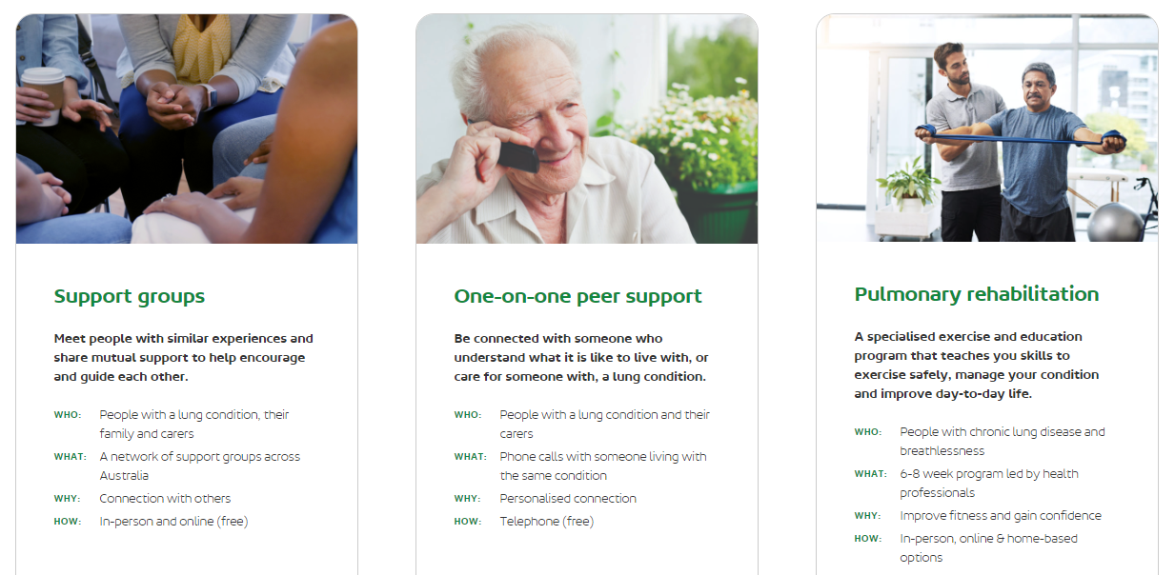
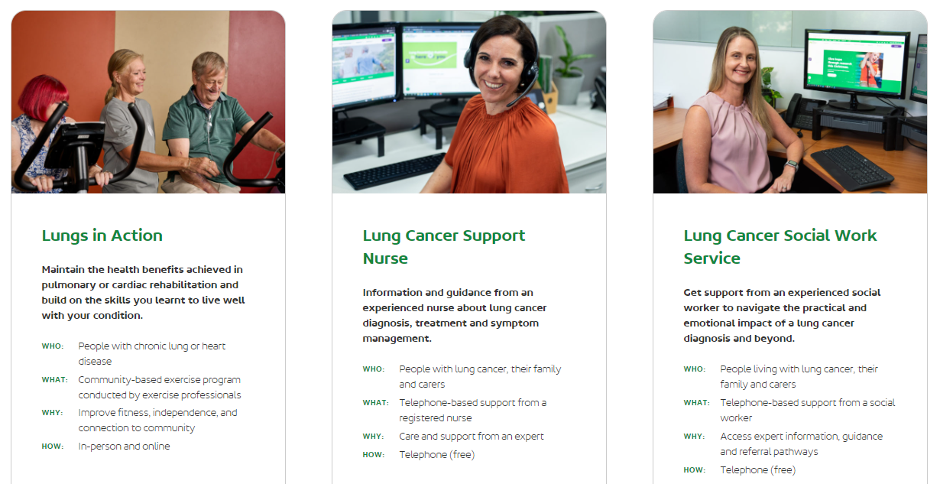
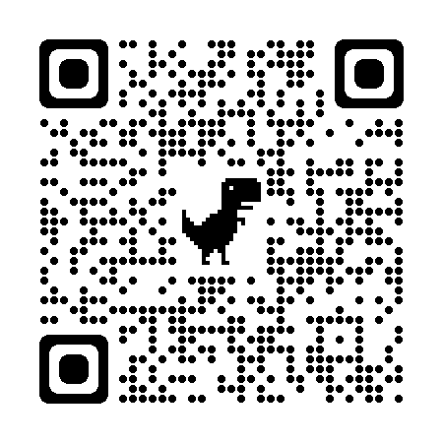
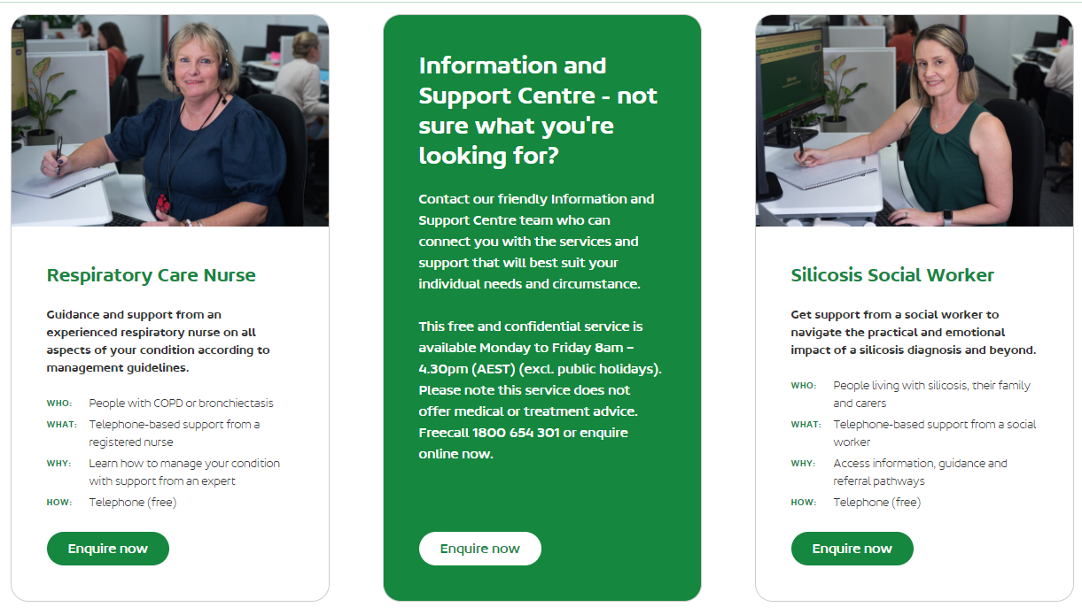
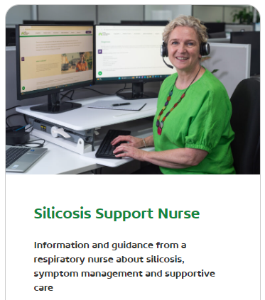
LFA offers a range of services and connects people to existing services – service navigation

