Slide 1
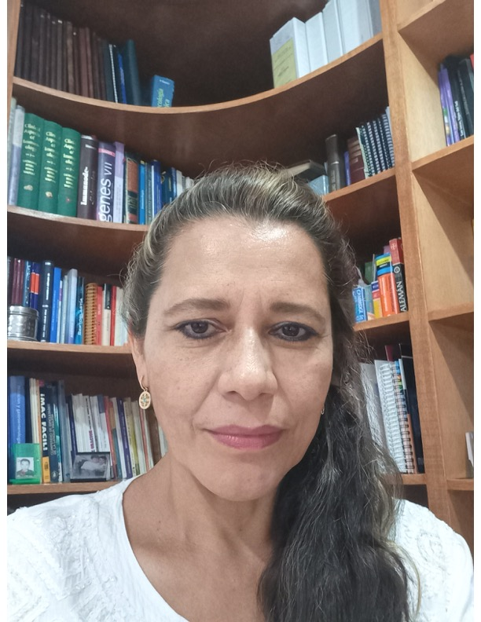
Dr. Nora E. Martínez Aguilar.
Pediatrician,
Immuno-allergist
MDPhD in research sciences in medicine
IPCRG-ARC Liaison, Mexico
CONAPEME Liaison

Slide 2
CONFEDERACION NACIONAL DE PEDIATRÍA DE MÉXICO A.C.
NATIONAL CONFEDERATION OF PEDIATRICS IN MEXICO
Founded in October 11th, 1975 in Campeche, Mexico.

Slide 3
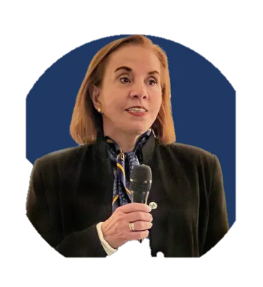
CONAPEME
Emblem..
“By a growth and harmonic development of the children”
DR. ANA BEATRIZ ROSAS SUMANO
CHAIRWOMAN

Slide 4
CONAPEME
OUR VALUES
Union
Respect
Tolerance
Communication
Continuous professional development

Slide 5
CONAPEME
> 17,000 pediatricians
32 State Colleges
23 Filial Societies
5 Regional Federations, covering all of Mexico
- NW, NE, West Central, Central, SE
1 National Confederation
- CONAPEME Board

Slide 6
Some member organizations of CONAPEME
Mexican Association of Pediatric infectious diseases.
Mexican College in teachers of Pediatric A.C.
Scientific Association of Professionals for the Comprehensive Study of the Child A.C.
Mexican School of the Child and its Environment “Colmena”
Mexican Association of Pediatric Pulmonology.
Mexican Association for the Health of the Adolescents
Mexican Association of Pediatric Immunology and Allergy Specialist.

Slide 7
Mexican Association of Vaccinology
Mexican Federation of Health Professionals for the Promotion Prevention and Care of the Child Development.
Ciberpeds A.C
. …… and now hopefully, the Inhaling Life Mexico group (IPCRG program)
Notes:
We will currently be part of CONAPEME

Slide 8
CONAPEME
Our Priorities
The ¨first 1000 days of life¨
Obesity and Nutrition
Breastfeeding
Vaccines
Infectious diseases

Slide 9
CONAPEME
Our Priorities
¨Promoting reading in children¨ campaign
Early neurodevelopmental assessment
Community education workshops
Training workshops for pediatricians
…Training workshops for asthma right care have been added
Notes:
..a priority that has been added is ARC

Slide 10
Events held in Mexico from July to November 2023
Event | Date | Participants – face to face | Participants - Virtual
1. Monterrey | Jul 7 | 300
2. Toluca | Aug 15 | 150 | 715
3. Morelos | Aug 18 | 100 | 300
4. Virtual | Sept 7 |  | 1,000
5. Virtual | Sept 14 |  | 500
6. Virtual | Sept 21 |  | 250
7. Tabasco | Sept23 | 100 | 776
8. Torreón | Sep 28 | 200
9. La Paz,BCS | Nov 11 | 100
10. Mexico City Nora | Jun 15 |  | 50
11. Mexico City Sarai | Aug 25 | 50 | -
Total |  | 1000 | 3591
Notes:
most of them with support from CONAPEME and GSK

Slide 11
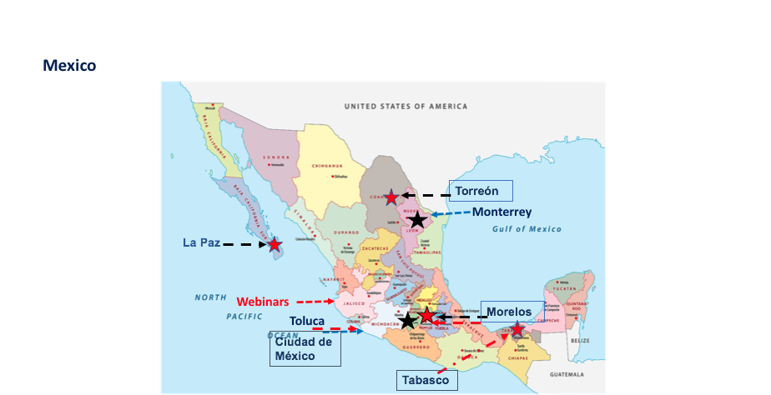
This were held in the different cardinal points of Mexico……
We try to cover most of the territory
Notes:
Actuación

Slide 12
We created and developed a workshop, which combined research tools with the IPCRG-ARC program. It was very well received amongst the participants, which is why it has been requested for this year in other different cities in Mexico, such as: Veracruz, Guanajuato, Hidalgo, Querétaro.

Slide 13
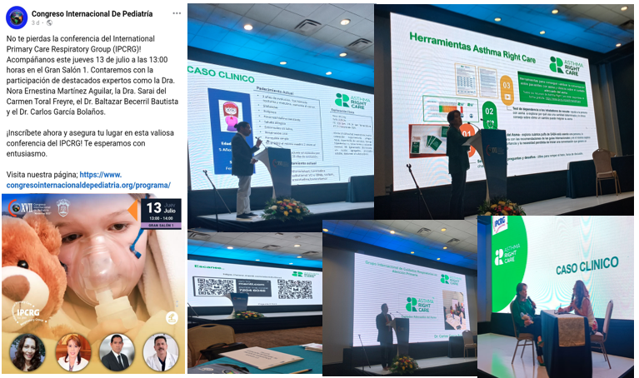

Slide 14
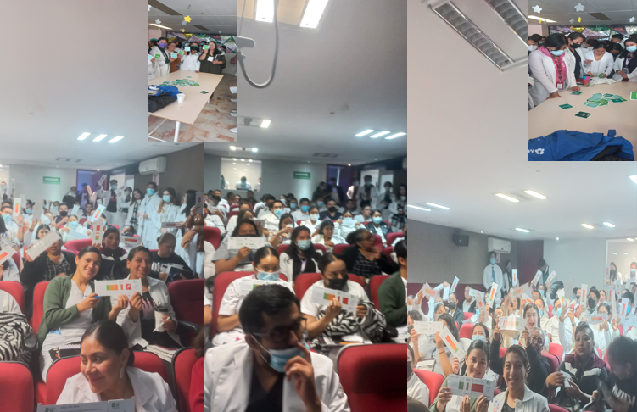

Slide 15
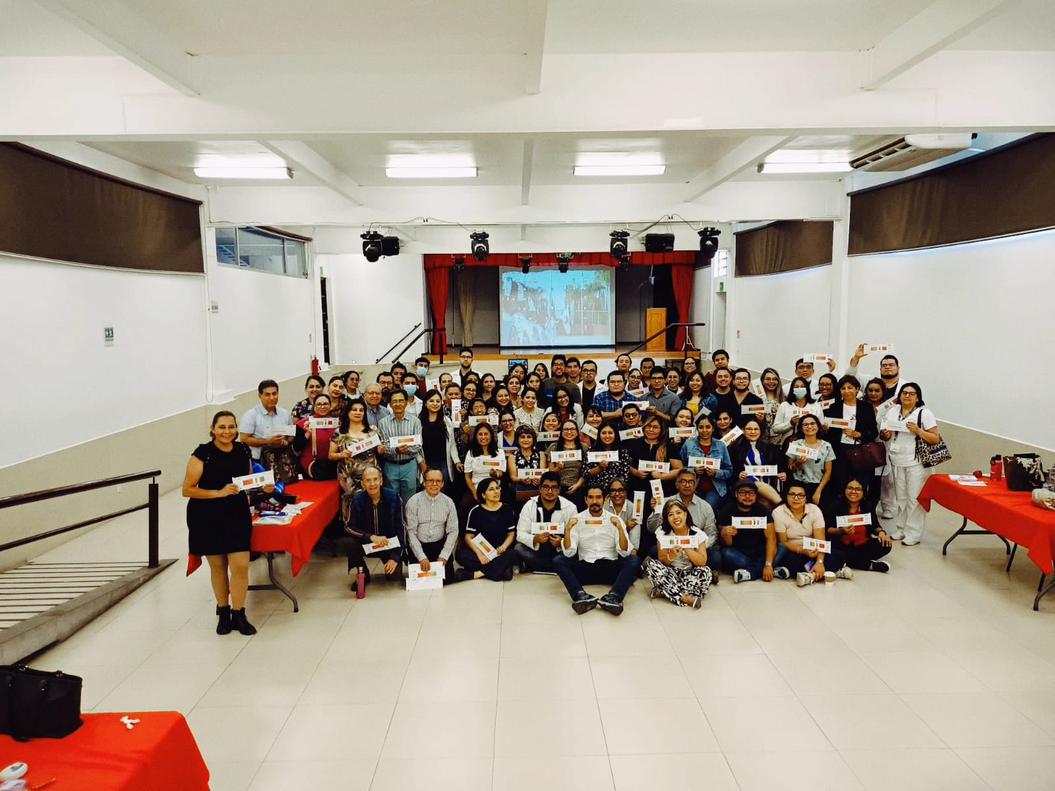

Slide 16
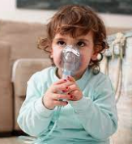
As a member of CONAPEME, we are hoping that the Inhaling Life Mexico group (IPCRG program) will be included in different activities, such as congresses and courses of CONAPEME, in which not only pediatricians participate, but also other health professionals.
THANKS FOR YOUR ATTENTION

