Slide 1
Empowering pharmacists in chronic respiratory disease management: Insights from FIP work
Luís Lourenço, Professional Secretary
International Pharmaceutical Federation (FIP)
May 2024

Slide 2

International Pharmaceutical Federation (FIP)
The International Pharmaceutical Federation (FIP) is the global body representing pharmacy, pharmaceutical sciences and pharmaceutical education, in official relations with the World Health Organization.
Through our 156 national organisations, academic institutional members and individual members, we represent over four million pharmacists, pharmaceutical scientists and pharmaceutical educators around the world.
We work to support the development of the pharmacy profession, through practice and emerging scientific innovations, and through developing the pharmacy workforce in order to meet the world’s health care needs and expectations.

Slide 3

Vision
A world where everyone benefits from access to safe, effective, quality and affordable medicines and health technologies, as well as from pharmaceutical care services provided by pharmacists, in collaboration with other healthcare professionals.

Slide 4

Mission
Support global health by enabling the advancement of pharmaceutical practice, sciences and education.

Slide 5


https://ncd.fip.org/fip-practice-transformation-programme-on-ncds/
Notes:
The FIP non-communicable diseases programme includes the FIP Practice Transformation Programme on NCDs, which we have been developing since 2021.
The Practice Transformation Programme on NCDs is an FIP transformation programme with a focus on pharmacy practice.

Slide 6
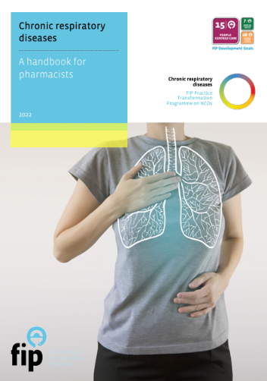
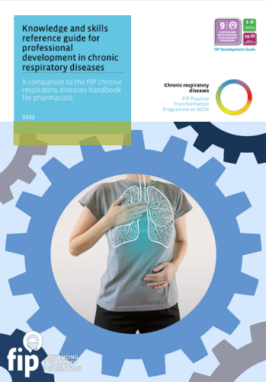



Programme resources – Chronic respiratory diseases
DIGITAL EVENT
28 September 2022
In collaboration with:
Notes:
In September 2022, at the “Transforming pharmacy practice for improved care and management of chronic respiratory diseases” digital event FIP launched the “Chronic respiratory diseases: A handbook for pharmacists” and the “Knowledge and skills reference guide for professional development in chronic respiratory diseases”.
Chronic respiratory diseases (CRDs) impose significant health and economic burdens on individuals, healthcare systems and society overall. Asthma and COPD are two common chronic respiratory diseases (CRD) that affect millions of people worldwide. Pharmacists have a role to play in the prevention, care and management of CRD.
This handbook has outlined the many ways in which pharmacists can contribute to improving respiratory well-being among their patients, including by acting as agents for health behaviour change and other preventive services, asking patients to take health status questionnaires, screening for CRDs, referring patients to additional care, working as part of interprofessional teams, optimising the use of inhaler devices (e.g., inhaler technique education), improving treatment adherence, and monitoring patients for exacerbation episodes and hospitalisations.
These publications were developed in collaboration with an international group of experts and with the input and support of the International Primary Care Respiratory Group (IPCRG) and the European Society of Clinical Pharmacy.

Slide 7
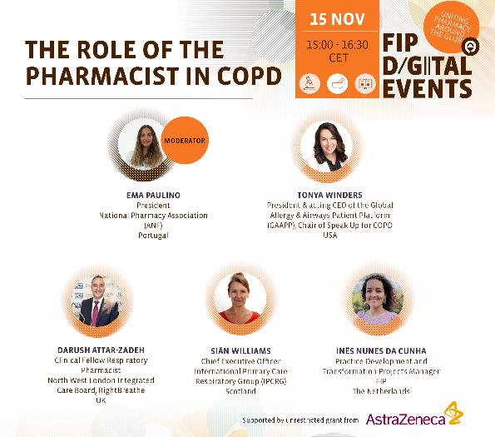
Programme resources – Chronic respiratory diseases
Notes:
Chronic obstructive pulmonary disease (COPD) is a common chronic respiratory disease that requires comprehensive care. Pharmacists have a role to play in the prevention, care and management of COPD. To mark World COPD Day 2023, FIP hosted a digital event where participants learned more about the role of pharmacists in COPD, the IPCRG COPD Right Care programme, the Speak Up for COPD campaign and FIP publications supporting the role of pharmacists in COPD.

Slide 8
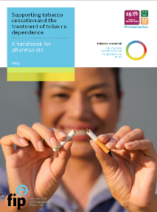
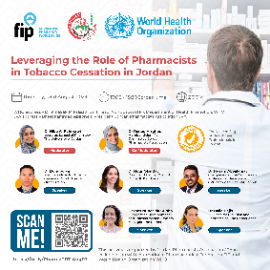
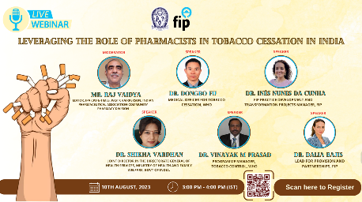
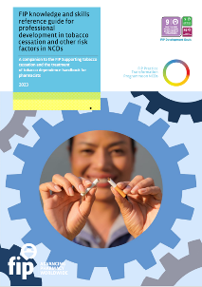
Programme resources
https://ncd.fip.org
Notes:
The programme has been expanded to include prevention of NCD risk factors, particularly in the area of tobacco cessation. To facilitate this, FIP published a handbook and a Knowledge and Skills (K&S) guide to equip pharmacists with the necessary tools to provide effective tobacco cessation services.
FIP has also initiated work at country level in Jordan and India in collaboration with our member organisations and the World Health Organization.

Slide 9
Programme resources – Tobacco cessation
Project titles
Pharmacist-led tobacco cessation services: Global intelligence report
FIP-WHO joint declaration on the role of the pharmacist in tobacco cessation
FIP statement of policy on the role of the pharmacist in establishing a future free from tobacco and nicotine dependence
Tobacco cessation – supporting work at country level in collaboration with WHO + Training modules
Tobacco cessation regional online events
Notes:
In 2024, we will continue to develop and expand non-communicable diseases, with a particular focus on tobacco cessation.

Slide 10


Partnerships
Notes:
FIP collaborates with key external partners in the area of respiratory health, such as IPCRG and the Speak Up for COPD coalition. These synergies contribute expertise to FIP's work in this area, including our publications, webinars and other projects, while consolidating the role of pharmacists as allies of these organisations in advancing their mission and work.
The IPCRG has collaborated with the FIP on several digital events and on the two FIP publications on chronic respiratory diseases: "Chronic respiratory diseases: A handbook for pharmacists” and the “Knowledge and skills reference guide for professional development in chronic respiratory diseases”.
FIP is one of the Speak Up for COPD partners, providing expertise to the coalition's activities. The SPEAK UP FOR COPD campaign is intended to raise awareness and understanding of COPD amongst policymakers and healthcare decision makers by amplifying the voices of patients, the COPD community and the public. The critical goal is to establish COPD as a public health priority.

Slide 11

GARD membership
In March 2024, FIP was admitted into the Global Alliance Against Chronic Respiratory Diseases (GARD) hosted by the WHO.
Notes:
In March 2024, FIP was admitted into the Global Alliance Against Chronic Respiratory Diseases hosted by the WHO. Approval as a member not only implies an acknowledgement of the role of pharmacists in the prevention and management of chronic respiratory diseases, but also a recognition of FIP’s work in this area. GARD membership will also give FIP the opportunity to further disseminate its work on CRDs and tobacco cessation, and to engage in collaboration with other GARD members and WHO itself.

Slide 12
Programme resources
FIP micro-site on NCDs:
https://ncd.fip.org/
FIP Practice Transformation
Programme on NCDs:
https://ncd.fip.org/fip-practice-transformation-
programme-on-ncds/
All of the programme publications, event
recordings and other resources and tools
are available from the FIP microsite on
NCDs.
Please check this website for updates
Queries / suggestions / comments welcome:
ncd@fip.org
Notes:
To learn more about this programme, please visit the FIP micro-site on NCDs at ncd.fip.org/, or send an email to ncd@fip.org.

Slide 13

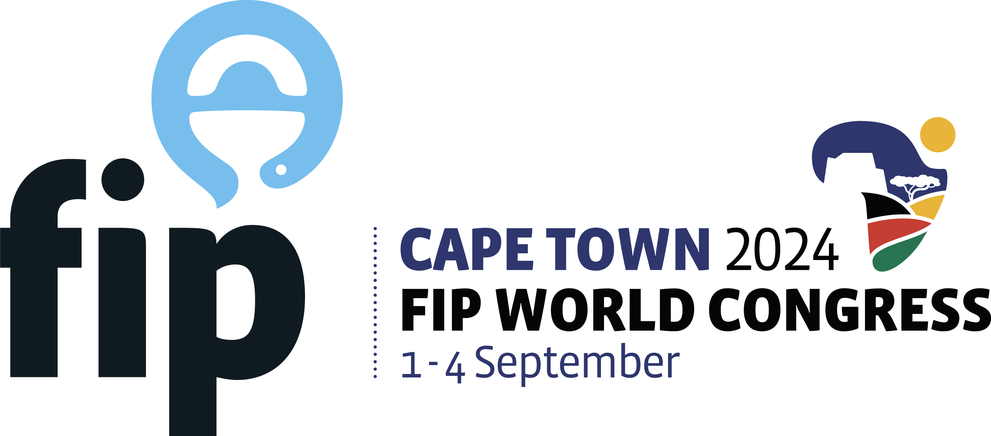


82nd FIP WORLD CONGRESS OF PHARMACY
AND PHARMACEUTICAL SCIENCES
Cape Town, South Africa
1 – 4 September 2024
Supported by the Pharmaceutical Society of South Africa
“Innovating for the future of healthcare”
For more information, visit congress website:
capetown2024.fip.org

Slide 14


Programme topics:
Topic 1
Topic 2
Topic 3
Equitable quality
health care
Innovative drug discovery and access
Revolutionising
health care with AI
Important dates:
Early Bird registration deadline (maximum registration fee discount) – 31 May 2024
More information about the congress: capetown2024.fip.org

Slide 15
Thank you

