Slide 1
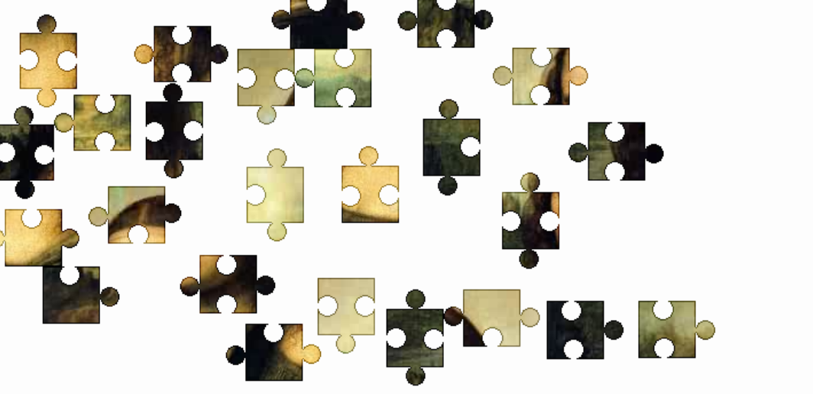
Diagnosing asthma:
Solving the jigsaw puzzle
Dermot Ryan, FRCGP
General Practitioner
Honorary Clinical Research Fellow, University of Edinburgh
Vice-President, Respiratory Effectiveness Group
Director, International Primary Care Respiratory Group

Slide 2
Or: How to diagnose Asthma in "real life"
Asthma
A common , chronic respiratory disorder
Which varies in severity and manifestation over time
Which has many symptoms which overlap other common diseases
The diagnosis of which is a critical step
“real-life”
Where the patient presents for the first time
Where there are few resources available
Where time is limited
Where expertise is limited
Where guidelines are not necessarily followed

Slide 3
Medicine is an art which utilizes science
“The whole art of medicine is in observation…
but to educate the eye to see, the ear to hear and the finger to feel takes time, and to make a beginning, to start a man on the right path, is all that you can do.”
Thus: Listen, observe, clarify, examine, evaluate
and formulate the diagnosis
(Osler, W. “The Hospital as a College” Aequanimitas. 1914:332)

Slide 4
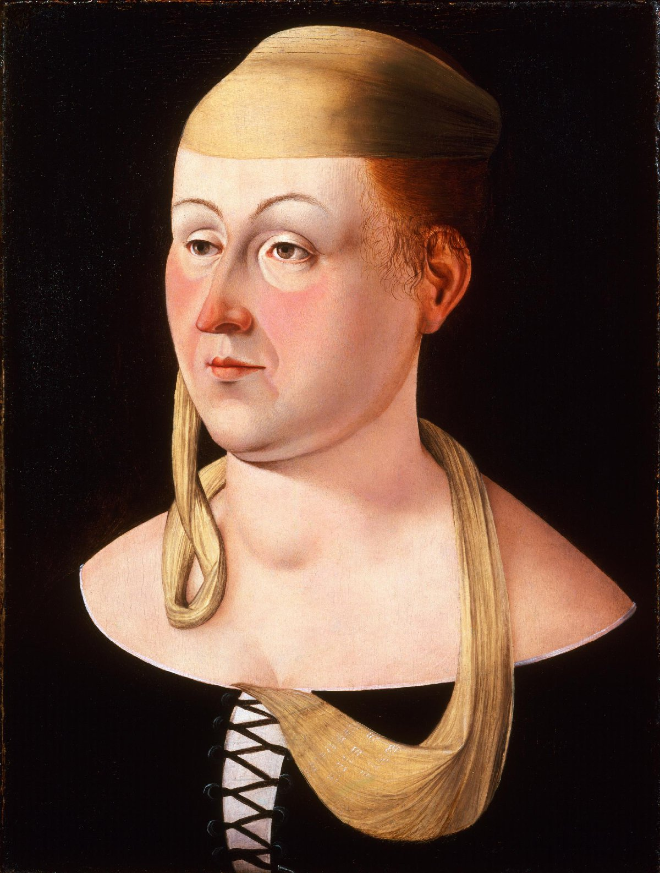
The art of observation
_{S.Mangione}
_{Journal of General}
_{Internal Medicine.}
_{2018 Dec;33:2244-7}
Alopecia
Inflamed lachrymal duct (Sjögren’s)
butterfly rash
polychondritis
Goîire
Auto-Immune thyroiditis
Portrait of a Lady
Jacometto Veneziano, c.
1470s.Philadelphia Museum of Art
Systemic
Lupus
Erythematosis
Notes:
Mangione S, Mockler GL, Mandell BF. The art of observation and the observation of art: Zadig in the twenty-first century. Journal of General Internal Medicine. 2018 Dec;33:2244-7.

Slide 5
I want to find the right algorithm
Nowadays, clinicians seem to spend
more time looking at the computer
screen than at the patient.
Failing to see, hear (listen) and feel
(examine)
I want to tell you what I am worried about
“I’m Not Feeling Like I’m Part
of the Conversation”
Journal of general internal medicine. 2020 Jun;35:1751-8.
Notes:
Gordon HS, Solanki P, Bokhour BG, Gopal RK. “I’m not feeling like I’m part of the conversation” patients’ perspectives on communicating in clinical video telehealth visits. Journal of general internal medicine. 2020 Jun;35:1751-8.

Slide 6
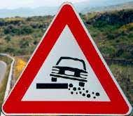
Comme dans tout voyage...
….il peut y avoir des obstacles!!!

Slide 7
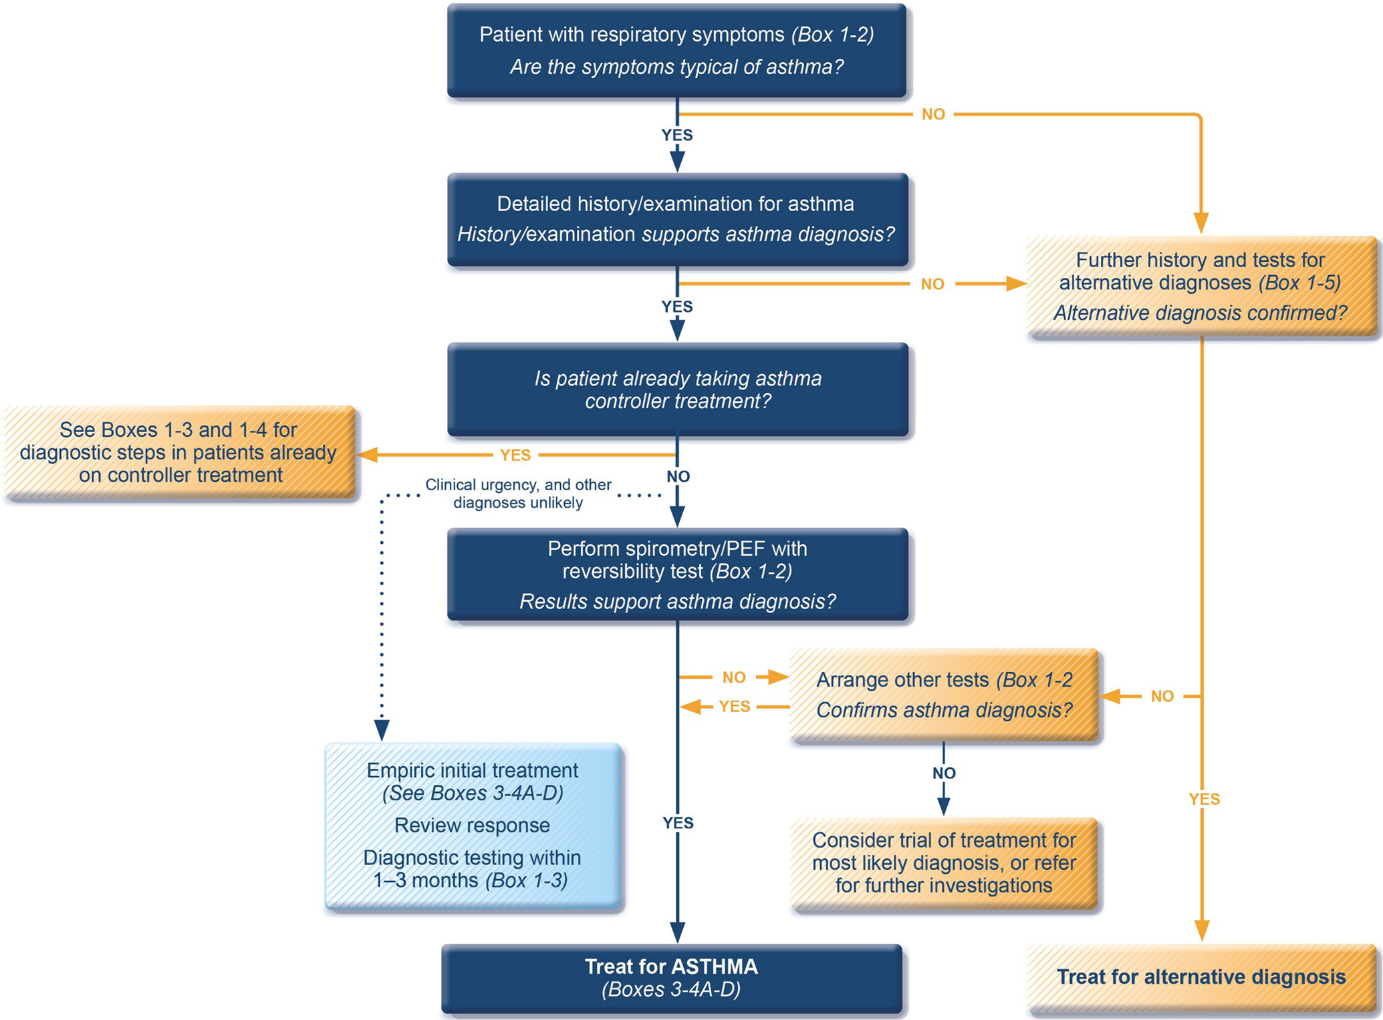
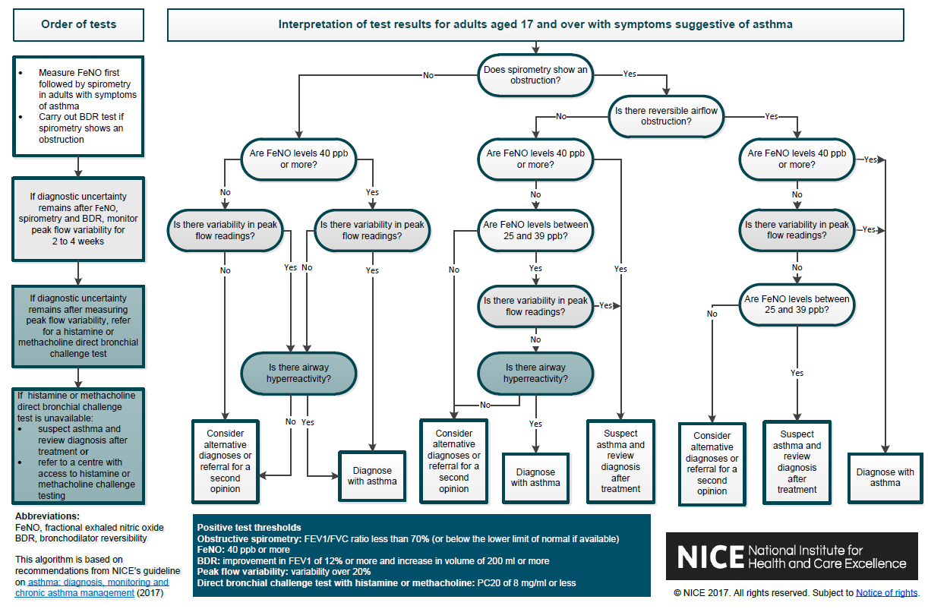
Current guidelines crate complexity: They do not facilitate clinical reasoning
GINA 2023
NICE, UK, 2017

Slide 8
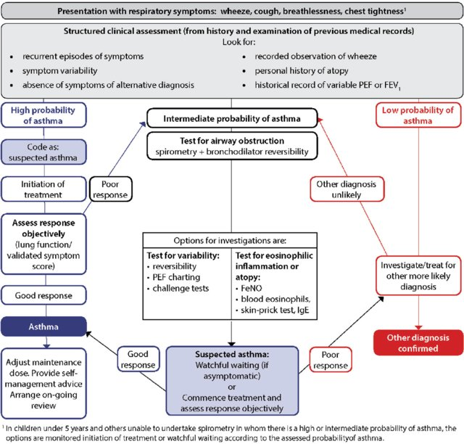
SIGN/BTS Guideline
Clinical table of key symptoms: wheeze, cough, shortness of breath, chest tightness
Highly likely to be asthma
Possiblity of asthma
Asthma unlikely

Slide 9
What are guidelines?
A collection of current evidence
An attempt to standardize care
A useful reference point
An excellent starting point in training
A GUIDE to clinical decision making

Slide 10
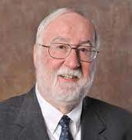
A few words of wisdom about guidelines
Good doctors use both individual clinical expertise and the best available external evidence, and neither alone is enough.
Without clinical expertise, practice risks becoming tyrannised by evidence, for even excellent external evidence may be
inapplicable to or inappropriate for an individual patient. Without current best evidence, practice risks becoming rapidly out of date, to the detriment of patients.
David Sackett
“Father of EBM”
Sackett DL & al., « Evidence based medicine: what it is and what it isn't », BMJ, vol. 312, nº 7023,‎ 1996, p. 71–2

Slide 11
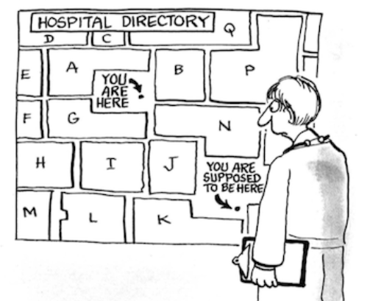
Are guidelines failing…?
They are used by managers and politicians
Blind adherence reduces the capacity for clinical reasoning
They may interfere with research
They often do not apply to the individual patient

Slide 12
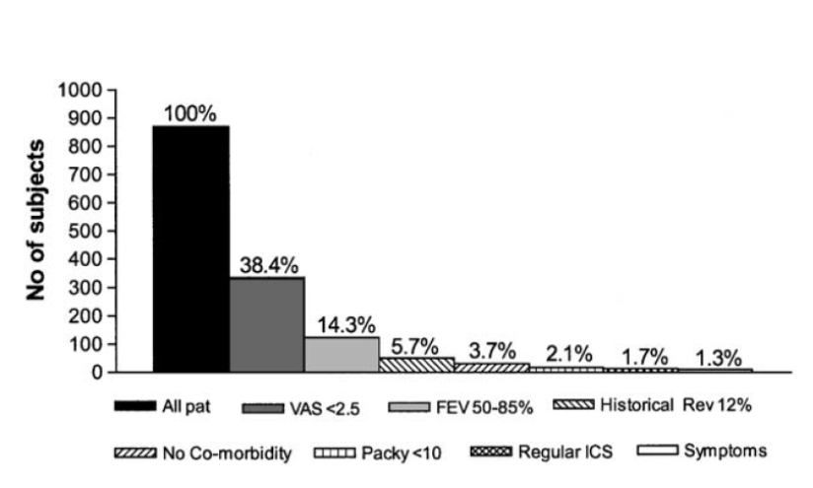
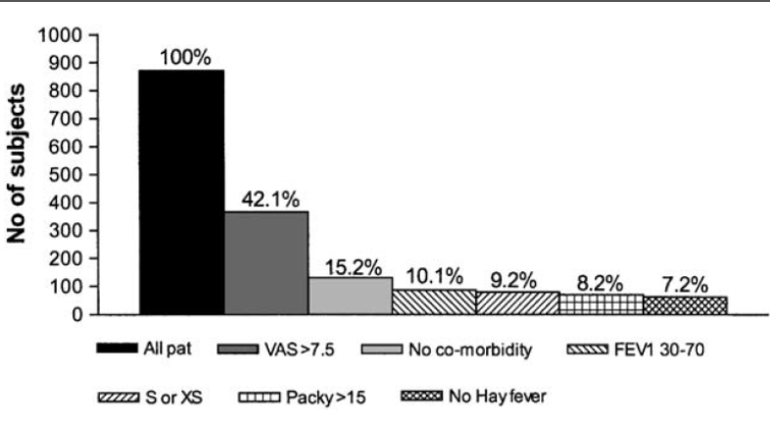
Limitations: RCTs inclusions/exclusions
Patient RCT eligibility drop-off with sequential application of standard inclusion criteria
Studies have shown that efficacy RCTs exclude about 95% of asthma and 90% of COPD routine care populations due to strict inclusion criteria.¹
COPD
Asthma
1. Herland K, et al. Respir Med 2005;99:11–19.

Slide 13
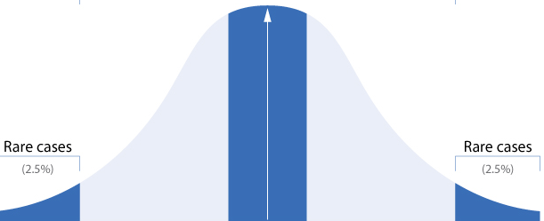
What proportion of the populations needs are met by guidelines?
45% 55%

Slide 14
Evidence based medicine: EBM
Clinical
experience
Research
evidence
Guideline
Directed
Care
Guideline
Informed
Care
Decision
Patient Preferences
Sackett DL et al,
BMJ 1996; 312(7023): 71-72

Slide 15
However, patients present with an unstructured collection of symptoms
http://www.jigzone.com/puzzles/BA055D4CF4A2

Slide 16
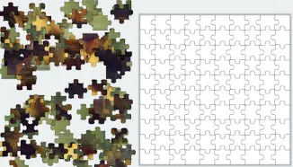
Asthma diagnosis is like a jigsaw puzzle

Slide 17
Half-day ‘puzzle’ workshop: IPCRG, Malaga, 2022
Four working groups in two rounds negotiated and prioritized jigsaw pieces most relevant for building a clinical picture of asthma
This process can be repeated and contextualized at national level
Presentation
Symptoms and physical examination
History
Objective tests
https://www.youtube.com/watch?v=jguPHc8XHDE

Slide 18
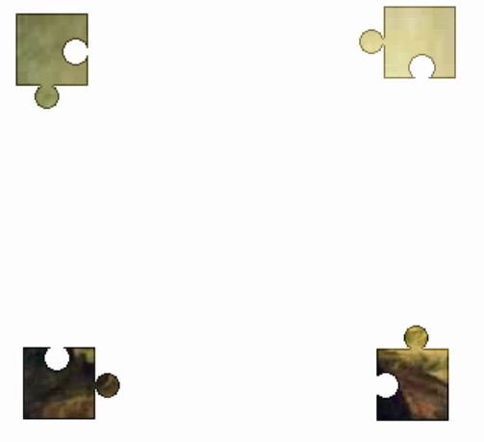
People often prefer starting with the corners, the clear and safe clinical signs and symptoms
Presentation
Symptoms and
Physical examination
History
Objective tests

Slide 19
Defining the content for asthma diagnosis
Presentation
Symptoms and physical examination
History
Objective tests
Personal and family
Examples:
Occupation
Atopy
Smoking
Hobbies
Rhinitis
Why has the person come to see you?
Examples:
Tight chest
Wheeze
Cough
‘Infection’
Breathless
Chest pain
Ask about symptoms and conduct physical exam
Examples:
Wheeze
Night-time symptoms
Variability
Fatigue
Exercise intolerance
Bronchodilator responsiveness (spirometry preferred)
Alternative tests of BD responsiveness
Serial peak flow
Micro-spirometry
(Response to treatment)
Other: FeNO, Eos, SIgE
These factors and their relative importance may differ at national level
BD, bronchodilator.

Slide 20
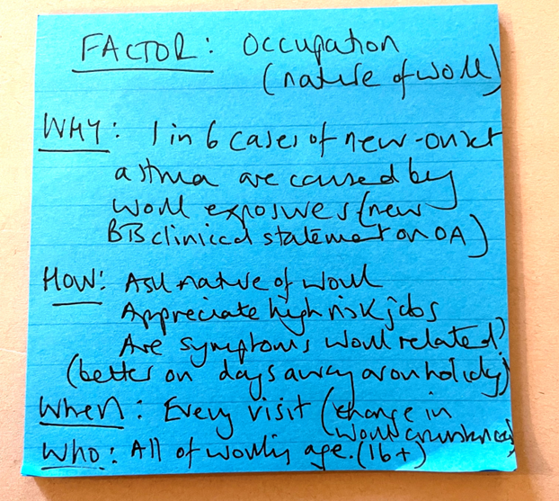
Puzzle piece: Occupation
WHY? | How will it influence decision-making?
HOW? | How will you elicit it? (question, test, observation, other); How will you interpret the answer? How will you code it?
WHEN? | When would you ask? (first consultation, subsequent, every time, once…)
WHO? | All, child, adult, sub-group?

Slide 21
The jigsaw puzzle approach
is a way of thinking
it is not all inclusive
it does not rely on all the pieces of the puzzle to be present
clarity of thought and reasoning leads to clarity of diagnosis

Slide 22
People often prefer starting with the corners, the clear and safe clinical signs and symptoms
Symptoms and
Physical examination
Presentation
Objective tests
History

Slide 23
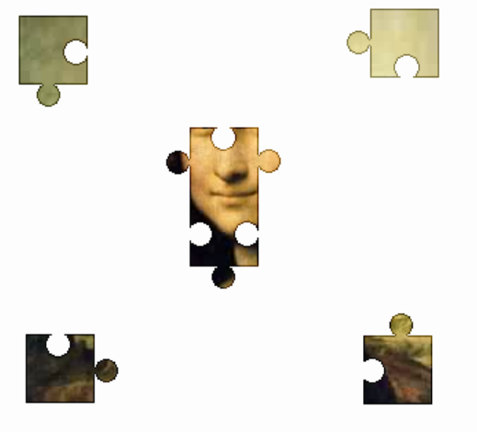
Sometimes we find clinical signs which allow us to leap to the conclusion.
Presentation
Symptoms and
Physical examination
Airway dysfunction
History
Objective tests

Slide 24
Combinations of pieces are more revealing than individual pieces e.g cough wheeze shortness of breath

Slide 25
Sometimes a crucial piece is missing Why?

Slide 26
Things some- times do not add up…..

Slide 27
Some signs/symptoms, puzzle pieces, do not fit: Look for another picture
haemoptysis
paraesthesiae

Slide 28
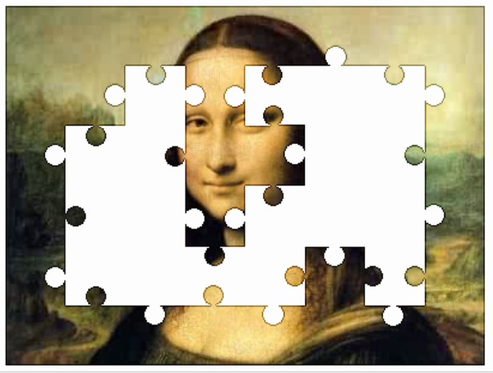
Even if all the signs and symptoms are not present diagnosis becomes clear

Slide 29
With history and examination we may be pretty certain
haemoptysis
paraesthaesia

Slide 30
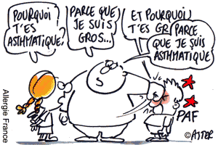
Pause for thought
Because I am fat
Because I have asthma!
Why do you have asthma?
And why are you fat?

Slide 31
Overlapping symptoms lead to diagnostic challenges
Obesity
De-conditioning
Dysfunctional breathing
Vocal cord dysfunction
Exercise Induced Laryngeal Obstruction (EILO)
COPD
GORD
Pulmonary fibrosis
Angina
Heart failure
Cystic Fibrosis
May mimic
or
may co-exist

Slide 32
Now, The picture is complete!!

Slide 33
A worked example
Clinical table of key symptoms: wheeze, cough, shortness of breath, chest tightness
Highly likely to be asthma
Possiblity of asthma
Asthma unlikely
SIGN/BTS
Guideline

Slide 34
Assembling the pieces: Asthma possible
Presentation
Symptoms and
physical exam
20 y.o. man
“I need more Ventolin”
10-20 puffs per day
daily Sx
Anxiious, annoyed.
Peak flow 580 (exp: 600 l/m
Pulse rate, reg 80/min
chest exam completely normal
Symtoms, cough, wheeze, night waking, exercise intolerance.
Mother had AD
Had eczema as a child
Hay fever.
Delivery man, non smoker
Objective Tests
Nil
History

Slide 35
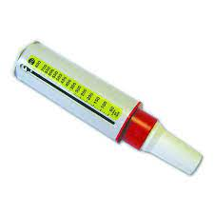
missing pieces: objective facts
Do not rely on one measurement of respiratory function
0–14% variability | Uncharacteristic of asthma
15–19% variability | Supports diagnosis of asthma
20–30% variability | Mild persistent asthma
31–100% variability | Moderate to severe persistent
26% variabilité
48% variabilité
PEF𝑚−PEF𝑒
0.5 (PEF𝑚+PEF𝑒)×100
Commence ICS
Notes:
Kunzli N, Stutz EZ, Perruchoud AP, Brandli O, Tschopp JM, Bolognini G, Karrer W, Schindler C, Ackermann-Liebrich U, Leuenberger P. Peak flow variability in the SAPALDIA study and its validity in screening for asthma-related conditions. American Journal of Respiratory and Critical Care Medicine. 1999 Aug 1;160(2):427-34.
Burge PS, o'Brien IM, Harries MG. Peak flow rate records in the diagnosis of occupational asthma due to colophony. Thorax. 1979 Jun 1;34(3):308-16.
Cross D, Nelson HS. The role of the peak flow meter in the diagnosis and management of asthma. Journal of allergy and clinical immunology. 1991 Jan 1;87(1):120-8.

Slide 36
Response to treatment after two weeks.
6% variabiliy
Note response to treatmentt
GINA 2022:
significant response after 4 weeks.
FEV1 > 12% ou 200ml
Peak flow >20%
Notes:
ERS Task force: European Respiratory Society Guidelines for the Diagnosis of Asthma in Adults
Recommendation • The TF suggests not recording PEF variability as the primary test to make a diagnosis of asthma diagnosis (conditional recommendation against the test, low quality of evidence) Remarks • PEF may be considered if no other lung function test is available including spirometry at rest and bronchial challenge testing • PEF should be monitored over a two--week period and a variation of >20% considered as supportive of asthma diagnosis • PEF variability

Slide 37
Gathering information over time
Gave a history consistent
with asthma
Physical examination at
presentation was normal
There were no objective signs available
Family and personal PMH were
helpful
New pieces of the puzzle:
demonstration of airway variability
response to treatment with ICS
Astjhma diagnosis secured!!
Notes:
ERS Task force: European Respiratory Society Guidelines for the Diagnosis of Asthma in Adults
Recommendation • The TF suggests not recording PEF variability as the primary test to make a diagnosis of asthma diagnosis (conditional recommendation against the test, low quality of evidence) Remarks • PEF may be considered if no other lung function test is available including spirometry at rest and bronchial challenge testing • PEF should be monitored over a two--week period and a variation of >20% considered as supportive of asthma diagnosis • PEF variability

Slide 38
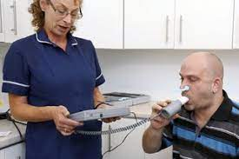
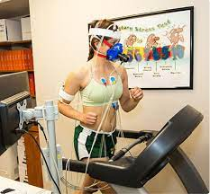
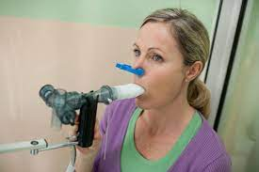
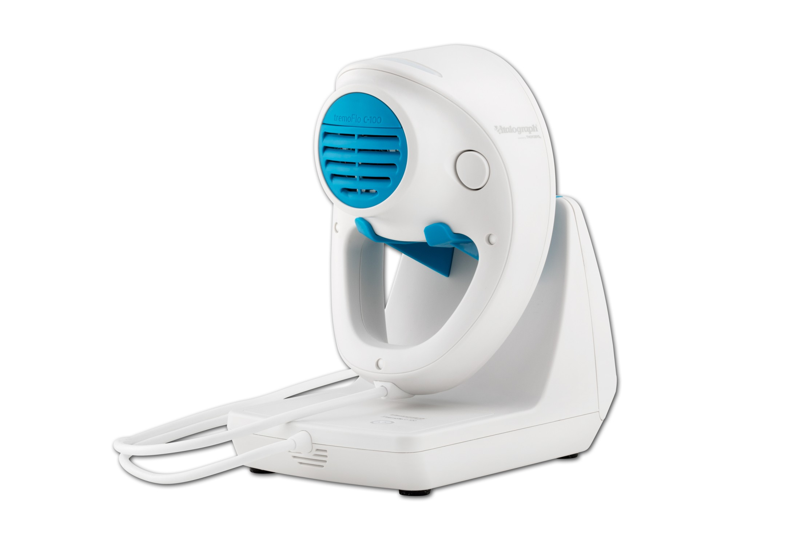
Other tests of pulmonary function
Spirometry with reversibility
Exercise challenge test
Bronchoprovocation (methacholine, mannitol)
The role of oscillometry is yet unclear
Comments:
Strong recommendation, low quality evidence
normal test does not exclude asthma
May be carried out informally in primary care
Frequently used in secondary care if diagnosis is difficult to establish
Quick and easy to use. Evidence is accumulating of it’s clear benefits
Notes:
An exercise challenge test (ECT) is a non-obtrusive, real-life test that provides patients, caregivers and medical professionals more insight into the predominant cause(s) of exertional dyspnea. An ECT is an indirect bronchoprovocation test assessing bronchial hyperreactivity to exercise. Subjects perform a submaximal effort during 4–6 min, attempting to provoke recognizable symptoms (48). Lung function is measured at baseline, post-exercise and post-salbutamol. EIB is diagnosed when exercise results in a fall in FEV1 (or FEV0.5) of ≥ 13–15% post-exercise compared to baseline (31). Indirect challenge tests trigger airway narrowing through activation of the endogenous inflammatory pathways involved in asthma. Direct bronchoprovocation challenges (e.g., methacholine) do not activate these pathways but act directly on the airway smooth muscle receptor. They are generally more sensitive but less specific than indirect bronchoprovocation challenges (49, 50). An advantage of an ECT compared to other direct and indirect tests is the possibility to identify other causes of exertional dyspnea besides EIB during one test (19, 51). Figure 1 visualizes the steps and points of attention during the phases of an ECT.

Slide 39
A couple of tips
Treat according to the patients needs
Work in collaboration with the patient
Do not rely on a single measurement of respiratory function
Lung function tests are best carried out when the patient is symptomatic or uncontrolled.
Record the criteria on which the diagnosis was made
Examine correctly

Slide 40
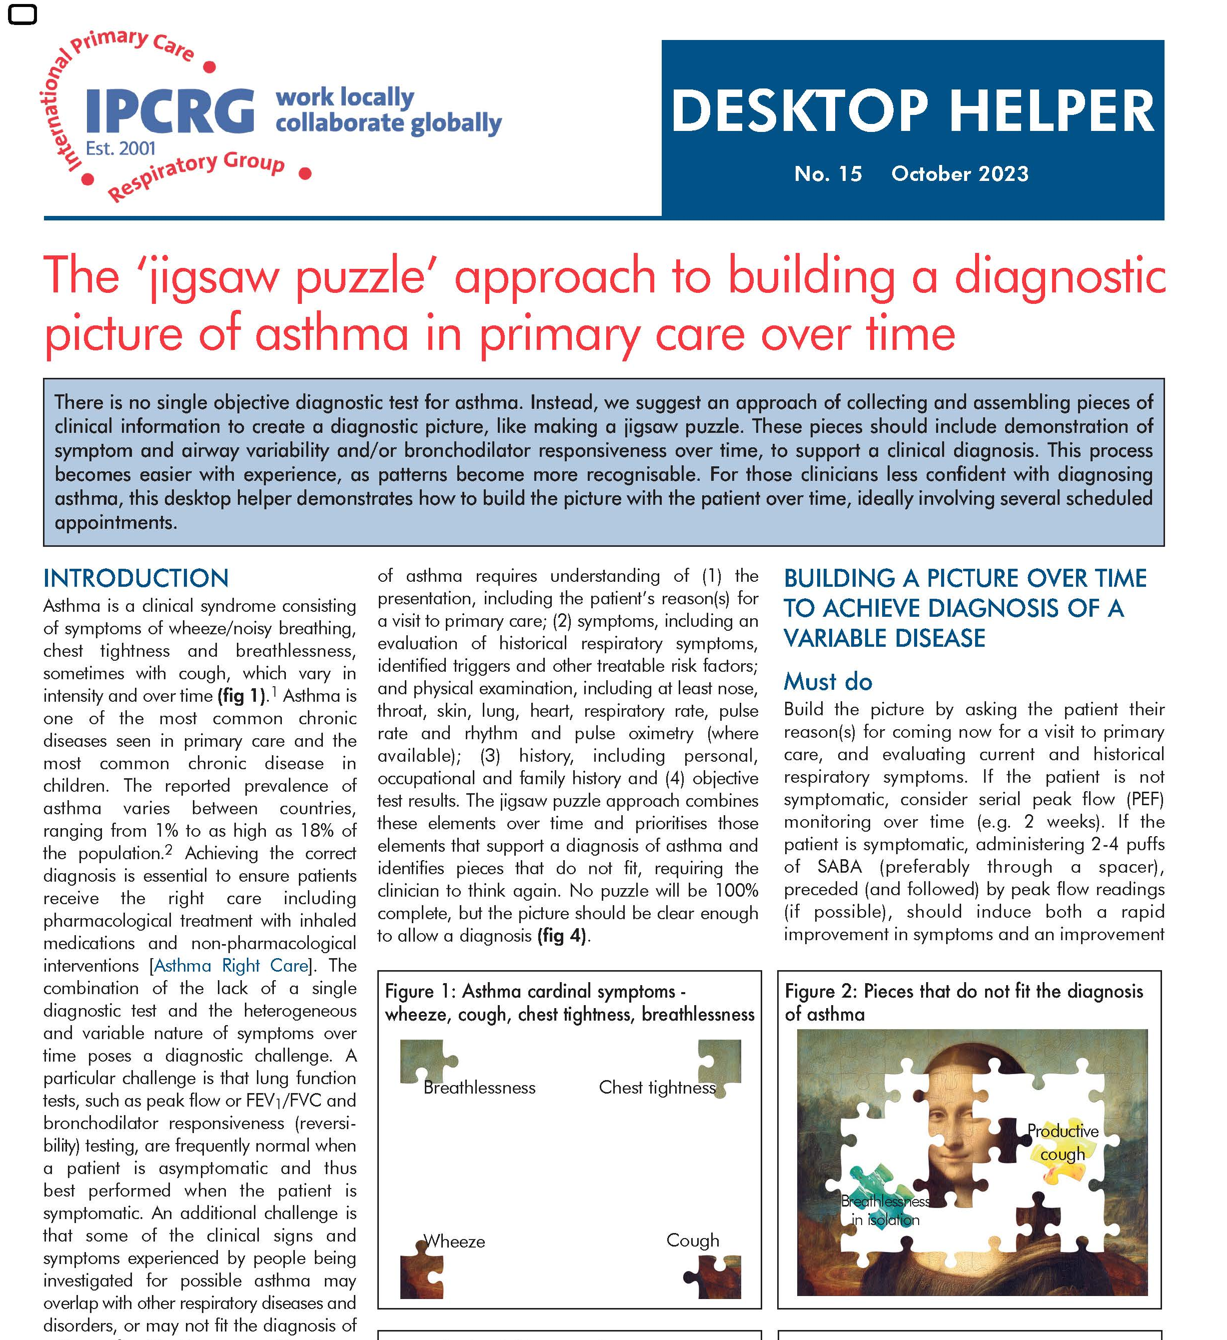
available at:
https://www.ipcrg.org/DTH15

Slide 41
Asthma diagnosis is a complex but essential task
Asthma management is multidimensional
Patient engagement is essential
There is a knowledge and skills deficit amongst HCPs
There is plenty of work for EUFOREA to do

