Slide 1
About these slides
Please feel free to use, update and share some or all of these slides in your non-commercial presentations to colleagues or patients
The slides are provided under creative commons licence CC BY-NC-ND
BY stands for attribution (the obligation to credit the author and other parties designated for attribution)
NC stands for NonCommercial (commercial use is excluded from the license grant)
ND means NoDerivatives (only verbatim copies of the work can be shared)
When using our slides, please retain the source attribution: DESKTOP Helper No. 11. www.ipcrg.org/dth11

Slide 2
Remote Respiratory Consultations [Your name] Other acknowledgements: Slides prepared by Siân Williams and Tracey Lonergan Expert panel of clinicians and patients: see slide 22 Reviewers: Joseph Wherton and Sundeep Salvi

Slide 3
Aims
DESKTOP Helper No. 11. www.ipcrg.org/dth11
Describe how remote consultations can be a useful alternative to face-to-face consultations in primary care
Enable HCPs to decide when a remote consultation may be appropriate, and when it may not
Empower HCPs to utilise and deliver remote consultations efficiently and effectively to meet the needs of individual patients
HCP, healthcare professional

Slide 4
What is a remote respiratory consultation?
DESKTOP Helper No. 11. www.ipcrg.org/dth11
Remote respiratory consultations are any consultation without physical contact between the HCP and the patient via:
Telephone
Video call
Web-based services used a smart phone, tablet or computer

Slide 5
When to consider a remote consultation
DESKTOP Helper No. 11. www.ipcrg.org/dth11
Consider a remote consultation for:
Telephone triage to decide which patients need face-to-face contact
Routine reviews
Medication review, including polypharmacy
Inhaler technique training and evaluation (video consultations)
Multidisciplinary consultations
Education and support (individual or group)
Pulmonary rehabilitation (individual or group)

Slide 6
Deciding on remote or face-to-face?
DESKTOP Helper No. 11. www.ipcrg.org/dth11
Consider a remote consultation if: | Consider a face-to-face consultation if:
Patient agrees or expresses a preference Patient is comfortable with the technology Both have access to smartphone or webcam Travel or parking difficulties, financial issues Supports involvement of family living apart from the patient Enables insight into the home situation Patient has equipment for observations (e.g. oxygen saturation, temperature, blood pressure, peak flow) Face-to-face consultation puts individual at risk | Patient expresses a preference Patient has Complex needs Hearing or sight problems Low digital literacy No access to internet Low trust for accuracy, safety or confidentiality of remote consultation There is a lack of privacy at home

Slide 7
Beware!
Be conscious of how the community might perceive any variation in approach between patients
Avoid increasing inequity for those who cannot use or afford apps or other home-based technology

Slide 8
Can exacerbations be assessed remotely?
DESKTOP Helper No. 11. www.ipcrg.org/dth11
Only consider remote assessment if the patient is well known to you
Triage for red flag symptoms and consider an urgent face-to-face assessment or direct to emergency care
Provide self-management tips and check these are understood
Red flags for urgent review:¹
Sudden onset or severe shortness of breath
Pain or pressure in the chest
Cold clammy or pale and mottled skin
Unexplained weight loss
Coughing up blood
Blue lips or face
High temperature
New pain
1. Greenhalgh T, et al. BMJ 2020;368:m1182.

Slide 9
Best used in context of chronic disease management

Slide 10
Can a diagnosis be reached remotely?
DESKTOP Helper No. 11. www.ipcrg.org/dth11
Only consider when the need for infection control is paramount
Video offers the closest match to face-to-face consultation
Conduct a structured clinical assessment
Consider possibility of home testing of vital signs and peak flow
Questionnaires may help and can be completed before or during the consultation
Be clear that a ‘suspected diagnosis’ has been reached and follow-up consultations/tests will likely be required
Help patients navigate to approved information and are clear what to do if their symptoms persist or worsen

Slide 11
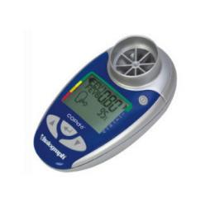
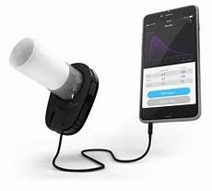
Tests that can be done remotely
DESKTOP Helper No. 11. www.ipcrg.org/dth11
Vital signs: temperature, pulse, respiratory rate
https://www.youtube.com/watch?v=Y-CWTqKilhQ
Pulse oximetry
https://www.youtube.com/watch?v=Y-CWTqKilhQ
Peak flow test
https://www.asthma.org.uk/advice/manage-your-asthma/peak-flow/
Inhaler technique
https://www.asthma.org.uk/advice/inhaler-videos/
1 minute sit-to-stand
COPD-6
AirSmart

Slide 12
Questionnaires that can be completed remotely
DESKTOP Helper No. 11. www.ipcrg.org/dth11
Breathlessness
MRC Breathlessness Scale Modified MRC
www.pcrs-uk.org/mrc-dyspnoea-scale https://academic.oup.com.ocmed/article/67/496/4095219
COPD
COPD Assessment Test Clinical COPD Questionnaire
https://catestonline.org/ www.ccq.nl
Asthma
Asthma Control Test CARAT RCP 3 questions
https://www.asthmacontroltest.com https://core.ac.uk/download/pdf/62692897.pdf https://cks.nice.org.uk/topics/asthma/management/follow-up/#the-royal-college-of-physicians-3-questions

Slide 13
DESKTOP Helper No. 11. www.ipcrg.org/dth11

Slide 14
Deliver effective remote consultations
DESKTOP Helper No. 11. www.ipcrg.org/dth11
PREPARE IN ADVANCE
SETTING UP
SOCIAL TALK
CLINICAL TALK
CHECK AND CLOSE
TIDYING UP
Prepare well
HCP and patient checklists
Follow a structured approach
Connect and set up
Ask the patient their concerns, take a detailed history, assessment and discuss thoughts and conclusions
Check understanding and agree next steps
Remember to ‘tidy up’ after the consultation – email or message links to further information

Slide 15
Preparing for a remote consultation: Checklist for HCPs
DESKTOP Helper No. 11. www.ipcrg.org/dth11
Am I aware of this patient’s needs?
Can I access their medical history?
Do I know the patient’s goals?
What is their physical, smoking and mental health status?
Do they have access to a phone, smartphone, tablet or computer?
Should I be expecting any questionnaire results or peak flow diary?
Do they have access to respiratory function testing equipment? Can they use it correctly?
Do I need to see them – if so, is a video consultation possible?
Is the family/home condition supportive?

Slide 16
Preparing patients for a remote consultation
DESKTOP Helper No. 11. www.ipcrg.org/dth11
Dear Patient
To help you prepare for our remote consultation please check:
Have I completed any tests, diary or questionnaires my HCP has sent?
Have I prepared a list of questions for my HCP?
Am I in a quiet and private place?
Which symptoms are bothering me most at the moment?
Do I have my medications to hand, including my inhaler(s)?
Do I have a pen and paper to hand to make notes?
Do I have my glasses/hearing aid with me (if I need them)?

Slide 17
Guide to remote consultation: for HCPs
DESKTOP Helper No. 11. www.ipcrg.org/dth11
PREPARE IN ADVANCE
SETTING UP
SOCIAL TALK
CLINICAL TALK
CHECK AND CLOSE
TIDYING UP
Review patient notes and recent history
Connect and check patient can see/hear you
Ensure privacy and if anyone is with patient
Contingency plan (what to do if cut off)
Operational talk: instructing and guiding the patient to
support the consultation
improve the quality of the consultation or during physical examinations (e.g. asking the patient to speak louder, reposition the webcam or change the lighting)
Repair talk
Correct significant disruption to the flow of the consultation due to latency or technical breakdowns e.g. pause, invite patient to continue talking when overlap/interr-uption occurs
Greet, non-clinical talk
Provide reassurance to build rapport and put patient at ease
Ask for description of concerns & priorities for the consultation
Take a detailed & focused history
Gather any physical assessments the patient is able to provide
Discuss thoughts & conclusions and decide on a course of action
OPERATIONAL TALK
REPAIR TALK
Check understanding of agreed action
Advise on reliable sources of information
Make sure the patient can collect any prescriptions
Arrange follow-up consultations with yourself or other HCP as needed
Send promised links and/or information

Slide 18
Guide to remote consultation: for patients
DESKTOP Helper No. 11. www.ipcrg.org/dth11
PREPARE IN ADVANCE
SETTING UP
SOCIAL TALK
CLINICAL TALK
CHECK AND CLOSE
TIDYING UP
Check access to call system and points for discussion
Have medications and any inhalers near you
Operational talk: instructing and guiding the patient to
support the consultation
improve the quality of the consultation or during physical examinations (e.g. asking the patient to speak louder, reposition the webcam or change the lighting)
Connect and check HCP can see/hear you
Let HCP know if anyone is with you
Contingency plan (what to do if cut off)
Repair talk
Correct significant disruption to the flow of the consultation due to latency or technical breakdowns e.g. pause, invite patient to continue talking when overlap/interr-uption occurs
Greet, non-clinical talk
OPERATIONAL TALK
Provide a description of concerns and priorities for the consultation
Provide any physical assessments the HCP requests
Discuss thoughts and conclusions and decide on a course of action
REPAIR TALK
Agree and clarify understanding of plan of actions
Take note of advice on reliable sources of information
Confirm you can collect any prescriptions
Check how to arrange follow-up consultations
Look out for promised links/information

Slide 19
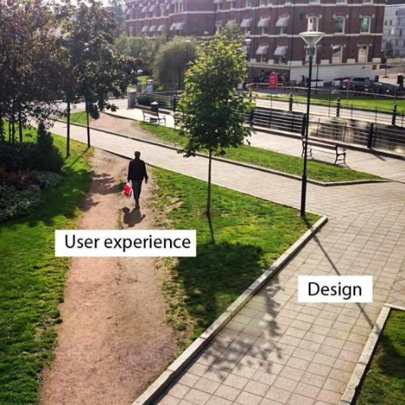
Remote respiratory consultations: Certainties
Needed to protect HCP and patient during COVID
Will change practice forever: new “desire lines”
Must create at least equivalent experience for HCP and patient
Quiet and private, not phoning from supermarket or driving
Needs preparation and follow up
Best for routine care not new diagnosis
Some tests can be done remotely
Video better but sometimes only phone possible
Takes as long or longer than face to face
Risk of increasing inequity for people with respiratory problems:
Poverty, educational level means risk of digital exclusion
Desire line
Williams S, et al. J Health Serv Res Policy 2022;Online ahead of print: doi: 10.1177/13558196221140318.
Notes:
Image source: https://99percentinvisible.org/article/least-resistance-desire-paths-can-lead-better-design/

Slide 20
Remote respiratory consultations: Uncertainties
How will IT systems be set up to enable it?
e.g RCGP UK calling for £1 billion investment in digital infrastructure for general practice
How to increase digital and health literacy of older patients?
Future of apps and other tests
Where pendulum between face to face and remote will stop
What is the default – phone or video?
Should be guided by patent choice but will it?
How it will be reimbursed?
Williams S, et al. J Health Serv Res Policy 2022;Online ahead of print: doi: 10.1177/13558196221140318.
Notes:
Image source: https://encrypted-tbn0.gstatic.com/images?q=tbn%3AANd9GcRGELGhzOIPepA-tlXuvx7pioo9ctAjqlyt1w&usqp=CAU

Slide 21
Additional remote respiratory consultations resources
Visit the webpage www.ipcrg.org/dth11 for access to:
Desktop Helper No.11 – Remote Consultations
Remote Consultations Policy Paper¹
Access to useful respiratory tests that can be done remotely
Remote respiratory consultation videos
Translations of materials
Examples of app-based technologies
1. Williams S, et al. J Health Serv Res Policy 2022;Online ahead of print: doi: 10.1177/13558196221140318.

Slide 22
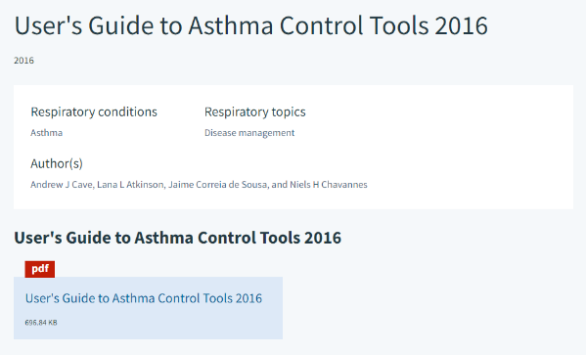
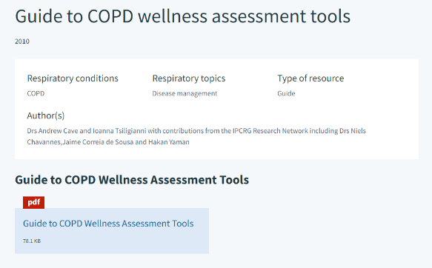
Other useful IPCRG resources
https://www.ipcrg.org/resources/search-resources/users-guide-to-asthma-control-tools-2016
https://www.ipcrg.org/resources/ipcrg_users_guide_to_copd_wellness_tools.pdf

Slide 23
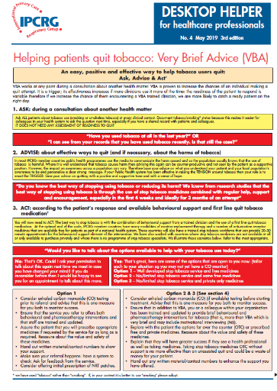
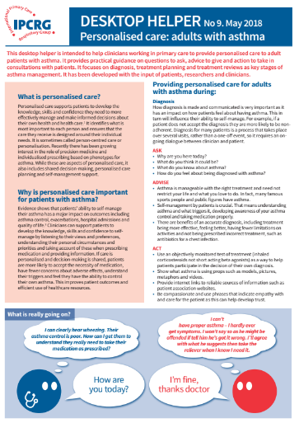
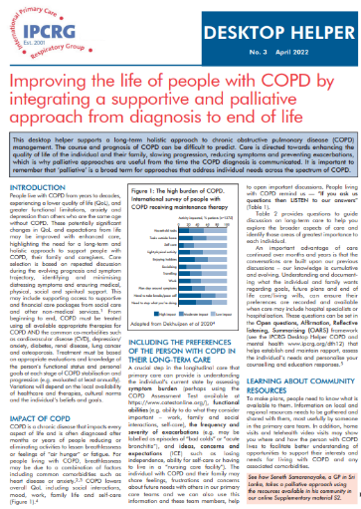
Other useful desktop helpers
DESKTOP Helper No. 4. www.ipcrg.org/dth4
DESKTOP Helper No. 9. www.ipcrg.org/dth9
DESKTOP Helper No. 3. www.ipcrg.org/dth3

Slide 24
With thanks to our expert panel of clinicians and patients
DESKTOP Helper No. 11. www.ipcrg.org/dth11
Amanda Barnard (Australia)
Phil Collis (UK)
Jaime Corrieia de Sousa (Portugal)
Suraj Ghimire (Nepal)
Monsur Habib (Bangladesh)
Tessa Jelen (UK)
Frank Kanniess (Germany)
Vince Mak (UK)
Sonia Martins (Brazil)
Ema Paulino (Portugal)
Hilary Pinnock (UK)
Miguel Roman (Spain)
Hanna Sandelowsky (Sweden)
Ioanna Tsiligianni (Greece)
Laurine van der Steen (The Netherlands)
Fabio Weber Donatelli (Brazil)

Slide 25
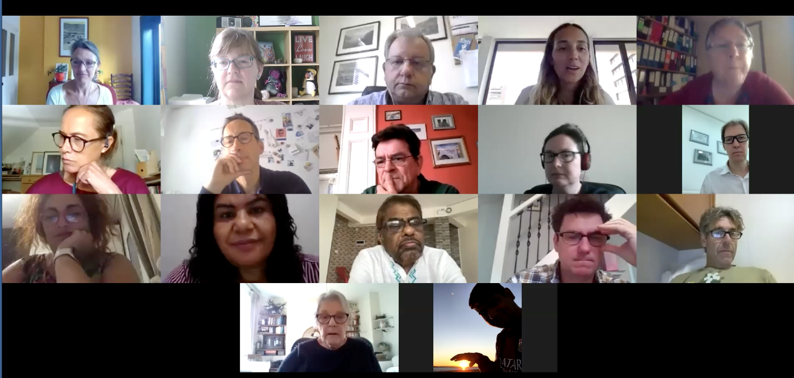
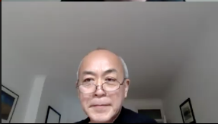
Expert panel
DESKTOP Helper No. 11. www.ipcrg.org/dth11

Slide 26
Questions?

Slide 27
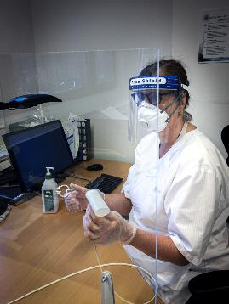
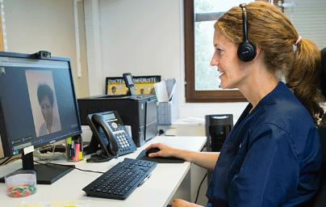
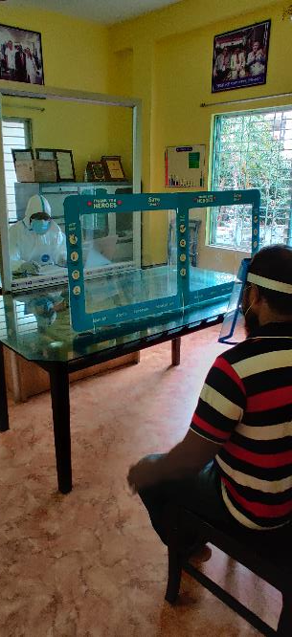
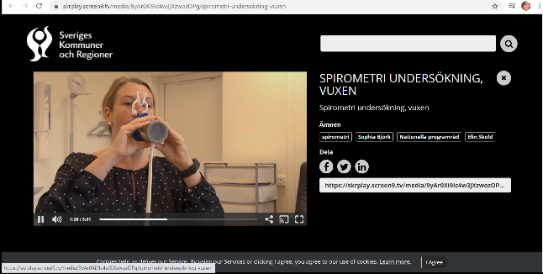
Remote respiratory consultations images

Slide 28
Figures and tables reproduced from the paper

Slide 29
PHASE 1: SITUATION ANALYSIS
What are the challenges, barriers and policy implications of integrating remote consultations into primary health care delivery?
Preliminary literature search and topic definition
Quantitative data generation
Clinician participants shared their experience of remote consultation delivery before and during the COVID-19 pandemic
Clinician questionnaire:
What proportion of your current clinical contact with patients is undertaken remotely?
What proportion of your current clinical contact with colleagues is undertaken remotely?
How does that compare with the proportion of remote working you undertook this time last year?
Meeting 1
PHASE 2: INSIGHT GENERATION
Review of literature and experience sharing
Meeting 2
Insights generation and preliminary identification of healthcare policy implications
PHASE 3: EXPERIENCE-LED CONSENSUS GENERATION
Meeting 3
Consensus on key healthcare policy implications

Slide 30
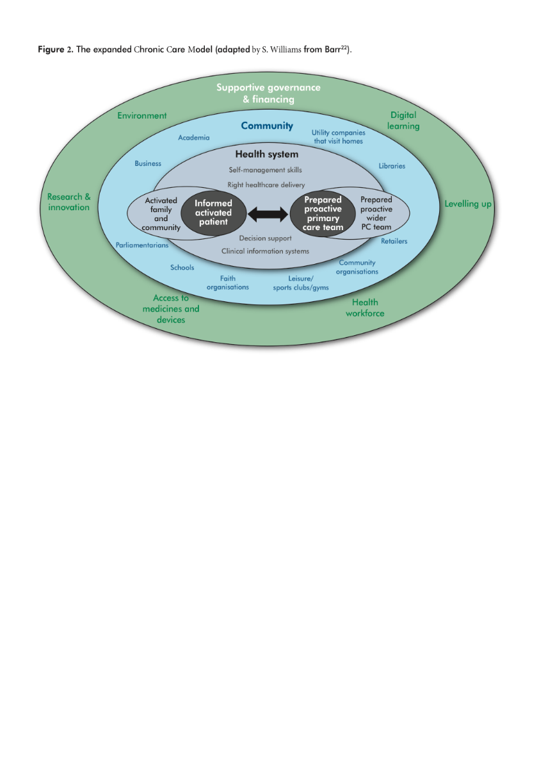

Slide 31
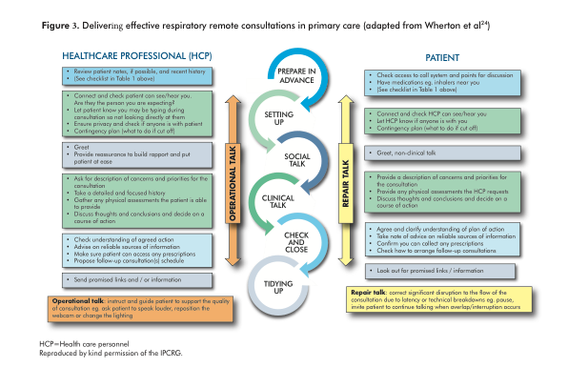

Slide 32
Table 1. Checklist approach to preparing for remote consultations.¹⁰
Checklist for PCPs (some could be done by trained receptionist/administration) | Checklist for patients
Am I aware of this patient’s needs? Can I access their medical history? Do I know the patient’s goals? What is their physical, smoking and mental health status? Do they have access to a phone, smartphone, tablet or computer? Should I be expecting any questionnaire results or a peak flow diary? Do they have access to respiratory function testing equipment? Can they use it correctly? Do I need to see them – if so, is a video-consultation possible? Is the family/home condition supportive? | Have I completed any tests, diary or questionnaire my PCP has sent*? Have I prepared a list of questions for my PCP? Am I in a quiet private space? Which symptoms are bothering me most at the moment? Do I have my medications to hand, including my inhaler(s)? Do I have a pen and paper to hand to make notes? Do I have my glasses with me (if I need them)? *You may prefer to complete these with your PCP during the consultation
PCPs=primary care practitioners
Reproduced by kind permission of the IPCRG

Slide 33
Table 2. Policy implications arising from the integration of the remote consultation model into primary healthcare service delivery
Future healthcare policy should: Ensure both remote and in person consultation opportunities are available to meet the preferences and expectations of patients Promote the potential of remote consultations to improve the coordination and integration of primary and secondary care providers Promote remote assessment and monitoring of chronic disease with due regard to avoiding a ‘digital divide’ for patients unable or unwilling to engage with remote consultations Digital access and literacy are not barriers to patient access to healthcare services
Healthcare policy makers should seek to ensure that: Payment systems are in place that acknowledge the values of patient-HCP interactions Reimbursement issues do not impair the capacity of the appropriate integration of remote consultations into primary care models IT infrastructure and support are available to enable HCPs to utilize remote consultations effectively where appropriate HCPs have the skills required to deliver efficient and effective remote consultations that meet the needs and expectations of patients
HCP, healthcare professional

Slide 34
Understanding the challenge and reaching consensus The following slides detail the process undertaken by the expert group to understand the challenges and reach consensus on key questions about remote respiratory consultations

Slide 35
Method
Three primary care focus groups from low, middle, high income countries between December 2020 and January 2021
Rural, remote and urban settings
With patients, clinicians and pharmacist
Literature review
Independent peer review
Funded from an educational grant from Boehringer Ingelheim
No involvement in meetings or resources

Slide 36
1st Meeting objectives
Guide the content of three IPCRG products: a practical desktop helper, a position paper and “how to” videos
Reach consensus on key questions about remote respiratory consultations
Share experience in the delivery of remote respiratory consultations

Slide 37
Pre-work: what does our clinical practice look like now?
 | LvdS | MR | MH | JCdS | HS | EP | SG | SM | FWD | FK
Country | Netherlands | Spain | Bangladesh | Portugal | Sweden | Portugal | Nepal | Brazil |  | Germany
Main clinical role | Patient | PCP | PCP | GP | GP | CPharm | PCP | PCP | Paed | GP, Allergist
What type of patients do you mainly see? | NA | General | All patients with respiratory disease (acute and chronic) | General | Gerneral | General | General | General | General | General, focus respiratory, diabetes
What proportion of your current clinical contact with patients is undertaken remotely? | 90% | 90% | 60% | 45% | 50% | 5% | 0% | 80% | 20% | 2%
What proportion of your current clinical contact with colleagues is undertaken remotely? | 0% | 75% | 50% | 30% | 20% | 10% | 20% | 80% | 80% | 0%
How does that compare with the proportion of remote working you undertook this time last year? | Normally I always go to the practice | Increased hugely | No remote consultations last year | More than double | About doubled | Bigger | Significantly different | Infinitely more this year | 100% bigger | Video consultations are new in COVID times

Slide 38
Agenda of first meeting
Time | Discussion topic
11.45 | Welcome and aims of the meeting
11.50 | What constitutes a ‘remote respiratory consultation’ and what does it look like now in your experience?
12.10 | Exploring different types of patient problem
12.40 | Breakout sessions: How should patients requiring a consultation be triaged? What are the barriers and challenges, and potential solutions, to the delivery of remote respiratory-related consultations
13.10 | Feedback on breakout discussions
13.20 | How can technology be used to establish peer to peer support networks and ‘GP-specialist/other HCP-patient’ networks?
13.40 | Next steps and meeting close

Slide 39
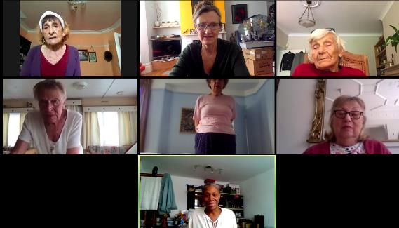
TOPIC 1: What constitutes a ‘remote respiratory consultation’ and what does it look like now in your experience?
Main modes of communication?
Advantages/disadvantages of the different modes and how this is influenced by:
Purpose of the consultation and patient problem
HCP involved
Length of consultation
Patient characteristics
Good examples from other disciplines?

Slide 40
TOPIC 2: What are the elements of a good remote consultation for respiratory problems?
For diagnosis?
For routine management?
For acute management?
For follow-up after an acute presentation?
What should happen before a remote consultation to ensure it is effective?

Slide 41
Breakout sessions

Slide 42
Group A start with Topic 3; Group B start with Topic 4
TOPIC 3: How should patients requiring a consultation be triaged?
Deciding when a remote consultation is appropriate and when it is not
Red flags indicating a need for a face to face consultation
TOPIC 4: What are the barriers, challenges and potential solutions?
Patient safety
Data sharing and governance
Reimbursement issues
Patient expectations
Patient-level access barriers

Slide 43
Feedback from breakout sessions

Slide 44
TOPIC 5: How can technology be used to establish therapeutic networks?
Peer to peer support?
HCP to patient?
HCP to Specialist to Patient?

Slide 45
Post COVID, where are we now: GP view Notes from meeting 2023-01-18
Routines disrupted, not yet back to normal
Need success stories (present at Athens 2024?):
From patients
From office staff about preparation: how to organise and prepare patient, family and HCP
Policy pressures to catch up and use technology but not necessarily time-saving
Targets for responding to patients and time for consultations vary
New patient “desire lines”
Happy to take calls at work, on bus, while driving, walking the dog “Don’t worry I can talk”
Least disruptive where remote options were offered pre-COVID
Changes dynamics of the queue
Telephone calls were used for focused single issues, increasingly straying into several issues (like in person) so hard to manage time
Do lose observational information if online eg seeing face

Slide 46
Managing the queue
Risk of separate queues which is operationally inefficient
Creates operational challenges about continuity of care, communication, prioritisation:
In person on the day queue
Online form and booking
Booked telephone
Advanced booking to see named GP (might be part-time)
In person queues tend to be self-regulating – see the length, decide if important enough to wait; staff on hand can make judgement if someone becoming unwell
Need to find better flow
Balance between accessibility and personalisation
What’s right appointment length…. More shorter (eg Spain/UK, or fewer longer appointments (eg Nordic countries); Portugal in middle

Slide 47
Post COVID, where are we now: Integrated care – respiratory view From meeting 2023-01-18
Remote used routinely for respiratory outpatients
Benefits in saved travel and waiting time and risk of COVID particularly if feeling breathless
Learning how to make it work after 3 years:
One text reminder, have phone number to call patient if they don’t turn up
First appointment in person to set baselines and start a relationship
Follow up can be in person or online or phone – about 50/50 split in preference
Use texts etc to convey test results
In person if worried about their breathlessness, to check inhaler technique
Hand out pulse oximeters so can ask patient to use if suspect an urgent situation
Use sit to stand to test for desaturation
Have advantage of an exacerbation helpline – training patients to ring earlier to avoid need for admission; bypass GP
Can also offer home visiting by specialist nurses
Still a local service although some online – doesn’t work to see people from out of area as may need to see them in person (eg doesn’t work to get referrals from online GP systems from outside area)
Single issue – so don’t get problems of “doorknob moments”

Slide 48
Post COVID, where are we now: patient view From meeting 2023-01-18
Routines disrupted, not yet back to normal
Instructions and reminders can be overwhelming:
Letters
Multiple texts but hard to respond to say
Preferences for in person and remote depend on:
How you’re feeling that day
Whether it’s a routine booked appointment or urgent
Ease of travel
Fear of COVID
Relationship with GP
Comfort with using technology

