Slide 1
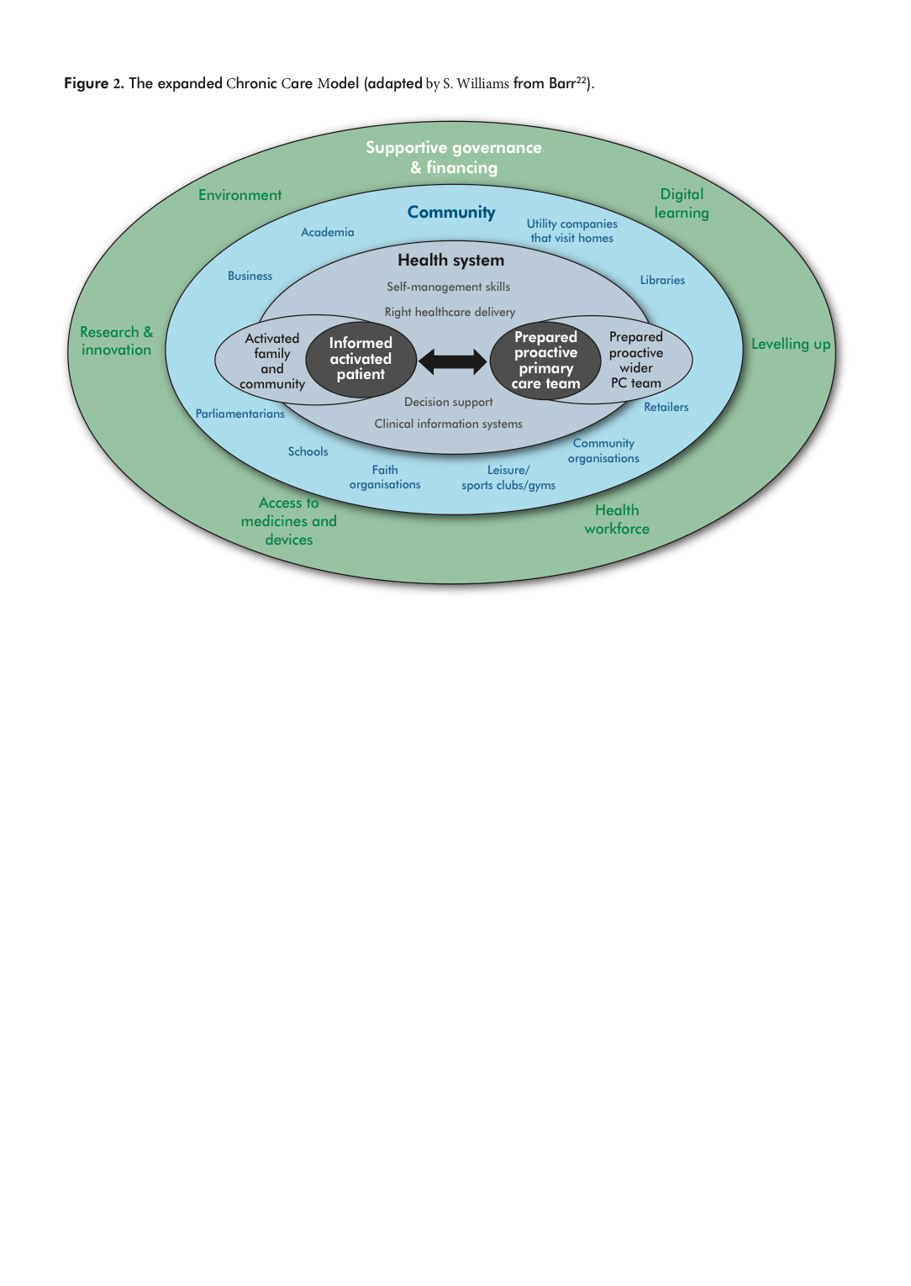
Williams S, Barnard A, Collis P, et al. Remote consultations in primary care across low-, middle- and high-income countries: Implications for policy and care delivery. J Health Serv Res Policy. 2023;28(3):181-189. doi:10.1177/13558196221140318

