Slide 1
WORKSHOP Patient-centred care: management of chronic respiratory diseases
Catalina Panaitescu
Jaime Correia de Sousa
Marina García-Pardo

Slide 2
Aim
To introduce
IPCRG Asthma and COPD Right Care,
To present for discussion
primary care-derived person-centred care statements and aligned primary care competencies
in the format “know, know how to do, and do”
for both asthma and COPD.

Slide 3
Workshop Outline
Introduction
The IPCRG
Patient-centred care
The Asthma Right Care initiative
The COPD Right Care initiative
Group work
Plenary Discussion

Slide 4
Objectives
At the end of the workshop, participants should be able to:
identify what good COPD and asthma care in primary care health looks like;
debate possible improvement actions at the personal, professional and system level;
prioritise those applicable in their setting;
discuss the best framing to galvanise action amongst peers.

Slide 5
Introduction to faculty and participants
Workshop facilitators
Catalina Panaitescu
Jaime Correia de Sousa
Marina García-Pardo
Participants
Please state your name and country

Slide 6
Time | Activity
5 min | Intro of facilitators and IPCRG Brief into of participants
10 | CRD and patient-centred care - issues in general
10 | Asthma- Asthma Right care and tools
10 | COPD Right Care
30 | Small group work
10 | Feedback/ Summary from GW rapporteur
Total 75

Slide 7
Introduction Why CRD What is the IPCRG Patient-centred care and CRD
Jaime Correia de Sousa, MD, PhD
Family Physician
Honorary Associate Professor, School of Medicine, University of Minho, Portugal

Slide 8
Conflict of interest disclosure
I have the following, real or perceived direct or indirect conflicts of interest that relate to this presentation:
Affiliation / financial interest | Nature of conflict / commercial company name
Tobacco-industry and tobacco corporate affiliate related conflict of interest | None
Grants/research support (to myself, my institution or department): | receipts of grants/research supports, honoraria or consultation fees and participation in sponsored speaker's bureau - AstraZeneca, GSK, Bial, Sanofi
Stock shareholder: | None
Spouse/partner: | None
Other support or other potential conflict of interest: | None

Slide 9
Introduction
Asthma and COPD - two important CRD in the community
Often underdiagnosed or misdiagnosed in PHC
Effective and cost-effective pharmacological and non-pharmacological interventions
The key treatment - inhaled medicines
Problems with PHC prescribing, patient adherence to treatment
Over-reliance on or misuse of symptom relief medicines - risks to patient safety

Slide 10
Introduction to IPCRG
International Primary Care Respiratory Group
Our vision is of a global population breathing and feeling well through universal access to right care.
Our mission is to work locally in primary care and collaborate globally to improve respiratory health.
We include multidisciplinary private and public providers

Slide 11
We are the only
Global primary care respiratory group
Representative of primary care on WHO-Global Alliance against chronic Respiratory Diseases (GARD)
Respiratory Group in collaborative relations with WONCA World
Respiratory Special Interest Group of WONCA Europe
And we have top 4 primary care journal (open access), npjPCRM, published by Springer Nature

Slide 12
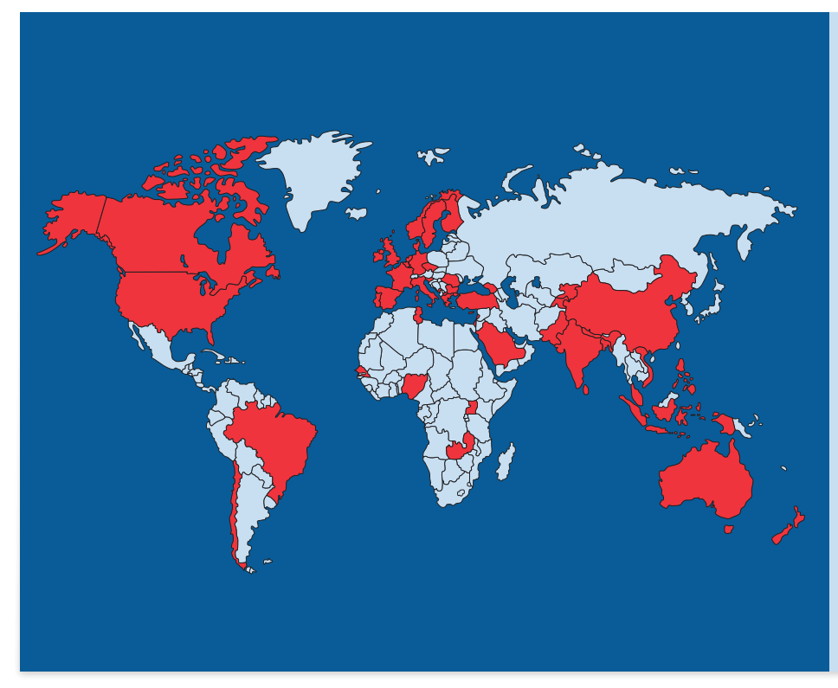
We reach 155,000 primary care colleagues through our 37 country members in high, middle and low income countries

Slide 13
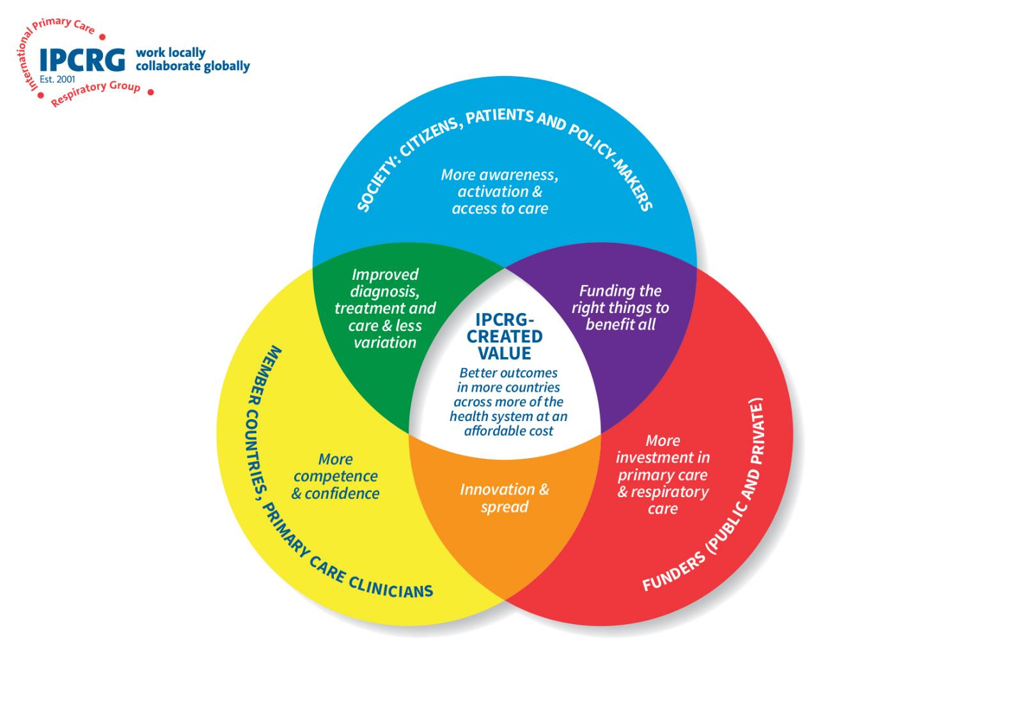
IPCRG’s strategy to add value

Slide 15
Patient-centred care
It is a way of thinking and doing things that
sees the people using health and social services as equal partners in
planning,
developing and
monitoring care
to make sure it meets their needs.
This means
putting people and their families
at the centre of decisions
and seeing them as experts,
working alongside professionals to get the best outcome.

Slide 16
The Patient-centred clinical model
Exploring both the disease and illness experience
Understanding the whole person
Finding common ground
CONTEXT
Problems
Physical, history, lab Disease
PERSON
Patient presents cues
Mutual Decision
Illness
Goals
Disease
Illness
Ideas, expectations,
feelings, effect on function
Roles
Enhancing the patient-doctor relationship
Incorporating prevention and health promotion
Being realistic
The patient-centred clinical method (Levenstein et al. 1986)
Notes:
Patient-Centred Model
1. Exploring both the disease and the illness experience
2. Understanding the whole person
3. Finding common ground regarding management
4. Incorporating prevention and health promotion
5. Enhancing the Doctor-Patient relationship
6. Being realistic

Slide 17
The asthma system (adapted Chronic Care Model)
Who are we?
Why are we here – what’s our purpose?
Supportive governance & financing
Tobacco
Community
Hospitals
Journalists
Environment
Universities
Social media influencers
Health system
NCDs v CDs
Business
Self-management skills
Retailers
Right healthcare delivery
Prepared proactive primary care team
Activated family and community
Informed activated patient
Prepared proactive wider PC team
Access to testing equipment, medicines & devices
Recruitment, training, retention of Health workforce
Decision support
Schools
Clinical information systems
Community organisations
Parliamentarians
Faith organisations
Leisure/sports clubs/gyms
Research & innovation
Williams S, et al Remote consultations in primary care across low-, middle- and high-income countries: Implications for policy and care delivery. J Health Serv Res Policy. 2022 Dec 9:13558196221140318.

