Slide 1
Cătălina Panaitescu
Family Physician
RespiRO - Romanian Primary Care Respiratory Group

Slide 2
Conflict of interest disclosure
I have the following, real or perceived direct or indirect conflicts of interest that relate to this presentation:
Affiliation / financial interest | Nature of conflict / commercial company name
Tobacco-industry and tobacco corporate affiliate related conflict of interest | None
Grants/research support (to myself, my institution or department): | None
Honoraria or consultation fees: | Receipt of honoraria or consultation fees from Astra Zeneca, Boehringer Ingelheim, Abbvie
Stock shareholder: | None
Spouse/partner: | None
Other support or other potential conflict of interest: | None

Slide 3
COPD is the 3rd leading cause of
death globally.
EU - COPD > 56% total healthcare
expenses of respiratory diseases.^{1,2}
1. ERS - Respiratory health and disease in Europe. Available from: https://www.erswhitebook.org/
2. Forum of International Respiratory Societies. The Global Impact of Respiratory Disease. 2nd ed. Sheffield:
European Respiratory Society, Forum of International Respiratory Societies; 2017
1. Who?
2. What?
3. Why?
4. How?
5. Where?
6. When?

Slide 4
One of the main objectives of this project is to understand what optimal and safe treatment looks like and why personalisation through shared decision-making is something possible to reach in COPD management.

Slide 5
COPD Value Pyramid: used in United Kingdom Outcomes Strategy for COPD
https://assets.publishing.service.gov.uk/government/uploads/system/uploads/attachment_data/file/216531/dh_134001.pdf

Slide 6
Clinically effective and cost-effective COPD care
Preventive measures including helping smokers to quit and vaccinations.
A correct, well communicated diagnosis.
Taking account of multimorbidity.
Therapy that includes multiple interventions to address personal need:
pulmonary rehabilitation
supported self-management helping people Breathe Well, Move More and Feel Better
palliative, symptom-relieving approaches
right pharmacological treatment addressing overuse, misuse and underuse.

Slide 7
COPD quality indicators in PC
A multidisciplinary expert panel (n = 12) consisted of four pulmonologists, three general practitioners, one physiotherapist, one nurse and three COPD patients.
RAND-modified Delphi method
(1) Selection of recommendations and existing QIs from evidence-based guidelines
(2) rating procedure by an expert panel in three rounds:
(a) individual written questionnaire
(b) online consensus meeting
(c) final appraisal
(3) translation of the recommendations into QIs.
Dewaele S, Van den Bulck S, Gerne L, Vaes B. Development of primary care quality indicators for chronic obstructive pulmonary disease using a Delphi-derived method.
NPJ Prim Care Respir Med. 2022;32(1):12. Published 2022 Mar 18. doi:10.1038/s41533-022-00276-w

Slide 8
COPD quality indicators
Definition: Obstruction severity and GOLD COPD clasification
Screening:
Adress smoking status
Patients over 40 presenting with symptoms or history of recurrent lower respiratory tract infections and/or a history of exposure to COPD risk factors who received spirometry.
Diagnosis:
COPD patients with a registered FEV1/FVC <70%
Oxygen saturation measured in COPD GOLD 4
Prevention and non-pharma treatment:
Flu, pneumococical vaccinations and physycal activity evaluation
Pharmacological treatment: according to GOLD guidelines
Referral: patients less than 40, oxygen saturation < 92% when stable, haemoptysis, > 2 thoracic infections a year, mMRC > 2
End of life: patients with COPD and FEV₁ ≤ 30% and starting with long-term oxygen therapy for whom advance care planning is determined
Dewaele S, Van den Bulck S, Gerne L, Vaes B. Development of primary care quality indicators for chronic obstructive pulmonary disease using a Delphi-derived method.
NPJ Prim Care Respir Med. 2022;32(1):12. Published 2022 Mar 18. doi:10.1038/s41533-022-00276-w

Slide 9
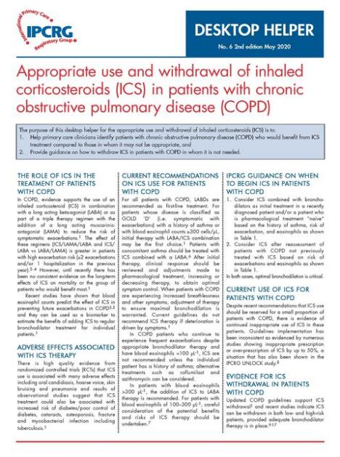
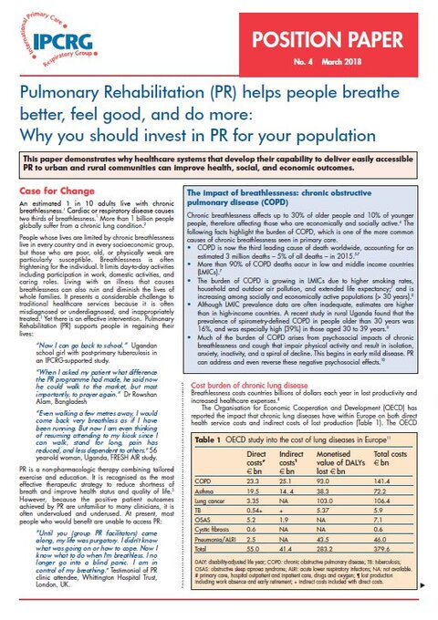
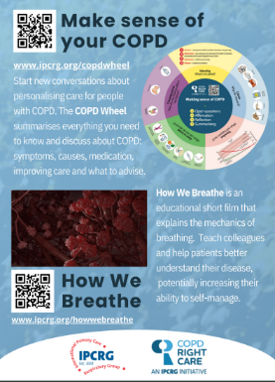
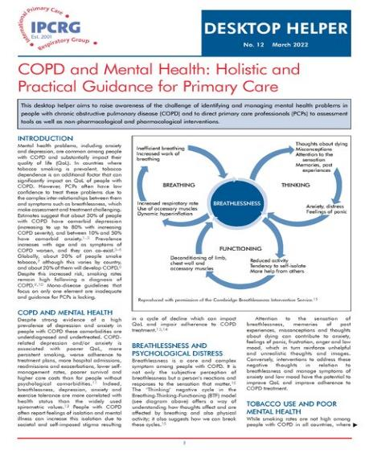
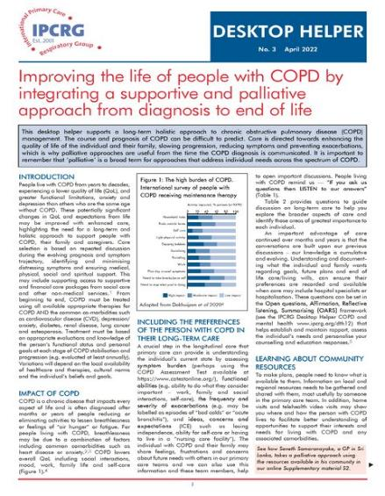
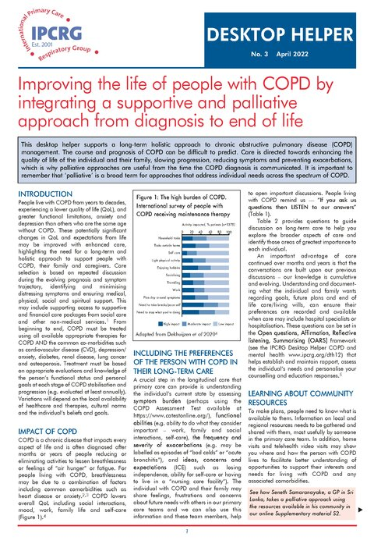
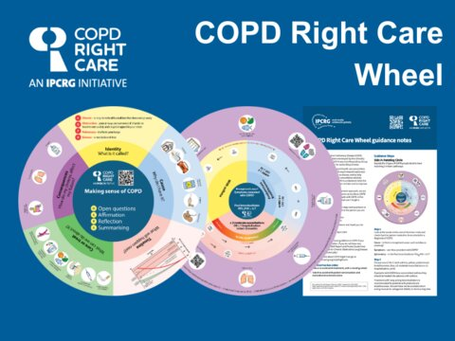
IPCRG materials
https://www.ipcrg.org/

Slide 10
Steroid safety card

Slide 11
COPD wheel

