Slide 1

Asthma Right Care
Marina García-Pardo
Family Physician, MD
Idisba (Research Institute of the Balearic Islands) Spain

Slide 2
Conflict of interest disclosure
I have the following, real or perceived direct or indirect conflicts of interest that relate to this presentation:
Affiliation / financial interest | Nature of conflict / commercial company name
Tobacco-industry and tobacco corporate affiliate related conflict of interest | None
Grants/research support (to myself, my institution or department): | Grant/research support and speaker’s honoraria: BI, GSK, TEVA
Honoraria or consultation fees: | Receipt of honoraria or consultation fees from GSK, Bl
Stock shareholder: | None
Spouse/partner: | None
Other support or other potential conflict of interest: | None

Slide 3

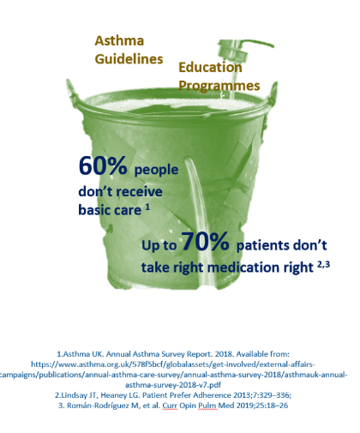
The problem
Every system is perfectly
designed to get
the results it gets¹
ASTHMA illustrates all the things wrong with healthcare systems globally:¹
Unwarranted variation (not due to disease difference)
Harm²
Failure to prevent disease and disability
Waste of human and physical resources through low value activity
Inequity
2. O’Byrne PM, Jenkins C, Bateman ED. The paradoxes of asthma management: time for a new approach? Eur Respir J 2017; 50: 1701103

Slide 4
Change for improvement starts with “hunches”
32
SABA use Needs major improvement
First Saba conversations affect future use
1
Gain acceptance that improvement needed
Disrupt comfort with the way things are done
Apply the evidence about achieving change at scale
Inspire followers
Teach right care – anti-inflammatory therapy, continuous care
2
3
Asthma is low
priority for change
HCPs need to want change
4
5

Slide 5

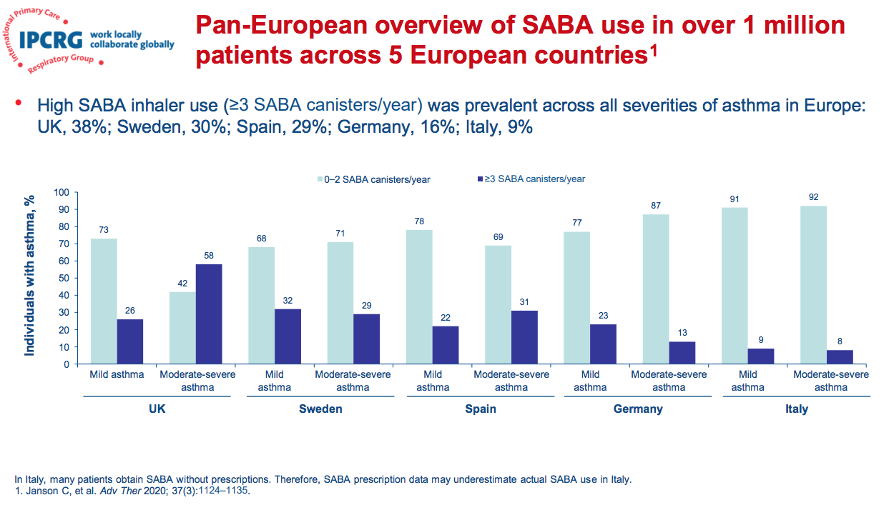

Then it was a hunch, now we have data….
Presented at IPCRG conference 2021 by Jenny Quint

Slide 6

Richard Horton, the Lancet 2017
“What is right care? …. it is care that weighs up
benefits and harms, is patient-centred… and is informed by evidence, including cost-effectiveness… most medical services fall into a grey zone where the benefit and harm ratio for a given individual is unknown.
However, an important start is to think about and aim to influence, the drivers of poor, unnecessary, and harmful care… these drivers fall into three important categories: money, finance, and organisations; knowledge, beliefs, assumptions, bias, and uncertainty; and power and human relationships.
https://www.thelancet.com/journals/lancet/article/PIIS0140-6736(16)32588-0/fulltext

Slide 7





What is ‘right care’?
Right things
Right way
Right people
Right time
Right place

Slide 8
Improvement needed
Overuse SABA
“Reliance”
Underuse ICS
Current ratio
“Desirable ratio”
Overuse OCS- toxicity
Rescue medication
Australian study ³ ³(10% sample of PBS date of those prescribed ICS) One‐quarter of people with asthma who use inhaler controllers are dispensed potentially toxic cumulative oral corticosteroid doses
3 Cumulative dispensing of high oral corticosteroid doses for treating asthma in Australia.
Hew M, McDonald VM, Bardin PG, Chung LP, Farah CS, Barnard A, Cooper MS, Gibson PG, Upham JW. Med J Aust. 2020 Oct;213(7):316-320. doi: 10.5694/mja2.50758. Epub 2020 Sep 9. PMID: 32906192 Free PMC article.

Slide 9


Disrupt comfort with the current way things are done
Nesta Innovation Foundation (2017) We change the world: what can we learn from global social movements for health? Nesta.org.uk
Notes:
Image sources HIV: https://www.google.com/url?sa=i&url=https%3A%2F%2Fcommons.wikimedia.org%2Fwiki%2FFile%3AMinnesota_AIDS_Project_-_HIV_Stigma_Stops_Here_-_Twin_Cities_Pride_Parade_(9180874836).jpg&psig=AOvVaw3Lx--5_9yEV6qtE1D79EZ_&ust=1606489655115000&source=images&cd=vfe&ved=2ahUKEwjdxYy7vqDtAhUhgM4BHeqvCNkQr4kDegQIARAc
Green: https://www.google.com/imgres?imgurl=https%3A%2F%2Fmedia.salon.com%2F2019%2F09%2Fprotesters-global-climate-strike.jpg&imgrefurl=https%3A%2F%2Fwww.salon.com%2F2019%2F12%2F23%2Fa-year-of-resistance-how-youth-protests-shaped-the-discussion-on-climate-change_partner%2F&tbnid=ihDr69EuX7TuYM&vet=12ahUKEwjdxYy7vqDtAhUhgM4BHeqvCNkQMygDegQIARAj..i&docid=2dm3W4zdtxRUSM&w=846&h=571&hl=en&safe=active&ved=2ahUKEwjdxYy7vqDtAhUhgM4BHeqvCNkQMygDegQIARAj
Disability: https://encrypted-tbn0.gstatic.com/images?q=tbn:ANd9GcQT8cUPM_QqTkxIYBJGsDdDatDh3Op09_zHKLDRqe2gFaIEZ5yIDBWNXIzd6ELPl1ByoDLthNi5AK9LU8smrak3N1Ed12jrbR4&usqp=CAU&ec=45732300

Slide 10



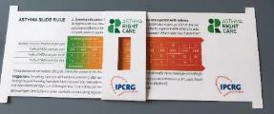
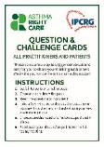

Kickstarting action
Emerging and building momentum
2
  Nurturing voices
  Cultivating diverse interests and motivations
3
Influencing and interacting
Navigating a complex array of relationships
Netherlands, Greece
France
ENVIRONMENT
Propellant & Plastic
INFORMATION
Coding
Public Information
MEDICINES
ICS: SABA Ratio
Inhaler Use
New Cultures
& Languages
Argentina Mexico Brazil
Ireland, the Gulf
6 drivers in asthma health system
More parts of health system
More
geographies
Original 4
UK & Canada
Spain
Portugal
WORKFORCE
GPs / Pharmacist / Nurses
FINANCE & LEADERSHIP
PERSONAL
Networking
Policy Briefing
Going deeper:
Paradigm / behaviour shift
Unconscious Incompetence
Asthma Slide Rule & Question Cards and RRT
Conscious Incompetence: what could I do better?
Conscious Competence
What is right care?
Regional Teach The Teacher Master Classes to create trusted regional master teachers
Unconscious Competence
Mastery: Conscious Competence of Unconscious Incompetence

Slide 11

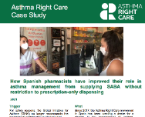







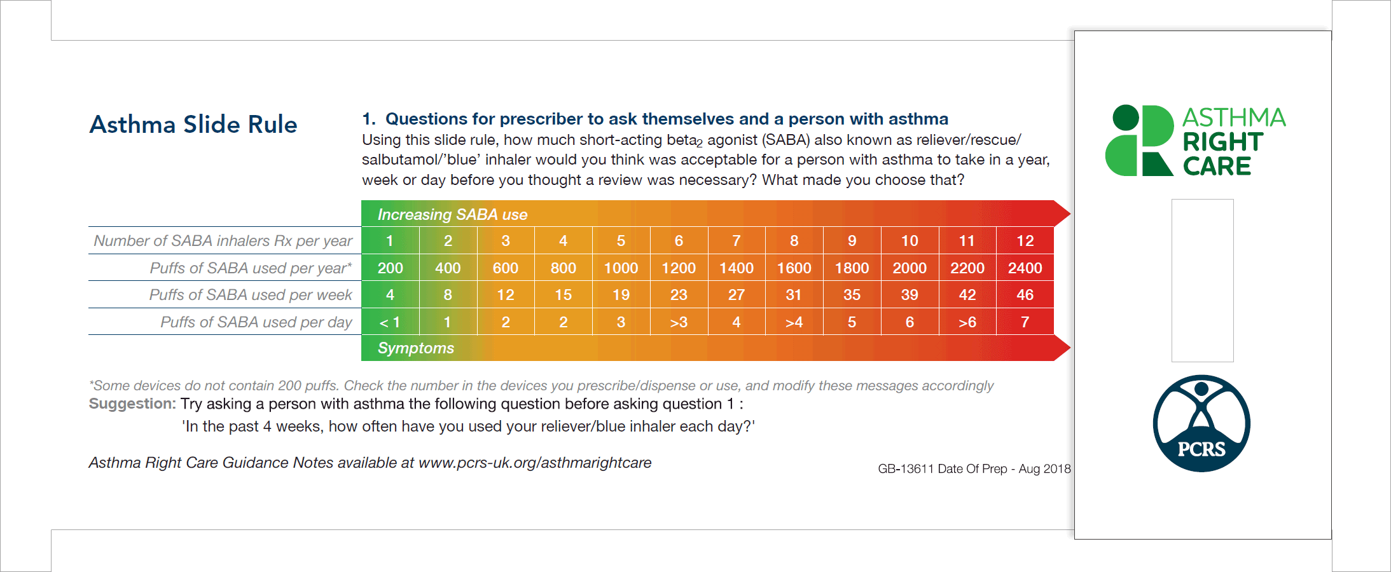

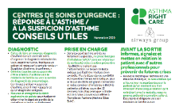

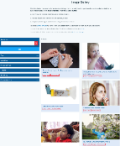
What are we doing, and what more can we do?
Pharmacists move to prescription only for SABA, and are part of the asthma pathway
GP relies on SABA to please patients and increase daily productivity
Pharmacist relies on OTC sales of SABA to earn a living
(small margin, high volume)
GP reflects on prescribing practices and adapts
Journalists use appropriate images to change the asthma narrative
Journalists rely on images of blue inhaler to communicate asthma
Emergency doctor seizes teachable moment: refers patient back to GP; no SABA without ICS
Emergency doctor relies
on SABA to reduce patient time in the ER
ICS, inhaled corticosteroid(s)
International Primary Care Respiratory Group. Asthma Right Care Key Resources. Available from: https://www.ipcrg.org/asthma-right-care-key-resources (Accessed 17 March 2022)
The Reliever Reliance Test has been developed by leading expert in behavioural medicine, Professor Rob Horne, University College London (UCL). IPCRG and AstraZeneca provided input into the development of the Reliever Reliance Test but do not have any editorial control, which is the responsibility of Professor Rob Horne. The production and distribution of this tool has been fully funded by AstraZeneca.

Slide 12

IPCRG and Asthma Right Care-Tools to help clinicians
Asthma SABA Slide Rule – physical analogue scale to explore how many puffs are used; reverse side uses motivational interviewing questions to explore importance and confidence to ask for a review
Reliever Reliance Test – identify and explore beliefs driving SABA use in individuals with asthma
Steroid alert card
(Question and Challenge Cards – for icebreakers, chats, social media)

Slide 13


Slide 14


