Slide 1
The ICS/Formoterol Reliever Therapy Regimen in Asthma: A Review
Richard Beasley, DSc, Pepa Bruce, MBBS, Claire Houghton, MBBS, Lee Hatter, MBBS
The Journal of Allergy and Clinical Immunology: In Practice
Volume 11 Issue 3 Pages 762-772.e1 (March 2023)
DOI: 10.1016/j.jaip.2023.01.002
Copyright © 2023 The Authors Terms and Conditions

Slide 2
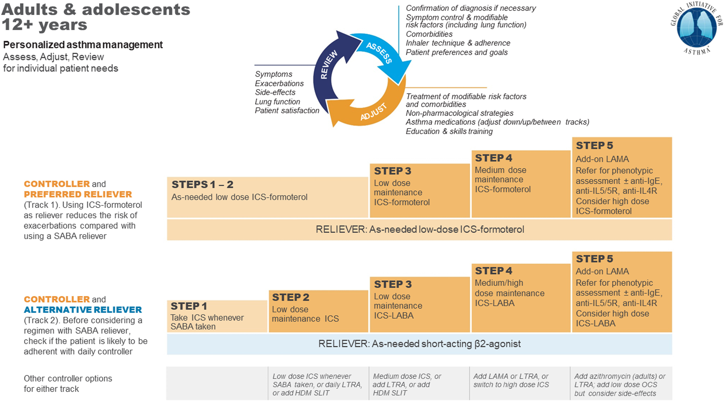
Figure 1
The Journal of Allergy and Clinical Immunology: In Practice 2023 11762-772.e1DOI: (10.1016/j.jaip.2023.01.002)
Copyright © 2023 The Authors Terms and Conditions
Notes:
The GINA stepwise algorithms for the management of adolescent and adult asthma. Reproduced with permission from the Global Initiative for Asthma.¹

Slide 3
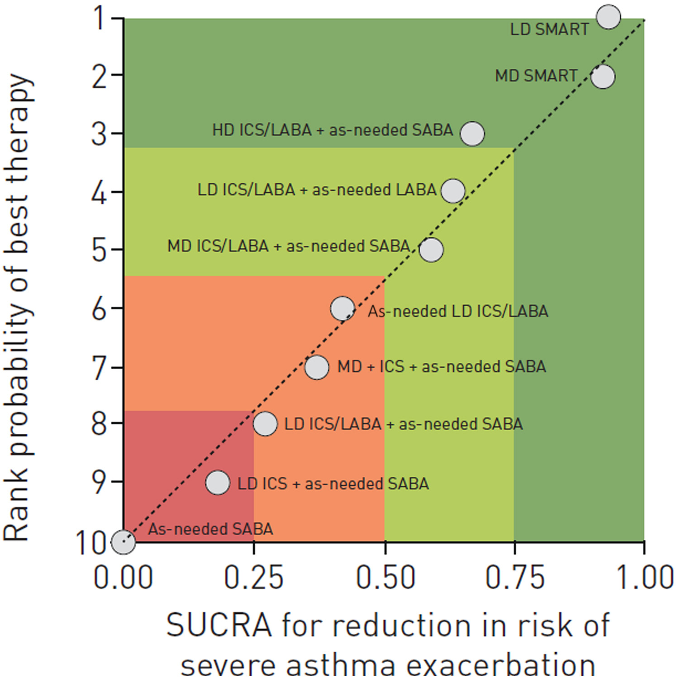
Figure 2
The Journal of Allergy and Clinical Immunology: In Practice 2023 11762-772.e1DOI: (10.1016/j.jaip.2023.01.002)
Copyright © 2023 The Authors Terms and Conditions
Notes:
Ranking plot of the efficacy of 10 therapeutic regimens in preventing the risk of severe exacerbation. Therapeutic regimens were plotted on the X-axis according to SUCRA, where 1 represents the treatment considered to be the best and 0 the treatment considered to be the worst. The treatments were plotted on the Y-axis according to the rank probability of best therapy, where a score of 1 is assigned to the best therapeutic strategy and 10 to the worst. HD, High-dose; LD, low-dose; MD, medium-dose; SUCRA, surface under the cumulative ranking curve. Reproduced with permission of the ©ERS 2022 from Rogliani et al.¹⁶

Slide 4
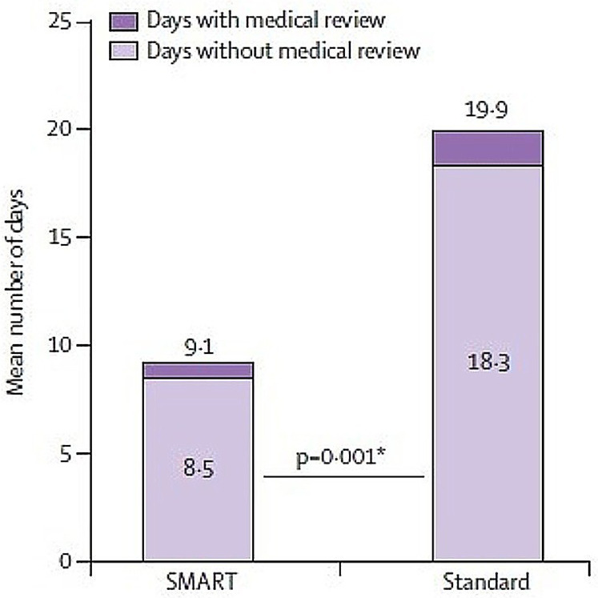
Figure 3
The Journal of Allergy and Clinical Immunology: In Practice 2023 11762-772.e1DOI: (10.1016/j.jaip.2023.01.002)
Copyright © 2023 The Authors Terms and Conditions
Notes:
Beta2-agonist reliever overuse and risk of delay in seeking medical review. ICS/formoterol vs SABA reliever therapy (designated SMART and Standard, respectively) in adults taking maintenance ICS/formoterol treatment. Mean number of high-use days in participants with at least 1 high-use episode and mean number of high-use days without medical review in participants with at least 1 high-use episode. Reproduced with permission from Patel et al.²³

Slide 5
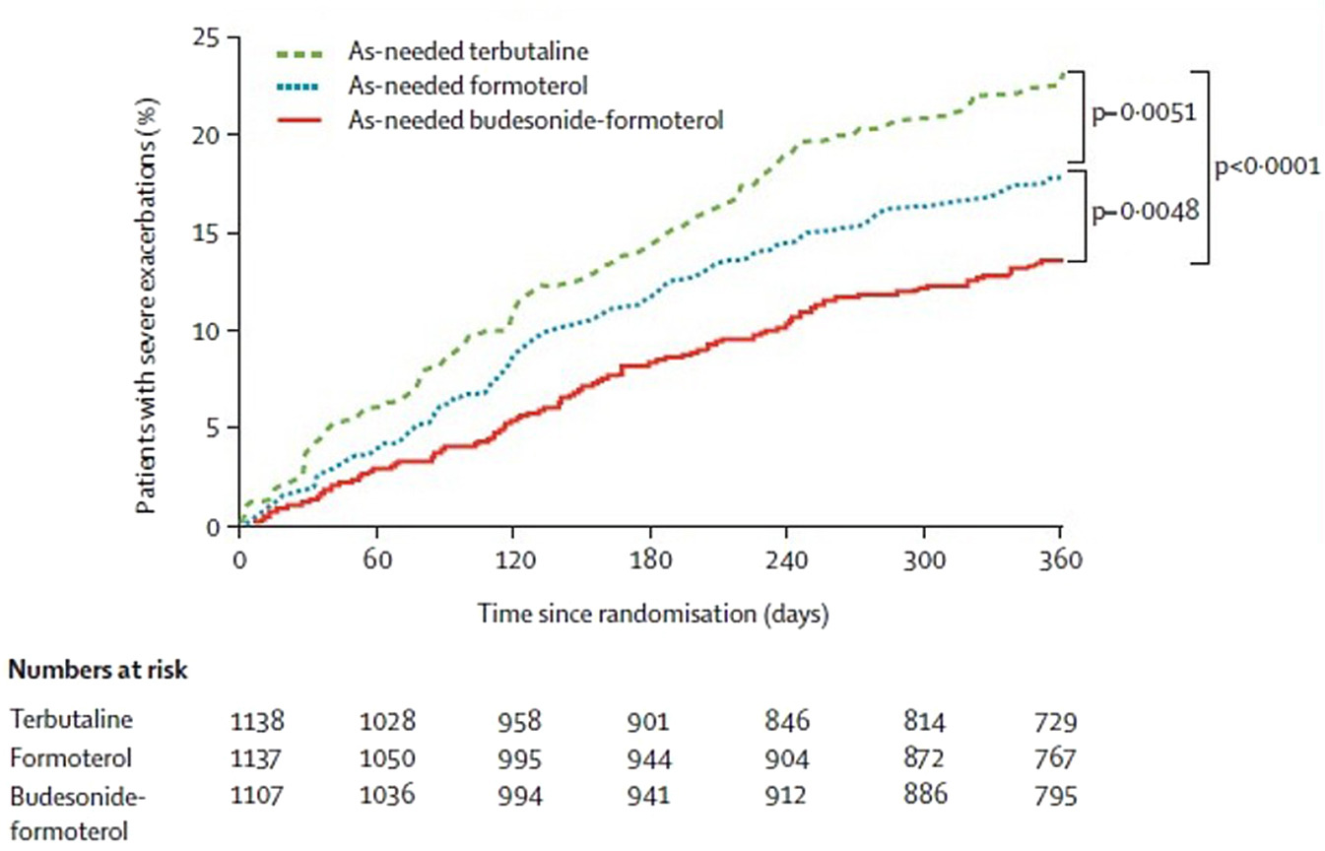
Figure 4
The Journal of Allergy and Clinical Immunology: In Practice 2023 11762-772.e1DOI: (10.1016/j.jaip.2023.01.002)
Copyright © 2023 The Authors Terms and Conditions
Notes:
Time to first severe exacerbation in adolescents and adults taking maintenance ICS/formoterol, randomized to as-needed terbutaline, formoterol, or budesonide/formoterol reliever. Reproduced with permission from Rabe et al.³⁹

Slide 6
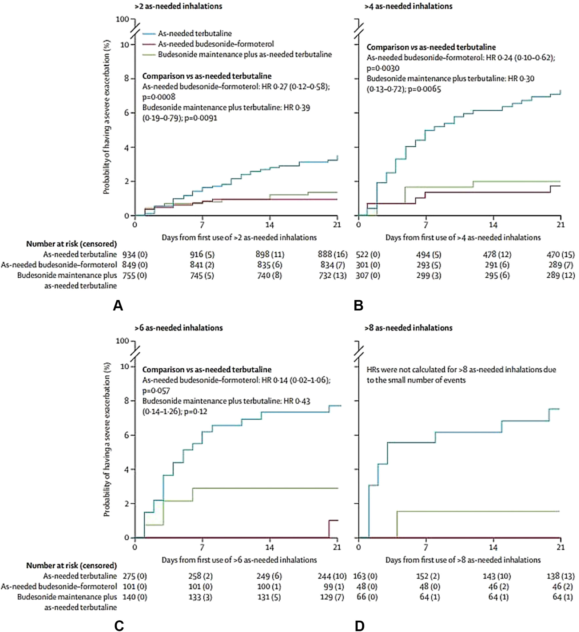
Figure 5
The Journal of Allergy and Clinical Immunology: In Practice 2023 11762-772.e1DOI: (10.1016/j.jaip.2023.01.002)
Copyright © 2023 The Authors Terms and Conditions
Notes:
Probability of a severe exacerbation during the 21 days after the first day with more than (A) 2, (B) more than 4, (C) more than 6, and (D) more than 8 as-needed inhalations. The data within each figure are adjusted HR (95% CI) and P value for each comparison with as-needed terbutaline. HR, Hazard ratio. Reproduced with permission from O’Byrne et al.⁴²

Slide 7
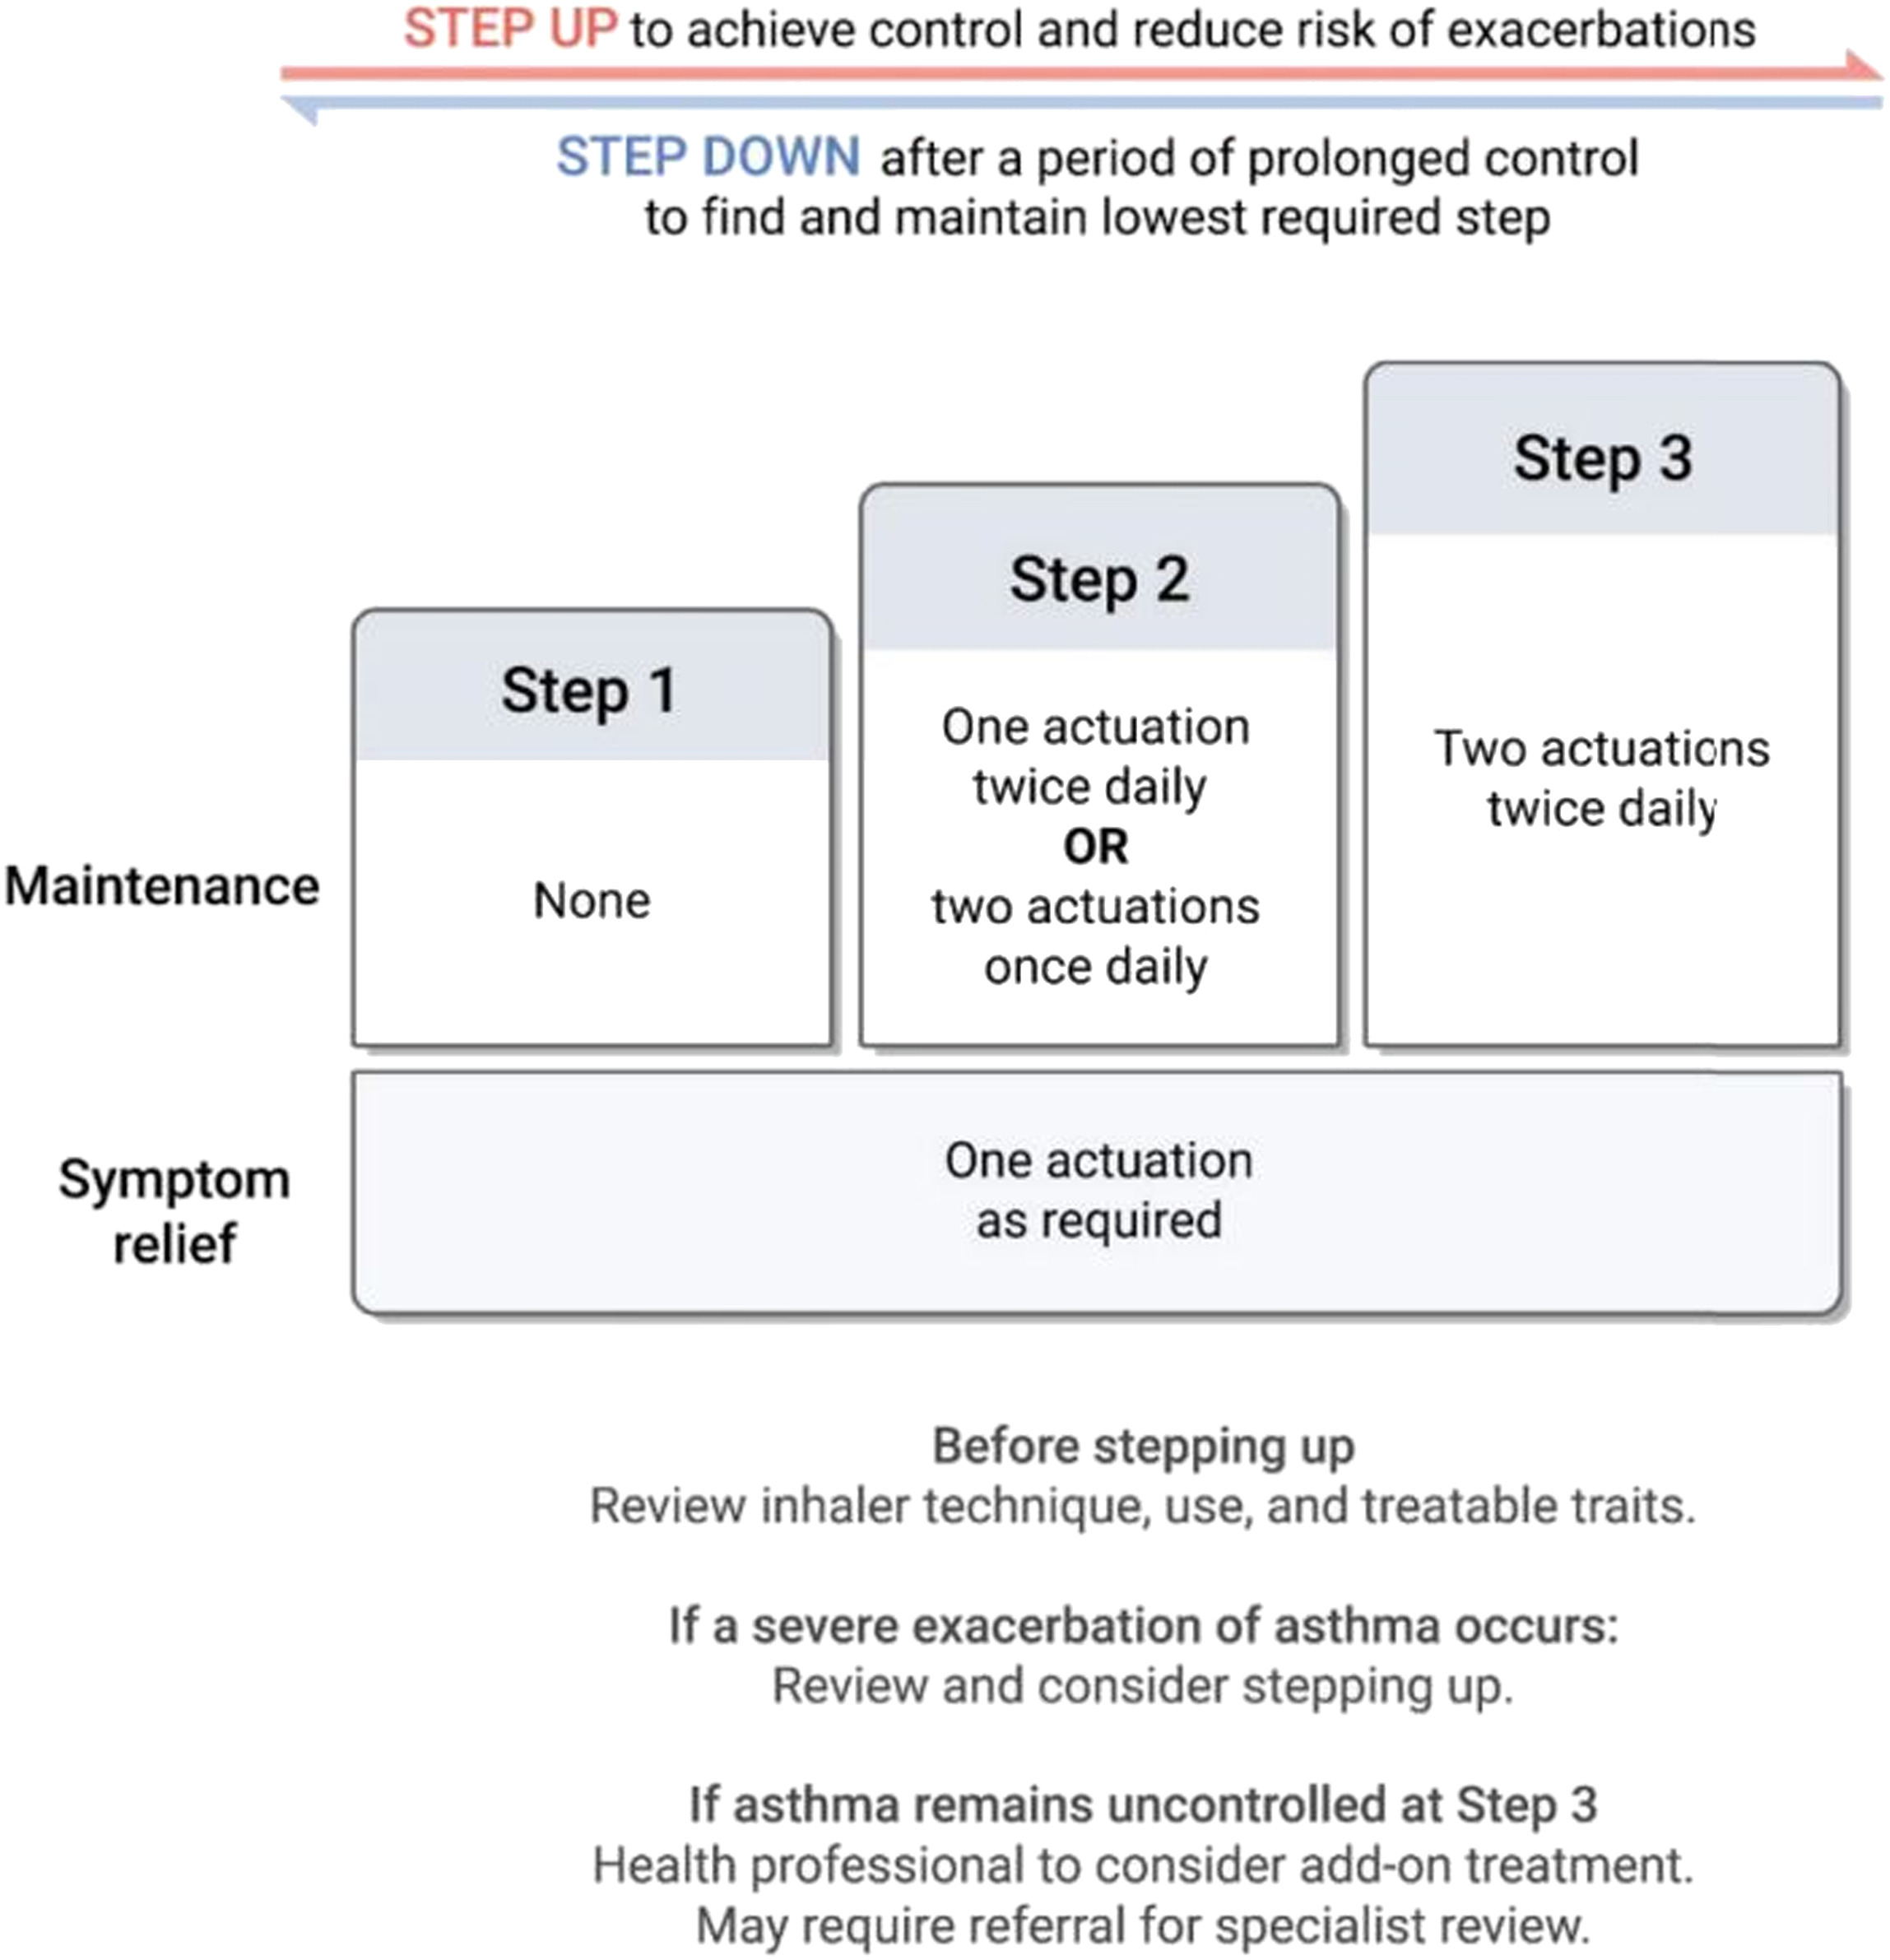
Figure 6
The Journal of Allergy and Clinical Immunology: In Practice 2023 11762-772.e1DOI: (10.1016/j.jaip.2023.01.002)
Copyright © 2023 The Authors Terms and Conditions
Notes:
New Zealand adolescent and adult asthma guidelines stepwise anti-inflammatory reliever therapy-based algorithm using budesonide/formoterol 200/6 μg. Reproduced with permission from the New Zealand Medical Journal (Beasley et al⁵⁵).

Slide 8
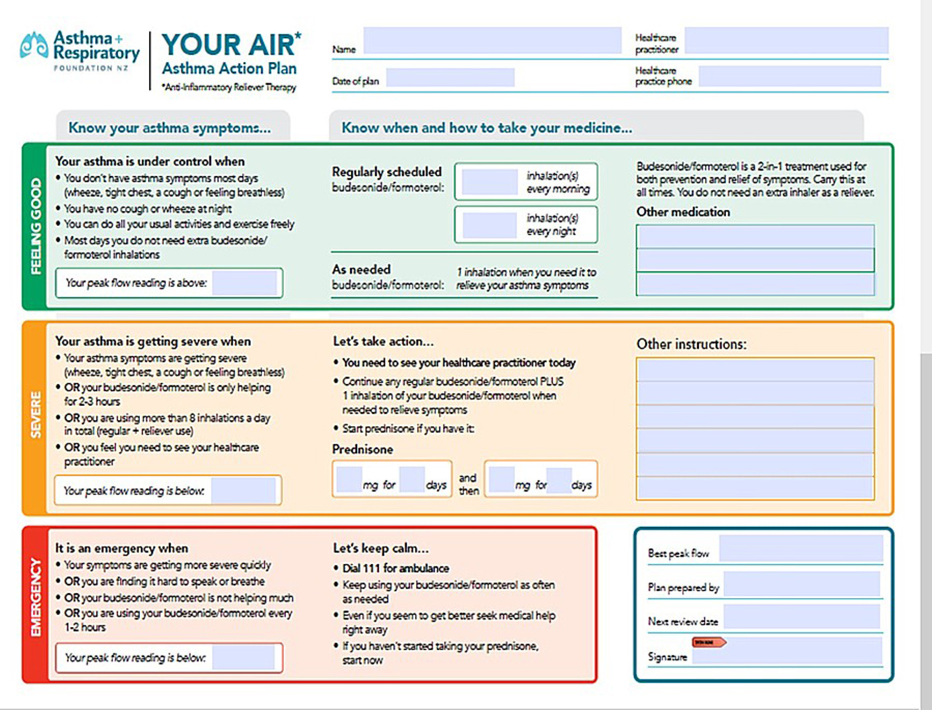
Figure 7
The Journal of Allergy and Clinical Immunology: In Practice 2023 11762-772.e1DOI: (10.1016/j.jaip.2023.01.002)
Copyright © 2023 The Authors Terms and Conditions
Notes:
New Zealand adolescent and adult asthma guidelines action plan based on budesonide/formoterol 200/6 μg reliever therapy. Reproduced with permission from the New Zealand Medical Journal (Beasley et al⁵⁵). See this article’s Online Repository at www.jaci-inpractice.org for a customizable version of this action plan for download.

