Slide 1
Introducing Asthma Right Care
Movement for Global Change
Siân Williams
AstraZeneca have sponsored and paid for this symposium as part of the Gold Sponsor Package. IPCRG received funding from AstraZeneca to develop the Asthma Right Care Initiative
Notes:
Hear the commentary here: https://www.useloom.com/share/b58d5e14534d47e8a9d47d43199bd14e

Slide 2
Every system is perfectly designed to get the results it gets
(Earl Conway and Paul Batalden)
Notes:
Both intended and unintended consequences are designed into our systems

Slide 3

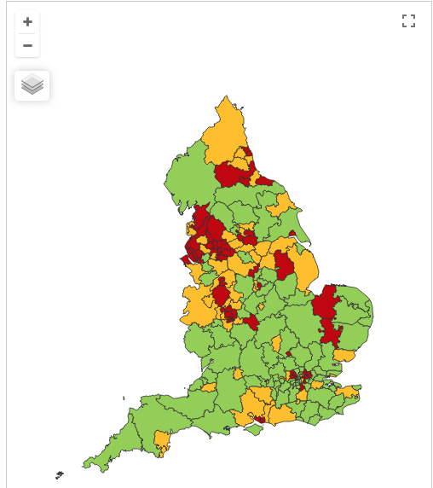

Making a case for change
Asthma illustrates all 5 global healthcare problems (Muir Gray):
Unwarranted variation
Harm, even when quality is high (over-diagnosis, over-treatment)
Failure to prevent disease and disability
Waste of human and physical resources through low value activity
Inequity
And new challenges are forming:
Financial constraints
Rising expectations of personalised care
Climate change/pollution
Increasing need
PHE Fingertips data Asthma admissions per 1000 population 2012/13 data
Notes:
Unwarranted variation as defined by Wennberg: Variation in utilization of health care services that cannot be explained by variation in patient illness or patient preferences
http://www.nhsconfed.org/~/media/Confederation/Files/Events/ACE15/1430%20Inaugural%20NHS%20value%20lecture.pdf

Slide 4
Context
Insufficient hospital champions: routine asthma and COPD not “interesting” enough;
General practitioners/family physicians keen to emphasise the art rather than the science of the consultation, and therefore not up-to-date with guidelines eg the guideline question “what’s the probability of them having asthma?” not a routine question yet
Lack of knowledge about how many puffs or doses in an inhaler and how many is too many in a year
Pharmacists keen to do more but out of date “take your blue inhaler to open up your airways” – (it is a logical way to think about it, and did used to be taught, so reveals lack of investment in their education)
Electronic medical records not sufficiently linked up across pathways to identify people at high risk of attack, and high risk of death
Physician assistants/nurses/ may be under-trained to ask open questions and have the confidence and knowledge to know how to respond: eg negotiating an asthma action plan
Doctors with asthma are often not role models!
A review of people taking 6+ SABA cannisters would create too many to review in the first instance,
so start with 12+ or more (and what about those who’ve used emergency care?)
eg 6000 GP population might generate about 15-20 patients with asthma on 6 or more inhalers
that’s 1.5 virtual clinics…

Slide 5
Start with “hunches” for improvement
Use of SABA in asthma in need of major improvement
  over-reliance, but how to define?
  NOT over-use – “reliance” = type of dependency
1st conversations about SABAs may effect future use
  Occur in many places eg community pharmacies, EDs, GP/FP
  We need to know more about these
Asthma is low priority for change in general HCP despite evidence of
  unwarranted variation in outcomes
  avoidable mortality, morbidity and healthcare utilisation
  education programmes
Need to want to change for messages about asthma improvement to be received & adopted
Let’s apply the evidence about achieving change at scale
Start to disrupt comfort with the current state!
Then move on to addressing underuse of ICS
Notes:
Hunches - this is a proven improvement technique

Slide 6
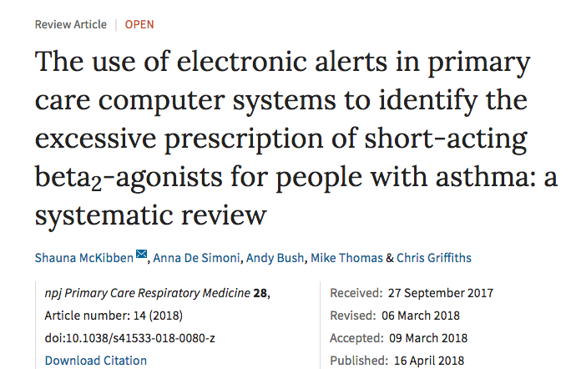
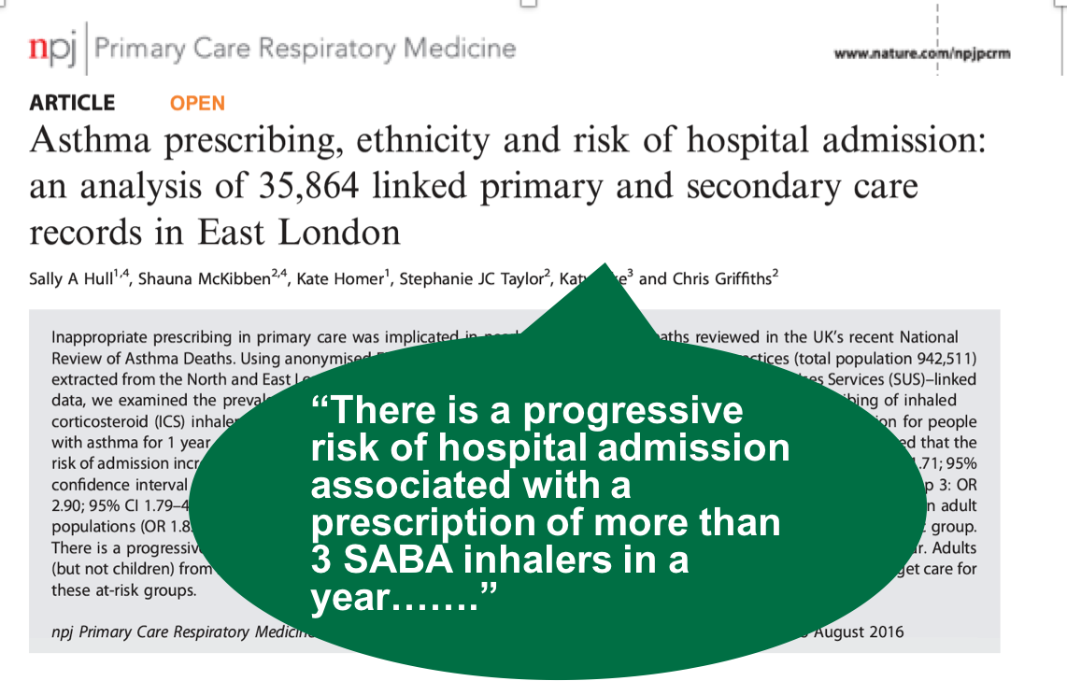
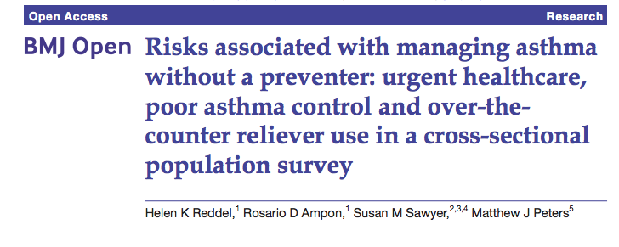
UK NRAD: 39% people on SABA at time of death had been prescribed more than 12 in the year before they died
4% had been prescribed more than 50 SABA inhalers
Those prescribed more than 12 were likely to have had poorly controlled asthma.
Guidelines: expect them to have at least 12 preventer prescriptions per year, but
38% issued with fewer than 4 and 80% issued with fewer than 12 previous year.”
NICE summary of NRAD

Slide 7
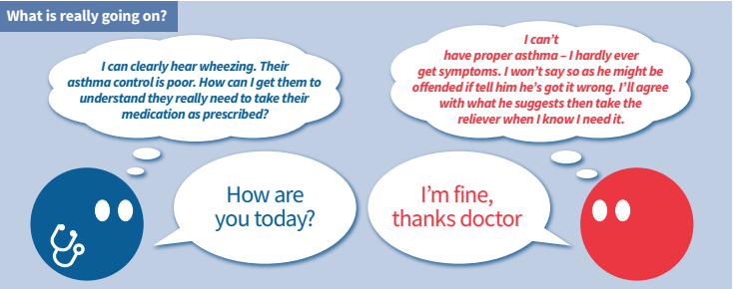
Understanding the world beyond the consultation

Slide 8
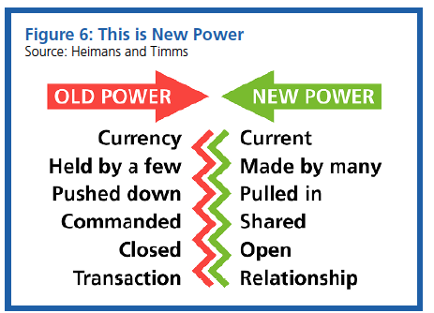
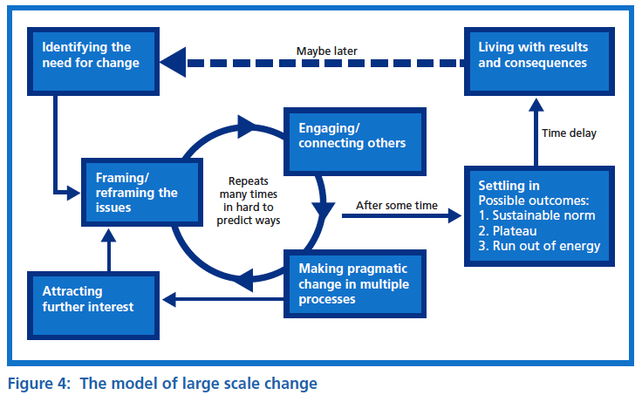
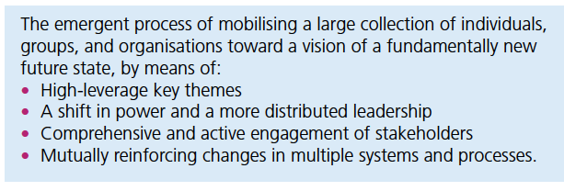

Leading large scale change: the evidence
Notes:
NHS cares for 65 million people. Sees more than 1million people every 36 hours.

Slide 9
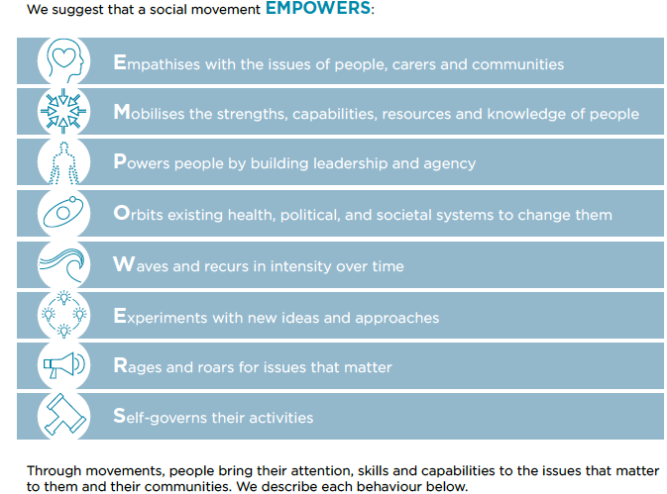

What are social movements and why are they relevant?
Sustained group action created from grassroots to stimulate social or political change
Relies on networks and connections between networks
Mobilise people globally and so often use technology – social media too, not just a communication campaign
Successful campaigns have an identity, clear call to action, and a message of hope (not just criticism)
Need a message and champions
Eg Obama’s campaign for election “yes we can” and HIV/AIDS movement; ”Hello, my name is..”; flu fighters; antibiotic guardians

Slide 10
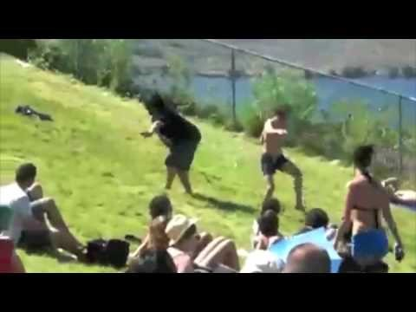


It’s all about the followers…being inspired and confident to try something different
https://www.youtube.com/watch?v=fW8amMCVAJQ

Slide 11
Asthma Right Care as a social movement
It’s all about the FOLLOWERS: We need to get the right people engaged, who will connect through the right channels to engage the maximum numbers of followers who are inspired to do something different: to reduce reliance on short-acting beta-agonists, and to increase faith in and use of effective medicines

Slide 12
What is Right Care?
Lancet Series 2017
“Many countries struggle with the question about sustainability, fairness, and equity of their health systems. With the focus firmly on universal health coverage as a central part to the UN Sustainable Development Goals, there is an opportunity to examine how to achieve optimum access to, and delivery of, health care and services. Underuse and overuse of medical and health services exist side-by-side with poor outcomes for health and wellbeing.
This Series ….provides a framework to begin to address overuse and underuse together to achieve the right care for health and wellbeing. The authors argue that achieving the right care is both an urgent task and an enormous opportunity.”

Slide 13
What is Right Care?
Our working definitions
Doing the right things and only the right things in the right way for the right people at the right time in the right place, whatever that means in the local context
Improving the value that each person with asthma derives from their own care and treatment and the value the whole population derives from the investment in asthma care by addressing unwarranted variation; reducing waste, avoidable harm and avoidable symptoms

Slide 14
Our case for change
“It is time to refocus attention on asthma because the total burden of disease in terms of quality of life is high yet avoidable and there is significant unwarranted variation and waste.
Only ≅ 40% of people take their prescribed treatment
Of whom only ≅ 30% then use it right
So only ≅12% are taking the right treatment right
Therefore the value of investment is severely compromised.”
BTS/SIGN Asthma 2016
Chrystyn, H., et al. (2017). "Device errors in asthma and COPD: systematic literature review and meta-analysis." NPJ Prim Care Respir Med 27(1): 22

Slide 15
Aim
Scope
To sort asthma care once and for all for the person with asthma and for the healthcare system so that there is no unwarranted variation, and no avoidable waste or harm*.
That is
We can and should do better by getting it right first time!
The pathway from the first time someone (adult or parent) is offered a SABA, wherever that is, through to all possibilities (existing and new) for review.
Phase 1: SABA use
*waste is waste of human, financial, health facility, energy and pharmacological assets.

Slide 16
What is the best single measure for our aim?
A shift in the practice average ratio of reliever:inhaled corticosteroid inhalers prescribed in a year, where the ideal ratio is 1:6 but is currently more likely to be 2:1
But we couldn’t do that in 8 months, so….
Notes:
Commentary https://www.useloom.com/share/b58d5e14534d47e8a9d47d43199bd14e ends here
https://mail.google.com/mail/u/0/?tab=wm#inbox

Slide 17
SCOPE, AIMS, OBJECTIVES, METRICS
Notes:
Second video commentary starts here: https://www.useloom.com/share/27f6a3d7906542b4a0115696926755b2

Slide 18
Scope
The pathway from the first time someone (adult or parent?) is offered a SABA, wherever that is, through to all possibilities (existing and new) for review.

Slide 19
Agreed working definitions of right care
Doing the right things and only the right things in the right way for the right people at the right time in the right place, whatever that means in the local context AND
Improving the value that each person with asthma derives from their own care and treatment and the value the whole population derives from the investment in asthma care by addressing unwarranted variation; reducing waste, avoidable harm and avoidable symptoms

Slide 20
Case for change
What global challenges does right care address and which of these are most relevant in asthma care? For background, see this Muir Gray presentation and this article.
Of the five global healthcare problems, in asthma the biggest problems are:
Unwarranted variation (as defined by Wennberg): Variation in utilization of health care services that cannot be explained by variation in patient illness or patient preferences
Failure to prevent disease and disability
Waste of human and physical resources through low value activity
Harm, from over-diagnosis & over-treatment even when quality is high
Plus additional challenges:
Financial constraints
Rising expectations of personalised care
Climate change/pollution

Slide 21
Therefore
It is time to refocus attention on asthma because the total burden of disease in terms of quality of life is high yet avoidable and there is significant unwarranted variation and waste. Only 40% of people take their prescribed treatment, of whom only 30% then use it right, therefore only 12% are taking the right treatment right, and therefore the value of investment is severely compromised.

Slide 22
So, asthma right care: why start with focus on overreliance on SABA?
There is substantial unwarranted variation in control of asthma due to multiple factors including the prescription, inhaler technique, adherence, triggers which have roots in ineffective communication, misdiagnosis of condition and of preferences, local context and so on. Over-reliance on SABAs indicates that these issues are not being addressed well enough. The aim of this is not to limit SABAs per se, but to improve asthma control.
We cannot ultimately limit the social movement to overreliance on SABAs, as it needs to look at better treatments too, but we can start here to raise awareness, to improve readiness to change, and start to explain how to reduce that reliance and then support each patient to do the right thing to improve asthma control

Slide 23
Aim
To sort asthma care once and for all for the person with asthma and for the healthcare system so that there is no unwarranted variation, and no avoidable waste or harm (where waste is waste of human, financial, health facility, energy and pharmacological assets).
That is
We can and should do better by getting it right first time!

Slide 24
Objectives (1)
By November 2017 write a case for change that persuades the asthma community in four national pilot countries that action is necessary, important and possible in primary care to reduce the over-reliance on SABAs (that we are defining as finishing 6 or more reliever inhalers in a year).
Between November 2017 and May 2018 use a social movement approach that engages leaders (with followers), grassroots primary care and the people with asthma who continue to have avoidable symptoms so that they pay attention to the issue.
By the end of February 2018, with support from a central Delivery Team and national steering committees and drawing on good examples such as Australian asthma campaign, Ireland/GSK video and other therapeutic areas eg antibiotic use, design simple tools for all clinicians in regular contact with people with asthma that enable them to have a realistic sense of how they are performing now in start conversations about asthma and SABAs so that any change in prescribing is clinically safe, practical and takes account of patient preferences.
Between February 2018 and May 2018, starting with national “design charrettes” engage the national “asthma community” in generating and testing ideas for improvement that are nationally feasible, effective, and affordable; this might include repurposing existing educational tools as well as new ones

Slide 25
Objectives (2)
Report back on the experience on 31 May 2018 at the IPCRG World Conference in Porto at a major symposium attended by delegates from the IPCRG’s member countries who wish to adapt and roll-out the programme.
Write up the discussion about the case for change, objectives and criteria as a paper for the npjPCRM to be submitted by the time of the Porto conference.

Slide 26
What are the criteria for measuring the aim and objectives?
The single best measure for the overall aim
A shift in the practice average ratio of reliever:inhaled corticosteroid inhalers prescribed in a year, where the ideal ratio is 1:6 but is currently more likely to be 2:1
But we can’t do that in the timescale, so….

Slide 27
Objectives and measures (1)
By November 2017 write a case for change that persuades the asthma community in five national pilot countries that action is necessary, important and possible in primary care to reduce the over-reliance on SABAs (that we are defining as finishing 6 or more reliever inhalers in a year)
Measure: An argument that is sound and robust when open to critical appraisal and persuasive when tested with 4 national pilots and the Steering Committee of the project so that there is a desire for action and engagement
Between November 2017 and May 2018 use a social movement approach that engages leaders (with followers), grassroots primary care and the people with asthma who continue to have avoidable symptoms so that they pay attention to the issue
Measure: Numbers of followers, measured through any channel – email groups, networks, twitter followers, people using the message or slide we have produced

Slide 28
Objectives and measures (2)
By the end of February 2018, with support from a central Delivery Team and national steering committees of four national pilots and drawing on good examples such as Australian asthma campaign, Ireland/GSK video and other therapeutic areas eg antibiotic use, design simple tools for all clinicians in regular contact with people with asthma that enable them to have a realistic sense of how they are performing now in comparison to their peers, to identify in priority order the patients registered who need review, and how to start conversations about asthma and SABAs so that any change in prescribing is clinically safe, practical and takes account of patient preferences.
Measure: A set of resources including, but not limited to:
- audit template;
- query for GP electronic records per country;
- “red flag” trigger on GP electronic records;
- communication tools to discuss with patients;
- aid for pharmacists who are dispensing inhalers to advise patients correctly;
- messages and slides to use in teaching;
- asthma review tools;
- discussion guides to use with peers (GPs, nurses, pharmacists, ED doctors);
- calculation about how many patients you might expect to review based on different register sizes;
- specific information for population segments: pregnant women, teenagers, people with seasonal allergy;
- motivating tools eg comparisons with other countries asking the question “how are we doing in comparison with….”

Slide 29
Objectives and measures (3)
Between February 2018 and May 2018, starting with national “design charrettes” engage the national “asthma community” in generating and testing ideas for improvement that are nationally feasible, effective, and affordable; this might include repurposing existing educational tools as well as new ones
Measure: four meetings by the end of February, each involving a wide range of stakeholders, a positive response to the concepts and discussion
Report back on the experience on 31 May 2018 at the IPCRG World Conference in Porto at a major symposium attended by delegates from the IPCRG’s member countries who wish to adapt and roll-out the programme.
Measure: symposium well attended and commitments to take on the movement

Slide 30
Some of our first questions
What standards should we aim for e.g. what does OK use of SABAs look like? What does best use of SABAs look like? What does just about acceptable use of SABAs look like? Therefore, what is over-reliance? This will help us craft the messages.
Resources
What resources do we need - how would we find out? Are we first looking for the key questions that patients, GPs, nurses, pharmacists should ask? Do we also need information giving resources?
What resources do we have – how would we find out?
What resources could we build on e.g. antibiotic prescribing
Therefore, where are the gaps?

Slide 31
What have we done so far?
First six months Jan-June 2018

Slide 32
Stakeholder engagement
Stakeholder analysis and plan
Use 9 C checklist to list stakeholders
Prioritise according to power, influence, impact
Invite to national design charrette
What could they do to support or prevent movement?
What’s in it for them? How could they benefit?

Slide 33
Identifying stakeholders 9Cs
Who? | Analysis | Engagement plan
Commissioners: payors £££
Customers: who are we targeting?
Collaborators: eg NGOs, professional societies
Contributors: provide content eg research
Channels: to markets or customers eg TV, radio
Commentators: opinion leaders for the customers eg community leaders
Consumers: end user eg patient, family, service user
Champions: eg policy makers
Competitors: offer similar or alternative services

Slide 34
Power, impact, influence analysis (from NHS Improvement)
High power to block or create change, might be due to position or to the individual
Low power to block or create change, might be due to position or to the individual
 | How much impact it will have on them: Low impact/stakeholding | How much impact it will have on them: High impact/stakeholding
Priority

Slide 35
Example: Who might PCRS-UK involve in a design charrette?
Who? | Analysis | Engagement plan
Commissioners: the GP groups who manage the NHS budget (CCGs)
Customers: prescribers
Collaborators: eg PCRS-UK members, British Thoracic Society, Asthma UK, British Lung Foundation, AstraZeneca
Contributors: Asthma UK research collaborative (universities of Edinburgh, London, Southampton etc), Academic Health Science Centres
Channels: own conference and newsletters, NHS England, NHS RightCare, Twitter
Commentators: most active Twitter accounts, Pulse, policy organisations eg Kings Fund, Nuffield,
Consumers: patients, family, service user
Champions: eg NHS Clinical Director, NHS RightCare
Competitors:

Slide 36
Who might your Delivery Team involve in a design charrette?
Who? | Analysis | Engagement plan
Commissioners/payors:
Customers: prescribers
Collaborators: NGOs, AZ, professional societies
Contributors: who has data?
Channels: conference and newsletters, website, Facebook, Twitter
Commentators:
Consumers: patients, family, service user
Champions: eg policy makers eg WHO
Competitors: other disease areas, other campaigns….

Slide 37
What will you discuss and co-create in your design charrette?
Our Asthma Right Care prototype conversation pieces
January-June 2018

Slide 38
SABA Slide Rule – inspired by the Readiness Ruler
General practitioners/family physicians keen to emphasise the art rather than the science of the consultation, and therefore not up-to-date with guidelines eg the guideline question “what’s the probability of them having asthma?” not a routine question yet
Pharmacists keen to do more but out of date “take your blue inhaler to open up your airways” – (it is a logical way to think about it, and did used to be taught, so reveals lack of investment in their education)
Lack of knowledge about how many puffs or doses in an inhaler and how many is too many in a year

Slide 39
SABA slide rule
The Readiness Ruler has two sides, each with one initial question and a zero-to-10 scale to help people evaluate the importance of the personal changes they desire and to evaluate their confidence about making those changes.
After a person chooses a number from the scale, ask these questions to elicit change-talk:
Why are you a ____ [insert # reported] and not a zero?
What would it take for you to get from ____ [insert # reported] to ____ [the next higher number]?
Importance Ruler
This side of the Readiness Ruler is designed to help people express in their own words their desire, ability, reasons, and need for change. Below are some examples of what you might hear:
Desire ("I'd like to ...")
Ability ("I could ...")
Reasons ("It's important because ...")
Need ("I have to ...")
Confidence Ruler
This side of the Readiness Ruler is designed to help people express their own intention, commitment, readiness, and willingness to change. It may also help people talk about the small steps they are already taking. Below are some examples of what you might hear:
Commitment ("I will ...")
Activation ("I'm ready to ...")
Taking steps ("I've tried ...," "I am doing ...")
Evidence Based
Research shows that people who express change-talk are more likely to change.
The Readiness Ruler is a helpful tool to support the use of Motivational Interviewing (MI), the evidence-based treatment, by service providers. MI is a conversational approach designed to help individuals you serve with the following:
Discover their own interest in considering and/or making a change in their life (e.g., diet, exercise, managing symptoms of physical or mental illness, reducing and eliminating the use of alcohol, tobacco, and other drugs)
Express in their own words their desire for change (i.e., "change-talk")
Examine their ambivalence about the change
Plan for and begin the process of change
Elicit and strengthen change-talk
Enhance their confidence in taking action and noticing that even small, incremental changes are important
Strengthen their commitment

Slide 40
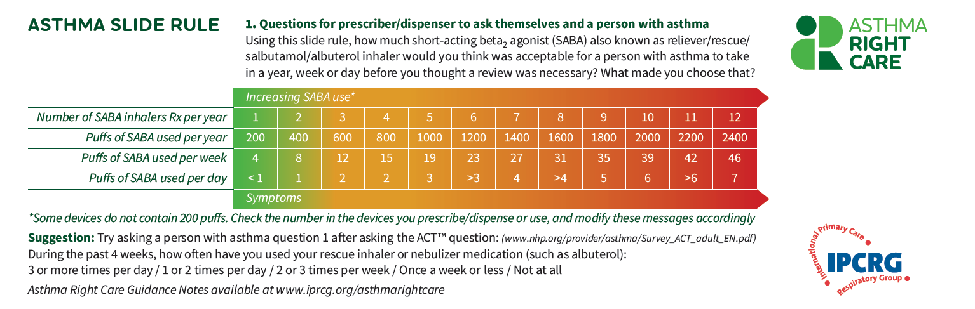
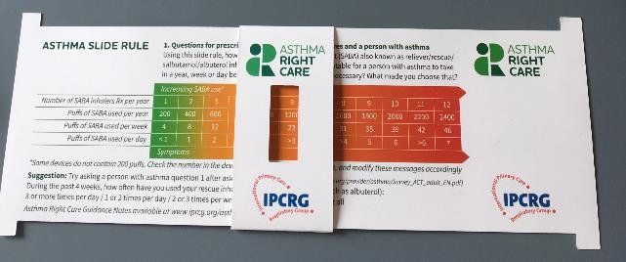
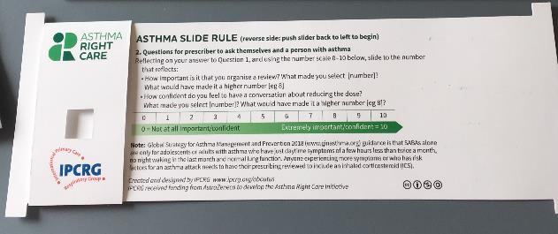

Slide 41
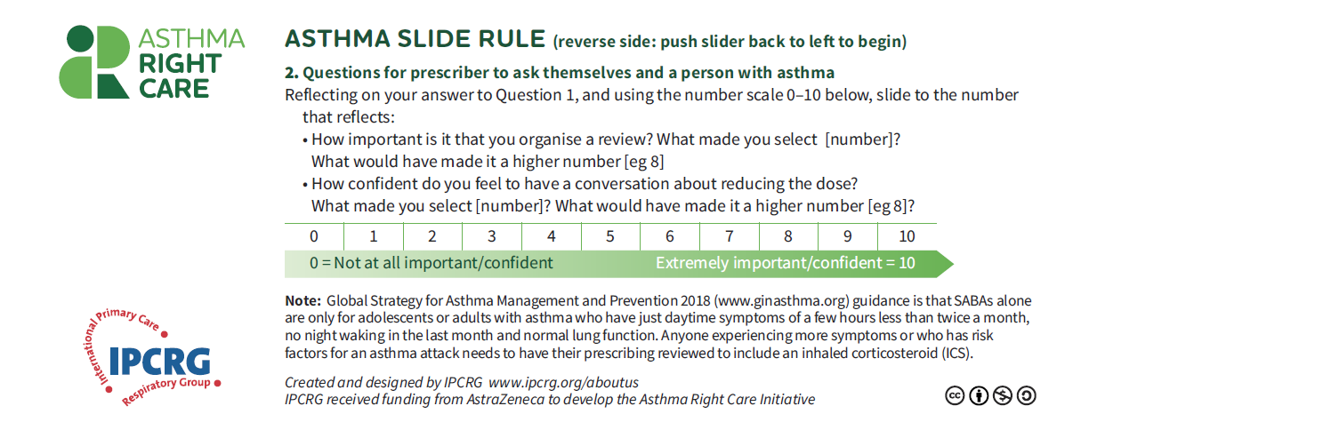

Slide 42
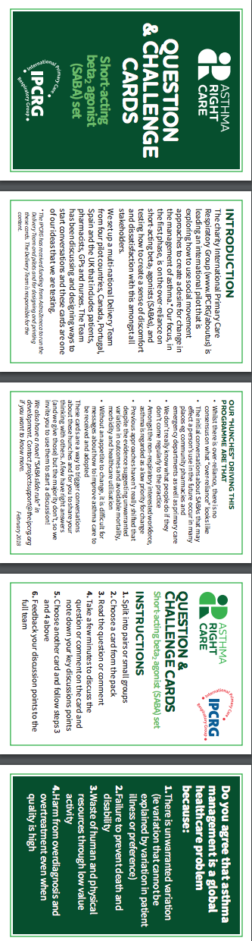
Embracing more people, more methods, bringing joy to lives:
let’s have fun, challenging conversations using prompts like our question and challenge cards…

Slide 43
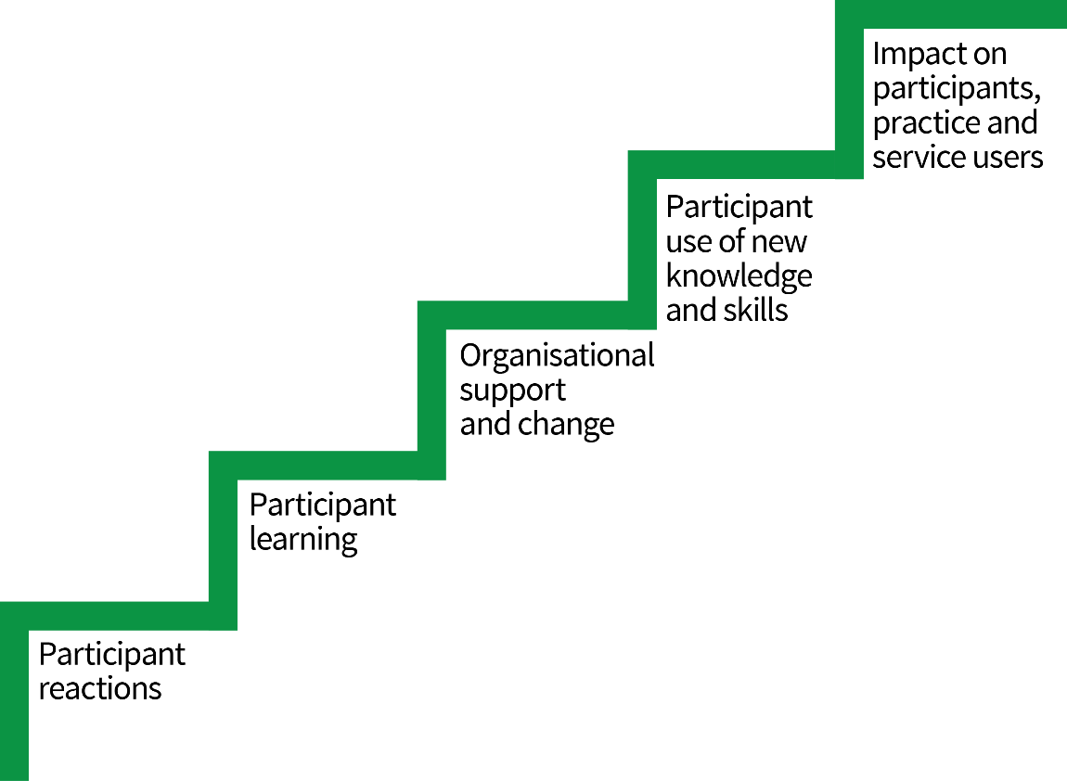
How will we know if it’s working
Is IPCRG’s Guskey framework for evaluation relevant?
Notes:
Second commentary finishes here https://www.useloom.com/share/27f6a3d7906542b4a0115696926755b2

Slide 44
Progress of first four national pilots Jan-June 2018
Notes:
Third commentary starts here https://www.useloom.com/share/5889ba905e6a46b1aa4162f676262189

Slide 45
Original Pilot Countries
Primary Care Respiratory Society, UK
GRESP, Portugal
GRAP, Spain
Family Physician Airways Group of Canada

Slide 46
Reporting & organisational structure
FUNDER - AZ
IPCRG – thought leadership, direction, global primary care network
Steering Group (invite external experts as needed)
Project manager
Delivery Team including 2 per country, plus 1 pharmacy and 1 patient rep
Spain collective leadership team
Portugal collective leadership team
Canada collective leadership team
UK collective leadership team
Asthma right carers: the national and international stakeholders

Slide 47

Getting our social movement going
Sept 2017
May 2018
Kickstarting action
Emerging and building momentum
  Nurturing voices
  Cultivating diverse interests and motivations
2
Steering Group formed and meets
3
Influencing and interacting
Navigating a complex array of relationships
National Champions Identified
SCALING UP
Delivery Team meeting
Delivery Team meeting
Delivery Team meeting
Delivery Team meeting
Symposium
Pervasiveness: affect all or just part of system?
National Steering Group Stakeholder
Mapping
Invitation UK
National Design Charrette
Pilot Phase
National Steering Group Stakeholder
Mapping
Invitation Portugal
National Design Charrette
Pilot Phase
Depth: ways of thinking and doing – cognitive, behavioural or paradigm shift?
Size: number
of people, geography
National Steering Group Stakeholder
Mapping
Invitation Canada
National Design Charrette
Pilot Phase
National Steering Group Stakeholder
Mapping
Invitation Spain
National Design Charrette
Pilot Phase
Notes:
References:
Nesta 2017. We change the world: what can we learn from global social movements for health?
NHS England. Sustainable Improvement and Horizons Team 2017. Leading large scale change: a practical guide.

Slide 48
Major milestones
Item/activity | Preparation | Approval Deadline IPCRG | Approval deadline AZ | Delivery deadline
1. Development Plan prepared and signed-off by Steering Committee | August 2017 | ERS Sep 11th 2017 | ERS Sep 11th 2017 | ERS Sep 11th 2017
2. Pilot Countries identified | September 2017 | ERS Sep 11th 2017 | November 2017 | November 2017
3. Each pilot countries identify two Delivery Team members, and IPCRG identifies 1 pharmacy and 1 patient rep. | September-November | End November | N/A | Delivery Team meeting ?5 December 2017
4. Stakeholder mapping: audiences, messages, channels | December 2017 | N/A | N/A | In time to invite them to the charrette in ?Feb 2018
4. Draft materials prepared including evaluation approach by Delivery Team | Sep 2017 – Jan 2018 | In time for first national design charrette |  | Mid Jan 2018
6. National asthma charrette demonstration sites run charrettes and agree message, process and evaluation that can be presented by 31 May 2018 |  |  |  | Jan – Mar 2018
7. Evaluation findings collected and analysed | Mar 30th – Apr 15th | Apr 15th 2018 | Apr 15th 2018 | Apr 15th 2018
8. Sponsored symposium agenda and speakers finalised including messages about evaluation and roll-out | Sep 2107 – Apr 2018 | Apr 31st 2018 | Apr 31st 2018 | Apr 31st 2018
9. Sponsored symposium presented and webcast to wide global audience |  |  |  | Porto 31 May 2018
10. Roll-out commences

Slide 49
What we did, what we learnt
Findings from our four pilots
Jaime Correia de Sousa
AstraZeneca have sponsored and paid for this symposium as part of the Gold Sponsor Package. IPCRG received funding from AstraZeneca to develop the Asthma Right Care Initiative

Slide 50

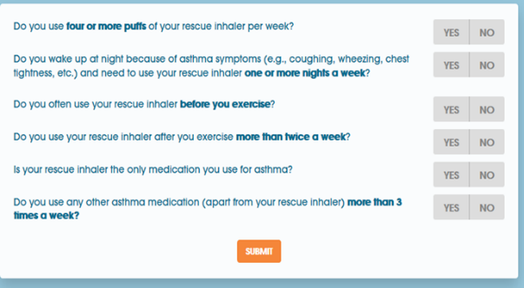
CANADA
3 Design charrettes
Primary care respiratory experts: FPAGC Exec + CFPC Respiratory Group
Non-respiratory expert primary care physicians
Certified Respiratory Educators due after Porto
Building followers
Slide rule for future discussion with clinicians and patients
Article on SABA overuse for newsletter
Social media initiative: with www.Howmuchistoomuch.ca in partnership with Asthma Society of Canada
Beginning of primary care CME program on asthma control and use of better prescribing options for alternative relief/asthma strategies
Making the case for change
Abstract on beta agonist attitudes submitted to IPCRG, REG, + ERS conferences
Dr. Fitzgerald's team to quantify problem with British Columbia data on SABA use
Other ideas to consider
Global advisory board of primary care champions for mild asthma
National implementation teams with respiratory and primary care clinicians to develop implementation strategies
White paper on mild asthma to eventually impact guidelines production
Howmuchistoomuch.ca

Slide 51
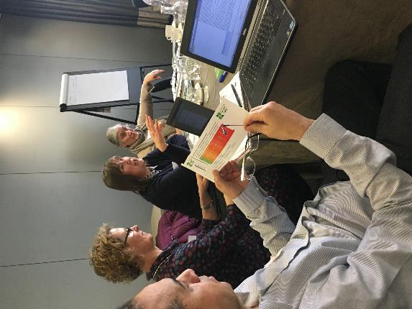
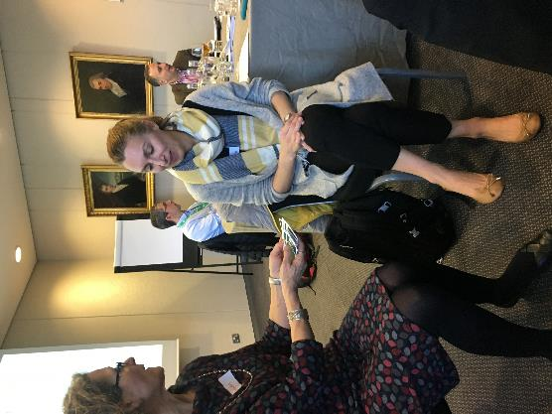
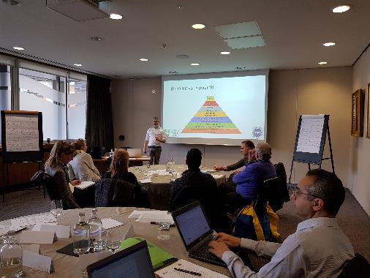
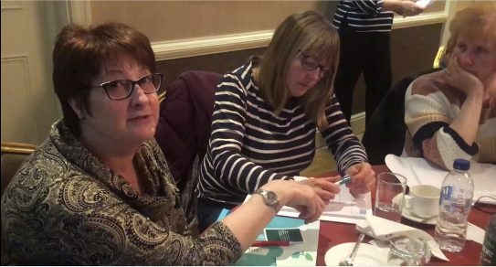

UK
Design Charrette
Lot of interest in attending
National Clinical Director Respiratory Care, patient charities, GPs, nurses, pharmacists
Key messages
  Slide rule seems promising - everyone wanted one!
We have confused messages about SABAs
    ‘life savers’ vs ‘dangerous – risk of death’ – but safety issues not top of minds of prescribers
  Guidelines not clear on threshold for what constitutes ‘too much SABA’
  Different policies about repeat prescriptions and quantities
  Beware unintended consequences if message is not clear:
  Want to ‘reduce unnecessary reliance on SABAs’ so messages need
    To be phrased positively
    To consider the role of SABAs in context of all medication, not in isolation
  Overwhelmed by the question & challenge cards – just pick a few!
  A patient ‘near miss’ story focuses the attention
Progress with initiatives & resources
  Pre- and post-education in practice questionnaire using slide rule
  Lots of testing in pharmacies
  Get better at the conversation the more you use the materials

Slide 52
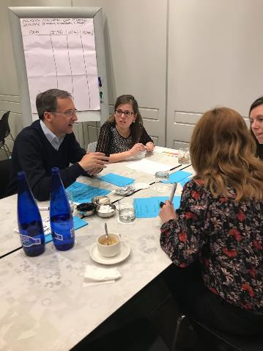
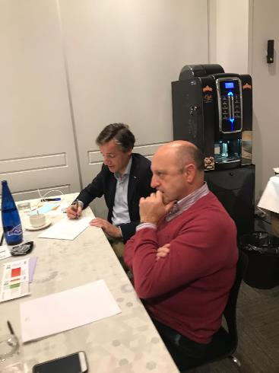
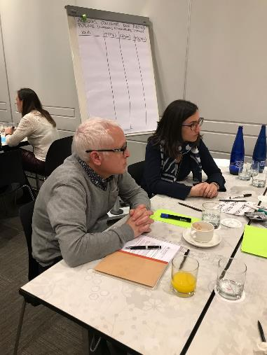
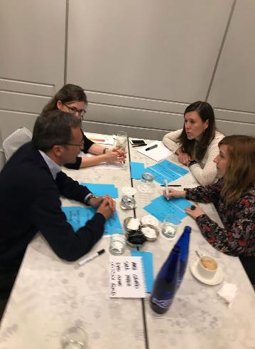
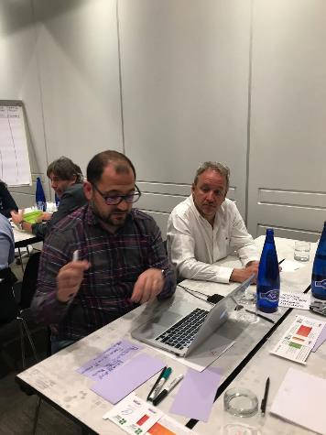

SPAIN
Design Charrette Delivery Team
Cristina Alonso Miguel Román
Miguel Ángel Galmés Mónica Sorribas
Mar Martínez Marta Villanueva
Enrique Mascarós
Design Charrette Stakeholders
Susana Cantero Xisco Morante
Eusebio Castaño Juan José Muñoz
Nuria Celorrio Sara Nuñez
Bernardino Comas Francisco Plaza
Sonia Fernández José Ignacio Prieto
Pilar Marcos Ana Urendez
Jesús Molina Diego Vargas
Key messages from Design Charrette
Give asthma more media visibility among general population
Increase asthma patients’ awareness about poor disease control + SABA overreliance and abuse using marketing campaigns
Equate asthma to other chronic conditions to promote same continuity of care from diagnosis to treatment
eg diabetes or hypertension
Create proper clinical pathways and follow-up recommendations
Remember to manage children-adult asthma transition
Notes:
Building followers
Journalists
ED clinicians
Sports medicine and cyclists
Pharmacists
Nurses
GPs

Slide 53

SPAIN
Making case for change
Promote + develop clinical research projects about prevalence, characteristics + consequences of SABA misuse/abuse and maps
Create social media campaigns about right dispensing and medication use for community pharmacists
Review clinical guidelines recommendations
Ideas for after Porto
Create CME programmes for health care professionals
Promote patients’ groups educational activities
Involve nurses in Asthma Right Care – through workshops
Organise multidisciplinary meetings/discussion tables during regional and national respiratory conferences around SABA misuse and asthma right care
Develop a primary care Asthma Right Care quality label/accreditation from national primary care
Progress with initiatives & resources
A systematic review of SABA overuse published in a Spanish education journal (not indexed).
Analysis being undertaken on no of SABAs used per year vs poor outcomes using a database of 50,000 asthma patients in Majorca. Available summer 2018
Spreading use of the Asthma Slide Rule between prescribers, asthma educators, pharmacists and patients to stimulate conversations about over-reliance on SABA for
Also made a selection of Question Cards to use in practice: colour coded for doctors, nurses, pharmacists and patients.
Idea is to configure these like the suits in playing cards - so we have introduced paintings and numbers simulating a deck of cards.
Notes:
Multi-disciplinary = (primary care doctors and nurses, pulmonologists, pharmacists and patients)
More detail on the accreditation available (Appendix 1)

Slide 54

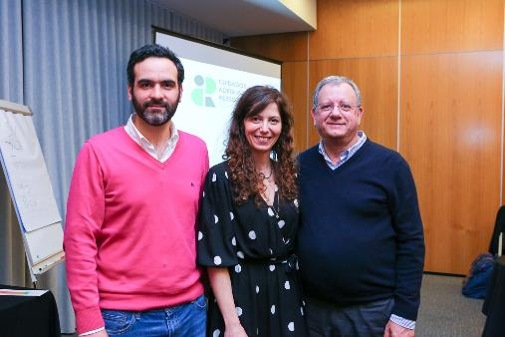
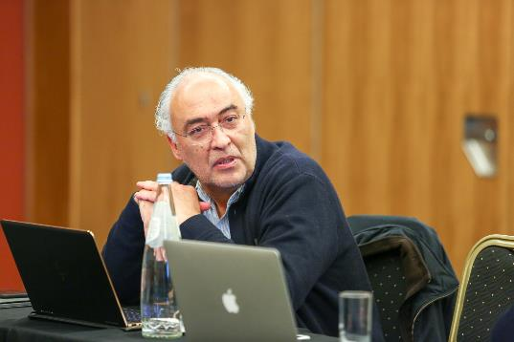
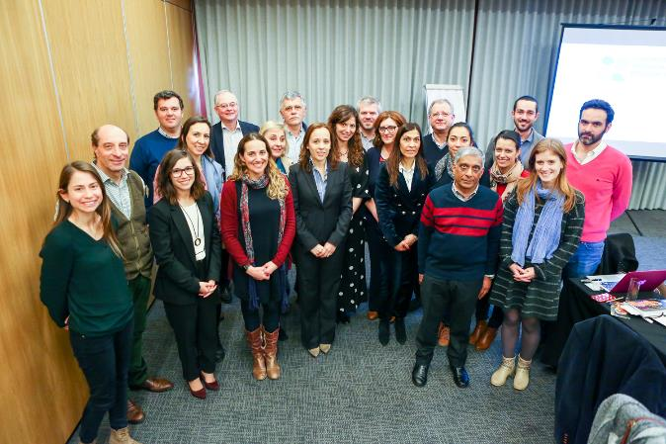
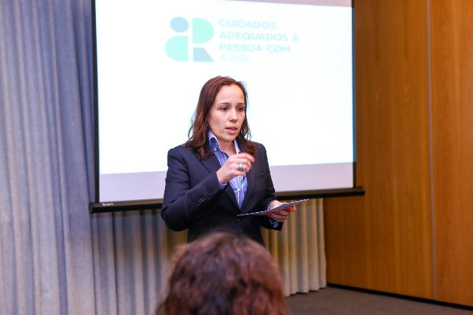
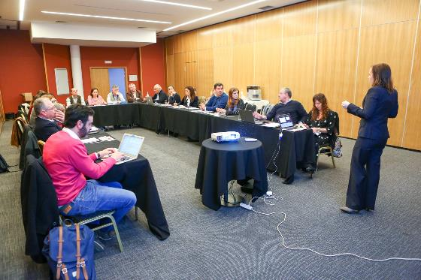

PORTUGAL
Design Charrette
The Design Charrette in Coimbra, April 14th and we had 23 attendees:
-CAPA Group
-APMGF (Portuguese Association of General and Family Medicine)
-3 pharmacists groups: ANF, AFP, Holon
-2 nurses: from primary and secondary care
-Cardio-pneumology technician
-Portuguese Pulmonology Society - SPP
-The Portuguese Directorate-General of Health – the official body that, among other things, develops guidelines in cooperation with the Portuguese Medical Association
-Portuguese Lung Foundation – FPP

Slide 55


PORTUGAL
Key messages from Design Charrette
Primary care
Asthma Slide Rules distributed with Portuguese primary care scientific journal
Education programme for family physicians and nurses: webinar; regional health administrations (ARS/ACES) + replicate in local health units;
Social initiative at World Family Doctor Day - create/adapt a classic board game for children
Reviewed algorithm of action in asthma and right care at SNS24 (health helpline), criteria and when to refer to emergency department, family physician, etc.
Electronic messages/alarms in the prescription programme when a SABA is prescribed
Actions in schools
Secondary care and emergency department (ED)
Review patient's plan on discharge and establish joint care plan for primary care
Review nurse care at ED: raise awareness +reinforce importance of right care
Social media intervention with bombastic messages, eg: "do you only have asthma on Mondays?"
Electronic messages/alarms in prescription programme when SABA prescribed
Education programme: webinar, e-learning courses
Pharmacy action
Use of consulting rooms in pharmacy for therapeutic follow-up eg review of inhaler technique, evaluation of disease control, SABA over-reliance
Electronic messages/alarms in prescription programme when SABA prescribed
Pharmacy algorithms to action when identifying a poorly controlled asthma patient: eg when to inform, refer….
Education programmes
Progress with initiatives & resources
“CAPA dossier”: we are writing about our CAPA key points for medical newspaper in May.
Each partner is writing an article reflecting their point of view about asthma and Asthma Right Care
ARC/CAPA movement presentation in a Pulmonology regional Conference
Portuguese Family Physician Association is celebrating Family Doctors World Day in Coimbra, which will include CAPA presentations and SABA slide Rule distribution
Presentation/ communication at EUROPREV Conference (November 2018) in Porto
Workshop at National Family Conference (APMGF Conference)

Slide 56
What has Asthma Right Care changed for you?
It has changed my approach to leading a large scale change for asthma management. It means to move towards a new vision that is better and fundamentally different from the Status Quo. This Project has pointed me in the right direction for creating and sustaining large scale change and transformation.This framework helps us to increase personal value, value for the population and rates of higher value intervention.
Mar Martinez, GP
ARC is changing our lives because we are reflecting about our work quality in a biopsychosocial dimension while we try to make every single step to provide all the asthma right care to patients and caregivers reconciling it with daily work. At the same time it is incredible how we can apply this knowledge to other diseases and procedures.
Teamwork is very rewarding, making us grow as a person and as a healthcare professional.
Cláudia Vicente, GP

Slide 57
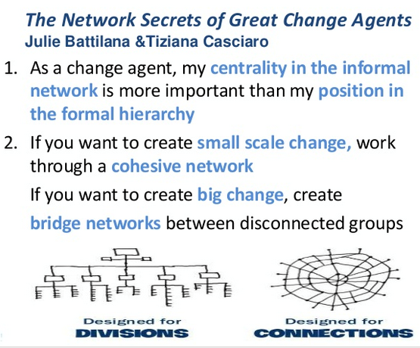
International networks
We are on the agenda at:
WONCA Europe
EQUIP: patient safety
EUROPREV: conference Porto 9-10 November 2018
FIP
International conference Glasgow September 2018
WHO-GARD
Annual meeting, Helsinki August 2018

Slide 58
Summary of learning
Be brave: talk numbers!
Be passionate about equity and safety
Select your words carefully
Be curious about what happens outside the consulting room
Consider role of pharmacist

Slide 59
Be brave: talk numbers
Systematic review 2018 “excessive over-use” but NO definition
How many people with asthma do you see – how long would it take to review all those on over 12 or 6 or 3 SABA inhalers a year?
What is the ratio we should be aiming for between ICS and SABA?
What is the current ratio in your practice and in your region?
Set red flags on electronic systems: what’s the number?

Slide 60
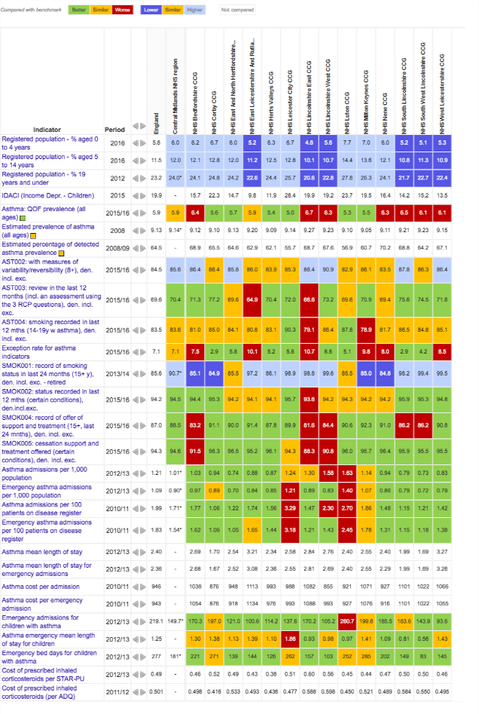
Be passionate about equity & safety!
Asthma patients deserve the same attention as people with hypertension, diabetes etc: fight their corner!
As medicines are the mainstay of treatment they need clinicians’ right care
Asthma is global, in all communities, in all ages
Use atlases like NHS Atlas of Variation
Just because SABA is cheap and brings immediate relief doesn’t mean it’s enough
Just because people can take a lot of SABA without side-effects doesn’t mean a lot of SABA use in asthma is safe

Slide 61
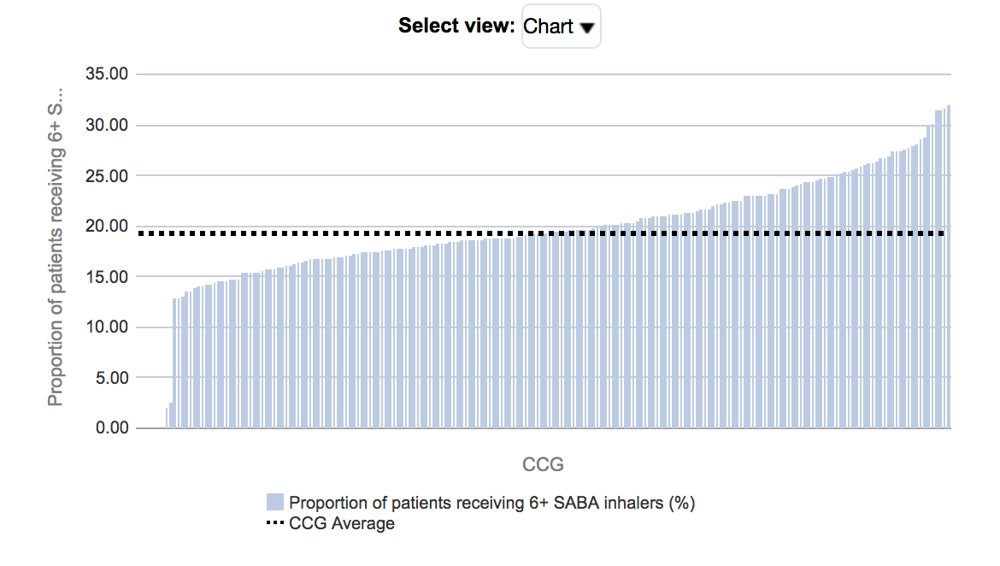
[New slide] Proportion of patients receiving 6+ SABA inhalers

Slide 62
Select your words carefully…
Pay attention to choice of words used in conversation and in writing:
  “Over-reliance” vs over-use
  SABA for asthma vs SABA for COPD
  Dose or puff
  Rescue or relieve
  Stops asthma vs stops asthma attacks
  As directed by your GP….
  As needed….
Use the same words each time and along the pathway
A “puff” is a breathless moment: count those moments…. 2400 breathless moments in a year = 12 inhalers
Build on existing “make every contact count” approaches eg Ask, Advise, Act used in treating tobacco dependence

Slide 63
Words: Social movements thrive on narratives
“Using the blue reliever is like dampening down a fire, but to put the embers out, and to stop it flaring up again, you need the ICS controller”
What stories do you tell to help explain?
What analogies and metaphors do you use?
Notes:
Pharmacists thought of antibiotics guardians, salt for hypertension/salbutamol for asthma

Slide 64
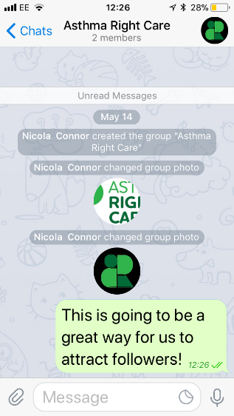
Images: Social movements also thrive on images: still & moving
 | What’s App | Telegram app | Twitter | Websites and Facebook
Internal | Up to 250 users | Up to 100,000 |  | www.ipcrg.org/asthmarightcare to download resources in English, Spanish & Portuguese
External | No | No | Yes | Possible!
Good for followers | Will need new groups if get more than 250 | Yes | Yes | Need to advertise
Images | Yes – uses lot of data. Encrypted | Yes – stored on Cloud. Encrypted | Yes | Yes
Films | Yes, uses lot of data. Encrypted | Yes – stored on Cloud. Encrypted | Yes – if short – plans in Porto! | Yes
Notes:
Pharmacists thought of antibiotics guardians, salt for hypertension/salbutamol for asthma

Slide 65
Be curious about what happens outside the consulting room
Who just goes to the pharmacist and by-passes the GP or nurse?
What is the scale of the problem with cyclists abusing salbutamol?
What do GPs with asthma do….
What do staff in the ED do? Who follows up patients from ED?

Slide 66
Consider role of pharmacist
The “rate limiting step” in most asthma pathways is the quality of the interaction with the pharmacist
Whether buying SABA over the counter or collecting a prescription
    Getting advice on how and when to use
    Inhaler check
    What investment is made in pharmacists’ training
    What reimbursement do they get to support doing the right thing?
    What if the prescription needs review?
What training do pharmacists get: does anyone you know still say “use the blue first to open up the airways” – it was the right teaching 30 years ago….?
Are pharmacists afraid to challenge the prescriber for fear of losing business?

Slide 67
What can you commit to?
AstraZeneca have sponsored and paid for this symposium as part of the Gold Sponsor Package. IPCRG received funding from AstraZeneca to develop the Asthma Right Care Initiative
Notes:
Commentary ends here https://www.useloom.com/share/5889ba905e6a46b1aa4162f676262189

