Slide 1
COPD and Mental Health
An IPCRG Initiative
Holistic and Practical Guidance for Primary Care
Boehringer Ingelheim provided an unrestricted educational grant to support the development, typesetting, printing and
associated costs but did not contribute to the content of this document

Slide 2
COPD and Mental Health Case Studies COPD and Depression Cláudia Vicente (Portugal) and Ioanna Tsiligianni (Greece)

Slide 3
About these slides
Please feel free to use, update and share some or all of these slides in your non-commercial presentations to colleagues or patients
There is a general introduction to COPD and mental health, followed by a case study
The slides are provided under creative commons licence CC BY-NC-ND
BY stands for attribution (the obligation to credit the author and other parties designated for attribution)
NC stands for NonCommercial (commercial use is excluded from the license grant)
ND means NoDerivatives (only verbatim copies of the work can be shared)
When using our slides, please retain the source attribution: IPCRG 2022 COPD and Mental Health

Slide 4
Glossary of terms, abbreviations and acronyms
bpm, beats per minute
BMI, body mass index
COPD, chronic obstructive pulmonary disease
CVD, cardiovascular disease
FEV₁, forced expiratory volume in 1 second
FVC, forced vital capacity
GOLD, Global Initiative for Chronic Obstructive Lung Disease
HbA1c, glycated haemoglobin
HDL, high-density lipoprotein
LDL, low-density lipoprotein
od, once daily
PCP, primary care physician
PHQ-4, Patient Health Questionnaire 4
PHQ-9, Patient Health Questionnaire 9
QoL, quality of life
SSRI, selective serotonin reuptake inhibitor

Slide 5
Our aim
To highlight the importance of assessing for and treatment of depression in people with COPD and provide an evidence-based intervention example through a clinical case

Slide 6
What you will learn
How to evaluate a person with COPD for symptoms of depression
Appropriate tools to use to assess depression in a person with COPD
How to manage depression in a person with COPD

Slide 7
Mental disorders: Important comorbidities in COPD
Anxiety and depression are common in COPD and are associated with poorer health status and increased risk of exacerbations and emergency hospital admissions¹
Multiple studies have demonstrated an association between cigarette smoking and increased anxiety symptoms or disorders²
Smoking, depression and anxiety are all associated with a higher risk of death in people with COPD³
1. GOLD 2022. Available at: https://goldcopd.org/2022-gold-reports-2/; 2. Moylan S, et al. Brain Behav 2013;3:302-26; 3. Lou P, et al. Respir Care 2014;59:54-61.

Slide 8
COPD and mental disorders: Depression
PCPs often have low confidence to evaluate and treat mental health problems due to the complex inter-relationships between them and symptoms such as breathlessness
About 30% of people with COPD have comorbid depression¹⁻³
Depression is underdiagnosed and undertreated in people with COPD
1. Pollok J, et al. Cochrane Database Syst Rev 2019;3:CD012347; 2. Sohapal R. Trials 2020;21:18 (2020); 3. Yohannes AM, Alexopoulos GS. Eur Respir Rev 2014:23:345-9.

Slide 9
Case study

Slide 10
Background
“I’m always a bit tired, I’m feeling even worse in the past few months but I take my respiratory medications every day”
Mrs Vitalina is 70 years old and is married
She is owner/manager of a small cork company
She was born in Mozambique, although is of Caucasian ethnicity, and currently lives in Mealhada in Portugal
She does not drink or smoke although her husband is a smoker. They also have a wood-burning fire in their home
Mrs Vitalina takes only limited exercise but has lost 5 kg in the last year and feels constantly fatigued

Slide 11
Medical history and risk factors
Medical conditions: Hypertension Dyslipidaemia Type 2 diabetes mellitus COPD | Current medication: Perindopril 5 mg + amlodipine 5 mg od Atorvastatin 10 mg od Metformin 1000 mg twice daily Tiotropium bromide 2 inhalations od
Risk assessment: Alcohol consumption: none Smoking status: none smoker (husband smokes) Exercise: limited, feels constantly fatigued | Allergies: none Vaccinations: up to date with influenza, pneumococcal and COVID-19 vaccinations

Slide 12
Reason for visiting her doctor
Mrs Vitalina has come to her family doctor to discuss her hypertension
She speaks slowly and softly and always looking down
She is worried about her husbands health and about her daughter who lost her job recently
Her medical records indicate 7 appointments in the last 5 months for primary care and the hospital emergency department, for various reasons including small pains or breathlessness
In the past 12 months she had one moderate exacerbation of her COPD

Slide 13
Physical examination
Appearance | Limited facial expressions (anhedonic) Dark circles under her eyes
Respiratory | No sign of respiratory distress; SpO₂ 95% aa Pulmonary auscultation: vesicular murmur present bilaterally, globally diminished, normal without sounds like wheezing or crackles
Cardiovascular | Blood pressure 138/74 mmHg, heart rate 80 bpm Cardiac auscultation: S1 and S2 rhythmic
Other physical observations | Abdomen normal No oedema of lower limbs
Height / weight | 149 cm / 52 kg
BMI | 23.4 kg/m²

Slide 14
What should you do?
Person with COPD
Time and tools
Family / caregivers
Structured appointment
Local resources
Clinical sense and knowledge

Slide 15
At her first appointment
Consider | What else?
Assess her Hypertension Diabetes control Cardiovascular risk COPD – airflow limitation, symptoms, risk of future events Conduct a clinical examination and review her medical notes Make any clinical adjustments to diet, exercise, inhaler technique, new medication (not only for COPD) Check for prescription renewal Schedule next appointment | Explore her feelings Investigate REAL consultation reasons Give time and space during the appointment so the patient can speak Use some tools/questionnaires

Slide 16
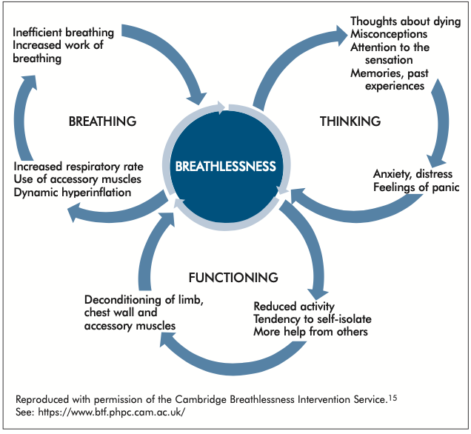
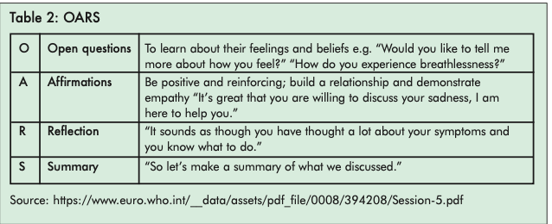
Available at: https://www.ipcrg.org/dth12.

Slide 17
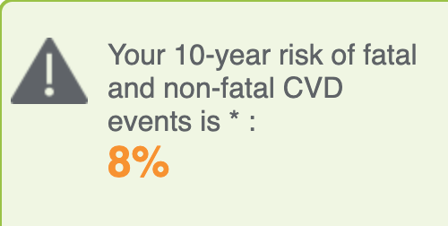
Mrs Vitalina’s cardiovascular risk results
Hypertension: 138/74 mmHg; heart rate 80 bpm
Diabetes control: HbA1c 6.3%
Cardiovascular risk 8%^{a1}
Total cholesterol 162 mg/dL
HDL cholesterol 50 mg/dL
LDL cholesterol 104 mg/dL
ªBased on SCORE2, Portugal is a moderate risk zone.
1. https://heartscore.escardio.org/Calculate/quickCalcResult.aspx?model=moderate.

Slide 18
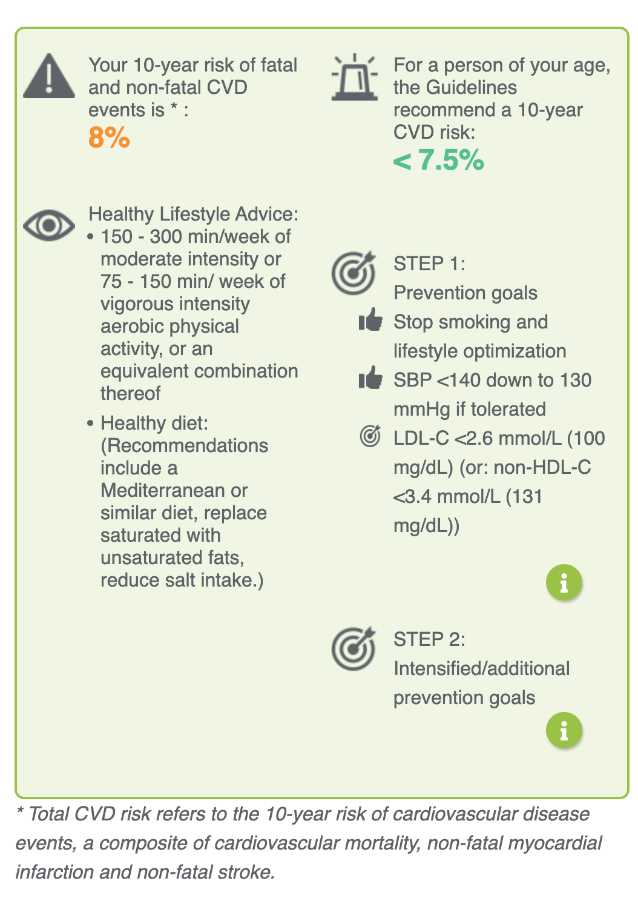
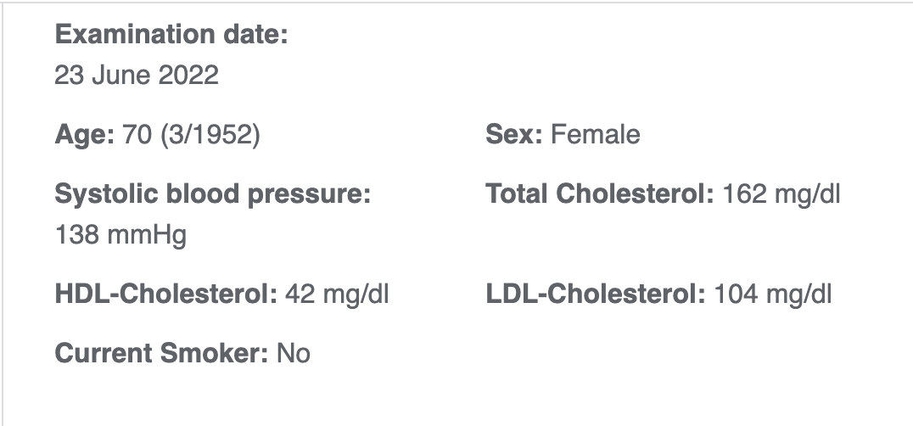
Mrs Vitalina’s cardiovascular risk results

Slide 19
Mrs Vitalina’s COPD assessment
Spirometric evaluation
Inhalation technique
Physical activity

Slide 20
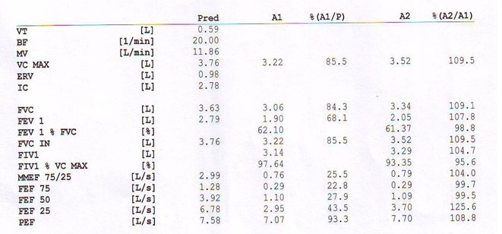
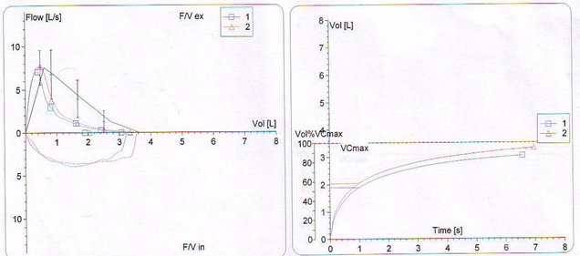
Spirometry

Slide 21
Airflow limitation severity assessment
Spirometry: post-bronchodilator FEV₁/FVC=61.37; reversibility 7.8% (<12%)
GOLD grade¹ |  | In patients with post-bronchdilator FEV₁/FVC <0.70: FEV₁ (% predicted):
GOLD 1 | Mild | ≥ 80%
GOLD 2 | Moderate | 50–79%
GOLD 3 | Severe | 30–49%
GOLD 4 | Very severe | < 30%
1. GOLD 2022. Available at: https://goldcopd.org/2022-gold-reports-2/.

Slide 22
Mrs Vitalina’s clinical picture
She has a number of comorbid conditions:
Diabetes
Hypertension
Dyslipidaemia
COPD – controlled?
Is there any condition that is missing?

Slide 23
Identifying mental health problems in people with COPD
Good patient-centred consultation
Active listening – avoid interruption
Show empathy
Observe carefully
Body language and non-verbal signals may offer useful information
Available at: https://www.ipcrg.org/dth12.

Slide 24
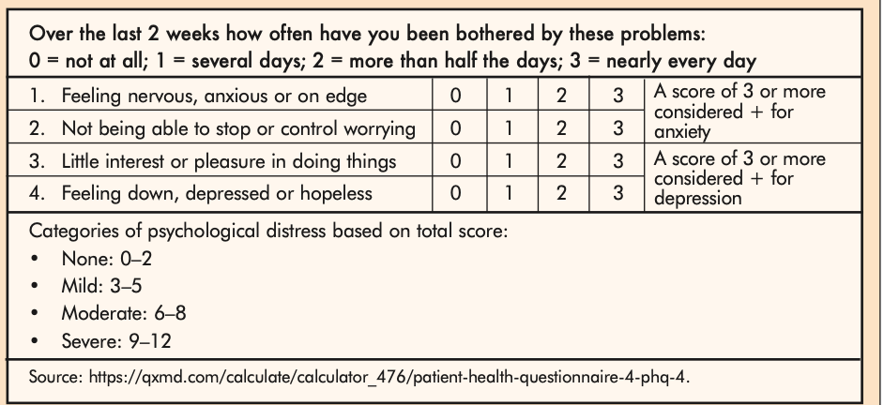
Identifying mental health problems in people with COPD: PHQ-4
For very brief measurement of depression and anxiety
Can be completed online
Mrs Vitalina scored 3 for items 3 and 4 that assess depressive symptoms
Available at: https://www.ipcrg.org/dth12.

Slide 25
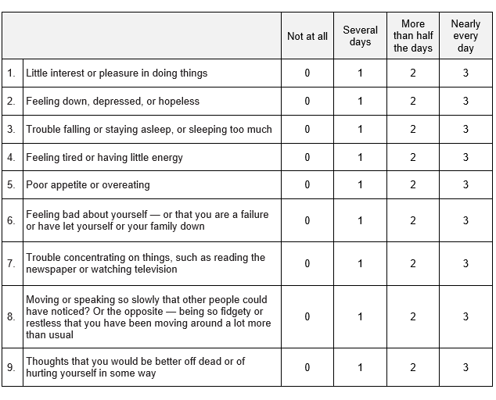
More detailed evaluation of depression: PHQ-9
To assist the clinician in making the diagnosis of depression
To quantify depression symptoms and monitor severity

Slide 26
Mrs Vitalina’s PHQ-9 score was 16

Slide 27
Thinking about Mrs Vitalina
Challenges | Positives
She has 4 comorbid conditions in addition to her COPD | She is up to date with her vaccinations
She takes a lot of medications every day | She is a non-smoker
She doesn’t know how to recognize and manage her COPD symptoms | She adheres well to her other medication regimens
She has no support at home | She has a good relationship with her doctor
SHE IS DEPRESSED. What to do?

Slide 28
Managing Mrs Vitalina’s COPD and her depression
Mind
Body
Environment

Slide 29
Interventions to address breathlessness may relieve symptoms of depression
Intervention | Purpose/aim
Cognitive behavioral therapy | Problem-solving approach that challenges unhelpful thoughts/behaviours; reduces anxiety in COPD in short-term and increases pulmonary rehabilitation attendance
Mindfulness/meditation | 20-minute mindful breathing reduces breathlessness in lung disease, and anxiety/depression in advanced disease; enhances non-evaluative attention and may increase self-efficacy
Relaxation techniques | Some evidence that relaxation interventions can help anxiety, breathlessness and fatigue in COPD. Guided imagery (“thinking of a nice place”), progressive muscular relaxation and counting are most acceptable
Acupuncture/pressure | Improves breathlessness in advanced disease and may reduce anxiety
Singing therapy | Most evidence suggests singing therapy can improve lung function; some evidence suggests it may improve anxiety and QoL; anecdotal evidence also suggest it is of value
Positive psychology giving sense of control/confidence | Not evidence-based, however, holistic breathlessness services reduce anxiety/depression and use positive psychology, improving self-efficacy
Social presence | Experimental evidence in healthy volunteers for social presence reducing breathless perception; patients describe reassurance from presence of others
Available at: https://www.ipcrg.org/dth12.

Slide 30
Managing Mrs Vitalina’s COPD and depression
Discuss her current situation in a holistic way
What she can change/cannnot change?
Shared planned consultation
Discuss increasing her physical activity
Mrs Vitalina should:
Be referred for pulmonary rehabilitation
Initiate an SSRI – for example sertraline 50 mg od
Avoid benzodiazepines
Schedule a follow-up appointment

Slide 31
Summary
When reviewing a person with COPD evaluate all the comorbid conditions
Be vigilant for depression and anxiety
Diagnosis and interventions to treat comorbid depression and anxiety in people with COPD will improve their QoL and their COPD outcomes

