Slide 1
The Primary Care Clinician as Advocate for the right to breath
Climate Change & Sustainable Care for Respiratory Health
Javiera Corbalán, Family Physician
Universidad Austral de Chile

Slide 2
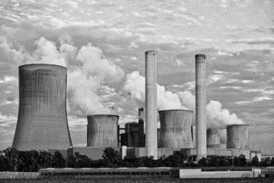
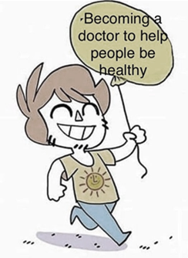
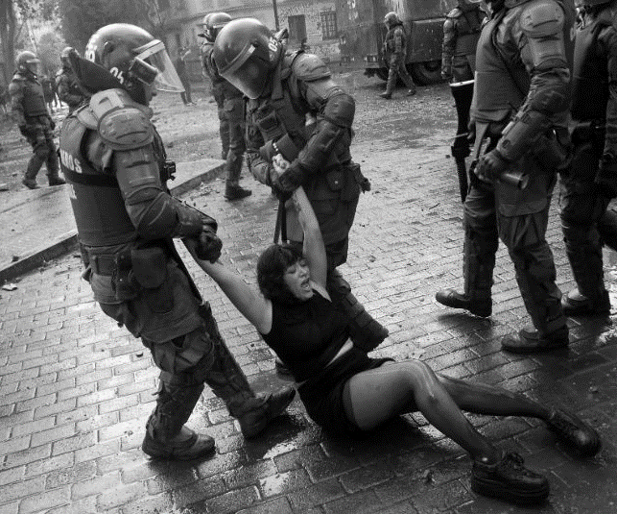
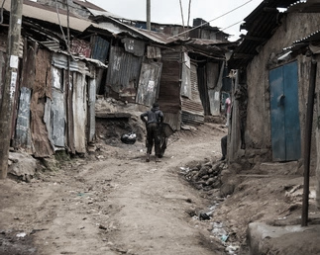
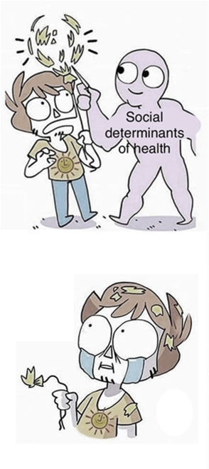
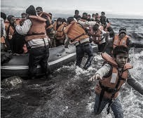
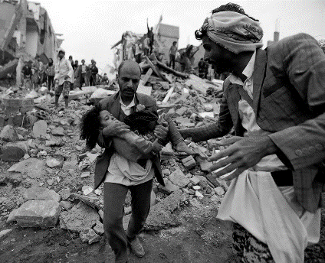

Slide 3
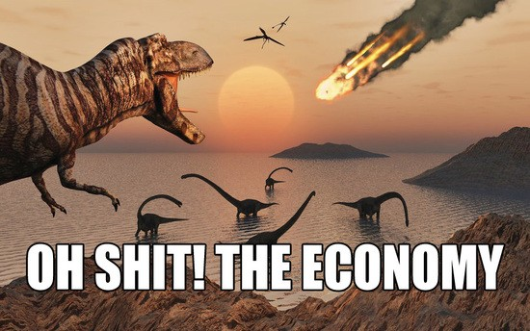

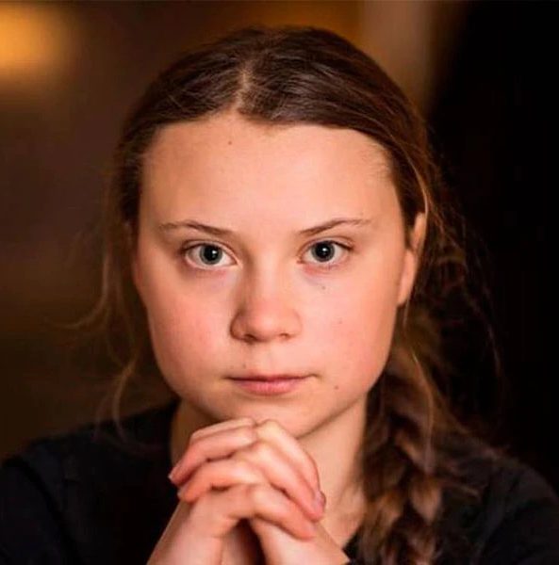

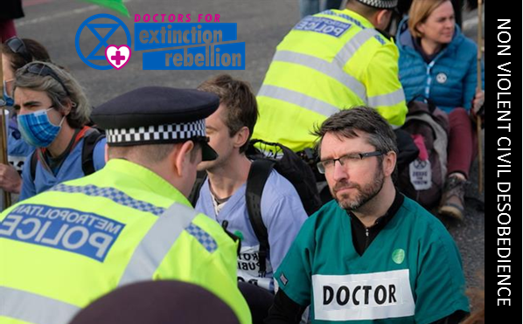
Air pollution: the single largest environmental cause of premature death globaly. WHO

Slide 4
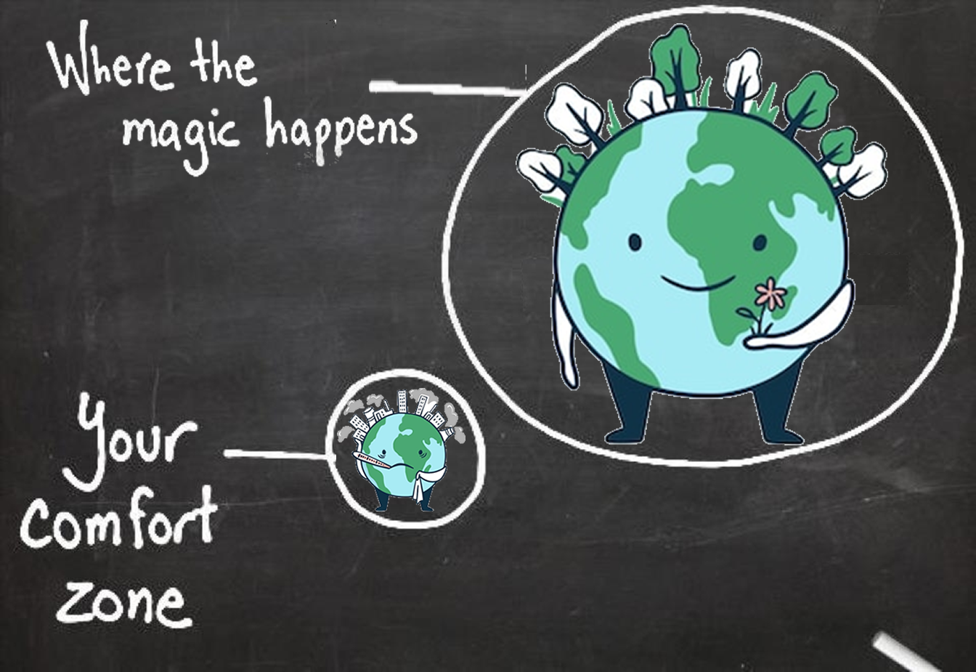

Slide 5
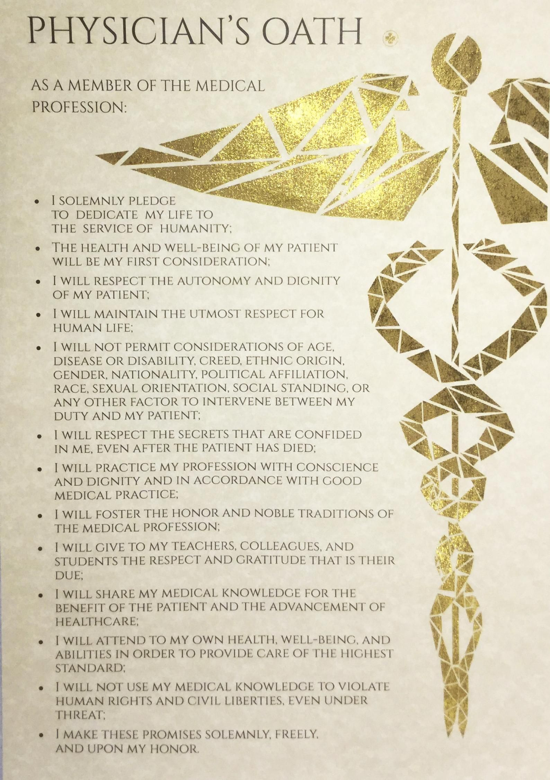
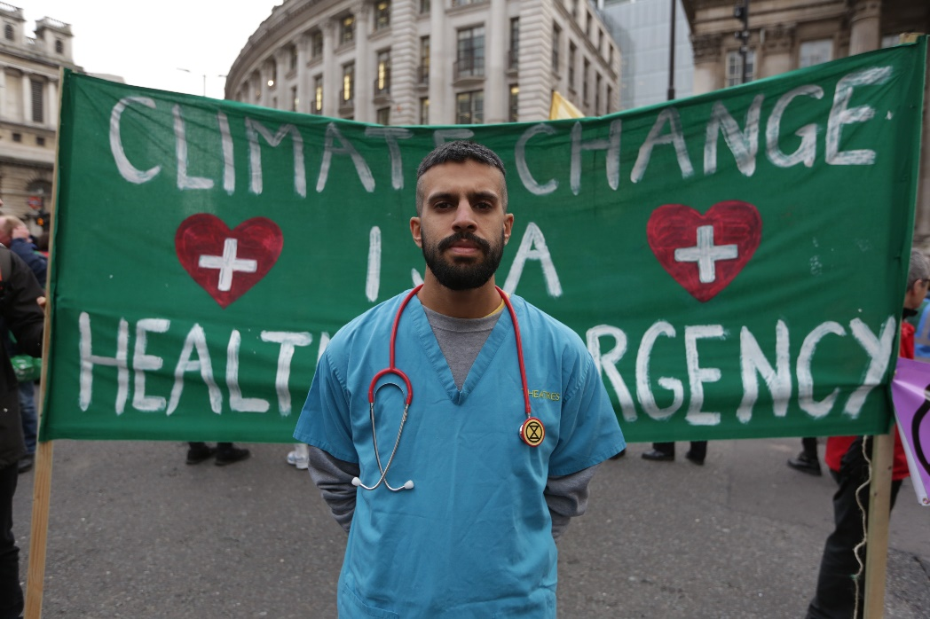
Physicians and health professionals have the responsability and obligation to engage in all kinds of non violent social protest to adress climate change.
Richard Horton, chief editor of The Lancet.
Justice
NoN-Maleficence
Beneficence
Autonomy

Slide 6
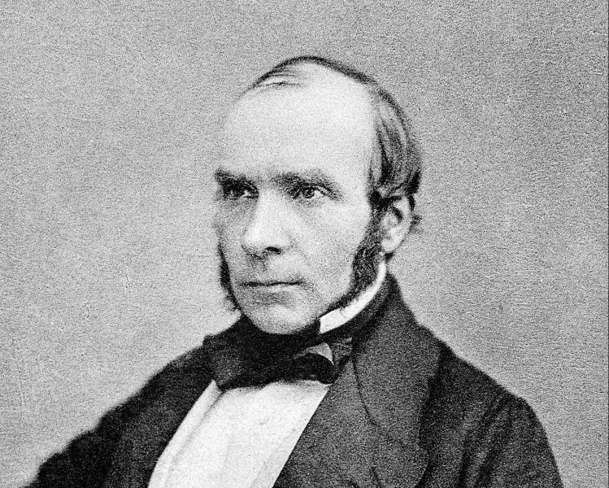
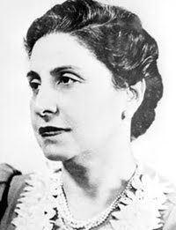
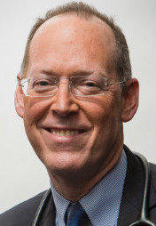
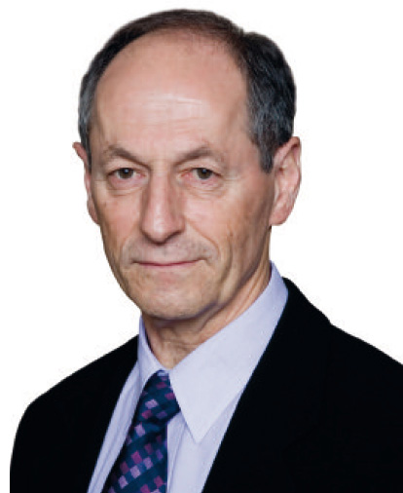
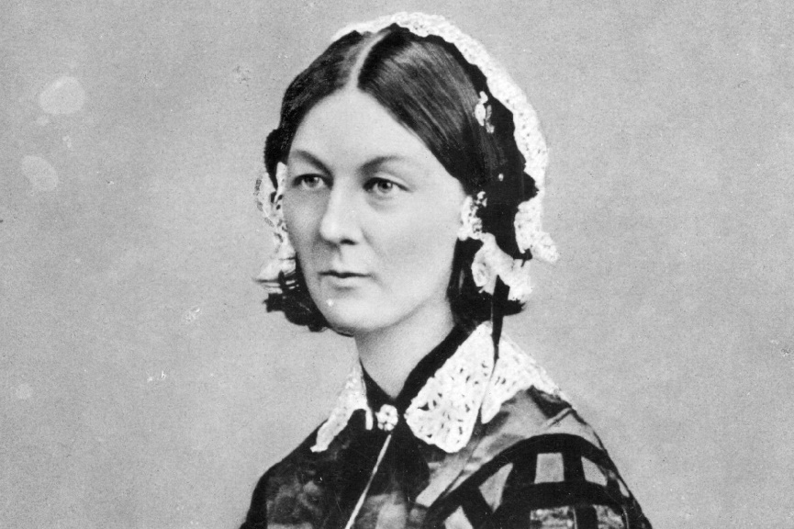
Advocacy!
John Snow
Eloisa Díaz
Paul Farmer
Florence Nightingale
Michael Marmot
Professional Advocacy: to promote those social, economic, educational, and political changes that amielorate the suffering and threats to human health and well-being that we identify trough our professional work and expertise.
Earnest y Wong, 2010

Slide 7
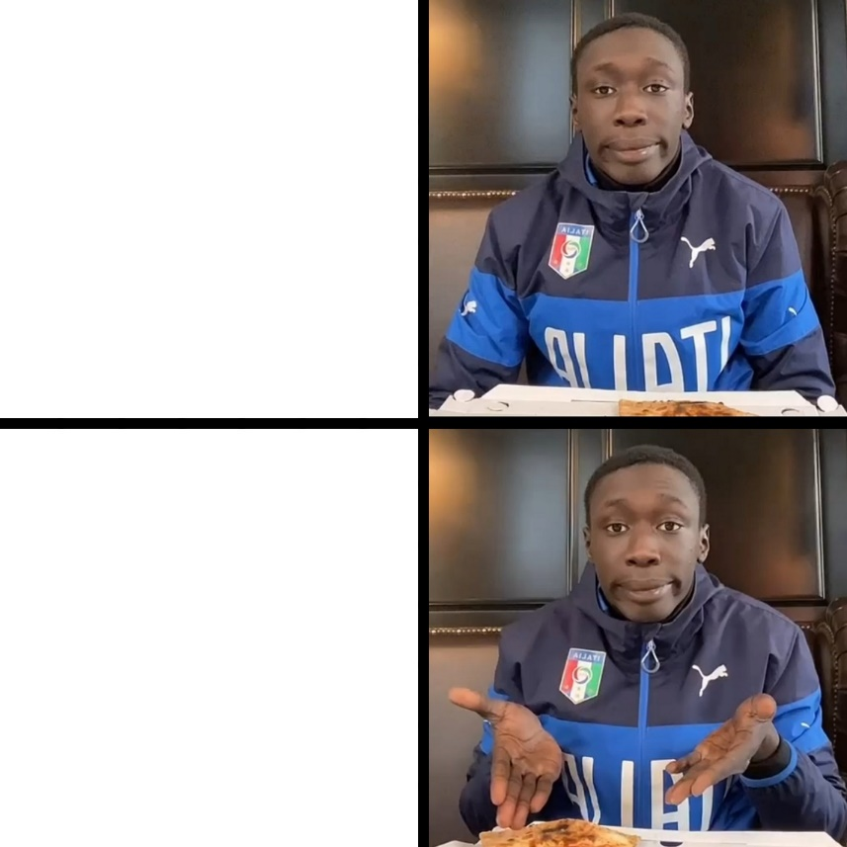
7 questions to know if a health issue merits professional advocacy
Or why i (and many others) think we SHOULD act as advocates
Just treat
Asthma
COPD
Strokes
Depression
Zoonosis
Injuries
Expertise: Do we know about the health impact of climate change?
Proximity: How close are we to the actual victims?
Effectiveness: Does our knowledge makes us more effective advocates than other professional groups?
Low risk or cost
Unique: Do we have a socially and culturally privileged professional position?
Severity: How severe is the threat if we fail to act?
Public trust: What does the public expect us to do?
Fight
Climate
Change!
C. Macpherson. Should Health Professionals Speak Up to Reduce the Health Risks of Climate Change? AMA J Ethics. 2017

Slide 8

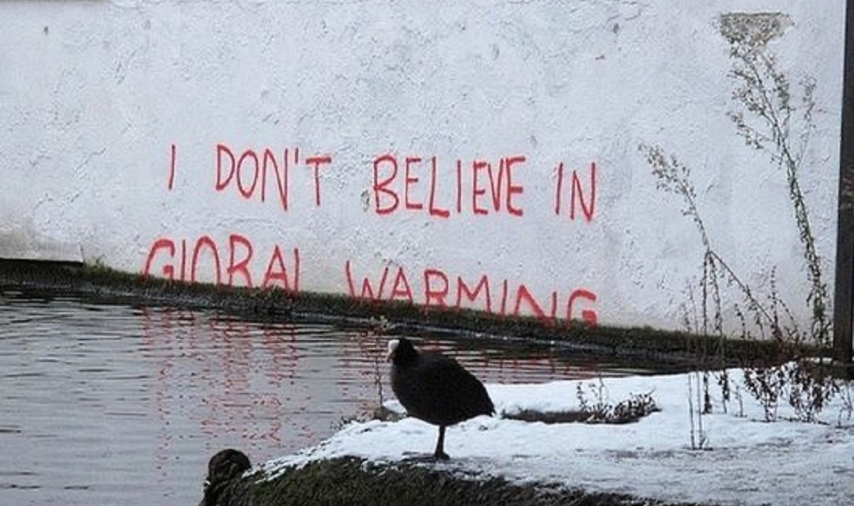
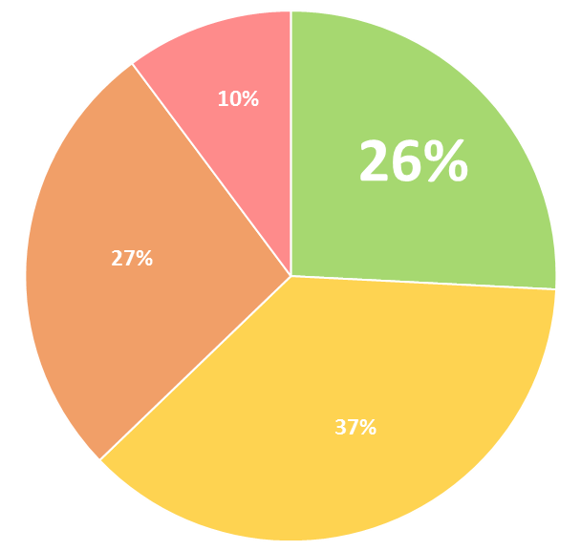


Health professionals have a responsibility to bring the health effects of climate change to the attention of the public.
Health professionals have a responsibility to bring the health effects of climate change to the attention of policy makers
Health professionals should world leaders to strengthen all nations' commitments to achieving the goal of the Paris Climate Agreement
86,4%
Would you personally be willing to participate in a global advocacy campaign by health professionals to encourage all world leaders to strengthen their commitment to achieving the goal of the Paris Climate Agreement?
Strongly agree + Agree
Yes
89,6%
Strongly agree + Agree
Possibly
88,7%
Strongly agree + Agree
J. Kotcher, Views of health professionals on climate change and health: a multinational survey study The Lancet Planetary Health. 2021

Slide 9
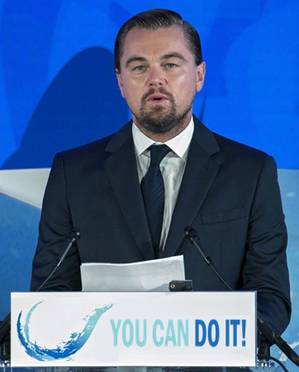

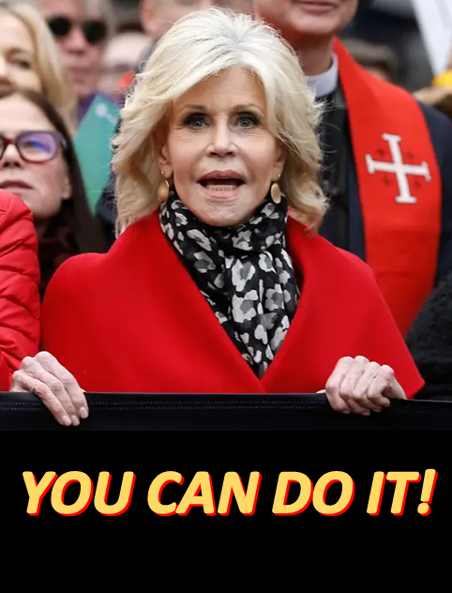
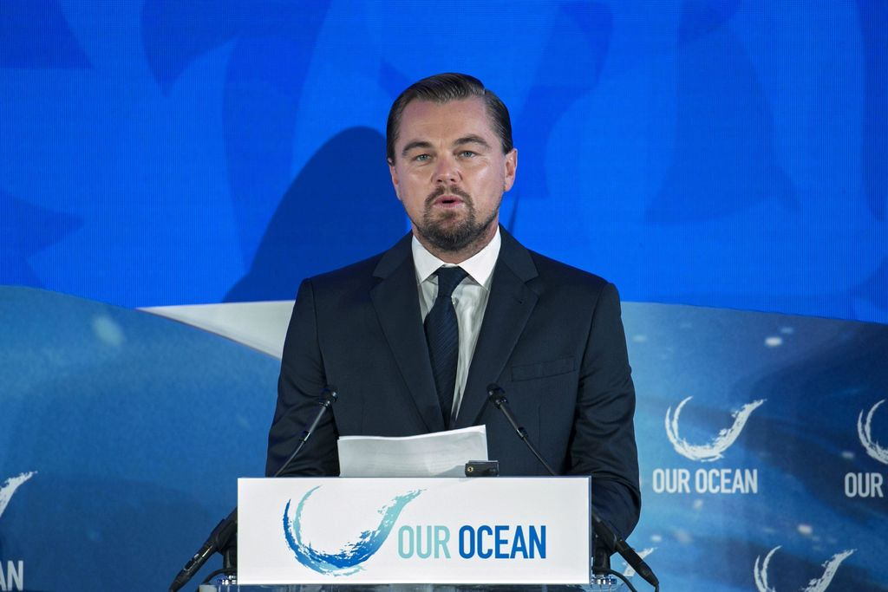

Factors that reduce health professionals willingness to advocate for climate change and health
Lack of time
Lack of knowledge
Lack of peer support or fear from peer criticism
Fear from asocciated risks
Feeling that its useless or to controversial
Extreme Modesty Syndrome

Slide 10
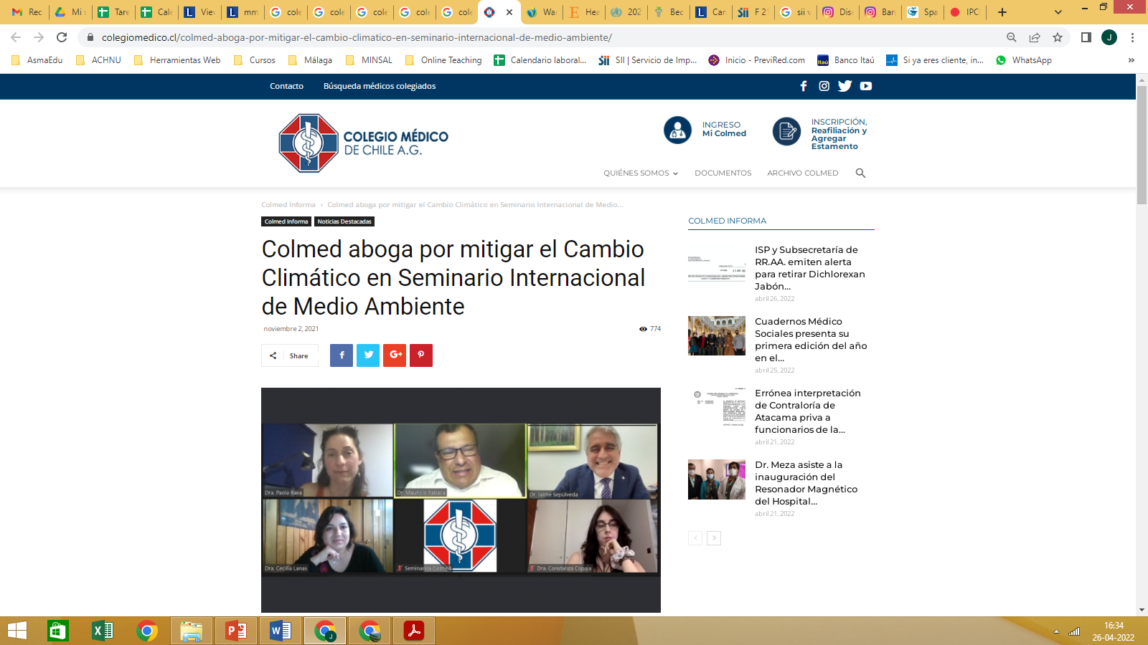
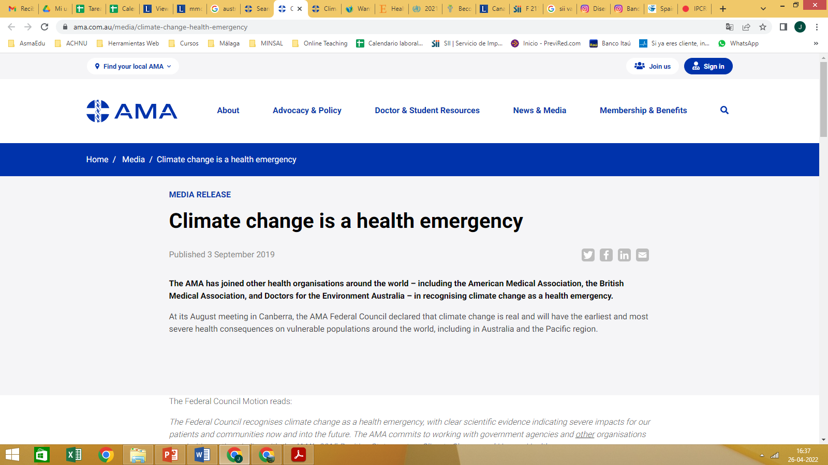
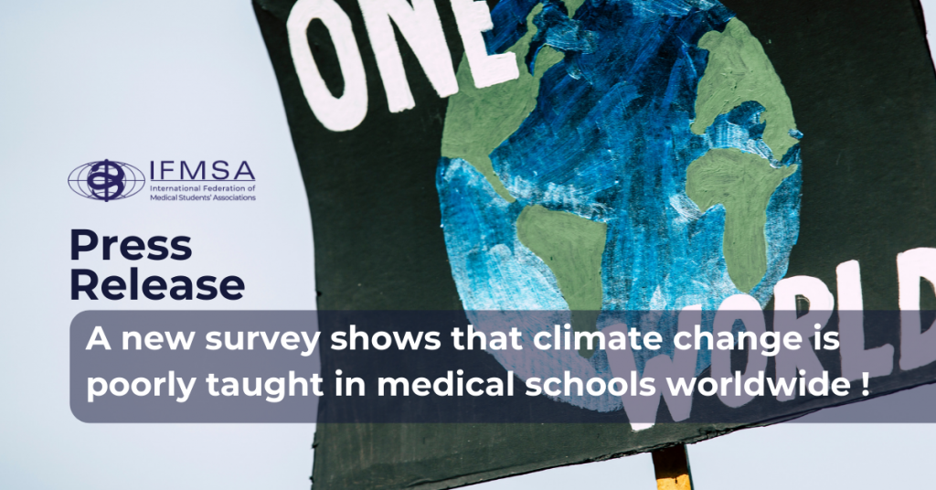
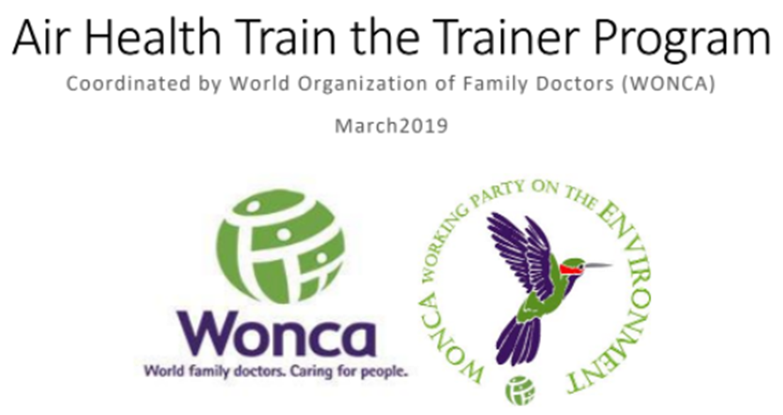
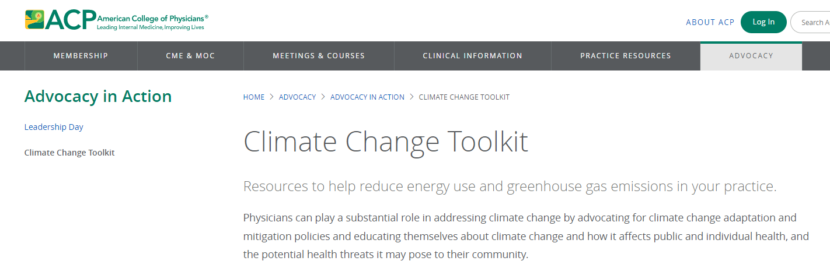
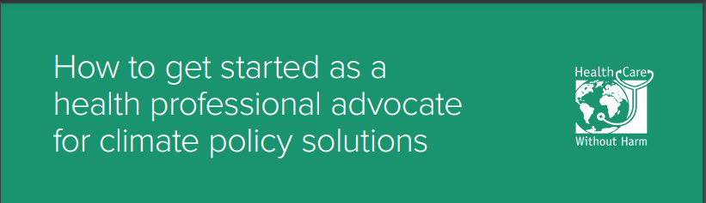
Colmed advocates for Climate Change mitigation in International Environmental Conference

Slide 11
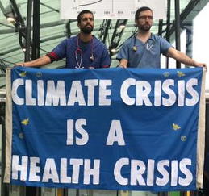
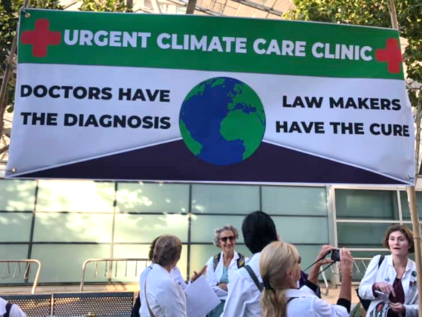
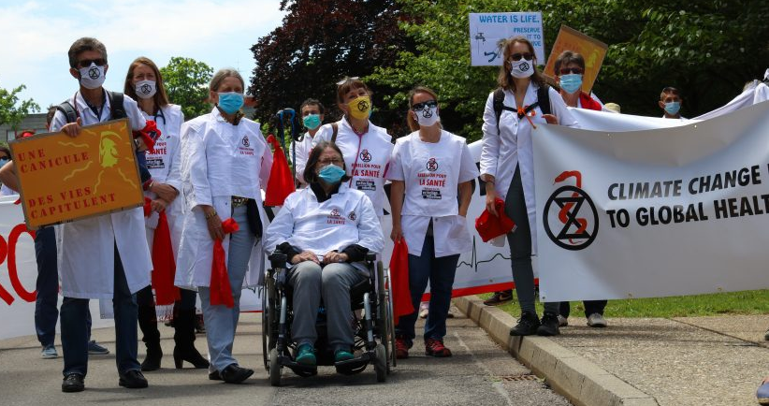



What could we do?
Do our homework
Take climate change into consultation and life
Promote greener health organizations
Work within our scientific societies or join others
Sign the Healthy Climate Prescription Letter
Support peers
Support youth-led initiatives
Push for curriculum changes in med schools
Have a voice, train ourselves in advocacy skills
Just what we could

Slide 12
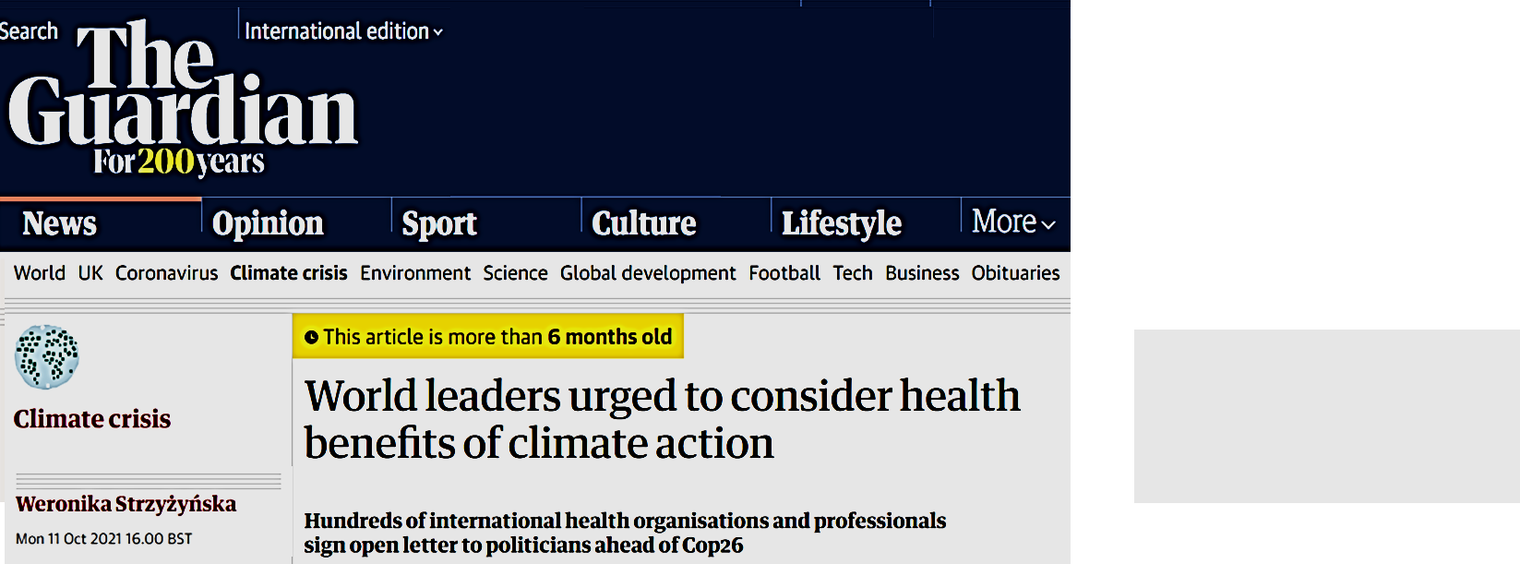
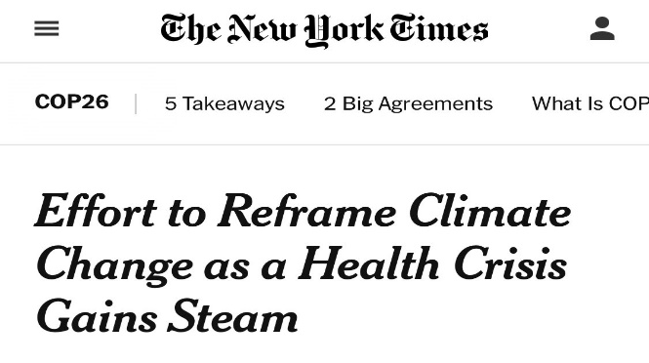
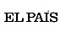
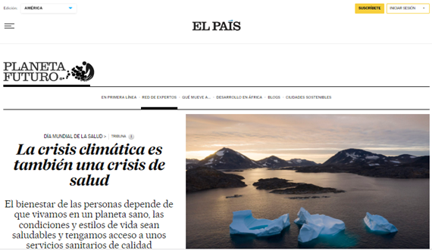
Impact of health professionals engaging and speaking out about climate change
Reframing climate change as a public health problem:
Generates the necessary public and political support to accelerate the adoption of sustainability solutions.
Inspires sustainability efforts with policy makers
Improves sustainability within the health-care industry
Motivates sustainability actions by others
Maibach E. Reframing climate change as a public health issue: an exploratory study of public reactions. BMC Public Health 2010
Hubbert B. Recruiting health professionals as sustainability advocates The Lancet Planetary Health 2020

Slide 13
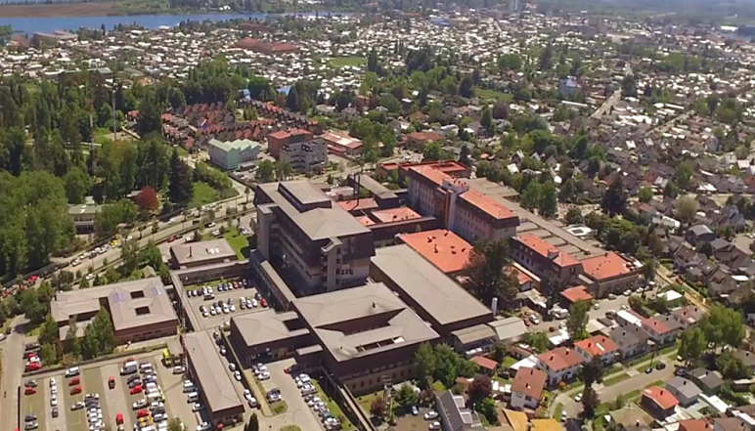
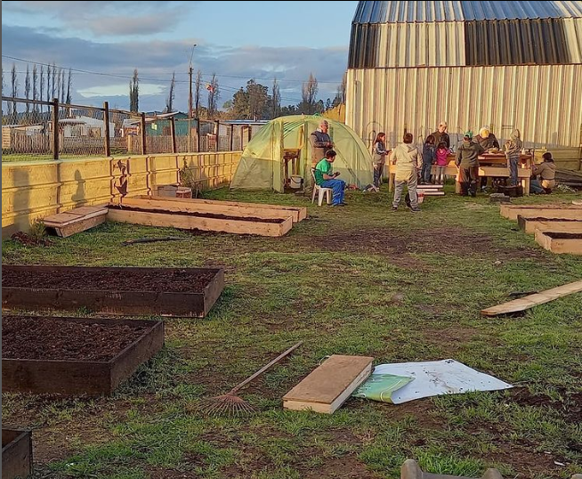
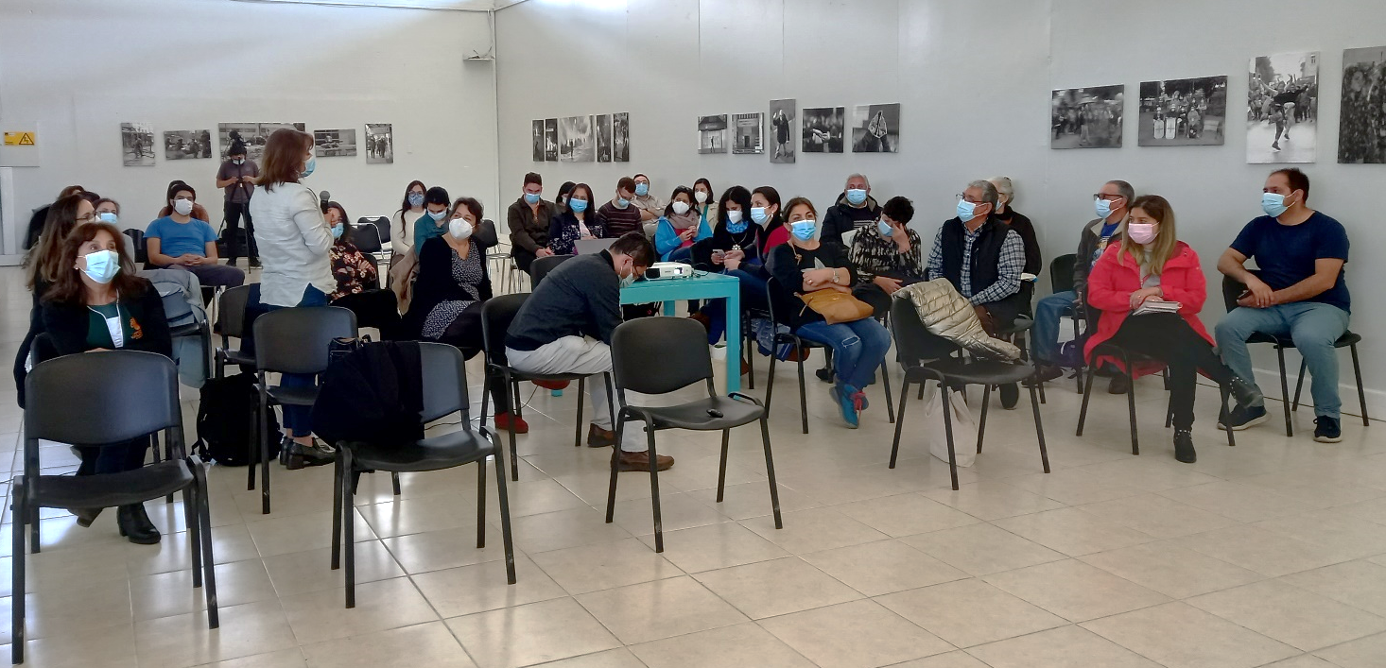
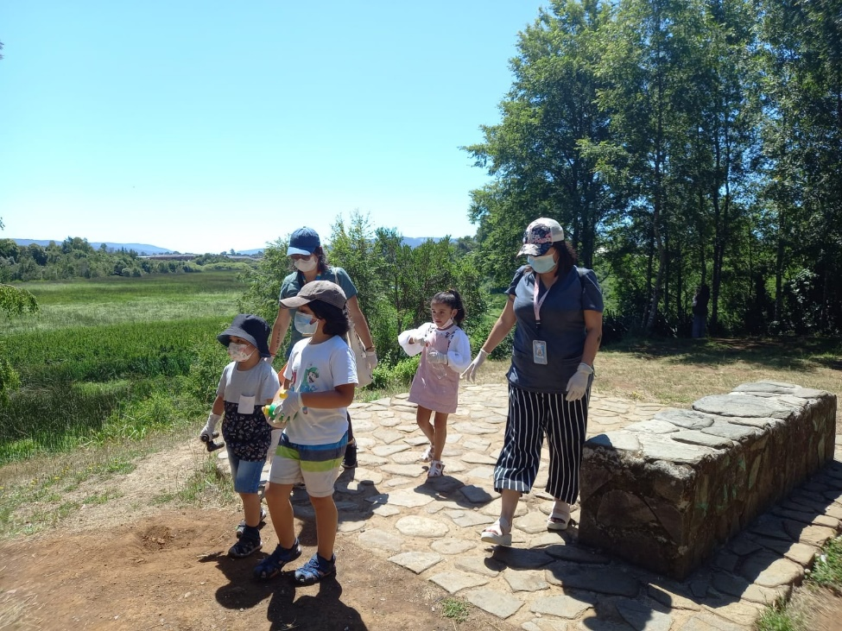
Valdivia base hospital
norte grande community orchard
Climate change seminar with family medicine residents
Angachilla wetlands

Slide 14
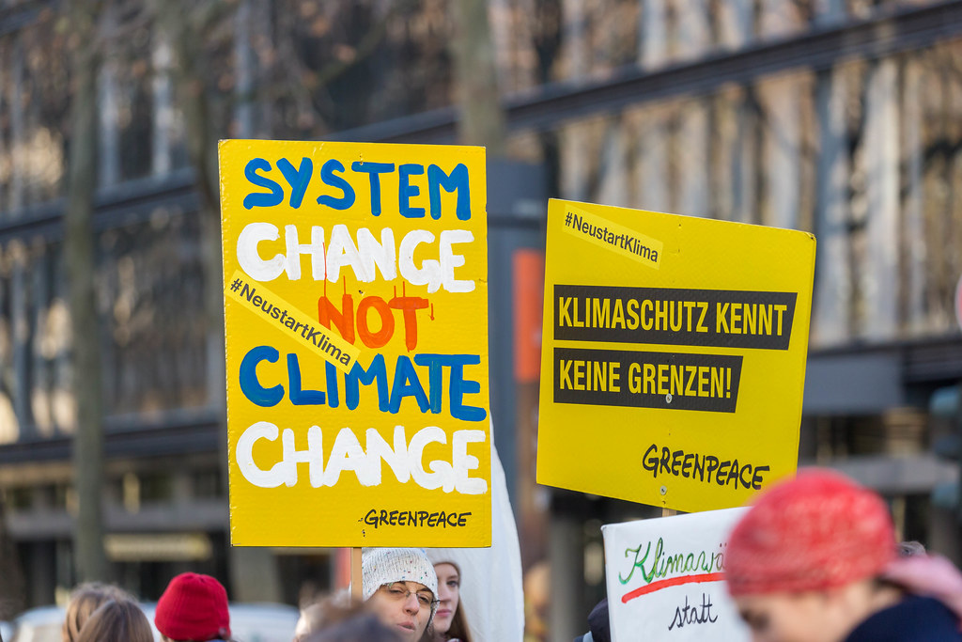
Wrap up
Breathing free and healthy is a human right
Climate Change is a health emergency and needs urgent action to stop adverse health outcomes
Advocacy is an ethical responsability and a trainable skill
Health education curriculum need to incorporate climate change and advocacy skills
Every one of us can contribute to change the system
Together we stand

Slide 15



Slide 16
Thank You!
☺
javiera.corbalan@gmail.com
@JavieraCP

