Slide 1
Remote Respiratory Consultations
Siân Williams

Slide 2
Remote Respiratory Consultations: Certainties
Needed to protect GP and patient during COVID
Will change practice forever: new “desire lines”
Must create at least equivalent experience for GP and patient eg quiet and private not phoning from supermarket or driving
Needs preparation and follow up
Best for routine not new diagnosis
Some tests can be done remotely
Video better but sometimes only phone possible
Takes as long or longer than face to face
Risk of increasing inequity for people with respiratory problems:
poverty, educational level means risk of digital exclusion
Desire line
Notes:
Image source: https://99percentinvisible.org/article/least-resistance-desire-paths-can-lead-better-design/

Slide 3
Remote Respiratory Consultations: Uncertainties
Where pendulum between face to face and remote will stop
What is the default – phone or video?
UK is phone
Should be guided by patent choice but will it?
How it will be reimbursed
How will IT systems be set up to enable it? Eg RCGP UK calling for £1 billion investment in digital infrastructure for general practice
How to increase digital and health literacy of older patients
Future of apps and other tests
Notes:
Image source: https://encrypted-tbn0.gstatic.com/images?q=tbn%3AANd9GcRGELGhzOIPepA-tlXuvx7pioo9ctAjqlyt1w&usqp=CAU

Slide 4
International Primary Care Respiratory Group 2021. www.ipcrg.org/dth11

Slide 5
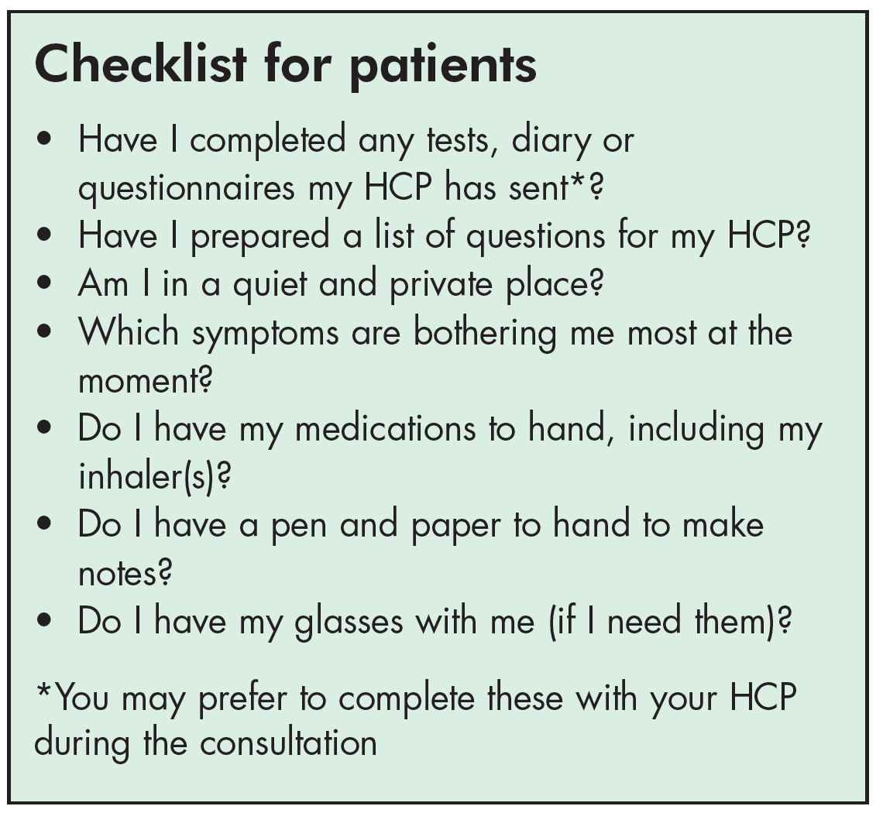
Remote respiratory consultations: checklists
https://www.ipcrg.org/dth11

Slide 6
Useful tests that can be done remotely
Vital signs – temperature, pulse and respiratory rate
Peak flow test
1 minute Sit to stand
Inhaler technique
Pulse oximetry
Breathlessness questionnaires
MRC Breathlessness Scale
Modified MRC
COPD questionnaires
COPD Assessment Test https://www.catestonline.org/
Clinical COPD Questionnaire (CCQ)
Asthma questionnaires
Asthma Control Test https://www.asthmacontroltest.com/
CARAT
RCP 3 questions
No instructional resources available to demonstrate how to do these remotely – IPCRG will address this in next year

Slide 7
Criteria suggesting remote consultation:
Patient preference eg neutral location
Their comfort with technology, e.g. apps for monitoring, note-taking, record-keeping
Access to smartphone or webcam
Travel or parking difficulties, financial issues
Value of involving family living apart from patient
Opportunity to gain insight into home situation
Has equipment for observations: O2 saturation, temperature, blood pressure, peak flow
Where face-to-face puts individual at risk

Slide 8
Criteria suggesting face to face:
Preference for the traditional approach
Complex needs
Hearing or sight problems
Low digital literacy
No access to internet
Low trust for accuracy, safety or confidentiality of remote consultation
Lack of privacy at home

Slide 9
Beware!
Be conscious of how the community might perceive any variation in approach between patients.
Avoid increasing inequity for those who cannot use or afford apps or other home-based technology

Slide 10
Resources: https://www.ipcrg.org/dth11
Desktop helper
Webpage
Videos of consultations
Translations

Slide 11
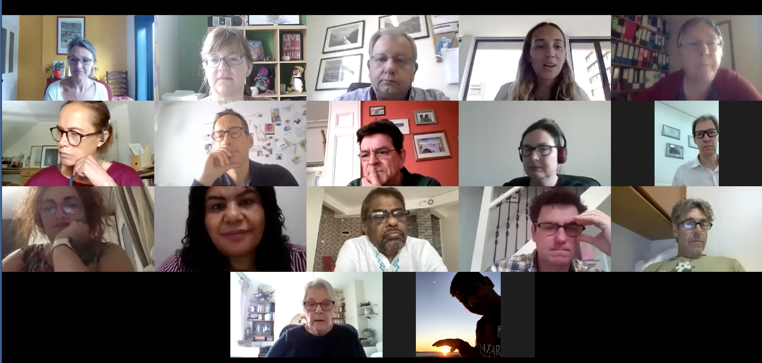
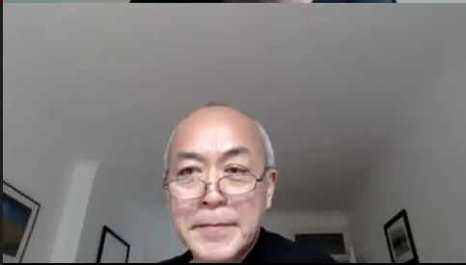
Source of this information

Slide 12
Source of this information
Three primary care focus groups from low, middle, high income countries December 2020-January 2021
Rural, remote and urban settings
With patients, GPs and pharmacist
Literature review
Independent peer review
Funded from an educational grant from Boehringer Ingelheim
No involvement in meetings or resources

Slide 13
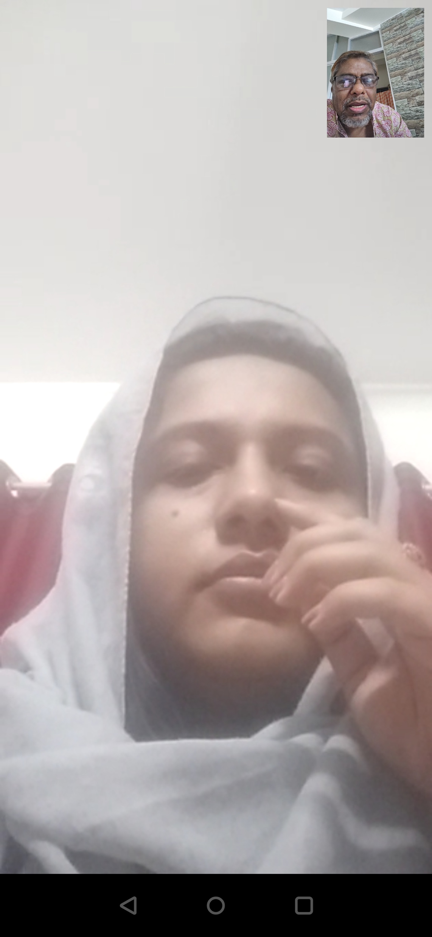
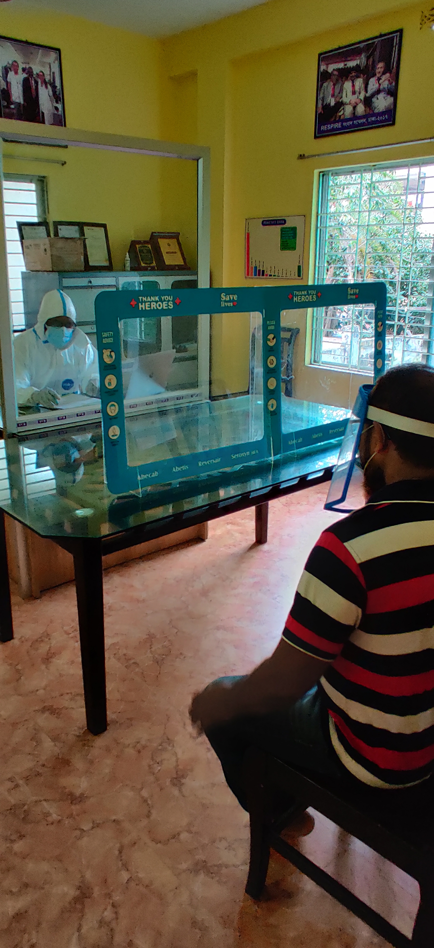
Two options in Bangladesh
Photos from Monsur Habib, Bangladesh

Slide 14
Original slides used at the first experience-led care meeting

Slide 15
Remote Respiratory Consultations Global experience-led care meeting Friday 11 September, 2020

Slide 16
Meeting objectives
Guide the content of three IPCRG products: a practical desktop helper, a position paper and “how to” videos
Reach consensus on key questions about remote respiratory consultations
Share experience in the delivery of remote respiratory consultations

Slide 17
Welcome and introductions
Siân Williams (IPCRG)
Tracey Lonergan (IPCRG)
Nicola Connor (IPCRG)
Vince Mak (UK)
Phil Collis (UK)
Miguel Roman (Spain)
Frank Kanniess (Germany)
Joe Wherton (UK)
Jaime Corrieia de Sousa (Portugal)
Ema Paulino (Portugal)
Hilary Pinnock (UK)
Ioanna Tsiligianni (Greece)
Tessa Jelen (UK)
Laurine van der Steen (The Netherlands)
Monsur Habib (Bangladesh)
Amanda Barnard (Australia)
Sonia Martins (Brazil)
Hanna Sandelowsky (Sweden)
Suraj Ghimire (Nepal)

Slide 18
What does our clinical practice look like now?
 | LvdS | MR | MH | JCdS | HS | EP | SG | SM | FWD | FK
Country | Netherlands | Spain | Bangladesh | Portugal | Sweden | Portugal | Nepal | Brazil |  | Germany
Main clinical role | Patient | PCP | PCP | GP | GP | CPharm | PCP | PCP | Paed | GP, Allergist
What type of patients do you mainly see? | NA | General | All patients with respiratory disease (acute and chronic) | General | Gerneral | General | General | General | General | General, focus respiratory, diabetes
What proportion of your current clinical contact with patients is undertaken remotely? | 90% | 90% | 60% | 45% | 50% | 5% | 0% | 80% | 20% | 2%
What proportion of your current clinical contact with colleagues is undertaken remotely? | 0% | 75% | 50% | 30% | 20% | 10% | 20% | 80% | 80% | 0%
How does that compare with the proportion of remote working you undertook this time last year? | Normally I always go to the practice | Increased hugely | No remote consultations last year | More than double | About doubled | Bigger | Significantly different | Infinitely more this year | 100% bigger | Video consultations are new in COVID times

Slide 19
Agenda
Time | Discussion topic | Facilitator
11.45 | Welcome and aims of the meeting | Siân Williams
11.50 | What constitutes a ‘remote respiratory consultation’ and what does it look like now in your experience? | Siân Williams
12.10 | Exploring different types of patient problem | Siân Williams
12.40 | Breakout sessions: How should patients requiring a consultation be triaged? What are the barriers and challenges, and potential solutions, to the delivery of remote respiratory-related consultations | Siân Williams Tracey Lonergan
13.10 | Feedback on breakout discussions | All
13.20 | How can technology be used to establish peer to peer support networks and ‘GP-specialist/other HCP-patient’ networks?
13.40 | Next steps and meeting close | Siân Williams

Slide 20
TOPIC 1: What constitutes a ‘remote respiratory consultation’ and what does it look like now in your experience?
Main modes of communication?
Advantages/disadvantages of the different modes and how this is influenced by:
Purpose of the consultation and patient problem
HCP involved
Length of consultation
Patient characteristics
Good examples from other disciplines?

Slide 21
TOPIC 2: What are the elements of a good remote consultation for respiratory problems?
For diagnosis?
For routine management?
For acute management?
For follow-up after an acute presentation?
What should happen before a remote consultation to ensure it is effective?

Slide 22
Breakout sessions
Group A (Siân Williams)
Vince Mak
Phil Collis
Miguel Roman
Frank Kanniess
Joe Wherton
Jaime Corrieia de Sousa
Ema Paulino
Monsur Habib
Group B (Tracey Lonergan)
Hilary Pinnock
Ioanna Tsiligianni
Tessa Jelen
Laurine van der Steen
Amanda Barnard
Sonia Martins
Hanna Sandelowsky
Suraj Ghimire

Slide 23
Group A start with Topic 3; Group B start with Topic 4
TOPIC 3: How should patients requiring a consultation be triaged?
Deciding when a remote consultation is appropriate and when it is not
Red flags indicating a need for a face to face consultation
TOPIC 4: What are the barriers, challenges and potential solutions?
Patient safety
Data sharing and governance
Reimbursement issues
Patient expectations
Patient-level access barriers

Slide 24
Feedback from breakout sessions

Slide 25
TOPIC 5: How can technology be used to establish therapeutic networks?
Peer to peer support?
HCP to patient?
HCP to Specialist to Patient?

Slide 26
At our next meeting we will
Review the draft Desk-top helper
Reach consensus on any outstanding issues
Consider the key points to be demonstrated in the ‘How to’ videos
Next meeting:
Friday 25th September, 12.00 – 14.00
Zoom details to follow

Slide 27
Thank you

