Slide 1

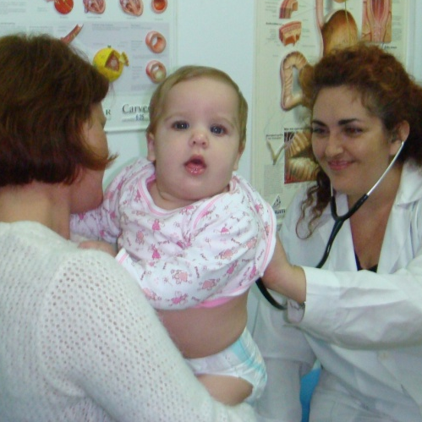
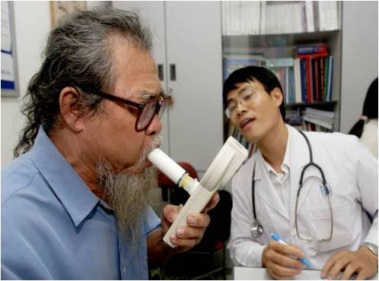
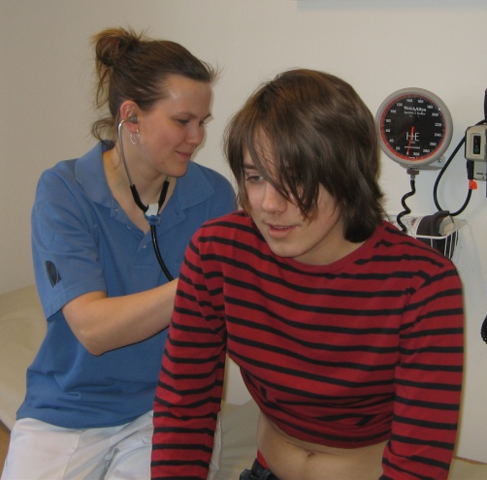
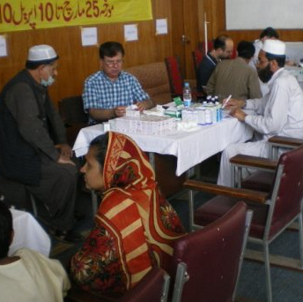
Osman Yusuf
Mike Thomas
Anders Ostrem
Ioanna Tsiligianni
Björn Ställberg
Miguel Roman-Rodriguez
Sian Williams
Hilary Pinnock
From needs to priorities.
Using a Delphi technique to prioritise the IPCRG Research Needs Statement
Notes:
Bullet page

Slide 2

http://www.theipcrg.org
http://www.thepcrj.org/index.php
The Research Needs Statement 2010
Notes:
In June 2010 the International Primary Care Respiratory Group (IPCRG) published a Research Needs Statement (RNS).¹
Draft statements were circulated to IPCRG members, other recognised experts, from a range of economic and healthcare backgrounds.
An iterative process was used to generate, prioritise and refine research questions
1 Pinnock H, Thomas M, Tsiligianni I, Lisspers K, Ostrem A, Ställberg B, Yusuf O, Ryan D, Buffels J, WL Cals J, Chavannes NH, Henrichsen SH, Langhammer A, Latysheva E, Lionis C, Litt J, van der Molen T, Zwar N, Williams S. The IPCRG Research Needs Statement 2010. Prim Care Resp J 2010; 19(Suppl 1): S1-S21

Slide 3

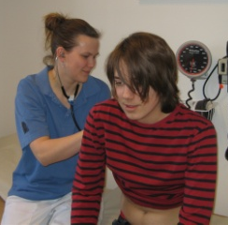
A key message
There is a need for research:
undertaken within primary care
recruiting populations representative of primary care patients
evaluating interventions realistically delivered within primary care
drawing conclusions meaningful to professionals working within primary care
IPCRG Research Needs Statement 2010
Notes:
A key message was the need for research undertaken within primary care, recruiting populations representative of primary care patients, evaluating interventions realistically delivered within primary care, drawing conclusions meaningful to professionals working within primary care

Slide 4
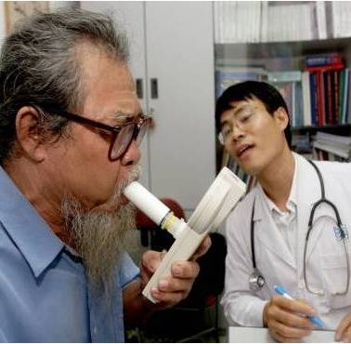
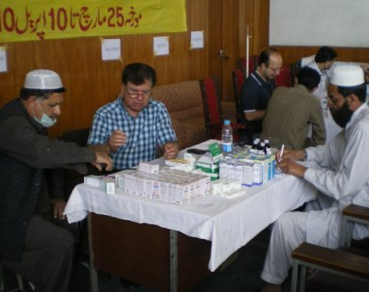
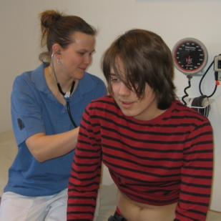
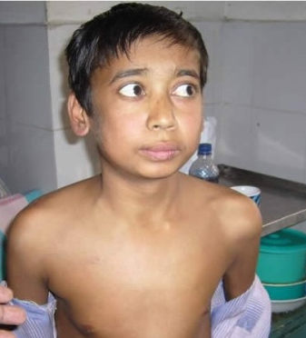
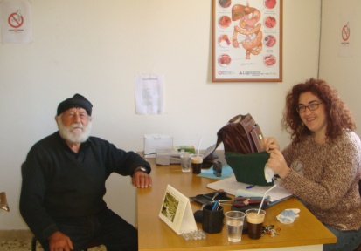
145 research needs
35
Allergic rhinitis
Asthma
26
COPD
Prevention
Diagnosis
Management
Self-management
Organisation of care
21
47
16
Tobacco
dependence
Respiratory
infections
IPCRG Research Needs Statement 2010
Notes:
145 questions were generated across the five disease areas (Asthma: 47, Allergic rhinitis: 26, COPD: 35, Tobacco dependence: 16, Respiratory infections: 21)
The questions covered aspects of prevention, diagnosis, management, self-management and organisation of care

Slide 5
145 research needs
35
Allergic rhinitis
Asthma
26
COPD
21
47
.. but which are priorities?
16
Tobacco
dependence
Respiratory
infections
IPCRG Research Needs Statement 2010
Notes:
From the list of 145 research needs, the IPCRG wished to identify the priority questions on which the organisation should focus

Slide 6
Hilary Pinnock, Edinburgh, UK
Osman Yusuf, Islamabad, Pakistan
Mike Thomas, Aberdeen, UK
Anders Ostrem, Oslo, Norway
Ioanna Tsiligianni, Heraklion, Crete
Björn Ställberg, Uppsala, Sweden
Miguel Roman-Rodriguez, Spain
Sian Williams, IPCRG
The e-Delphi
Notes:
An international team of researchers led an e-Delphi consensus process

Slide 7
To use an e-Delphi consensus process
to identify the priority research questions
in each disease domain
of the IPCRG Research Needs Statement
Aim
Notes:
To use an e-Delphi consensus process to identify the priority research questions in each disease domain of the IPCRG Research Needs Statement

Slide 8
Method
Notes:
Bullet page

Slide 9
Method
An expert panel who contribute ideas
Invited 63 participants
Authors and other contributors to the RNS
IPCRG research sub-committee and network
Leads of member and associate member countries
IPCRG education sub-committee and panel
IPCRG RNS e- Delphi 2011
Notes:
The first stage of an e-Delphi process is to recruit an expert panel.
In 2011, we invited the leads of IPCRG member and associate member countries, and members of education and research committees

Slide 10
Method
The questions
145 questions
Five disease area
Score 1 (low) to 5 (top)
Feedback the median score for subsequent round
IPCRG RNS e- Delphi 2011
Notes:
The members of the expert panel scored the questions from the RNS from 1 (low) to 5 (high)

Slide 11
Method
IPCRG RNS e- Delphi 2011
Notes:
This is an example of a third round spreadsheet which the members of the expert completed:
The grey column is the median score from the previous round
The white column was the participants’ score from the previous round
The blue column is the column for completion in the third round

Slide 12
Method
Defining priority
First round
Clinical importance
Feasibility
International relevance
Round 2
Round 3
}
Priority for the IPCRG
Priority for the IPCRG
IPCRG RNS e- Delphi 2011
Notes:
In the first round, participants considered the questions from three perspectives:
How important is it for improving the care of people with respiratory conditions in your healthcare system to have the answer to this question?
How feasible do you think a research project in this area would be in your healthcare setting?
What is the potential for collaborative research to answer this question involving a number of countries, either working together or comparing between healthcare systems?
In the second round, we provided the median scores from round 1, and participants were asked to balance the relative importance of these three questions and score the overall priority for the IPCRG
In the third round, we provided the median scores from round 2, and participants were offered an opportunity to revise their scores if they wished

Slide 13
Method
Defining consensus
Consensus was defined
as 80% agreement
for the priority score of 4 or 5.
IPCRG RNS e- Delphi 2011
10
Notes:
Consensus was defined as 80% agreement for the priority score of 4 or 5

Slide 14
Results
Notes:
Bullet page

Slide 15

Results
21 countries
Academics
Practising clinicians
Range of clinical interests
Expert panel
23 members
100% completion
IPCRG RNS e- Delphi 2011
Notes:
23 members from 21 countries participated

Slide 16
Consensus
80% agreement
Score of 4 or 5
100%
7 questions
90%
24 questions
80%
62 questions
145 questions
IPCRG RNS e- Delphi 2011
Notes:
62 questions achieved 80% consensus for priority score of 4 or 5
24 questions achieved 90% consensus for priority score of 4 or 5
7 questions achieved 100% agreement

Slide 17

Asthma
100%
2 questions
90%
9 questions
80%
20 questions
47 questions
IPCRG RNS e- Delphi 2011
Notes:
This is the breakdown of the questions prioritised in asthma.
Of the 47 asthma questions in the RNS, 20 reached 80% consensus, 9 reached 90% consensus and 2 achieved 100% agreement

Slide 18
Asthma
Asthma
80%
20 questions
100%
What simple tools enable assessment of asthma control, and is their use acceptable and feasible in primary care?
How can guided self-management be implemented in real life primary care practice?
96%
How can asthma be diagnosed earlier in primary care?
How and when should regular medication be stepped down or stopped?
IPCRG RNS e- Delphi 2011
Notes:
These are the highest scoring questions in asthma:
They relate to assessing asthma control, diagnosing asthma in primary care, and implementing self-management

Slide 19
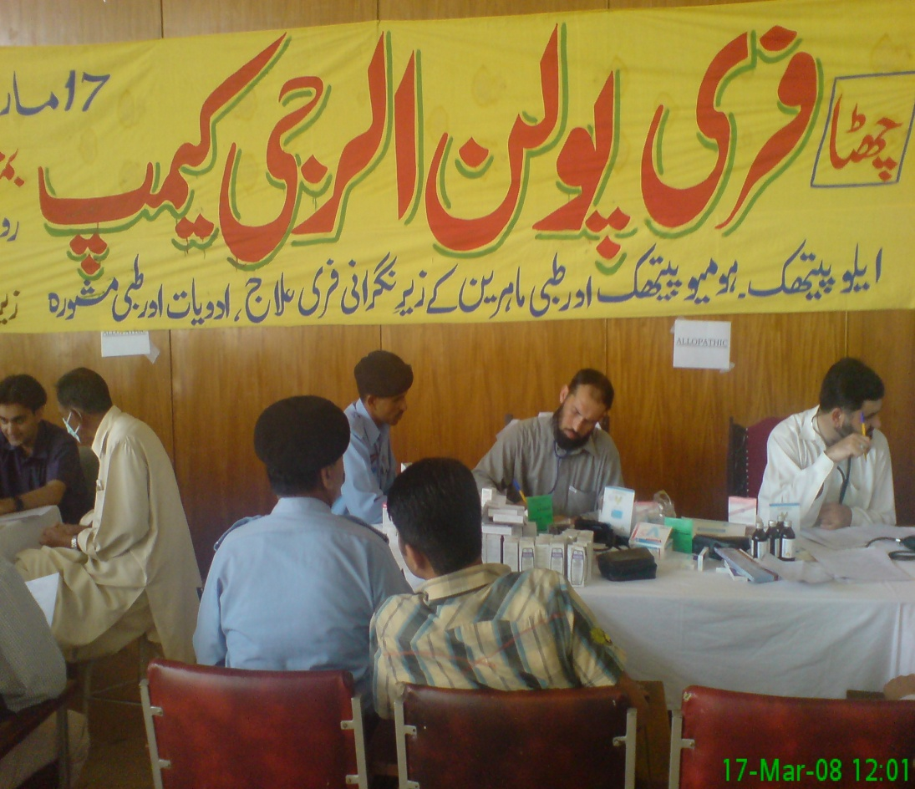
Allergic rhinitis
100%
2 questions
90%
3 questions
80%
9 questions
26 questions
IPCRG RNS e- Delphi 2011
Notes:
This is the breakdown of the questions prioritised in allergic rhinitis
Of the 26 allergic rhinitis questions in the RNS, 9 reached 80% consensus, 3 reached 90% consensus and 2 achieved 100% agreement

Slide 20
Allergic rhinitis
Rhinitis
80%
9 questions
100%
What (combinations of) management strategies for treating rhinitis improve asthma control, and/or improve quality of life?
What tools (e.g. validated, symptom-based questionnaires for rhinitis or screening for atopy) could help the primary care clinician differentiate between allergic rhinitis....and other similar conditions?.
91%
What questions for use in primary care practice will determine rhinitis control, and identify those at risk of worsening symptoms and/or onset of co-morbid asthma?
IPCRG RNS e- Delphi 2011
Notes:
These are the highest scoring questions in allergic rhinitis:
They relate to assessing control, diagnosing allergic rhinitis in primary care, and management strategies

Slide 21
COPD
100%
2 questions
90%
6 questions
80%
19 questions
35 questions
IPCRG RNS e- Delphi 2011
Notes:
This is the breakdown of the questions prioritised in COPD
Of the 35 asthma questions in the RNS, 19 reached 80% consensus, 6 reached 90% consensus and 2 achieved 100% agreement

Slide 22
COPD
COPD
80%
19 questions
100%
Can the use of a simple validated questionnaire improve the accurate identification of COPD in different of countries (including those without access to spirometry)?
When a primary care approach to the diagnosis of COPD is applied, what is the diagnostic yield compared to currently accepted diagnostic criteria?
96%
What is the best way to identify and diagnose COPD in primary care? Does this incorporate history, age, symptoms and spirometry?
Which measurements ....are feasible, and provide useful information for routine monitoring ....in primary care worldwide
IPCRG RNS e- Delphi 2011
Notes:
These are the highest scoring questions in COPD:
They relate to identifying and diagnosing COPD in primary care (without spirometry in countries where it is not available) and assessing COPD control

Slide 23

Smoking
90%
2 questions
80%
9 questions
16 questions
IPCRG RNS e- Delphi 2011
Notes:
This is the breakdown of the questions prioritised in tobacco dependence
Of the 16 asthma questions in the RNS, 9 reached 80% consensus, 2 reached 90% consensus

Slide 24
Tobacco
dependence
Smoking
80%
9 questions
96%
How can brief advice be used more effectively to increase motivation to quit, and what elements are most efficient for a busy primary care practitioner?
91%
What questions provide the most sensitive and specific assessment of tobacco dependence and motivation to quit....?
How can primary care clinicians in different countries be made more aware of strategies to prevent smoking in young people / pregnancy?
87%
IPCRG RNS e- Delphi 2011
Notes:
These are the highest scoring questions in tobacco dependence:
They relate to assessing dependence and motivation to quit, brief interventions in primary care, and strategies for preventing smoking in young people

Slide 25

Respiratory infections
100%
1 question
90%
5 questions
80%
5 questions
24 questions
IPCRG RNS e- Delphi 2011
Notes:
This is the breakdown of the questions prioritised in respiratory infections
Of the 24 asthma questions in the RNS, 5 reached 80% consensus, 5 reached 90% consensus and 1 achieved 100% agreement

Slide 26

Respiratory
infections
Infections
80%
5 questions
100%
How can primary care clinicians reliably identify patients who would benefit from antibiotic therapy? What diagnostic criteria are used in deciding on antibiotic treatment ...?
96%
How can primary care clinicians differentiate between serious and self-limiting LRTIs?
Should management strategies for LRTI be different in subgroups with co-morbidities, in smokers, in the elderly, children, or pregnancy?
Which subgroups of patients with LTRIs need antibiotic treatment?
IPCRG RNS e- Delphi 2011
Notes:
These are the highest scoring questions in respiratory infections:
They relate to assessing severity and the need for antibiotic treatment, and management strategies in different populations

Slide 27
Over-arching themes
Notes:
There were some over-arching themes

Slide 28
Themes
Of the prioritised questions
46% related to diagnosis and assessment
23% identified the need for ‘a primary care approach’
16% specified the need for validated questions
19% related to management strategies
IPCRG RNS e- Delphi 2011
Notes:
Nearly half the prioritised questions were about simple tools to aid diagnosis and assessment in primary care – including validated questions which could be used conveniently in primary care consultations
A fifth of the questions were about over-arching management strategies (rather than efficacy of individual treatments)

Slide 29
Conclusion
Notes:
Bullet page

Slide 30
Conclusions
The five diseases all contributed priorities for the IPCRG
Specific priority questions in the five diseases
Overarching priority themes
Diagnosis and assessment
Questionnaires and other ‘simple tools’
Practical management/treatment strategies
Implementing self-management
IPCRG RNS e- Delphi 2011
10
Notes:
The five diseases all contributed priorities for the IPCRG
Overarching priority themes focussed on validating simple tools (including questionnaires) to assist the primary care practitioner to diagnose and assess disease, and testing practical strategies for managing respiratory conditions

Slide 31
The expert panel
The research team for advice and support
Katie Searles for the administration
Thanks!
Notes:
Bullet page

Slide 32
Osman Yusuf
Mike Thomas
Anders Ostrem
Ioanna Tsiligianni
Björn Ställberg
Miguel Roman-Rodriguez
Sian Williams
Hilary Pinnock
From needs to priorities.
Using a Delphi technique to prioritise the IPCRG Research Needs Statement
Notes:
Bullet page

