Slide 1
Ex prescription and FITT principles/ Interpretations/home exercises in Pulmonary Rehabilitation
By
Maria Buxton
(With grateful acknowledgment to Sally Singh)

Slide 2
Aerobic Exercise Prescription
Large muscle groups over a sustained length of time
PR – must be lower limb
65-85% of baseline (can be lower in deconditioned)
Minimum 6 weeks
Individualised and progressed appropriately
Impact of rehab – NEJM 2009
Cognitive / desensitisation, reduce anxiety and depression, reduce dynamic hyperinflation (?), IMPROVE skeletal muscle function

Slide 3
Aerobic Prescription - FITT
FITT principle
F = Frequency – 5 x week
I = Intensity (more later)
T = Time – 30 mins ideally CONSTANT approach
T = Type – walking, cycling, rowing, stepper
N.B. – Walking – most user friendly exercise, its important to patients, and they can do it at home
Other types of exercise will get you fitter, but walking is what you want to be doing
Top Tip – Walking should be a major component in PR training

Slide 4
PR class and ‘homework’
F – Class = 2 x week
‘Homework’ = 3 x week extra – so exercise diaries
required

Slide 5
Intensity of Aerobic Prescription
Intensity – prescription based on original assessment –
Aerobic prescription requires peak VO2 and training % level based on that
Difficult to prescribe accurately and train appropriately if not using this method
What tests can we do that give us VO2 peak? Test are required to be maximal performance
ISWT – peak VO2 and peak ISWT – STRONG correlation
6MWT – peak VO2 and 6MWT – NOT STRONG as not maximal and also cannot use 6MWT to predict Cycle intensity
Cycle Ergometry / Treadmill walking – not a field test typically used in PR

Slide 6
Intensity…..
The final and most difficult aspect of the exercise prescription to write is intensity. The optimal intensity for aerobic exercise training occurs between 50% to 85% of the functional aerobic capacity (VO2max). Deconditioned patients should start at 40% to 50% of their VO2max
Exercise intensity can be prescribed by several methods, the most popular of which are utilization of the:
target heart rate - not typical in PR
calculated VO2max – only have ISWT for this in community
scales for rating of perceived exertion RPEs - BORG, OMNI, VAS

Slide 7
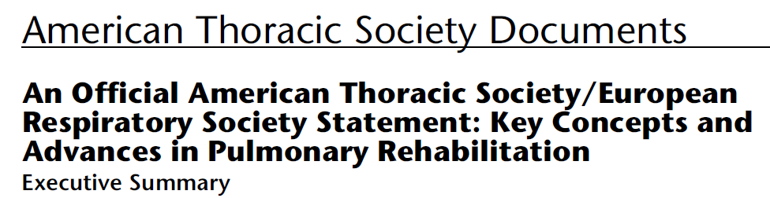
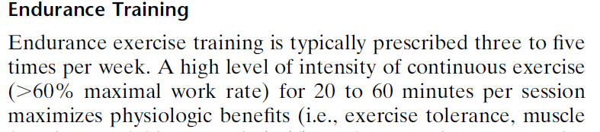
2013

Slide 8
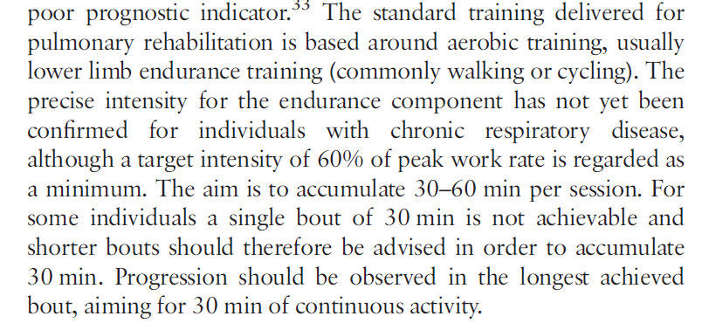
BTS PR Guidelines 2013

Slide 9
Time
30 mins x 5 a week
Minimum – 20 mins and build up to 30 mins
Always aim to achieve 20 mins of continuous aerobic exercise
Might be a long term aim if patient extremely limited and cannot exercise for 20 min continuously
Top Tip - Allow a 20 min window for the aerobic component of the exercise class – ultimately over 6 weeks, they will improve and be able to increase the time they can exercise before stopping as they get fitter – and maybe able to achieve a full 20 mins by end of programme or even the hoped for 30mins!

Slide 10
Top Tip on the time spent doing aerobic exercise
20 mins minimum, but 30 mins main goal CONSTANT exercise
Constant = Constant (this can include rest periods if too breathless, but time allocated to the exercise still is 20 mins
This is NOT a circuit when 2 mins on, 1 min off approach
Evidence of breaking up 20 mins into 2 x 10 min sessions, but try and aim at the end of 6 weeks to combine sessions to a continuous 20 mins and ultimately 30min

Slide 11
Fitness levels
PR = initial conditioning phase lasts approximately 4 to 6 weeks. During this phase, training effects should be appreciated. These are a decrease in resting heart rate, more rapid recovery of resting heart rate following physical activity, and the ability to increase duration and intensity without increasing fatigue.
Post PR = improvement conditioning phase lasts approximately 4 to 6 months. Patients can be progressed to reach target heart rates or desired duration of physical activity. It is best to first increase the duration of activity to the desired length and then increase the intensity. The patient will continue to enhance cardiorespiratory fitness resulting in improved endurance and resistance to early fatigue.
Long term - Most patients enter the maintenance conditioning phase after 6 months of regular exercise

Slide 12
Interval vs Continuous Training
Continuous approach is what is recommended
Interval Training = 100% peak work rate!!!!!
Interval endurance training allows intense loads on peripheral muscles without reaching the ventilatory limit
E.g. cycle at 100% = So Interval training regimen = 30 secs cycle at 100%, then 30 secs rest, - repeated x 45 mins
ONLY possible in Cycle Ergometry and so NOT for typical PR
Interesting point – reported dyspnoea is less in interval training that in continuous

Slide 13
Circuit Training
Variety of exercises – aerobic and strength
Aerobic Part - practical field exercises (other than walking / cycle ) – e.g. Marching on the Spot, Star Jacks
How to prescribe Intensity? Impossible to be perfect as no maximal VO2 equivalent assessment performed
Top Tip –
1. Try using ESWT speed – as this is 85% of ISWT peak speed which correlates to VO2 peak – perceived exertion when walking at ESWT – BORG. Use this score to address how they should feel during the Marching, Star Jacks etc – it needs to be the same to address the Intensity
This implies that have done ISWT and experience of ESWT
2. Or use BORG, OMNI or RPE – as long as this is reproducible and achieving desired outcome of intensity

Slide 14
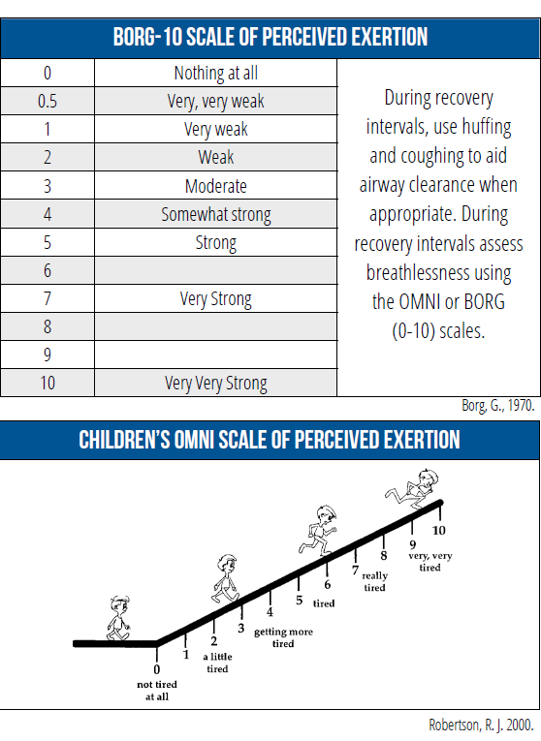

Slide 15
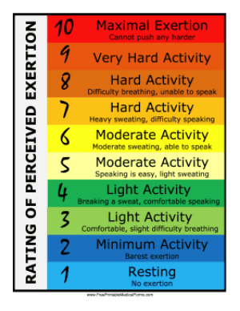
Cardiovascular exertion level should be 4-6

Slide 16
Top Tip of how to get constant approach into aerobic part of Circuit training
Aim is 20 mins (ideally 30min)
20 mins practical in a class situation with an hour allocated for the class – this includes warm up/cooldown, moving between types of exercise
Try spiltting the 20 mins of aerobic exercises into separate exercises:-
10 mins walking – longer component as specific to needs of patient group
5 mins step ups / cylce
5 mins marching / star jacks
Minimal transition time between exercises
Time represents allocation to the exercise, not necessarily that the patient will be able to do this constantly for this time, they may need to rest, but they then continue and do as much as they can

Slide 17
Aerobic – 20 mins constant e.g.
WALKING x 10mins
+
STEP UPS x 5 mins
+
MARCHING x 5 mins

Slide 18
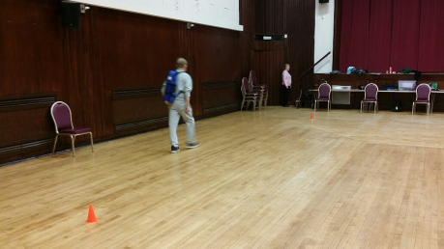
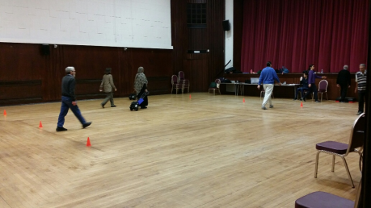
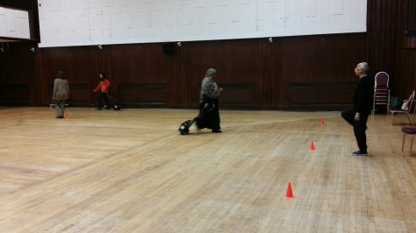
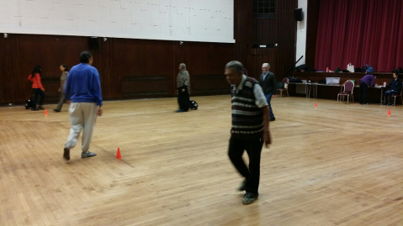
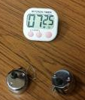
WALKING – 10 MINS AT ESWT PACE
INTENSITY = EXPECTED DISTANCE COVERED IN A 10 MIN SESSION

Slide 19
TARGET DISTANCE – ISWT to ESWT
ISWT (m) | ESWT | Time per shuttle (s) | Target Distance @ 10 minutes
0 - 60 | - | -
70 - 90 | 1 | 20.3 | 300
100 - 110 | 2 | 17.3 | 340
120 - 130 | 3 | 14.8 | 400
140 - 150 | 4 | 13.3 | 450
160 - 180 | 5 | 12.0 | 500
190 - 210 | 6 | 11.0 | 540
220 - 230 | 7 | 10.0 | 600
240 - 290 | 8 | 9.5 | 630
300 - 330 | 9 | 8.8 | 680
340 - 380 | 10 | 8.3 | 720
390 - 420 | 11 | 7.8 | 770
430 - 450 | 12 | 7.3 | 820
460 - 500 | 13 | 7.0 | 860
510 - 560 | 14 | 6.5 | 920
570 - 620 | 15 | 6.3 | 950
630+ | 16 | 6.0 | 1000

Slide 20
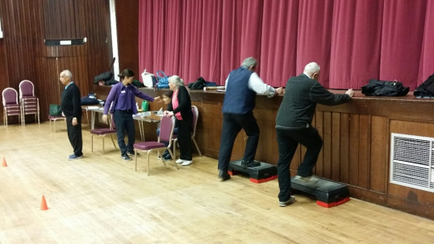
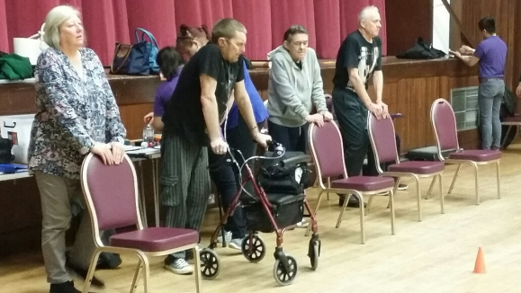

AEROBIC - CONTINUOUS
STEP UPS X 5 MINS
MARCHING X 5 MINS

Slide 21
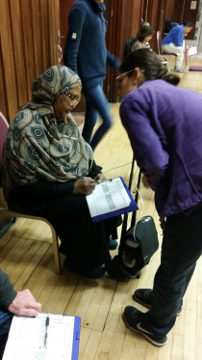
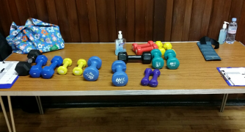
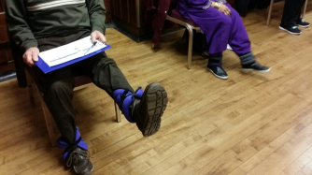
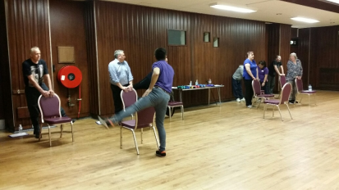
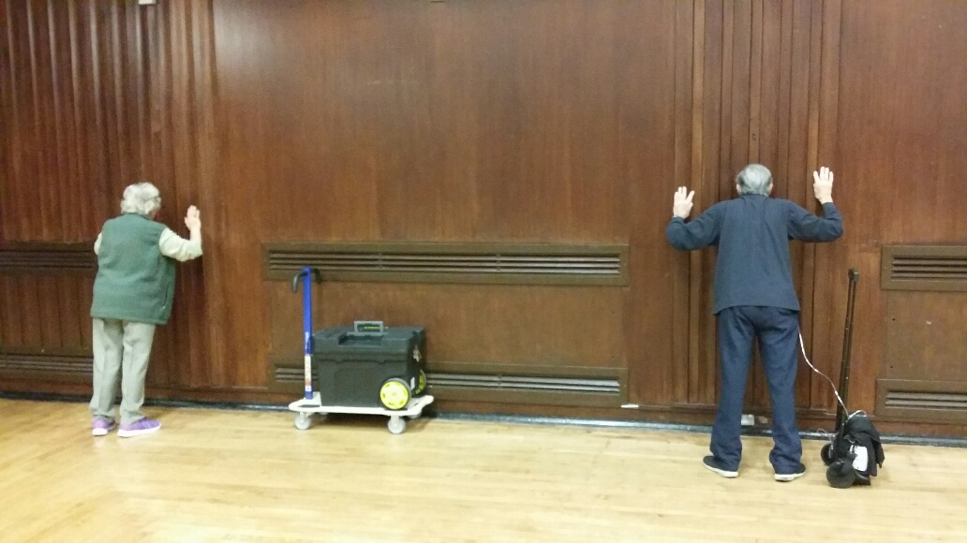
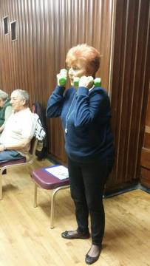
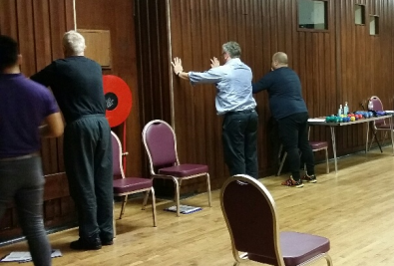
STRENGTH

Slide 23
‘Homework’
3 extra aerobic sessions to classes
20-30 mins – ideally 30 mins as they have time!
Field exercises – walking, step ups, marching, star jacks, easiest for patients to do at home
Top Tip –
1.Specific instructions needed about intensity and approach to homework – normal walking doesn’t count e.g. strolling to shop, browsing around shops, walking the dog that stops at every tree
2. Homework – diary – open discussion about who did what for their homework – with advice and comments from class leader. Good motivational tool

Slide 24
Strength (Resistance) Training
2 main resistance approaches – power & endurance
Large muscle groups, rhythmical, slow pace, full ROM
Sets & Reps approach
Typical strength prescription tackles BOTH power and endurance – unless extreme pure approach required e.g. body builder
= 2-4 sets at 8-15 reps of 40-80% 1 Rep Max
NOT based on time
2-3 x week only – so not typically included in PR homework

Slide 25
Circulation. 2013;128:873-934
To achieve a balanced increase in both muscular strength and endurance, a repetition range of 8 to 12 is recommended for healthy participants <50 to 60 years of age (60%–80% of 1-RM), and a range of 10 to 15 repetitions at a lower relative resistance (40%–60% of 1-RM) is recommended for cardiac patients and healthy older participants – applied to PR group

Slide 26

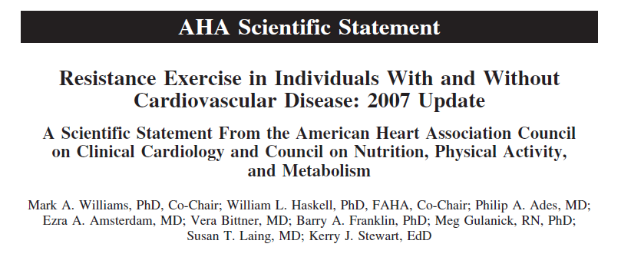

Slide 27
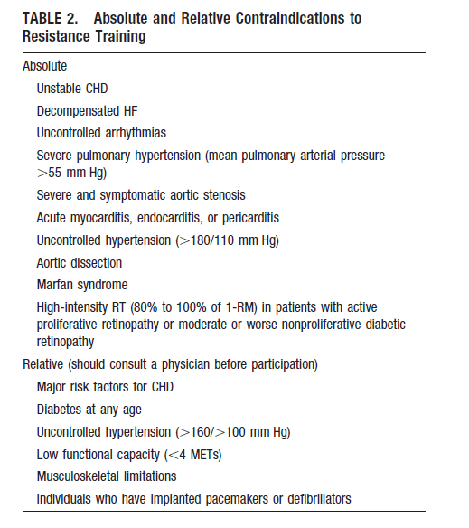

Slide 28
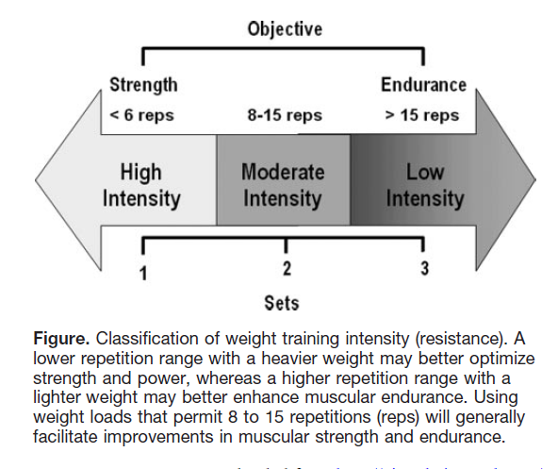
Typical PR prescription
= 3 sets x 10 reps

Slide 29
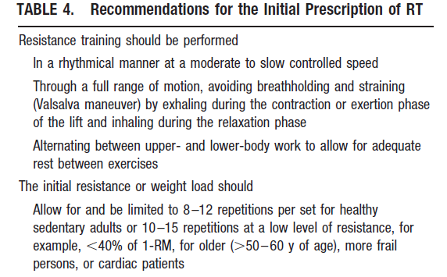

Slide 30


Slide 31
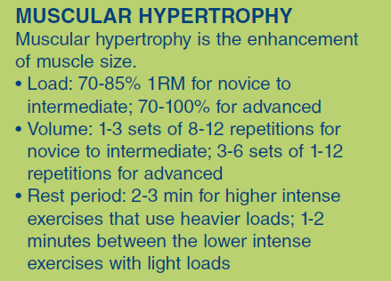
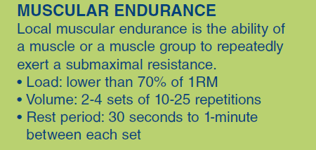

Slide 32
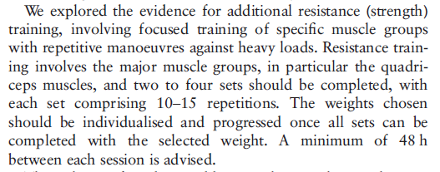
BTS PR Guidelines 2013
3 sets x 10 reps

Slide 33
Strength prescription for Weights
What assessment? – 1 Rep Max or Maximal Isometric contraction
This is not feasible outside of a comprehensive gym environment
E.g. Quads – 1RM - equipment
- use quads bench with incremental weights
- isometric quads bench
E.g. Biceps – 1RM – equipment
- free weights, biceps bench

Slide 34
Strength Assessment in the field
If you cannot perform 1RM then alternatives need to be sought
Evidence specifically in PR scant for field based programmes – but more evidence in ‘normals’ and elderly populations which can be applied to PR population
If cannot perform 1RM, then a 6-12 i.e. ’10’ Rep Max (muscle exhaustion) is suitable with a perceived exertion of BORG/RPE 4-6
Top Tip – choose a weight – can they lift it for 10 reps and complain of muscle exhaustion? Great – keep this weight and prescribe 3 sets of 10

Slide 35
Prescription after 1RM or 6-12 (‘10’)RM established
= 2-4 sets at 6-12 reps of 50-80% 1 Rep Max
2-4 sets of OR – 6-12 i.e. ‘10’ Rep Max (muscle exhaustion)
should feel like BORG / RPE / OMNI 4-6,
So, why not be easy and say 3 sets of 10! As a typical starting prescription and adapt it if required for individuals who cannot hope to do this at all
So – again – prescription is 3 sets of 10 reps, which may not be possible, but that is always the AIM – the documentation shows the reality of what they can do
If they can only do 2 sets of x weight for 4 reps, it is too heavy so try a lower weight and do the 10RM test
Always keep the AIM at 3 sets of 10 until they can reach it, but record what they can do

Slide 36
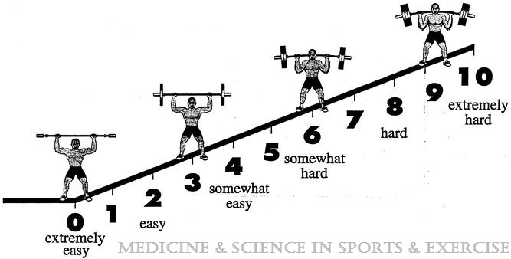
OMNI-Resistance Exercise Scale (OMNI-RES) of perceived exertion.
Concurrent Validation of the OMNI Perceived Exertion Scale for Resistance Exercise
ROBERTSON, ROBERT J.; GOSS, FREDRIC L.; RUTKOWSKI, JASON; LENZ, BROOKE; DIXON, CURT; TIMMER, JEFFREY; FRAZEE, KRISI; DUBE, JOHN; ANDREACCI, JOSEPH
Medicine & Science in Sports & Exercise. 35(2):333-341, February 2003.
Control of Resistance Training Intensity by the Omni Perceived Exertion Scale
Naclerio, Fernando; Rodríguez-Romo, Gabriel; Barriopedro-Moro, Maria I; More
Naclerio, Fernando; Rodríguez-Romo, Gabriel; Barriopedro-Moro, Maria I; Jiménez, Alfonso; Alvar, Brent A; Triplett, N Travis Less
Journal of Strength & Conditioning Research . 25(7):1879-1888, July 2011.

Slide 37
Progression of Weight exercises
If they can easily do 3 sets of x weight for 10 reps for 2 classes – INCREASE weight
Re-prescribe as target is 3 sets of 10 reps, but in reality they can only do 3 sets of 4 reps - keep this prescription until they can do it
RESTS between each set – Important due to metabolic, hormonal changes within muscle – rest is required – usually 1-2mins between sets get the best results

Slide 38
Biceps Curl – weight 2kg
AIM (Prescription = 3 sets of 10 reps at 2kg) Rest between each set
Mon | Tue | Wed | Thur | Fri
1 x 10 1 x 8 1 x 4 |  | 1 x 10 1 x 10 1 x 6
Once they can do 3 sets of 10 reps on 2 classes – INCREASE weight
Avoid combining ex into 1 block of 30 – keep sets and reps theme within accepted parameters

Slide 40
Non-weight resistance exercises
E.g. sit to stand, wall push offs, squats,
Possible methods :–
e.Max test in 1 minute – Reps = 60-75% x 3 sets
Intensity to RPE / BORG 4-6 – then apply intensity based on BORG/RPE at level 4-6 to other exercises
Top Tip – they should ‘feel’ that all exercises are as hard as each other even if the weights / reps are totally different

Slide 41
Quantity and Quality of Exercise for Developing and Maintaining Cardiorespiratory, Musculoskeletal, and Neuromotor Fitness in Apparently Healthy Adults: Guidance for Prescribing Exercise
Medicine & Science in Sports & Exercise:
July 2011 - Volume 43 - Issue 7 - pp 1334-1359

Slide 42


