Slide 1
Introducing Asthma Right Care
Movement for Global Change
Siân Williams
AstraZeneca have sponsored and paid for this symposium as part of the Gold Sponsor Package. IPCRG received funding from AstraZeneca to develop the Asthma Right Care Initiative

Slide 2
Every system is perfectly designed to get the results it gets
(Earl Conway and Paul Batalden)
Notes:
Both intended and unintended consequences are designed into our systems

Slide 3

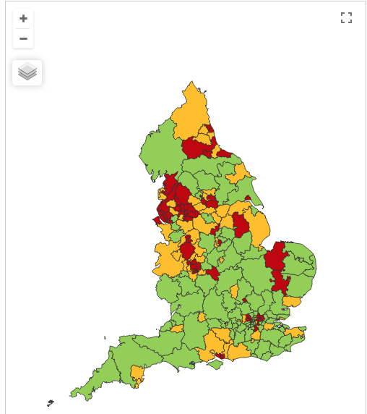

Making a case for change
Asthma illustrates all 5 global healthcare problems (Muir Gray):
Unwarranted variation
Harm, even when quality is high (over-diagnosis, over-treatment)
Failure to prevent disease and disability
Waste of human and physical resources through low value activity
Inequity
And new challenges are forming:
Financial constraints
Rising expectations of personalised care
Climate change/pollution
Increasing need
PHE Fingertips data Asthma admissions per 1000 population 2012/13 data
Notes:
Unwarranted variation as defined by Wennberg: Variation in utilization of health care services that cannot be explained by variation in patient illness or patient preferences
http://www.nhsconfed.org/~/media/Confederation/Files/Events/ACE15/1430%20Inaugural%20NHS%20value%20lecture.pdf

Slide 4
Start with “hunches” for improvement
Use of SABA in asthma in need of major improvement
  over-reliance, but how to define?
  NOT over-use – “reliance” = type of dependency
1st conversations about SABAs may effect future use
  Occur in many places eg community pharmacies, EDs, GP/FP
  We need to know more about these
Asthma is low priority for change in general HCP despite evidence of
  unwarranted variation in outcomes
  avoidable mortality, morbidity and healthcare utilisation
  education programmes
Need to want to change for messages about asthma improvement to be received & adopted
Let’s apply the evidence about achieving change at scale
Start to disrupt comfort with the current state!
Then move on to addressing underuse of ICS
Notes:
Hunches - this is a proven improvement technique

Slide 5
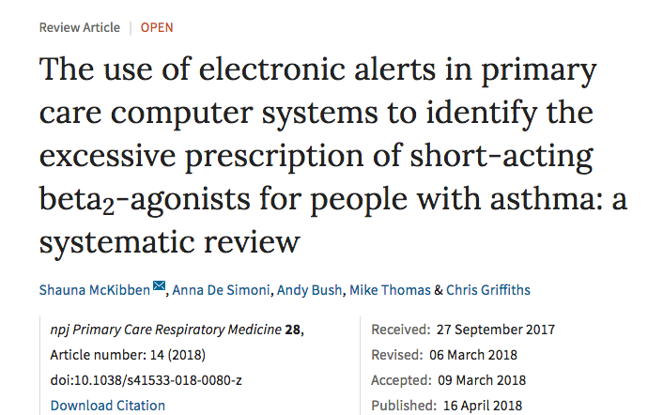
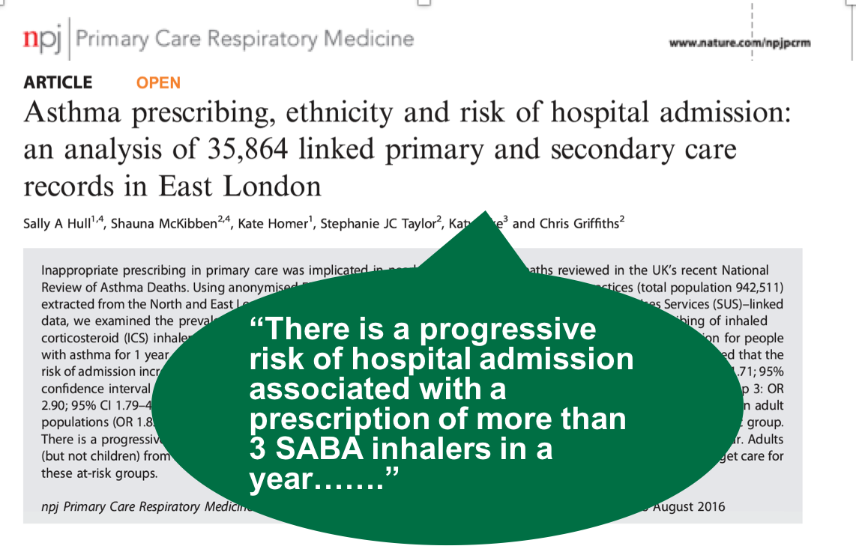
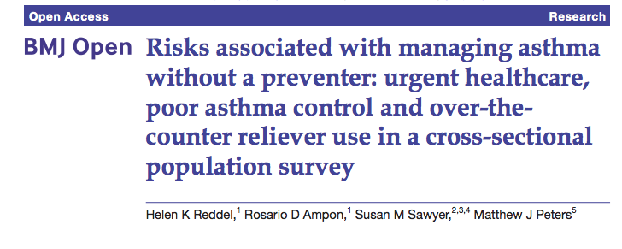
UK NRAD: 39% people on SABA at time of death had been prescribed more than 12 in the year before they died
4% had been prescribed more than 50 SABA inhalers
Those prescribed more than 12 were likely to have had poorly controlled asthma.
Guidelines: expect them to have at least 12 preventer prescriptions per year, but
38% issued with fewer than 4 and 80% issued with fewer than 12 previous year.”
NICE summary of NRAD

Slide 6

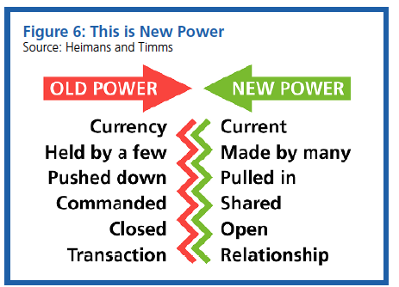
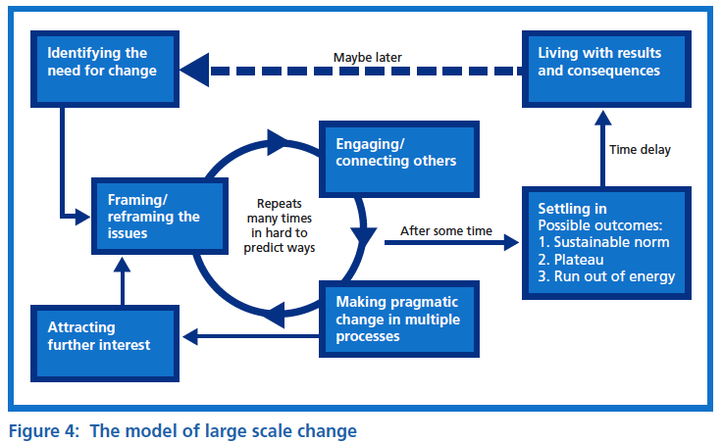
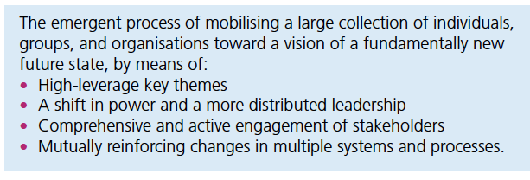

Leading large scale change: the evidence
Notes:
NHS cares for 65 million people. Sees more than 1million people every 36 hours.

Slide 7
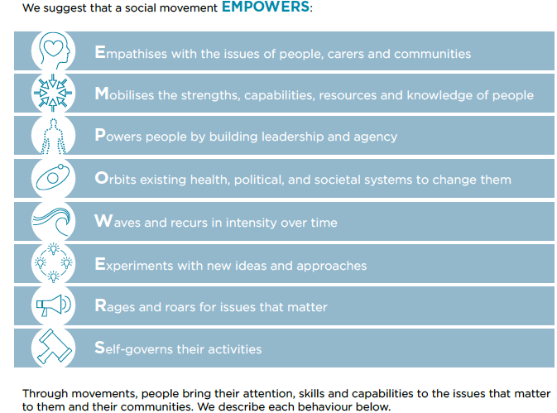

What are social movements and why are they relevant?
Sustained group action created from grassroots to stimulate social or political change
Relies on networks and connections between networks
Mobilise people globally and so often use technology – social media too, not just a communication campaign
Successful campaigns have an identity, clear call to action, and a message of hope (not just criticism)
Need a message and champions
Eg Obama’s campaign for election “yes we can” and HIV/AIDS movement; ”Hello, my name is..”; flu fighters; antibiotic guardians

Slide 8
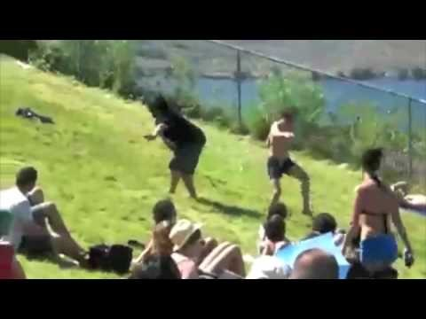
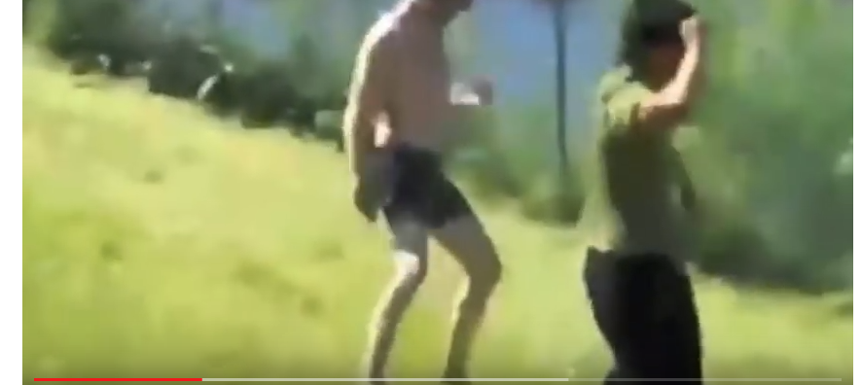
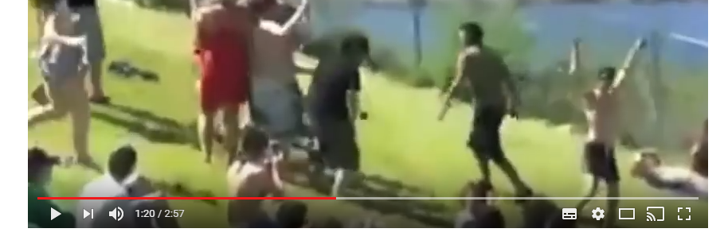
It’s all about the followers…being inspired and confident to try something different
https://www.youtube.com/watch?v=fW8amMCVAJQ

Slide 9
What is Right Care?
Lancet Series 2017
“Many countries struggle with the question about sustainability, fairness, and equity of their health systems. With the focus firmly on universal health coverage as a central part to the UN Sustainable Development Goals, there is an opportunity to examine how to achieve optimum access to, and delivery of, health care and services. Underuse and overuse of medical and health services exist side-by-side with poor outcomes for health and wellbeing.
This Series ….provides a framework to begin to address overuse and underuse together to achieve the right care for health and wellbeing. The authors argue that achieving the right care is both an urgent task and an enormous opportunity.”

Slide 10
What is Right Care?
Our working definitions
Doing the right things and only the right things in the right way for the right people at the right time in the right place, whatever that means in the local context
Improving the value that each person with asthma derives from their own care and treatment and the value the whole population derives from the investment in asthma care by addressing unwarranted variation; reducing waste, avoidable harm and avoidable symptoms

Slide 11
Our case for change
“It is time to refocus attention on asthma because the total burden of disease in terms of quality of life is high yet avoidable and there is significant unwarranted variation and waste.
Only ≅ 40% of people take their prescribed treatment
Of whom only ≅ 30% then use it right
So only ≅12% are taking the right treatment right
Therefore the value of investment is severely compromised.”
BTS/SIGN Asthma 2016
Chrystyn, H., et al. (2017). "Device errors in asthma and COPD: systematic literature review and meta-analysis." NPJ Prim Care Respir Med 27(1): 22

Slide 12
Aim
Scope
To sort asthma care once and for all for the person with asthma and for the healthcare system so that there is no unwarranted variation, and no avoidable waste or harm*.
That is
We can and should do better by getting it right first time!
The pathway from the first time someone (adult or parent) is offered a SABA, wherever that is, through to all possibilities (existing and new) for review.
Phase 1: SABA use
*waste is waste of human, financial, health facility, energy and pharmacological assets.

Slide 13
What is the best single measure for our aim?
A shift in the practice average ratio of reliever:inhaled corticosteroid inhalers prescribed in a year, where the ideal ratio is 1:6 but is currently more likely to be 2:1
But we couldn’t do that in 8 months, so….

Slide 14

Getting our social movement going
Sept 2017
May 2018
Kickstarting action
Emerging and building momentum
  Nurturing voices
  Cultivating diverse interests and motivations
2
Steering Group formed and meets
3
Influencing and interacting
Navigating a complex array of relationships
National Champions Identified
SCALING UP
Delivery Team meeting
Delivery Team meeting
Delivery Team meeting
Delivery Team meeting
Symposium
Pervasiveness: affect all or just part of system?
National Steering Group Stakeholder
Mapping
Invitation UK
National Design Charrette
Pilot Phase
National Steering Group Stakeholder
Mapping
Invitation Portugal
National Design Charrette
Pilot Phase
Depth: ways of thinking and doing – cognitive, behavioural or paradigm shift?
Size: number
of people, geography
National Steering Group Stakeholder
Mapping
Invitation Canada
National Design Charrette
Pilot Phase
National Steering Group Stakeholder
Mapping
Invitation Spain
National Design Charrette
Pilot Phase
Notes:
References:
Nesta 2017. We change the world: what can we learn from global social movements for health?
NHS England. Sustainable Improvement and Horizons Team 2017. Leading large scale change: a practical guide.

Slide 15
Pilot Countries
Primary Care Respiratory Society, UK
GRESP, Portugal
GRAP, Spain
Family Physician Airways Group of Canada

Slide 16
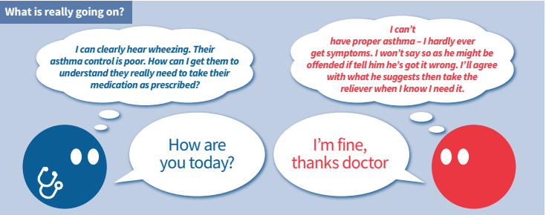
Understanding the world beyond the consultation

Slide 17
Stakeholders
Stakeholder analysis and plan
Use 9 C checklist to list stakeholders
Prioritise according to power, influence, impact
Invite to national design charrette
What could they do to support or prevent movement?
What’s in it for them? How could they benefit?

Slide 18
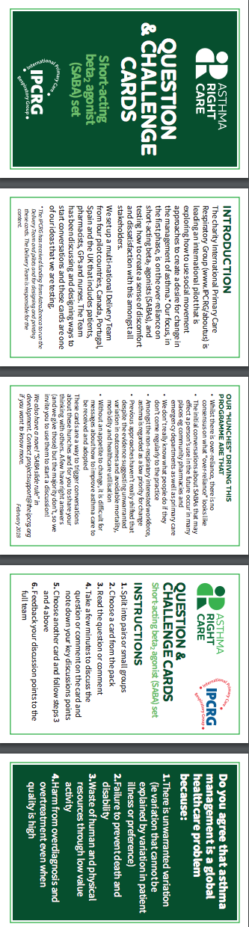
Embracing more people, more methods, bringing joy to lives:
let’s have fun,challenging conversations using prompts like our question and challenge cards…

Slide 19
SABA Slide Rule – inspired by the Readiness Ruler
General practitioners/family physicians keen to emphasise the art rather than the science of the consultation, and therefore not up-to-date with guidelines eg the guideline question “what’s the probability of them having asthma?” not a routine question yet
Pharmacists keen to do more but out of date “take your blue inhaler to open up your airways” – (it is a logical way to think about it, and did used to be taught, so reveals lack of investment in their education)
Lack of knowledge about how many puffs or doses in an inhaler and how many is too many in a year

Slide 20
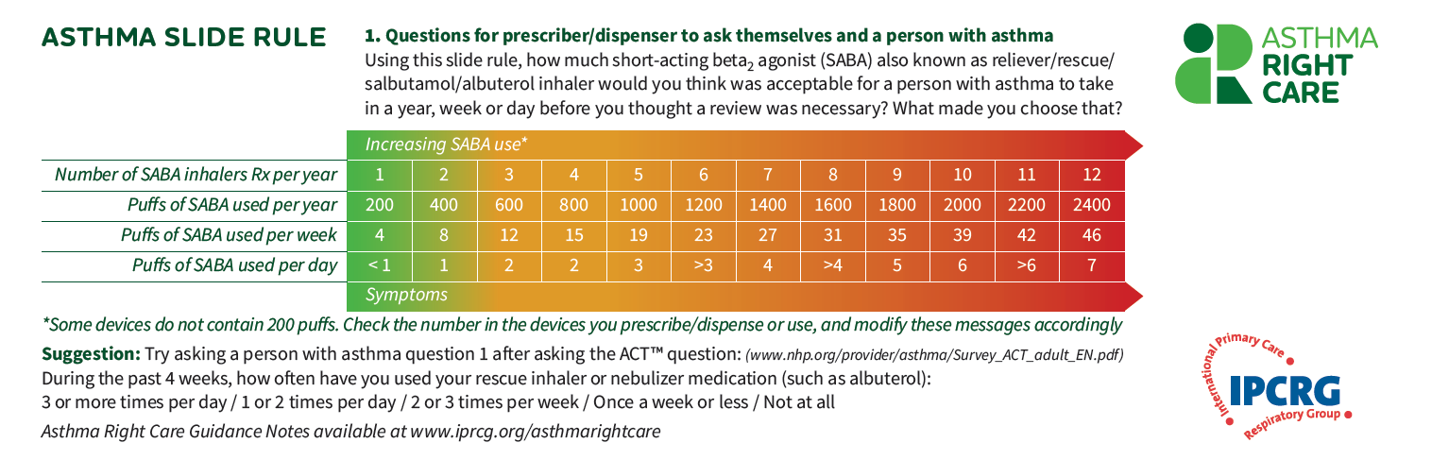

Slide 21
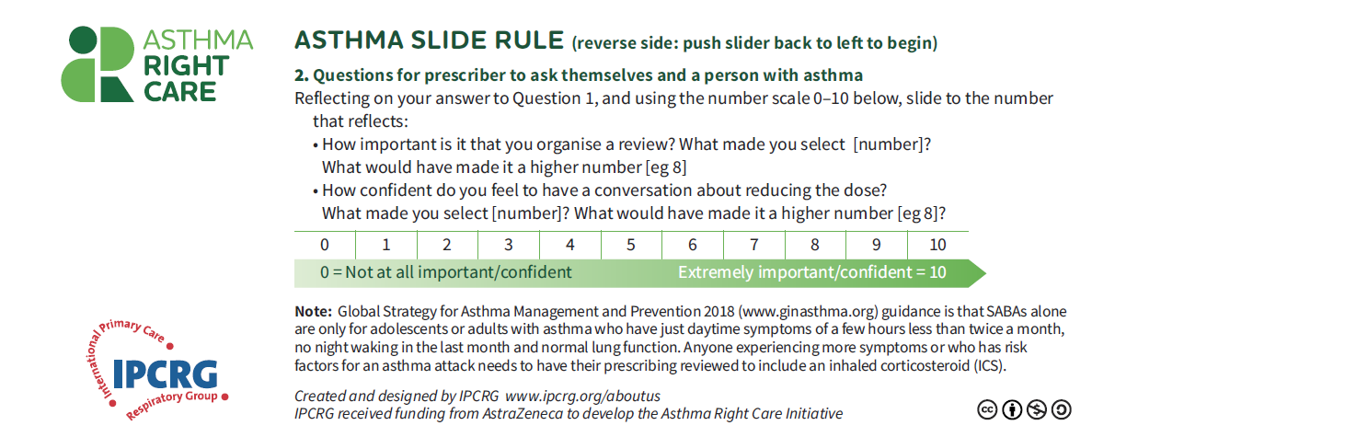

Slide 22
What we did, what we learnt
Findings from our four pilots
Jaime Correia de Sousa
AstraZeneca have sponsored and paid for this symposium as part of the Gold Sponsor Package. IPCRG received funding from AstraZeneca to develop the Asthma Right Care Initiative

Slide 23

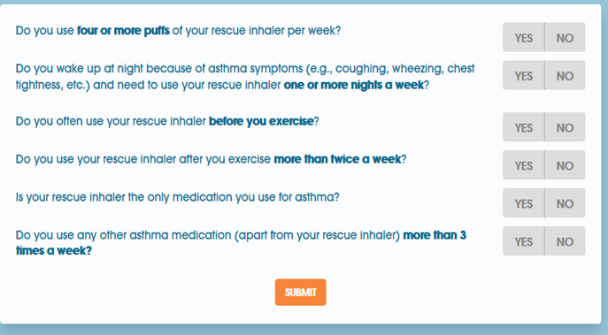
CANADA
3 Design charrettes
Primary care respiratory experts: FPAGC Exec + CFPC Respiratory Group
Non-respiratory expert primary care physicians
Certified Respiratory Educators due after Porto
Building followers
Slide rule for future discussion with clinicians and patients
Article on SABA overuse for newsletter
Social media initiative: with www.Howmuchistoomuch.ca in partnership with Asthma Society of Canada
Beginning of primary care CME program on asthma control and use of better prescribing options for alternative relief/asthma strategies
Making the case for change
Abstract on beta agonist attitudes submitted to IPCRG, REG, + ERS conferences
Dr. Fitzgerald's team to quantify problem with British Columbia data on SABA use
Other ideas to consider
Global advisory board of primary care champions for mild asthma
National implementation teams with respiratory and primary care clinicians to develop implementation strategies
White paper on mild asthma to eventually impact guidelines production
Howmuchistoomuch.ca

Slide 24
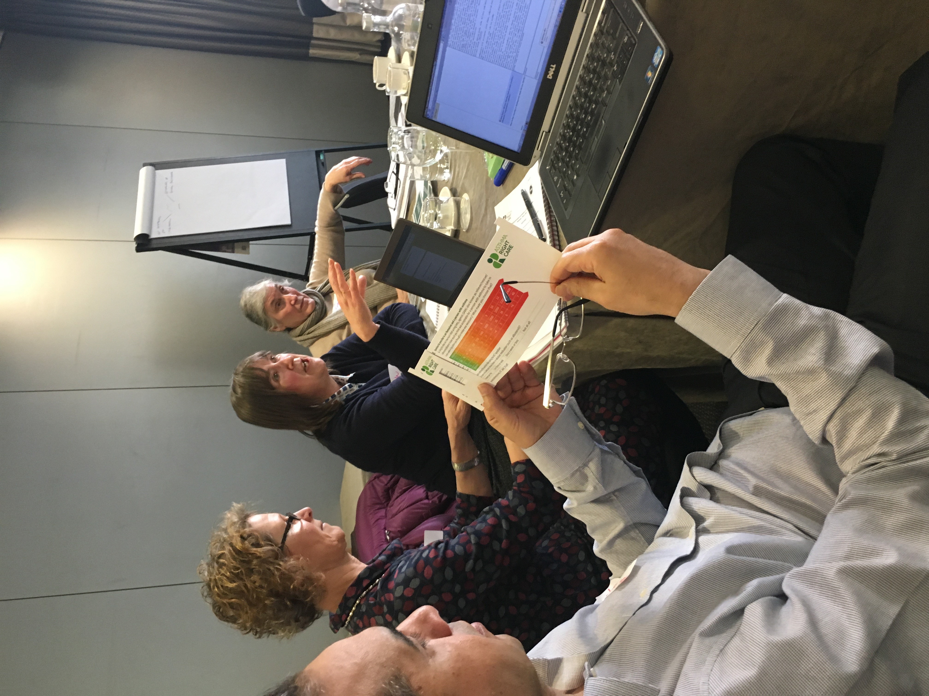
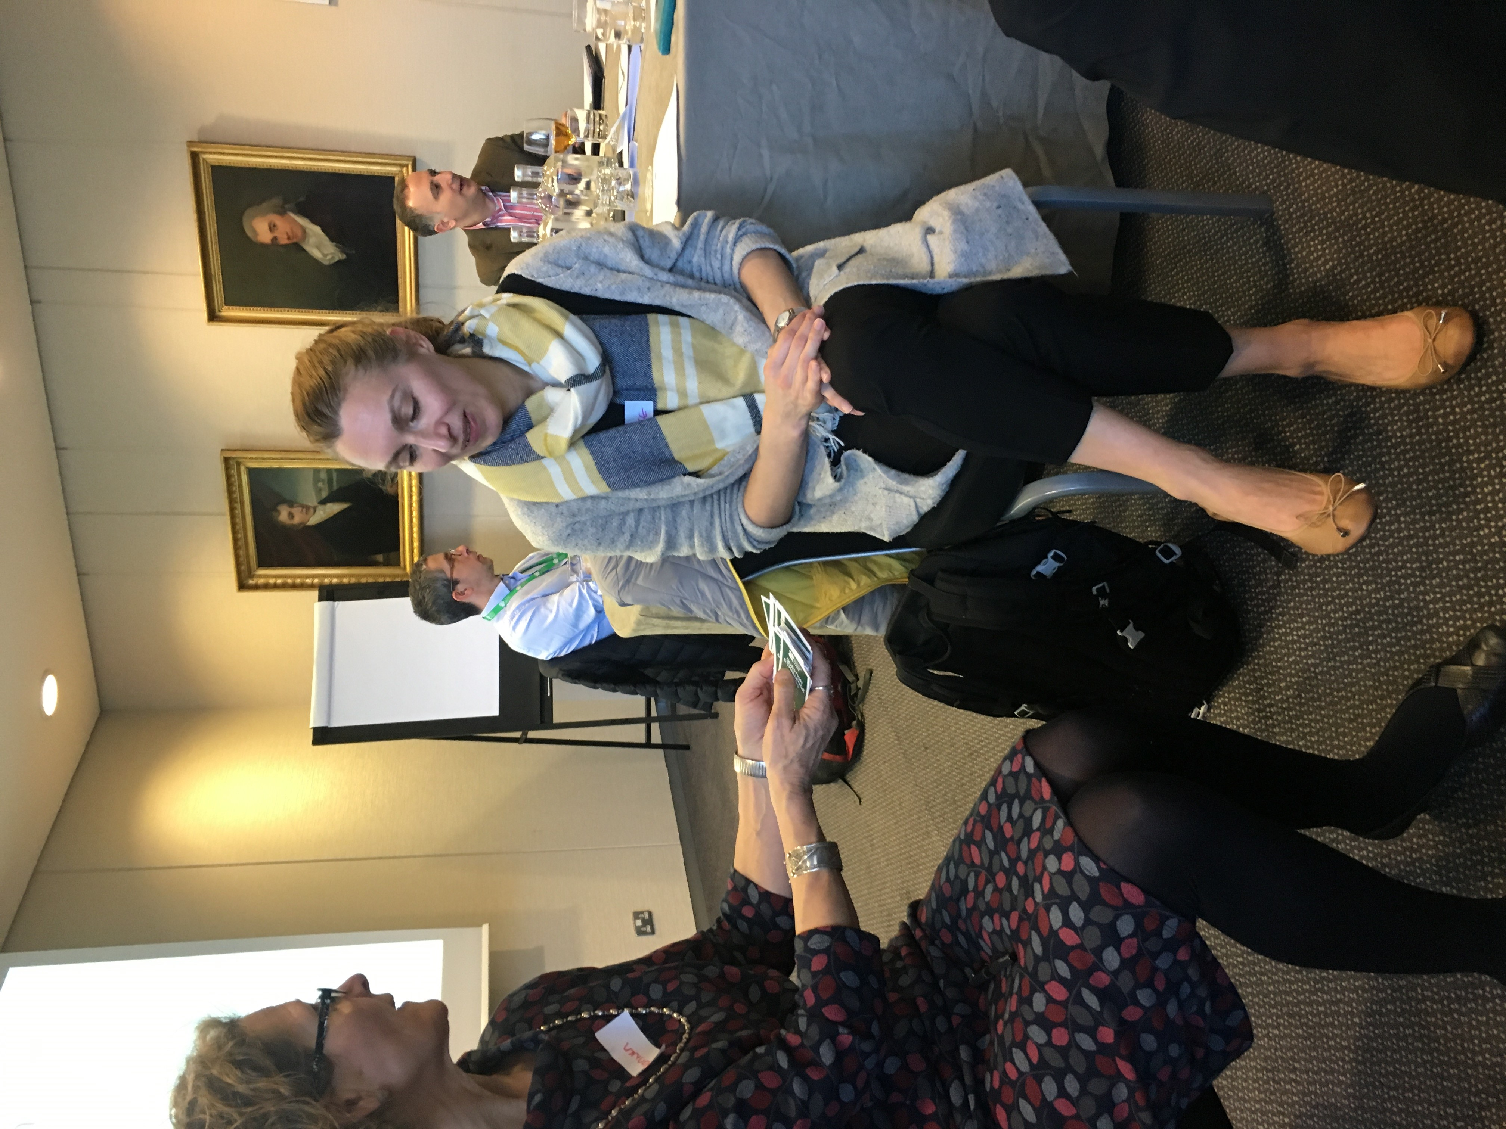
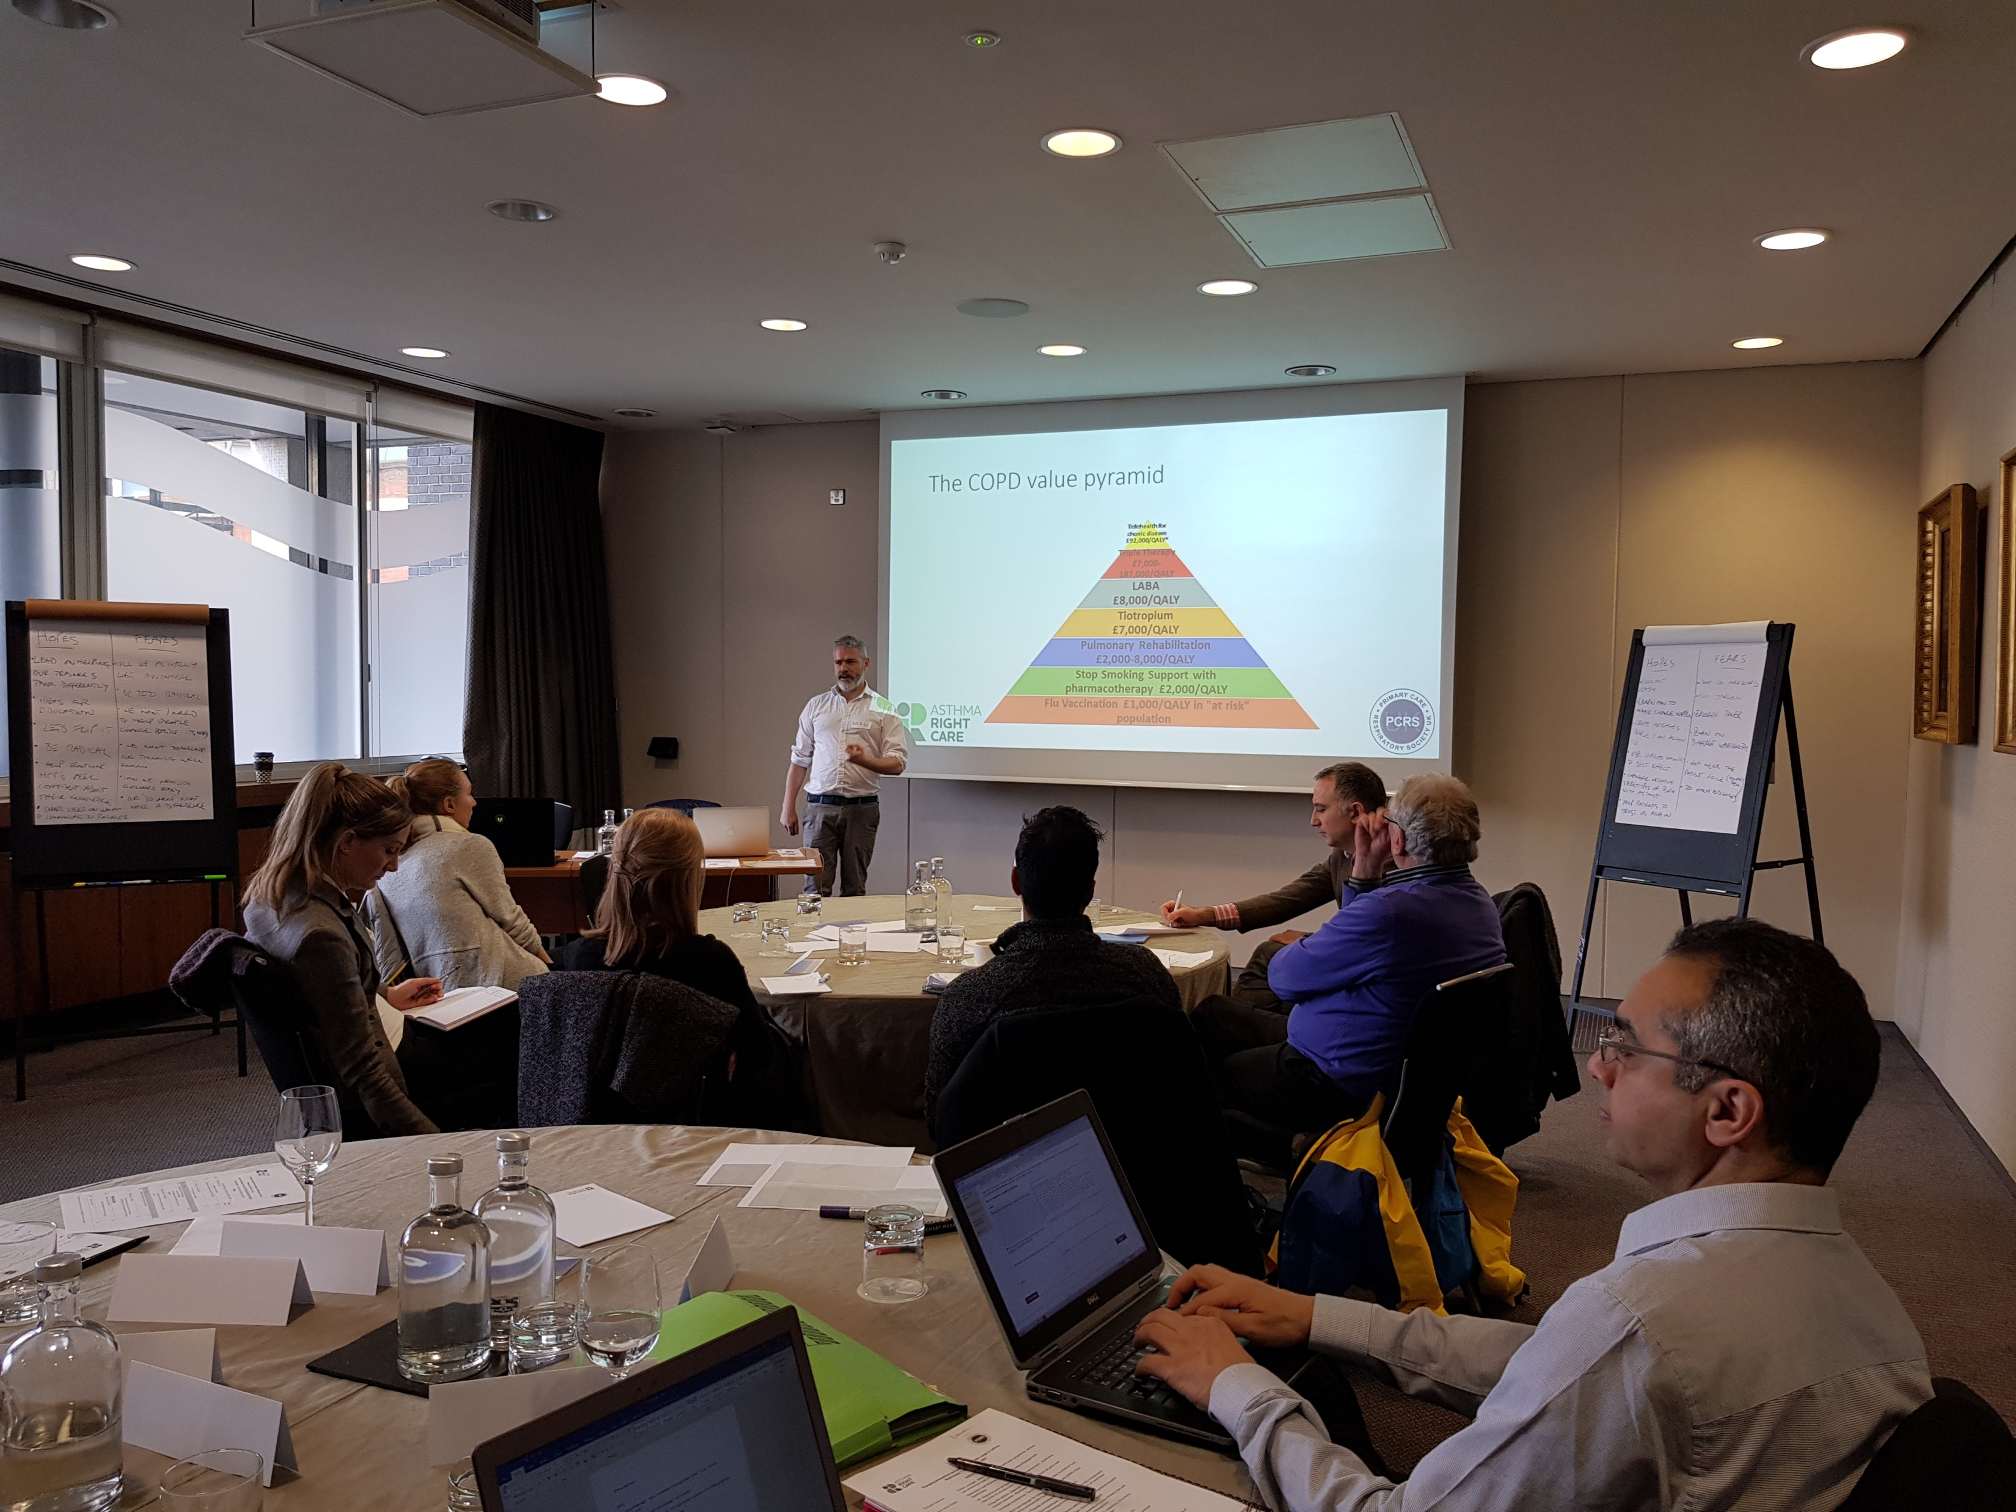
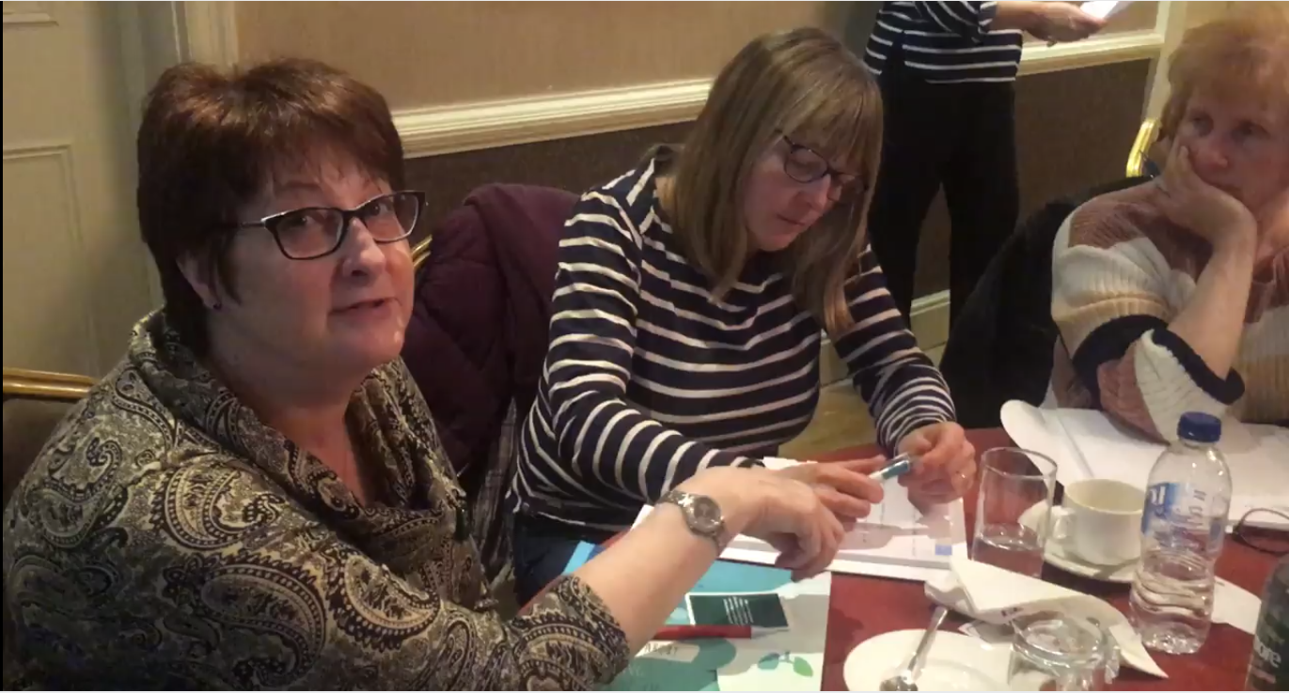

UK
Design Charrette
Lot of interest in attending
National Clinical Director Respiratory Care, patient charities, GPs, nurses, pharmacists
Key messages
  Slide rule seems promising - everyone wanted one!
We have confused messages about SABAs
    ‘life savers’ vs ‘dangerous – risk of death’ – but safety issues not top of minds of prescribers
  Guidelines not clear on threshold for what constitutes ‘too much SABA’
  Different policies about repeat prescriptions and quantities
  Beware unintended consequences if message is not clear:
  Want to ‘reduce unnecessary reliance on SABAs’ so messages need
    To be phrased positively
    To consider the role of SABAs in context of all medication, not in isolation
  Overwhelmed by the question & challenge cards – just pick a few!
  A patient ‘near miss’ story focuses the attention
Progress with initiatives & resources
  Pre- and post-education in practice questionnaire using slide rule
  Lots of testing in pharmacies
  Get better at the conversation the more you use the materials

Slide 25
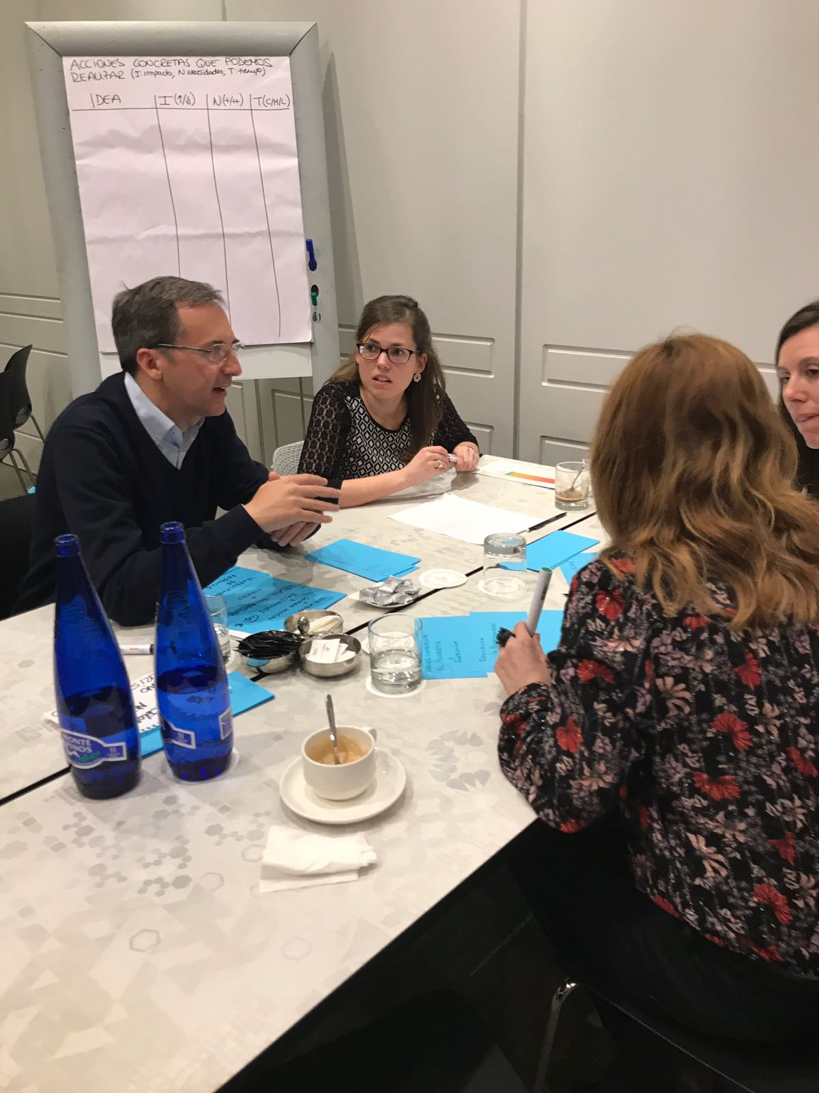
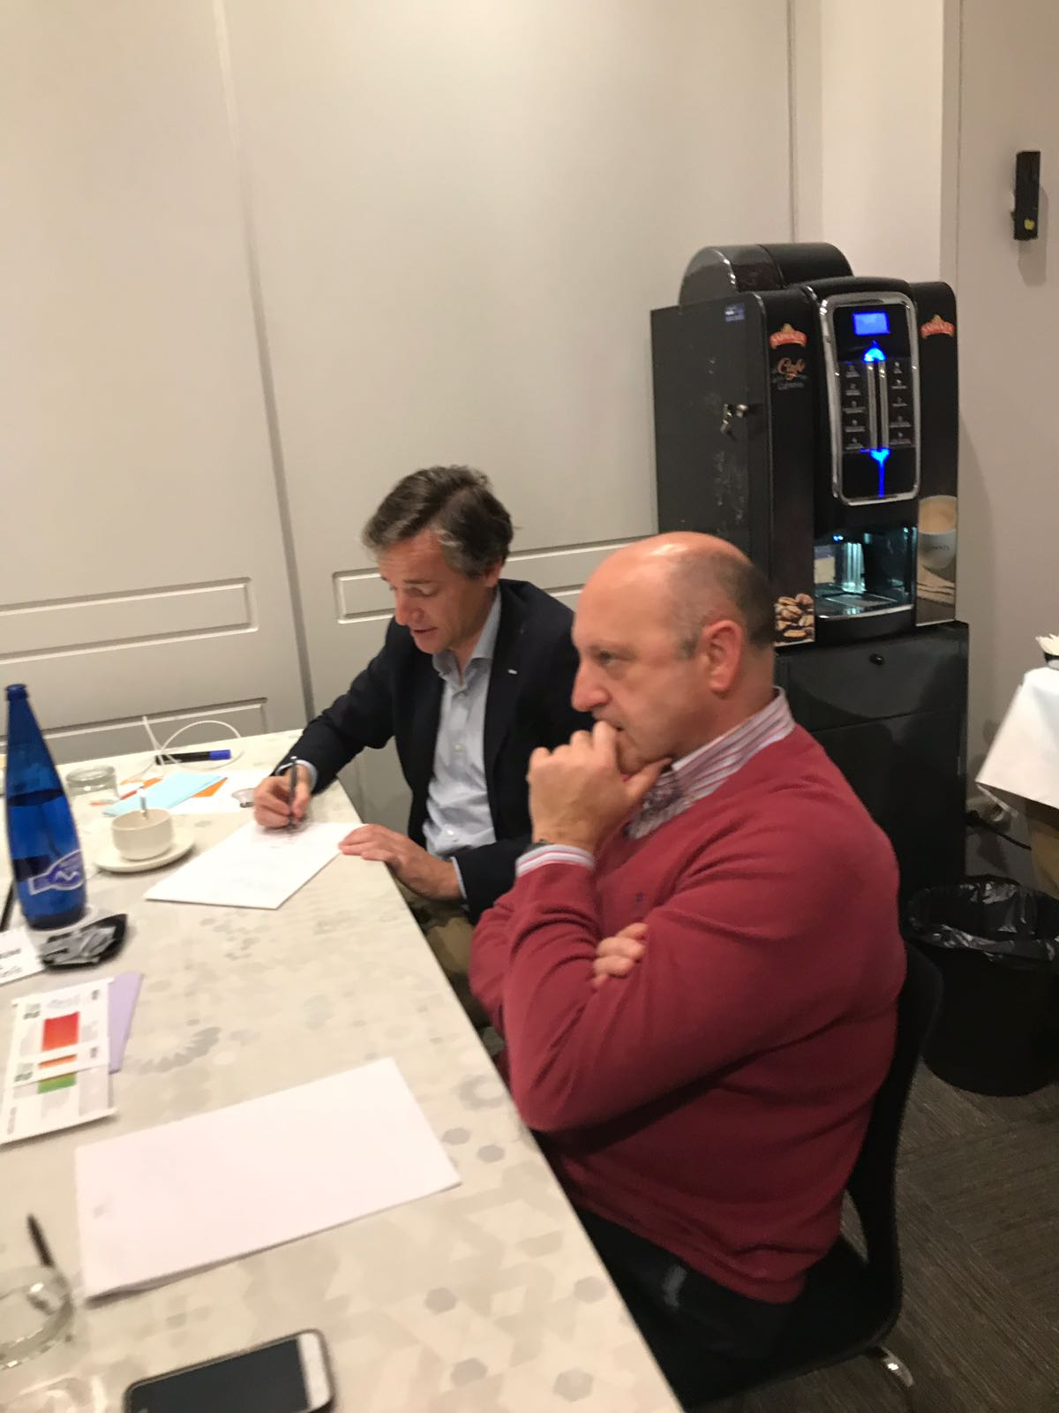
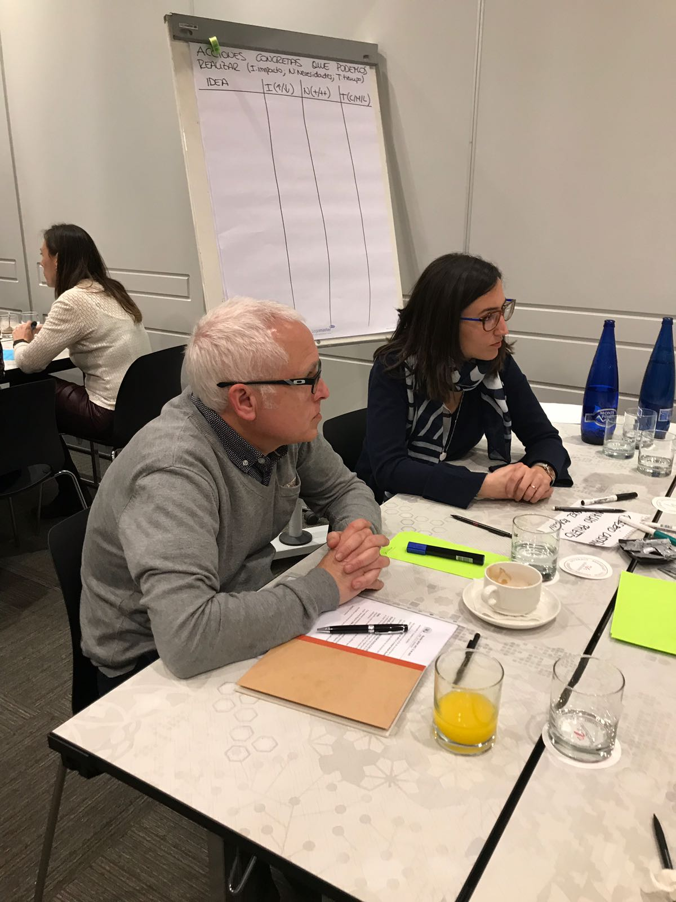
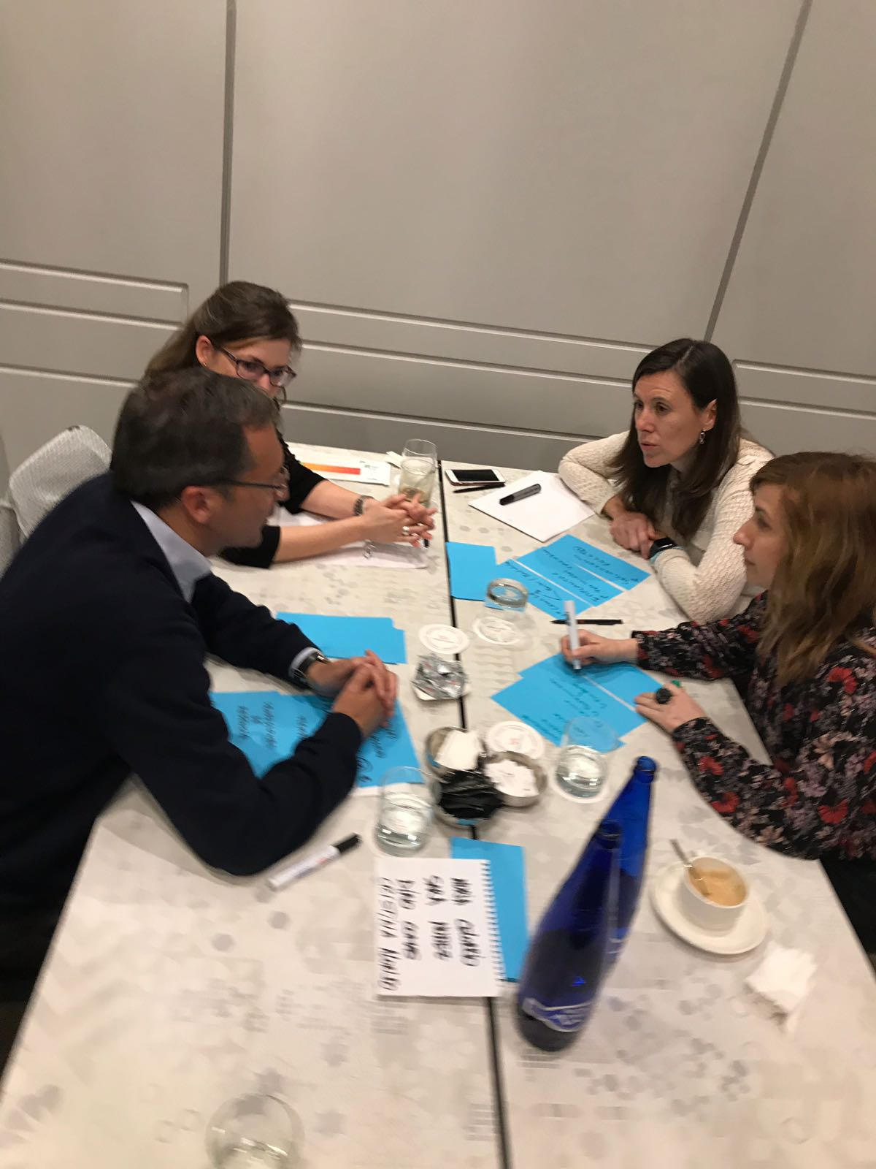
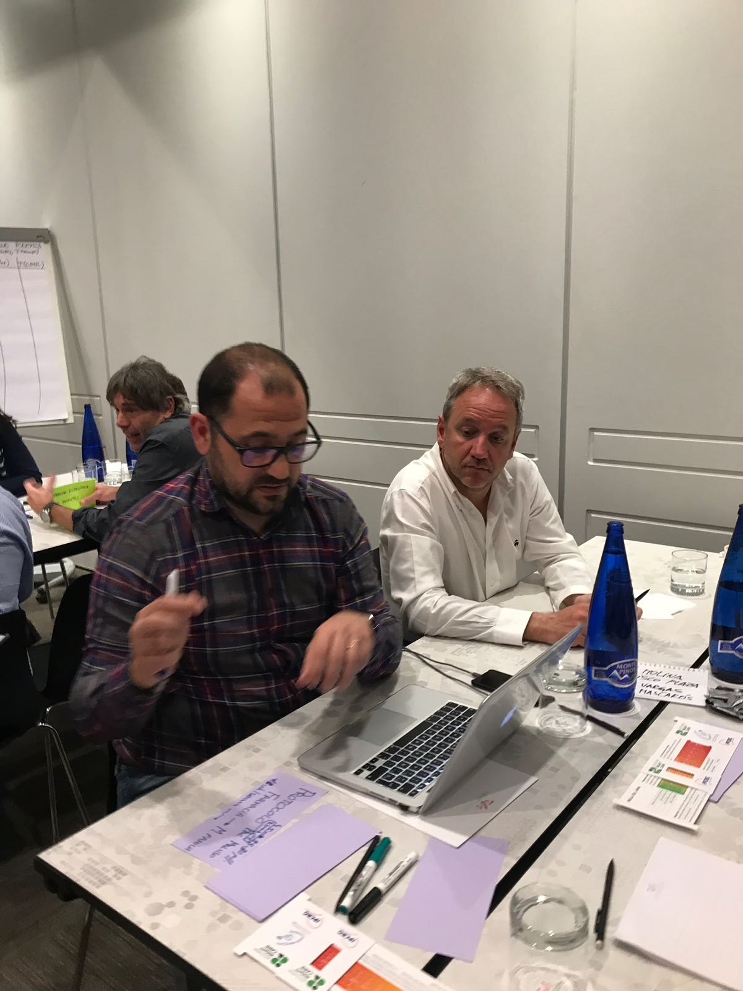

SPAIN
Design Charrette Delivery Team
Cristina Alonso Miguel Román
Miguel Ángel Galmés Mónica Sorribas
Mar Martínez Marta Villanueva
Enrique Mascarós
Design Charrette Stakeholders
Susana Cantero Xisco Morante
Eusebio Castaño Juan José Muñoz
Nuria Celorrio Sara Nuñez
Bernardino Comas Francisco Plaza
Sonia Fernández José Ignacio Prieto
Pilar Marcos Ana Urendez
Jesús Molina Diego Vargas
Key messages from Design Charrette
Give asthma more media visibility among general population
Increase asthma patients’ awareness about poor disease control + SABA overreliance and abuse using marketing campaigns
Equate asthma to other chronic conditions to promote same continuity of care from diagnosis to treatment
eg diabetes or hypertension
Create proper clinical pathways and follow-up recommendations
Remember to manage children-adult asthma transition
Notes:
Building followers
Journalists
ED clinicians
Sports medicine and cyclists
Pharmacists
Nurses
GPs

Slide 26
SPAIN
Making case for change
Promote + develop clinical research projects about prevalence, characteristics + consequences of SABA misuse/abuse and maps
Create social media campaigns about right dispensing and medication use for community pharmacists
Review clinical guidelines recommendations
Ideas for after Porto
Create CME programmes for health care professionals
Promote patients’ groups educational activities
Involve nurses in Asthma Right Care – through workshops
Organise multidisciplinary meetings/discussion tables during regional and national respiratory conferences around SABA misuse and asthma right care
Develop a primary care Asthma Right Care quality label/accreditation from national primary care
Progress with initiatives & resources
A systematic review of SABA overuse published in a Spanish education journal (not indexed).
Analysis being undertaken on no of SABAs used per year vs poor outcomes using a database of 50,000 asthma patients in Majorca. Available summer 2018
Spreading use of the Asthma Slide Rule between prescribers, asthma educators, pharmacists and patients to stimulate conversations about over-reliance on SABA for
Also made a selection of Question Cards to use in practice: colour coded for doctors, nurses, pharmacists and patients.
Idea is to configure these like the suits in playing cards - so we have introduced paintings and numbers simulating a deck of cards.
Notes:
Multi-disciplinary = (primary care doctors and nurses, pulmonologists, pharmacists and patients)
More detail on the accreditation available (Appendix 1)

Slide 27

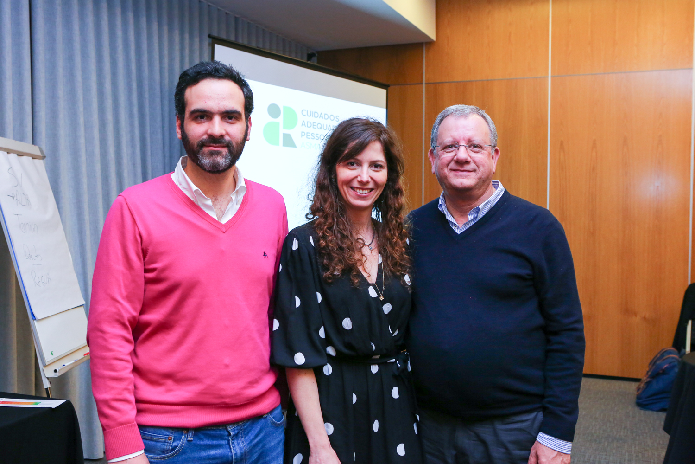
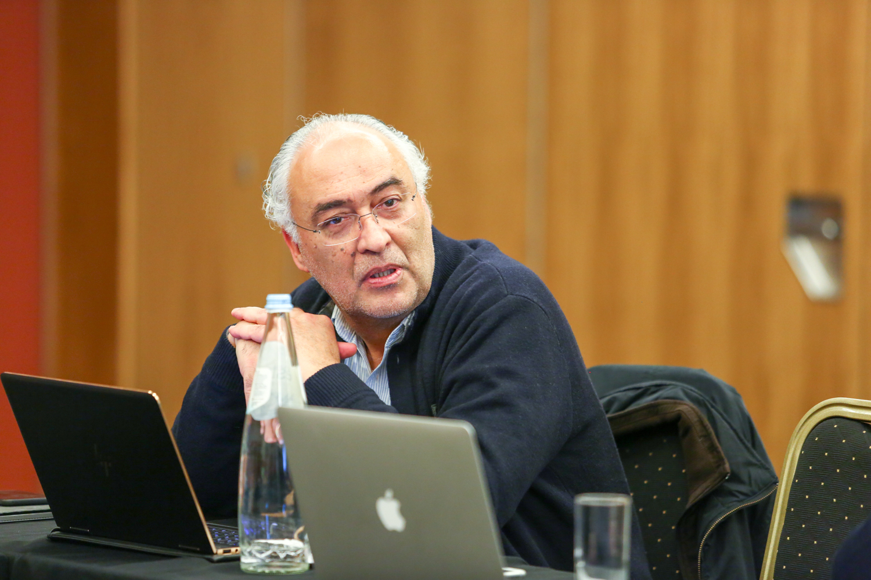
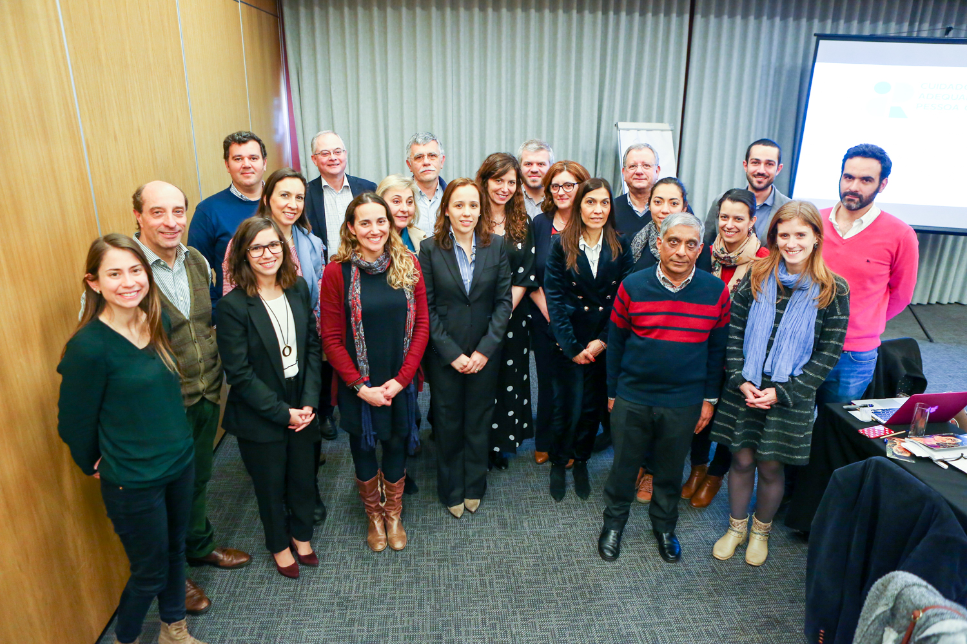
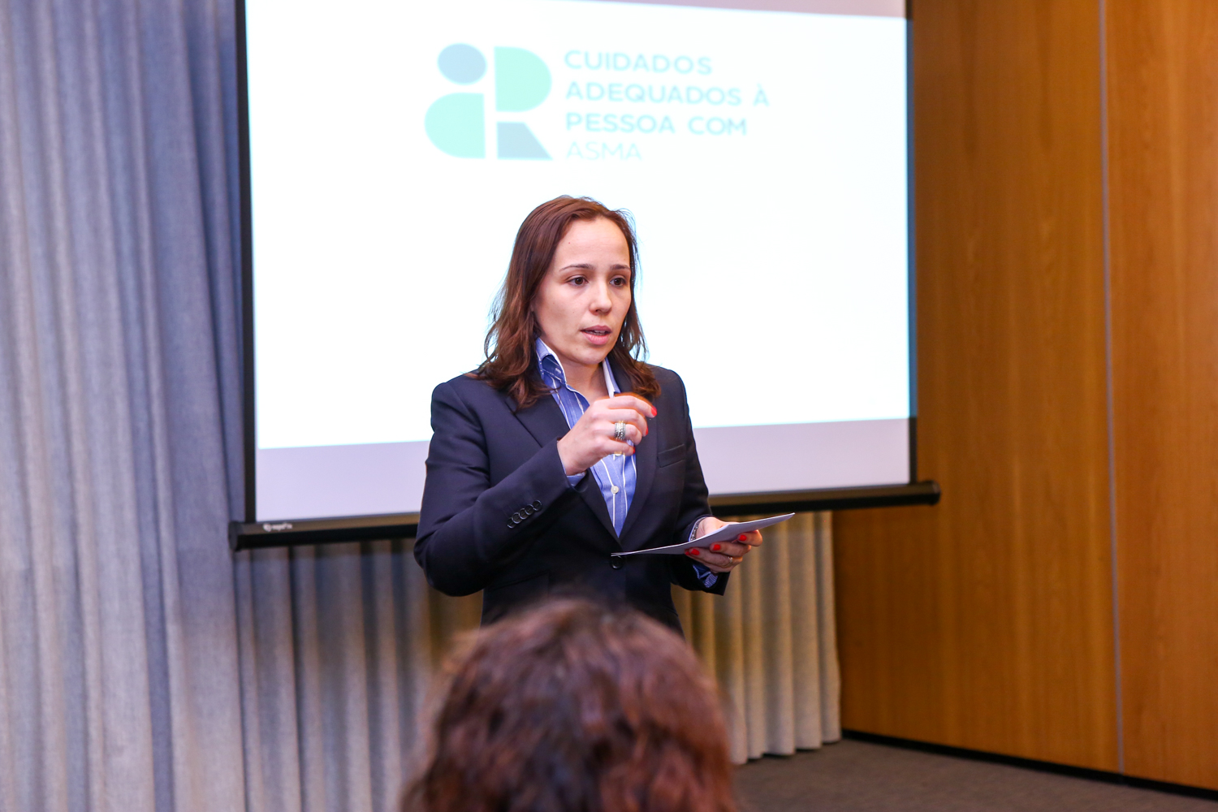
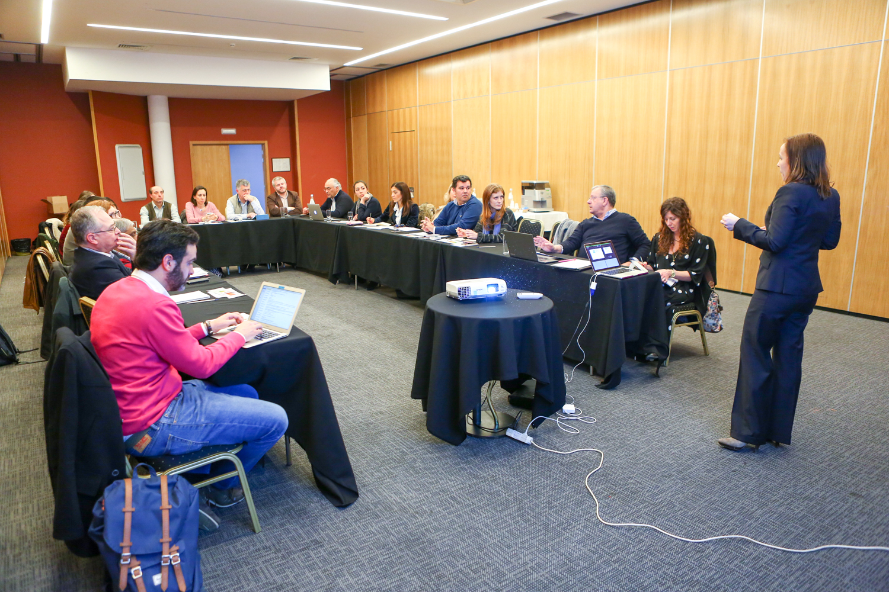

PORTUGAL
Design Charrette
The Design Charrette in Coimbra, April 14th and we had 23 attendees:
-CAPA Group
-APMGF (Portuguese Association of General and Family Medicine)
-3 pharmacists groups: ANF, AFP, Holon
-2 nurses: from primary and secondary care
-Cardio-pneumology technician
-Portuguese Pulmonology Society - SPP
-The Portuguese Directorate-General of Health – the official body that, among other things, develops guidelines in cooperation with the Portuguese Medical Association
-Portuguese Lung Foundation – FPP

Slide 28
PORTUGAL
Key messages from Design Charrette
Primary care
Asthma Slide Rules distributed with Portuguese primary care scientific journal
Education programme for family physicians and nurses: webinar; regional health administrations (ARS/ACES) + replicate in local health units;
Social initiative at World Family Doctor Day - create/adapt a classic board game for children
Reviewed algorithm of action in asthma and right care at SNS24 (health helpline), criteria and when to refer to emergency department, family physician, etc.
Electronic messages/alarms in the prescription programme when a SABA is prescribed
Actions in schools
Secondary care and emergency department (ED)
Review patient's plan on discharge and establish joint care plan for primary care
Review nurse care at ED: raise awareness +reinforce importance of right care
Social media intervention with bombastic messages, eg: "do you only have asthma on Mondays?"
Electronic messages/alarms in prescription programme when SABA prescribed
Education programme: webinar, e-learning courses
Pharmacy action
Use of consulting rooms in pharmacy for therapeutic follow-up eg review of inhaler technique, evaluation of disease control, SABA over-reliance
Electronic messages/alarms in prescription programme when SABA prescribed
Pharmacy algorithms to action when identifying a poorly controlled asthma patient: eg when to inform, refer….
Education programmes
Progress with initiatives & resources
“CAPA dossier”: we are writing about our CAPA key points for medical newspaper in May.
Each partner is writing an article reflecting their point of view about asthma and Asthma Right Care
ARC/CAPA movement presentation in a Pulmonology regional Conference
Portuguese Family Physician Association is celebrating Family Doctors World Day in Coimbra, which will include CAPA presentations and SABA slide Rule distribution
Presentation/ communication at EUROPREV Conference (November 2018) in Porto
Workshop at National Family Conference (APMGF Conference)

Slide 29
What has Asthma Right Care changed for you?
It has changed my approach to leading a large scale change for asthma management. It means to move towards a new vision that is better and fundamentally different from the Status Quo. This Project has pointed me in the right direction for creating and sustaining large scale change and transformation.This framework helps us to increase personal value, value for the population and rates of higher value intervention.
Mar Martinez, GP
ARC is changing our lives because we are reflecting about our work quality in a biopsychosocial dimension while we try to make every single step to provide all the asthma right care to patients and caregivers reconciling it with daily work. At the same time it is incredible how we can apply this knowledge to other diseases and procedures.
Teamwork is very rewarding, making us grow as a person and as a healthcare professional.
Cláudia Vicente, GP

Slide 30
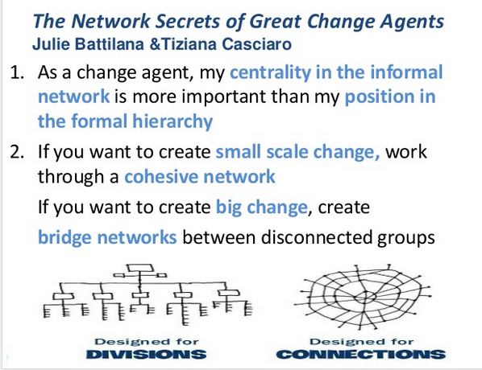
International networks
We are on the agenda at:
WONCA Europe
EQUIP: patient safety
EUROPREV: conference Porto 9-10 November 2018
FIP
International conference Glasgow September 2018
WHO-GARD
Annual meeting, Helsinki August 2018

Slide 31
Summary of learning
Be brave: talk numbers!
Be passionate about equity and safety
Select your words carefully
Be curious about what happens outside the consulting room
Consider role of pharmacist

Slide 32
Be brave: talk numbers
Systematic review 2018 “excessive over-use” but NO definition
How many people with asthma do you see – how long would it take to review all those on over 12 or 6 or 3 SABA inhalers a year?
What is the ratio we should be aiming for between ICS and SABA?
What is the current ratio in your practice and in your region?
Set red flags on electronic systems: what’s the number?

Slide 33
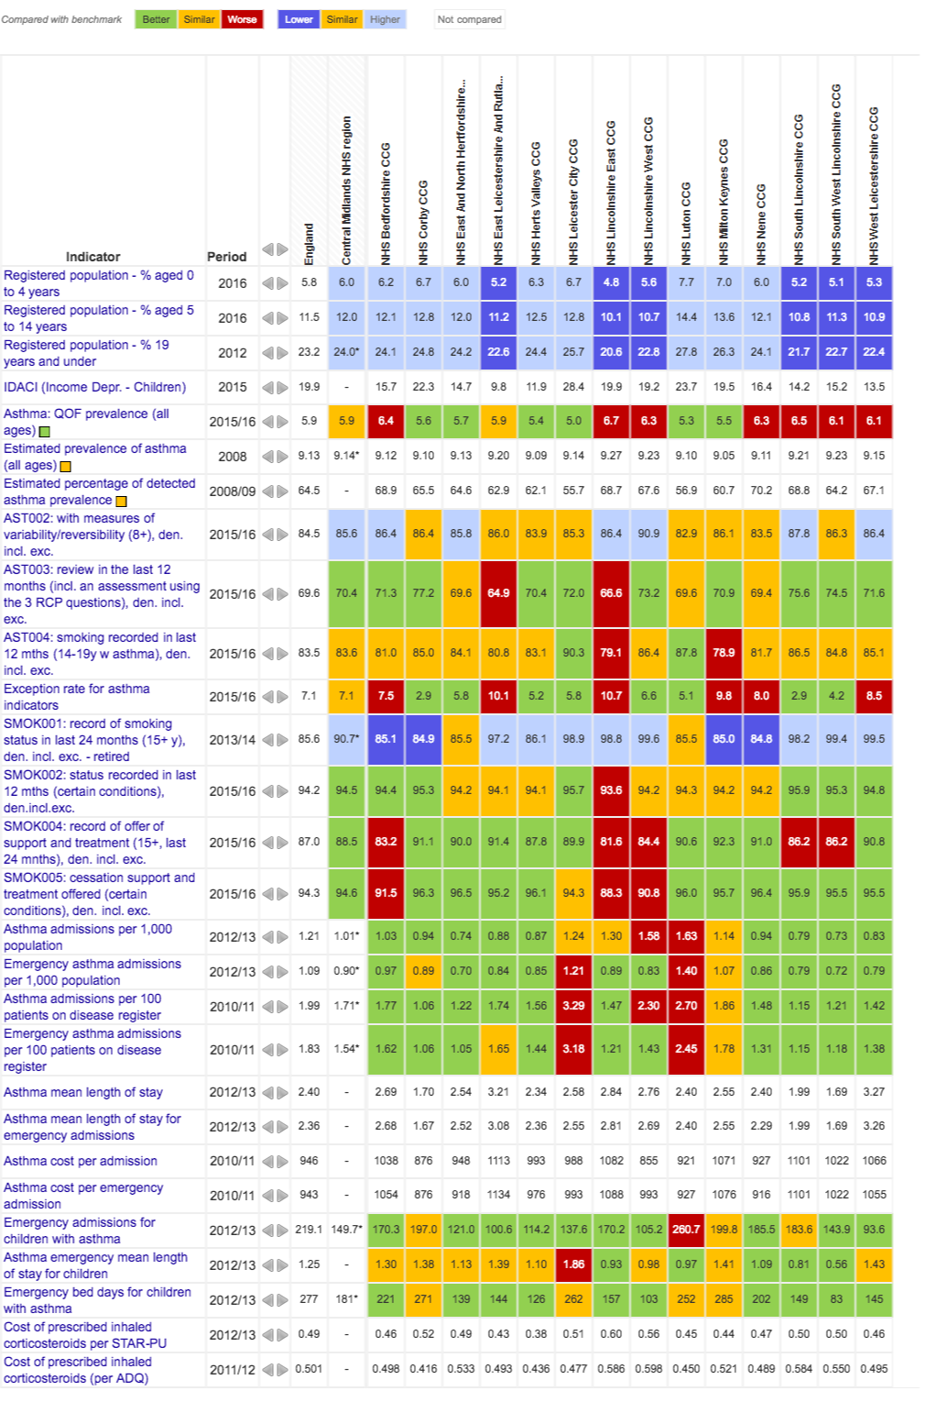
Be passionate about equity & safety!
Asthma patients deserve the same attention as people with hypertension, diabetes etc: fight their corner!
As medicines are the mainstay of treatment they need clinicians’ right care
Asthma is global, in all communities, in all ages
Use atlases like NHS Atlas of Variation
Just because SABA is cheap and brings immediate relief doesn’t mean it’s enough
Just because people can take a lot of SABA without side-effects doesn’t mean a lot of SABA use in asthma is safe

Slide 34
Select your words carefully…
Pay attention to choice of words used in conversation and in writing:
  “Over-reliance” vs over-use
  SABA for asthma vs SABA for COPD
  Dose or puff
  Rescue or relieve
  Stops asthma vs stops asthma attacks
  As directed by your GP….
  As needed….
Use the same words each time and along the pathway
A “puff” is a breathless moment: count those moments…. 2400 breathless moments in a year = 12 inhalers
Build on existing “make every contact count” approaches eg Ask, Advise, Act used in treating tobacco dependence

Slide 35
Words: Social movements thrive on narratives
“Using the blue reliever is like dampening down a fire, but to put the embers out, and to stop it flaring up again, you need the ICS controller”
What stories do you tell to help explain?
What analogies and metaphors do you use?
Notes:
Pharmacists thought of antibiotics guardians, salt for hypertension/salbutamol for asthma

Slide 36
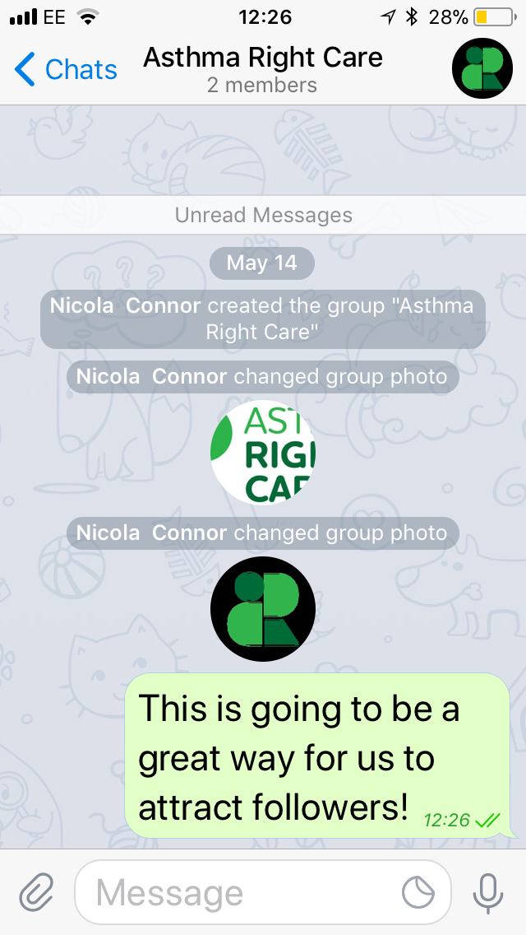
Images: Social movements also thrive on images: still & moving
 | What’s App | Telegram app | Twitter | Websites and Facebook
Internal | Up to 250 users | Up to 100,000 |  | www.ipcrg.org/asthmarightcare to download resources in English, Spanish & Portuguese
External | No | No | Yes | Possible!
Good for followers | Will need new groups if get more than 250 | Yes | Yes | Need to advertise
Images | Yes – uses lot of data. Encrypted | Yes – stored on Cloud. Encrypted | Yes | Yes
Films | Yes, uses lot of data. Encrypted | Yes – stored on Cloud. Encrypted | Yes – if short – plans in Porto! | Yes
Notes:
Pharmacists thought of antibiotics guardians, salt for hypertension/salbutamol for asthma

Slide 37
Be curious about what happens outside the consulting room
Who just goes to the pharmacist and by-passes the GP or nurse?
What is the scale of the problem with cyclists abusing salbutamol?
What do GPs with asthma do….
What do staff in the ED do? Who follows up patients from ED?

Slide 38
Consider role of pharmacist
The “rate limiting step” in most asthma pathways is the quality of the interaction with the pharmacist
Whether buying SABA over the counter or collecting a prescription
    Getting advice on how and when to use
    Inhaler check
    What investment is made in pharmacists’ training
    What reimbursement do they get to support doing the right thing?
    What if the prescription needs review?
What training do pharmacists get: does anyone you know still say “use the blue first to open up the airways” – it was the right teaching 30 years ago….?
Are pharmacists afraid to challenge the prescriber for fear of losing business?

Slide 39
What can you commit to?
Session facilitated by Miguel Roman Rodriguez
AstraZeneca have sponsored and paid for this symposium as part of the Gold Sponsor Package. IPCRG received funding from AstraZeneca to develop the Asthma Right Care Initiative

Slide 40
Act now!
Join our IPCRG Asthma Right Care Telegram group
Come to our stand to sign up
AstraZeneca have sponsored and paid for this symposium as part of the Gold Sponsor Package. IPCRG received funding from AstraZeneca to develop the Asthma Right Care Initiative

