Slide 1



IPCRG presentations on respiratory diseases
Asthma control and severity. What doctors should do to support patients with uncontrolled and severe asthma.
Notes:
Title page option 1

Slide 2
Jaime Correia de Sousa
Miguel Román-Rodríguez
Notes:
Title page option 1

Slide 3
Session Outline
Introduction
Definition
What is asthma control and reasons for poor control
Group Work / Case vignettes
How to measure asthma control?
Difficult to manage asthma: a practical guide

Slide 4
Introduction
Definition
Difficult to manage asthma is asthma that either the patient or the clinician finds difficult to manage.
A patient with difficult to manage asthma has daily symptoms and regular exacerbations despite apparently best treatment.

Slide 5
Introduction
There are two main groups of patients with difficult to manage asthma:
  People whose asthma has been controlled in the past but who have now lost control.
  People whose asthma has never been controlled.

Slide 6
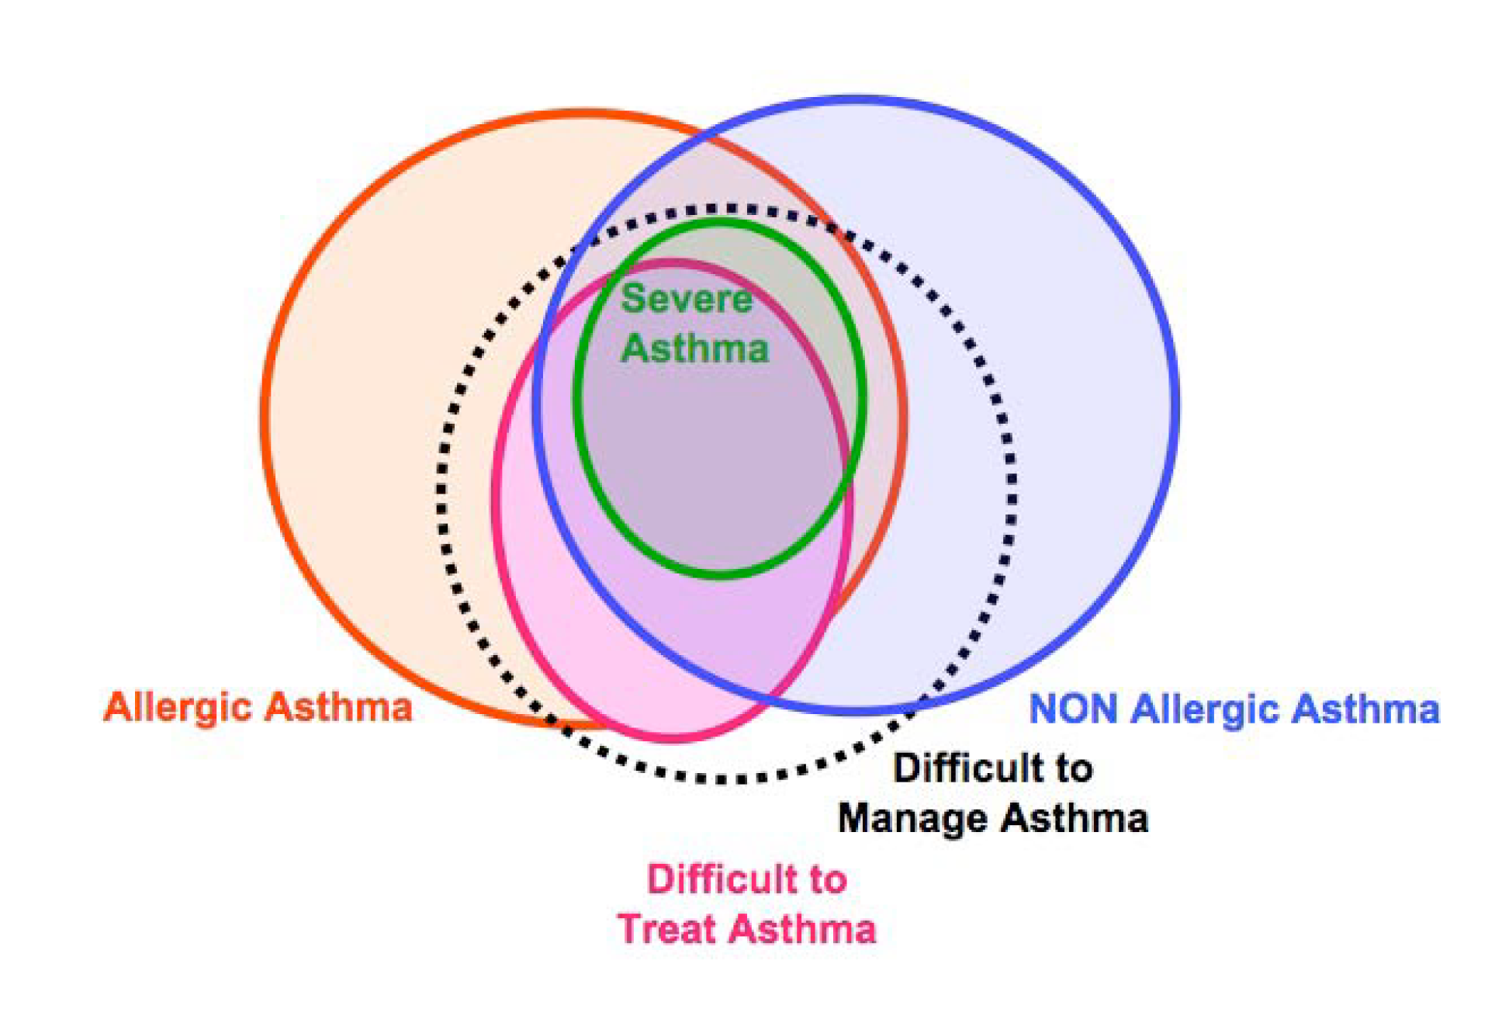
Difficult to manage asthma

Slide 7
Poorly controlled asthma:
What should we do?
Notes:
Title page option 1

Slide 8
1. What is asthma control
2. Reasons for poor asthma control
In groups of 3, please:
  define asthma control
  list 3 reasons for poor asthma control
After 3 m one member from each team should report to the group

Slide 9
What is asthma control?
As defined by the Global Initiative for Asthma (GINA), 2007
Minimal to no daytime asthma symptoms
No limitations on activities
No nocturnal symptoms or awakenings
Minimal to no need for reliever or rescue therapy
Normal lung function (FEV₁ or PEF)
No exacerbations
www.ginasthma.org

Slide 10
Reasons for poor asthma control
Wrong diagnosis or confounding illness
Incorrect choice of inhaler or poor technique
Concurrent smoking
Concomitant rhinitis
Unintentional or intentional nonadherence
Individual variation in treatment response
Under treatment
Haughney J et al. Respir Med. 2008;102:1681–93.

Slide 11
Clinical cases

Slide 12
Group Work
We will present a case vignette
Please take your notes and discuss the case in small groups (3-5 persons)
After 5 m we will discuss the case in the plenary

Slide 13
Case 1:
Sara- 43 year old, goes for a routine asthma consultation:
Never smoked
Atopic dermatitis since childhood
Asthma diagnosis since 1992
Never tested for allergenic sensitivity
She is regularly taking inhaled beta-2 agonists and corticosteroids medium dose fixed combination and salbutamol as needed
Daytime symptoms > twice a week
Nocturnal awakenings
In recent weeks used rescue medication 2/3 times a week
Notes:
Sara and to get her maintenance treatment prescription

Slide 14

Is her asthma controlled?
Characteristic | Controlled (All of the following) | Partly controlled (Any present in any week) | Uncontrolled
Daytime symptoms | Twice or less per week | More than twice per week | 3 or more features of partly controlled asthma present in any week
Limitations of activities | None | Any
Nocturnal symptoms / awakening | None | Any
Need for rescue / “reliever” treatment | Twice or less per week | More than twice per week
Lung function (PEF or FEV₁) | Normal | < 80% predicted or personal best (if known) on any day
www.ginasthma.org
Notes:
There are many tools to measure asthma control but independently of which one we use, we find that Sara’s asthma is uncontrolled as we can objective in this slide
Depending on level of asthma control, the patient is assigned to one of five treatment steps
Treatment is adjusted in a continuous cycle driven by changes in asthma control status. The cycle involves:
- Assessing Asthma Control
- Treating to Achieve Control
- Monitoring to Maintain Control

Slide 15
How do we measure asthma control?

Slide 16
How do we measure asthma control ?
History
Prescription review
Questionnaires
Objective measures
Notes:
Occasional daytime symptoms defined as less than twice a week maybe consistent with good control but disturbed sleep due to asthma signals loss of control.
Exhaled Nitric oxide as a measure of inflammation may have a place in clinical care in the future.

Slide 17
How to assess asthma control in practice?
Simple tools that both healthcare providers and patients can use.
  Asthma Control Questionnaire (ACQ)
    7-item questionnaire. Based upon day/night-time symptoms, daily activities, rescue bronchodilator
  Royal College of Physicians (RCP)
    3 questions based upon day/night-time symptoms and daily activities
  Asthma Control Test (ACT)
    Validated instrument. 5 questions based upon day/night-time symptoms, rescue bronchodilator use and daily activities.
  Control of Allergic Rhinitis and Asthma Test (CARAT)
    Validated instrument. 4 questions on rhinitis + 6 on asthma. Available in several languages
Juniper et al ERJ 1999;14:902-7, Br Med J 1990;301:651-653, Nathan J Allergy Clin Immun, 2004:113:59-65

Slide 18
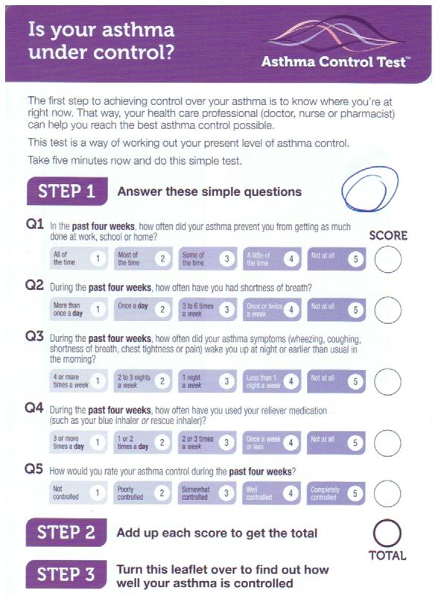
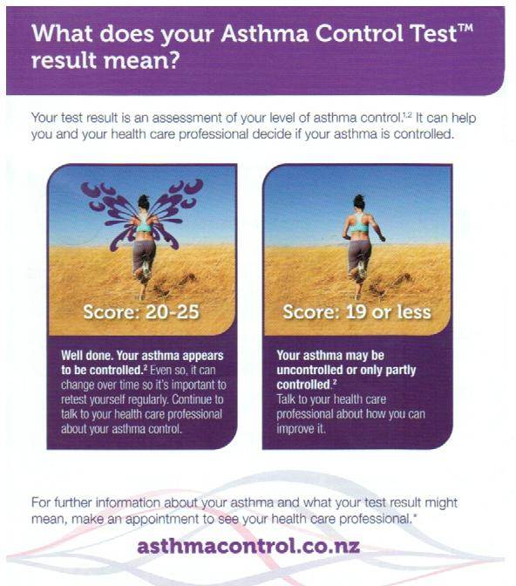

Slide 19
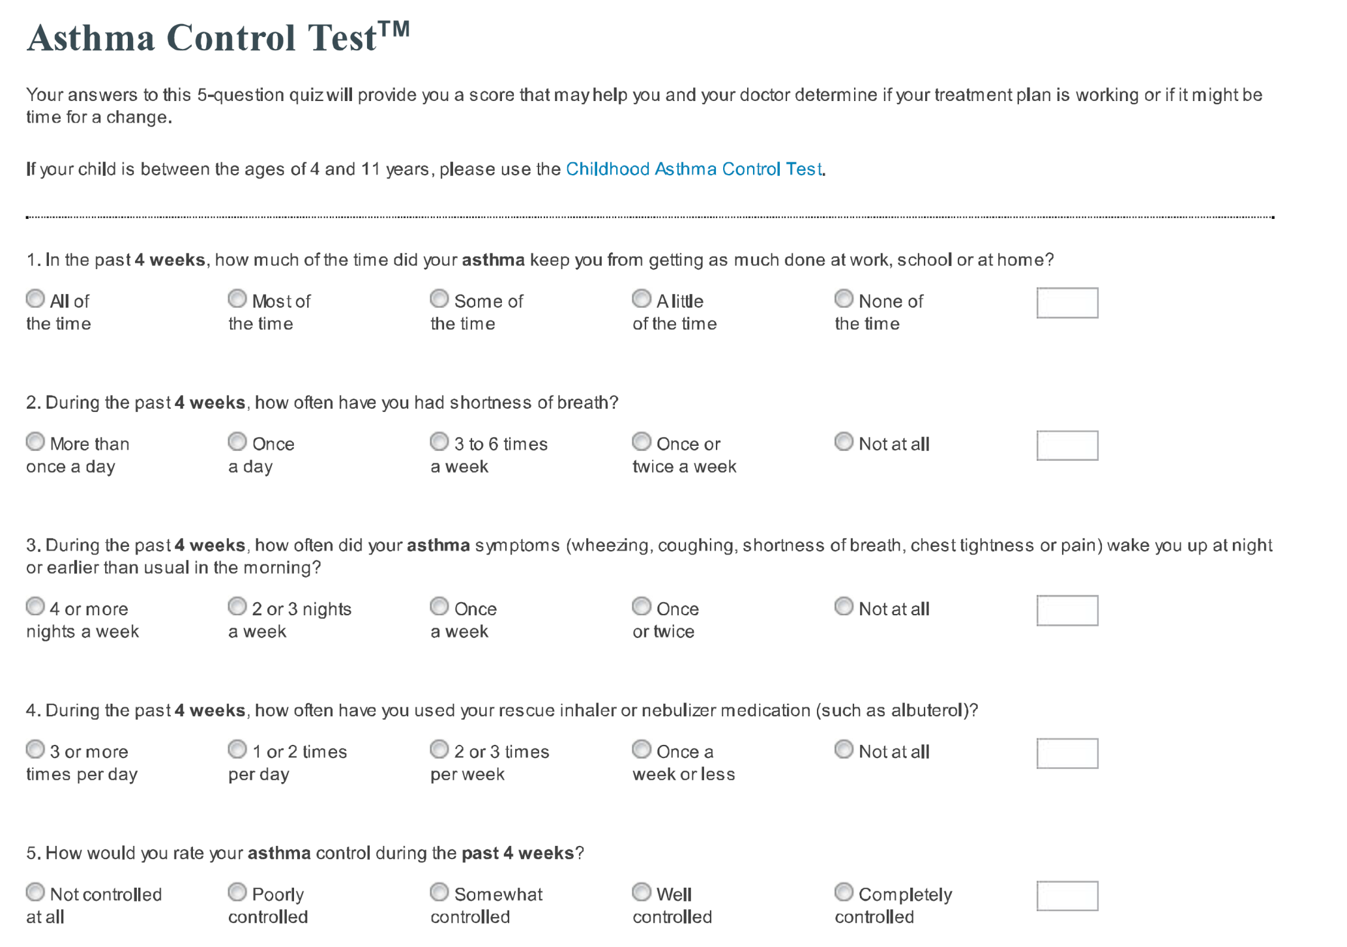

Slide 20
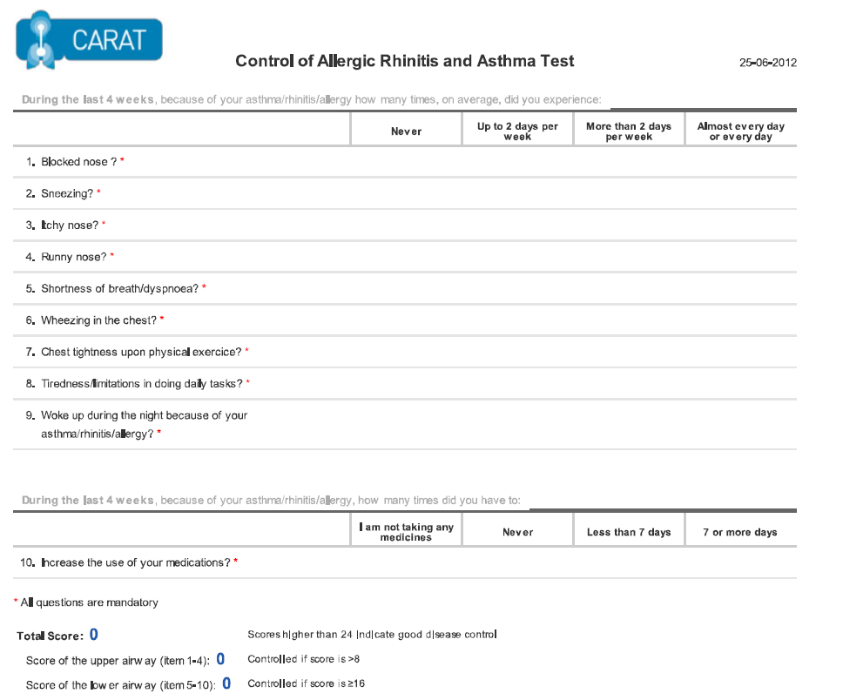

Slide 21





If this criterion is important, not good enough
Good enough
Very poor
Recommended
Highly
Recommended
Criteria / Tool | Fully validated in all ages | Clinically meaningful | Practical use in primary care consultations | Flexible administration eg postal, telephone, self-completion, electronic | Suitable for different age ranges: children and adults | Available in different languages (1)
RCP 3
RCP 21 Questions
Rules of two TM
The 30 second Asthma Test TM
ACQ
ACT
ATAQ
Note 1: Availability in other languages does not necessarily mean that it is validated for use in that language.
Check if the translation has been validated using appropriate methodology. Also, there may be cultural adaptations that are needed.
Notes:
Table example

Slide 22
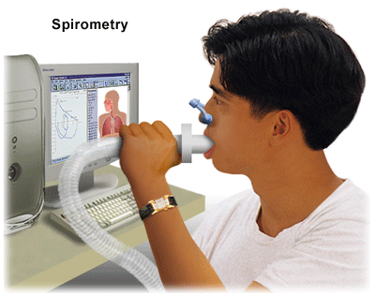
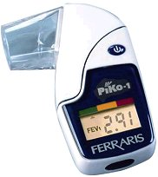
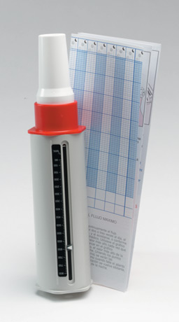

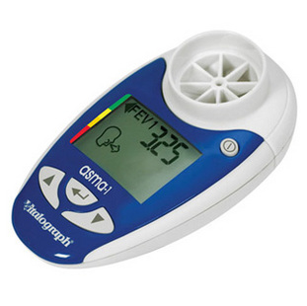
Objective measures

Slide 23
Reasons for poor asthma control: Case 2

Slide 24
Case 2:
Sara- 43 year old, goes for a routine asthma consultation:
Never smoked
Atopic dermatitis since childhood
Asthma diagnosis since 1992
Never tested for allergenic sensitivity
Once we check asthma control and we discover that she has an uncontrolled asthma
What is next?
Notes:
Sara and to get her maintenance treatment prescription

Slide 25
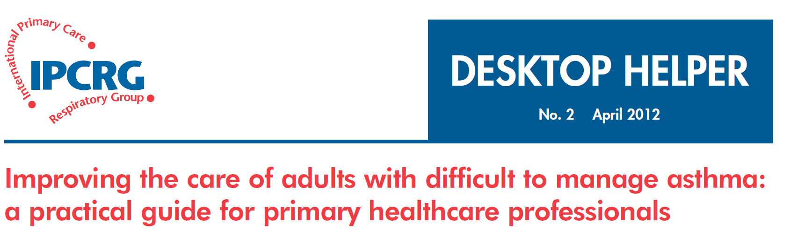

Slide 26
How to review a patient with difficult to manage asthma
SIMPLES
Smoking
Inhaler technique
Monitoring
Pharmacotherapy
Lifestyle
Education
Support

Slide 27
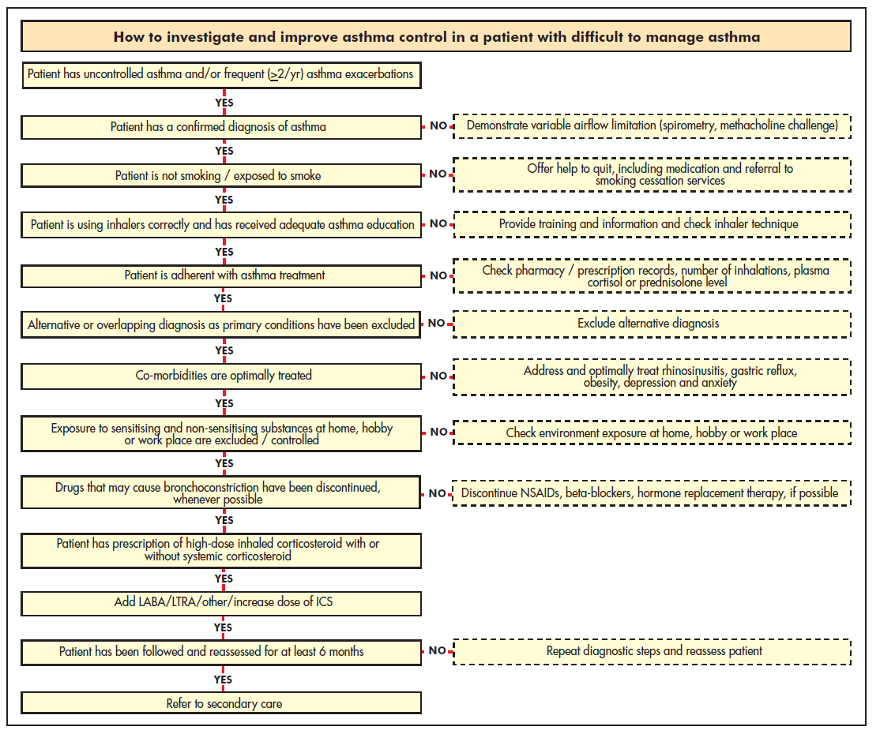

Slide 28
Step1: confirm the diagnosis of asthma
If the patient is not responding as expected to asthma therapy:
  Confirm the asthma diagnosis and rule out (or in) confounding illness before changing or increasing medications
Tools for asthma diagnosis must be stratified by age
Objective measures of reversible airflow obstruction (spirometry, PEF) are important if available

Slide 29
Diagnosing asthma in primary care
IPCRG guidelines. Prim Care Respir J. 2006;15:20–34.
Compatible clinical history
  Episodic or persistent dyspnoea, wheeze, tightness, cough
  Triggers (allergic, irritant)
  Risk factors for asthma development
  Consider occupational asthma for adults with recent onset
Objective evidence
  Spirometry or peak expiratory flow
  Bronchoprovocation test (methacholine challenge)
Ancillary tests
  Chest x-ray
  Eosinophils, IgE level
  Allergy testing
  Exhaled nitric oxide
  Induced sputum
Notes:
A diagnosis of asthma should ideally be based on objective evidence of reversible airflow obstruction. Guidelines vary in their criteria for this (IPCRG spirometry at http://www.theipcrg.org/resources/resources_diagnostics.php).

Slide 30
Step 2: question about smoking
Smoking adversely impacts asthma control
  Current smokers are almost 3 times more likely than non-smokers to be hospitalised for their asthma over a 12-month period
Why does smoking adversely impact asthma?
  Asthma misdiagnosed as COPD or concomitant COPD
  Relative steroid resistance
Price D et al. Clin Exp Allergy. 2005;35:282–7.
Notes:
There is clear evidence now that concurrent smoking adversely impacts asthma control.

Slide 31
Inhaled steroids are less effective in smokers than nonsmokers with asthma
The pattern of airway inflammation differs
Smokers have a higher percentage of neutrophils in induced sputum, and steroids are not very effective in reducing neutrophils.
Smoking produces oxidative stress
The oxidative stress produced by smoking impairs the activity of histone deacetylase-2 (HDAC2), resulting in reduced anti-inflammatory activity of steroids.
Smoking triggers leukotriene production
Leukotrienes are not reduced by steroid therapy.
Boulet LP et al. Chest. 2006;129:661–8. Barnes PJ et al. Lancet. 2004;363:731–3. Fauler J et al. Eur J Clin Invest. 1997;27:43–7.

Slide 32
Clinical approach to smoking
Tools
  Take a smoking history
  Investigate the possibility of COPD
    IPCRG guidance includes tool to differentiate asthma from COPD*
Solutions
  Encourage smokers to quit!
    IPCRG guidance on smoking cessation: http://www.theipcrg.org/smoking/index.php
  Try alternative therapy:
    Leukotriene receptor antagonist
    Possibly theophylline
*IPCRG Guidelines: diagnosis of respiratory diseases in primary care. Prim Care Respir J. 2006;15:20–34.
Notes:
Clinical approach to suspected smokers with asthma
It is important to identify the current smoking habits of patients with asthma, particularly those whose symptoms are poorly controlled. Patients who do not admit to smoking during an oral history may be more likely to admit to smoking on a written self-completed questionnaire, as they may feel less threatened.
For patients who are suspected or confirmed smokers, the consultation should include investigations to exclude COPD. The IPCRG guidelines for diagnosing respiratory diseases in primary care include a tool to help differentiate between asthma and COPD (lhttp://www.thepcrj.org/journ/view_article.php?article_id=137&volissue=12).
The ideal therapy for smokers with asthma is to quit smoking. The IPCRG has published guidance on smoking cessation (http://www.theipcrg.org/smoking/index.php). The percentage of neutrophils in induced sputum falls after patients quit smoking; thus, while neutrophils do not respond to steroids they do respond to smoking cessation.
For patients who continue to smoke, alternatives to inhaled steroids for treating asthma include leukotriene modifiers, theophylline, or possibly high-dose inhaled steroids (up to 1600 µg/day), although this last alternative is not yet fully supported by clinical trial evidence.

Slide 33
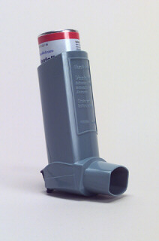
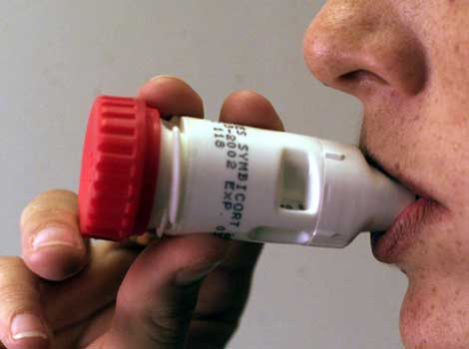
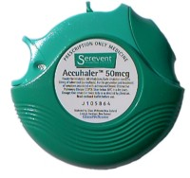
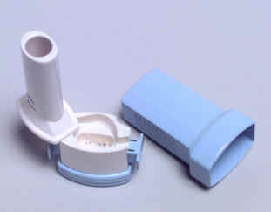
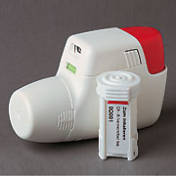
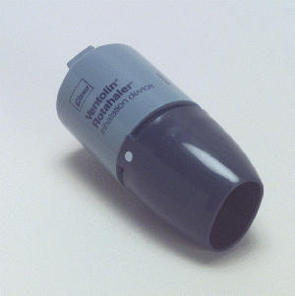
Step 3: asses inhaler technique

Slide 34
Step 3: asses inhaler technique
Correct inhaler choice or poor technique
There is no clinical difference between inhaler devices when used correctly, but each type requires a different pattern of inhalation for optimal drug delivery to the lungs
Problems with inhaler technique are common in clinical practice & can lead to poor asthma control
Asthma control worsens as the number of mistakes in inhaler technique increases
All patients should be trained in technique, and trainers should be competent with the inhalation technique

Slide 35
Inhaler choice and technique
Key recommendations:
Take patient preference into account when choosing the inhaler device
Simplify the regimen and do not mix inhaler device types
The choice of steroid inhaler is most important because of the narrower therapeutic window
Invest the time to train each patient in proper inhaler technique:
    Observe technique & let patient observe self (using video demonstrations)
    Devices to check technique & maintain trained technique are available (eg, 2Tone Trainer & Aerochamber Plus spacer for metered dose inhalers; In-Check Dial, Turbuhaler whistle, Novolizer for dry powder inhalers)
Recheck inhaler technique on each revisit
Haughney J et al. Respir Med. 2008;102:1681–93.
Notes:
35
Choosing an inhaler device
The three most common types of inhaler device available are 1) pressurised metered-dose inhalers (MDIs), 2) breath-actuated MDIs, and 3) dry powder inhalers (DPIs). Available in generic form and the least expensive, MDIs are also frequently used incorrectly, as these devices require coordination between inhalation and actuation of the inhaler. Use of a breath-actuated MDI can improve lung deposition and decrease oropharyngeal deposition. DPI use instead requires adequate acceleration rate on inhalation to obtain good lung deposition and avoid excess orophayngeal deposition.
Key features of MDIs and DPIs
Metered-dose inhalers:
Require slow and deep inhalation over 5 seconds, with co-ordination between dose release and start of inhalation (good co-ordination not critical if slow inhalation but dose has to be released after the start of the inhalation);
Can be used with spacers, large or small (spacers scored lowest in patient preference);
Solving common problems:
poor coordination of actuation & inhalation → switch to breath-actuated MDI;
stopping inhalation when cold spray hits the throat ("cold Freon effect") → add a spacer or switch to inhaler with CFC-free propellant;
inhaling too fast → switch to ultrafine particle inhaler;
inhaling through the nose → training to inhale through mouth.
Dry powder inhalers:
Breath-actuated;
Require adequate acceleration on inhalation: must inhale deeply and forcibly at the start of the inhalation;
If the patient does not inhale fast enough or long enough:
Not all the dose is emitted;
Particles generated are too big to enter the lungs, resulting in increased oropharyngeal deposition.
Do not prescribe to children <5 years old;
Do not prescribe to patients with insufficient inspiratory effort;
Sensitive to moisture, store in dry place.
If the dose is supplied in a capsule then two inhalations are required to empty the dose.
Inhaler training aids:
Several devices to check inhaler technique and maintain trained technique are now available. For use with a MDI, the Aerosol Inhalation Monitor (AIM, Vitalograph Ltd, Buckingham, England) provides useful feedback about a patient’s technique, whilst the 2Tone Trainer (Canday Medical Ltd., Newmarket, England) is a training aid to help patients use a slow inhalation flow. The AeroChamber Plus spacer (Forest Pharmaceuticals, Inc., St. Louis, US) makes a noise when the inhalation flow used is too fast.
For use with a dry powder inhaler, the In-Check Dial (Clement Clarke International Ltd., Essex, UK) is a device to check if the patient can generate the required fast inhalation. The Turbuhaler whistle (AstraZeneca International, London, UK) is an example of a simple device that has been introduced to check for the required inhalation rate for patients prescribed this device. Finally, the Novolizer (MEDA Pharma GmbH & Co. KG, Bad Homburg, Germany) has been designed to release its dose only when the required inhalation rate is achieved.

Slide 36

Step 4: assess patient adherence to treatment

Slide 37
Step 4: assess patient adherence to treatment
Unintentional & intentional nonadherence
Nonadherence to asthma therapy, particularly to inhaled steroids, is a common problem contributing to poor asthma control
Nonadherence is often a hidden problem as assessment of adherence is often not included in routine asthma review
Barriers to assessing adherence:
  Patient and physician may prefer to avoid the subject
  Lack of clear, easy methods for addressing barriers to adherence
  Perception that little can be done?
Appreciating the factors involved is the first step toward improving adherence
Horne R. Chest. 2006;130:65S–72S.

Slide 38
Unintentional versus intentional nonadherence
Intentional nonadherence derives from the balance between the patient’s beliefs about the personal necessity of taking a given medication relative to any concerns about taking it
Horne R et al. 2005. National Co-ordinating Centre for NHS Service Delivery and Organisation R&D, London.
Notes:
Horne R, Weinman J, Barber N, Elliott RA, Morgan M. Concordance, Adherence and Compliance in Medicine Taking: A conceptual map and research priorities (2005). National Co-ordinating Centre for NHS Service Delivery and Organisation R&D, London.
Understanding nonadherence: unintentional versus intentional nonadherence
There are two types of nonadherence:
Unintentional nonadherence results from practical barriers to adherence, such as:
misunderstanding the prescribing instructions;
language barriers; and, frequently and understandably,
forgetfulness.
Intentional nonadherence results from the patient’s conscious decision not to take the medication as prescribed, i.e., to take less or none or to take it differently than prescribed. Intentional nonadherence is related to a patient’s beliefs about treatment (which may differ from the clinician’s) and derives from the balance between the individual’s beliefs about his or her personal necessity of taking a given medication relative to any concerns about taking it. Thus, in the case of asthma, for example:
patients may doubt the necessity of taking a daily medication for a condition that they experience episodically, while
they may have concerns about potential adverse effects of inhaled steroids.

Slide 39
Nonadherence: identifying the causes
Tools for identifying & assessing nonadherence:
  Beliefs about Medicines Questionnaire (BMQ) — developed to measure necessity beliefs and concerns
  Medication Adherence Report Scale (MARS) — developed to assess patient adherence
  Minimal Asthma Assessment Tool (MAAT) — undergoing pilot testing as a simple, self-administered patient questionnaire for use before a clinical consultation to evaluate asthma control, adherence to medication, and comorbidities such as allergic rhinitis and smoking
Interventions to facilitate optimal adherence are likely to be more effective if they:
  Facilitate honest discussion of adherence behaviour
  Identify the mix of perceptual & practical barriers for the individual patient
  Help clinicians to elicit and respond to patient beliefs and concerns
We need to tailor the intervention & support according to specific barriers & patient preferences
Haughney J et al. Respir Med. 2008;102:1681–93.

Slide 40
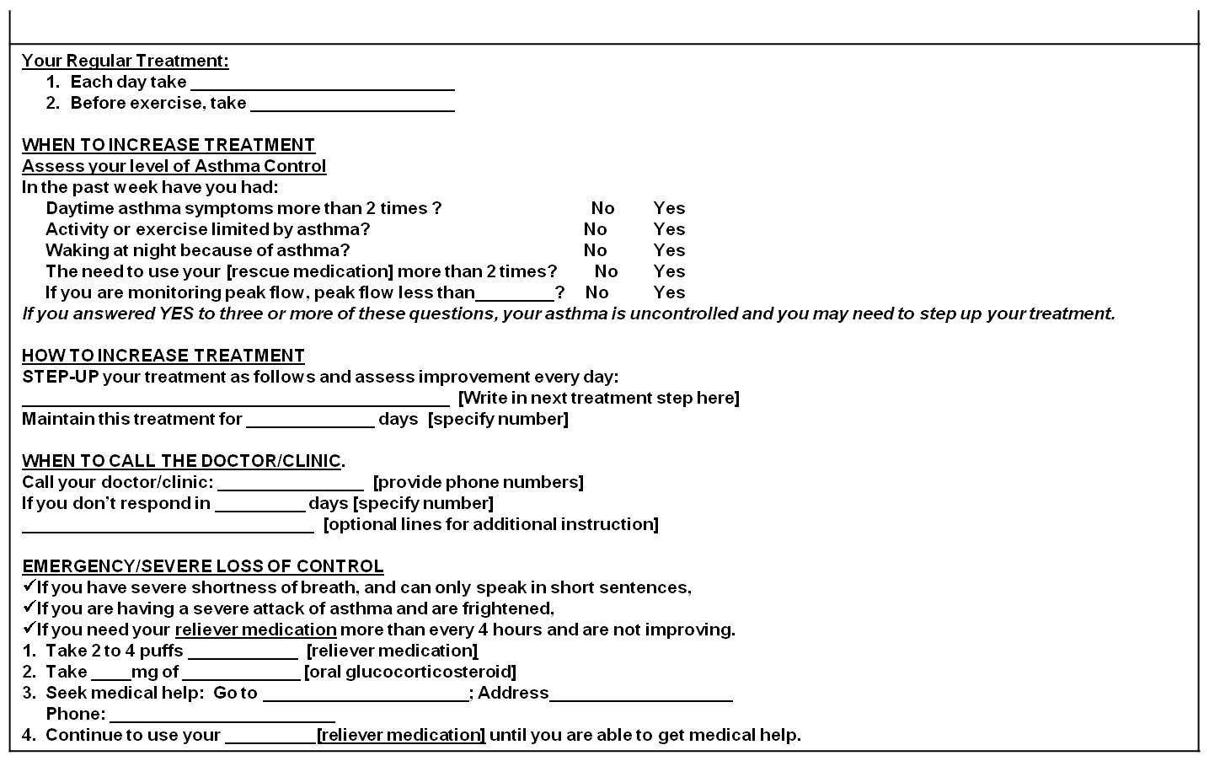
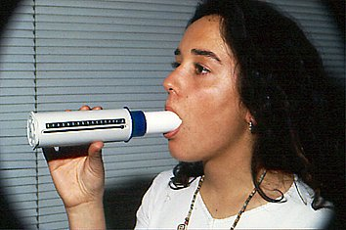
Written action plan
Non adherence
Action - Provide training on self-management skills
Notes:
The use of a written action plan itself has independently demonstrated better outcomes in asthma control and decrease exacerbations.
The use of peak-flow measurements could also be useful if available in cases of bad perceivers

Slide 41
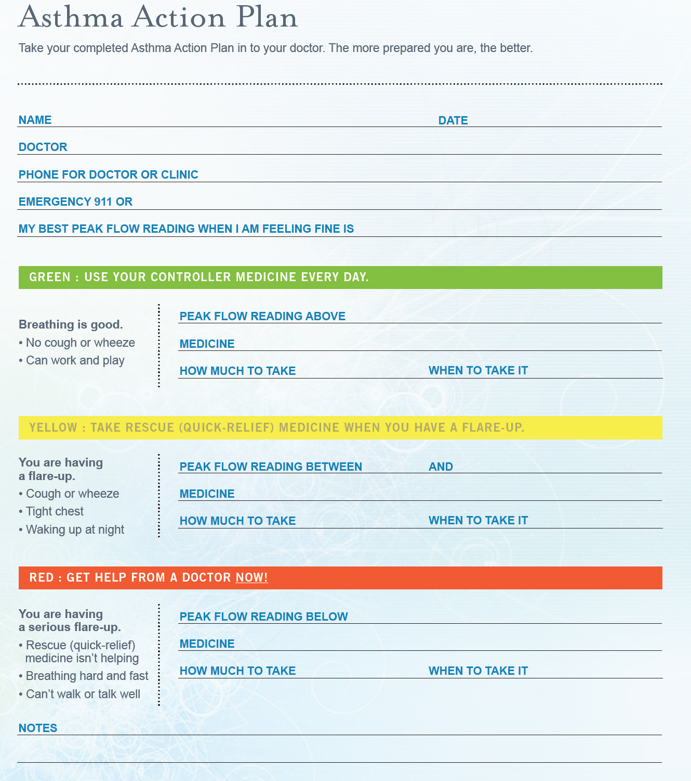

Slide 42
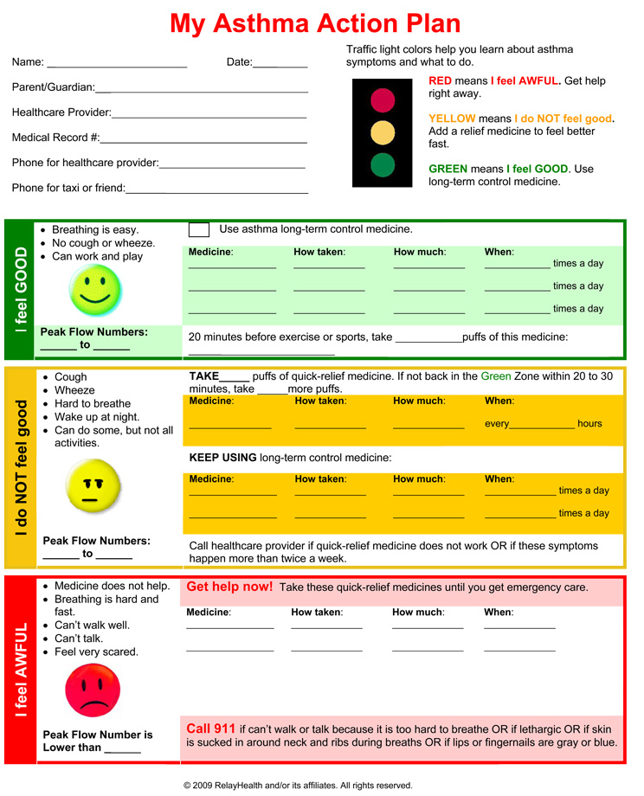

Slide 43



Step 5: exclude alternative or overlapping diagnosis as primary conditions

Slide 44
Wrong diagnosis or confounding illness
Action - Rule out (or in) confounding illness before changing medications
Chronic rhino-sinusitis,
Reflux disease
Obstructive sleep apnoea syndrome
Cardiac disorders
Vocal cord dysfunction
Anaemia
Obesity
Depression and anxiety
  Consider occupational asthma for adults with recent onset

Slide 45
Wrong diagnosis or confounding illness
Should we refer to secondary care?
Doubts about diagnosis and tests unavailable:
  Bronchoprovocation test
  Allergy test
  Rhino fibro-scope
Occupational asthma
Treating co-morbidities
Pregnancy in a bad controlled patient
Not available treatments (immunotherapy…)
5% suffering from difficult to control asthma
Notes:
45
It includes all patients with particularly aggressive asthma which is inadequate or poorly controlled, despite following an appropriate control based therapeutic strategy
Synonyms for difficult to control asthma: refractory asthma, refractory asthma, glucocorticoid resistant asthma and steroid dependent asthma

Slide 46




Step 6: Identify and treat co-morbidities

Slide 47
Co morbidities can worsen asthma symptoms - identify and treat them
allergic rhinitis
COPD
gastro-oesophageal reflux disease (GERD)
respiratory infection
cardiac disorders
anaemia
vocal cord dysfunction
Notes:
The presence of comorbidities can worsen asthma symptoms, and these should be treated to successfully control asthma.

Slide 48
Concomitant rhinitis
Patients with asthma & concomitant rhinitis use more health care resources than those without rhinitis
In epidemiologic studies in the UK:
  Adults with asthma & concomitant rhinitis were 50% more likely to be hospitalised for their asthma & significantly more likely to visit their primary care physician than those without rhinitis
  Children with asthma & concomitant rhinitis had double the likelihood of being hospitalised and significantly increased likelihood of a physician visit for asthma than those without rhinitis
>50% of patients with asthma have rhinitis
  Both allergic & nonallergic rhinitis are linked to asthma
Price D et al Clin Exp Allergy. 2005;35:282–7. Thomas M et al. Pediatrics. 2005;115:129–34.
Notes:
Many patients with asthma, over 50% in most studies, have rhinitis.
Patients with asthma who have rhinitis, both adults and children, use more health-care resources than those without rhinitis, indicating that their asthma is less well-controlled.

Slide 49
Evidence linking asthma & rhinitis
>50% of patients with asthma have rhinitis
Similar epidemiology
Common triggers
Similar pattern of inflammation:
  T helper type 2 cells, mast cells, eosinophils
Nasal challenge results in asthmatic inflammation & vice versa
Rhinitis predicts development of asthma
Thomas M. BMC Pulm Med. 2006;6:S4.
Notes:
Asthma and rhinitis, both allergic and nonallergic, share
a similar epidemiology,
common triggers, and
a similar pattern of inflammation involving T helper type 2 cells, mast cells, and eosinophils.
Nasal challenge results in asthmatic inflammation and vice versa.
Rhinitis is an independent risk factor for the development of asthma.
Thomas M. Allergic rhinitis: evidence for impact on asthma. BMC Pulm Med. 2006;6 Suppl 1:S4.

Slide 50
Clinical approach to rhinitis
Diagnosing rhinitis
  Use the International Study of Asthma and Allergies in Childhood (ISAAC) question:
    "Do you have an itchy, sneezy, runny, or blocked nose when you don't have a cold?“
  Take a good history & examine the nose
  Assess severity – as relates to asthma control
Treat the inflammation of both asthma & rhinitis
  Target upper & lower airways concomitantly or
  Combine upper plus lower airway therapies
IPCRG Guidelines: management of allergic rhinitis. Prim Care Respir J. 2006;15:58–70.

Slide 51
Treatment of co morbid rhinitis & asthma
Upper airway treatment options | Lower airway treatment options
Nasal steroids | Inhaled steroids
Antihistamines
Upper and lower airway treatment options
Leukotriene receptor antagonists
Anti-IgE
Immunotherapy

Slide 52
Step 7: control environmental factors
Exposure to sensitising and non- sensitising substances at home, hobby or work place are excluded / controlled

Slide 53

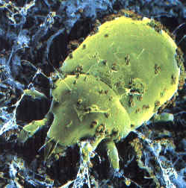
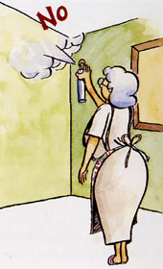

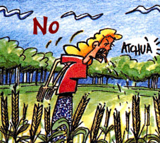
Environmental Factors:
Action - Advice on allergens avoidance
Animals outside the home (cats, dogs, hamsters)
Dust Mites: Allergy Waterproof Cases
Damp cloth and vacuum
Home Humidity <50%
No carpets in the bedroom
Washing with hot water weekly
Pollens: Close windows in time of pollination
Snuff: Avoid smoking and passive exposure
Fungi: Remove mildew stains on the walls
Avoid wood stoves, smoke, air fresheners, etc..
Notes:
Measures to prevent the development of asthma, and asthma exacerbations by avoiding or reducing exposure to risk factors should be implemented wherever possible.
Asthma exacerbations may be caused by a variety of risk factors – allergens, viral infections, pollutants and drugs.
Reducing exposure to some categories of risk factors improves the control of asthma and reduces medications needs.

Slide 54
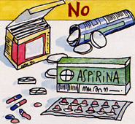
Step 8: think about drugs which could lead to poor asthma control
NSAID’s
Iron-dextran
Carbamazepine
Vaccines
Allergen extracts (immunotherapy)
Antibiotics: penicillins, tetras, erythromycin, sulfa
Beta-blockers (oral and topical eye drops)
Cholinesterase inhibitors: tacrine, rivastigmine
MDI propellants

Slide 55
Step 9: Consider individual variation in treatment response
Randomised controlled trials (RCTs) are the basis of recommendations made by clinical guidelines. However, several factors limit our ability to generalise RCT results to our patients.
  Fewer than 10% of people with asthma in a general practice population are eligible for the typical RCT
  Patient adherence to therapy may be better in an RCT than in the real world
  The definition of “response” to therapy in an RCT (eg, FEV₁ improvement) may not correspond to results relevant for our patients (eg, improved asthma control, improved quality of life)
  The inclusion/exclusion criteria can influence RCT results (eg, requirement for bronchodilator reversibility may favour β agonist)
  Group mean data from RCTs may not predict individual patient response
Haughney J et al. Respir Med. 2008;102:1681–93.
Notes:
Bullet page

Slide 56
Step 10: consider stepping up treatment
If the patient already has high-dose inhaled corticosteroid with or without systemic corticosteroid
Add LABA /LTRA /other /increase dose of ICS
Follow and reassess for at least 6 months

Slide 57
Step 11: consider a referral to secondary care
Who to refer?
Patients who continue to have difficult to manage asthma after review and taking steps to reduce all possible causes and despite being on guideline-based treatment should be referred to a specialist clinic.

Slide 58
Where to refer?
Patients should be referred to clinics with experience in difficult to manage asthma, able to provide care and treatment by a multidisciplinary team.
What to include in a referral letter?
Occupation
Onset of symptoms
Dyspnoea
Specified dyspnoea
Cough
Specified cough
Wheezing
Smoking
Known allergies
Peak flow
Spirometry and bronchodilatation test
Use of asthma medication
Other diseases
Other current medication

Slide 59
Conclusions:
what should we do?
Educate the patient
Written action plan
Identify triggers and allergens and avoid
Check adherence and good inhaler technique
Rule out or treat co-morbidities
Changes in pharmacological treatment
Refer only when needed

Slide 60
Distinction between severe and uncontrolled asthma
Uncontrolled asthma refers to the extent to which the manifestations of asthma (symptoms-use of rescue medicine etc) remain besides treatment

Slide 61
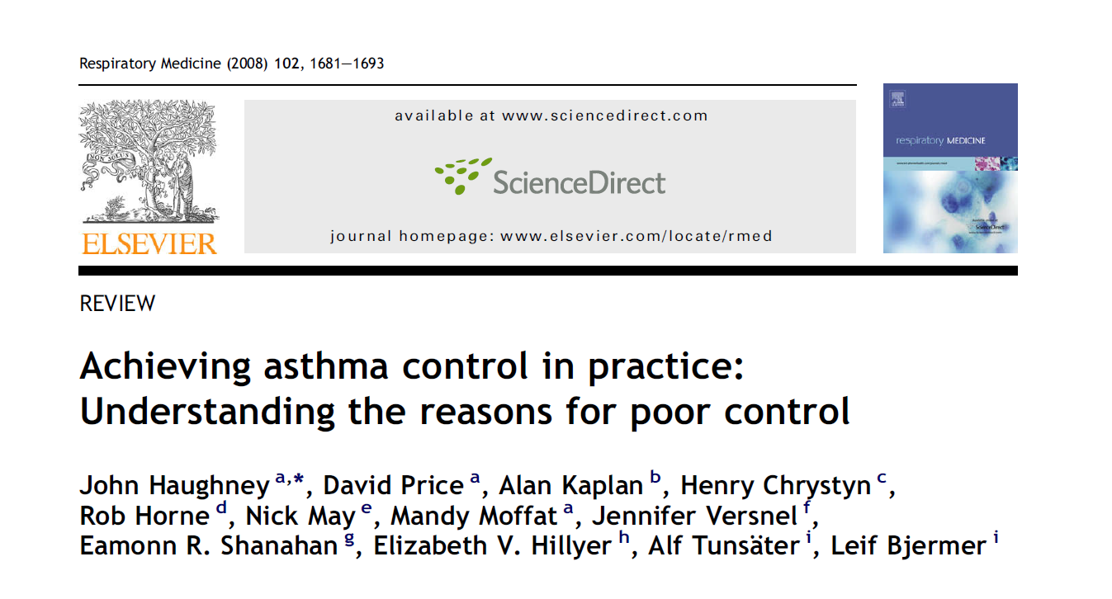
Recommended reading

Slide 62
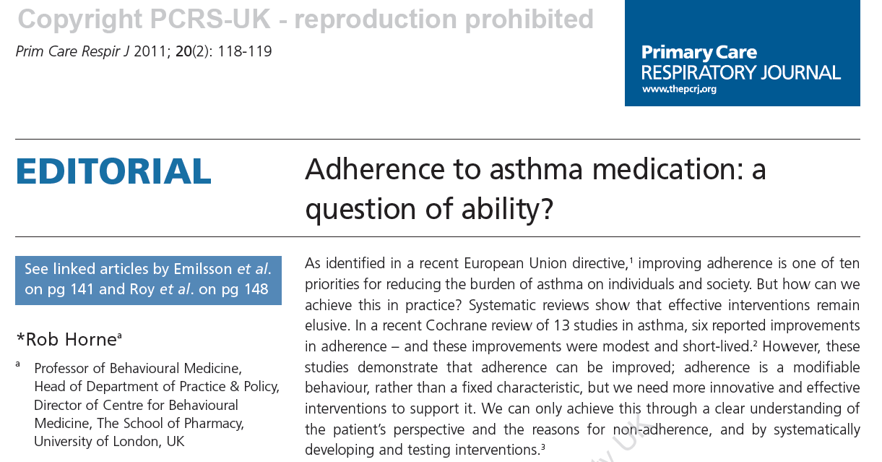

Slide 63
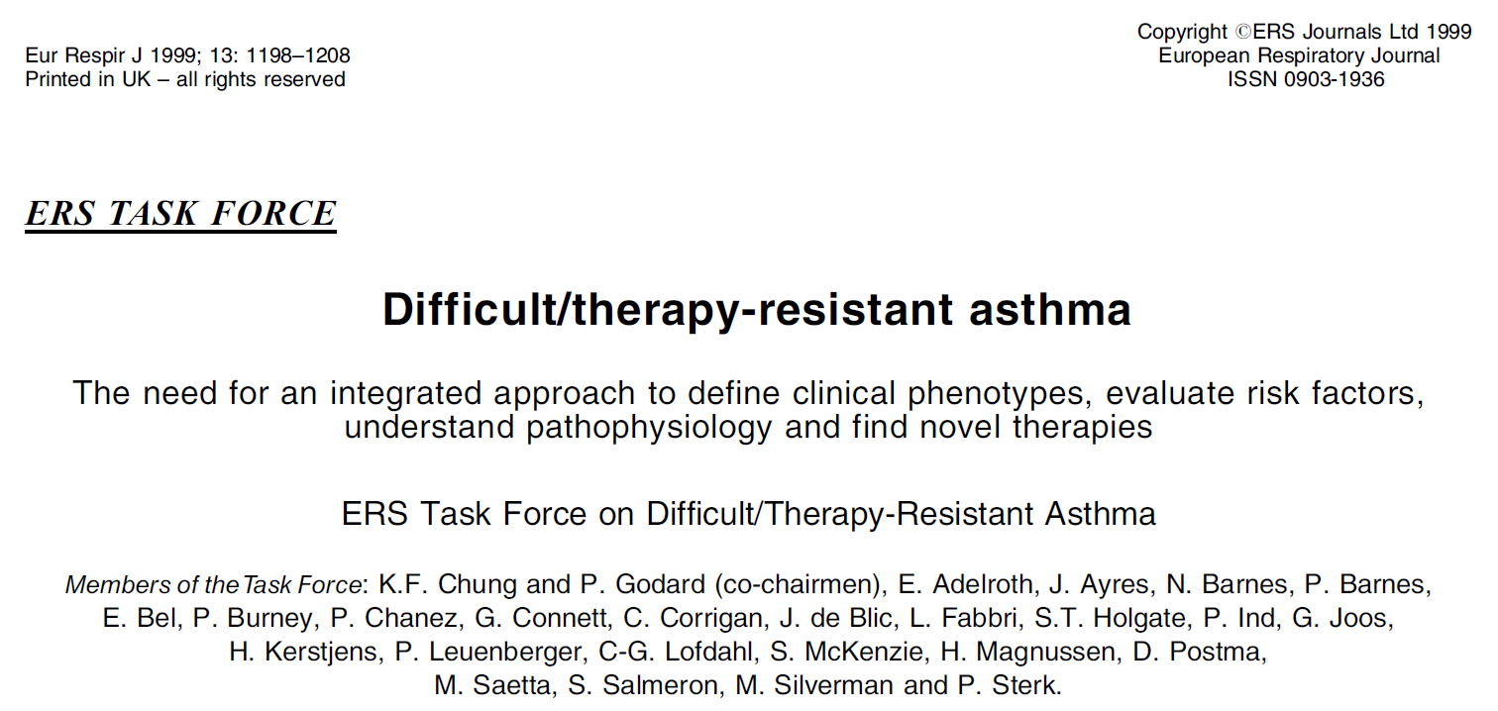

Slide 64
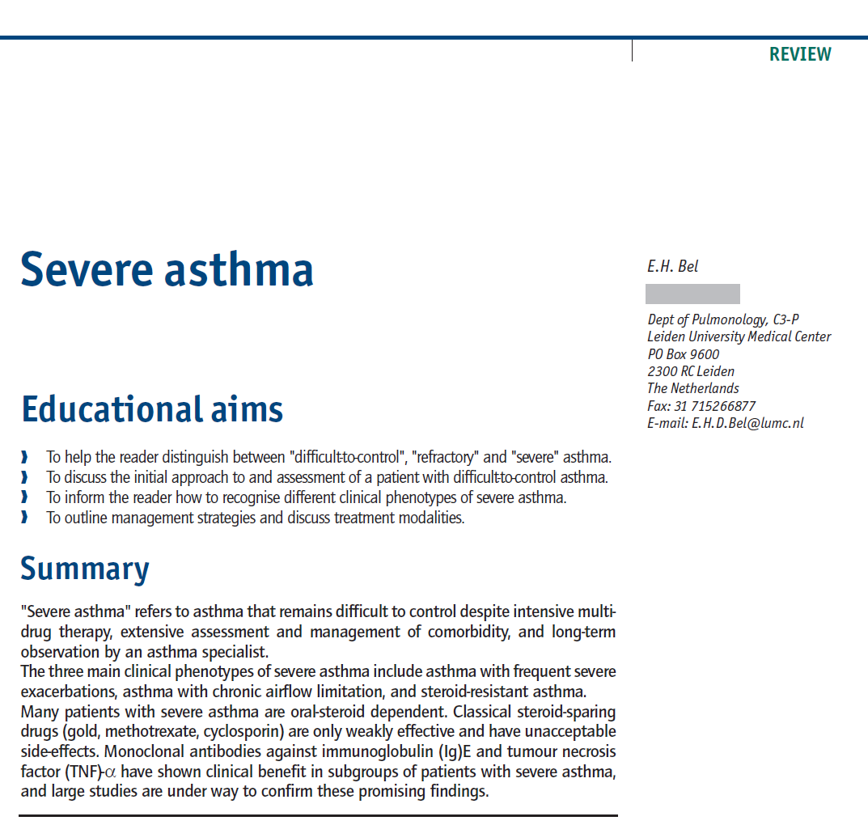

Slide 65
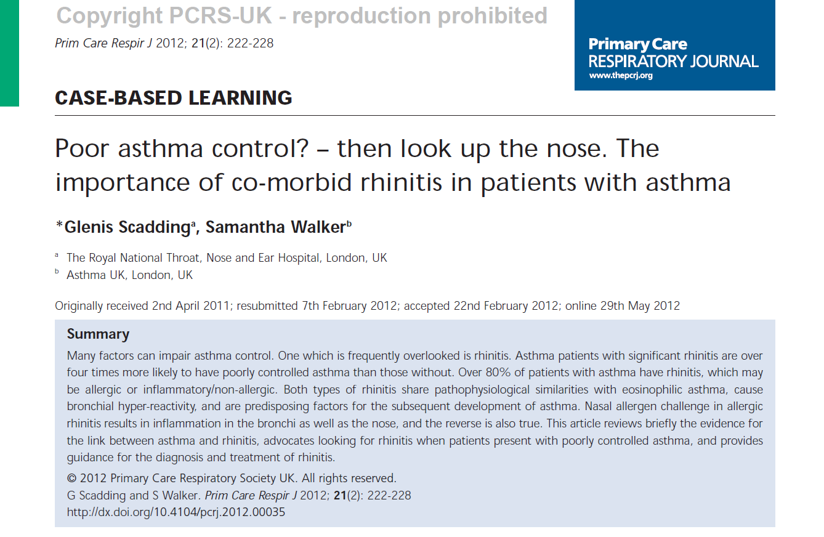

Slide 66

IPCRG 7th IPCRG World Conference
Athens 2014 21st – 24th May

Slide 67
Thank you for your attention!

