Slide 1
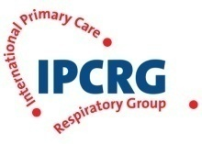
IPCRG presentations on respiratory diseases Allergic disease: A practical approach in primary care
Notes:
1
Title page option 1

Slide 2
Contents
Common allergic conditions in primary care
Diagnosis prevention and testing
Svein Høegh Henrichsen
Aria Guidelines A practical approach
The carat questionnaire
Jaime Correia de Sousa

Slide 3
Common allergic conditions in primary care Diagnosis?Prevention?
Svein Høegh Henrichsen G.P. Oslo, Norway
Chair Norwegian College of General Practice
Working group on Respiratory Disease
Senior Adviser Norwegian Directorate of Health
Notes:
Title page option 1

Slide 7
Notes:
As we all learned long ago, the body produces a whole family of immunoglobulin antibodies—A, D, E, G, and M. IgE is the antibody responsible for allergic responses, and therefore, the one we will focus on today.
Here is a basic scientific review of the IgE-mediated allergic inflammatory process. [Click]
First, B lymphocytes are exposed to an allergen, which, as we know, can be anything from cat dander or food to a mold spore or pollen. [Click]
The initial exposure triggers the production of IgE antibodies for that particular allergen. [Click]
Those IgE antibodies then attach themselves to basophils and mast cells. [Click]
During subsequent allergen exposures, the basophils and mast cells release histamines and other chemicals that trigger inflammation and cause symptoms.

Slide 18
Cumulative Threshold Disease
House dust mite
Symptoms
Birch pollen
Cat dander
No avoidance
Measures
Normal Exposure
Normal threshold
No avoidance
measures
Third allergen
Ie.Increased exposure
Normal threshold
Avoidance measures
employed
Third allergen
1. Pharmacia & Upjohn Diagnostics. The Value of Allergen Identification. 1998. Publication 98006.01.
2. Ciprandi G, et al. J Allergy Clin Immunol. 1995;96:971-979.
3. Boner AL, et al. Clin Exp Allergy. 1993;23:1021-1026.
Notes:
AR patients are seldom monosensitized
They get symptoms when exposure load

Slide 19
Cumulative Threshold Disease
House dust mite
Symptoms
Birch pollen
Cat dander
No avoidance
Measures
Normal Exposure
Normal threshold
No avoidance
measures
Third allergen
Ie.Increased exposure
Normal threshold
Avoidance measures
employed
Third allergen
Lowered threshold-
Stress,infections
Irritants,SMOKING
1. Pharmacia & Upjohn Diagnostics. The Value of Allergen Identification. 1998. Publication 98006.01.
2. Ciprandi G, et al. J Allergy Clin Immunol. 1995;96:971-979.
3. Boner AL, et al. Clin Exp Allergy. 1993;23:1021-1026.
Notes:
AR patients are seldom monosensitized
They get symptoms when exposure load

Slide 21
Common allergic conditions in primary care Prevention?
Svein Høegh Henrichsen G.P. Oslo, Norway
Chair Norwegian College of General Practise
Working group on Respiratory Disease
Notes:
Title page option 1

Slide 24
Notes:
ETAC eraly treatment of the atopic child PAT Preventive allergy treatment CCAPPS Canadian childhood allergy primary prevention Study

Slide 32
Testing
History and physical alone gives correct diagnosis only 50% of the time¹
Different causes demand different treatment
Testing for specific IgE levels can rule in/out atopy
If atopic:
– Antihistamines probably drug of choice
– Testing can help clinician in advising avoidance measures
If non-atopic:
– Results will allow you to focus on other etiologies
– Drugs of choice may include decongestants/steroids
– Patient can avoid unnecessary/ineffective treatment
1. Homburger HA. Arch Pathol Lab Med. 2004;128:1028-1031.
Notes:
Non-allergic rhinitis, sinusitis, and allergic rhinitis present with similar symptoms. A definitive diagnosis of URD is difficult without objective evidence. In fact, studies show that primary care physicians correctly diagnose allergies only 50% of the time using history and physical (H&P) alone.¹
The most persuasive reason for testing? Diagnostic test results may affect how you manage your patient. Treatment options for atopic and non-atopic patients are different, and you can’t select an effective treatment without a definitive diagnosis. Right now, you may be prescribing antihistamines, but they won’t work if the patient is not allergic.
Specific IgE testing will definitively rule in or rule out atopy (allergy) as a cause of nasal symptoms.
If your patient is allergic, testing can identify the specific offending allergens so you can counsel for avoidance and prescribe antihistamines with the confidence that they will truly target the underlying etiology.
If there is no atopy, you will then be able to focus your evaluation on other possibile non-allergic etiologies and select appropriate, effective treatments.
Homburger HA. Arch Pathol Lab Med. 2004;128:1028-1031.

Slide 37
Quantitative Measurements of spesific IgE/
Blood test – easily done
In vitro blood testing and skin prick testing (SPT) viewed as equally good
Regional respiratory profiles
Geographic pollen patterns
Regional disease prevalence
Cross reactivity to other allergens in each inhalant class
Allergy March profiles include key food/inhalant allergens
Six foods account for 90% of food allergy reactions in children⁴
Inhalants include common/cross-reactive indoor and outdoor allergens
Generally recommended for children ≤6 years of age, based on symptoms
Notes:
CAP RAST offers primary care clinicians an exceedingly valuable and relatively convenient tool for use in your daily management of common illnesses and allergy-like symptoms.
It’s an FDA-cleared quantitative measure of specific IgE.
Unlike skin prick testing, CAP RAST requires only a single blood draw.
CAP RAST is covered under most insurance plans.
It offers accuracy superior to RAST^{TM1}, which is very important: despite what you’ve been told about previous in vitro allergy test modalities and their shortcomings, CAP RAST is NOT RAST, but several generations beyond. Its enhanced accuracy and sensitivity is consistently reproducible lab to lab,² and evidence presented in more than 2,000 peer-reviewed scientific publications has established CAP RAST as the de facto standard for in vitro allergy testing.³
In fact, in vitro blood testing and skin prick testing (SPT) are now viewed as interchangeable.⁴ (Hidden slide available here.)
CAP RAST is available throughout the nation from clinical laboratories including Quest Diagnostics.
Williams PB, et al. J Allergy Clin Immunol. 2000;105:1221-1230.
Szeinbach SL, et al. Ann Allergy Asthma Immunol. 2001;86:373-381.
Johansson SGO. Expert Rev Mol Diagn. 2004;4:273-279.
Hamilton RG. In: Pediatric Allergy: Principles and Practice. Mosby-Year Book, Inc; 2003:233-242.

Slide 40
ARIA guidelines. A practical approach for the diagnosis and treatment of rhinitis
Jaime Correia de Sousa, MD, PhD
Associate Professor, Chair of the Department of Community Health, University of Minho, Portugal. Member of the Board of IPCRG
Chair of the Respiratory Group of the Portuguese Society of Family Physicians (GRESP)
Notes:
Title page option 1

Slide 41
Diagnosis of allergic rhinitis
Sneezing
Nasal discharge
Postnasal drip
Itchy nose
Bilateral nasal obstruction
Search
for
Family history
Allergic triggers:
Pollens
House dust mite
Animal dander
Insects
Moulds

Slide 42
Differential diagnosis (1)
Symptoms | Infective rhinitis | Allergic rhinitis
Runny nose | Common | Common
Stuffy nose | Common and often severe | Common and variable in severity
Sneezing | Usual | Common
Itchy nose | Never | Usual
Nasal pain | Usual | Never
Itchy eyes | Rare or never | Common
Cough | Common | Often
Fever | Rare | Never
General aches, pain | Slight | Never
Fatigue, weakness | Slight | Sometimes slight
Sore throat | Common | Never
Itchy palate and throat | Never | Sometimes
Duration | 3–14 days | Weeks to months
National Institute of Allergy and Infectious Diseases. Adapted from:
http://www3.niaid.nih.gov/healthscience/healthtopics/allergicDiseases/PDF/ColdAllergy.pdf

Slide 43
Differential diagnosis (2)
Non-allergic rhinitis:
vasomotor rhinitis ( triggered by physical / chemical agents and common in middle age with rinorrhea, especially in the morning);
hormonal changes (pregnancy, puberty, hormone replacement therapy, the contraceptive pill);
drugs and medications (aspirin, NSAIDs, ACE inhibitors, alpha-adrenergic blockers, prolonged use of nasal decongestants, cocaine);
alcohol, irritants, nasal blockage
foods: chilies, spices, alcohol
Angier E et all, Management of allergic and non-allergic rhinitis: a primary care
Summary of the BSACI guideline, PCRJ 2010, 19(3), 217-222.

Slide 44
Physical examination:
mouth breathing, nasal sept deviation;
rhinoscopy: crusting, polyps, mucosal congestion, clear nasal discharge;
Routine investigations :
blood tests
full blood count; eosinophilia
plasma viscosity (inflammatory/ infective processes);
liver function tests (alcohol-related rinorrhea);
thyroid function tests (rinorrhea).
Allergy testing:
skin prick tests
serum specific immunoglobulin E

Slide 45
Possible reasons why allergic rhinitis
and asthma are related:
The nasal and bronchial membranes are made up of almost the same type of tissue.
The nerves of the upper airway (nasal cavity) and the lower airway (bronchial tubes) are connected.
Nasal congestion causes mouth breathing.
Mucus from the nasal cavity may drip from the back
of the nose into the bronchial tubes, especially during sleep.

Slide 46
How to assess control in practice?
Assessing control of asthma and rhinitis simultaneously
The CARAT project
Developing and disseminating CARAT

Slide 47
Allergic rhinitis and Asthma
Allergic rhinitis and Asthma (ARA) are inflammatory diseases and are often associated.
The primary goal for the treatment of allergic respiratory diseases is disease control

Slide 48
ARIA 2008
A combined approach for both evaluation and management of ARA is recommended.
Thus, measurement of disease control should concurrently consider upper and lower airways disease

Slide 49
The CARAT project
1st Phase
Preliminary version
2nd Phase
Final version
3rd Phase - Prospective observational study
4th Phase – Dissemination and implementation

Slide 50
CARAT

Slide 51
CARAT

Slide 52
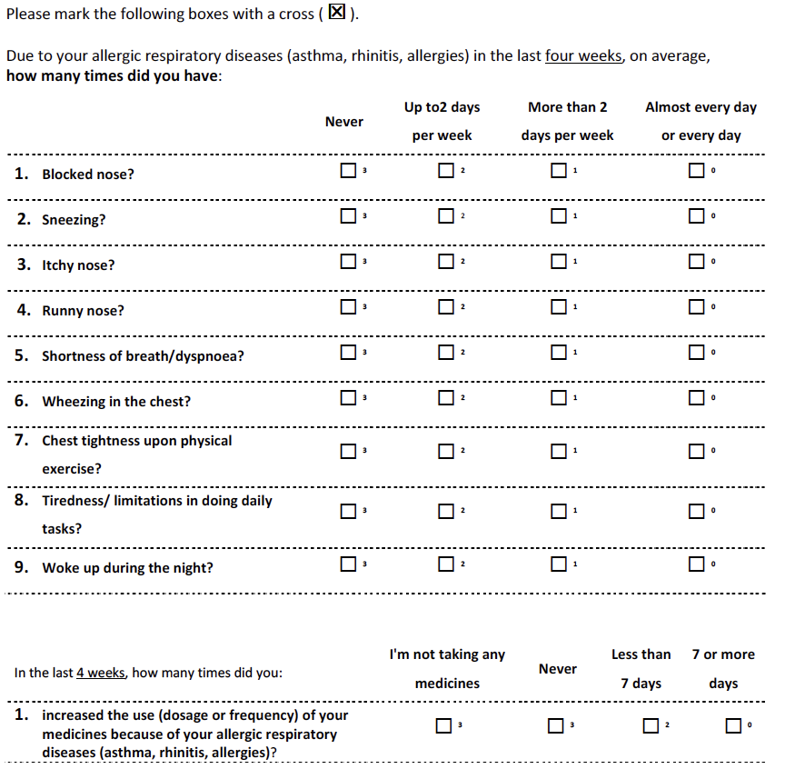
The CARAT questionnaire
Quantify the degree of control of ARA in adult patients
Self-administered
10 questions, 2 factors (upper & lower airways)
4 weeks time-frame
Nasal and bronchial symptoms, sleep disturbances, activity limitations, relief medication
Score: 0 - 30 (full control)
Cut-off >24

Slide 54
Cross cultural adaptation of CARAT
Aim
To develop versions of CARAT in 9 countries in order to be used as a tool to implement ARIA guidelines.
Cross-cultural adaptation of CARAT within different countries follows GA²LEN network recommendations

Slide 55
Cross cultural adaptation of CARAT

Slide 56
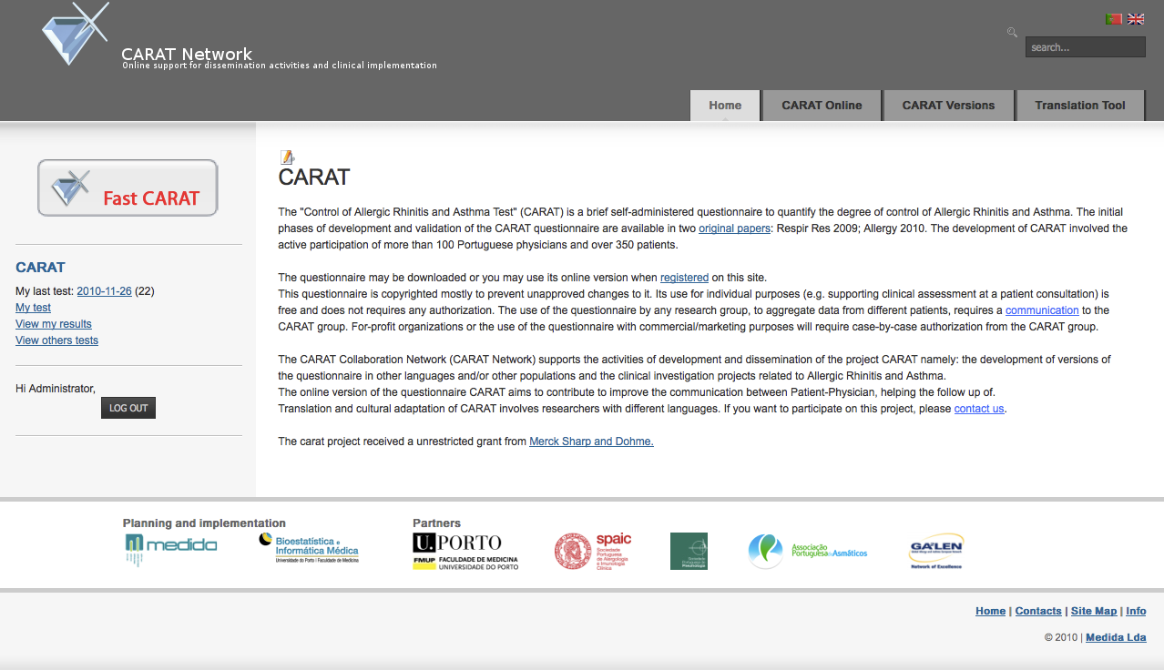
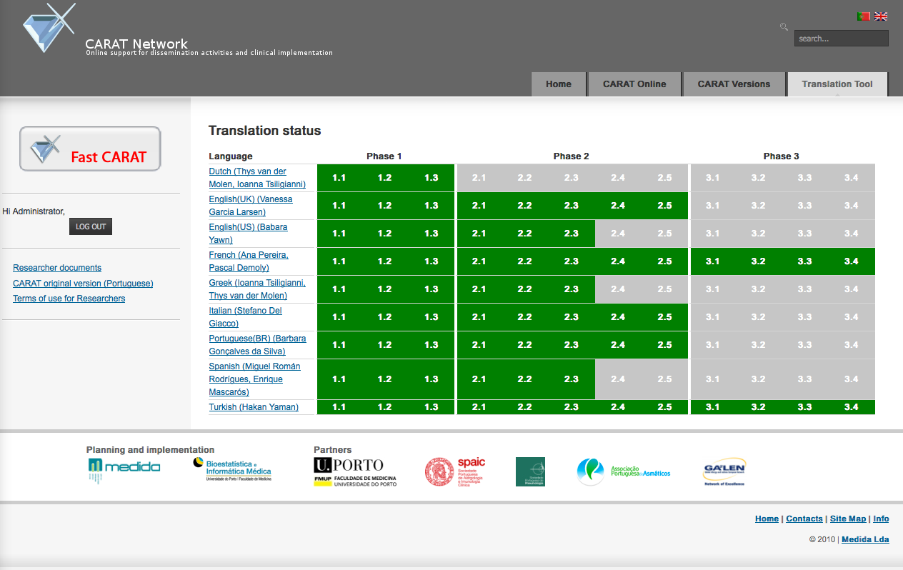
www.caratnetwork.org

Slide 57
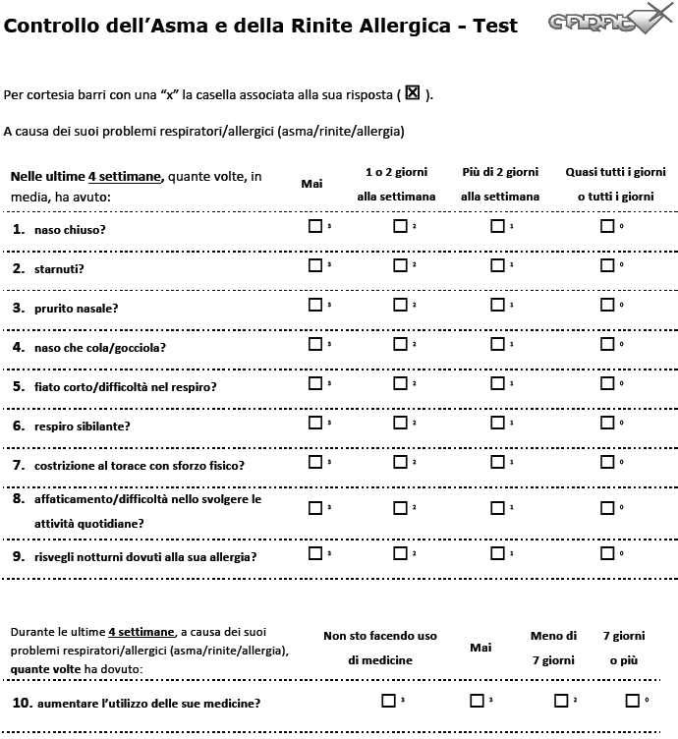
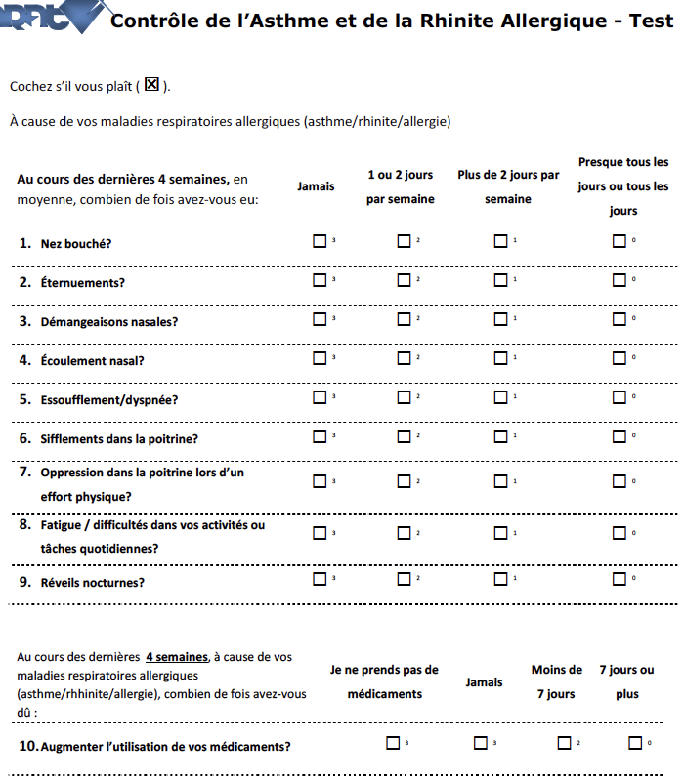
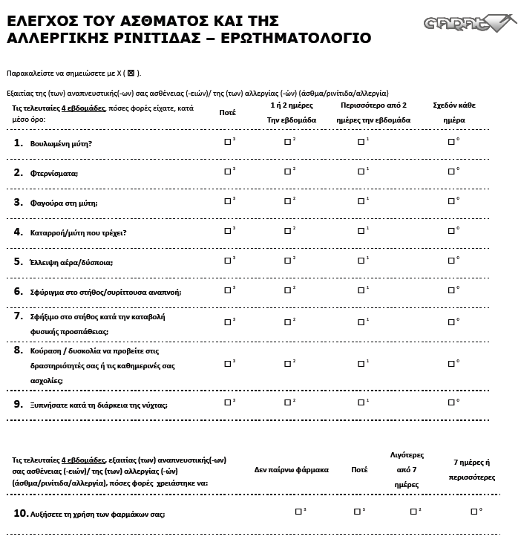
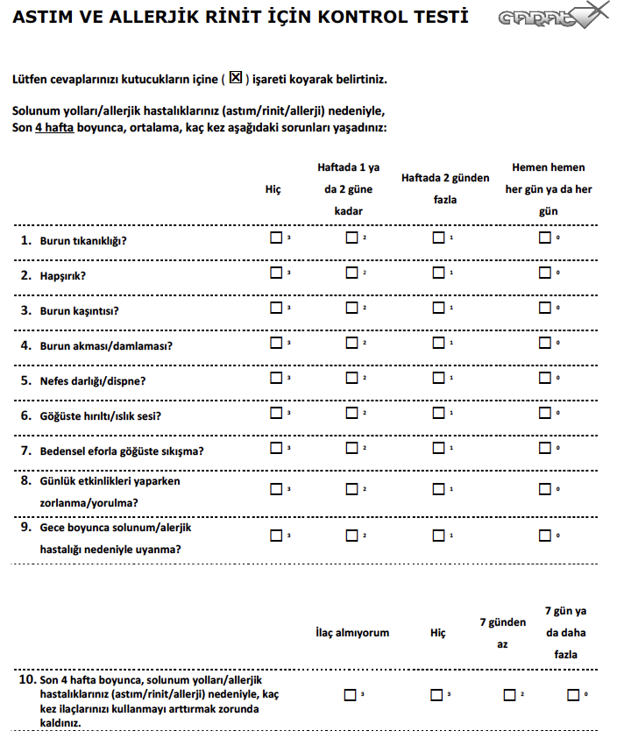
CARAT in different languages
Turkish
Finnish
French
Greek
Italian
English (UK)
English (US)
Portuguese (Br)
Spanish
Dutch
Slovenian*
Swedish*

Slide 58
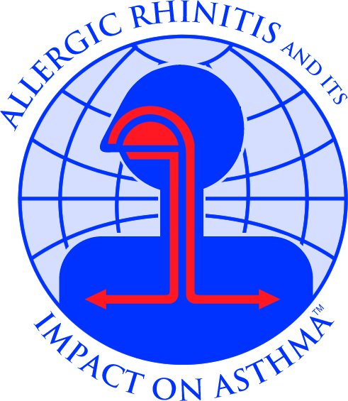
ARIA guidelines
1)New classification of rhinitis.
2)Importance of nasal inflammation.
3)Treatment based on evidence.
http://www.whiar.org/
Notes:
The state-of-the-art reference for GPs and hospital doctors as well is nowdays considered to be the ARIA guidelines. As you know, they brought a new classification of AR and updated knowledge about the importance of the nasal inflammation and the therapeutical options. The document equally highlights the fact that AR worsens asthma, increases the risk of hospitalisation and leads to increased asthma exacerbations. It also report what I’ve said before, that up to 80%of people with asthma also have rhinitis.

Slide 59
Intermittent symptoms <4 days/week or<4weeks/year | Persistent symptoms > 4 days/week and > 4 consecutive weeks/year
Mild (all of the following): Normal sleep No impairment of daily activities, sport or leisure No impairment of work and school Symptoms present but not troublesome | Moderate-Severe (one or more of the following): Sleep disturbance impairment of daily activities, sport or leisure impairment of school or work Troublesome symptoms
http://www.whiar.org/docs/ARIA_PG_08_View_WM.pdf

Slide 60
Treatment of allergic rhinitis
(ARIA)
moderate
severe
persistent
mild
persistent
moderate
severe
intermittent
mild
intermittent
intra-nasal steroid
local chromone
oral or local non-sedative H1-blocker
intra-nasal decongestant (<10 days) or oral decongestant
allergen and irritant avoidance
immunotherapy
http://www.whiar.org/
Notes:
First generation e.g. chlorphenamine cause sedation and should be avoided.
Nasal douching with saline solution.
No matter the treatment, the patient should be evaluated after 2-4 weeks of therapy and then appreciate if step-down or step-up therapy or if the case, specialist refferal for immunotherapy.
Education is about telling the patient to avoid allergens altough this is more or less feasible.

Slide 61
Treatment of allergic rhinitis
(IPCRG) 1
Mild intermittent AR | Mild persistent AR
oral or intra-nasal antiH1 and/or decongestives IF severe obstruction and/or saline lavage | oral or intra-nasal antiH1 and/or decongestives IF severe obstruction and/or saline lavage or intra-nasal steroids/ antileucotriens/chromons

Slide 62
Treatment of allergic rhinitis
(IPCRG) 2
Moderate-severe intermittent AR | Moderate-severe persistent AR
oral or intra-nasal antiH1 and/or decongestives IF severe obstruction and/or saline lavage or intra-nasal steroids/antileu-cotriens/chro-mons | In this order: intra-nasal steroids oral antiH1 OR antileucotriens decongestives IF severe obstruction and/or saline lavage

Slide 63
Key messages
Patients with persistent allergic rhinitis should be evaluated for asthma by means of a medical history, chest examination and, if possible and when necessary, the assessment of airflow obstruction before and after bronchodilator.
Patients with asthma should be appropriately evaluated (history and physical examination) for rhinitis.
Ideally, a combined strategy should be used to treat upper and lower respiratory diseases to optimize efficacy and safety.

Slide 65
Thank you for your attention!

