Slide 1
IPCRG workshop on respiratory diseases
Spirometry made easy
Jaime Correia de Sousa, MD, MSc, PhD
Family Physician
Associate Professor, School of Medicine, Minho University, Portugal
President of the International Primary Care Respiratory Group
Tiago Maricoto, MD
Family Physician, Aveiro, Portugal

Slide 2
Objectives
To know the important spirometry parameters
To identify a “good quality” spirometry
To identify the different spirometry patterns
To accurately “read” the results of the test

Slide 3
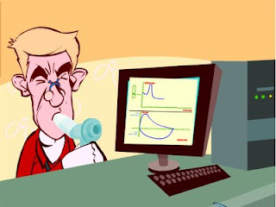
Forced spirometry
Spirometry measures airflow and lung volumes, and is the preferred lung function test for COPD and asthma in primary care
Forced exhalation from a maximal inspiration

Slide 4
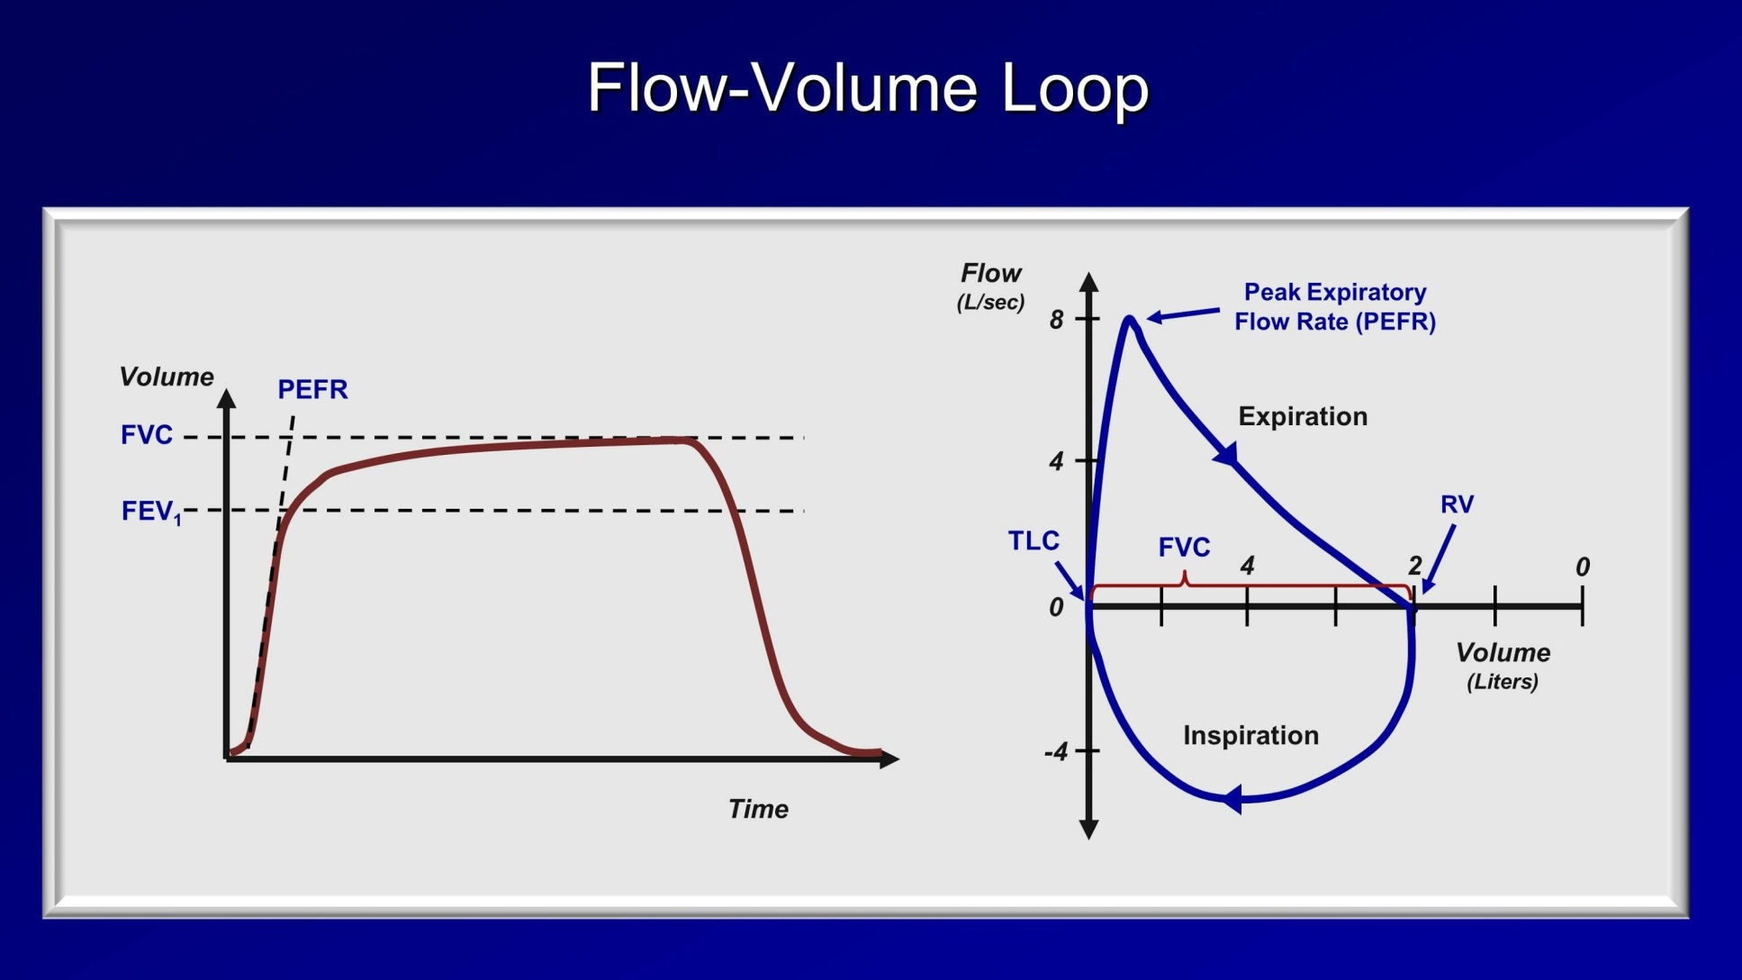
To understand the concept

Slide 5
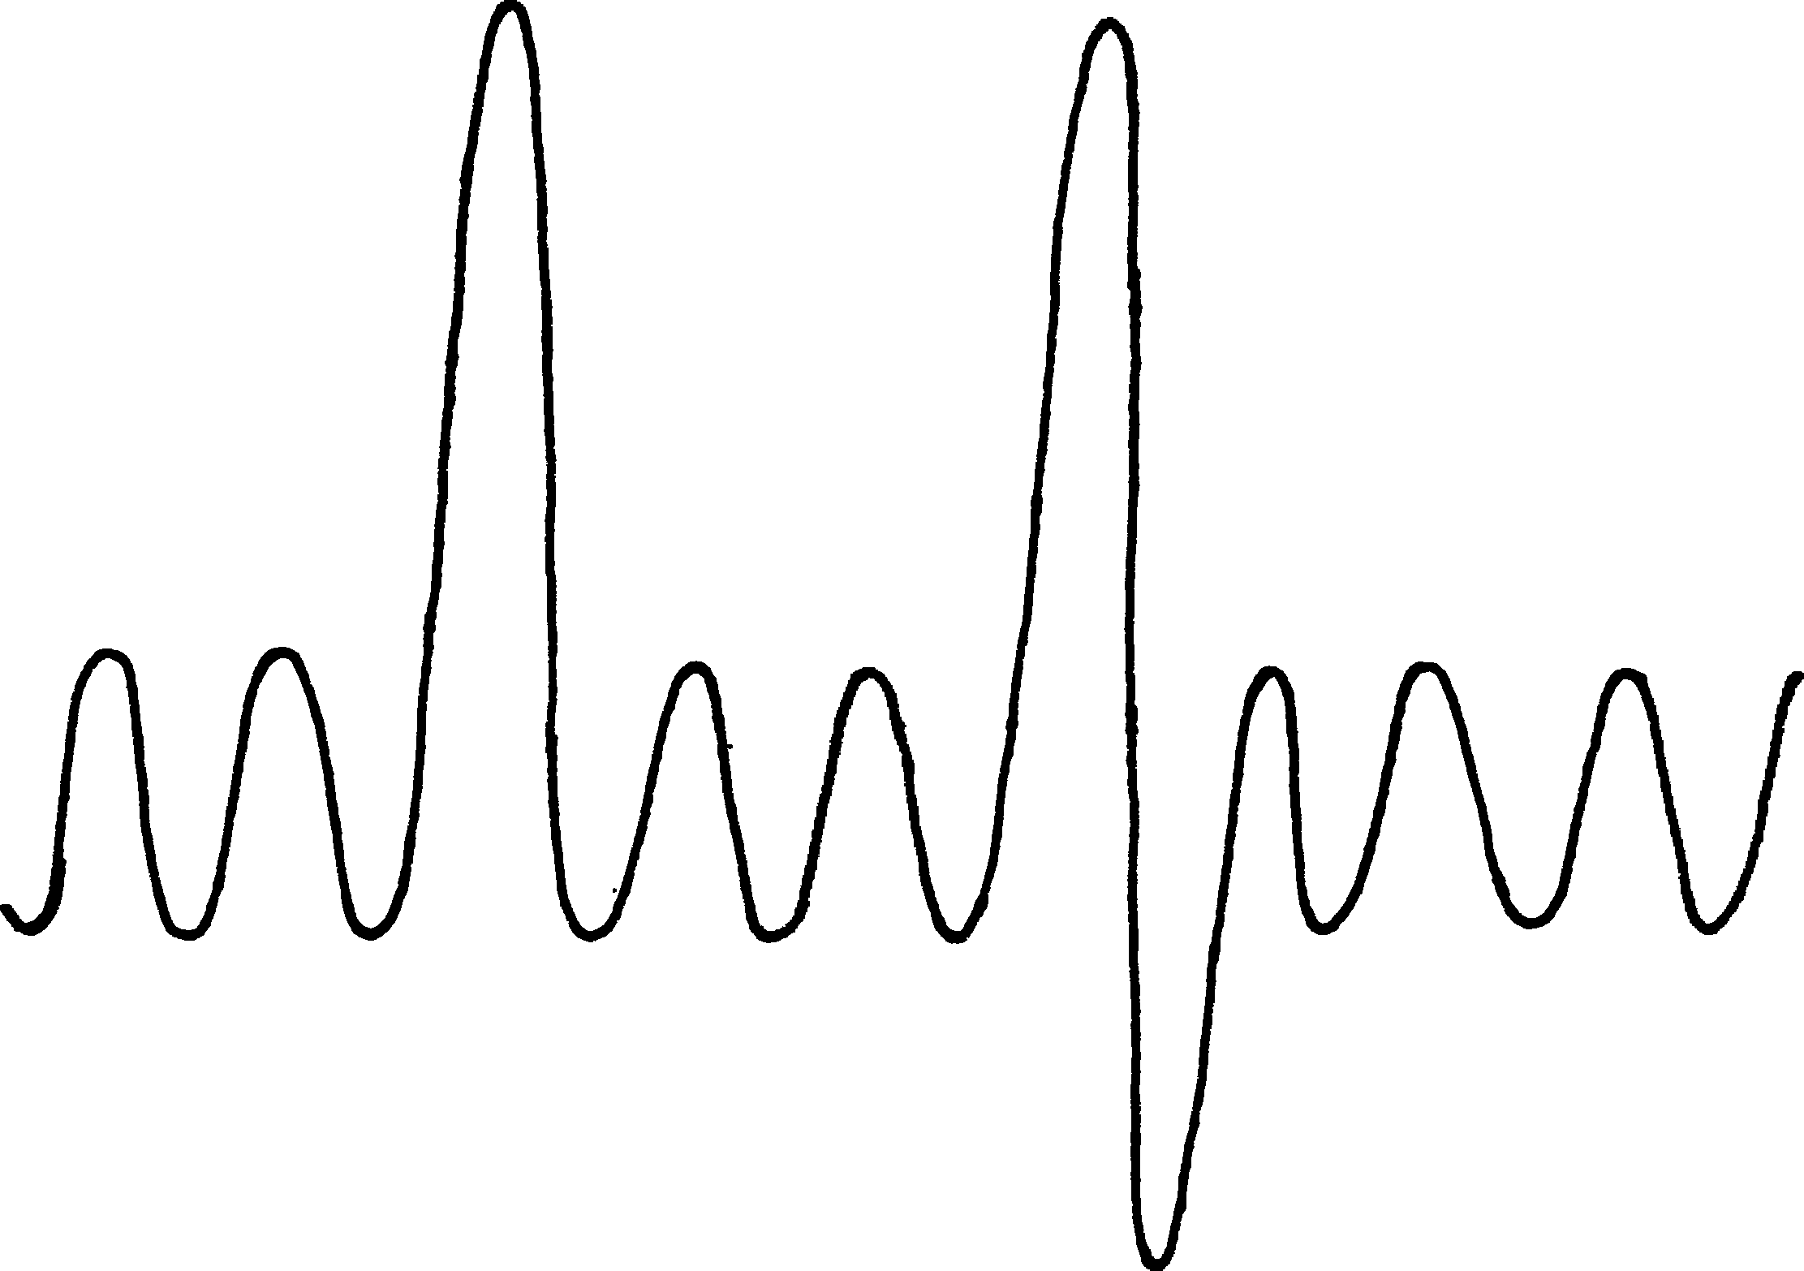
Inspiratory Reserve Volume (IRV)
Inspiratory Capacity (IC)
Total Lung Capacity (TLC)
Vital Capaciity (VC)
Tidal Volume (TV)
Expiratory Reserve Volume (ERV)
Residual Functional Capacity (RFC)
Residual Volume (RV)

Slide 6
Important measurements
FVC: Forced Vital Capacity
Volume of air exhaled after full inspiration and full exhalation
FEV1: Forced Expiratory Volume in 1 second
Volume of air exhaled in the first second of forced exhalation.
FEV1 / FVC:
Ratio of vital capacity exhaled in 1 second expressed as a percentage of the total volume of air exhaled after full inspiration and full exhalation

Slide 7
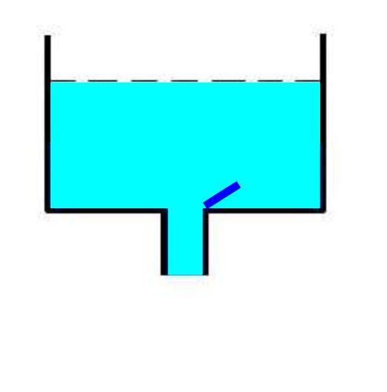
FVC
Total volume of exhaled air in a forced expiratory manoeuvre after a maximal inspiration.
The less total volume /capacity the less FVC

Slide 8
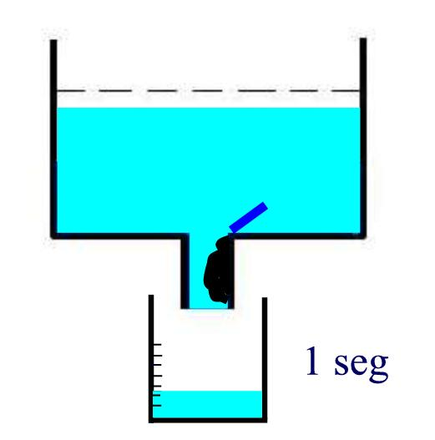
FEV1
Exhaled volume in the first second of a forced expiration after a maximal inspiration.
If there is an obstruction, the FEV1 is diminished

Slide 9
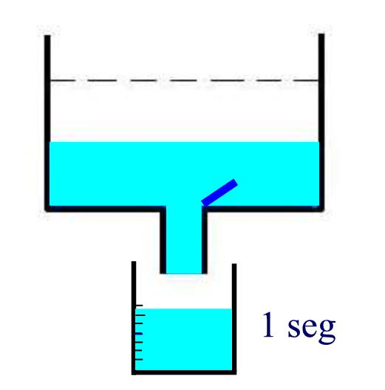
Bronchial obstruction generates less volume in the first second

Slide 10
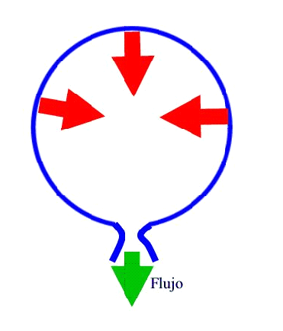
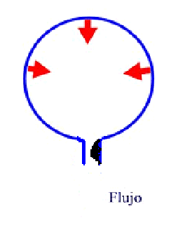
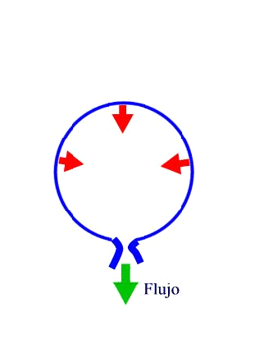
Airflow
Airflow
Flow
Flow
Airflow
Flow
FEV1 / FVC
Best obstruction measurement
% of forced vital capacity expelled during the first second

Slide 11
Factors that influence normal values
Height
  Tall people have larger lungs
Age
  Respiratory function declines with age
Sex
  Lung volumes smaller in females
Ethnicity
  Peculiarly studies show Black and Asian people as a whole, have smaller lung volumes (-12-20 %). No studies for Pacific People.
Posture
  Little difference between sitting and standing. Reduced in supine position.

Slide 12
When to perform a spirometry?
Asthma and COPD diagnosis and follow up
To asses chronic respiratory symptoms
To identify smokers at risk of COPD

Slide 13
When not to perform spirometry
Absolute contraindications
Recent pneumothorax
Pulmonary Embolism (before anticoagulation)
Active respiratory infection
Recent myocardial infarction or unstable angor pectoris
Retinal detachment
Aortic Aneurisms
Recent abdominal surgery
Intracranial hypertension
Relative contraindications
Traqueostomy
Problems holding the mouthpiece
Facial hemiparesis
Poor mental condition.

Slide 14
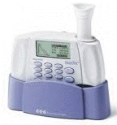
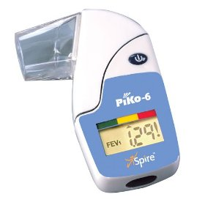
Effective Methods to Identify the Silent Population with COPD
Diagnostic standard spirometry
  The only recognised method for confirming diagnosis
Handheld screening devices
  Inexpensive and easy-to-use monitors
  Useful for case identification
Validated screening questionnaires
  COPD Population Screener™ (COPD-PS)
  Simple and easy to use

Slide 15
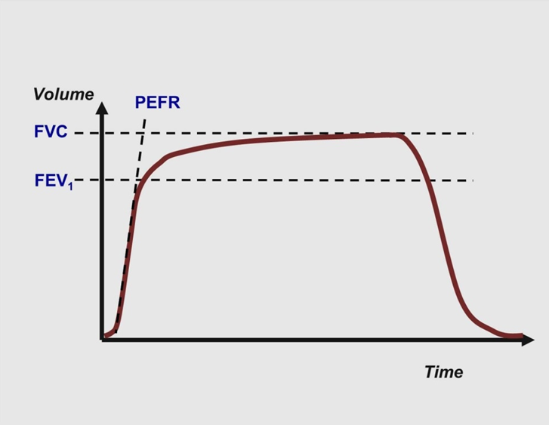
The most important matter: curves
Any test is only as good as its accuracy
Time/volume
Flow/volume

Slide 16
The most important matter: curves
FEV1: Volume of air exhaled in the first second of a forced exhalation after complete inspiration
FVC
5
4
FEV₁ = 4L
FVC = 5L
FEV₁/FVC = 0.8
3
FVC: Total volume of air exhaled after full inspiration and full exhalation
2
Volume, liters
1
1
2
3
4
5
6
Time, seconds
1

Slide 17
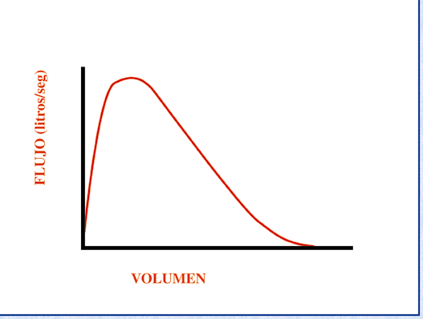
The most important matter: curves
Peak-flow: Maximum airflow during the manoeuvre
FEV₁
FVC

Slide 18
Flow/volume loop
Residual volume: volume present in the lung in the transition between maximum expiration and inspiration
Total lung capacity: volume present in the lung in the transition between maximum inspiration and expiration
Notes:
TLC
Total lung capacity: volume present in the lung in the transition between maximum inspiration and expiration
RV
Residual volume: volume present in the lung in the transition between maximum expiration and inspiration

Slide 19
Spirometry Interpretation

Slide 20
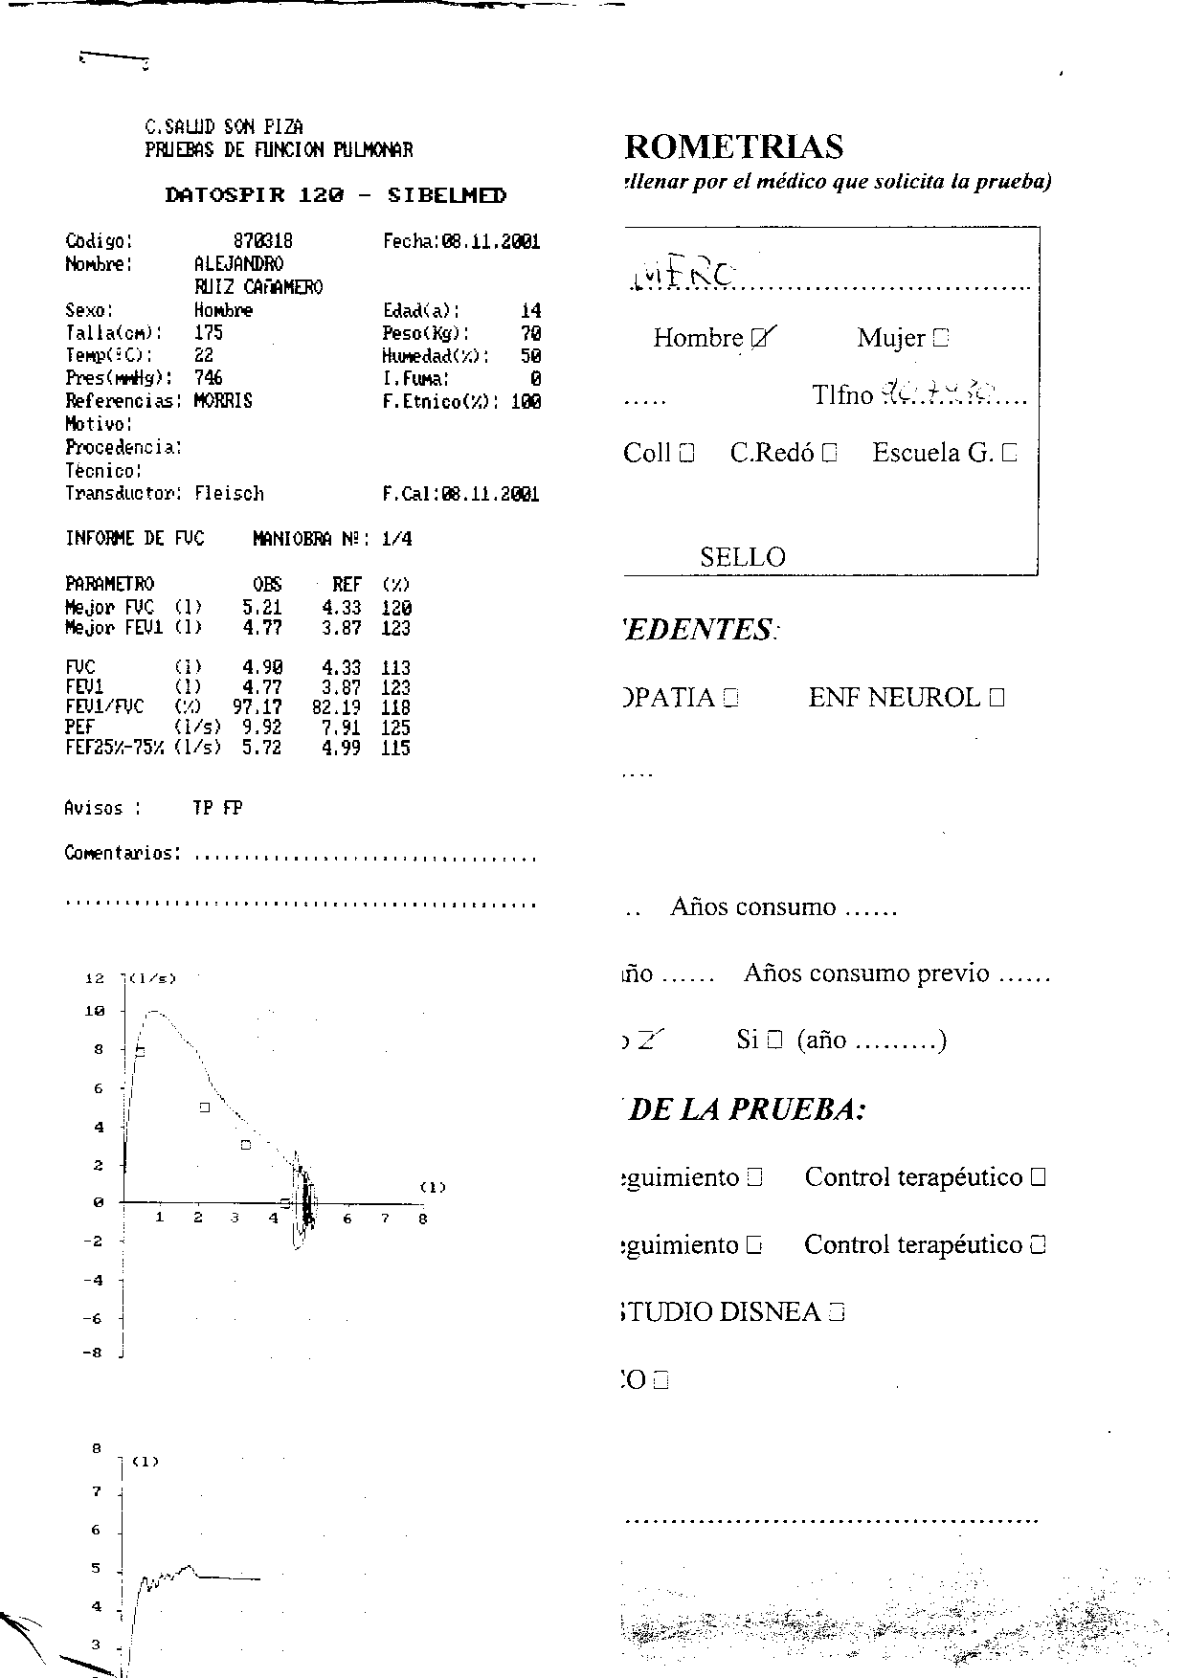

Slide 21
Is there an obstruction?
FVC
5
4
FEV₁ = 4L
FVC = 5L
FEV₁/FVC = 0.8
Volume, liters
3
2
1
1
2
3
4
5
6
1
Time, seconds

Slide 22
Spirometry Interpretation
Is it acceptable and repeatable?
The traces’ shape
Measurements assessment

Slide 23
Reasons for unacceptable /unreliable readings:
Inadequate or incomplete inhalation
Slow start to the forced exhalation
Lack of blast effort during exhalation
Coughing
Additional breath taken during manoeuvre
Lips not tight around the mouthpiece
Exhalation stops before complete expiration

Slide 24
Reasons for unacceptable /unreliable readings:
Airflow [L/s]
Inadequate initial effort
Cough
Hesitation
Early ending
Volume [L]
Notes:
A inspecção da curva D/V ajuda a decidir se a medição foi feita correctamente e a confirmar a presença duma alteração.
A curva débito-volume pode ser usada para avaliar a aceitabilidade das manobras espirométricas.
A falta de um pico inicial sugere pouco esforço.
A tosse é fácilmente reconhecível. Uma curva que inclua tosse pode ser aceitável se o declive total não estiver interrompido
Uma queda abrupta da curva expiratória sugere que o doente deixou de soprar demasiado cedo.
Se a manobra for completada com um esforço inspiratório para voltar à capacidade pulmonar total, uma falha no início e no fim da curva sugerem uma fuga de ar.

Slide 25
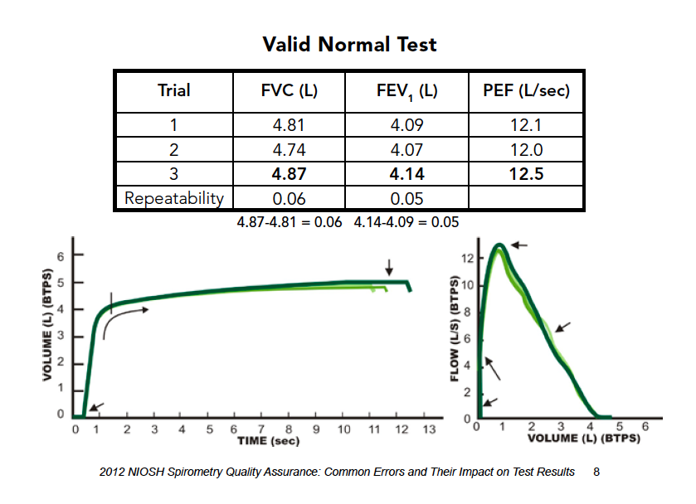
Recognizing unacceptable /unreliable readings :
DHHS (NIOSH) Publication No. 2012-116 January 2012

Slide 26
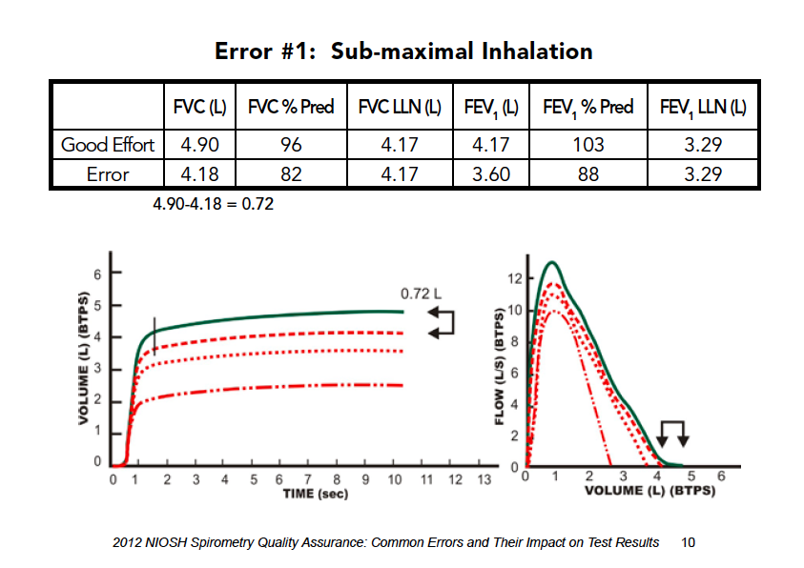
Recognizing unacceptable /unreliable readings :
Lack of repeatability
Falsely reduced FVC can be misinterpreted as indicating a “restrictive impairment.
DHHS (NIOSH) Publication No. 2012-116 January 2012

Slide 27
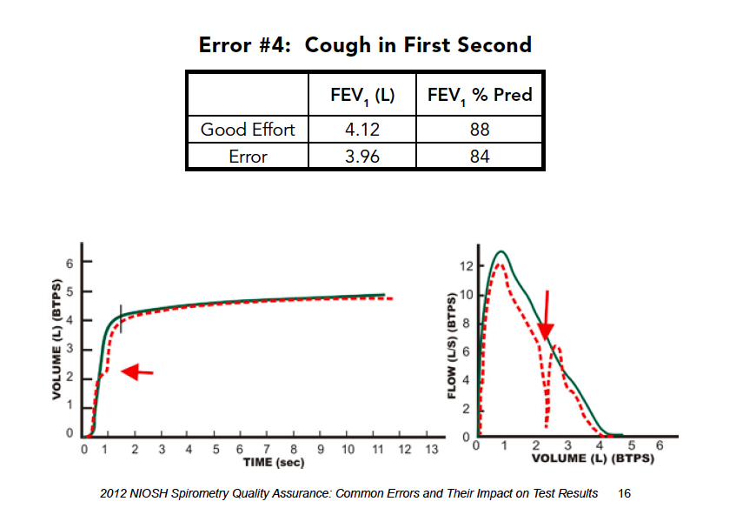
Recognizing unacceptable /unreliable readings :
A cough can cause either a falsely reduced or falsely elevated FEV1
DHHS (NIOSH) Publication No. 2012-116 January 2012

Slide 28
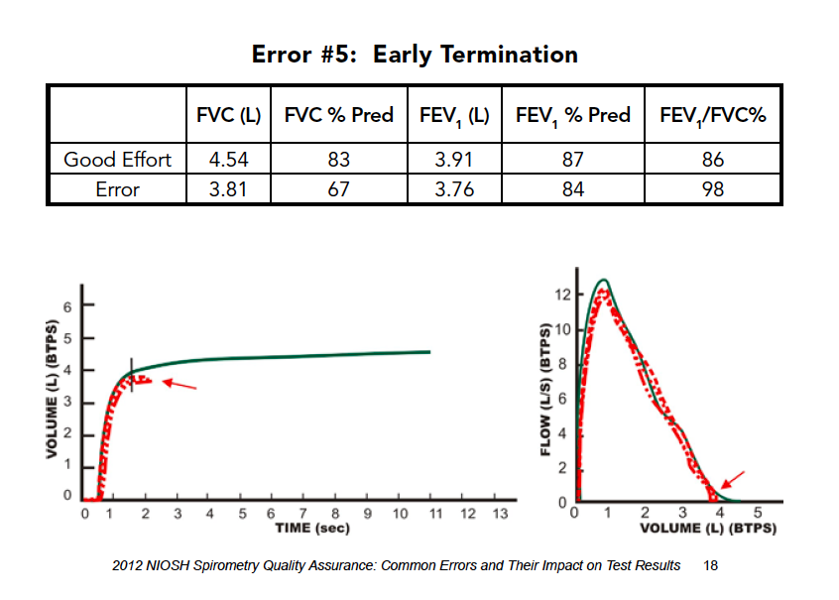
Recognizing unacceptable /unreliable readings :
Falsely reduced FVC may be misinterpreted as indicating a “restrictive impairment.” The falsely increased FEV1/FVC ratio may cause a true “obstructive impairment” to be missed.
DHHS (NIOSH) Publication No. 2012-116 January 2012

Slide 29
Spirometric patterns
Obstructive
Restrictive
Mixed
Normal

Slide 30
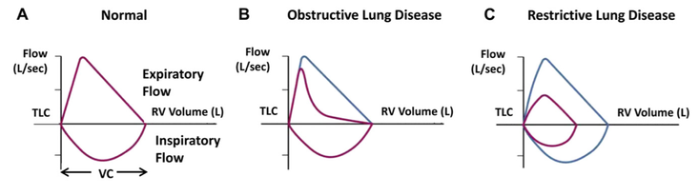

Slide 31
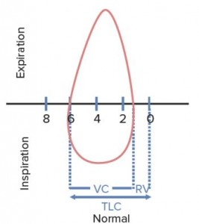
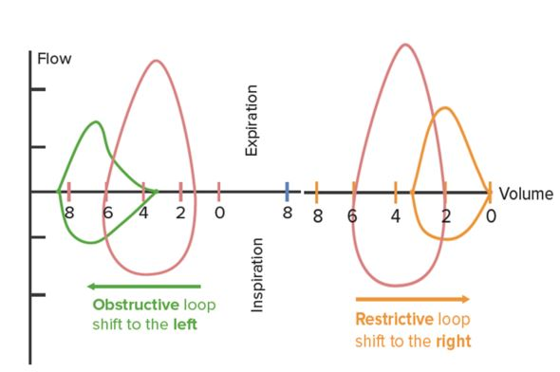

Slide 32
Obstruction

Slide 33
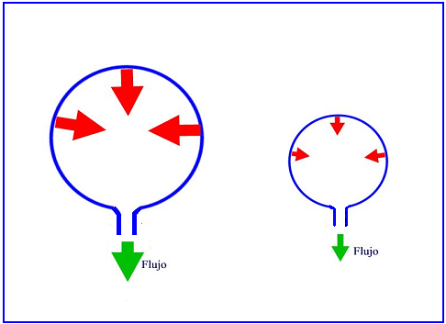
Restriction

Slide 34
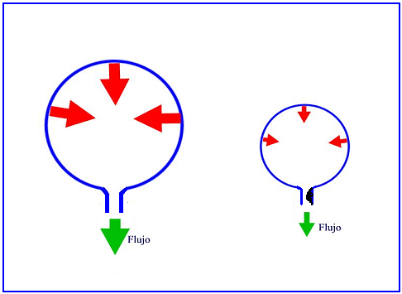
Mixed

Slide 35
Spirometric patterns
FEV₁/FVC
FVC
FEV₁
Obstruction
N
Restriction
N
N
Mixed
Obstruction and hyperinflation
Pletismography and lung volumes studies are needed

Slide 36


Any other assesment?
Severity of obstruction
Mild Obstruction | FEV₁ ≥ 80%
Moderate Obstruction | FEV1 < 80% ≥ 50%
Severe Obstruction | FEV1 < 50% ≥ 35%
Very Severe Obstruction | FEV1 < 35%
GOLD classification

Slide 37
Quick spirometry assesment
FEV₁ /FVC
≥ 70%
Normal
< 70%
Obstruction
FVC
FVC
< 80% ref value
< 80% ref. value
≥ 80% do teórico
Mixed pattern
≥ 80% ref value
OBSTRUCTION
+ HYPERINFLATION (↑VR)
RESTRICTION
OBSTRUCTION
NORMAL
OBSTRUCTION
+
RESTRICTION
(VR normal)
FEV₁ : to asses severity of obstruction

Slide 38
Reversibility Test
Second full spirometry 15 minutes after inhalation of 400µg of salbutamol or equivalent
Essential for the diagnosis of respiratory diseases
EX
Positive if:
    Increase in FEV₁ ≥ 12% and 200 ml form basal values
Flow (L/s)
Post
Bronchodilation
PRÉ
Volume (L)
IN
Notes:
Geralmente útil relatar as alterações absolutas (em ml) assim como a alteração em % do valor basal, para estabelecer a melhoria no contexto clínico
Considera-se actualmente que:
FEV1 <8% ou < 150 ml é uma variação normal.

Slide 39
Notes:
Normal
Nuestro compañero de la mañana , ávido de poner en marcha la espirometría ha decidido poner en marcha el espirómetro y actuar como conejillo de indias . Esta es la espirometría que obtenemos
PREGUNTA :
¿ Aunque la espirometría sea normal debemos hacer prueba broncodilatadora ¿

Slide 40
Notes:
PBD positiva y chepa normal

Slide 41
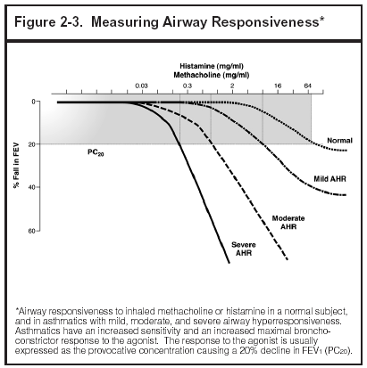
Bronchial provocation test
Useful to identify bronchial hyperreactivity
Useful when asthma is suspected and normal spirometry
Progressive increasing inhalation doses of Histamine, methacholine, allergens, hypertonic solution, or exercise
Positive test: 20% decrease in FEV₁ or more

Slide 42
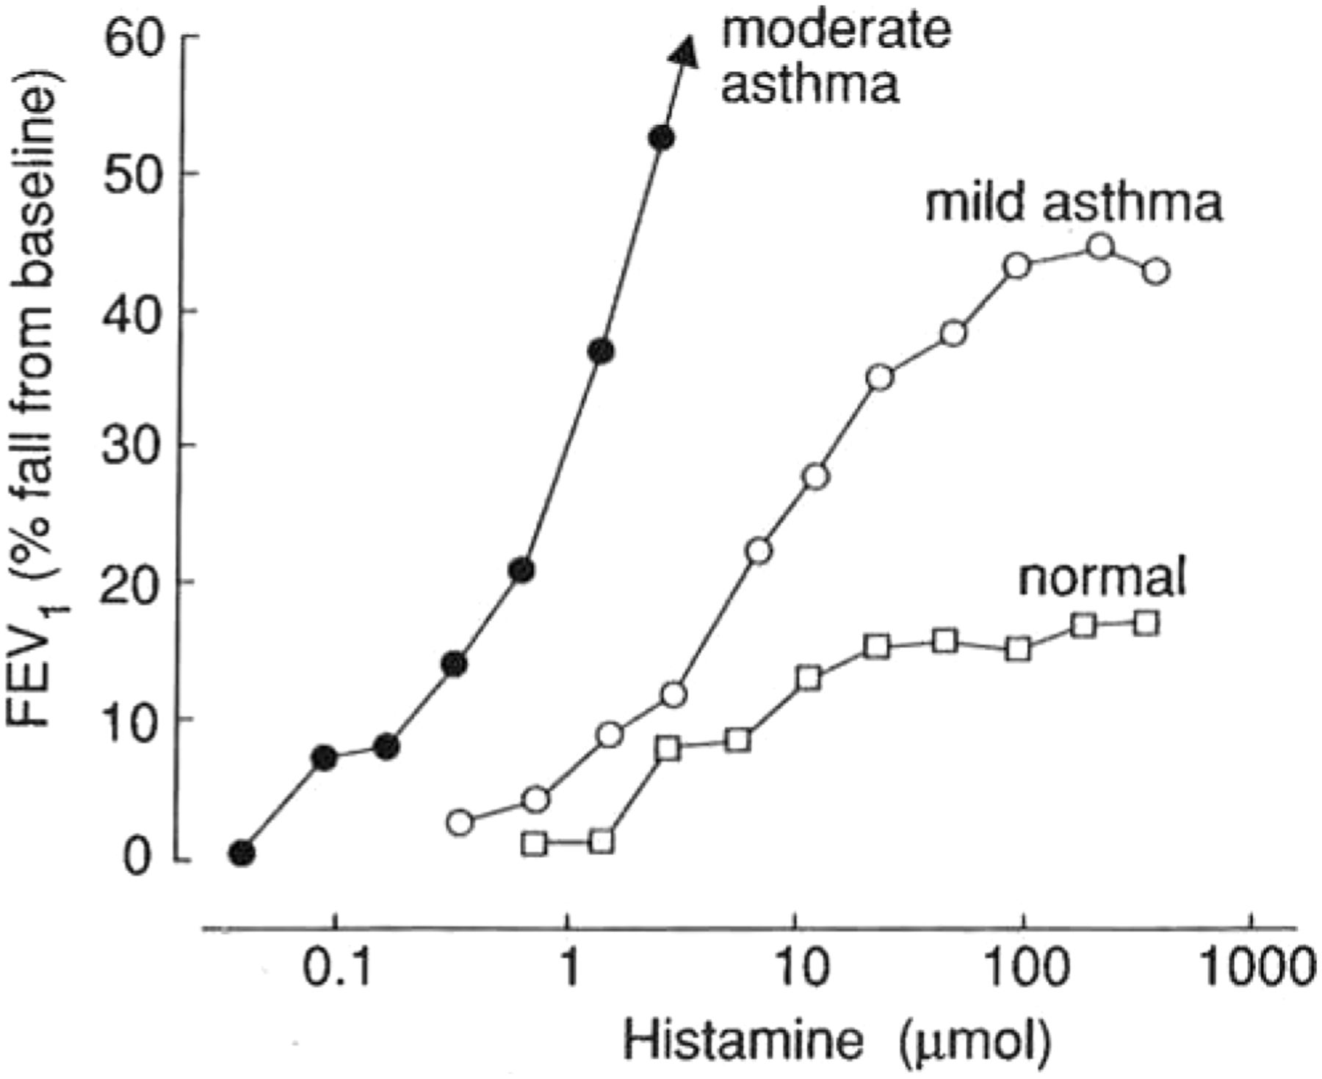
Bronchial provocation test

Slide 43
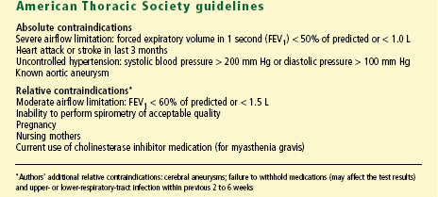
Contraindications to methacholine challenge testing

Slide 44
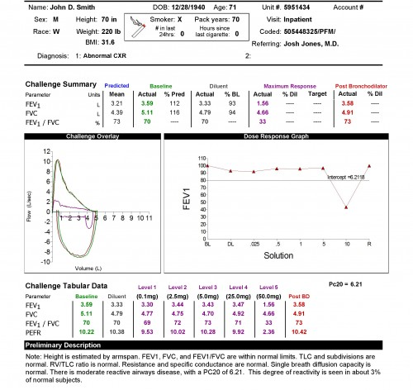

Slide 45
Clinical case 1
Male, 58 years
Works in a ceramics factory
Smoker 15 pack years
Complains of nocturnal dyspnoea and wheezing

Slide 46
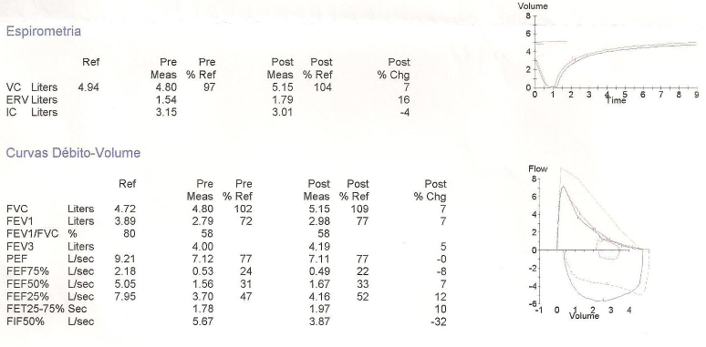
Clinical case 1

Slide 47
What about the bronchodilation test?

Slide 48
Clinical case 2
Female, 59 years
Works in a home for the elderly
Hypertension and dyslipidemia
MBI 26,5 kg/m²
Dyspnoea and wheezing with moderate exertion

Slide 49
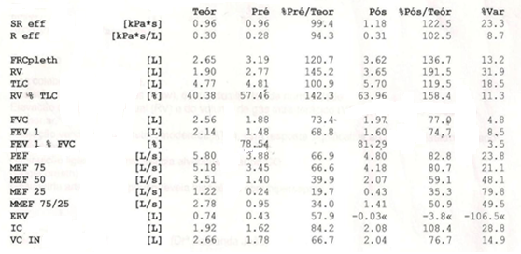
Clinical case 2
Notes:
Itiff 78,54% bem
FVC 73,4 (< 80%) – indica um padrão restritivo
BD _ FEV1 – 68,8 passou a 74,7% e de 148 ml a 160 ml – prova negativa

Slide 50
Clinical case 3
Male, 35 years
Works as a mechanic
MBI 28 kg/m²; smoker of 15 pack year
Episodes of night dyspnoea, cough and wheezing
Symptoms also with moderate exertion

Slide 51
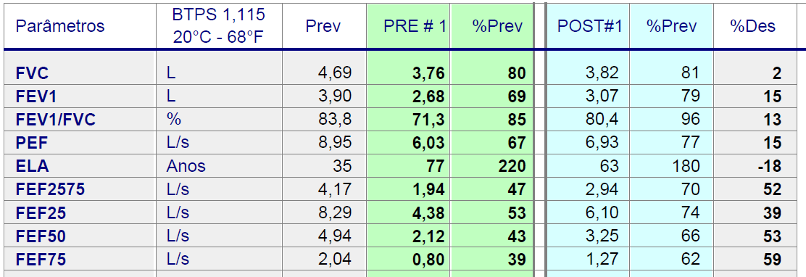
Clinical case 3

Slide 52
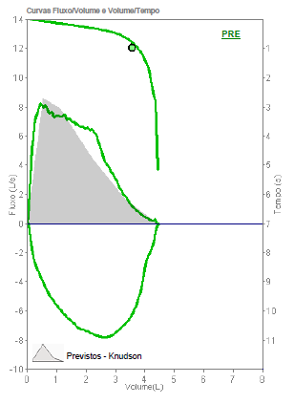
Clinical case 4
Male, 58, former smoker, 12 pack year
BMI 24.26 Kg / ^{m2}
Light cough and wheezing with moderate / heavy exertion
Sporadic morning cough and sputum or with “colds”

Slide 53
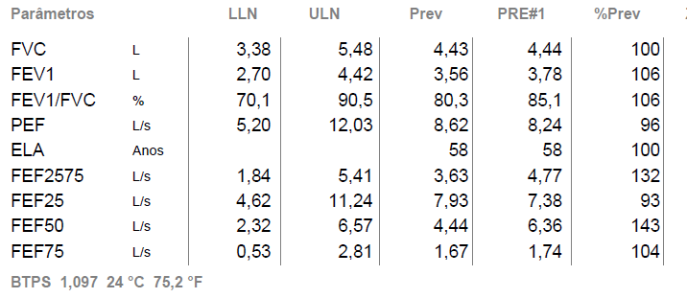
Clinical case 4

Slide 54
Conclusion
Spirometry interpretation is easy
Family physicians should know when to order spirometries
Every family physician should be able to interpret most tests
Look at the curves, values and ratios
Go home and practice

Slide 55

Respiratory Health: Adding Value
in a Resource Constrained World
In collaboration with:
GRESP Portugal
GRESP Brazil
GRAP Spain
GRAP Chile

Slide 56


Slide 57


Slide 58
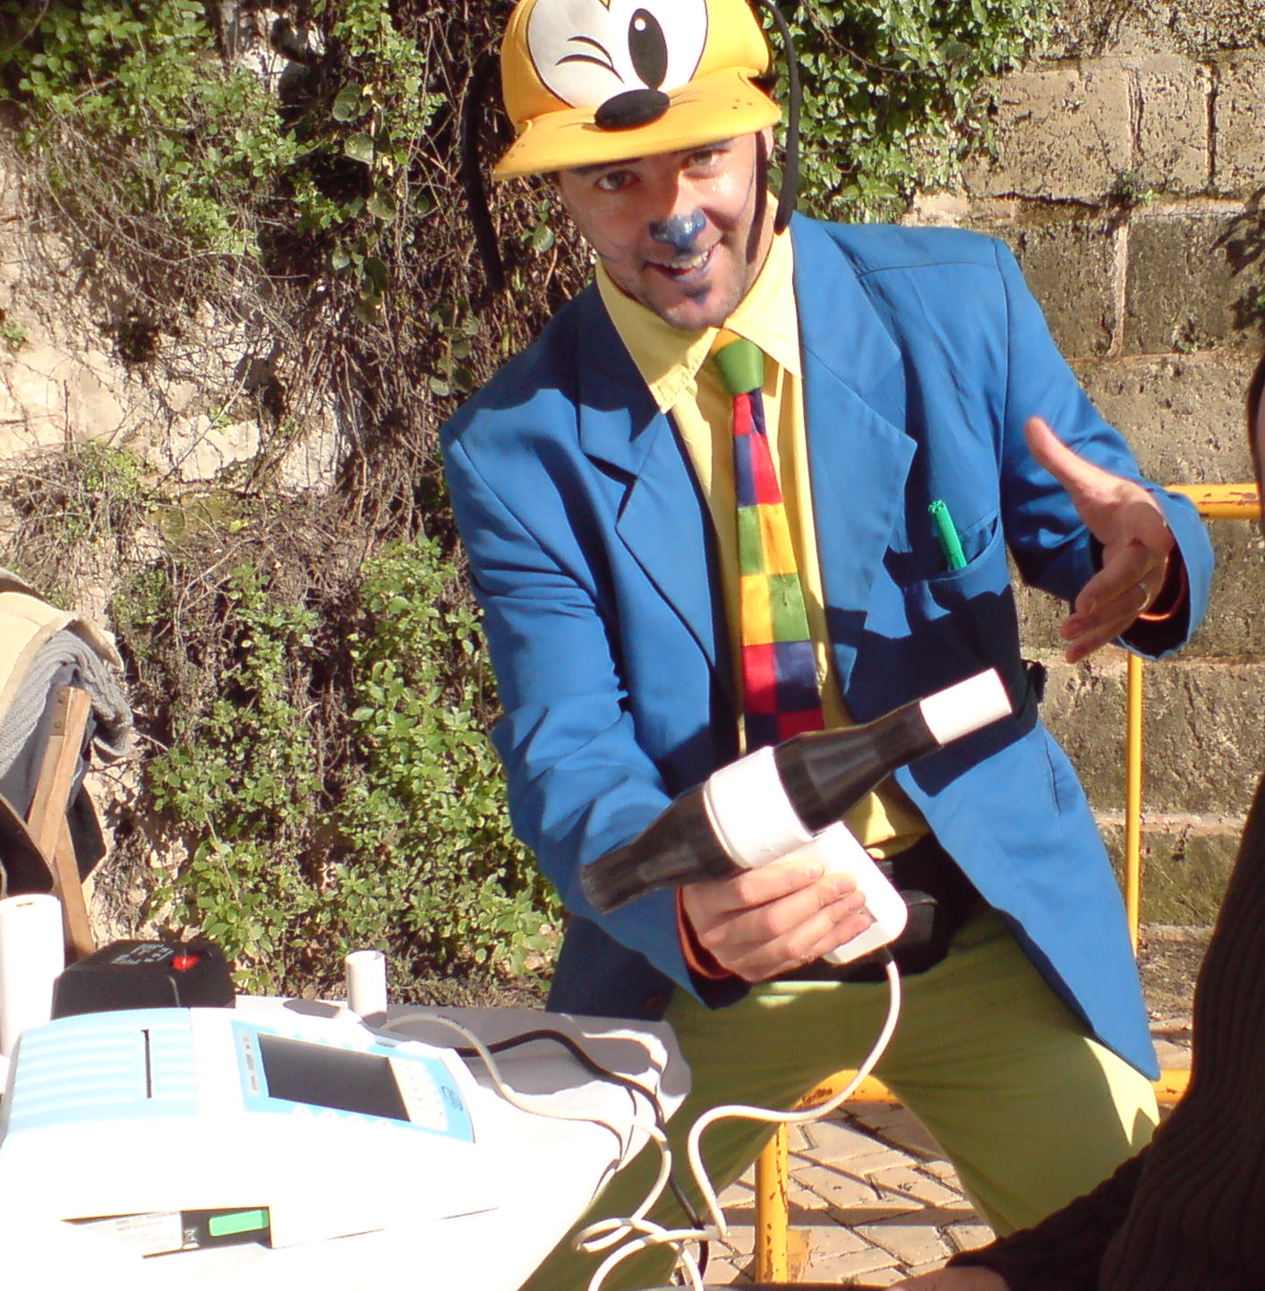
Now you are ready for that... Go home and try!
Thank you for your attention!

