Slide 1
IPCRG workshop on respiratory diseases
Spirometry made easy
Miguel Román-Rodríguez
Family Physician
Son Pisa Primary Health Care Centre, Palma de Mallorca. Spain
Spanish Primary Care Respiratory Group
Jaime Correia de Sousa, MD, MSc, PhD
Family Physician
Associate Professor, School of Medicine, Minho University, Portugal
President of the International Primary Care Respiratory Group

Slide 2
Objectives
To know the important spirometry parameters
To identify a “good quality” spirometry
To identify the different spirometry patterns
To accurately “read” the results of the test

Slide 3
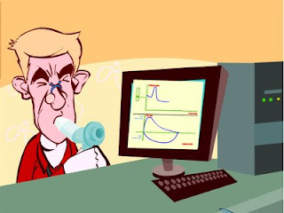
Forced spirometry
Spirometry measures airflow and lung volumes, and is the preferred lung function test for COPD and asthma in primary care
Forced exhalation from a maximal inspiration

Slide 4
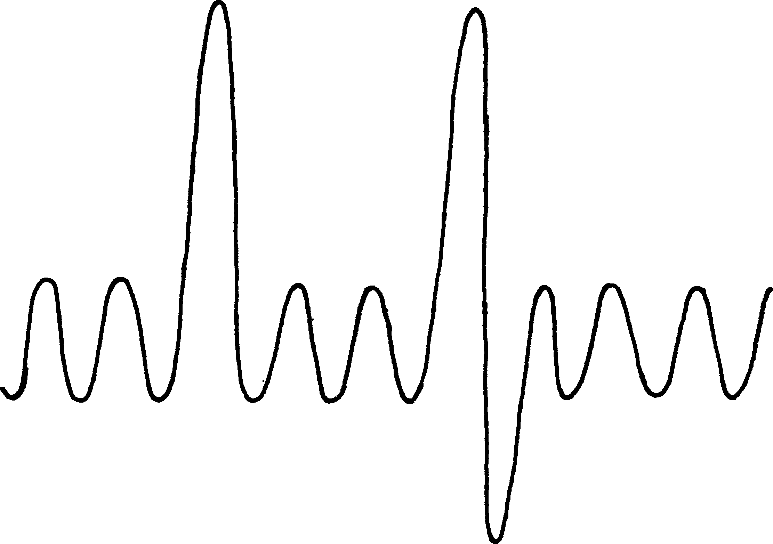
Inspiratory Reserve Volume (IRV)
Inspiratory Capacity (IC)
Total Lung Capacity (TLC)
Vital Capaciity (VC)
Tidal Volume (TV)
Expiratory Reserve Volume (ERV)
Residual Functional Capacity (RFC)
Residual Volume (RV)

Slide 5
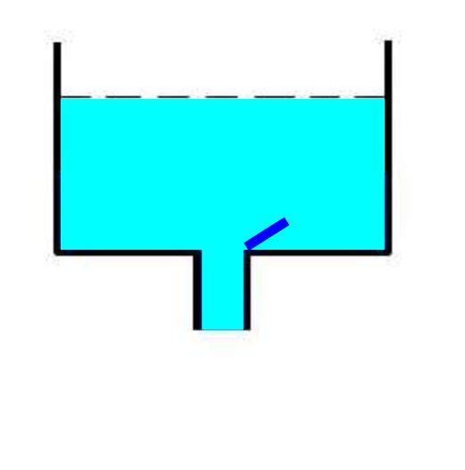
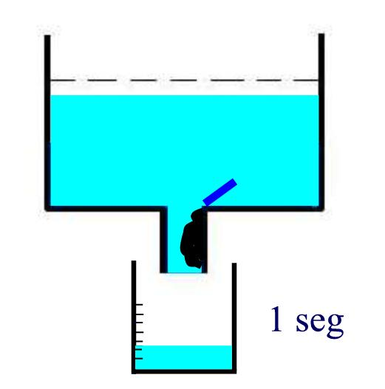
FEV1
Exhaled volume in the first second of a forced expiration after a maximal inspiration.

Slide 6
FVC
Total volume of exhaled air in a forced expiratory manoeuvre after a maximal inspiration.
The less total volume /capacity the less FVC

Slide 7
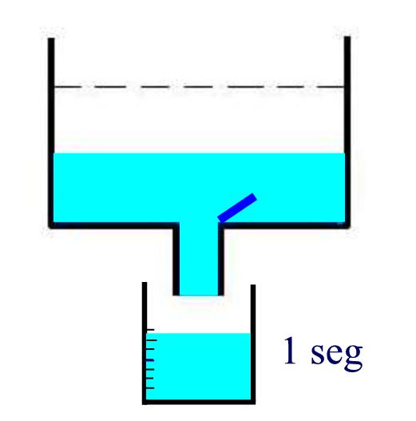
Bronchial obstruction generates less volume in the first second

Slide 8
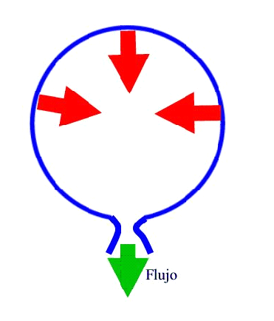
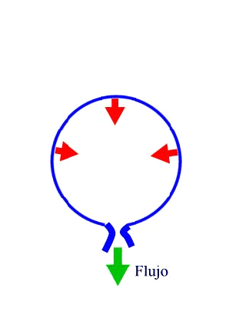
FLOW
FLOW
FLOW
FEV1 / FVC
Best obstruction measurement
% of forced vital capacity expelled during the first second

Slide 9
Important measurements
FVC: Forced Vital Capacity
Volume of air exhaled after full inspiration and full exhalation
FEV1: Forced Expiratory Volume in 1 second
Volume of air exhaled in the first second of forced exhalation.
FEV1 / FVC:
Ratio of vital capacity exhaled in 1 second expressed as a percentage of the total volume of air exhaled after full inspiration and full exhalation

Slide 10

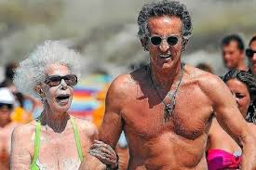
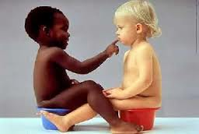
Does anyone blow the same?
Height
  Tall people have larger lungs
Age
  Respiratory function declines with age
Sex
  Lung volumes smaller in females
Ethnicity
  Peculiarly studies show Black and Asian people as a whole, have smaller lung volumes (12-20 %).
  No studies for Pacific People.
Posture
  Little difference between sitting and standing. Reduced in supine position.

Slide 11
When to perform a spirometry?
Asthma and COPD diagnosis and follow up
To asses chronic respiratory symptoms
To identify smokers at risk of COPD

Slide 12
When NOT to perform a spirometry?
Absolute contraindications
Recent pneumothorax
Pulmonary Embolism (before anticoagulation)
Active respiratory infection
Recent myocardial infarction or unstable angor pectoris
Retinal detachment
Aortic Aneurisms
Recent abdominal surgery
Intracranial hypertension
Relative contraindications
Traqueostomy
Problems holding the mouthpiece
Facial hemiparesis
Poor mental condition.

Slide 13
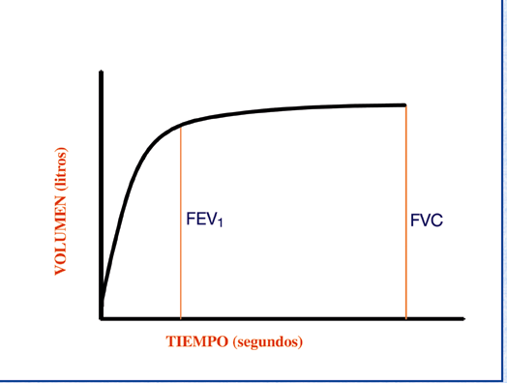
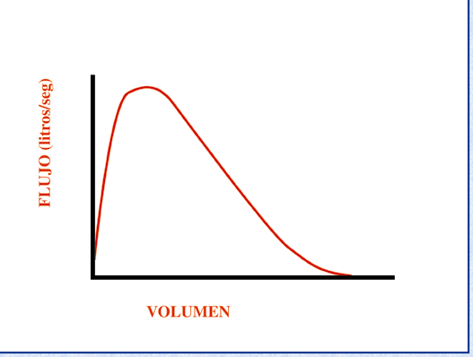
The most important matter: curves
Any test is only as good as its accuracy
Time/volume
Flow/volume

Slide 14
The most important matter: curves
FEV1: Volume of air exhaled in the first second of a forced exhalation after complete inspiration
FVC
5
4
FEV₁ = 4L
FVC = 5L
FEV₁/FVC = 0.8
3
FVC: Total volume of air exhaled after full inspiration and full exhalation
2
Volume, liters
1
1
2
3
4
5
6
Time, seconds
1

Slide 15
The most important matter: curves
Peak-flow: Maximum airflow during the manoeuvre
FEV₁
FVC

Slide 16
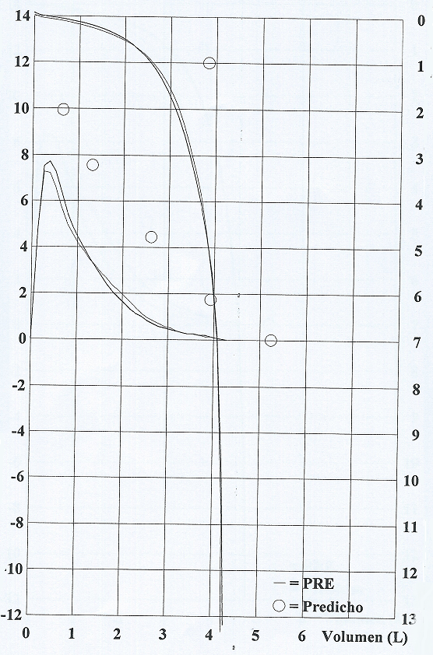
FEV1

Slide 17
Spirometry Interpretation

Slide 18
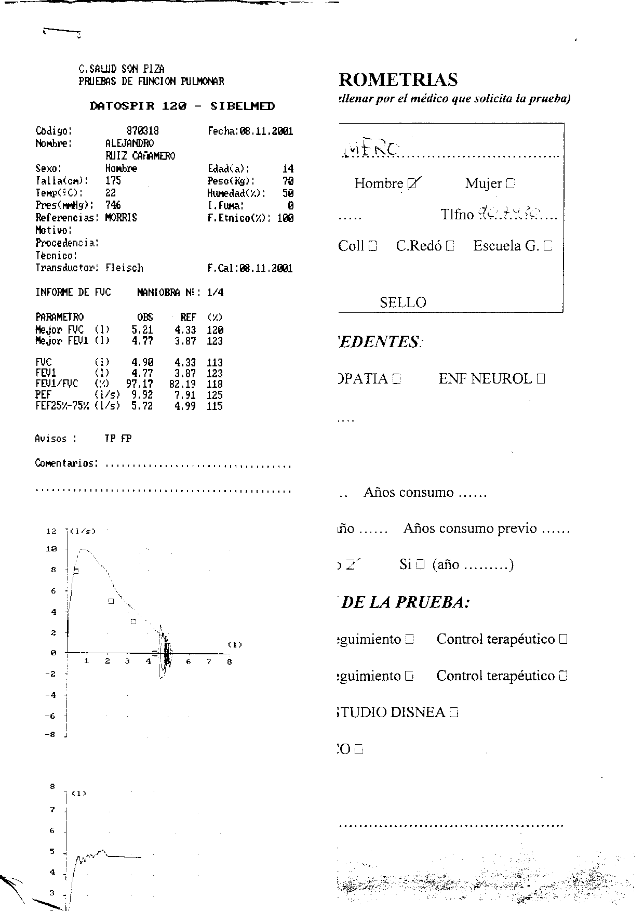

Slide 19
Spirometry Interpretation
Is it acceptable and reproducible?
The traces’ shape
Measurements assessment

Slide 20
Reasons for unacceptable /unreliable readings:
Inadequate or incomplete inhalation
Slow start to the forced exhalation
Lack of blast effort during exhalation
Coughing
Additional breath taken during manoeuvre
Lips not tight around the mouthpiece
Exhalation stops before complete expiration

Slide 21
Reasons for unacceptable /unreliable readings:
Airflow [L/s]
Inadequate initial effort
Cough
Hesitation
Early ending
Volume [L]
Notes:
A inspecção da curva D/V ajuda a decidir se a medição foi feita correctamente e a confirmar a presença duma alteração.
A curva débito-volume pode ser usada para avaliar a aceitabilidade das manobras espirométricas.
A falta de um pico inicial sugere pouco esforço.
A tosse é fácilmente reconhecível. Uma curva que inclua tosse pode ser aceitável se o declive total não estiver interrompido
Uma queda abrupta da curva expiratória sugere que o doente deixou de soprar demasiado cedo.
Se a manobra for completada com um esforço inspiratório para voltar à capacidade pulmonar total, uma falha no início e no fim da curva sugerem uma fuga de ar.

Slide 22
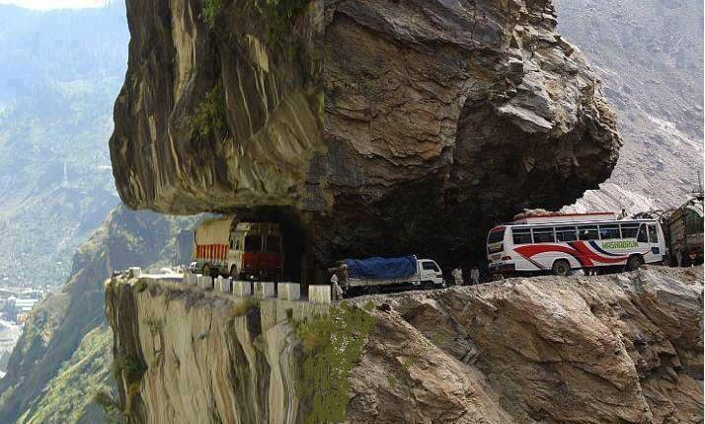

Please be careful with the curves !!

Slide 23
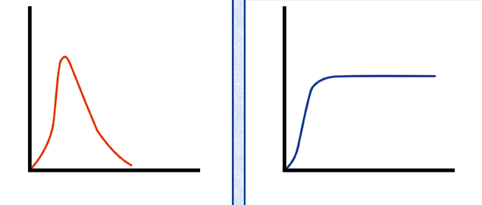
Doubtful start: extrapolated volume

Slide 24
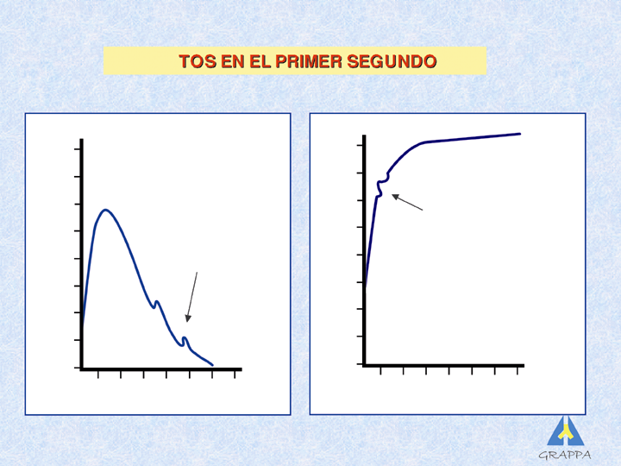
Flow problem: cough

Slide 25
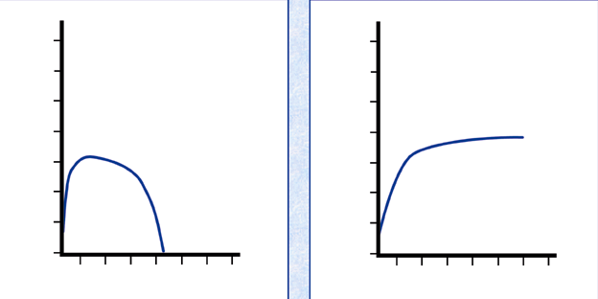
Weak effort: no shouting, no peak

Slide 26
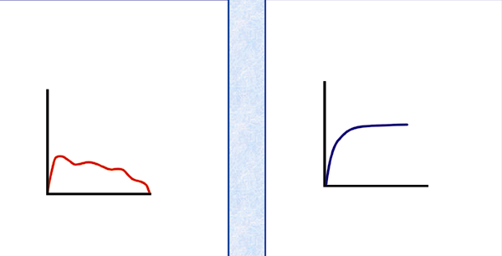
Variable effort

Slide 27
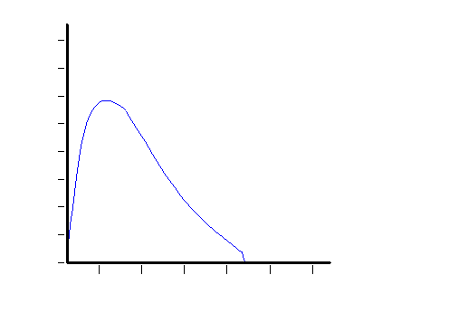
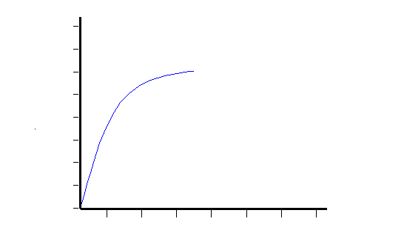
Early ending: short encouragement

Slide 28
Reproducibility
Mínimum of 3 and máximum of 8 manouvers
Less tan 5% or 100 ml difference in FEV1 and FVC
Best test= best parameters sum

Slide 29
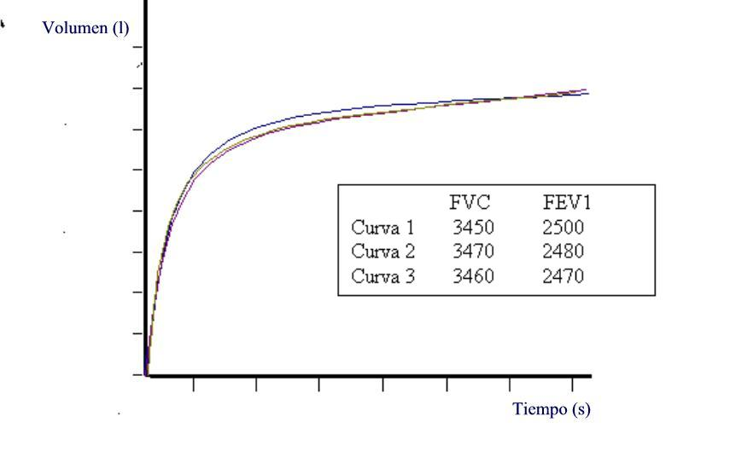
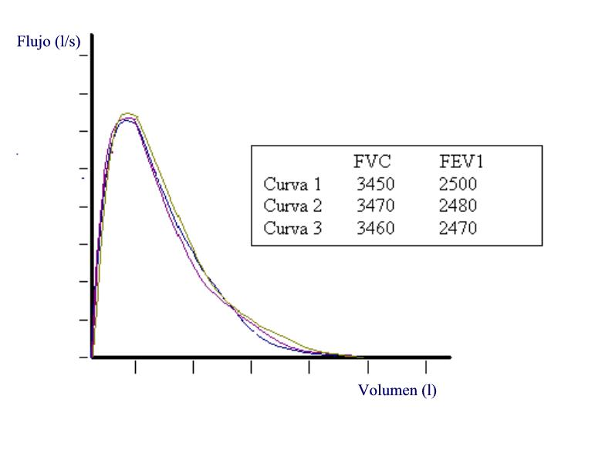
Reproducibility

Slide 30
Is there an obstruction?
FVC
5
4
FEV₁ = 4L
FVC = 5L
FEV₁/FVC = 0.8
Volume, liters
3
2
1
1
2
3
4
5
6
1
Time, seconds

Slide 31
Spirometric patterns
Obstructive
Restrictive
Mixed
Normal

Slide 34
Obstruction

Slide 35
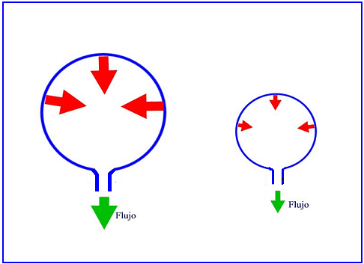
Restriction

Slide 36
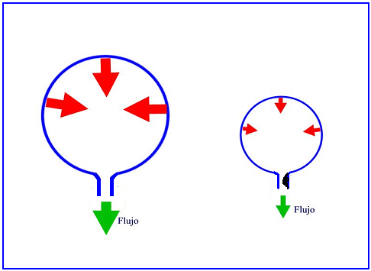
Mixed

Slide 37
Spirometric patterns
FEV₁/FVC
FVC
FEV₁
Obstruction
N
Restriction
N
N
Mixed
Obstruction and hyperinflation

Slide 38
Spirometric patterns
FEV₁/FVC
FVC
FEV₁
Obstruction
N
Restriction
N
N
Mixed
Obstruction and hyperinflation

Slide 39
Any other assesment?
Severity of obstruction
Mild Obstruction | FEV₁ ≥ 80%
Moderate Obstruction | FEV1 < 80% ≥ 50%
Severe Obstruction | FEV1 < 50% ≥ 35%
Very Severe Obstruction | FEV1 < 35%
GOLD classification

Slide 40
Quick spirometry assesment
FEV₁ /FVC
≥ 70%
Normal
< 70%
Obstruction
FVC
FVC
< 80% ref value
< 80% ref. value
≥ 80% ref value
Mixed pattern
≥ 80% ref value
OBSTRUCTION
+ HYPERINFLATION (↑VR)
NORMAL
RESTRICTION
OBSTRUCTION
OBSTRUCTION
+
RESTRICTION
(VR normal)

Slide 41
Reversibility Test
Second full spirometry 15 minutes after inhalation of 400µg of salbutamol or equivalent
Essential for the diagnosis of respiratory diseases
EX
Flow (L/s)
Post
Positive: Increase in FEV₁ ≥ 12% and 200 ml from basal values
Bronchodilation
PRÉ
Volume (L)
IN
Notes:
Geralmente útil relatar as alterações absolutas (em ml) assim como a alteração em % do valor basal, para estabelecer a melhoria no contexto clínico
Considera-se actualmente que:
FEV1 <8% ou < 150 ml é uma variação normal.

Slide 42
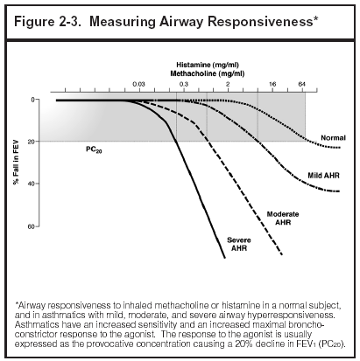
Bronchial provocation test
Useful to identify bronchial hyperreactivity
Useful when asthma is suspected and normal spirometry
Progressive increasing inhalation doses of Histamine, methacholine, allergens, hypertonic solution, or exercise
Positive test: 20% decrease in FEV₁ or more

Slide 43
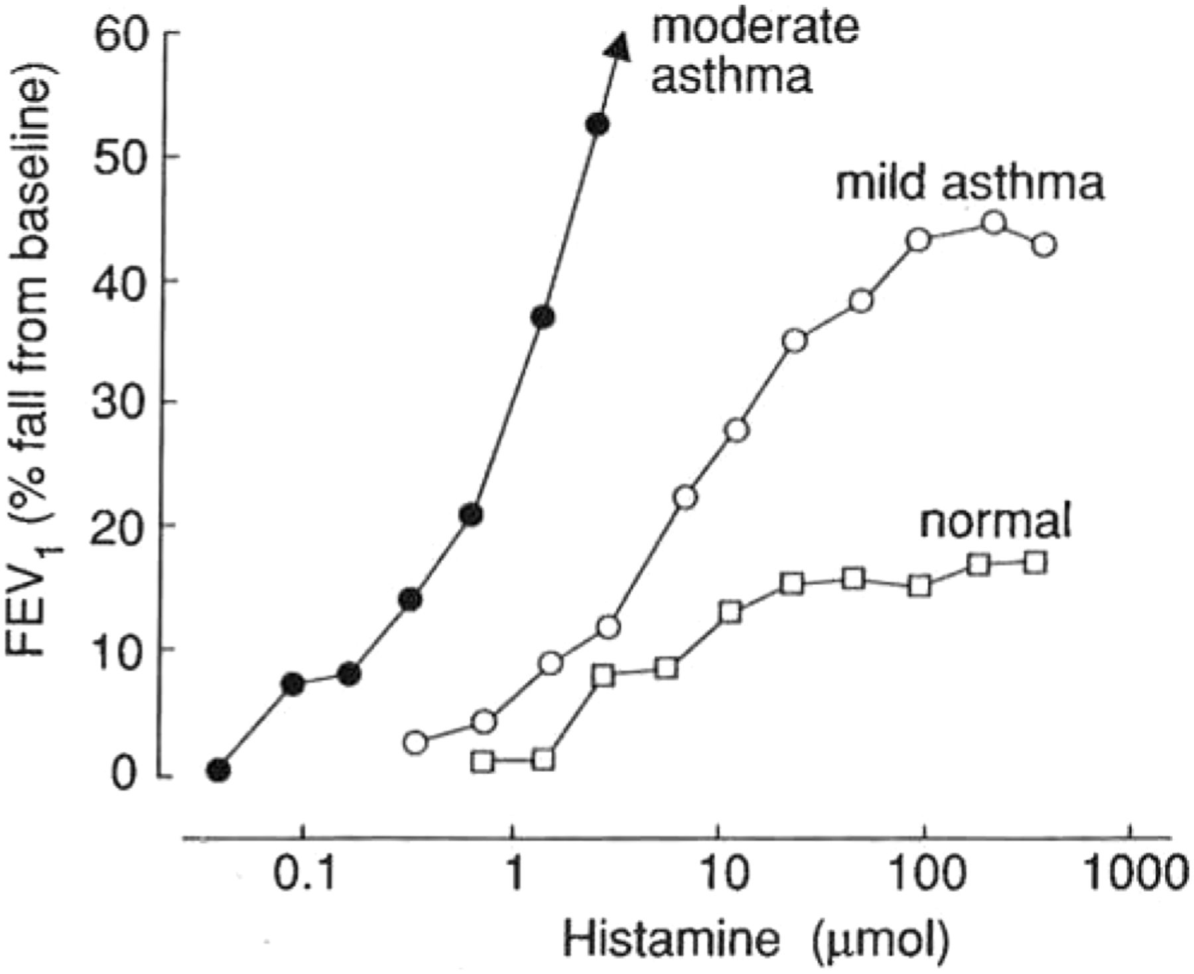
Bronchial provocation test

Slide 44
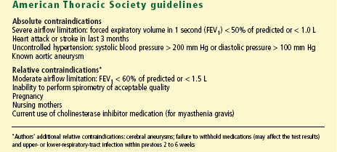
Contraindications to methacholine challenge testing

Slide 45
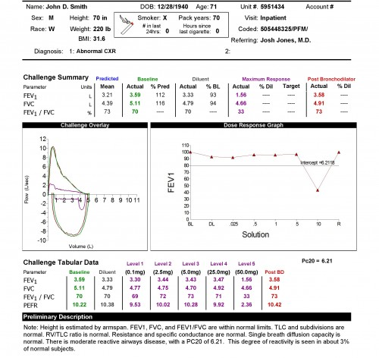

Slide 46
Let’s practice

Slide 47
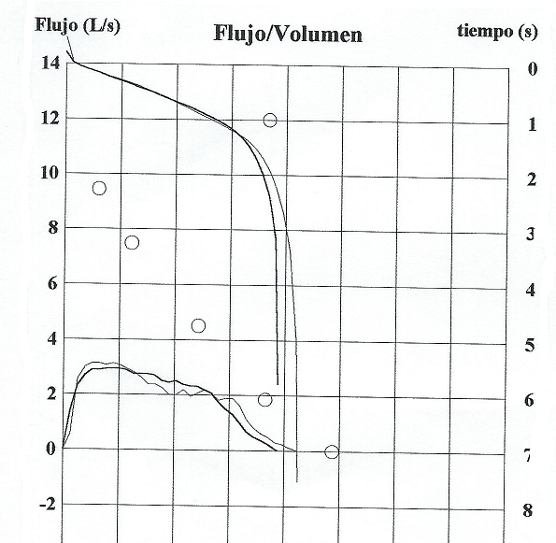
Notes:
No hay pico

Slide 48
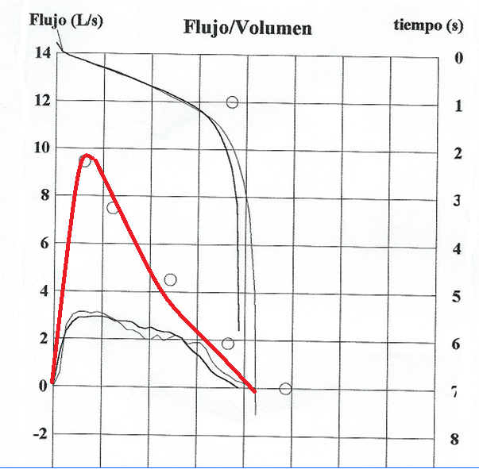

Slide 49
Notes:
Normal
Nuestro compañero de la mañana , ávido de poner en marcha la espirometría ha decidido poner en marcha el espirómetro y actuar como conejillo de indias . Esta es la espirometría que obtenemos
PREGUNTA :
¿ Aunque la espirometría sea normal debemos hacer prueba broncodilatadora ¿

Slide 50
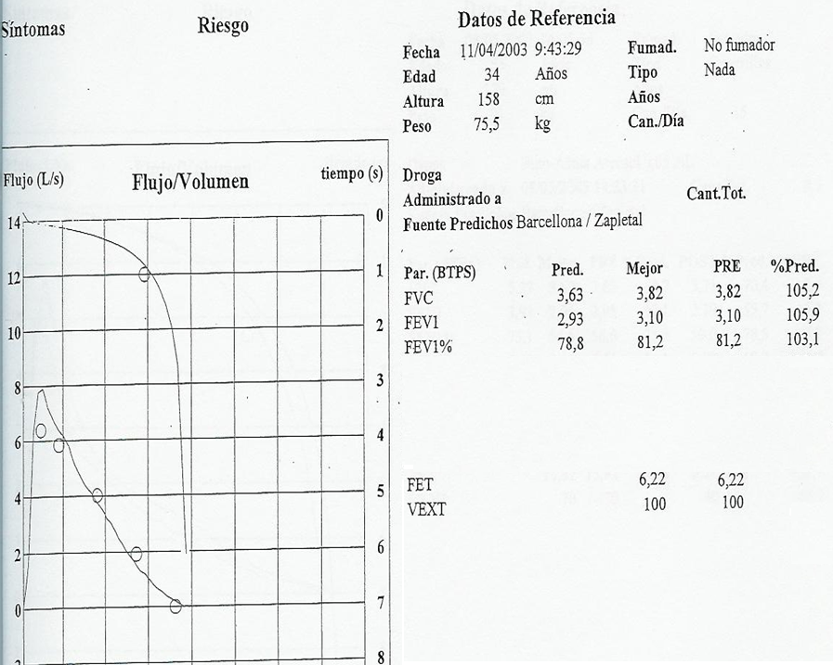

Slide 51
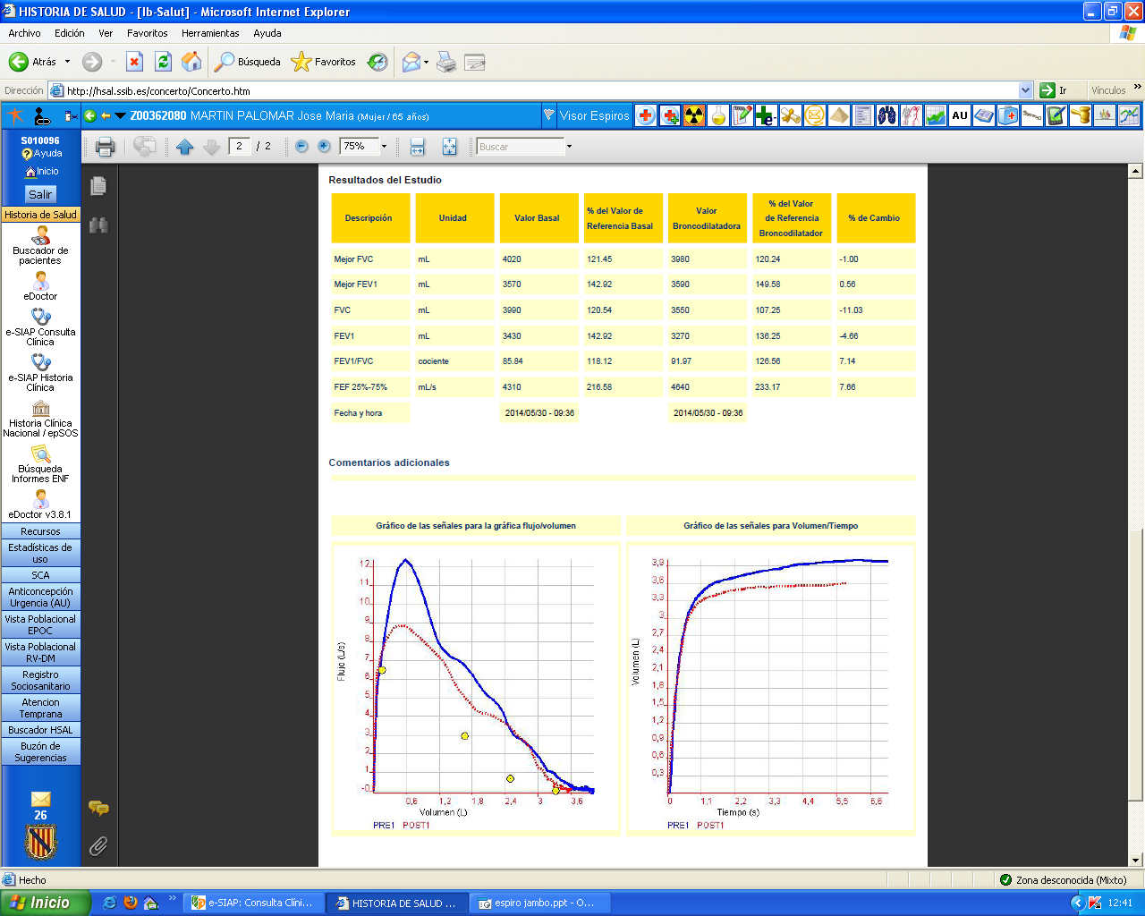
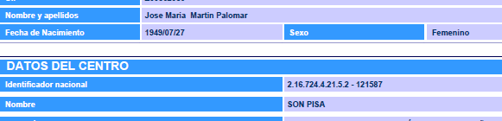
Non acceptable
Notes:
Hombre con valores de referencia de mujer

Slide 52
Acceptable
Notes:
Chepa normal

Slide 53
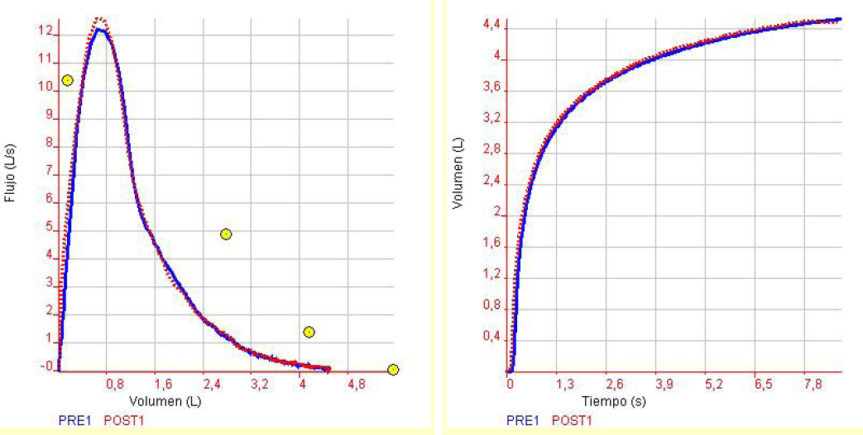
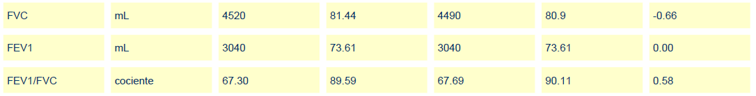

Slide 54
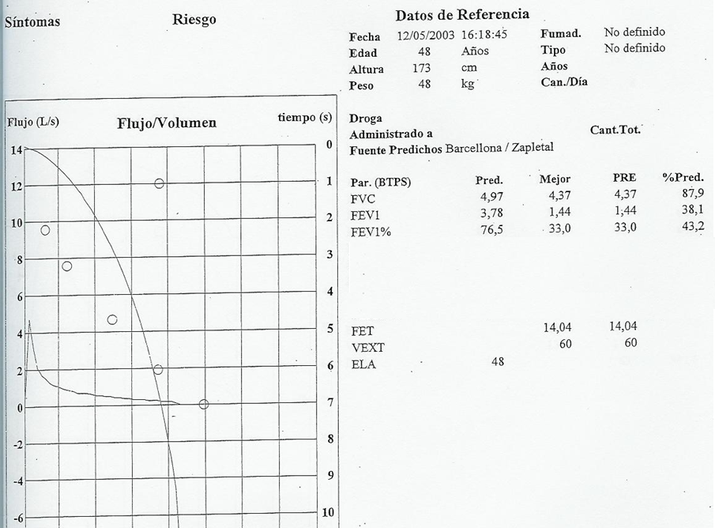

Slide 55
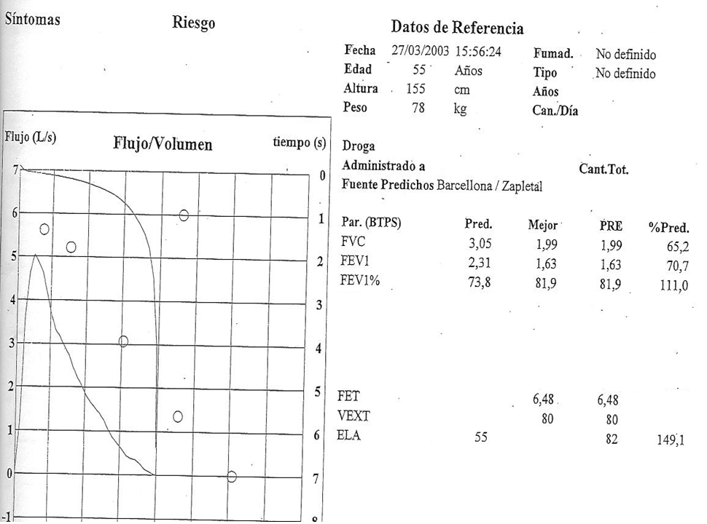

Slide 56
Notes:
Normal

Slide 57
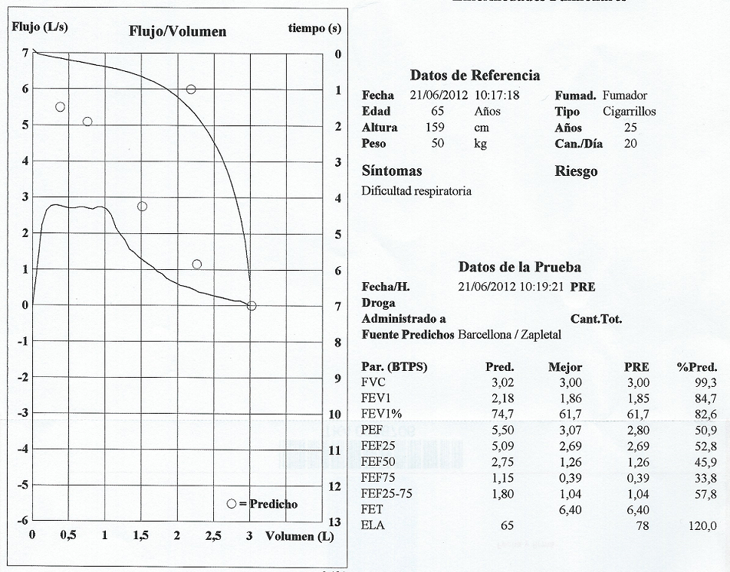
Non acceptable

Slide 58

Notes:
Asma

Slide 59
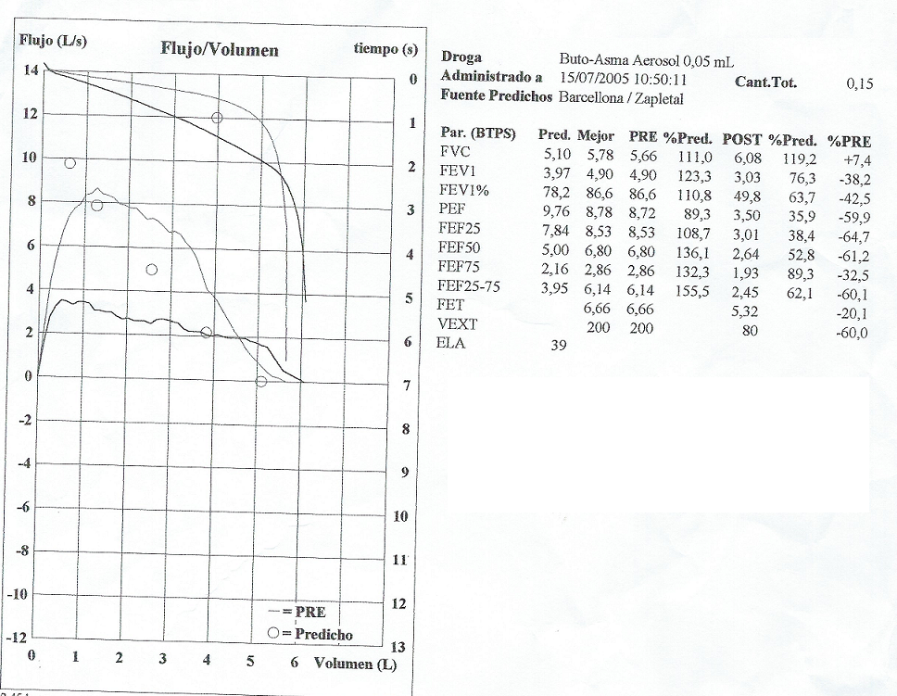
Non acceptable

Slide 60
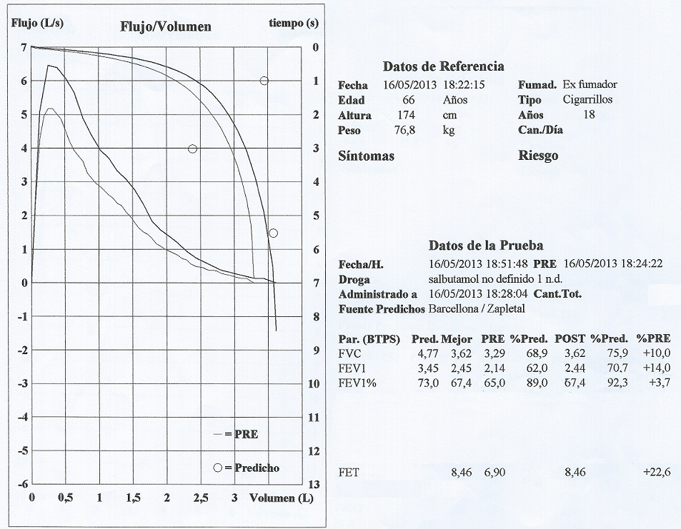

Slide 61

Respiratory Health: Adding Value
in a Resource Constrained World
In collaboration with:
GRESP Portugal
GRESP Brazil
GRAP Spain
GRAP Chile

Slide 62
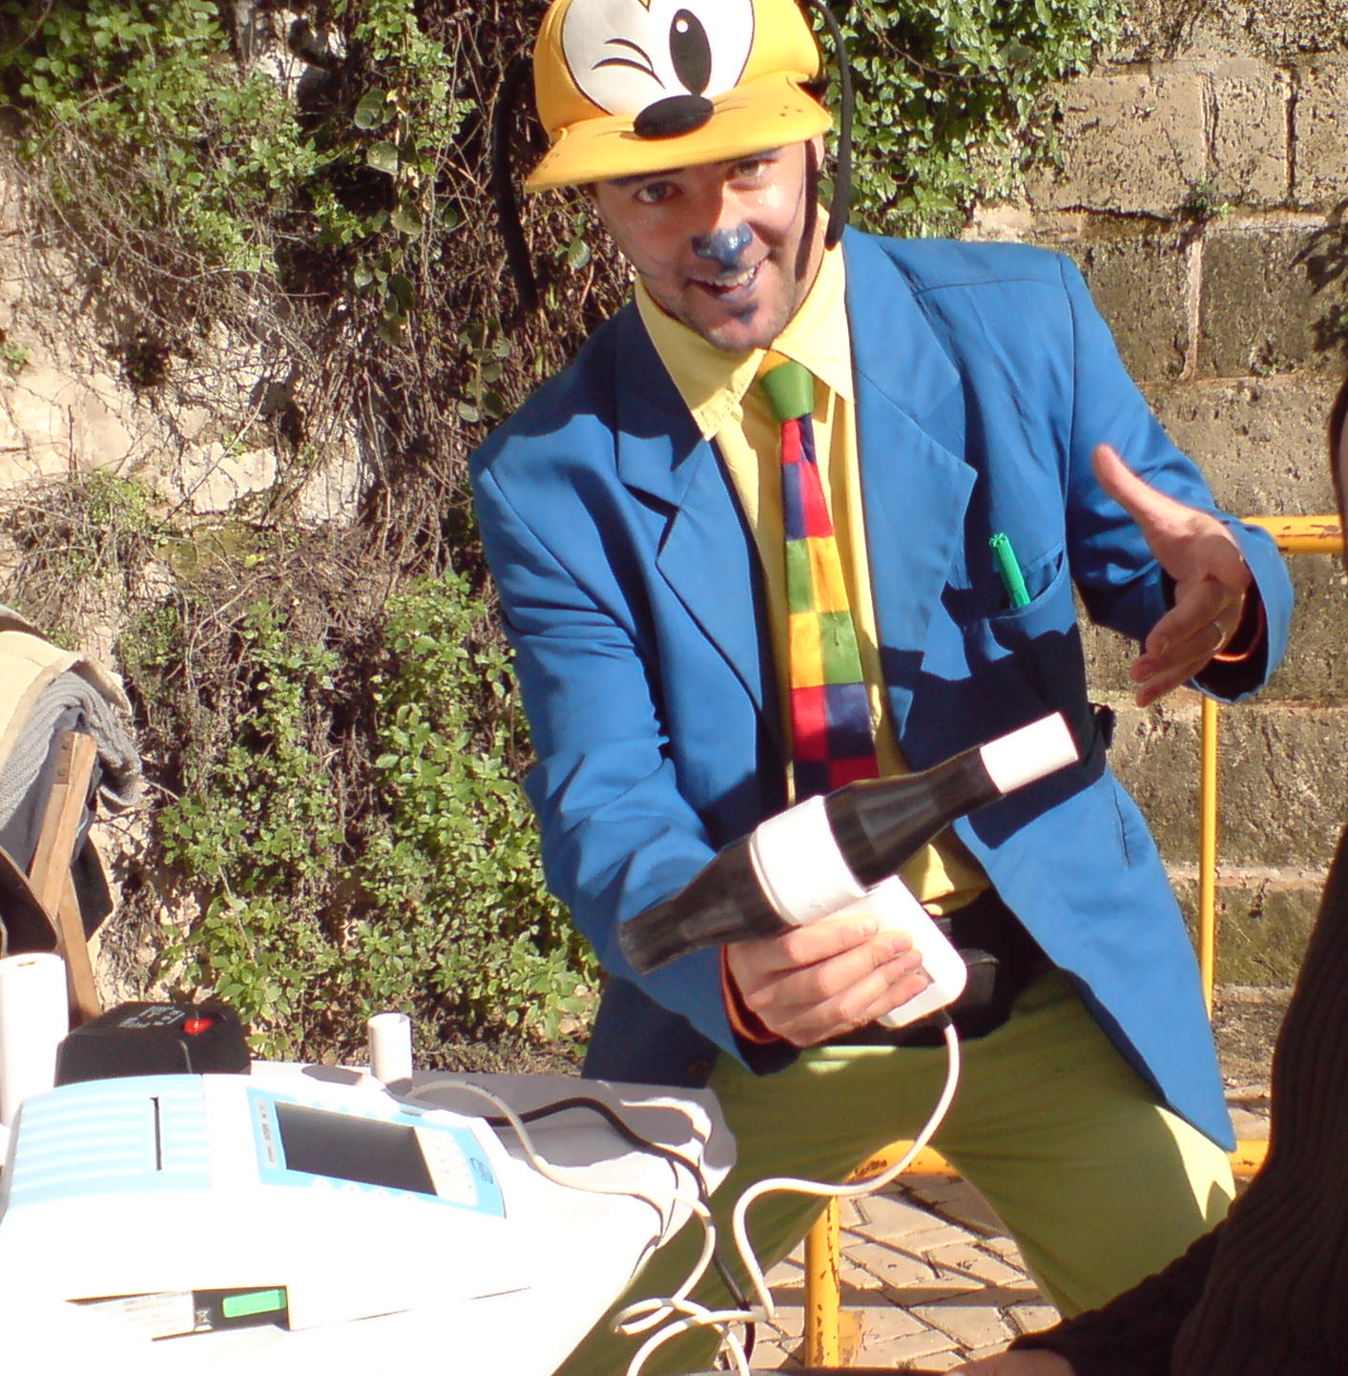
Now you are ready for that...
Go home and try!
Thank you for your attention!

Slide 63
Notes:
EPOC sin pico y restrictivo asociado. Cuidado

Slide 64
x
Notes:
No forzada

Slide 65

Notes:
Falta de pico

Slide 66
