Slide 1
What doctors should do to support patients with uncontrolled and severe asthma.
Jaime Correia de Sousa
Ioanna Tsiligianni
Anders Østrem

Slide 2
Session Outline
Introduction
Definition
What is asthma control and reasons for poor control
Group Work / Case vignettes
How to measure asthma control?
Difficult to manage asthma: a practical guide

Slide 3
Introduction
Definition
Difficult to manage asthma is asthma that either the patient or the clinician finds difficult to manage.
A patient with difficult to manage asthma has daily symptoms and regular exacerbations despite apparently best treatment.

Slide 4
Introduction
There are two main groups of patients with difficult to manage asthma:
  People whose asthma has been controlled in the past but who have now lost control.
  People whose asthma has never been controlled.

Slide 5
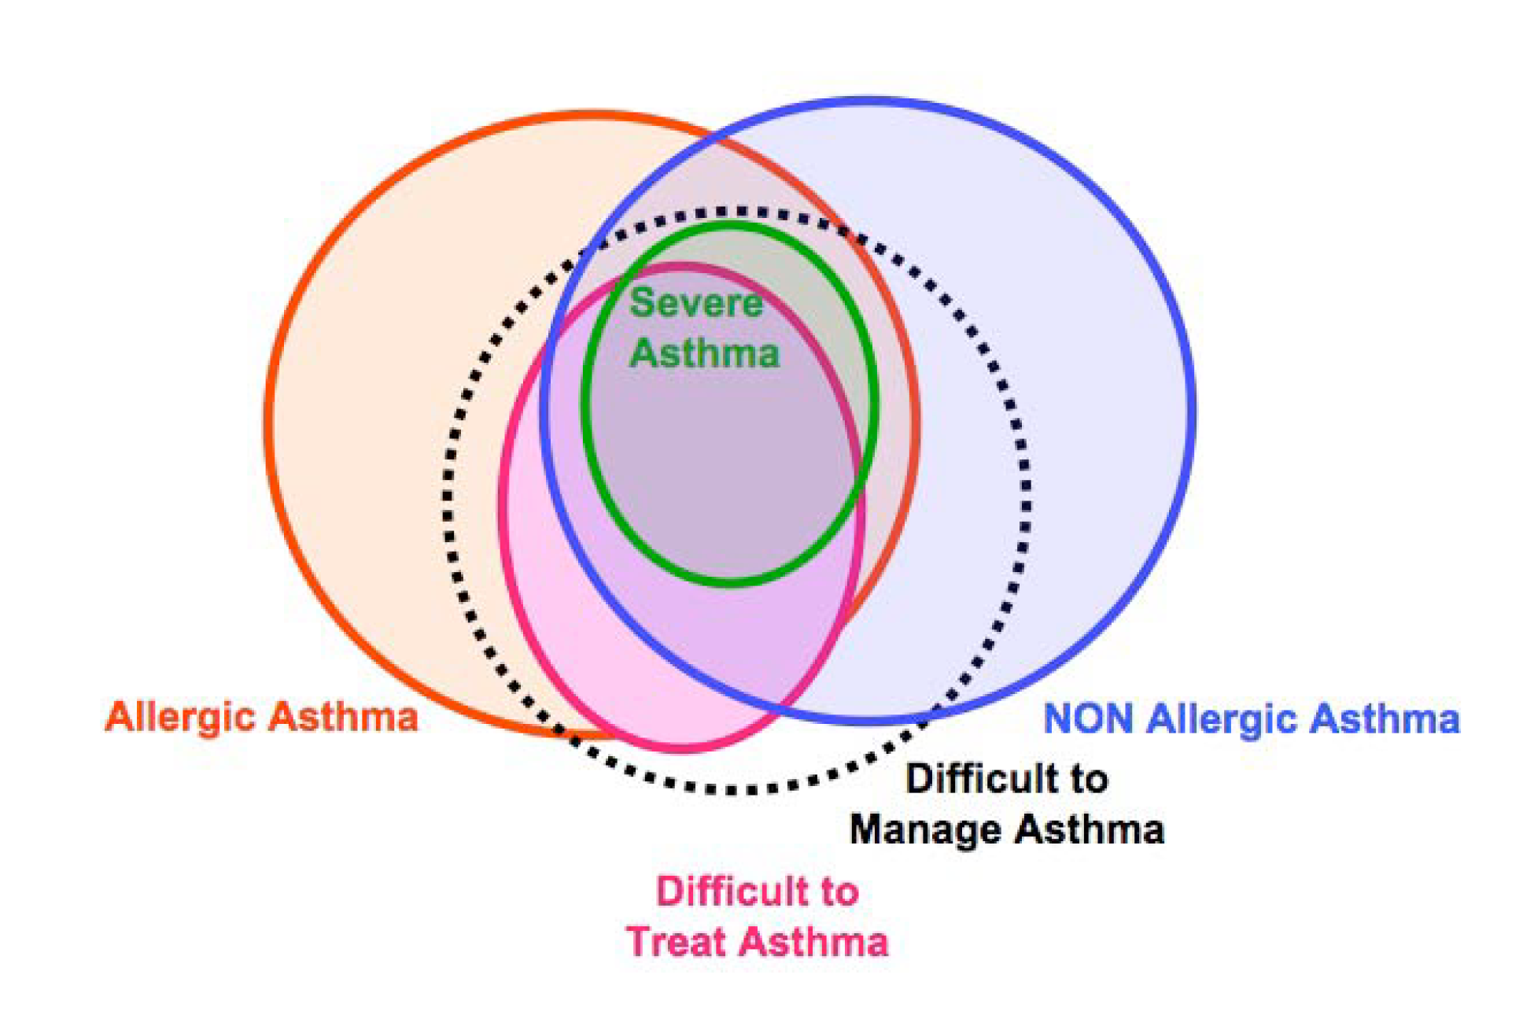
Difficult to manage asthma

Slide 6
Poorly controlled asthma:
What should we do?
Notes:
Title page option 1

Slide 7
What means asthma control?
In groups of 3, please:
  define asthma control
  list 3 reasons for poor asthma control
After 5 m one member from each team should report to the group

Slide 8
What is asthma control?
As previously defined by the Global Initiative for Asthma (GINA)
Minimal to no daytime asthma symptoms
No limitations on activities
No nocturnal symptoms or awakenings
Minimal to no need for reliever or rescue therapy
Normal lung function (FEV₁ or PEF)
No exacerbations
www.ginasthma.org

Slide 9
How to describe a patient’s asthma control?
As defined by the Global Initiative for Asthma (GINA), 2016
Asthma control has two domains:
  symptom control (previously called ‘current clinical control’)
  future risk of adverse outcomes
Both should always be assessed.

Slide 10
GINA assessment of symptom control
A. Symptom control
In the past 4 weeks, has the patient had: | Well-controlled | Partly controlled | Uncontrolled
Daytime asthma symptoms more than twice a week? Yes No | None of these | 1-2 of these | 3-4 of these
Any night waking due to asthma? Yes No
Reliever needed for symptoms* more than twice a week? Yes No
Any activity limitation due to asthma? Yes No
Level of asthma symptom control
*Excludes reliever taken before exercise, because many people take this routinely
This classification is the same as the GINA 2010-12 assessment of ‘current control’, except that lung function now appears only in the assessment of risk factors
GINA 2016, Box 2-2A

Slide 11
GINA assessment of symptom control
A. Symptom control
In the past 4 weeks, has the patient had: | Well-controlled | Partly controlled | Uncontrolled
Daytime asthma symptoms more than twice a week? Yes No | None of these | 1-2 of these | 3-4 of these
Any night waking due to asthma? Yes No
Reliever needed for symptoms* more than twice a week? Yes No
Any activity limitation due to asthma? Yes No
B. Risk factors for poor asthma outcomes
Assess risk factors at diagnosis and periodically Measure FEV₁ at start of treatment, after 3 to 6 months of treatment to record the patient’s personal best, then periodically for ongoing risk assessment ASSESS PATIENT’S RISKS FOR: Exacerbations Fixed airflow limitation Medication side-effects
Level of asthma symptom control
GINA 2016 Box 2-2B (1/4)

Slide 12
Reasons for poor asthma control
Wrong diagnosis or confounding illness
Incorrect choice of inhaler or poor technique
Concurrent smoking
Concomitant rhinitis
Unintentional or intentional nonadherence
Individual variation in treatment response
Under treatment
www.ginasthma.org
Haughney J et al. Respir Med. 2008;102:1681–93.

Slide 13
Clinical case

Slide 14
Group Work
We will present a case vignette
Please take your notes and discuss the case in small groups (3-4 persons)
After 3 m we will discuss the case in the plenary

Slide 15
Case 1:
Sara- 43 year old, goes for a routine asthma consultation:
Never smoked
Atopic dermatitis since childhood
Asthma diagnosis since 1992
Never tested for allergenic sensitivity
She is regularly taking inhaled beta-2 agonists and corticosteroids medium dose fixed combination and salbutamol as needed
Daytime symptoms > twice a week
Nocturnal awakenings
In recent weeks used rescue medication 2/3 times a week
Notes:
Sara and to get her maintenance treatment prescription

Slide 16
Is her asthma controlled?
As previously defined by the Global Initiative for Asthma (GINA)
Characteristic | Controlled (All of the following) | Partly controlled (Any present in any week) | Uncontrolled
Daytime symptoms | Twice or less per week | More than twice per week | 3 or more features of partly controlled asthma present in any week
Limitations of activities | None | Any
Nocturnal symptoms / awakening | None | Any
Need for rescue / “reliever” treatment | Twice or less per week | More than twice per week
Lung function (PEF or FEV1) | Normal | < 80% predicted or personal best (if known) on any day
www.ginasthma.org
Notes:
There are many tools to measure asthma control but independently of which one we use, we find that Sara’s asthma is uncontrolled as we can objective in this slide
Depending on level of asthma control, the patient is assigned to one of five treatment steps
Treatment is adjusted in a continuous cycle driven by changes in asthma control status. The cycle involves:
- Assessing Asthma Control
- Treating to Achieve Control
- Monitoring to Maintain Control

Slide 17
How do we measure asthma control?

Slide 18
How do we measure asthma control?
History
Prescription review
Questionnaires
Objective measures
Notes:
Occasional daytime symptoms defined as less than twice a week maybe consistent with good control but disturbed sleep due to asthma signals loss of control.
Exhaled Nitric oxide as a measure of inflammation may have a place in clinical care in the future.

Slide 19
How to assess asthma control in practice?
Simple tools that both healthcare providers and patients can use.
  Asthma Control Test (ACT)
    Validated instrument. 5 questions based upon day/night-time symptoms, rescue bronchodilator use and daily activities.
  Control of Allergic Rhinitis and Asthma Test (CARAT)
    Validated instrument. 4 questions on rhinitis + 6 on asthma. Available in several languages
  Asthma Control Questionnaire (ACQ)
    7-item questionnaire. Based upon day/night-time symptoms, daily activities, rescue bronchodilator
  Royal College of Physicians (RCP)
    3 questions based upon day/night-time symptoms and daily activities
Juniper et al ERJ 1999;14:902-7, Br Med J 1990;301:651-653, Nathan J Allergy Clin Immun, 2004:113:59-65

Slide 20
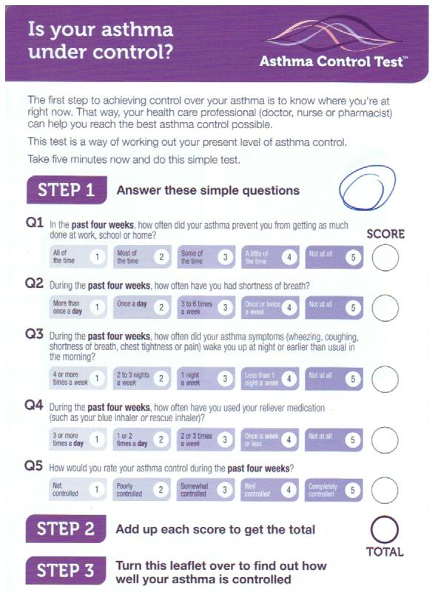
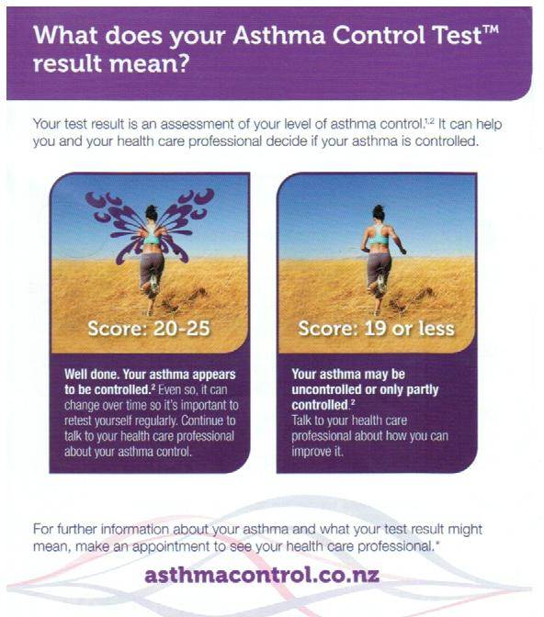
  Asthma Control Test (ACT)

Slide 21
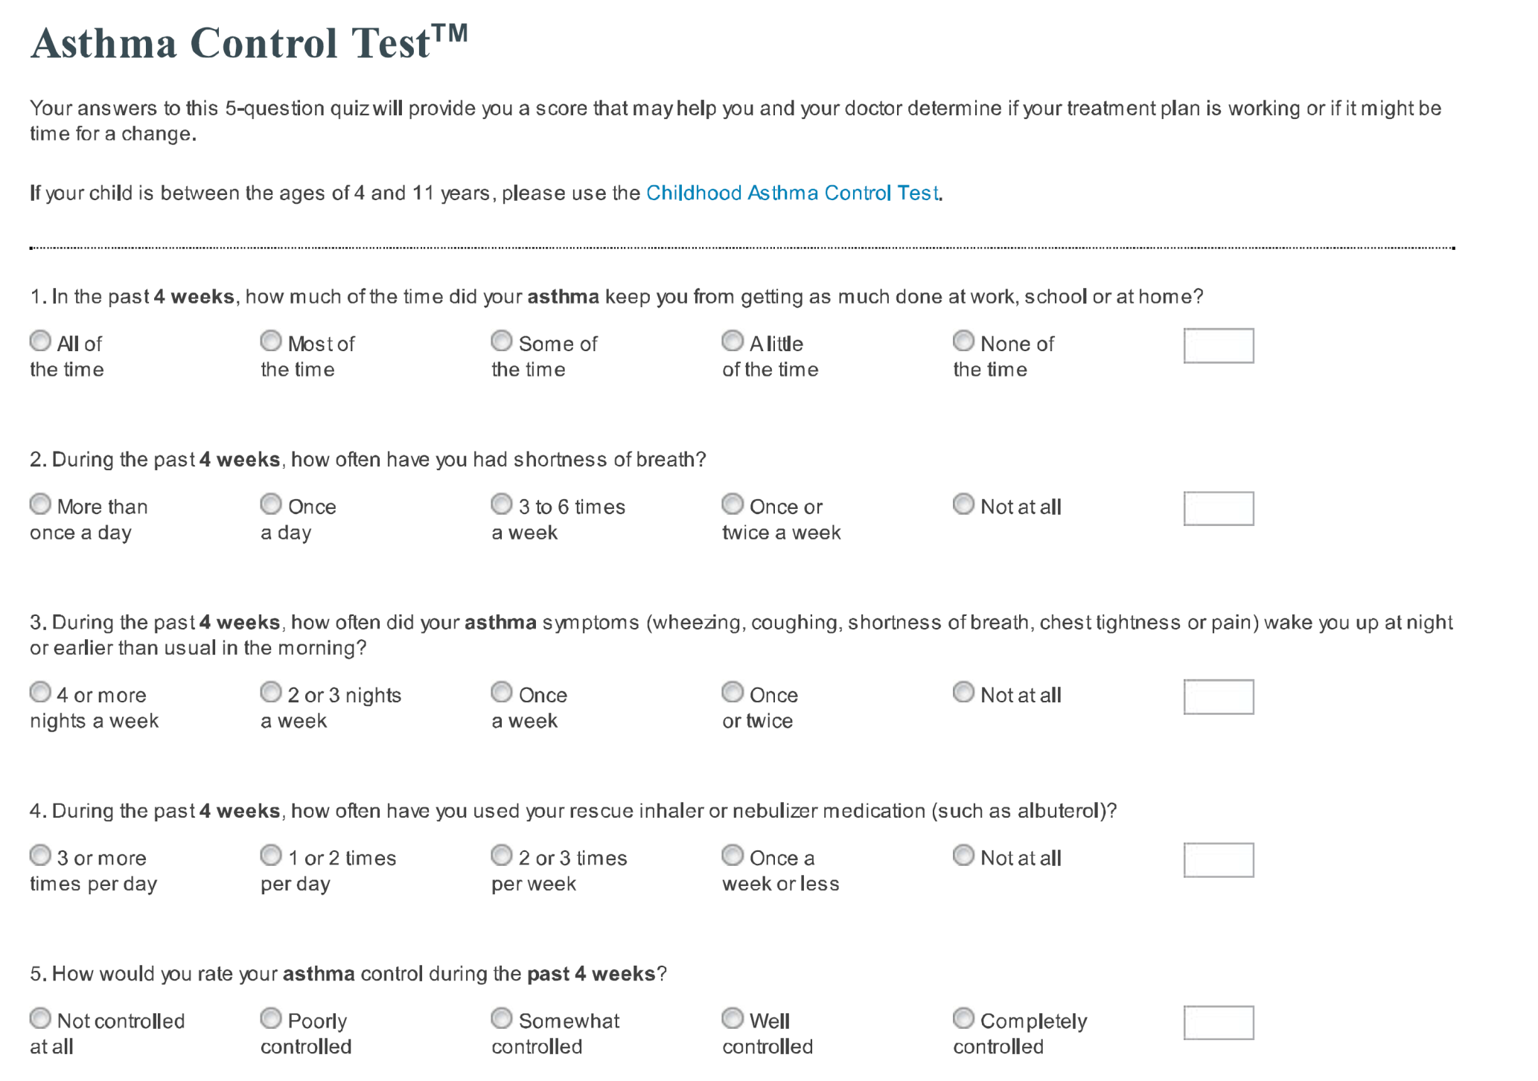

Slide 22
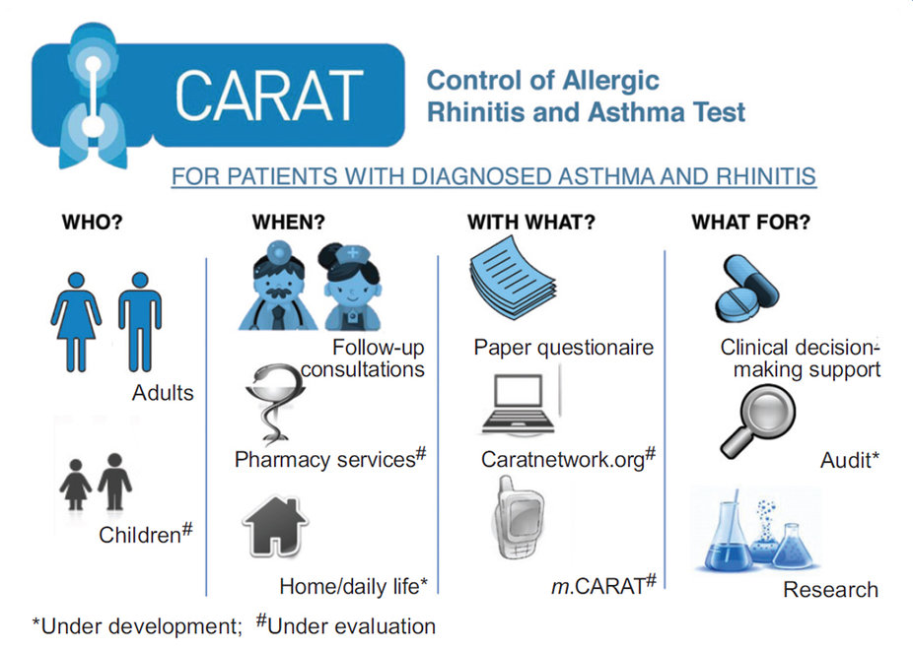

Slide 23
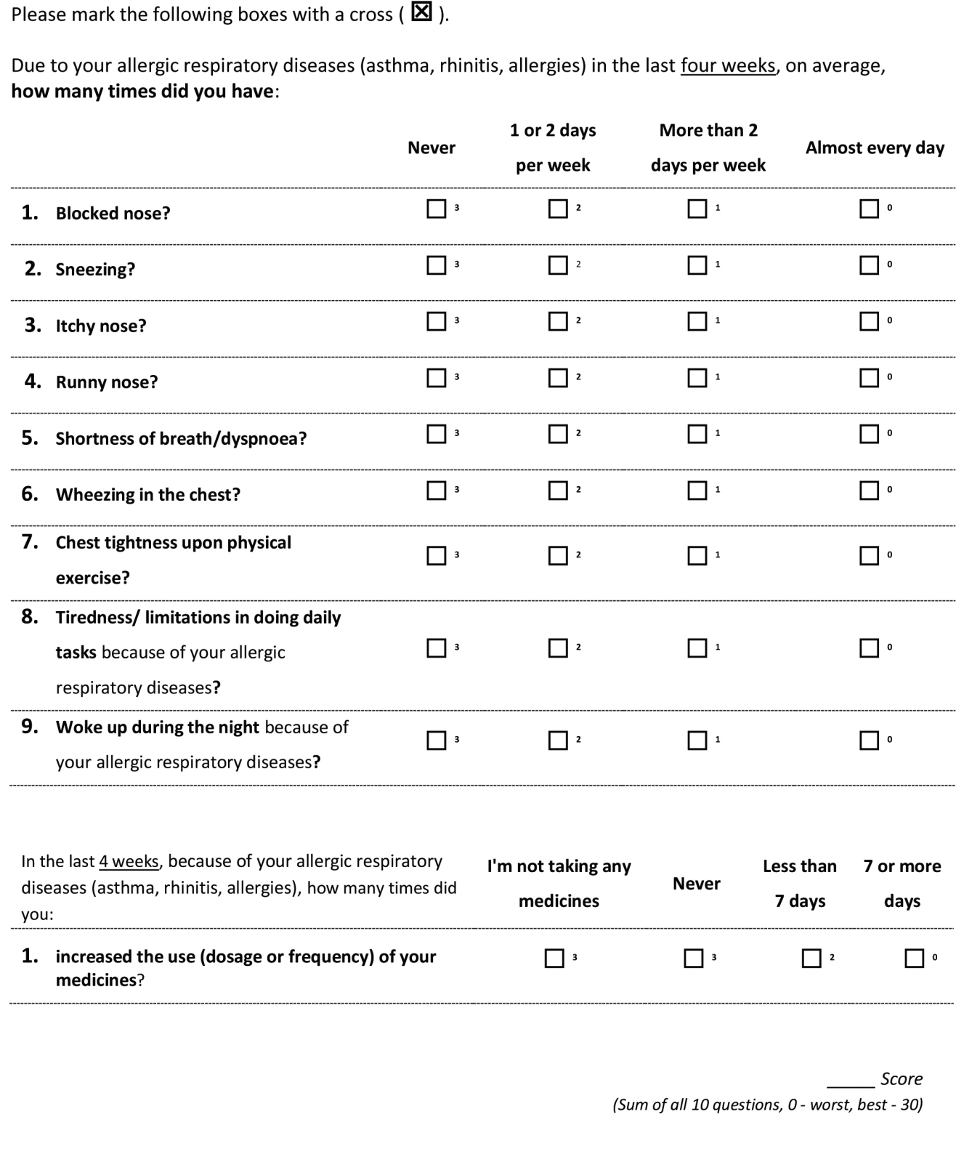
Scores
Total scores > 24 indicate good disease control
Score of the upper airway: controlled if score is > 8
Score of the lower airway : controlled if score is > 16

Slide 24
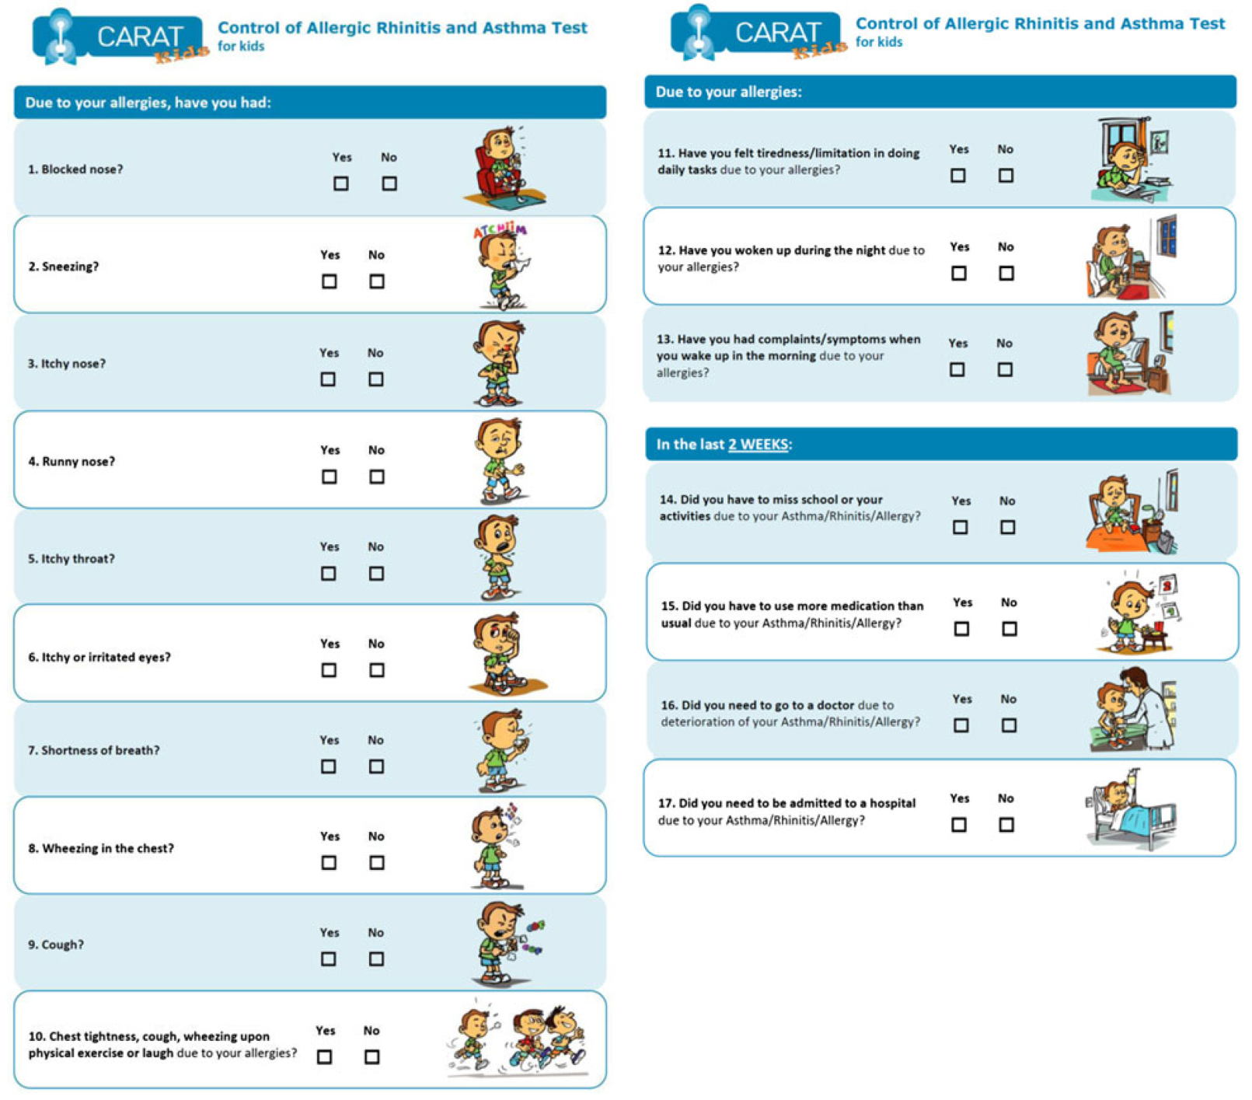
CARAT Kids

Slide 25
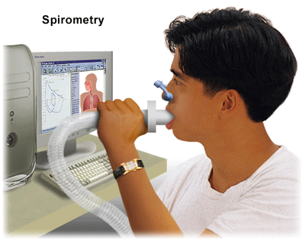
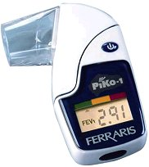
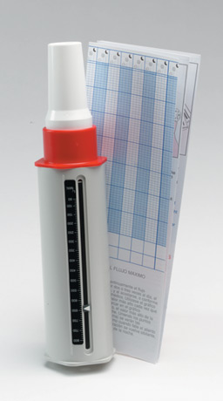

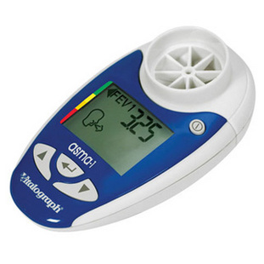
Objective measures

Slide 26
Reasons for poor asthma control: Clinical Case 2nd part

Slide 27
Case 2:
Sara- 43 year old, goes for a routine asthma consultation:
Never smoked
Atopic dermatitis since childhood
Asthma diagnosis since 1992
Never tested for allergenic sensitivity
Once we check asthma control and we discover that she has an uncontrolled asthma
What to do next?
Notes:
Sara and to get her maintenance treatment prescription

Slide 28
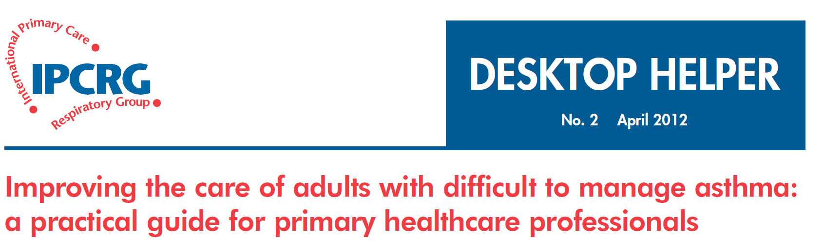

Slide 29
How to review a patient with difficult to manage asthma
SIMPLES
Smoking
Inhaler technique
Monitoring
Pharmacotherapy
Lifestyle
Education
Support

Slide 30
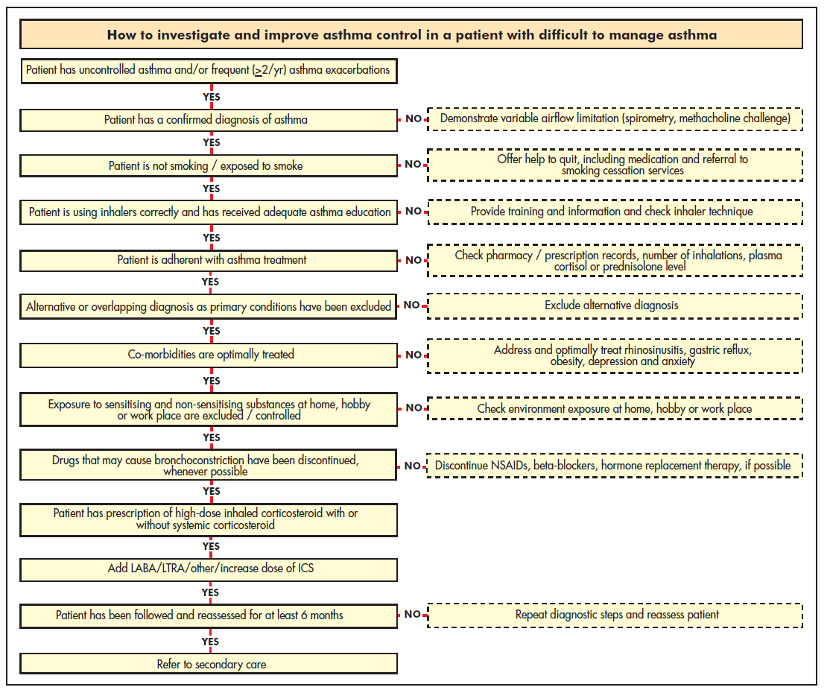

Slide 31
Step1: confirm the diagnosis of asthma
If the patient is not responding as expected to asthma therapy:
  Confirm the asthma diagnosis and rule out (or in) confounding illness before changing or increasing medications
Tools for asthma diagnosis must be stratified by age
Objective measures of reversible airflow obstruction (spirometry, PEF) are important if available

Slide 32
Diagnosing asthma in primary care
IPCRG guidelines. Prim Care Respir J. 2006;15:20–34.
Compatible clinical history
  Episodic or persistent dyspnoea, wheeze, tightness, cough
  Triggers (allergic, irritant)
  Risk factors for asthma development
  Consider occupational asthma for adults with recent onset
Objective evidence
  Spirometry or peak expiratory flow
  Bronchoprovocation test (methacholine challenge)
Ancillary tests
  Chest x-ray
  Eosinophils, IgE level
  Allergy testing
  Exhaled nitric oxide
  Induced sputum
Notes:
A diagnosis of asthma should ideally be based on objective evidence of reversible airflow obstruction. Guidelines vary in their criteria for this (IPCRG spirometry at http://www.theipcrg.org/resources/resources_diagnostics.php).

Slide 33

Patient with
respiratory symptoms
Are the symptoms typical of asthma?
YES
NO
Detailed history/examination
for asthma
History/examination supports
asthma diagnosis?
Further history and tests for
alternative diagnoses
Alternative diagnosis confirmed?
Clinical urgency, and other diagnoses unlikely
NO
YES
Perform spirometry/PEF
with reversibility test
Results support asthma diagnosis?
Repeat on another
occasion or arrange
other tests
Confirms asthma diagnosis?
NO
YES
NO
Empiric treatment with
ICS and prn SABA
Review response
Diagnostic testing
within 1-3 months
YES
NO
YES
Consider trial of treatment for
most likely diagnosis, or refer
for further investigations
Treat for ASTHMA
Treat for alternative diagnosis
GINA 2016, Box 1-1 (4/4)
© Global Initiative for Asthma

Slide 34
Step 2: question about smoking
Smoking adversely impacts asthma control
  Current smokers are almost 3 times more likely than non-smokers to be hospitalised for their asthma over a 12-month period
Why does smoking adversely impact asthma?
  Asthma misdiagnosed as COPD or concomitant COPD
  Relative steroid resistance
Price D et al. Clin Exp Allergy. 2005;35:282–7.
Notes:
There is clear evidence now that concurrent smoking adversely impacts asthma control.

Slide 35
Clinical approach to smoking
Tools
  Take a smoking history
  Investigate the possibility of COPD
    IPCRG guidance includes tool to differentiate asthma from COPD*
Solutions
  Encourage smokers to quit!
    IPCRG guidance on smoking cessation: http://www.theipcrg.org/smoking/index.php
  Try alternative therapy:
    Leukotriene receptor antagonist
    Possibly theophylline
*IPCRG Guidelines: diagnosis of respiratory diseases in primary care. Prim Care Respir J. 2006;15:20–34.
Notes:
Clinical approach to suspected smokers with asthma
It is important to identify the current smoking habits of patients with asthma, particularly those whose symptoms are poorly controlled. Patients who do not admit to smoking during an oral history may be more likely to admit to smoking on a written self-completed questionnaire, as they may feel less threatened.
For patients who are suspected or confirmed smokers, the consultation should include investigations to exclude COPD. The IPCRG guidelines for diagnosing respiratory diseases in primary care include a tool to help differentiate between asthma and COPD (lhttp://www.thepcrj.org/journ/view_article.php?article_id=137&volissue=12).
The ideal therapy for smokers with asthma is to quit smoking. The IPCRG has published guidance on smoking cessation (http://www.theipcrg.org/smoking/index.php). The percentage of neutrophils in induced sputum falls after patients quit smoking; thus, while neutrophils do not respond to steroids they do respond to smoking cessation.
For patients who continue to smoke, alternatives to inhaled steroids for treating asthma include leukotriene modifiers, theophylline, or possibly high-dose inhaled steroids (up to 1600 µg/day), although this last alternative is not yet fully supported by clinical trial evidence.

Slide 36
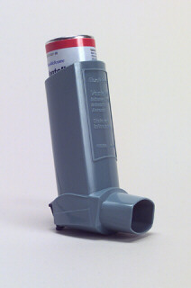
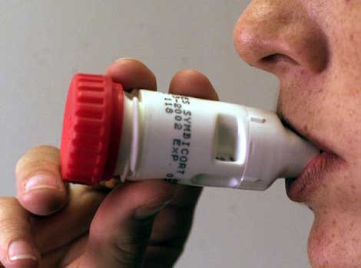
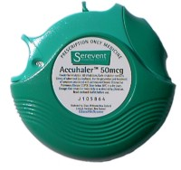
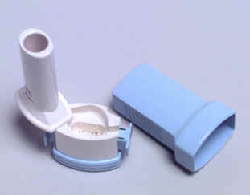
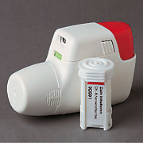
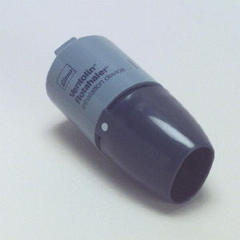
Step 3: assess inhaler technique

Slide 37
Step 3: assess inhaler technique
Correct inhaler choice or poor technique
Problems with inhaler technique are common in clinical practice & can lead to poor asthma control
All patients should be trained in technique, and trainers should be competent with the inhalation technique

Slide 38
Inhaler choice and technique
Key recommendations:
Take patient preference into account when choosing the inhaler device
Simplify the regimen and do not mix inhaler device types
The choice of steroid inhaler is most important because of the narrower therapeutic window
Invest the time to train each patient in proper inhaler technique:
    Observe technique & let patient observe self (using video demonstrations)
    Devices to check technique & maintain trained technique are available
Recheck inhaler technique on each revisit
Haughney J et al. Respir Med. 2008;102:1681–93.
Notes:
38
Choosing an inhaler device
The three most common types of inhaler device available are 1) pressurised metered-dose inhalers (MDIs), 2) breath-actuated MDIs, and 3) dry powder inhalers (DPIs). Available in generic form and the least expensive, MDIs are also frequently used incorrectly, as these devices require coordination between inhalation and actuation of the inhaler. Use of a breath-actuated MDI can improve lung deposition and decrease oropharyngeal deposition. DPI use instead requires adequate acceleration rate on inhalation to obtain good lung deposition and avoid excess orophayngeal deposition.
Key features of MDIs and DPIs
Metered-dose inhalers:
Require slow and deep inhalation over 5 seconds, with co-ordination between dose release and start of inhalation (good co-ordination not critical if slow inhalation but dose has to be released after the start of the inhalation);
Can be used with spacers, large or small (spacers scored lowest in patient preference);
Solving common problems:
poor coordination of actuation & inhalation → switch to breath-actuated MDI;
stopping inhalation when cold spray hits the throat ("cold Freon effect") → add a spacer or switch to inhaler with CFC-free propellant;
inhaling too fast → switch to ultrafine particle inhaler;
inhaling through the nose → training to inhale through mouth.
Dry powder inhalers:
Breath-actuated;
Require adequate acceleration on inhalation: must inhale deeply and forcibly at the start of the inhalation;
If the patient does not inhale fast enough or long enough:
Not all the dose is emitted;
Particles generated are too big to enter the lungs, resulting in increased oropharyngeal deposition.
Do not prescribe to children <5 years old;
Do not prescribe to patients with insufficient inspiratory effort;
Sensitive to moisture, store in dry place.
If the dose is supplied in a capsule then two inhalations are required to empty the dose.
Inhaler training aids:
Several devices to check inhaler technique and maintain trained technique are now available. For use with a MDI, the Aerosol Inhalation Monitor (AIM, Vitalograph Ltd, Buckingham, England) provides useful feedback about a patient’s technique, whilst the 2Tone Trainer (Canday Medical Ltd., Newmarket, England) is a training aid to help patients use a slow inhalation flow. The AeroChamber Plus spacer (Forest Pharmaceuticals, Inc., St. Louis, US) makes a noise when the inhalation flow used is too fast.
For use with a dry powder inhaler, the In-Check Dial (Clement Clarke International Ltd., Essex, UK) is a device to check if the patient can generate the required fast inhalation. The Turbuhaler whistle (AstraZeneca International, London, UK) is an example of a simple device that has been introduced to check for the required inhalation rate for patients prescribed this device. Finally, the Novolizer (MEDA Pharma GmbH & Co. KG, Bad Homburg, Germany) has been designed to release its dose only when the required inhalation rate is achieved.

Slide 39

Step 4: assess patient adherence to treatment

Slide 40
Step 4: assess patient adherence to treatment
Unintentional & intentional nonadherence
Nonadherence to asthma therapy, particularly to inhaled steroids, is a common problem contributing to poor asthma control
Nonadherence is often a hidden problem as assessment of adherence is often not included in routine asthma review
Barriers to assessing adherence:
  Patient and physician may prefer to avoid the subject
  Lack of clear, easy methods for addressing barriers to adherence
  Perception that little can be done?
Appreciating the factors involved is the first step toward improving adherence
Horne R. Chest. 2006;130:65S–72S.

Slide 41
Nonadherence: identifying the causes
Tools for identifying & assessing nonadherence:
Interventions to facilitate optimal adherence are likely to be more effective
We need to tailor the intervention & support according to specific barriers & patient preferences
Haughney J et al. Respir Med. 2008;102:1681–93.

Slide 42
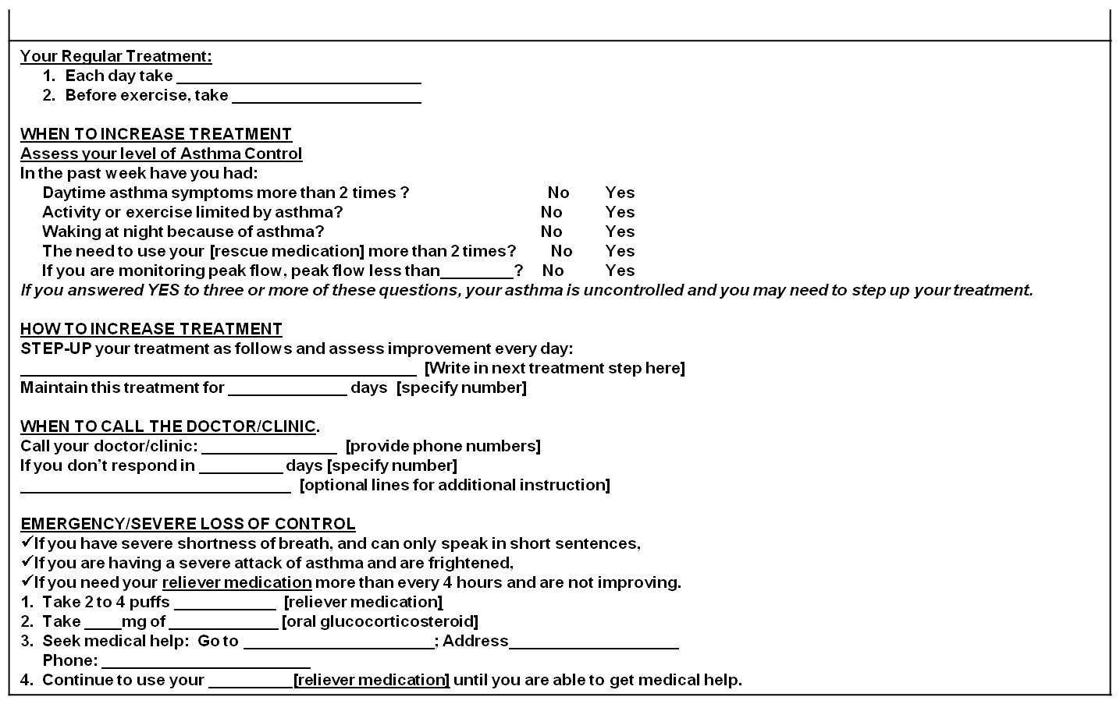
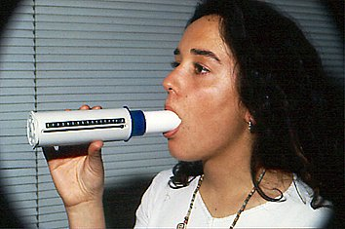
Written action plan
Non adherence
Action - Provide training on self-management skills
Notes:
The use of a written action plan itself has independently demonstrated better outcomes in asthma control and decrease exacerbations.
The use of peak-flow measurements could also be useful if available in cases of bad perceivers

Slide 43
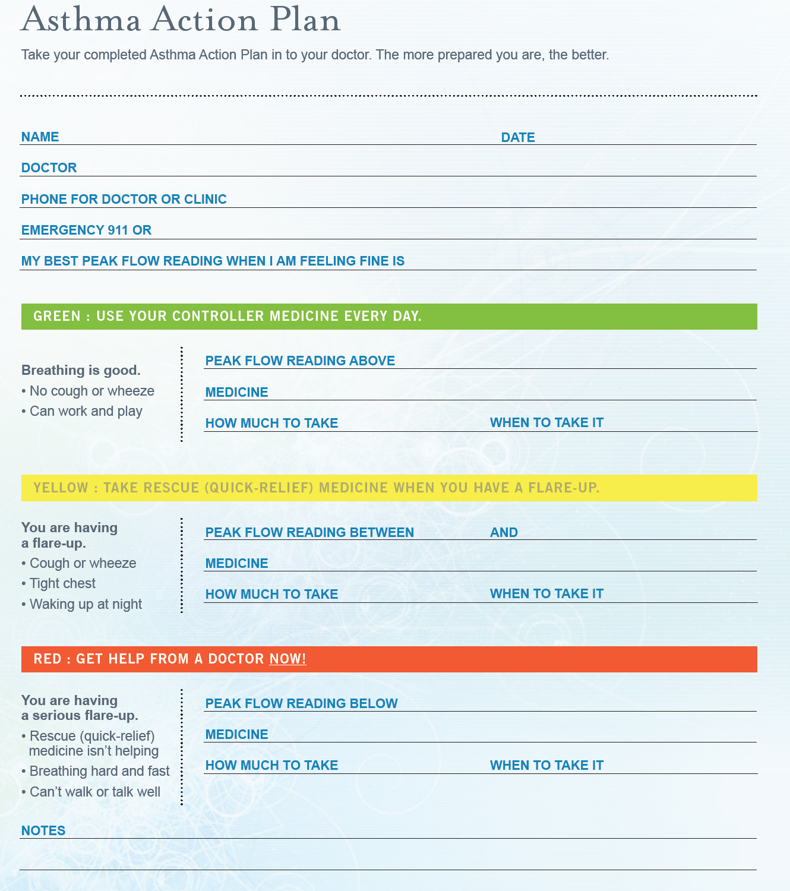

Slide 44
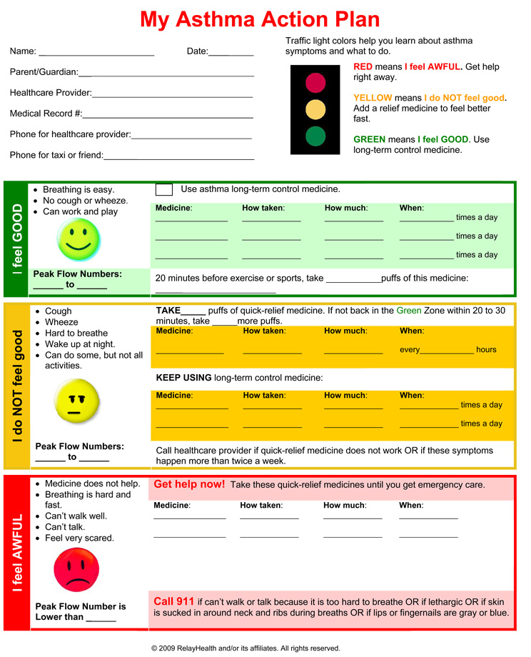

Slide 45



Step 5: exclude alternative or overlapping diagnosis as primary conditions

Slide 46
Wrong diagnosis or confounding illness
Action - Rule out (or in) confounding illness before changing medications
Chronic rhino-sinusitis,
Reflux disease
Obstructive sleep apnoea syndrome
Cardiac disorders
Vocal cord dysfunction
Anaemia
Obesity
Depression and anxiety
  Consider occupational asthma for adults with recent onset

Slide 47




Step 6: Identify and treat co-morbidities

Slide 48
Co morbidities can worsen asthma symptoms - identify and treat them
Allergic rhinitis
COPD
Gastro-oesophageal reflux disease (GERD)
Respiratory infection
Cardiac disorders
Anaemia
Vocal cord dysfunction
Notes:
The presence of comorbidities can worsen asthma symptoms, and these should be treated to successfully control asthma.

Slide 49
Concomitant rhinitis
Patients with asthma & concomitant rhinitis use more health care resources than those without rhinitis
Children with asthma & concomitant rhinitis had double the likelihood of being hospitalised and significantly increased likelihood of a physician visit for asthma than those without rhinitis
>50% of patients with asthma have rhinitis
  Both allergic & nonallergic rhinitis are linked to asthma
Price D et al Clin Exp Allergy. 2005;35:282–7. Thomas M et al. Pediatrics. 2005;115:129–34.
Notes:
Many patients with asthma, over 50% in most studies, have rhinitis.
Patients with asthma who have rhinitis, both adults and children, use more health-care resources than those without rhinitis, indicating that their asthma is less well-controlled.

Slide 50
Treating co morbid rhinitis & asthma
Upper airway treatment options | Lower airway treatment options
Nasal steroids | Inhaled steroids
Antihistamines
Upper and lower airway treatment options
Leukotriene receptor antagonists
Anti-IgE
Immunotherapy

Slide 51
Step 7: control environmental factors
Exposure to sensitising and non- sensitising substances at home, hobby or work place are excluded / controlled

Slide 52

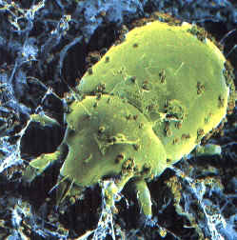
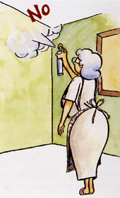

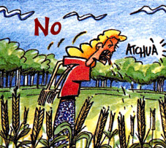
Environmental Factors:
Action - Advice on allergens avoidance
Animals outside the home (cats, dogs, hamsters)
Dust Mites: Allergy Waterproof Cases
Damp cloth and vacuum
Home Humidity <50%
No carpets in the bedroom
Washing with hot water weekly
Pollens: Close windows in time of pollination
Snuff: Avoid smoking and passive exposure
Fungi: Remove mildew stains on the walls
Avoid wood stoves, smoke, air fresheners, etc..
Notes:
Measures to prevent the development of asthma, and asthma exacerbations by avoiding or reducing exposure to risk factors should be implemented wherever possible.
Asthma exacerbations may be caused by a variety of risk factors – allergens, viral infections, pollutants and drugs.
Reducing exposure to some categories of risk factors improves the control of asthma and reduces medications needs.

Slide 53
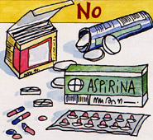
Step 8: think about drugs which could lead to poor asthma control
NSAID’s
Iron-dextran
Carbamazepine
Vaccines
Allergen extracts (immunotherapy)
Antibiotics: penicillins, tetras, erythromycin, sulfa
Beta-blockers (oral and topical eye drops)
Cholinesterase inhibitors: tacrine, rivastigmine
MDI propellants

Slide 54
Step 9: Consider individual variation in treatment response
Randomised controlled trials (RCTs) are the basis of recommendations made by clinical guidelines.
However, several factors limit our ability to generalise RCT results to our patients.
Haughney J et al. Respir Med. 2008;102:1681–93.
Notes:
Bullet page

Slide 55
Step 10: consider stepping up treatment
If the patient already has high-dose inhaled corticosteroid with or without systemic corticosteroid
Add LABA /LTRA /other /increase dose of ICS
Follow and reassess for at least 6 months

Slide 56


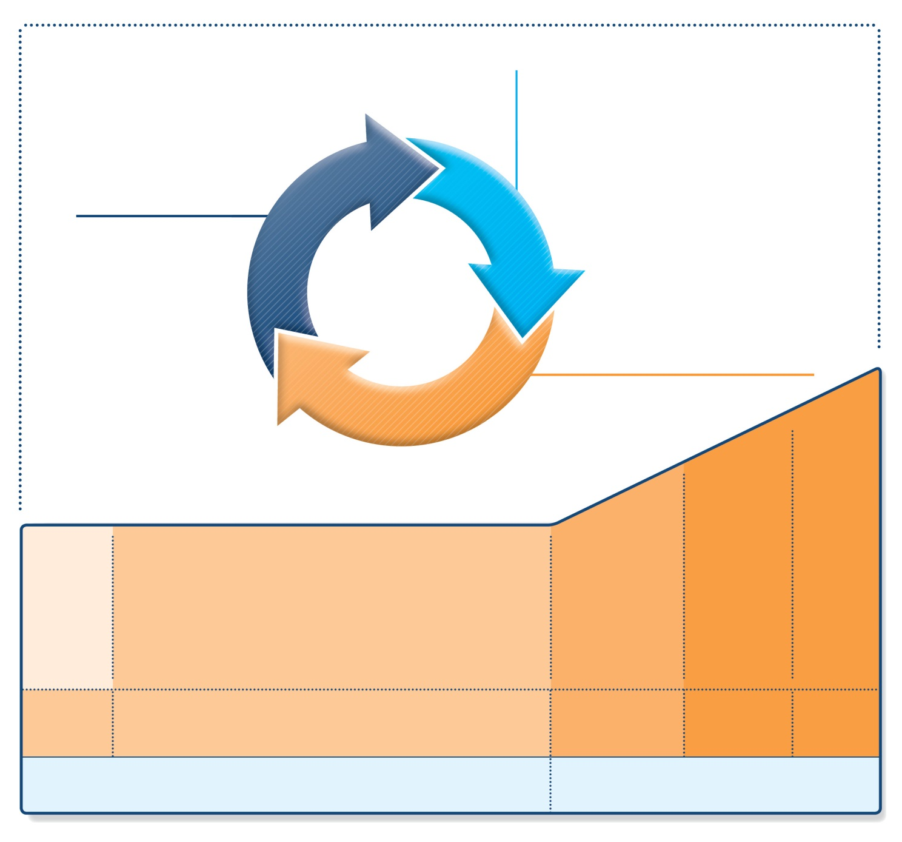
Stepwise management - pharmacotherapy
UPDATED!
Diagnosis
Symptom control & risk factors
(including lung function)
Inhaler technique & adherence
Patient preference
ASSESS
REVIEW RESPONSE
Symptoms
Exacerbations
Side-effects
Patient satisfaction
Lung function
ADJUST TREATMENT
Asthma medications
Non-pharmacological strategies
Treat modifiable risk factors
STEP 5
STEP 4
STEP 1
STEP 2
STEP 3
Refer for add-on treatment
e.g.
tiotropium,* omalizumab, mepolizumab*
*Not for children <12 years
**For children 6-11 years, the preferred Step 3 treatment is medium dose ICS
#For patients prescribed BDP/formoterol or BUD/ formoterol maintenance and reliever therapy
 Tiotropium by mist inhaler is an add-on treatment for patients ≥12 years with a history of exacerbations
PREFERRED
CONTROLLER
CHOICE
Med/high
ICS/LABA
Low dose ICS
Low dose
ICS/LABA**
Other
controller
options
Consider low dose ICS
Leukotriene receptor antagonists (LTRA)
Low dose theophylline*
Med/high dose ICS
Low dose ICS+LTRA
(or + theoph*)
Add tiotropium*
High dose ICS
+ LTRA
(or + theoph*)
Add low
dose OCS
RELIEVER
As-needed short-acting beta²-agonist (SABA)
As-needed SABA or
low dose ICS/formoterol#
GINA 2016, Box 3-5 (2/8) (upper part)

Slide 57
Step 11: consider a referral to secondary care
Doubts about diagnosis and tests unavailable:
  Bronchoprovocation test
  Allergy test
  Rhino fibro-scope
Occupational asthma
Treating co-morbidities
Pregnancy in a bad controlled patient
Not available treatments (immunotherapy…)
5% suffering from difficult to control asthma
Notes:
57
It includes all patients with particularly aggressive asthma which is inadequate or poorly controlled, despite following an appropriate control based therapeutic strategy
Synonyms for difficult to control asthma: refractory asthma, refractory asthma, glucocorticoid resistant asthma and steroid dependent asthma

Slide 58
Step 11: consider a referral to secondary care
Who to refer?
Patients who continue to have difficult to manage asthma after review and taking steps to reduce all possible causes and despite being on guideline-based treatment should be referred to a specialist clinic.

Slide 59
Where to refer?
Patients should be referred to clinics with experience in difficult to manage asthma, able to provide care and treatment by a multidisciplinary team.
What to include in a referral letter?
Occupation
Onset of symptoms
Dyspnoea
Specified dyspnoea
Cough
Specified cough
Wheezing
Smoking
Known allergies
Peak flow
Spirometry and bronchodilatation test
Use of asthma medication
Other diseases
Other current medication

Slide 60
Conclusions: what should we do?
Empower/enable the patient
Written action plan
Identify triggers and allergens and avoid
Check adherence and good inhaler technique
Rule out or treat co-morbidities
Changes in pharmacological treatment
Refer only when needed

Slide 61
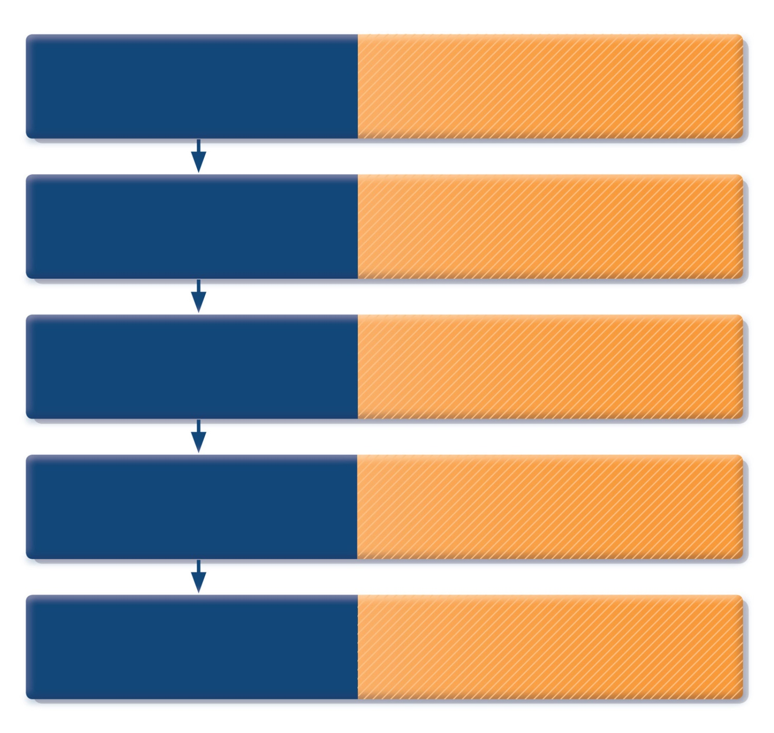
How to distinguish between uncontrolled and severe asthma
Watch patient using their
inhaler. Discuss adherence
and barriers to use
Compare inhaler technique with a device-specific checklist, and correct errors;
recheck frequently. Have an empathic discussion about barriers to adherence.
Confirm the diagnosis
of asthma
If lung function normal during symptoms, consider halving ICS dose and repeating
lung function after 2–3 weeks.
Remove potential
risk factors. Assess and
manage comorbidities
Check for risk factors or inducers such as smoking, beta-blockers, NSAIDs, allergen exposure. Check for comorbidities such as rhinitis, obesity, GERD, depression/anxiety.
Consider treatment
step-up
Consider step up to next treatment level.
Use shared decision-making, and balance potential benefits and risks.
Refer to a specialist or
severe asthma clinic
If asthma still uncontrolled after 3–6 months
on Step 4 treatment, refer for expert advice. Refer earlier if asthma symptoms severe,
or doubts about diagnosis.
GINA 2016, Box 2-4 (5/5)
© Global Initiative for Asthma

Slide 62
Distinction between severe and uncontrolled asthma
Uncontrolled asthma refers to the extent to which the manifestations of asthma (symptoms-use of rescue medicine etc) remain besides treatment

Slide 63
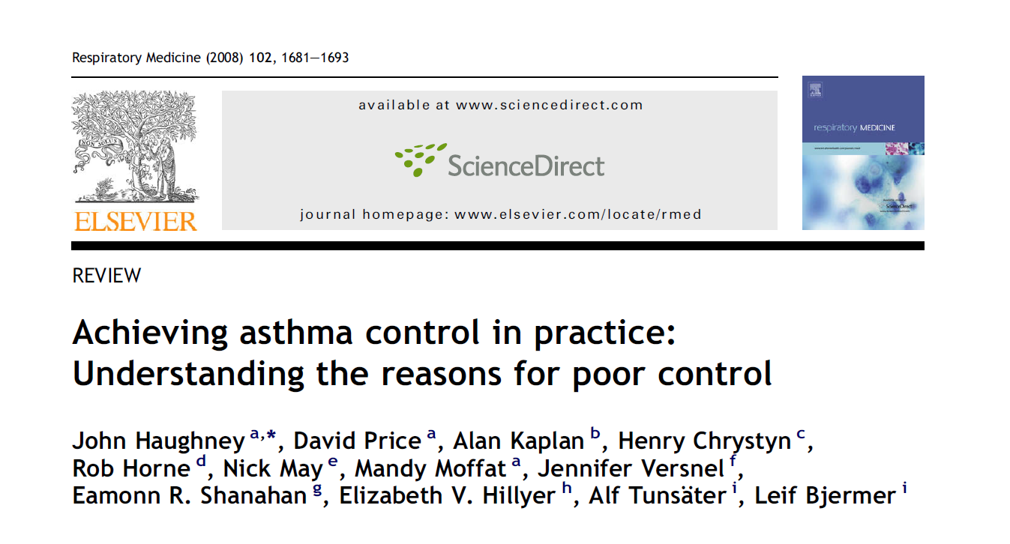
Recommended reading

Slide 64
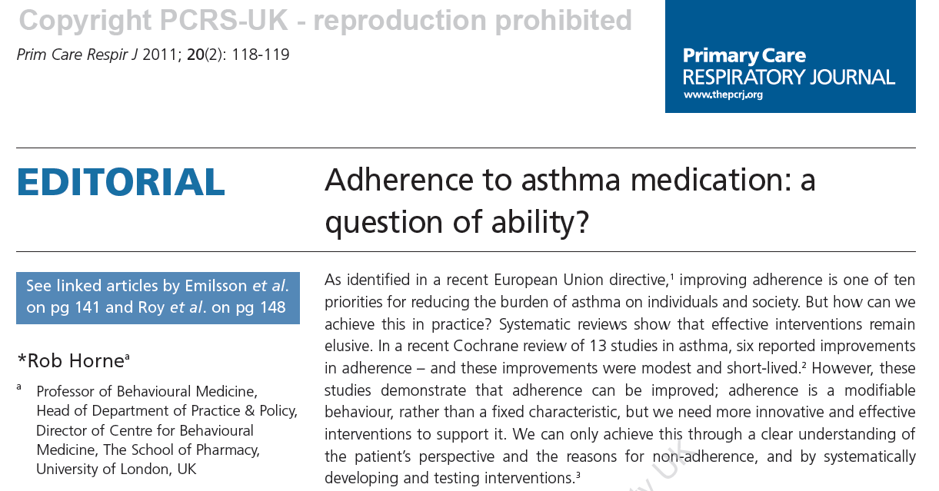

Slide 65
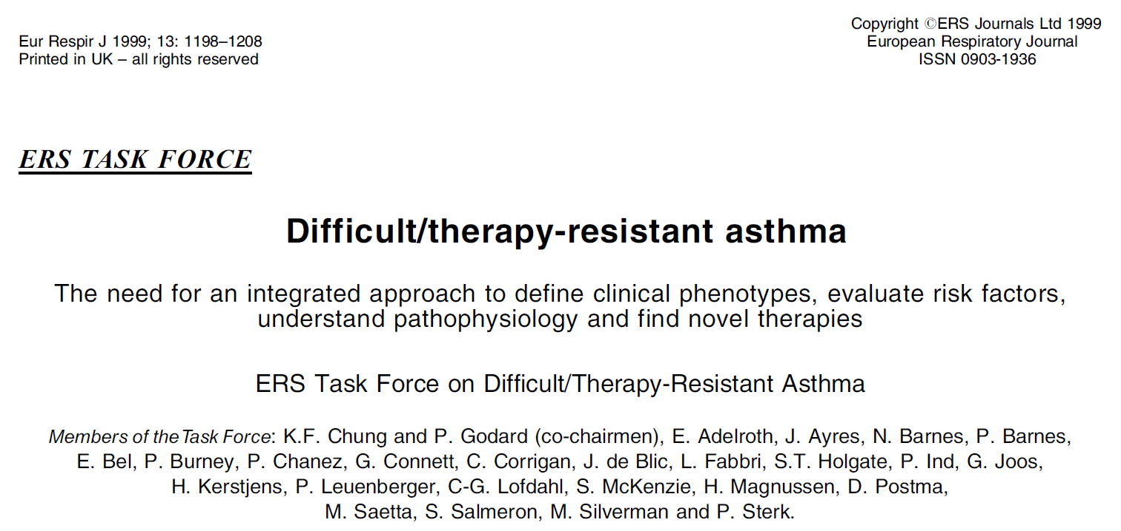

Slide 66
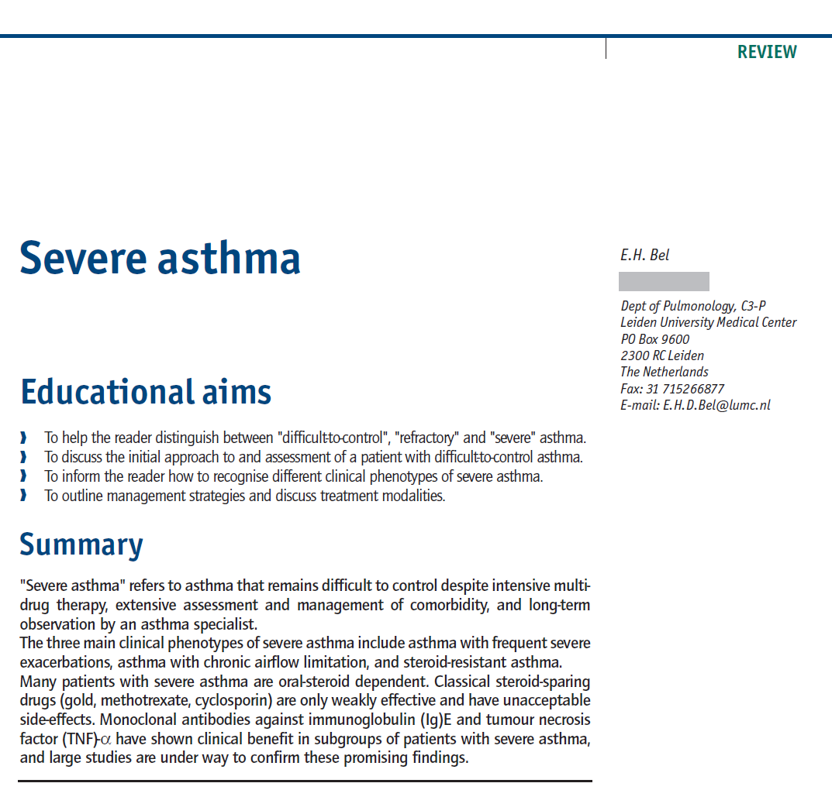

Slide 67
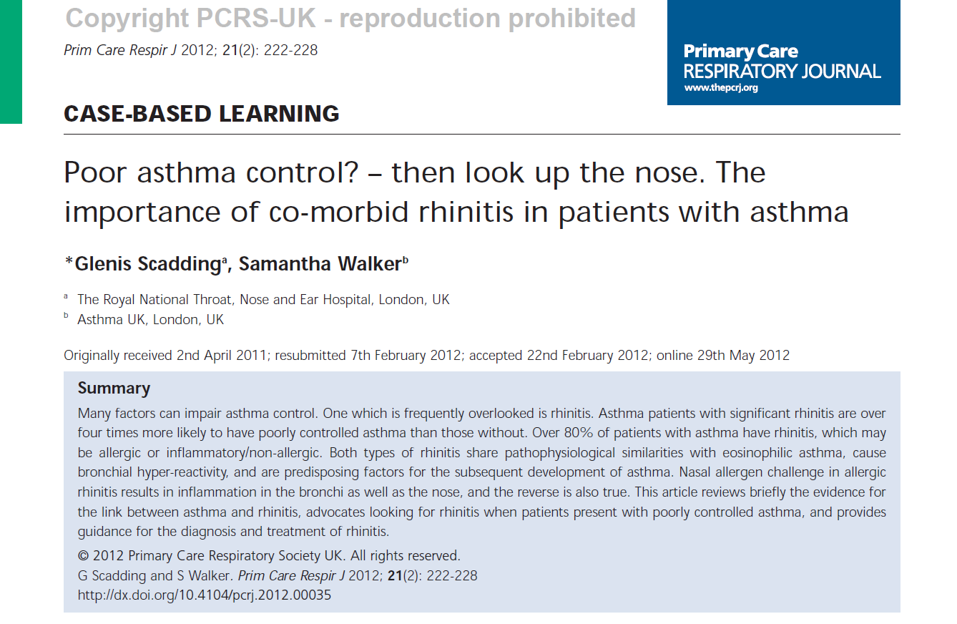

Slide 68
Thank you for your attention!

Slide 69


